Slide 2
is the study of the speed at which chemical and physical processes take place. In a chemical reaction it is the amount of product that forms in a given interval of time or it can be defined as the amount of reactant that disappears in a given interval of time.
Reactions occur at many different rates, some reactants are so rapid that they appear to be instantaneous, as neutralization of strong acid with strong base.
Others are so slow at ordinary temperature that no detectable change would be observed in the course of years, as combination of H₂ and O₂.
Between these two extremes, there are a lot of reactions taking place with measurable velocities.
The branch which studies the rates of these reactions is called chemical kinetics.
Chemical kinetics is divided into study of homogeneous reactions (occurring entirely within one phase) and heterogeneous reactions (occurring at an interface between phases).

Slide 3
Reaction rates can be affected in a number of ways.
The factors are:
1)- Nature of the reactants.
2)- Concentration of the reactants.
3)- Particle size of the solid or liquid in heterogeneous reactants.
4)- Temperature.
5)- Nature of catalyst present.
Molecularity ,orders of reactions and elementary reaction:
Molecularity: is the number of atoms or molecules whose taking part in each act leading to a chemical reaction.
Order: is the number of atoms or molecules whose concentrations determine the velocity or kinetics of the process,or the sum of the exponents of the concentrations in the rate equation.
.
Elementary reaction: the reaction with no intermediate steps in its reaction mechanism, or a reaction may take place in a single step.

Slide 4
The rate law or rate equation for a chemical reaction is an equation that links the reaction rate with concentrations or pressures of reactants and constant parameters (normally rate coefficients and partial reaction orders).
The rate equation is a differential equation, and it can be integrated to obtain an integrated rate equation that links concentrations of reactants or products with time.
The rate of formation of C or the rate of disappearance of A and B, is proportional to powers of the concentrations of A and B:
The numerical values of x and y must be determined experimentally.

Slide 5

The values of x and y need not necessarily to be the same as a and b.
̋k ̋ is called the ̋ specific reaction rate ̋ or ̏velocity constant ̋ or ̋velocity coefficient̋
The rate equation may be expressed also as :
In the above example, the sum of ̏a+b̏ is the molecularity of the reaction whereas the sum of ̋ x+ y ̋ is the order of reaction.
The reactions may be classified as unimolecular, bi, trimolecular elementary steps, ….etc or as first, second ,third,…or zero order reaction.

Slide 6
A rate law is a differential equation that describes the rate of change of a reactant (or product) concentration with time.
If we integrate the rate law then we obtain an expression for the concentration as a function of time, which is generally the type of data obtained in an experiment.
In many simple cases, the rate law may be integrated analytically.
The simplest rate laws are given following:

Slide 7

A reactions is said to be zero order if the rate of reaction is independent of the concentrations of substances participating in the reaction.
The rate of change of concentration is constant.
For the reaction: A → Products (x)

Slide 8
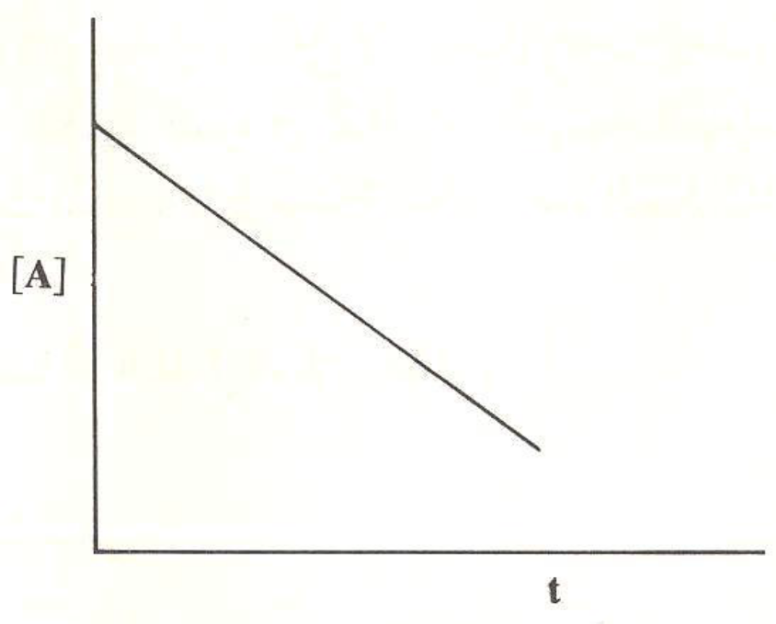

Slide 9
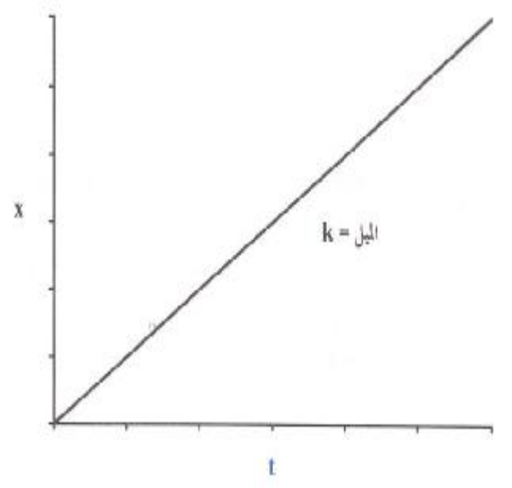

Slide 10


Example: decomposition of nitrous oxide or ammonia gases on hot platinum wire.
The units of k is expressed as (Conc. .time⁻¹).

Slide 11

The rate is directly proportional to the concentration of the reacting substance.
A → Product
If ̏a ̏ is the initial concentration of the reacting species, ̏
x ̏ is decrease after time ̋ t ̏ .

Slide 12



We integrate to get the value k:
The above equation may be written as:

Slide 13
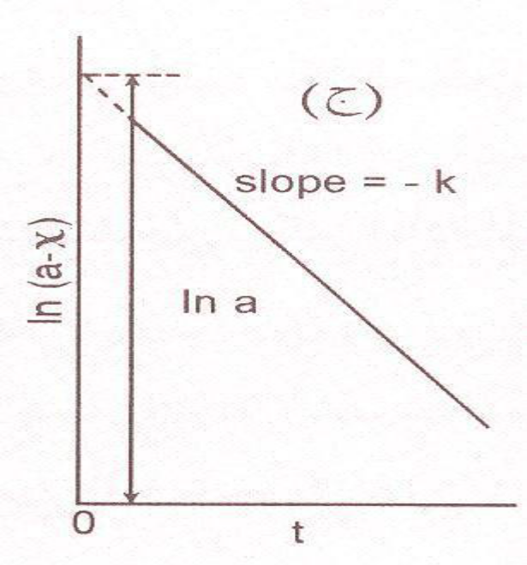
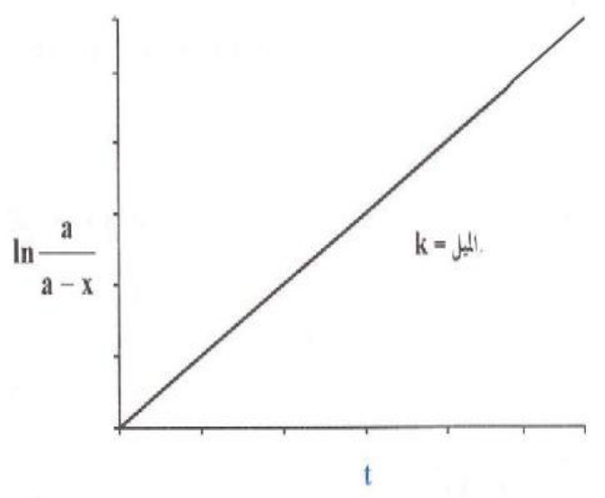

The reaction is complete when C_{t}= 0.
slope

Slide 14


The value of k is expressed in reciprocal time units :sec⁻¹, min⁻¹;…etc.
Half time(t_{1/2}): the time for the concentration to be reduced to half its initial value if (x) = (a/2).
t_{1/2}
t_{1/2} is independent of the initial concentration.
The same result is obtained for the time to reduce the concentration by any other given fraction.

Slide 15





In this case the reactant molecules may be of the same concentration:
A + A → Products,
or of different concentrations:
A + B→ Products.
We shall consider firstly the first case:
A + A → Products or 2A→ Products

Slide 16

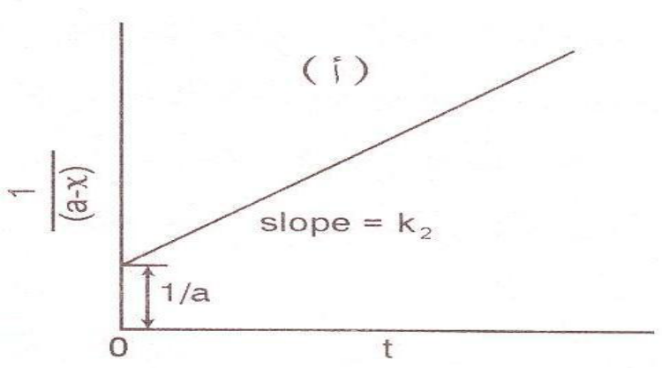
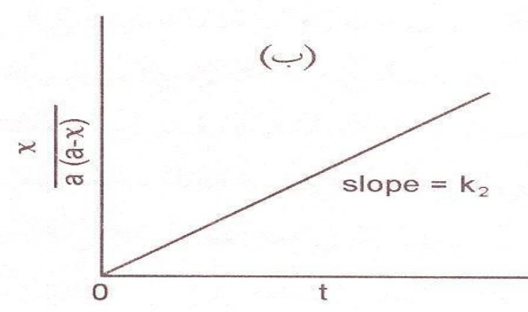

A
B
t_{1/2}

Slide 17






We shall consider now the 2nd case:
A + B→ Products.

Slide 18



are the initial concentration of A and B,
are the concentration of A,B and at time t.
The value of k have is expressed as (time⁻¹.Conc⁻¹) in both cases.
If one reactants is present in very large excess we neglect (x) compared to its concentration, and also the other concentration.

Slide 19


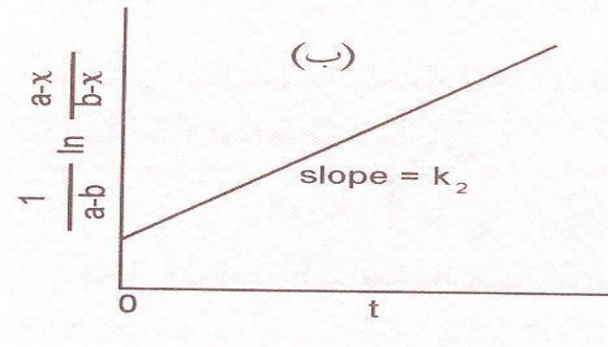
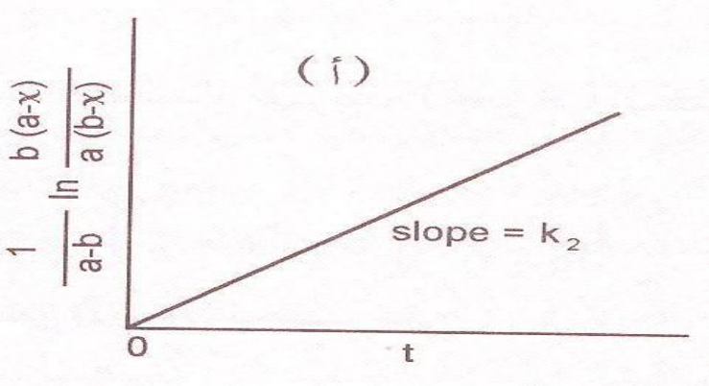



Since a remains nearly constant through the experiment.
A
B

Slide 20





The possibilities are:
A+ A+A → Products
A+A+ B → Products
A+B + C→ Products
We shall consider the simplest case in which the initial concentration of the three reactants are the same and represented by ̋ a ̏ if the concentration at time ̋ t ̏ is (a-x).

Slide 21


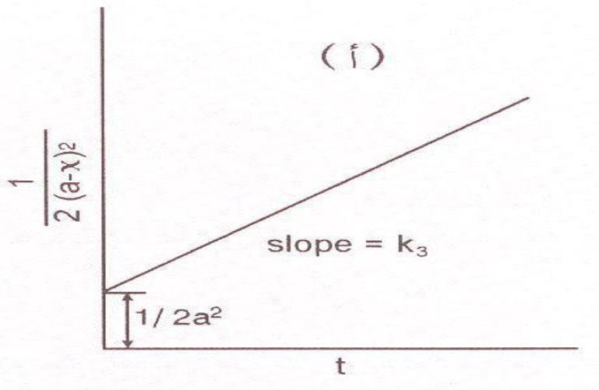
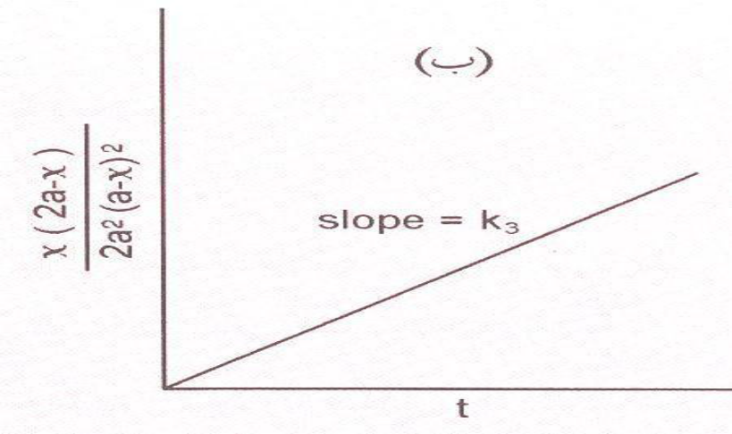


and t_{1/2}
t_{1/2 =}
$$\frac{1}{k} . \frac{3}{{2a}^{2}}$$
t_{1/2}
The value of k is given in terms of Conc⁻².time⁻¹.
B
A

Slide 22







If we consider of (n) order involving a single reactant.
nA → Products

Slide 23

Not all reactions are simple and direct as these given before it is now necessary to consider some complications arising from the possibility of the occurrence of other processes at the same time; example: opposing side reactions, (parallel) and consecutive reactions.
Consider the reaction :
(k) is the specific rate of forward reaction and (k*)for backward reaction.
If (a) is the concentration of reactants at time(t) = 0 and there is no any amount of products B, then after time (t) the amounts present of A and B are (a-x) and (x) respectively.

Slide 24







Where x_{e} is the amount of B formed or of A changed at equilibrium.

Slide 25





The value of the specific rate of forward reaction can be known if both (a) and (x_{e}) are known.
A reversible first order reaction may be treated as if it is not reversible; (x_{e}) replaces (a) and (k + k*) replaces( k ).

Slide 26

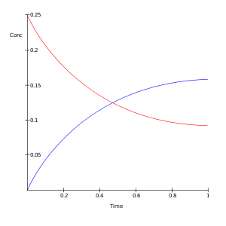
Example: the formation of Ethyl acetate from Alcohol and Acetic acid.
E
The two curves meet at point E where(red curve) is the forward velocity or esterfication = backward velocity reaction or hydrolysis (blue curve).

Slide 27



This is presented as:
If (a) is the initial concentration of (A) and (x) is the amount decomposed after time(t),both are assumed to be first order.
Are the specific rates for the two sides reactions.
By integration:
it behaves as a simple 1st order, with the observed value of (k ) being the sum of the specific rates of the two simultaneous reactions.

Slide 28


In order to determine k₁ and k₂ separately, we use the following facts:
Rate of formation of B = k₁(a-x) and C = k₂(a-x)
If the ratio of concentration of B to C at the end of the reaction is determined;
the ratio of
will also be known.
Example(1): when KOH reacts with ethyl chloride; both ethylene and ethanol are produced.
Example(2): alcohol can be dehydrated to olefins or dehydrogenated to aldehydes

Slide 29



As example:
If the concentration of A, B,C are C_{A},C_{B},C_{C}, respectively after time t; then a = C_{A}+ C_{B} + C_{C}
The rate at which A disappears is given by:
The rate at which C is formed from B is:
The rate of accumulation of B in the system is equal to the difference in rates of disappearance from A and formation to C.

Slide 30







By multiplying both sides by:
By integration :

Slide 31





Slide 32
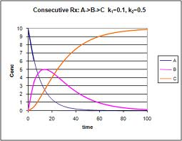
If k₁ and k₂ are known, it is possible to evaluate C_{A,}C_{B},C_{C} for given concentration (a) at different times after the commencement.(see figure):
(C_{B})_{max}
The conc. of A decreases steadily from the beginning (zero at end).
The conc. of B increases steadily from the beginning till it reaches the initial concentration.

Slide 33




The conc. of B increases at first ,but as it accumulate the rate of decomposition becomes greater and so its concentration., passes through a maximum, and then decreases till it becomes zero at the end.
The condition that(C_{B})_{max ;} differentiating and equating to zero.

Slide 34






