Slide 1
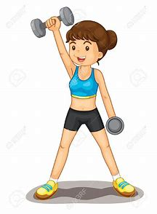
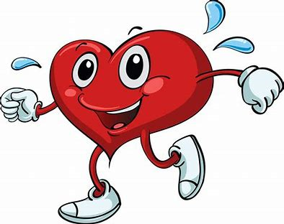


The Pressures of Hypertension
Rachel Tierney
State College of Florida
Abstract
Results
Methodology
This paper is based on evidence-based studies that either conducted a randomized controlled trial or reviewed those types of trials and other experiments. Hypertension is a deadly disease and without proper control of it, can lead to death or long-term impairment. One overview of a randomized controlled trial and another meta-analysis were used for this paper. It is the goal of this evidence-based paper to show the results of studies regarding the question “does it truly matter if a person does not manage their blood pressure versus managing it with diet, exercise or medication?”. The literature reviewed determines the importance of using medication for blood pressure above a sustaining systolic blood pressure of 160 or greater.
A qualitative study was a systematic review and meta-analysis including 21 studies which involved 3,454 children, as well as a review of 15 randomized control trials which included 869 people. The study recommended that individuals with a blood pressure near or above 160/100mmhg or who have an existing cardiovascular disease should seek pharmacologic treatment rather than relying solely on diet and exercise. It suggested that they should first start with a low dose thiazide-type diuretic and if that does not work, one should try a beta-blocker such as metoprolol. Each study stated that the goal blood pressure for drug therapy should be to get the blood pressure down to 140/90mmhg if it aligns with the patient's safety and does not negatively affect any other comorbidities.
One of the research journals used was a randomized controlled trial that was based on the effects of aerobic and resistance exercise and a healthy diet versus no diet change or exercise. The trial was eight weeks long of which sixty-nine people who were at risk for cardiovascular disease participated it, all participants signed informed consent and were all safely monitored throughout the trial (Schroeder et al., 2019). This quantitative study found that combined aerobic and resistance reduced systolic blood pressure by 3-4 mmHg (2019) and that even though it seems only like a small decrease, it is estimated to reduce cardiac morbidity by 5%, stroke by 8–14%.
The Johns Hopkins Nursing (JHN) Evidence-Based Practice (EBP) Model and Guidelines were used to guide this EBP project. The State College of Florida’s online library was accessed, and their databases for Joanna Briggs Institute, Academic OneFile, and PubMed were used in completing this evidence-based research paper. All journals used in this paper are in English and have been cited using APA format and are peer-reviewed and published in the last five in order to obtain accurate information. The search terms used were hypertension, Blood pressure, diet, and exercise. The scholarly review of the literature used showed that all trials and analysis of material are good or of high quality.
Add your information, graphs and images to this section.
TRIFOLD AREA – THIS GUIDE WILL BE REMOVED BEFORE PRINTING – TRIFOLD AREA – THIS GUIDE WILL BE REMOVED BEFORE PRINTING – TRIFOLD AREA – THIS GUIDE WILL BE REMOVED BEFORE PRINTING – TRIFOLD AREA – THIS GUIDE WILL BE REMOVED BEFORE PRINTING – TRIFOLD
TRIFOLD AREA – THIS GUIDE WILL BE REMOVED BEFORE PRINTING – TRIFOLD AREA – THIS GUIDE WILL BE REMOVED BEFORE PRINTING – TRIFOLD AREA – THIS GUIDE WILL BE REMOVED BEFORE PRINTING – TRIFOLD AREA – THIS GUIDE WILL BE REMOVED BEFORE PRINTING – TRIFOLD
Conclusion
These three peer-reviewed journals all conclude that diet, exercise, and medication are all critical when attempting to treat hypertension. If an individual did nothing about their high blood pressure the chances of them having a stroke or a heart attack are very high. Nurses have the unique opportunity to educate their patients and others around them of the dangers of unhealthy living. Education must be more available for those who have not been diagnosed with cardiovascular disease in order to decrease the growing rate of individuals with heart disease.
Introduction
The purpose of this poster is to describe the evidence of whether blood pressure medication and lifestyle changes are necessary to treat hypertension. Specifically, the PICO question used to guide this EBP project is, "In adults with hypertension, how does blood pressure medication or a lifestyle change affect a person's life compared to not treating the issue?”
Notes:
References:
Schroeder, Elizabeth C., et al. "Comparative effectiveness of aerobic, resistance, and combined training on cardiovascular disease risk factors: A randomized controlled trial." Academic OneFile,http://link.galegroup.com/apps/doc/A568671809/AONE?u=lincclinmcc&sid=AONE& xid=fdba0518. Accessed 26 Jan. 2019.

