Slide 1

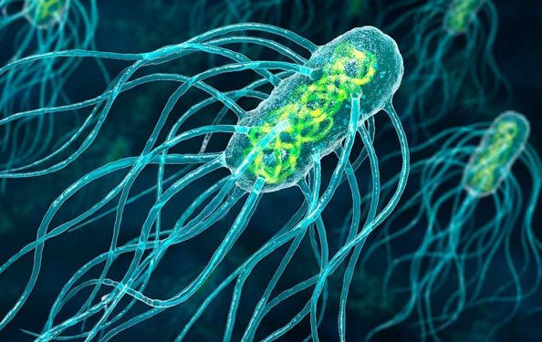
Typhoid
Dr Rasheed Ahmed
(Homoeo Physician)
DA.C Acupuncture (Sri Lanka)
Alternative medicines & Treatment
Specialty Sciatica Pain treatment
Email; New_haz@yahoo.com
Facebook: Fb/Dr Rasheed Ahmed / New Hazara Clinic
Contact no: 0092-3005363046/ +92.995.619592

Slide 2
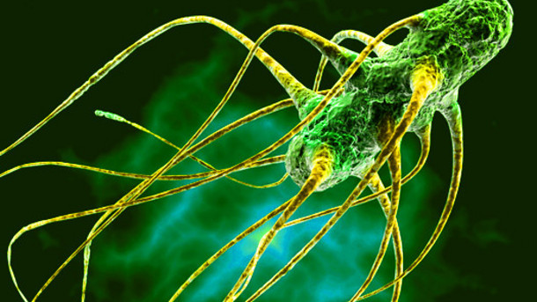
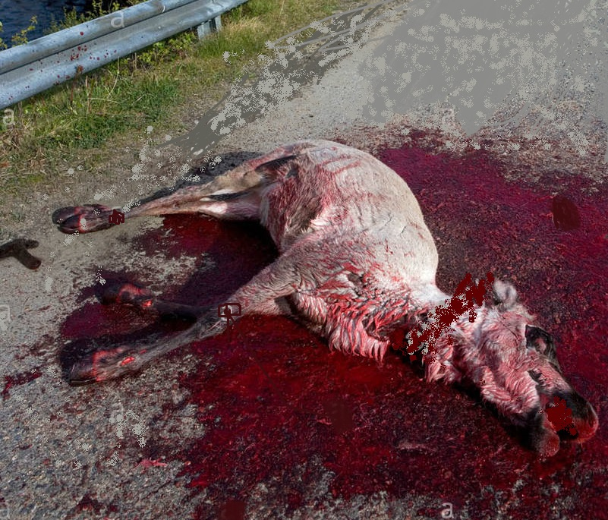
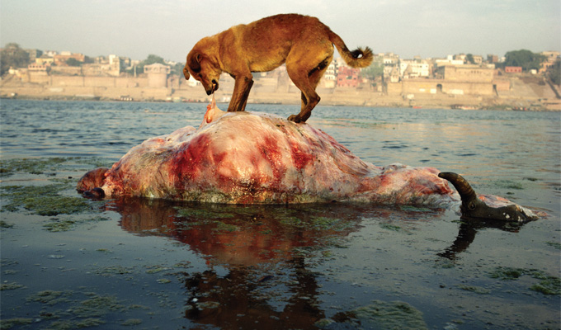
What is Typhoid?
Typhoid is a bacterial infection caused by the Salmonella typhi bacteria. It can also be caused by Salmonella paratyphi, a related bacterium that usually causes a less severe illness. These bacteria originate from rotten dead bodies either in water or on land.

Slide 3
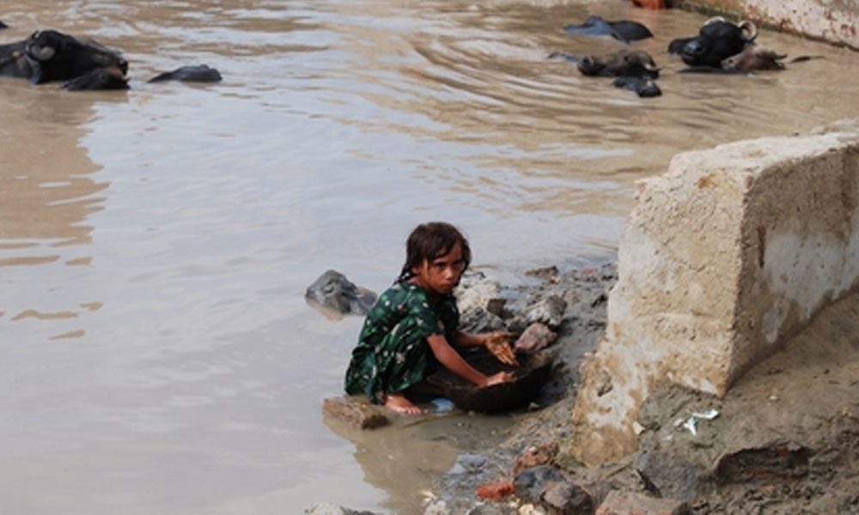
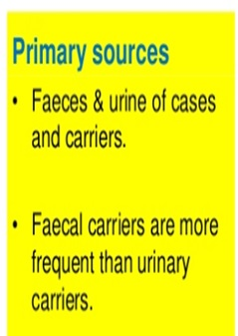
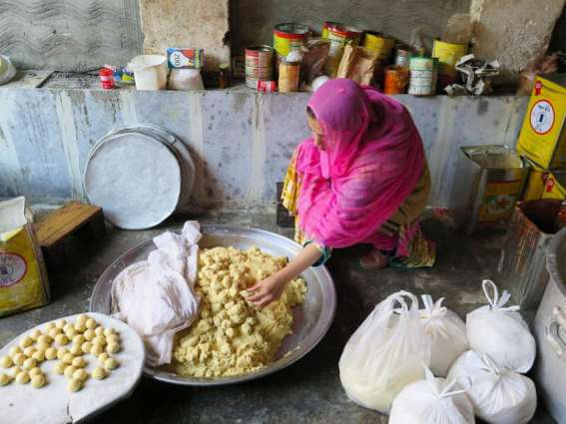
Secondary Sources of Infection
Primary Sources of Infection
Drinking
Baths
Daily Use
Used in juices, Beverages on stalls
Contaminated Water
Grill food
Uncovered food
Vegetables
Crops
Contaminated Food

Slide 4
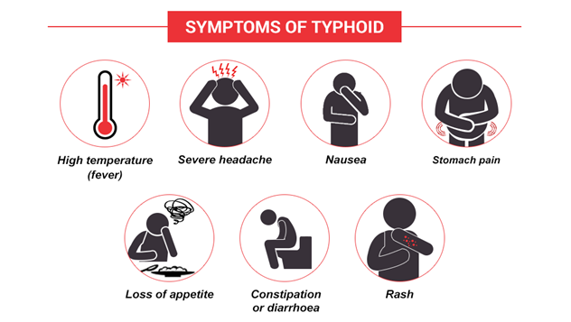

Slide 5
Reports
1. According to the National Institute of Health Islamabad the first known epidemic of extensively drug-resistant typhoid is spreading through Pakistan, infecting at least 850 people in 14 districts since 2016.
2. According to WHO about 21 million people suffer from typhoid each year, and about 161,000 die.
3. Typhoid is endemic to Pakistan, where poor infrastructure, low vaccination rates and overpopulated city dwellings persist. Doctors in the Sindh province were not surprised by an outbreak in November 2016 until cases proved unresponsive to ceftriaxone, used to treat multidrug-resistant, or MDR, strains of typhoid.
4. Doctors still prescribe an estimated 50 million doses of antibiotics for typhoid globally each year. In Karachi, the capital of Sindh province, antibiotic resistance is increasing by 30 percent each year, according to the W.H.O; at that rate, all typhoid cases in the city will be resistant to multiple drugs by 2020.
5. A report by the Centers for Disease Control and Prevention (CDC) states that an estimated 22 million cases of typhoid fever and 22,000 deaths resulting from typhoid are reported annually. In addition to this, 6 million cases of paratyphoid are reported every year.

Slide 6
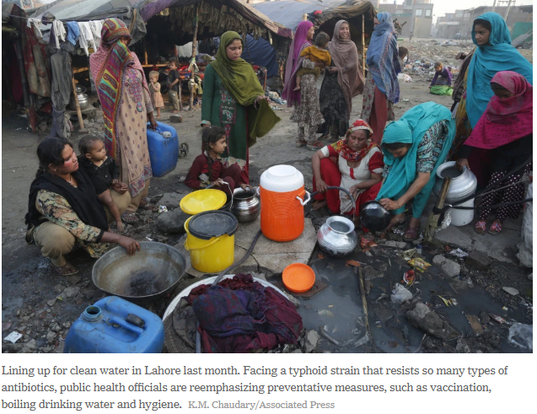

Slide 7
Our Findings and Research
During patients treatment our focus turned toward stomach and intestine as 75% immune system depends on activity of these internal organs. When we further investigate the problematic reasons in these organs we found that maximum patients have typhoid that was diagnosed through blood and urine tests of those patients.
After that we started our research on typhoid, mostly patients have stomach, Gallbladder, intestines, liver, heart, kidneys, spleen, pancreas problems and muscular pains that lead them toward acidity, Constipation, ulcer, swelling in large intestine and infections, fatty liver, triglyceride, cholesterol, disturb HDL, LDL, cretonne, urea problems, spleen swelling, high B.P and kidneys stones and muscular pains.
Mostly patients gallbladder were removed through surgery and infection move toward spleen which further effects the red blood cells and increase lower back pain which became sciatica pain. In such cases doctors tried to find cancer or T.B and did endoscopy, dialysis, neurosurgery, or operations for these illnesses.
Medical specialist tried to diagnose but they didn’t found root cause they couldn’t paid attention toward this typhoid; as we called it “Silent Typhoid”. It was typhoid without symptom of fever but laboratory findings show the presence of Salmonella typhi bacteria in their blood and urine samples.

Slide 8

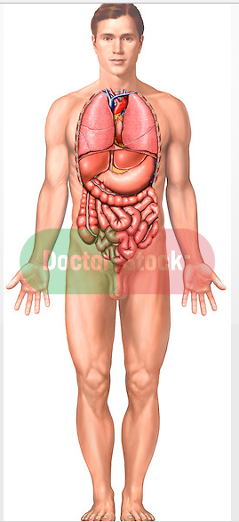
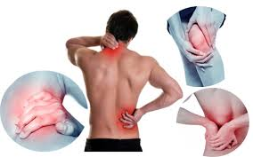

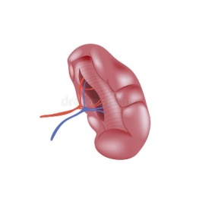
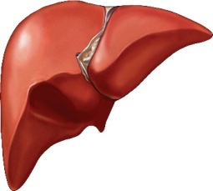

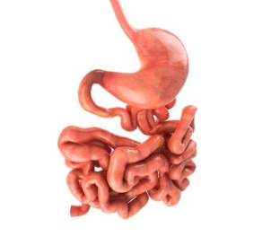
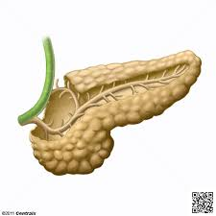
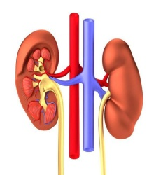
Typhoid
Eyes inside
Bad taste, smell
Yellowish Tongue
No freshness
Paralysis
Heart attack
Brain hemorrhage
Face
Cholesterol
Triglycerides
Heartbeat
Disturb HDL, LDL
Muscular Pain
Heart
Swelling
Blood deficiency
Fatty Liver
ALT
Bilirubin disturb
Spleen
Liver
Stones
Swelling
Acidity
Intestine infection
Ulcer
Nausea
Bitter Taste
Gall-
bladder
Stomach
Imbalance
Disturbances
Cretonne
Urea
UTI
Uric acid
Stones
Pancreas
Kidneys

Slide 9
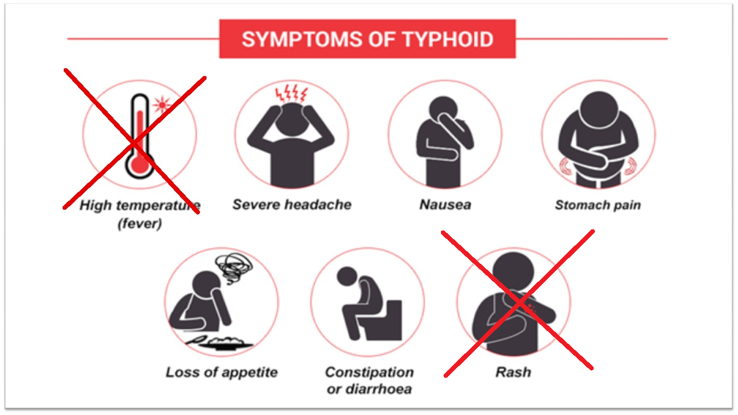
Symptoms of “SILENT” Typhoid

Slide 10
Those patients who suffered from typhoid once in their life they might have salmonella typhi bacteria inside their body because medicines only weakest the bacteria but not properly finish it. Whenever it get trigger inside body either in the form of contaminated food, water or flies it attacks again on the person but without showing sever temperature symptoms.
Due to absence of temperature medical specialist never paid attention toward this typhoid and ignored its other symptoms, so it become chronic and start to affect the internal organs of patients. We treated those patients successfully for whom doctors were hopeless in their diagnoses. We maintained the record of those patient’s pre laboratory tests and post laboratory test.
Now I Dr Rasheed Ahmed and my team litigate with full confidence that we can treat those patients to whom medical science is hopeless to diagnose and we have evidence to prove that Typhoid without temperature is the cause of all above mention illnesses. And also want to share my expertise with others medical experts.

Slide 11
Recommendations and Strategies
As it is declared in WHO report that in 2020 medicines will never work on typhoid. In Pakistan and its neighbor countries it its ratio increases day by day. If it is not controlled it may become a big challenge for world, and our new generation will be disable. Those parts of body that are destroy by Polio and typhoid will never recover again because these illnesses kill those parts and “there is no treatment for death”.
We work on typhoid by using alternative medicines (Homeo) and getting very successful results. Patients recover with our medicines and treatment plans; these are both illiterate and highly educated people such as doctors, lawyer, engineers and teachers also.
We further want to work on typhoid and we have very good and effective strategies but due to limited resources we are bound. If we get support from any health related organization or institute we can do good work not in words but practically.

Slide 12
THANK YOU

