Slide 1

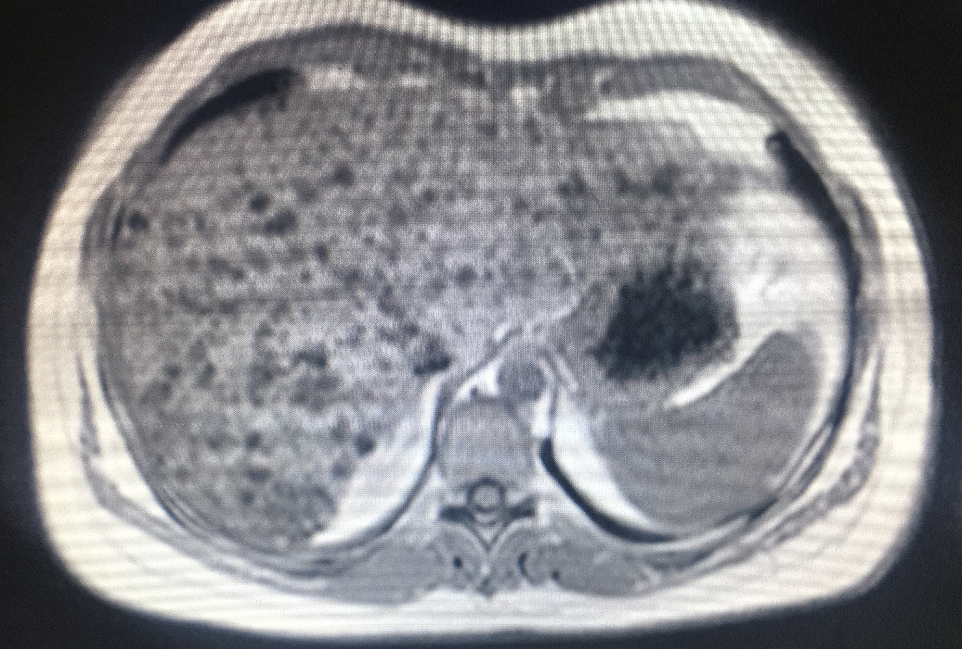
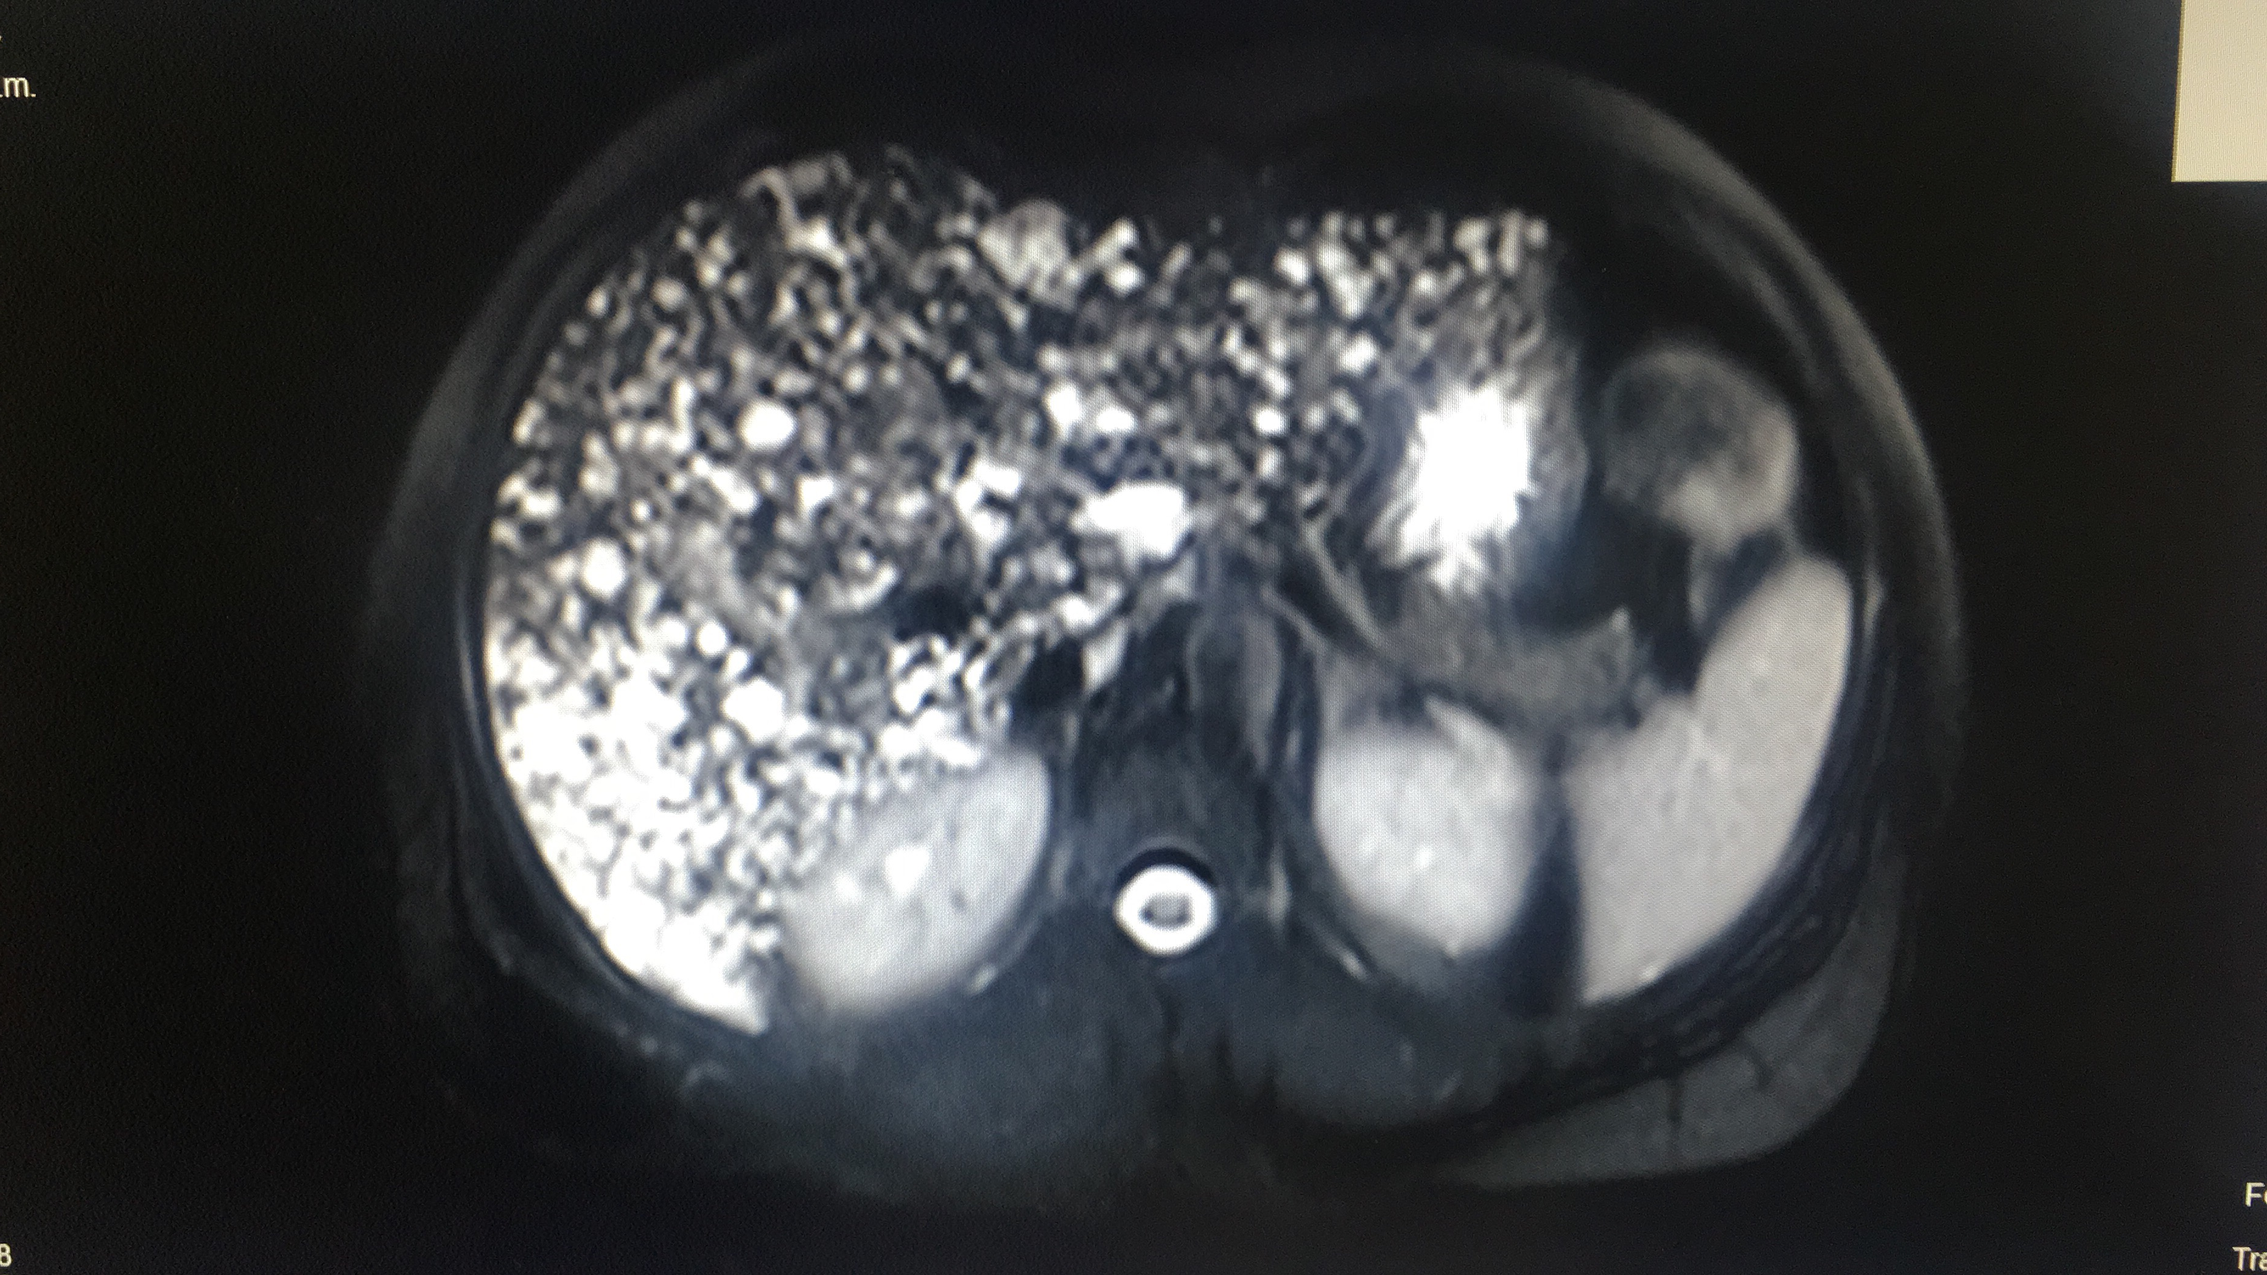
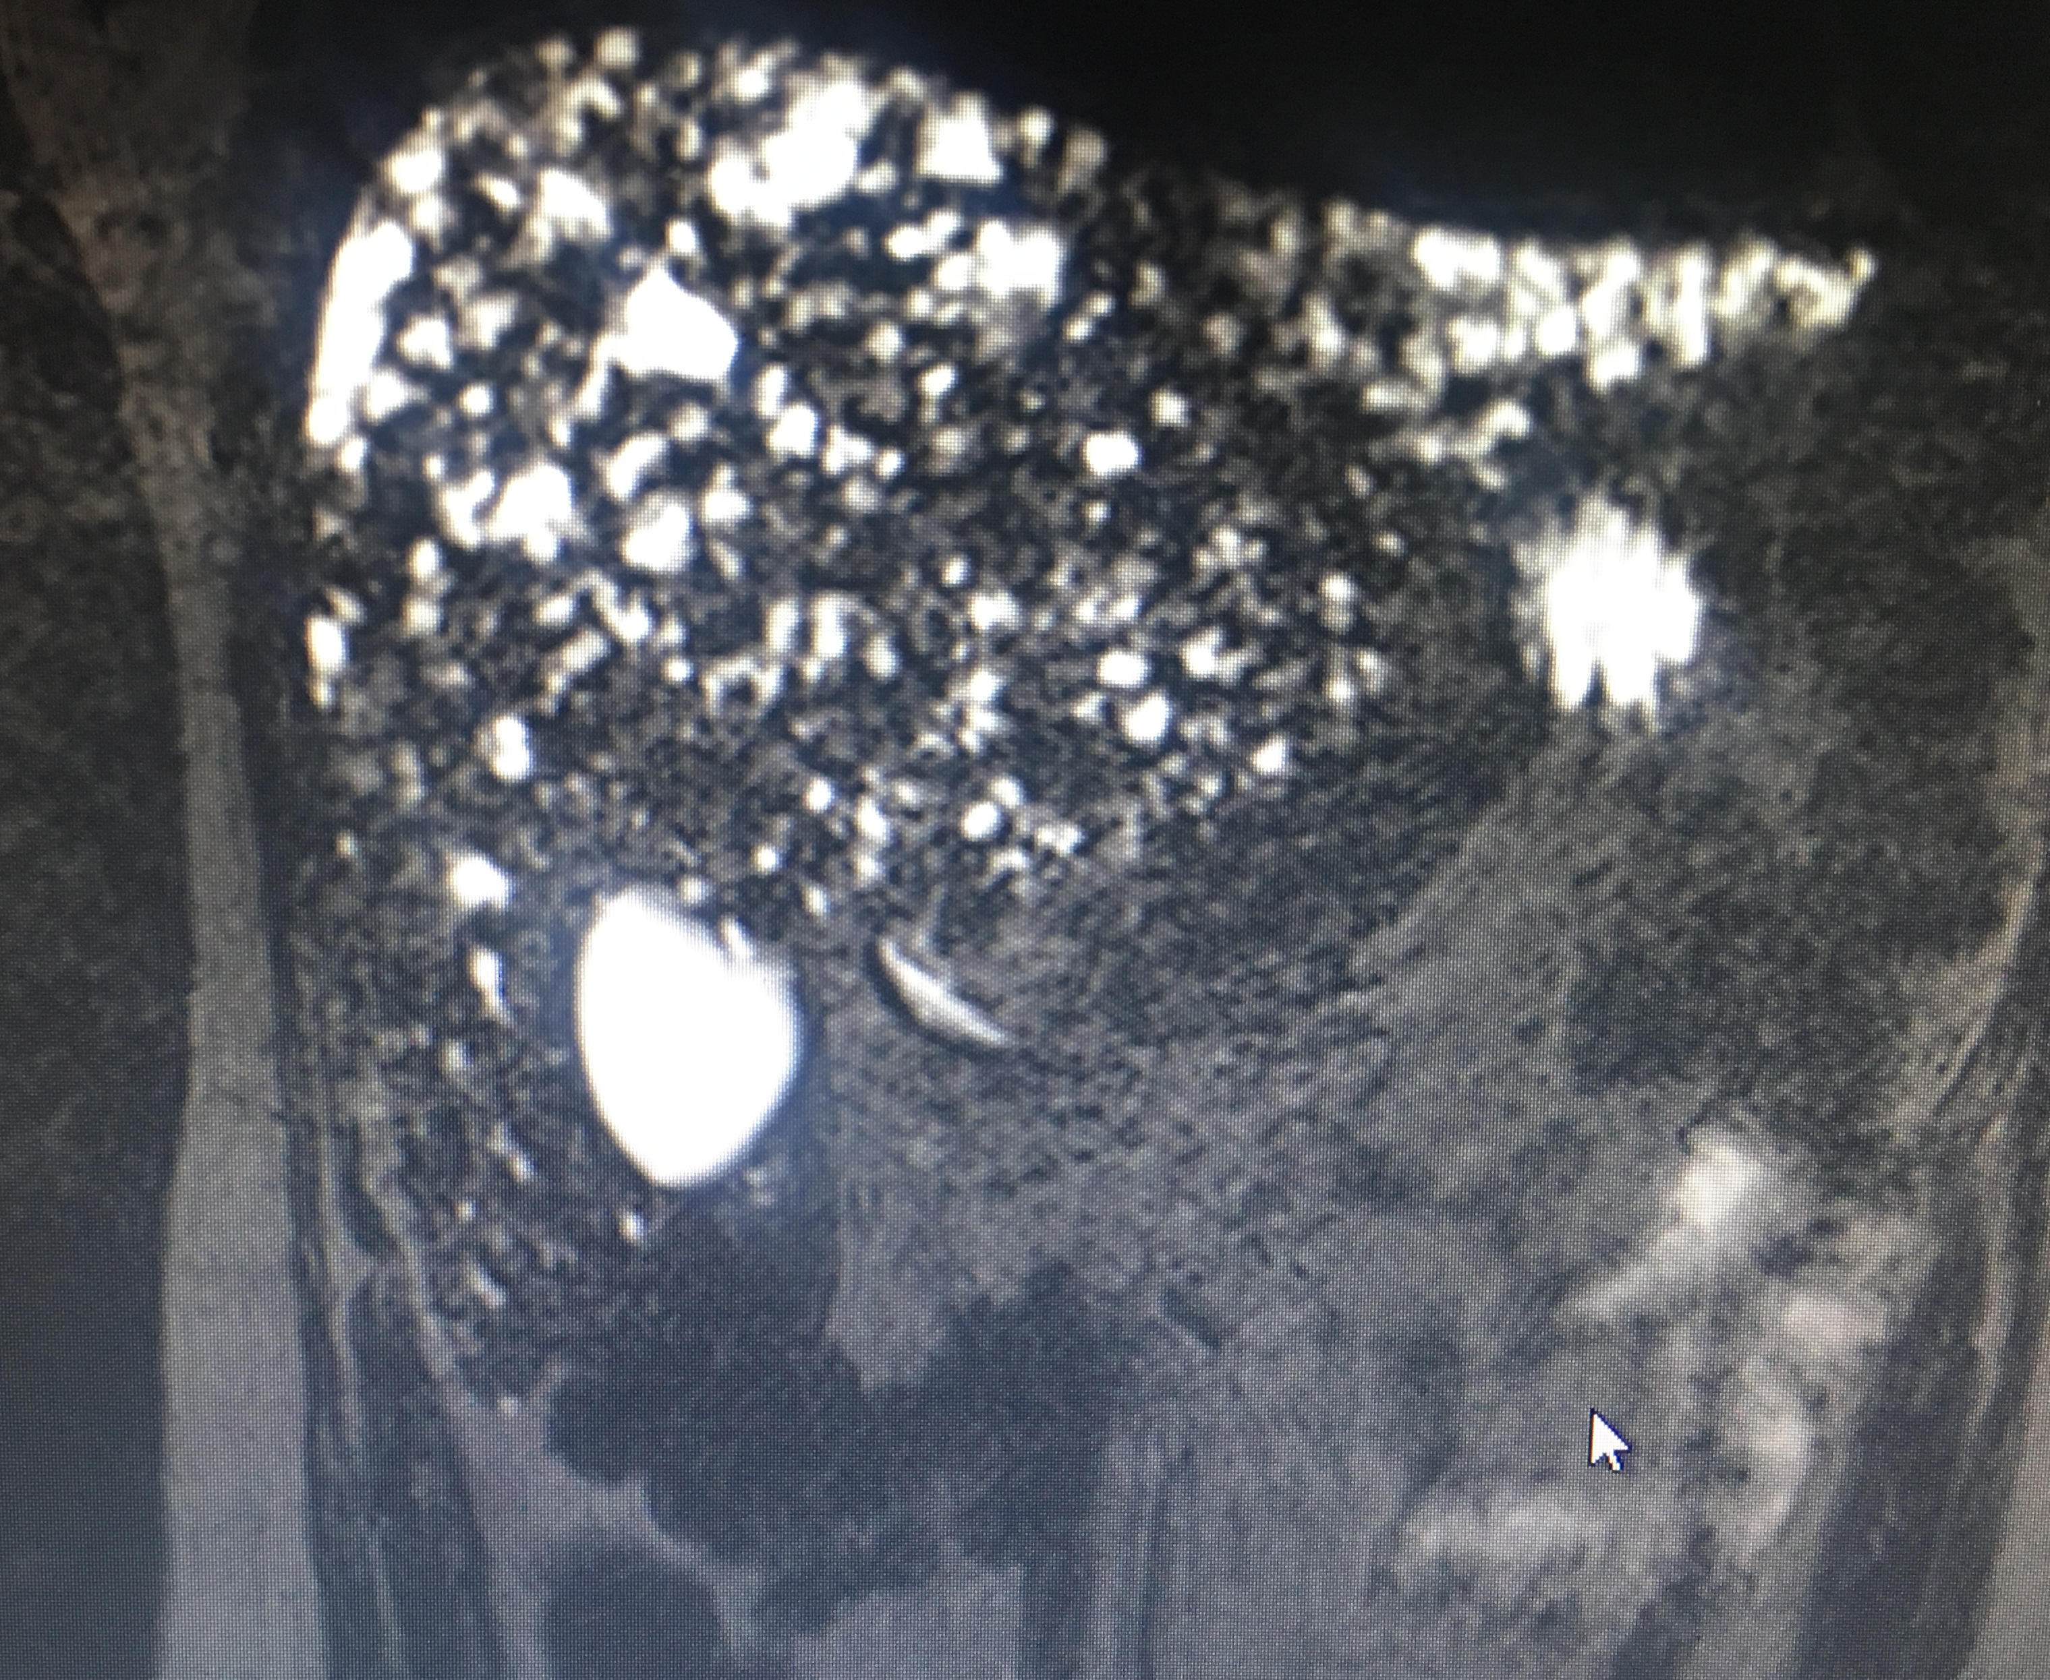
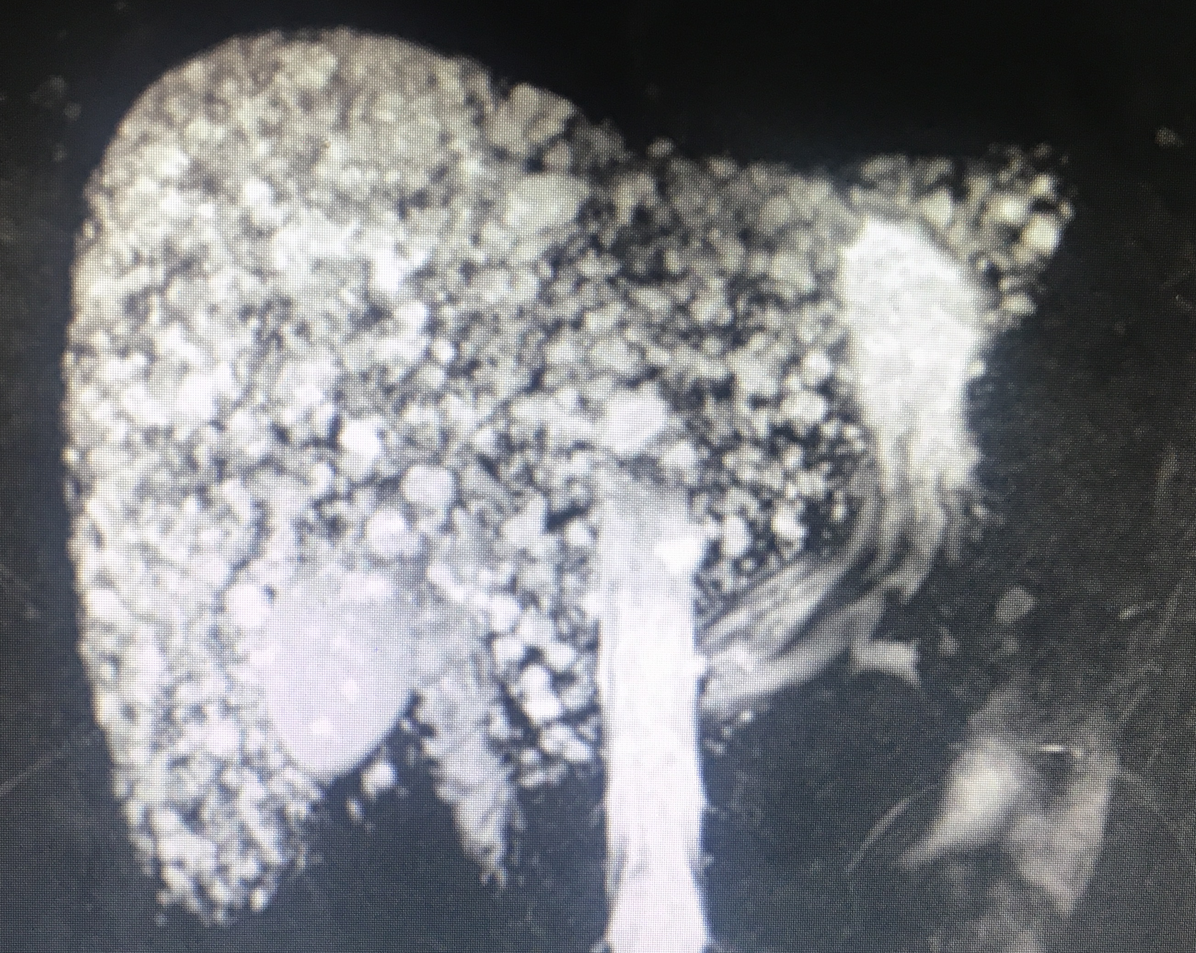
MULTIPLE BILIAR HAMARTOMATOSIS "COMPLEX DE VON MEYENBURG"
Dr. Jorge A. Hernández Hernández (Resident of second year of gastrointestinal endoscopy).
Dr. Rolando Armienta Sarabia - Professor of Gastrointestinal Endoscopy course)
Dra. Ma. Elena Hernández Gomez - Associate Professor and Head of the Department of Digestive Physiology
Endoscopy and digestive physiology service of the Regional Hospital "Gral. Ignacio Zaragoza "
INTRODUCTION
Multiple biliary hamartomatosis or Meyenburg Complex was described in 1918 and consists of a deformation and disorganization of the bile ducts, forming cystic structures that vary in size. An incidence of 5.6% in adults and 0.9% in children is reported.
The diagnosis of this disease has gone very far thanks to the technological advances of imaging.
Previously the management was conservative, maintaining an expectant and continuous periodic behavior, however, at present, the increase in the number of cases, that there is a possible association with the development of cholangiocarcinoma.
The treatment for isolated and unique lesions is surgical resection whenever the sea is possible.
CLINICAL CASE
Female, 56 years of age without risk factors, controlled hypertension, without allergic or surgical history, assigned to the outpatient clinic with hepatobiliary ultrasound that reports hypoechoic, multiple images in the hepatic parenchyma, gallbladder and extrahepatic bile duct without alterations , the intrahepatic bile duct with multiple ectasias that deform the gland.
MATERIAL AND METHODS:
It is protocolized for primary tumor search thinking about metastatic disease, basic paraclinical without alterations, liver function tests without alterations, normal tumor markers, normal panndoscopy and colonoscopy.
Magnetic cholangiography is performed, which in T2 sequence shows multiple hyperintense images, alternating with areas of low signal uptake and in spin echo sequence with T2 reinforcement hyperintense images are identified coinciding with cystic lesions that cover more than 90% of the hepatic gland.
DISCUSSION:
Multiple biliary hamartomatosis had been considered and managed as a benign behavior pathology, however, experience, technological progress and its relationship with the development of cholangiocarcinoma makes us question the need to consider its surgical treatment, including liver transplantation in cases so demand it.
1. von Meyenburg H: Uber die Cystenleber. Beitr Pathol Anat 64: 477‑532, 1918 (In German). 2. Singh Y, Cawich SO, Ramjit C and Naraynsingh V: Rare liver tumor: Symptomatic giant von Meyenburg complex. J Surg Case Rep 2016: pii: rjw195, 2017, Kim HK and Jin SY: Cholangiocarcinoma arising in von Meyenburg complexes. Korean J Hepatol 17: 161-164, 2011.

