Slide 1
Chest Pain
Dr,Moemen Moaaz
consultant&head of cardiology&cath lab department,Elkharga General Hospital,Elwady Elgedeed,Egypt

Slide 2
Patient Data
Name: Lotfy
Gender: Male
Age: 47 years
Occupation: Social Insurance government employee

Slide 3
Symptoms
Reports a six-month history of intermittent chest discomfort while hurrying up to catch the train or climbing 3 flights of stairs to his office.
He describes lower sub-sternal tightness with numbness of the left upper arm only during moderately severe exertion.

Slide 4
What is the type of chest pain the patient is experiencing?
Typical angina
Atypical angina
Chest pain of non-cardiac origin

Slide 5
Clinical Classification of Chest Pain
Typical angina (definite)
1) substernal chest discomfort with a characteristic
quality and duration that is ...
2) provoked by exertion or emotional stress and
3) relieved by rest or nitroglycerin
Atypical angina (probable)
meets 2 of the of characteristics
Noncardiac chest pain
meets ≤ 1 of the typical angina characteristics
J Am Coll Cardiol. 1983;1:574, Letter

Slide 6
Family History
His father died suddenly at the age of 49 years
(Family history of premature CHD)
  CHD in male first degree relative <55 years
  CHD in female first degree relative <65 years)

Slide 7
Patient Lifestyle
He smokes 10-15 cigarettes a day.
He spends his leisure time watching TV, reading magazines and newspapers or in cafees. He never walks or exercises.

Slide 8
Probability Estimate the Diamond and Forrester approach
The simple clinical observations of
Type of chest pain
Age
Gender
are powerful predictors of the likelihood of CAD
N Engl J Med 1979;300:1350-8

Slide 9
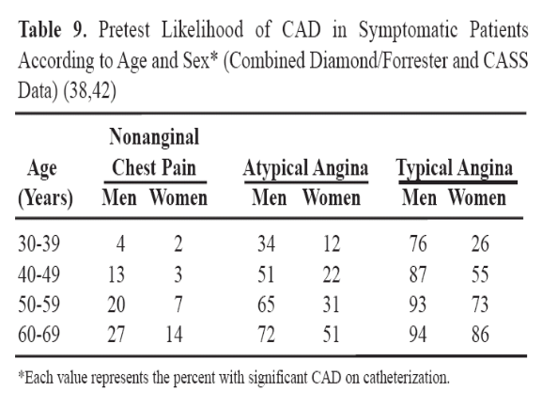

Slide 10
Probability Estimate the Diamond and Forrester approach
  a 64-year-old
  man
  with typical angina
  has a 94 % likelihood of having significant CAD

Slide 11
Probability Estimate the Diamond and Forrester approach
  a 32-year-old
  Woman (premenopausal)
  with nonanginal chest pain
  has a 2% chance of CAD

Slide 12
Probability Estimate
The Duke and Stanford models
The likelihood of disease for women <55 years old with atypical angina and no risk factors is < 10%; but if
Diabetes,
Smoking
Dyslipidemia
are present, the likelihood jumps to 40 %.
Ann Intern Med 1993;118:81-90

Slide 13
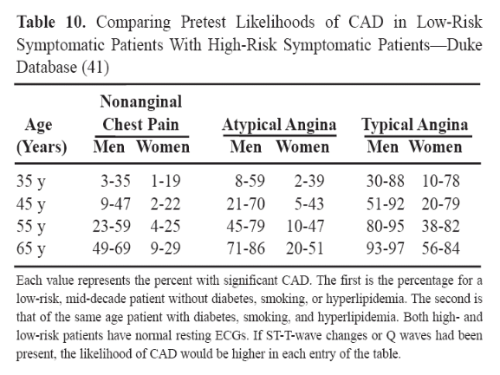

Slide 14
Probability Estimate of significant coronary artery disease
Age
Gender
Type of chest pain
CV risk factors

Slide 15
On examination
His blood pressure is 158/96 mm Hg.
Pulse is 86 bpm.
His weight is 98 Kg, height is 176 cm, his BMI is 31.6 KG/M2
waist circumference is 104 cm.
Otherwise, physical exam was unremarkable.

Slide 16
Investigations Performed
Lab tests:
  TC…261 mg/dl
  LDL-C….172 mg/dl
  HDL-C…. 50
  TG…113 mg/dl
  FBS….108 mg/dl
  Other lab. Test (kidney and liver functions, CBC, serum electrolytes, thyroid function, urinary albumin) were unremarkable.

Slide 17
Risk Factors for CAD
Increase the likelihood that CAD will be present
  cigarette smoking
  hyperlipidemia
  diabetes
  hypertension
  family history of premature CAD
  past history of CVA or PVD

Slide 18
What is the most appropriate test to rule in/out coronary artery disease?
An ECG stress test
Transthoracic echocardiography
Resting myocardial perfusion scintigraphy
Electron beam computed tomography for coronary calcium
Coronary CT angiography

Slide 19
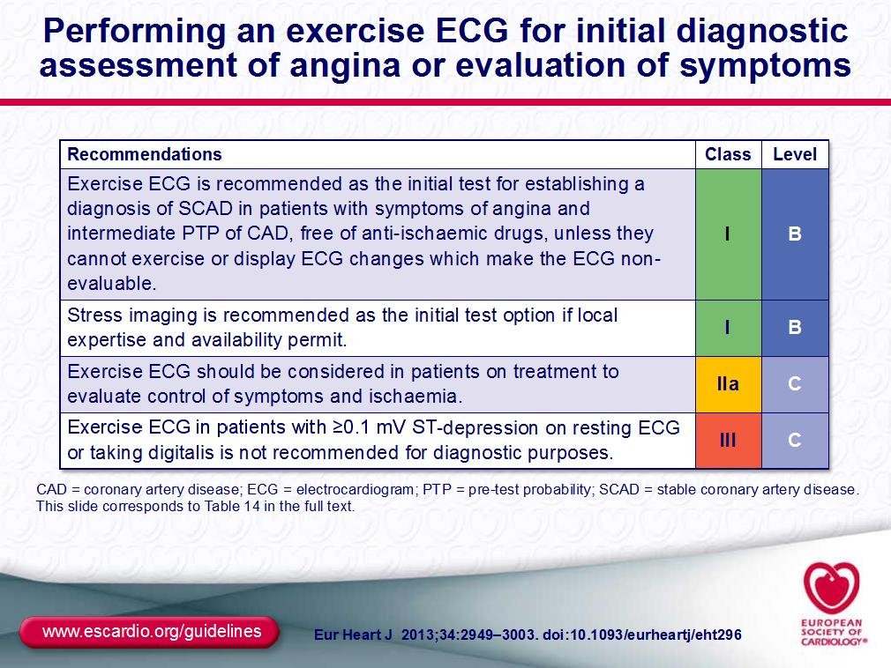

Slide 20
Stress Tests - cost issues
exercise ECG is least costly 1X
stress echocardiography 2X 2X
stress SPECT myocardial imaging 5X
coronary angiography 20X

Slide 21
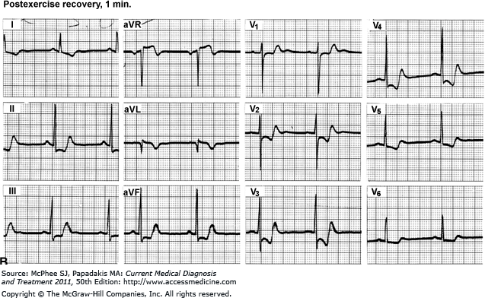

Slide 22
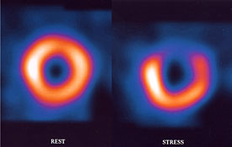

Slide 23
Exercise Stress Test Results:
  Exercise stress test was positive with 1.5 mm ST segment depression at stage IV of Bruce protocol.
  Duration of exercise was 10:40 min.
  Patient achieved 90% of his predicted max. heart rate with appropriate BP response.
  Patient felt mild chest discomfort at peak exercise which soon disappeared 1 min. into recovery.

Slide 24
Goals of Current Therapy of Angina
Control of anginal Symptoms
Reduction of major adverse cardiovascular events

Slide 25
Approaches for management
Lifestyle modification (Management should routinely include lifestyle modifications, including smoking cessation, weight control, and regular exercise, and aggressive control of other cardiovascular risk factors).
Drugs
Antianginal agents...B-blockers, sublingual nitrates
Vasculoprotective agents…aspirin, statins, ACE-I

Slide 26
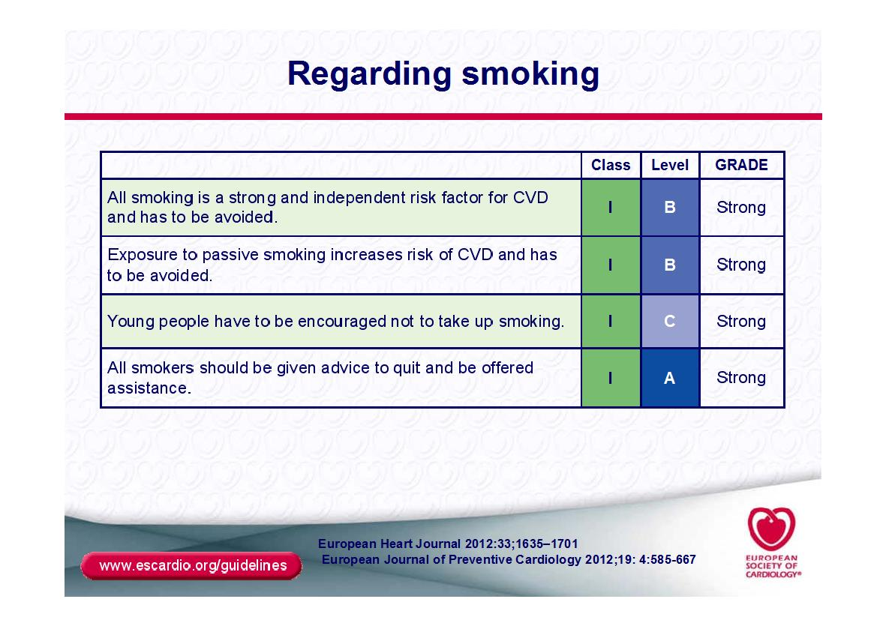

Slide 27
Revascularization
Revascularization (performed by any technique) has not been shown to decrease the risk of myocardial infarction or death from coronary artery disease in patients with chronic stable angina and preserved left ventricular function.

Slide 28
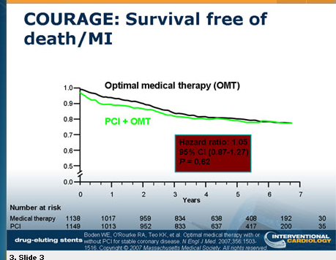

Slide 29
Approaches for management
Several trials have indicated that treatment with a combination of anti-ischemic and vasculoprotective agents, along with lifestyle changes —
with the option to proceed to percutaneous revascularization if symptoms worsen — results in rates of myocardial infarction and death that are not significantly different from those associated with revascularization in patients with class I or II stable angina whose disease involves one or two vessels.

Slide 30
REVASCULARIZATION
Lifestyle-limiting angina
Early onset of ischemia on stress testing
ST-segment depression of 2 mm or more.
A large ischemic burden on nuclear or echocardiographic stress testing
Left ventricular systolic dysfunction
Diabetes?

Slide 31
REVASCULARIZATION
High-risk angiographic features
Symptomatic multivessel disease
Left main coronary artery disease
Proximal left anterior descending artery disease

Slide 32
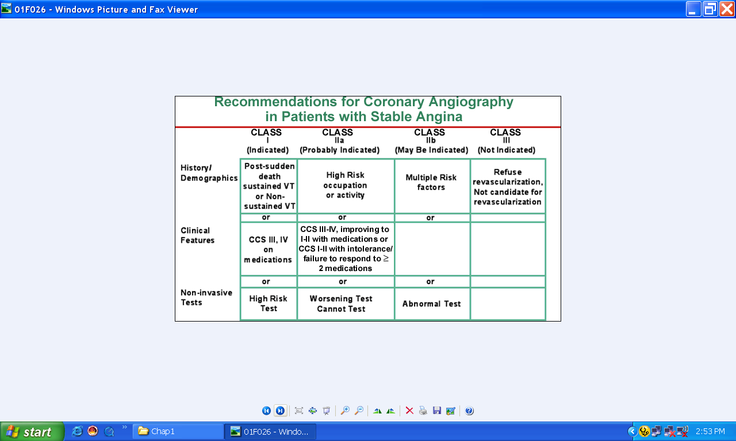

Slide 33
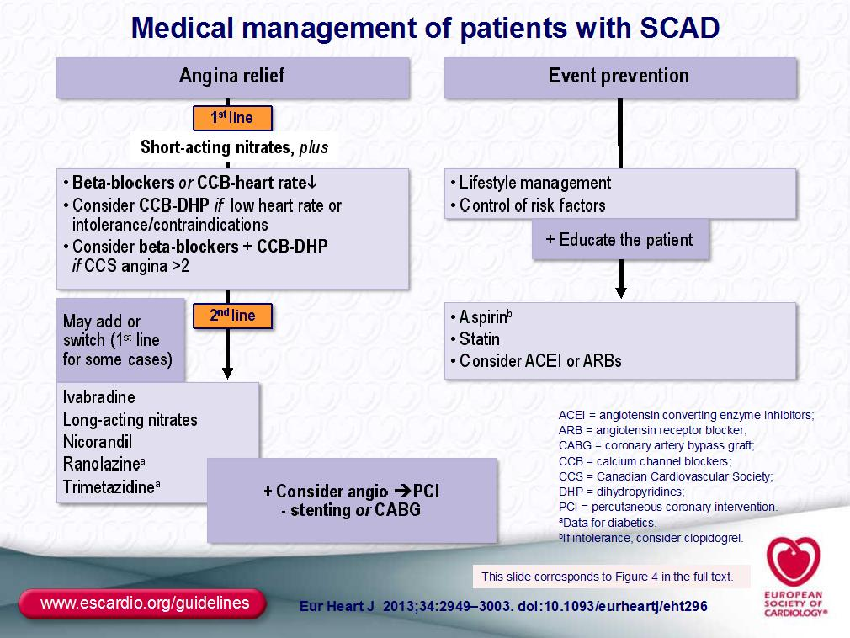

Slide 34
Improving symptoms of angina:
(32-39%)
(27-37%)
(32-39%)
WAGNER G: J. Cardiovasc. Pharmacol. (1992)

Slide 35
Advice for follow up
Symptoms
Lifestyle modification
Drugs
Laboratory work-up
Non-invasive testing

Slide 36
Thank You

