Slide 1



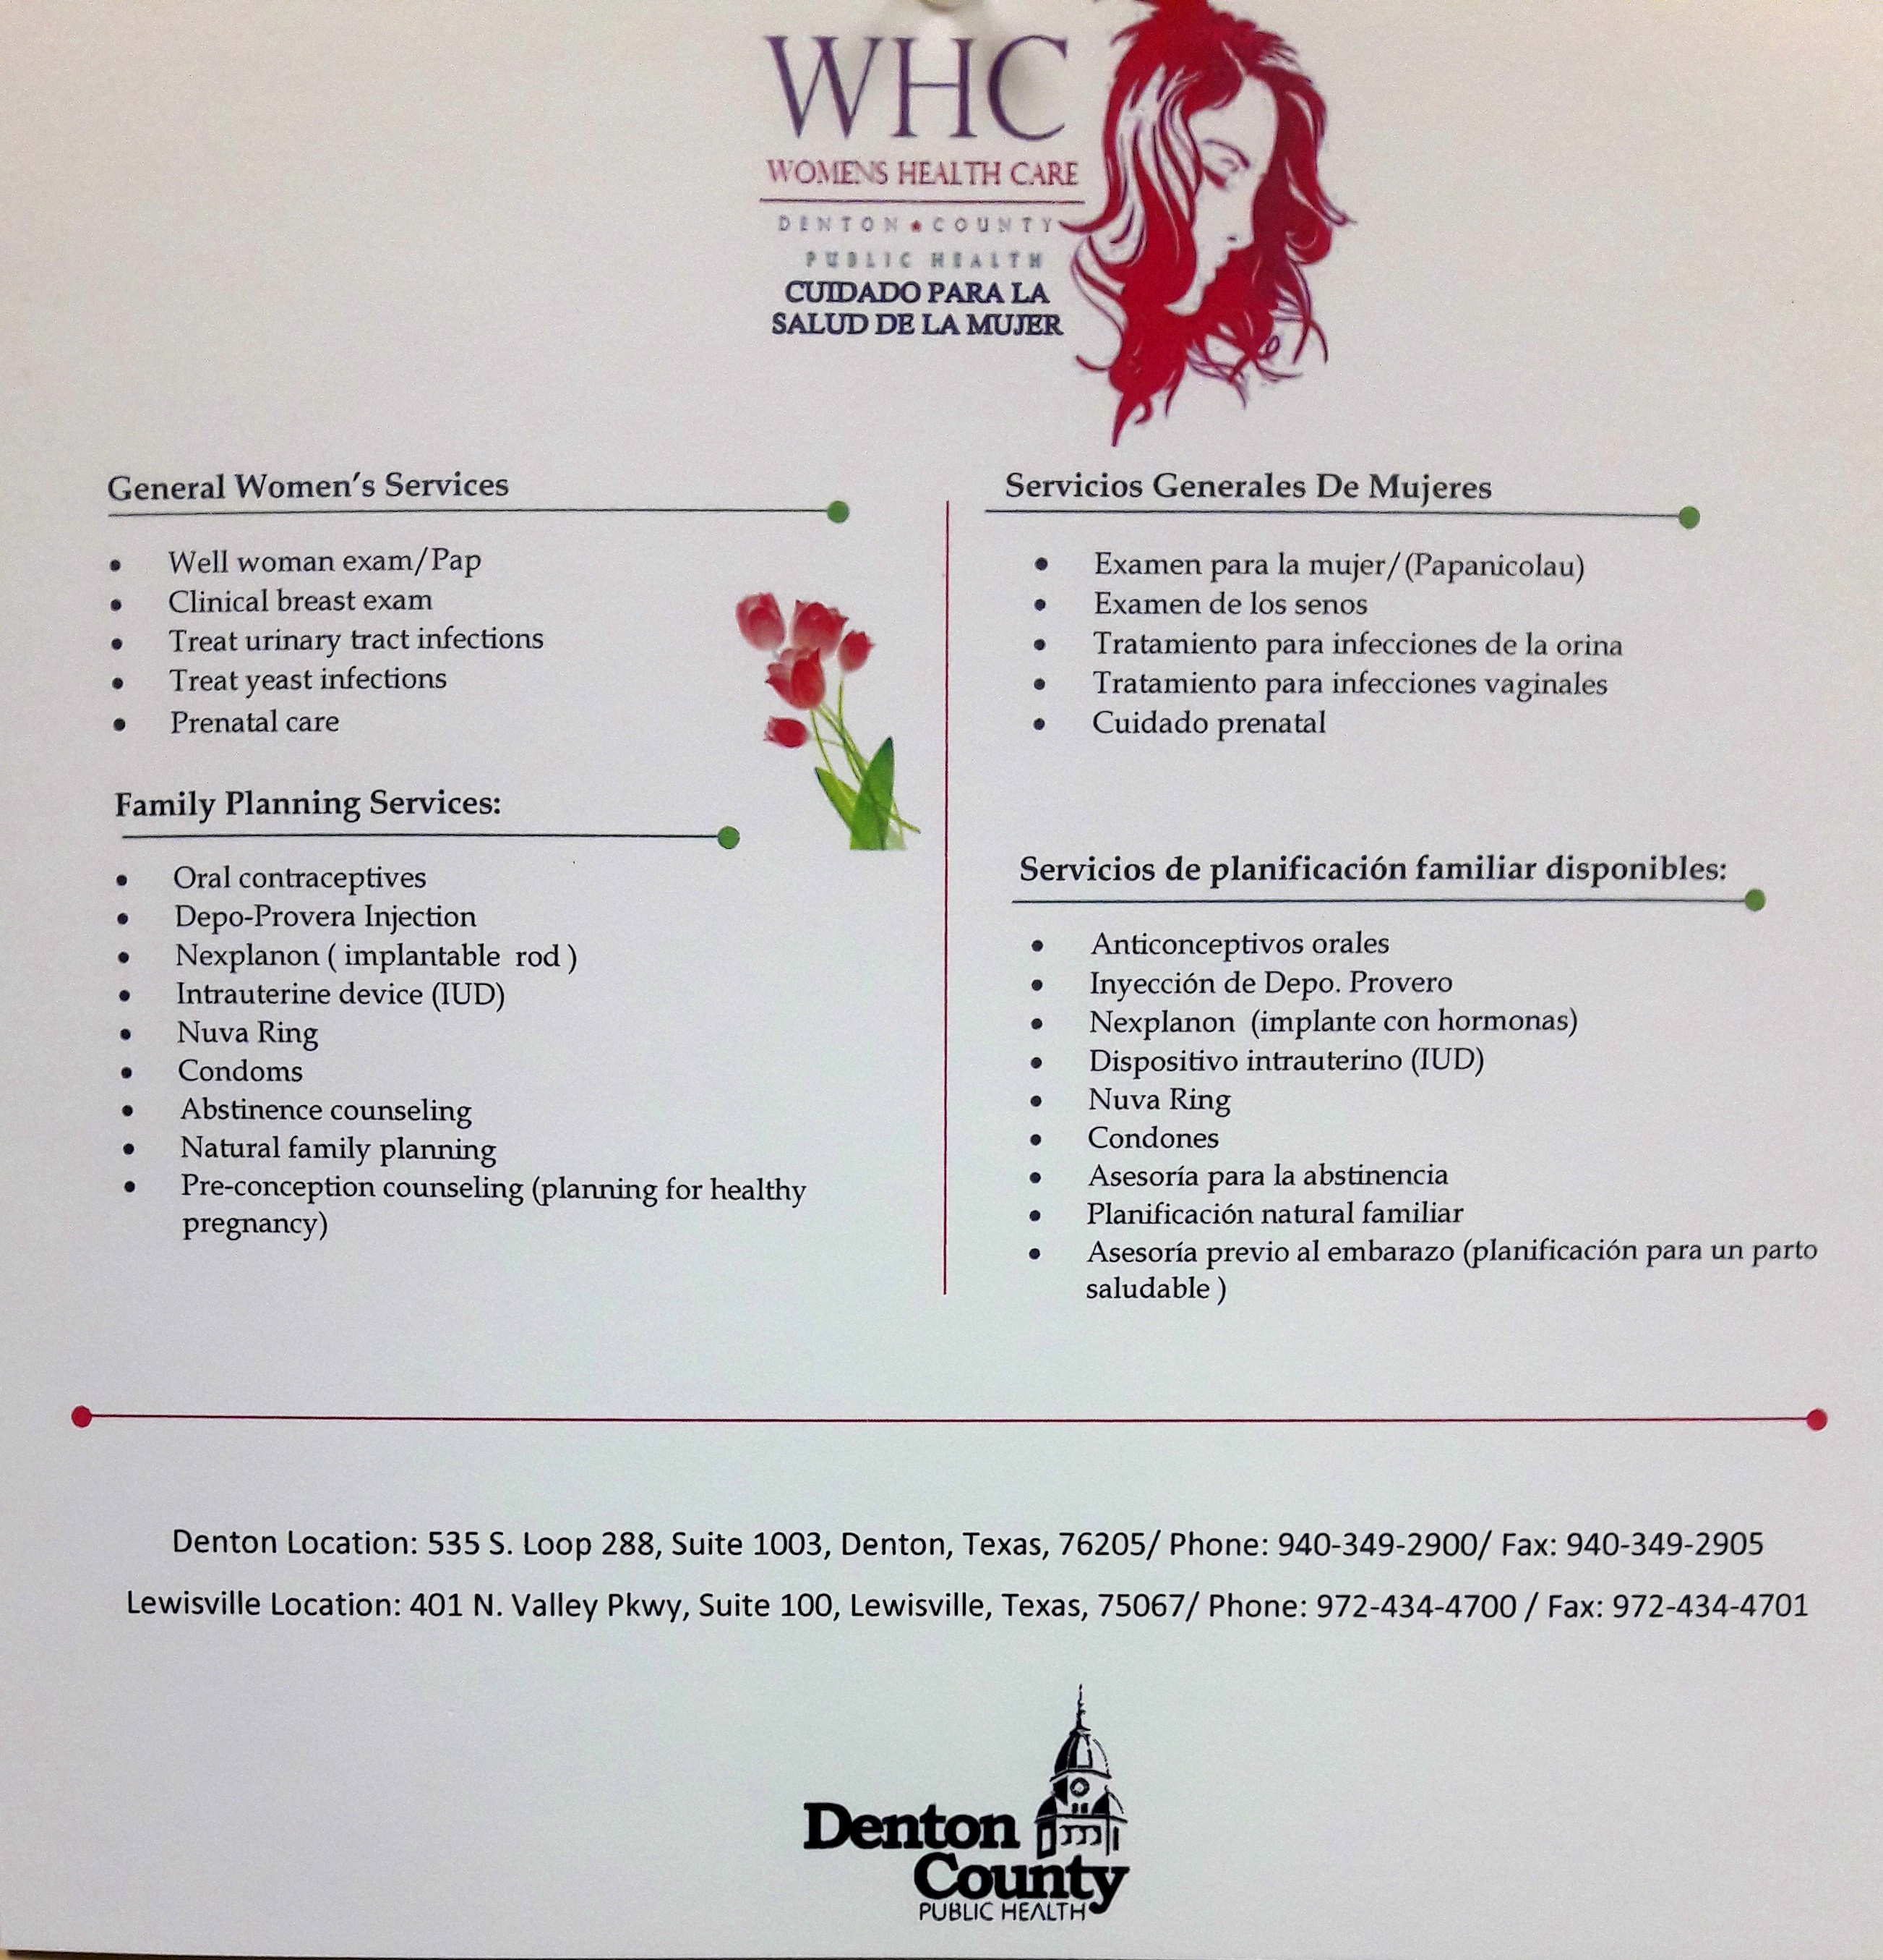
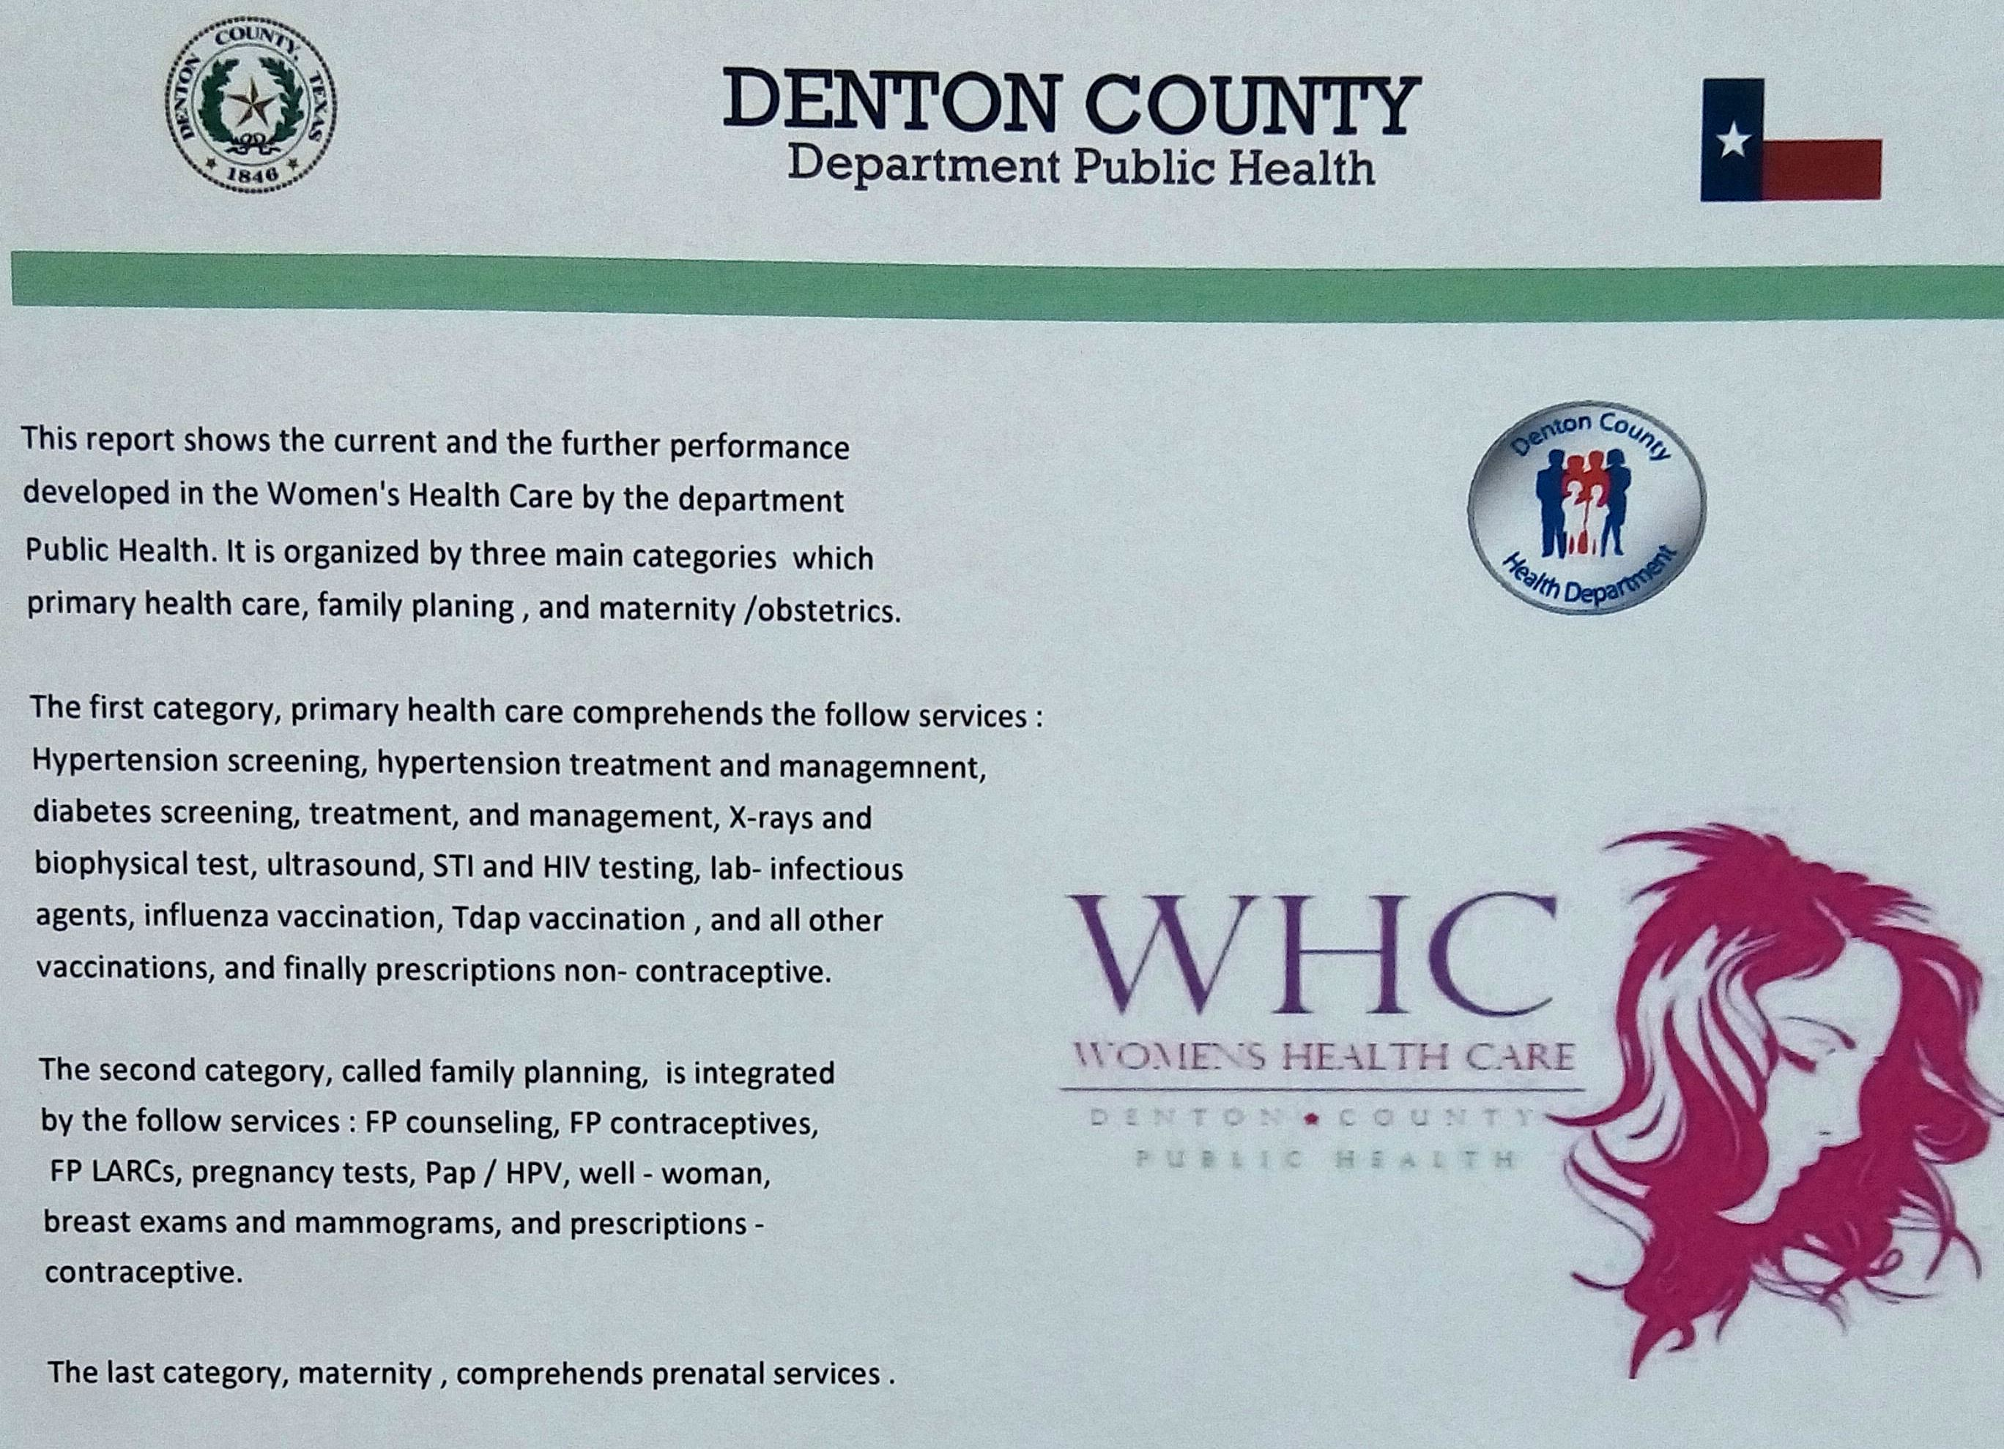
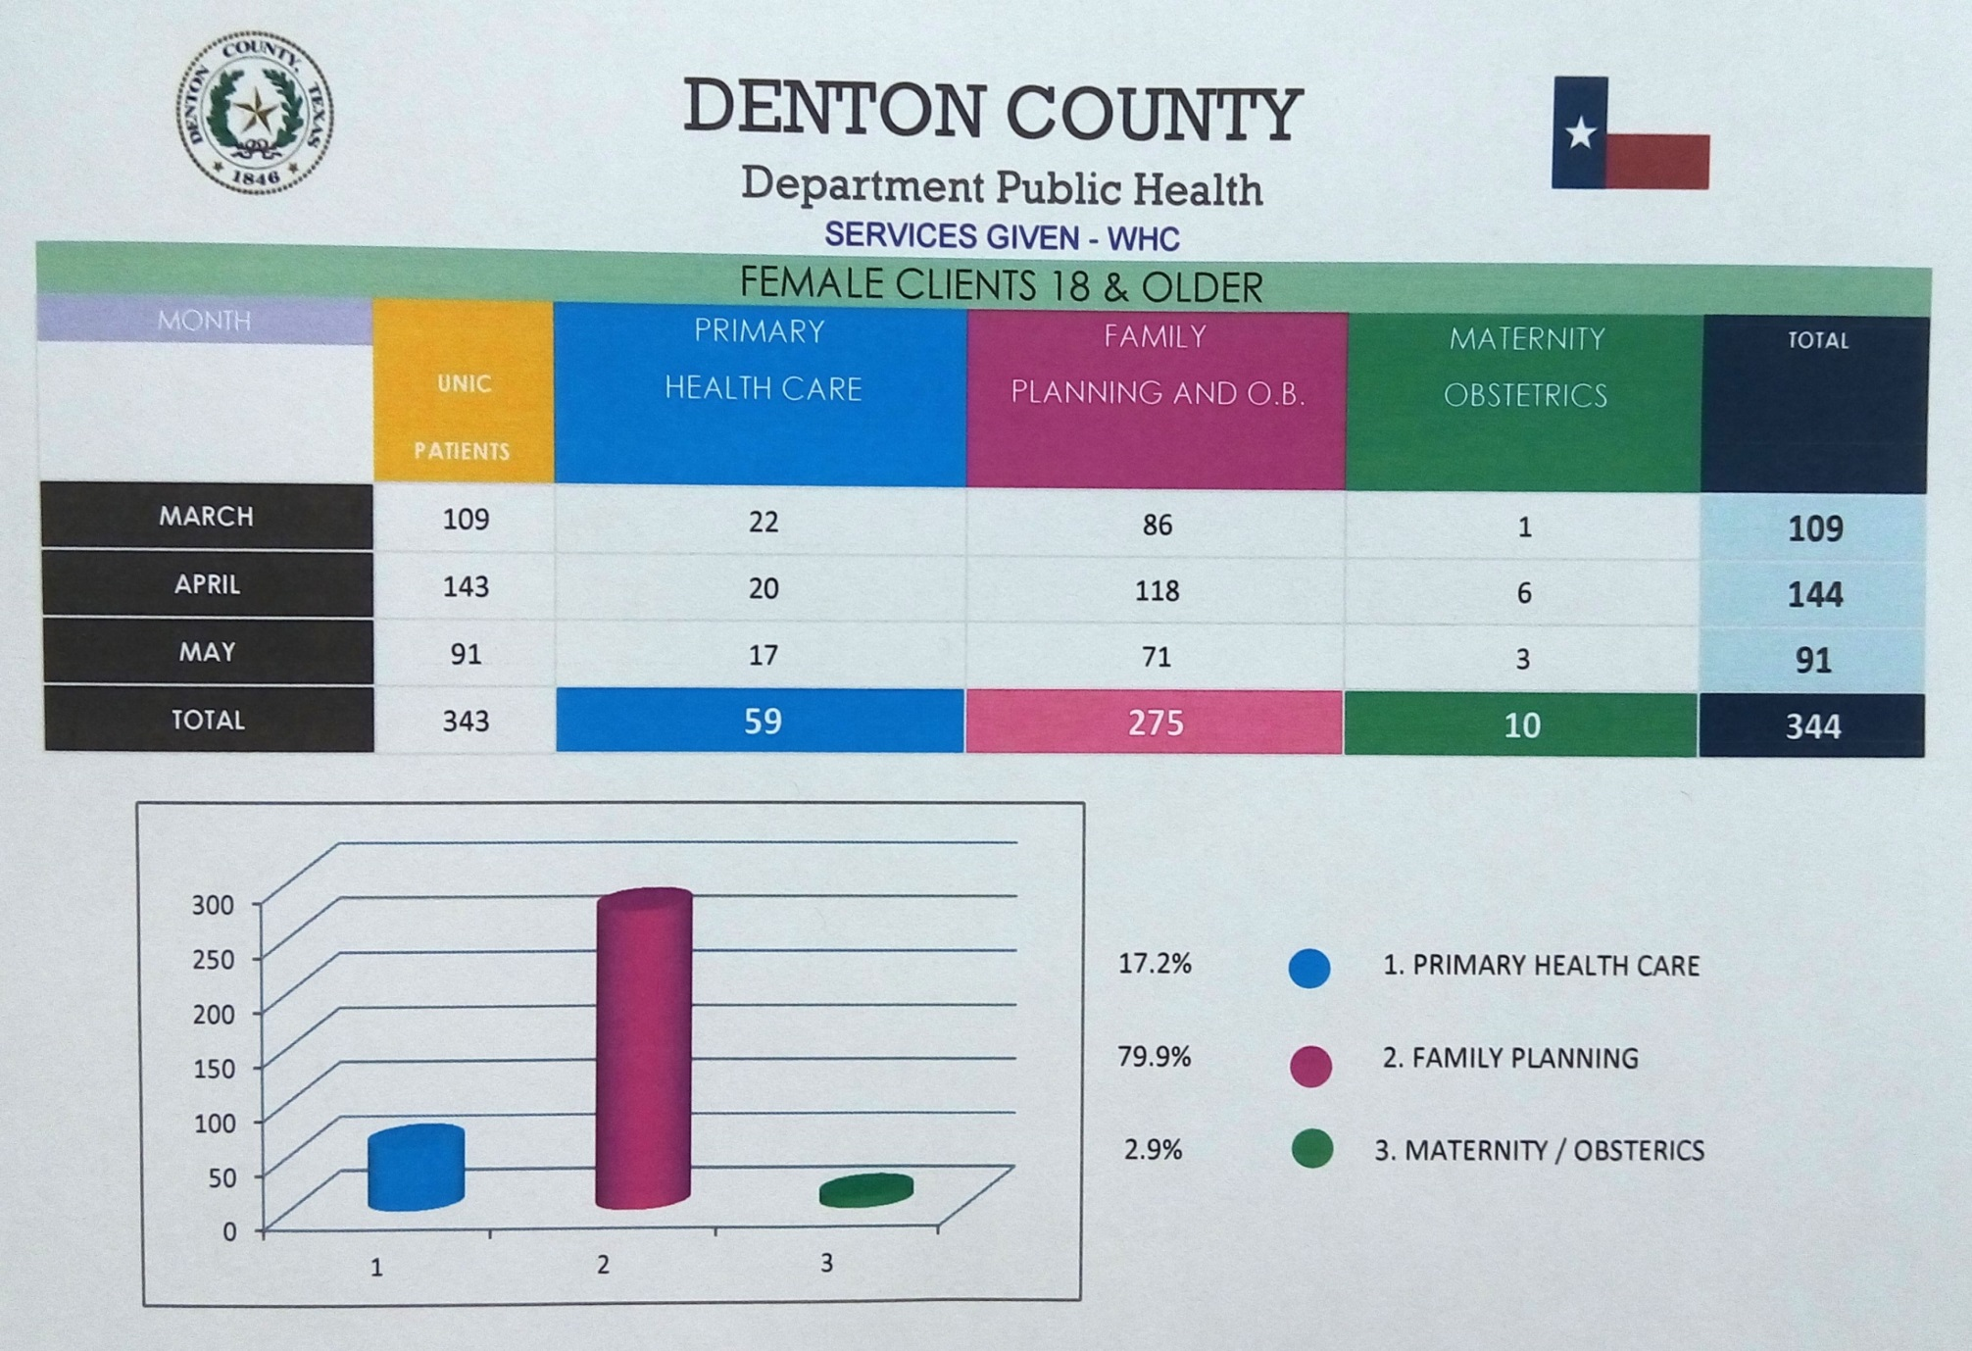

Denton County Public Health
Women’s Health Program
Introduction
Materials and Methods
Conclusions
The use of these preventative health care services are central to improving long term health status. Therefore, it is our mission to make sure each woman has access to these services. In doing so, each woman has the ability to successfully plan out her pregnancies, while ensuring a healthy birth physically, and mentally. Our program delivers our services such as:
Educational lectures within universities, public schools, mental health clinics, major companies within the area, day care facilities, and churches.
Representing our program at career fairs, health fairs, and special events catering to a specific population. For example, last year our women’s program was presented at K-Loves/Air-1 radio’s annual Single Mom’s Night event, Univision’s radio program in Dallas, and Tarrant County’s Hispanic Wellness Health Fair.
Our services include:
Improving the health status of Denton County residents requires the use of preventive health care services such as those our women’s health care program provides which, in turn, leads to positive health behaviors. Unfortunately, 1 out of 2 pregnancies go unplanned and lead to health complications along the way. Also, 1 out of 3 women report not visiting a doctor due to costs. Therefore, our goal is to create access and opportunities for our health services, help women plan out their pregnancies, and make sure their well-woman needs are met. In closing, Denton County Health Department Women’s Health Program aims to educate women to make better and more informed choices about their health.
The Texas Administrative Code(TAC) states that access to primary health care services are for persons, who are at or below 200% of the Federal Poverty Level (FPL), who are unable to access the same care through other funding sources or programs. In 2013, the Texas Legislature appropriated funds to be used for expanded primary care services for women 18 years and older. The statute and rules are effective for both Primary Health Care and the Expanded Primary Health Care Programs.
Results
Objective
The purpose of the Department of State Health Services (DSHS) Expanded Primary Health Care (EPHC) program is to deliver preventative and primary care medical services, while providing contraceptive services to uninsured women age 15 years and older residing in Texas. Providing these important health services enables Denton County Health Department to empower Denton county residents to make better and more informed choices about their health.
References
Denton County Health Department http://dentoncounty.com/Departments/Health-Services/Womens-Health-Care.aspx
Office of Women's Health http://womenshealth.gov/index.html

