Slide 1
Burden of Gynaecological cancer and inequity in cancer care in developing world
Prof. Haleema A. Hashmi
Department Of Obstetrics & Gynaecology
Liaquat National Hospital & Medical College
Karachi – PAKISTAN

Slide 2
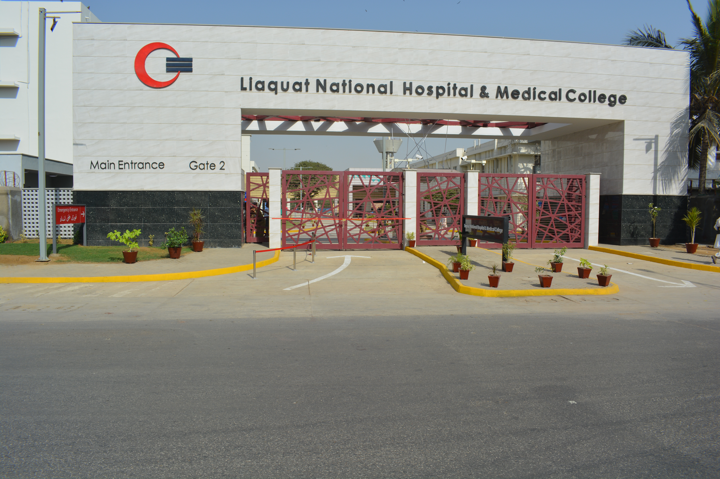

Slide 3
Introduction
25% of all cancers diagnosed in women aged upto 65 years in developing countries are gynaecological cancers compared to 16% in developed world.¹
Developing countries accounted for 820265 cases (77.7%) of global estimates for new cases of commonest gynaecological cancers including cervical, corpus and ovarian cancer in 2009.²
The data to be discussed is derived from the comprehensive global cancer statistics published by the International Agency for Research on Cancer (IARC) of the World Health Organization (WHO) and prepared by GLOBOCAN.

Slide 4
Emerging global trend in gynaecological cancers
According to IARC (International Agency for Research on Cancer) in 2008, 53% of 12.7 million new cases of cancer and 63% of the 7.6 million cancer deaths occurred in developing countries.³
Three decades earlier developing countries accounted for only 15% of global cancer burden.
By the year 2020, about 10.25 million new cases of cancer would be diagnosed in developing countries compared to 5.9 million in the developed countries (IARC / GLOBOCAN 2002)

Slide 5
Reasons for changing trend
Lifestyle changes: smoking, low fiber, high fat diet, indulgence in alcohol & substance abuse
Increasing prevalence of immunosuppressive conditions such as malnutrition, tuberculosis, and HIV.
High prevalence of oncogenic infections e.g. Hepatitis B & C virus, HPV & Helicobacter pylori
More reporting to hospitals rather than to herbalists

Slide 6
Definition of developing world
World bank defines low-income economies as those with a gross national income (GNI) per capita of $1,005 or less in 2016; lower middle-income economies are those with a GNI per capita between $1,006 and $3,955; upper middle-income economies are those with a GNI per capita between $3,956 and $12,235; high-income economies are those with a GNI per capita of $12,236 or more.³
  Low standard of living
  Poor access to health
  Poor nutrition
  Poor access to safe drinking water
  Poor sanitation
  Low level of literacy
  Low life expectancy
  High infant and maternal morbidity and mortality
Includes most countries of sub-Saharan Africa, South & South East Asia, Latin & South America

Slide 7
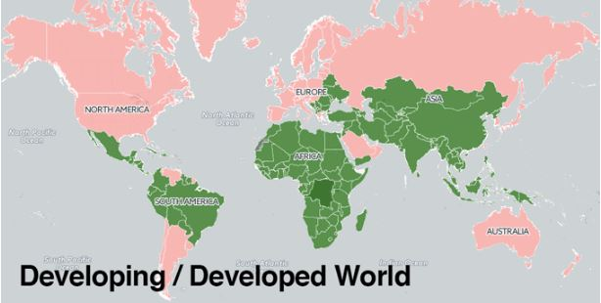

Slide 8
Indicators of cancer burden⁵
Incidence:
  The absolute number of new cases occurring in a defined population in 1 year
  As a rate in terms of number of new cases per 100,000 people per year.
Mortality
  Cancer mortality is expressed as the absolute number of people who die from a specific cancer in a year or a rate of cancer deaths / 100,000 people per year.
Prevalence
  Absolute number and relative proportion of individuals affected by the disease during a defined period in a population.

Slide 9
Importance of indicators
Formulation of cancer control policies
Planning of health services
Demands of care assessment
Implementation of strategies to reduce cancer burden
Help to define priorities for preventive, diagnostic, therapeutic and palliative care
To evaluate the outcomes of targeted interventions in relation to cost and resource inputs

Slide 10
Etiological factors of gynaecological cancers
Group A = Cancer cervix, vulva & vagina, with common factors
  Known premalignant stages before invasion & importance of population screening
  Association with high risk human papilloma virus infection, which is sexually transmitted.
  Cervical carcinoma has recognizable premalignant condition (CIN)
Co-factors which modify effect of chronic HPV infection⁶
High parity
Prolonged use of oral contraceptive
Multiple sexual partner
Cigarette smoking
Early age of sexual contact

Slide 11
Etiological factors of gynaecological cancers
Group B: Used to occur more in developed countries, but now trend is reversing
Ovarian, fallopian tube & corpus cancers
Genetic predisposition responsible for 10% cases
Inherited gene line mutation BRCA-1 and BRCA-2
Lynch type 2 gene is associated with hereditary non polyposis colon cancer
Epithelial tumours have risk factors
  Family history
  Old age
  Postmenopausal status
  Use of HRT
Endometrial carcinoma is the 3rd commonest malignancy in developing countries.

Slide 12

Cervical Cancer
453 531 cases of cervical cancer in developing world reported by IARC in 2008 (89% of global estimate)¹
273 000 deaths occur world wide every year³ (83% in developing countries)
Developed world with good screening, case fatality rate is as low as 32%.⁵
Among developing countries the rate is variable, highest in sub Saharan Africa.
South and south east Asia have 200,000 new cases and mortality 15/100,000.²

Slide 13
Barriers for screening in developing countries
Competing health needs
Limited human & financial resources
Poorly developed health care services
Women are uninformed and disempowered
War and civil disturbances
Widespread poverty
The nature of the screening test

Slide 14
Screening in low resource setting
The challenges can be approached by:
Screening, diagnosis & treatment provided on site or in clinics accessible to the majority of at risk women
Low cost, low technology, effective tests; cytological & HPV screening tests are expensive, VIA to be encouraged that can lead to immediate treatment of abnormalities
Wide coverage of at risk women
Appropriate educational programs directed towards health workers and women
Built in mechanism for evaluation of the screening program

Slide 15
Factors leading to high mortality
Limited screening facilities
Diagnosis in advanced clinical stage
Non compliance of treatment or incomplete treatment
Deficiencies in treatment availability & accessibility
Financial constraints

Slide 16
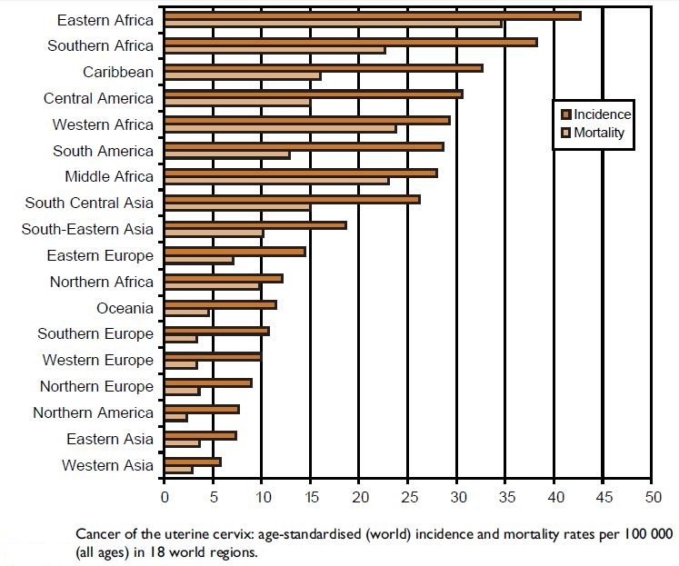

Slide 17

Ovarian Cancer
Second commonest
18.8% of all in developing and 28.7% in developed countries (2009).²
Case fatality rate 59.2% in developing and 54.8% in developed countries
Common reason - delayed diagnosis
80% are epithelial in origin

Slide 18
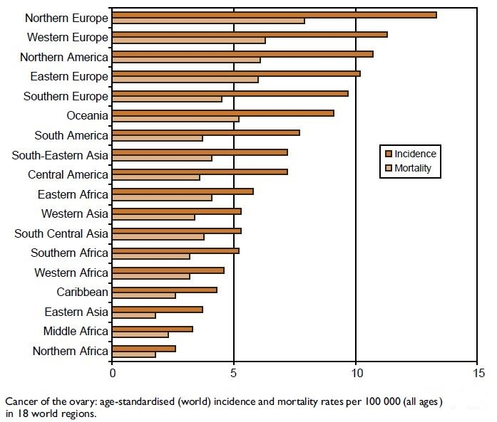

Slide 19

Corpus Cancer
Commoner in developed countries
In 2009, 236643 cases reported worldwide
113486 in developing world (48%)
Low incidence, less than 4/100,000 in south Asia and Africa²
Better prognosis, 5 year survival rates around 75% in developing countries

Slide 20
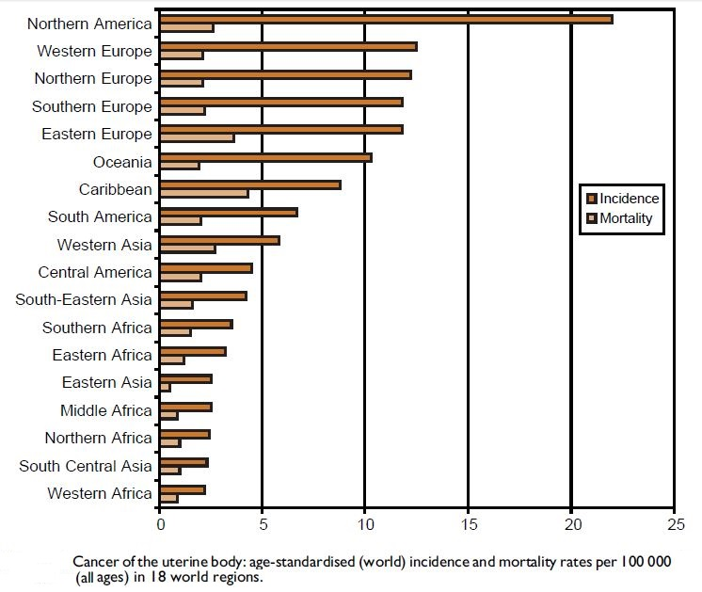

Slide 21

Vaginal Cancer
Less than 2% worldwide
13,200 cases globally reported in 2002, 900 (68%) in developing countries
Incidence 0.5/100,000 in any region
Case fatality in developing world: 44.7% compared to 15.4% in developed world

Slide 22

Vulval Cancer
3% of gynaecological caners worldwide
26,800 cases (2002), 11,100 (41.4%) in developing countries
50% occur in women over 70 years, 2/3 occur in labia majora

Slide 23

Choriocarcinoma
0.6% of all gynaecological cancers
8500 cases (2002), 5400 (96.4%) in developing countries
Highest in south Asia (0.43 – 1.7) 100,000 cases

Slide 24
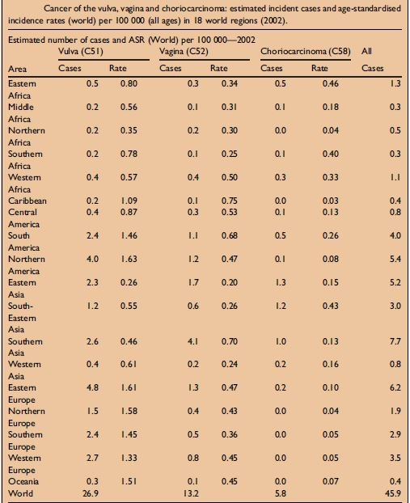

Slide 25
Cancer care inequity for women in developing countries
Gynaecological cancers are examples of global health disparity.
Lack of well designed cancer registries obstructs accurate assessment & planning for international agency resource allocation.
Increasing rates of smoking and obesity
Women present in late stages & have fewer options for treatment.
Currently only 5% of global spending on cancer is directed towards developing countries.¹
Lack of skilled health care providers in preventive and therapeutic services, leading to serious morbidity & mortality
Ref: Breast cancer in developing countries. Lancet. 2009;374:1567. [PubMed]

Slide 26
Common challenges to cancer care and therapy in the developing world
Asymptomatic conditions receive little attention in day-to-day struggles
Competition with other health needs & infectious disease burden
Educational, religious and economic barriers
Shortage of diagnostic & treatment centres
Availability and cost of anti cancer drugs
Delivery of drugs and lack of skilled health care professionals for administration & toxicity management

Slide 27
Common challenges to cancer care and therapy in the developing world
Lack of radiotherapy centers
Access to laboratories for blood count & other tests
Non availability & cost of effective antiemetic treatment
Lack of computerized data base to facilitate the follow-up
Restrictions to provide palliative and comfort care, especially as part of end-of-life care due to financial constraints and non-availability of drugs and religious views

Slide 28
Prediction of the future burden
Breast cancer cases will continue to rise by 3.2 million per year.
For cervical cancer if decline continues, still the same number will be diagnosed in 2030, i.e. 500,000 case.
Annual rise predicted 700,000 per year by 2030

Slide 29
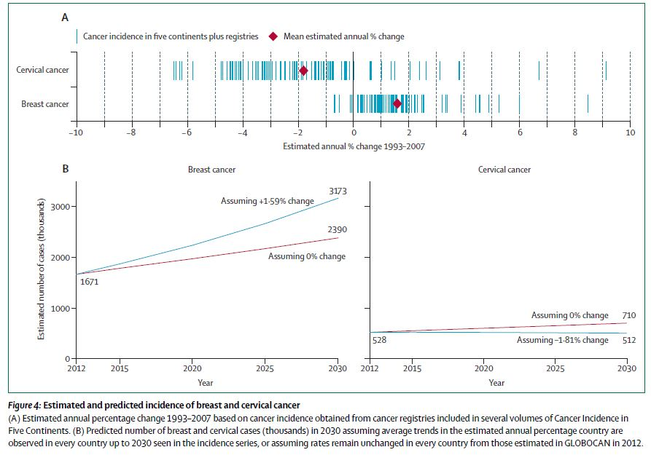
by the year 2030

Slide 30
Conclusion
Women in developing countries have access to fewer resources & suffer serious morbidity & mortality.
Huge unmet need for funding of cancer in developing world
Greater collaboration between developed & developing countries to overcome the problem
It is the responsibility & moral obligation of international health organization as well as resource rich & developed countries to provide capital resources, mentorship & training to aid developing countries in control efforts.
LOW & MIDDLE INCOME COUNTRIES SHOULD INVEST IN THE ENTIRE CONTINUUM OF CANCER CONTROL

Slide 31
Right answer to consequent perplexity is to paraphrase
"The problems of the world can not be solved by sceptics & cynics whose horizons are limited by obvious realities. We need women and men who can dream of things that never were and why not”.
George Bernard Shaw

Slide 32
References
Ferlay J, Shin HR, Bray F, Forman D, Mathers C, Parkin DM. GLOBOCAN 2008 v2.0, Cancer incidence and mortality worldwide: IARC Cancer Base No. 10 [Internet]. Lyon, France: International Agency for Research on Cancer; 2010. Available from: http://globocan.iarc.fr [accessed 12/07/2012].
The economist intelligence unit. Breakaway: The burden of cancer challenges and opportunities, The Economist, 2009.
World bank. World Development indicators. Available from: URL: http: //data.worldbank.org/data-catalog/world development-indicators?cid=GDP_WDI. Accessed: April 24,2012. https://datahelpdesk.worldbank.org/knowledgebase/articles/906519-world-bank-country-and-lending-groups
United Nations Statistics Division. Composition of macrogeographical (continental) regions, geographical sub regions and selected economies and other groupings (“Footnote c”). United Nations, 2008.

Slide 33
References
Sankaranarayanan R, Ferlay J. Worldwide burden of gynaecological cancer: the size of the problem. Best Pract Res Clin Obstet Gynaecol 2006; 20: 207-225 [PMID: 16359925 DOI: 10.1016/j.bpobgyn.2005.10.007].
Chukwuemeka Anthony Iyoke: "Burden of gynaecological cancers in developing countries" World J Obstet Gynecol. Feb 10, 2013; 2(1): 1-7.
Kim SG, Hahm MI, Choi KS, Seung NY, Shin HR, Park EC. The economic burden of cancer in Korea in 2002. Eur J Cancer Care (Engl). 2008;17:136-144.
Jelovac D, Armstrong DK. Recent progress in the diagnosis and treatment of ovarian cancer. CA Cancer J Clin. 2011;61:183-203.

