Slide 1

Title Layout
Subtitle

Slide 2
BHARTIY PRADHAN MANTRI JAN AUSHDHI
BASIC CONCEPT ABOUT GENERIC MEDICINES
DIFFERENCE BETWEEN GENERIC MEDICINE& STANDARD MEDICINE
HOW PRADHAN MANTRI JAN AUSHDHI HELP TO THE COMMON PEOPLE

Slide 3
GENERIC MEDICINES
INDIA ALSO KNOWN AS A LARGEST DEMOCRACY IN THE WORLD
70% PERSOAN PEOPLE LIVE SIMPLE LIFE
HEALTH FACTOR EFFECTS THIS SIMPLE ( COMMON) PEOPLE
FOR THAT REASON GOVERNMENT MOVED TO GENERIC MEDICINE FOR FULLFILL THAT 70% COMMON PEOPLE NEED

Slide 4
WHAT IS GENERIC MEDICINE??
A generic drug is a pharmaceutical drug that is equivalent to a brand-name product in dosage, strength, route of administration, quality, performance, and intended use. ... A generic drug must contain the same active ingredients as the original brand-name formulation.

Slide 5
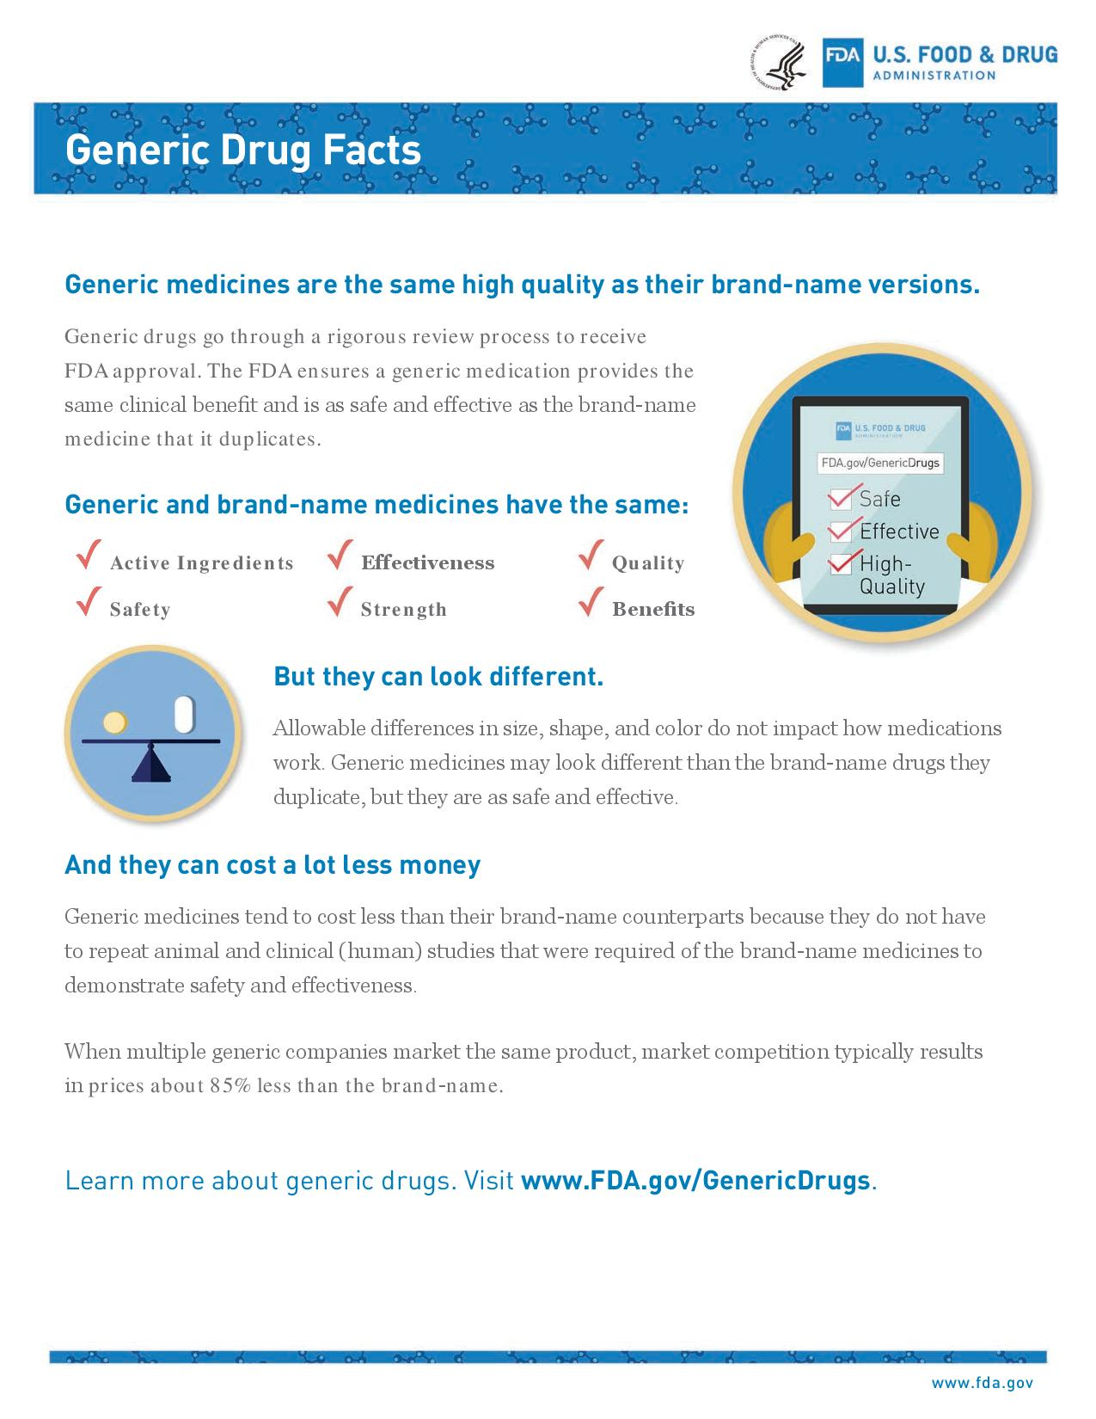

Slide 6
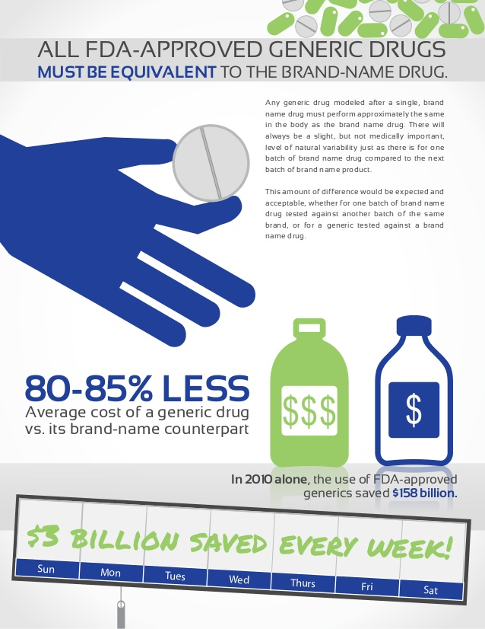

Slide 7
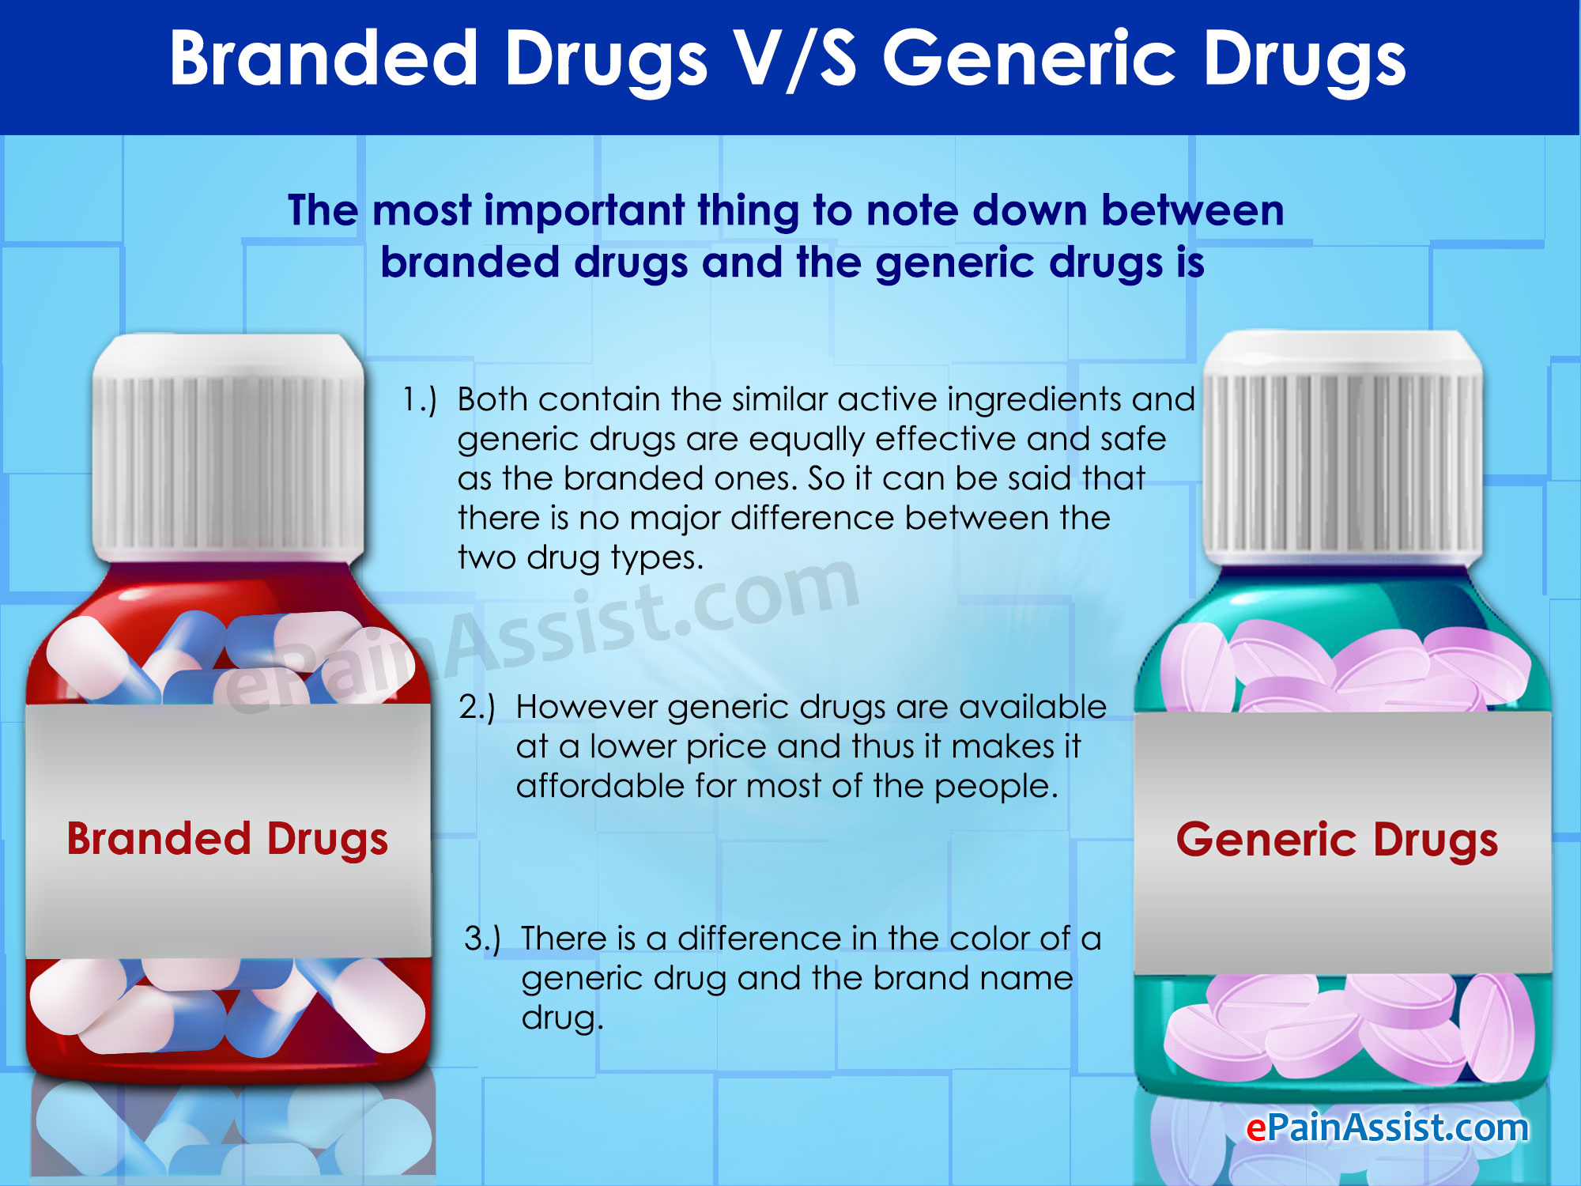
DIFFERENCE BETWEEN GENERIC & STANDARD MEDICINES

Slide 8

Thats why government introduce Pradhan mantri jan aushdhi

Slide 9
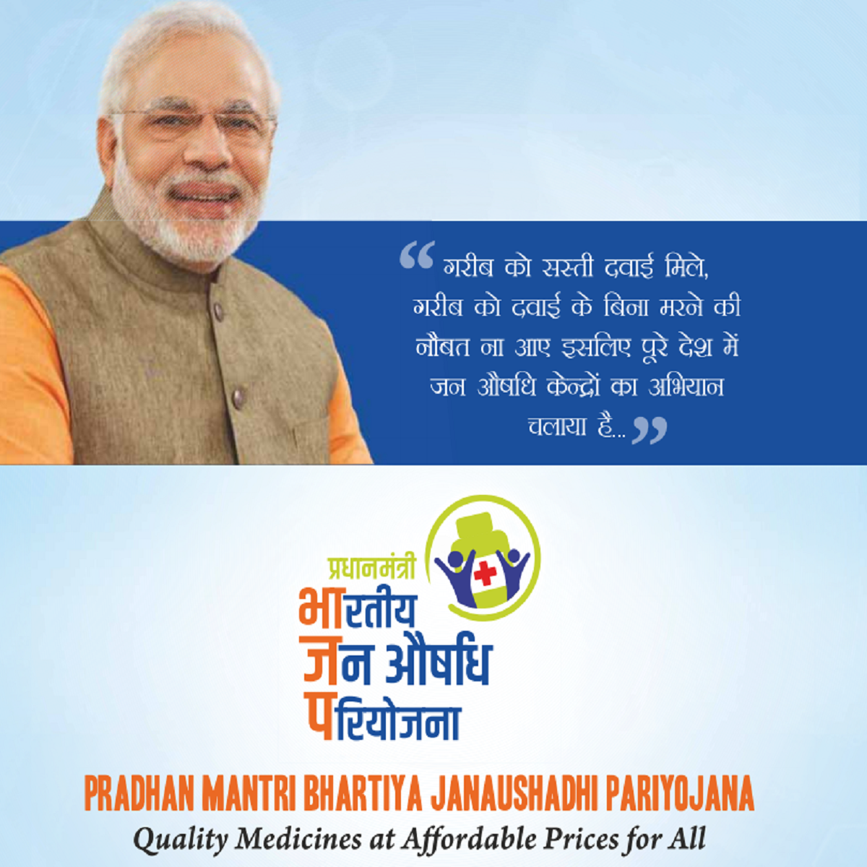

Slide 10
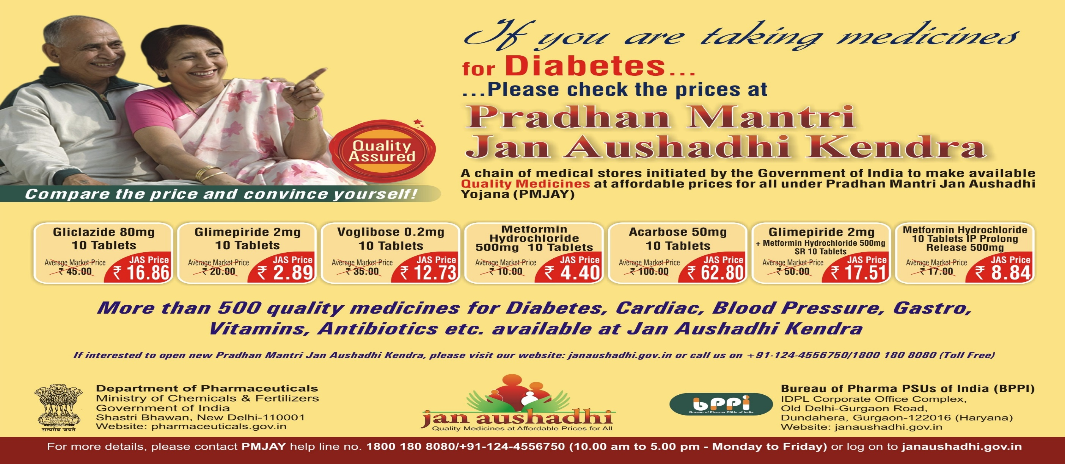
COMPARISION OF RATE Generic vs Standard

Slide 11
Conclusion
Lets promote generic medicines
Lets administrate generic medicines
Lets prescribe generic medicines
We are part of good government .so lets decide to support government for promote generic medicines
Nobel cause

Slide 12
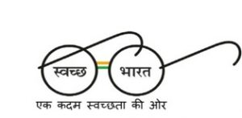

Slide 13
THANK YOU…

