Slide 1

MEDICAL HUMOUR
DR.VILAS LADDHA
AYURVEDIC PHYSICIAN
FAMILY PHYSICIAN
www.upchar.in a medical helpline

Slide 2
ITS ALL ABOUT
L( I )FESTYLE

Slide 3
What is “I” .
mai….me….myself
‘I’ is the smallest letter in dictionary
Lets not make it largest and heaviest word in our life
Dil khamosh hai, magar hoth hasa karte hain
Basti viran hai, magar log basaa karte hain
Nasha maykado me, aaj-kal kaha hai yaro
Kyon ki log MAY ka,nahi MAI ka nasha karte hai

Slide 4
Does Medicine is everything
NO
Non Medicinal remedies as well
Saline gargle for throat infection
be honest to your doctor dont lie
Give some time to heal
Have a change like tourism or going for outing with your loved ones
Though strict words by doctor its for your betterment
Diet Rxed by doctor before or after meals
Don’t try to please everyone
Zindagi choti nahi hai Janab ..
log jeena deri se suru karte hai…..
Jabtak raste samazme aate hai,,
Tabtak lautneka waqt aa jata hai..

Slide 5

*Googlopathy*
its a most modern branch of medicine where Patient prescribes Medicines to His Doctor
Trust your Doctor more than

Slide 6
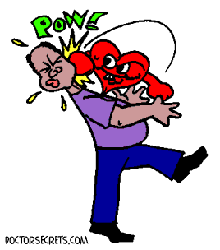
Sabse bada rog
kya kahenge log
Salon se mein apne
aap se dhoka karta raha….
Dhool chehre par thi aur mein aina saaf karta raha.

Slide 7

Yaddasht ka kamjor hona acchi bat hai janab
Bade dukhi hai wo log jinhe har bat yad rahti hai..

Slide 8
IT company rejected some of their employees after medical checkup
Saying that how their BP, Sugar’s are normal after two years service in IT industry
Jahar marne ke liye thoda
Lekin jinda rahne ki liye jyada pina padta hai
Strongly Mental Or mentally strong
Hopless end or endless hope
Hum Acchi adate pendrive mein aur buri adate dil mein chuoake rakhate hai

Slide 9
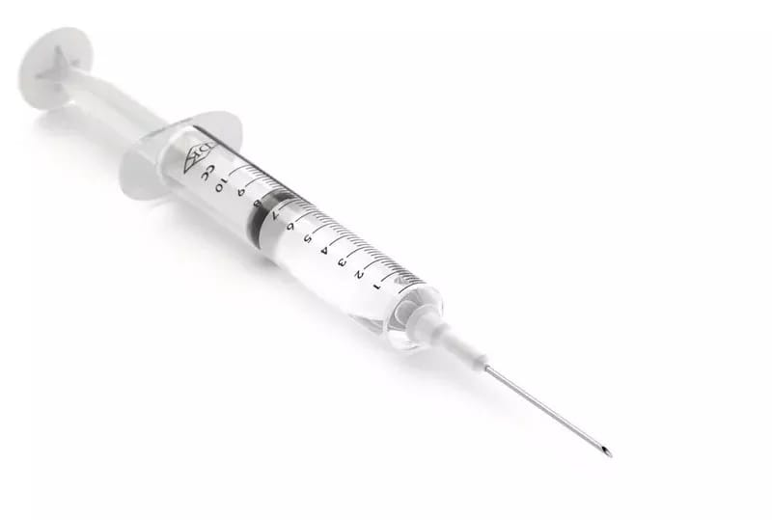
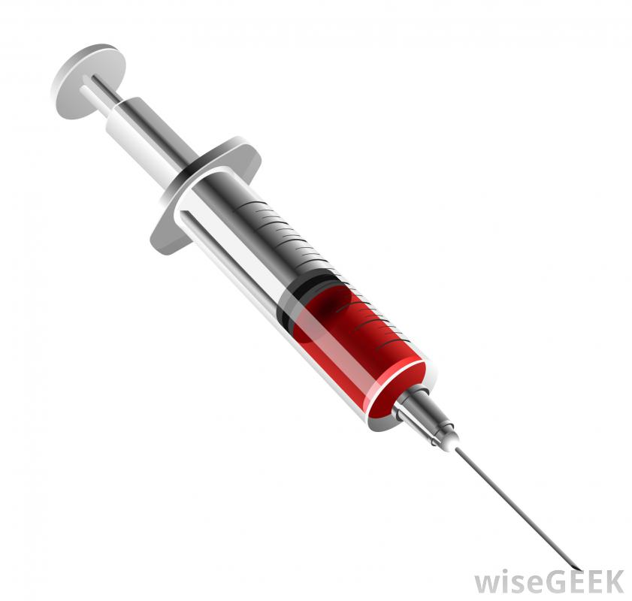
NORMAL INJECTION
FILMY INJECTION

Slide 10
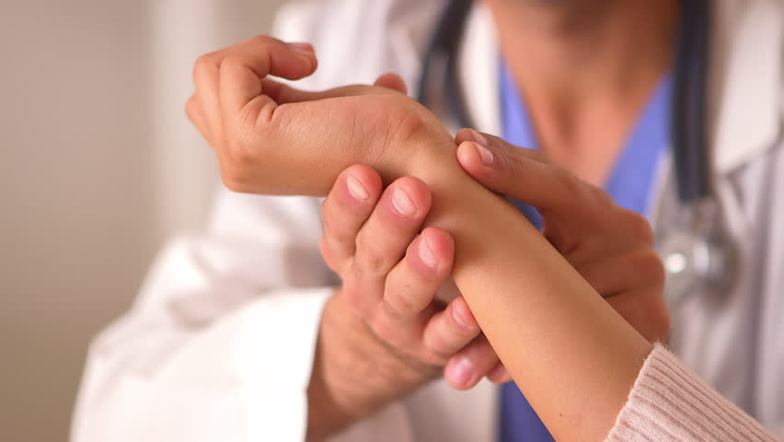
Badhayi ho……

Slide 11
Patient:
Is there any medicine for long & happy life
Doctor: Get married
Patient :Will it help?
Doctor: No, but it will avoid such thoughts!!

Slide 12
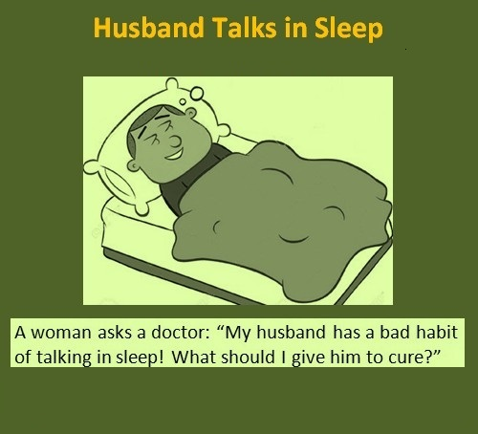


Slide 13
FOOD INTAKE
MITAHAR
CONTROLED DIET
Otherwise it becomes MITHYAHAR….
Annen puryet ardham toyench tritiykam…
Udarsya turiansh cha sanrakshet vayuchalne

Slide 14
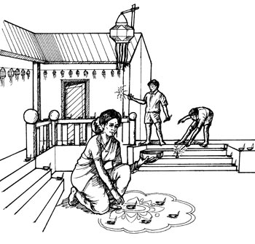
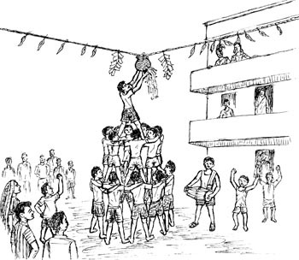
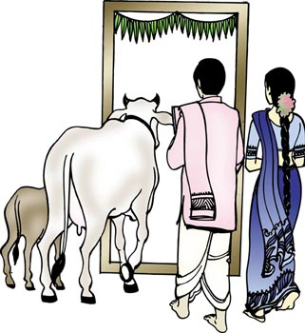
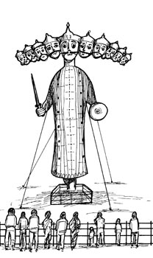
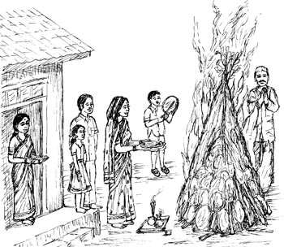
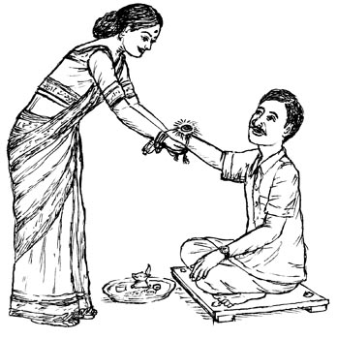
Festival & Traditional Diet

Slide 15
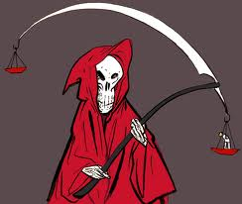
CANCER ?
CANCEL

Slide 16
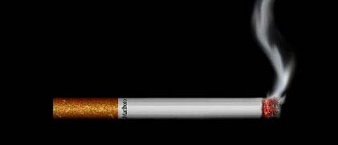
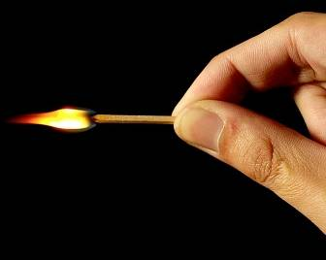
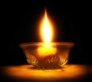
Its Your Life
So Its
Your
Choice

Slide 17
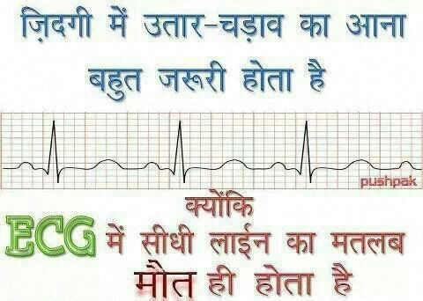
EVERYONE KNOWS……

Slide 18
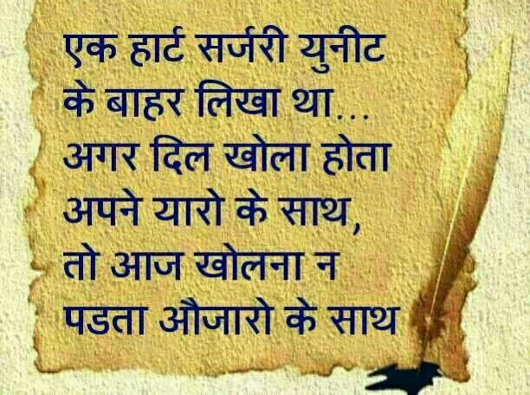

Slide 19

Har Marz ka ilaj nahi hai davakhane me,
Kuch marz chale jate hai sirf muskurane me
Laughter is the best medicine

Slide 20
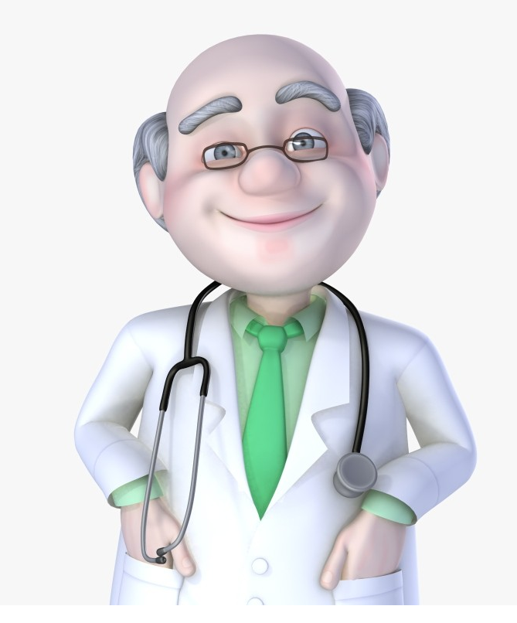
Group of 100 + highly
Qualified doctors
Of all specialty and
Super-specialty

Slide 21

Do Not send your organs to heaven, Because
Heaven Knows they are needed more on earth

Slide 22



Slide 23

Please feel free to contact
9892417179
7738450586
vilasladdha@gmail.com
DIRGHAAYU foundation
Dr. Vilas Laddha
BAMS
Ayurvedic &wellness Physician

