Slide 1
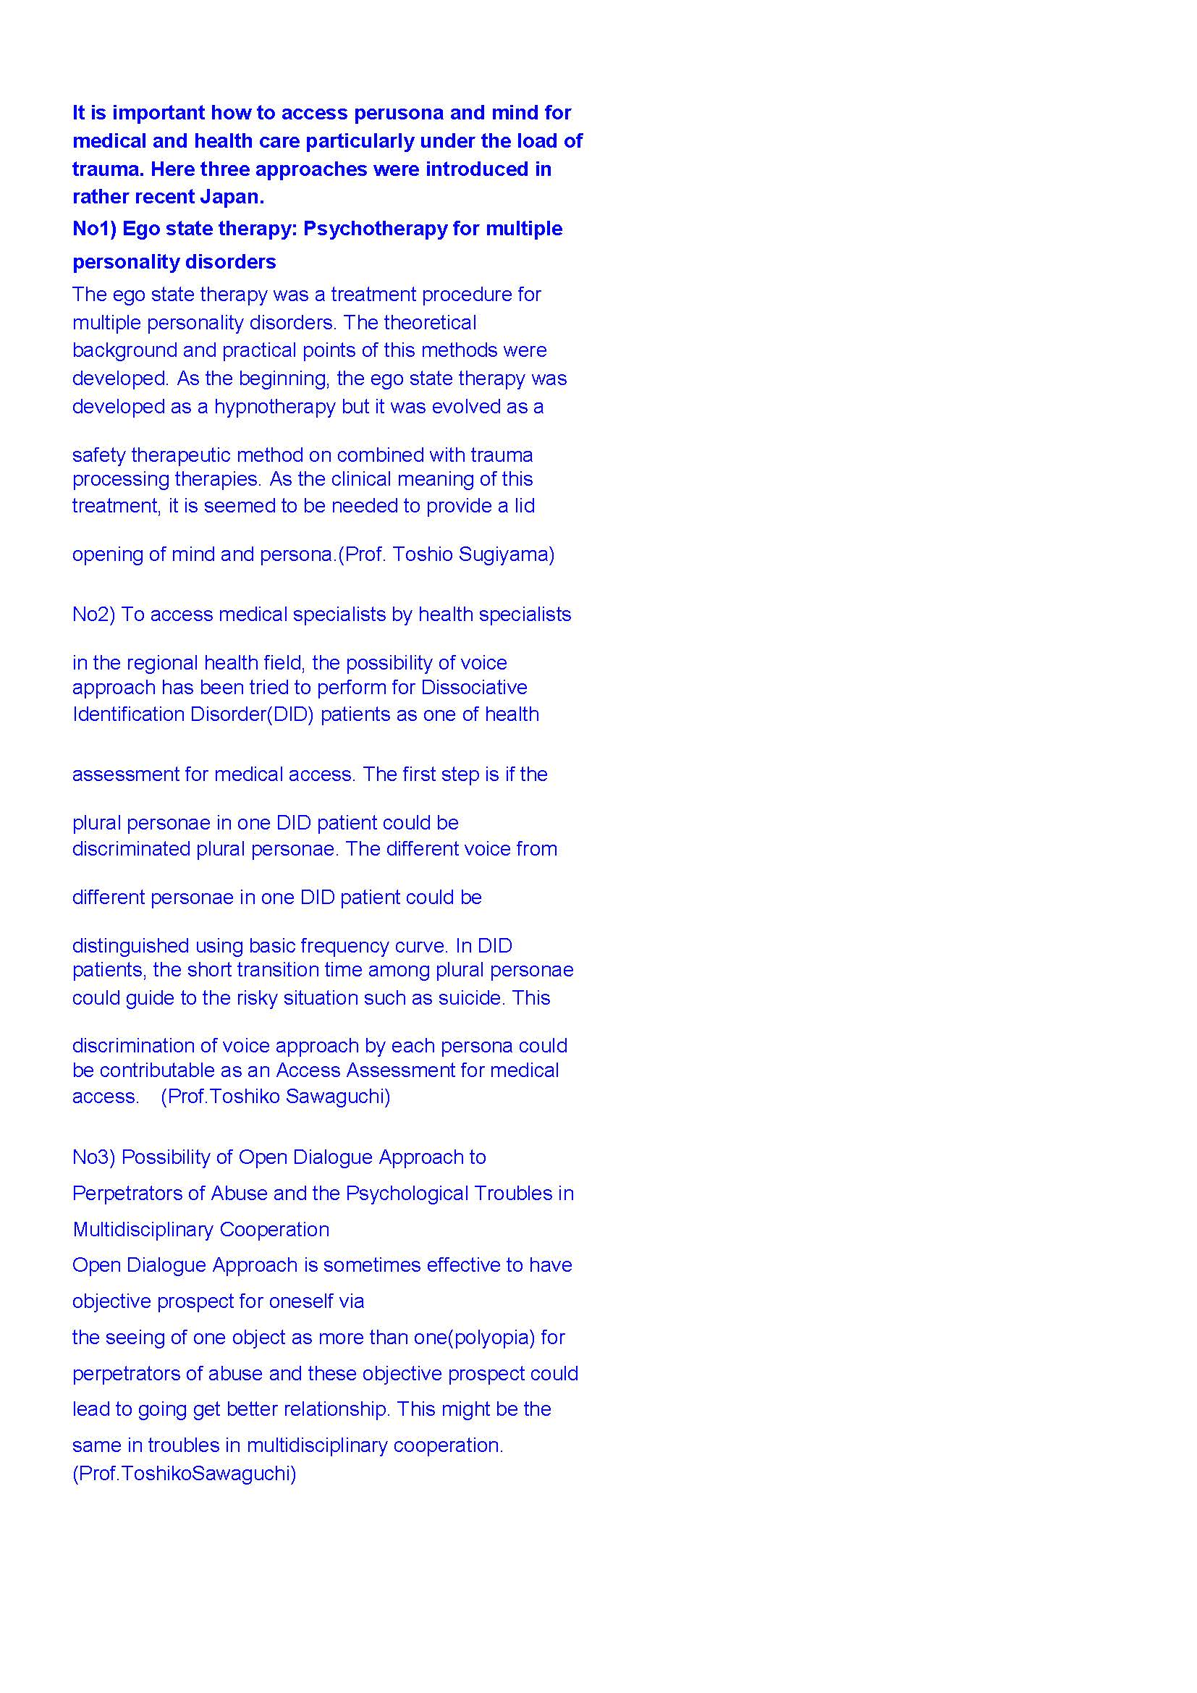

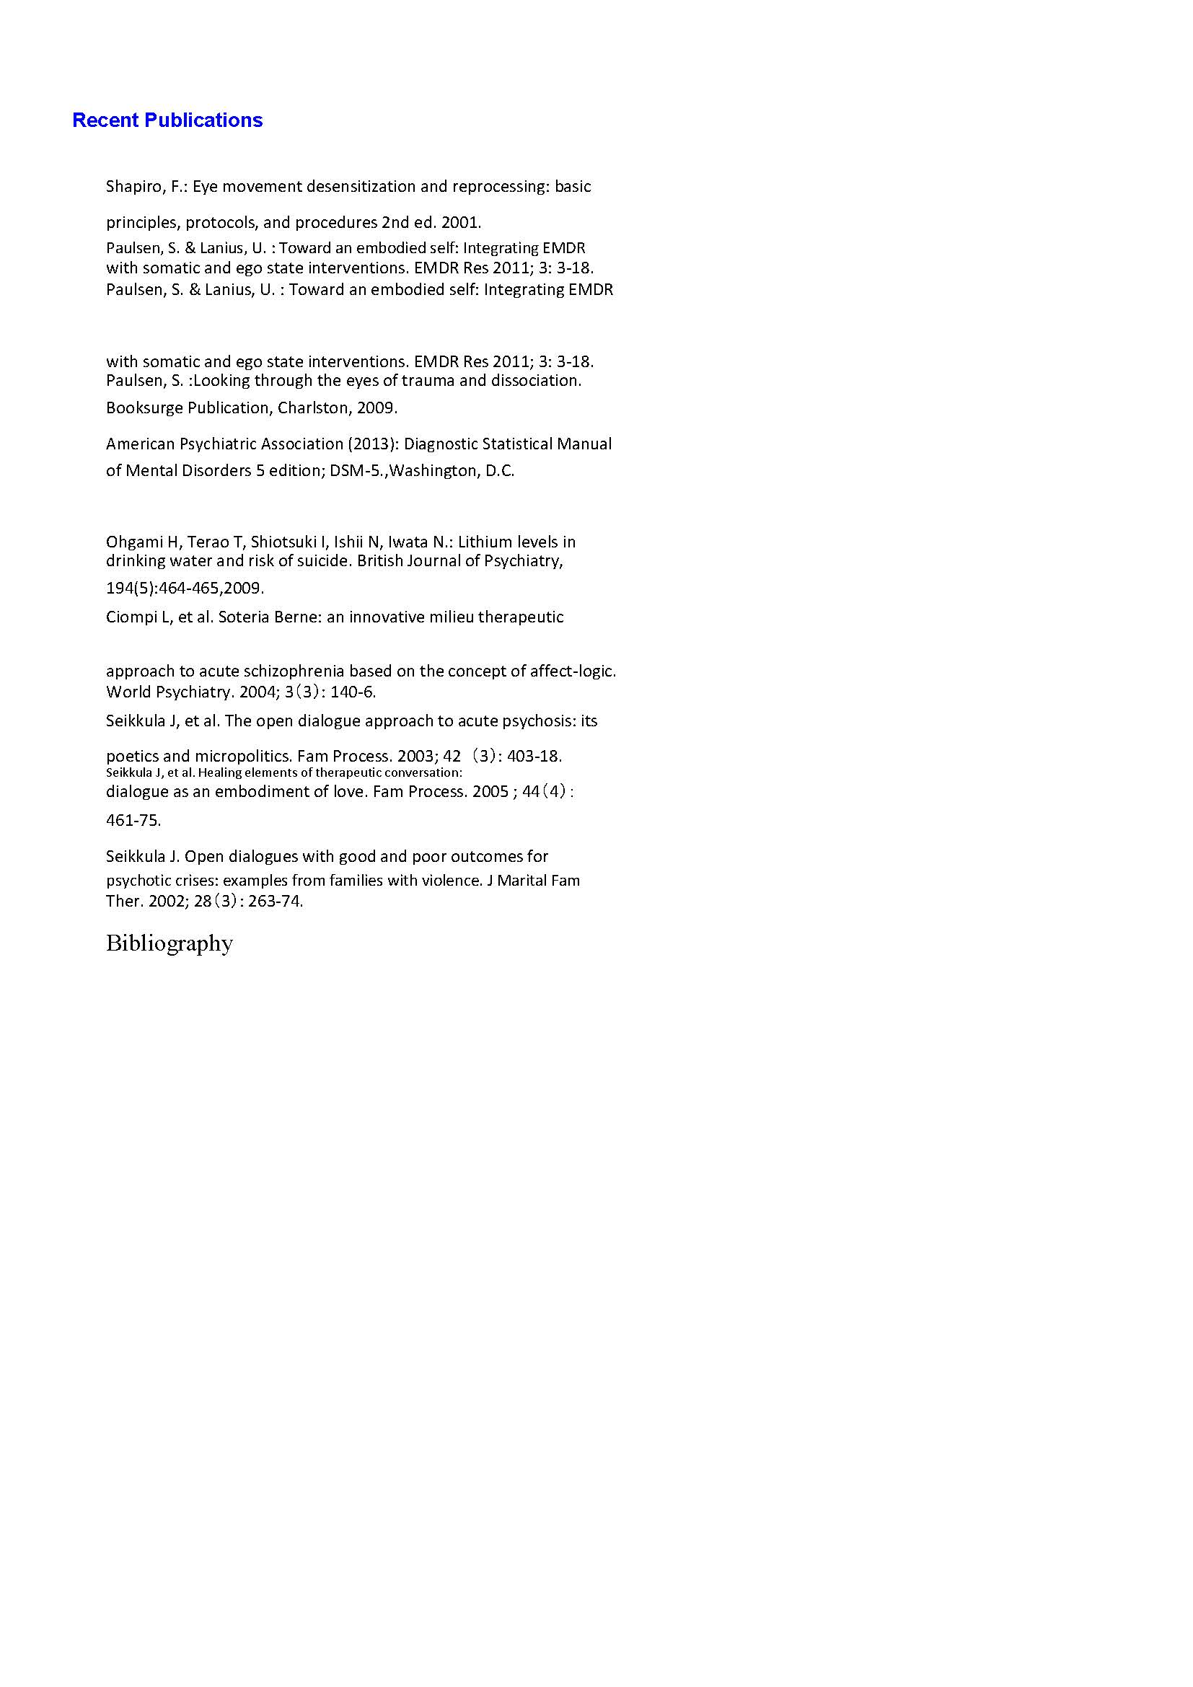
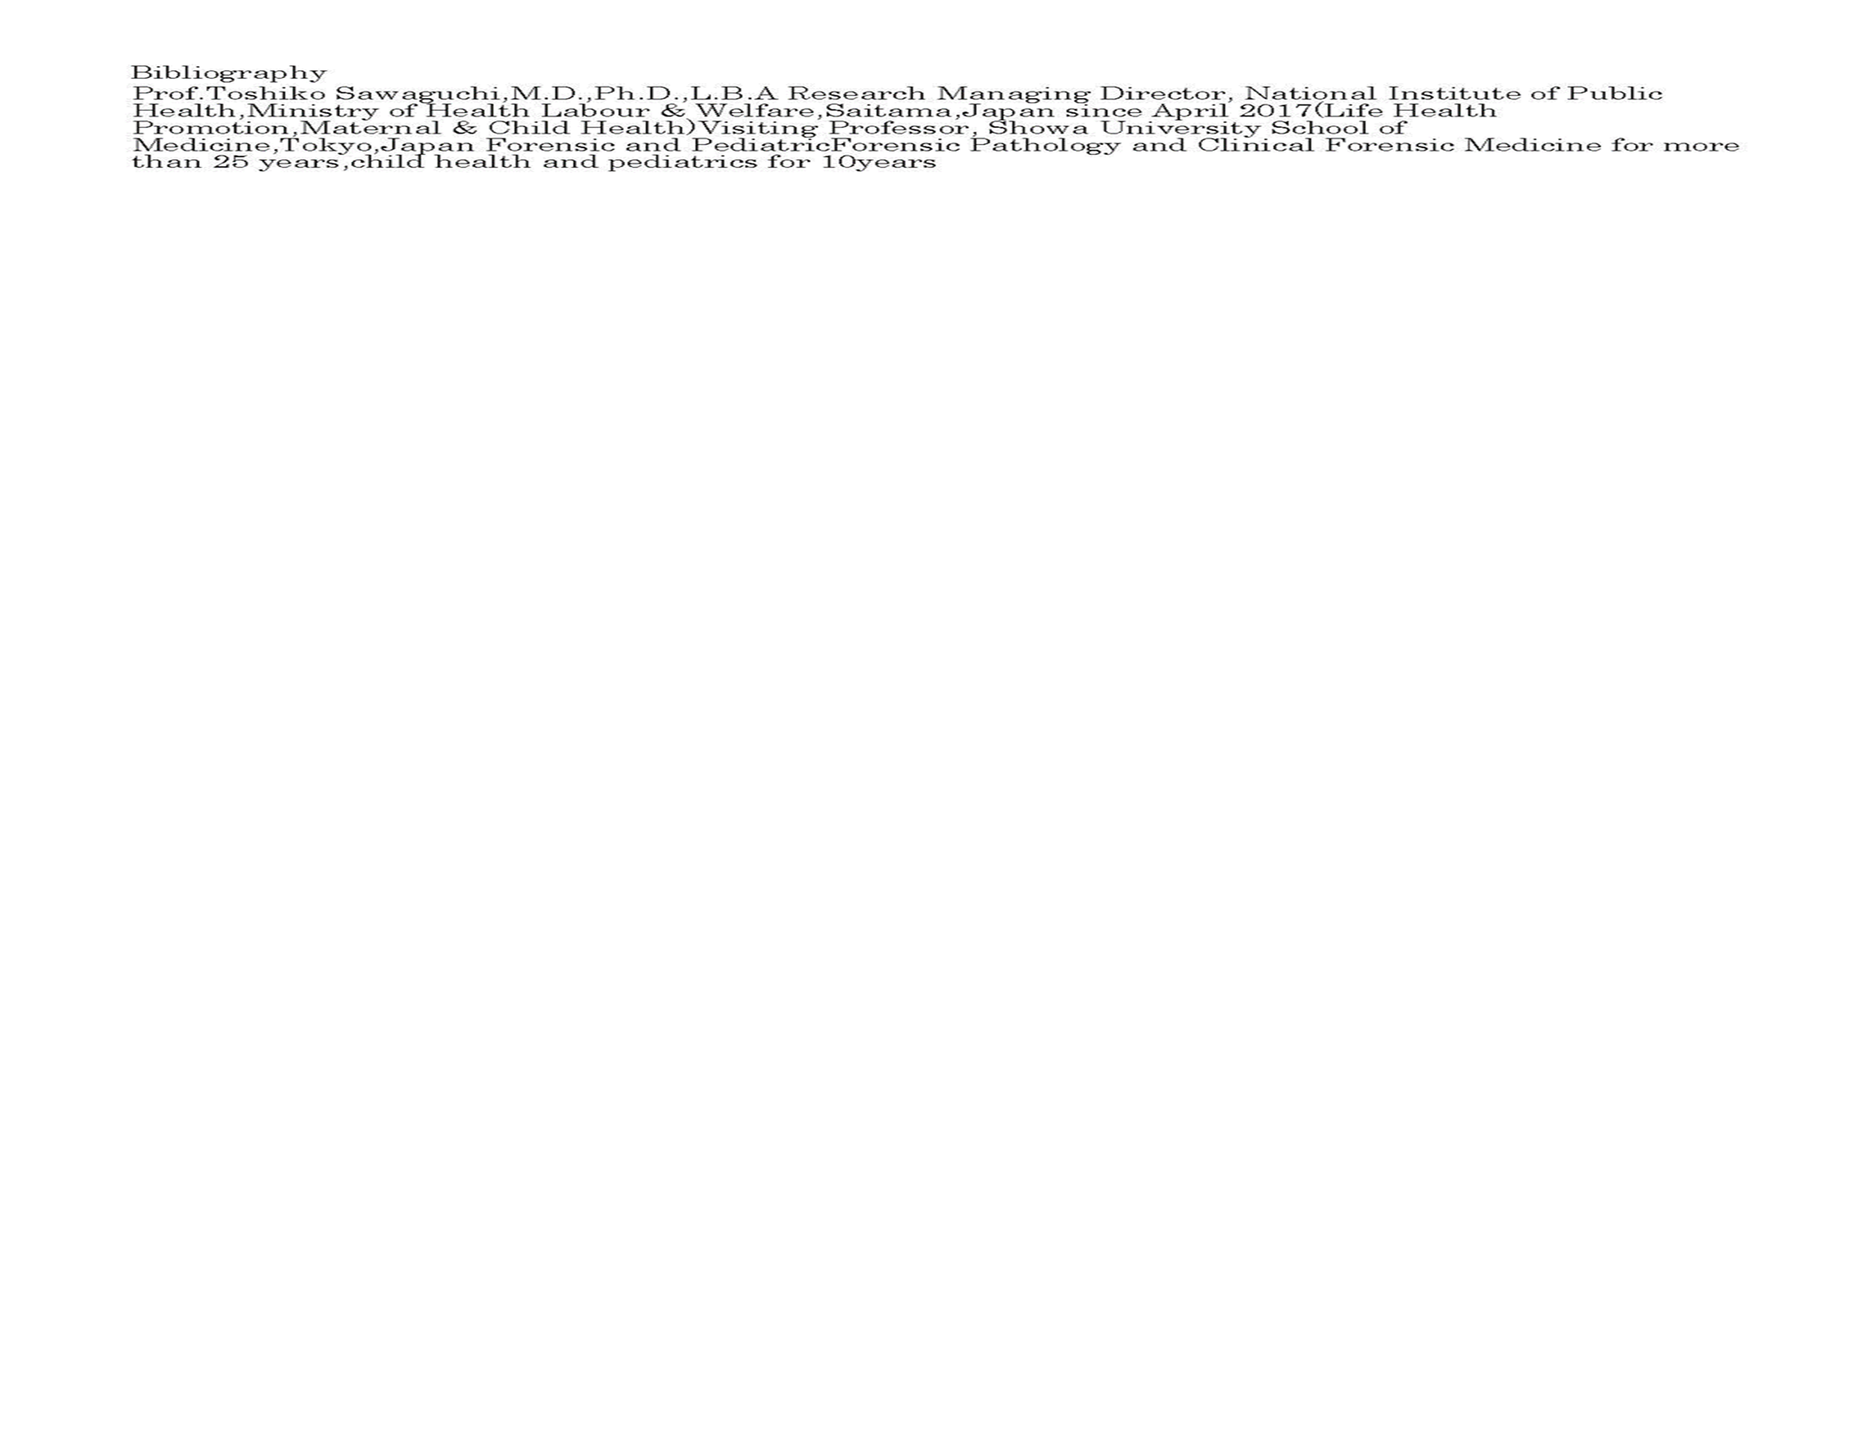
Accession to Persona and Mind without or with less Pharmaceuticals approach under the load of trauma
Toshiko Sawaguchi,M.D.,Ph.D.,L.B.A.(visit Prof)NIPH & Showa Univ. School of Medicine.Japan
Toshihiro Sugiyama,M.D.(Prof.)Fukui Univ .School of Medicine.Japan

