Slide 1


"رَبِّ أَوْزِعْنِي أَنْ أَشْكُرَ نِعْمَتَكَ الَّتِي أَنْعَمْتَ عَلَيَّ وَعَلَى وَالِدَيَّ وَأَنْ أَعْمَلَ صَالِحًا تَرْضَاهُ وَأَدْخِلْنِي بِرَحْمَتِكَ فِي عِبَادِكَ الصَّالِحِينَ”
صَدَقَ اللّهُ الْعَظِيمِ
(النمل اَية 19 )

Slide 2


جامعة المنصورة
كلية الطب البيـطري
قسم الرقابة الصحية علي الأغذية (صحة اللحوم)
مرحبا بالسادة الحضور
مناقشة رسالة الماجستير الخاصة
ط.ب/ أحمد مدحت محمد البنا

Slide 3


Acknoledgment

Slide 4
Firstly of all, I'm indebted in my work and success to our Merciful "ALLAH", who gave me the ability to finish this work.
I would like to extend my gratitude to Prof. Dr. Mohammed M. M. I. Elgazzer, prof. of Meat hygiene, Food Hygiene and Control Dept., Faculty of Vet. Medicine, Mansoura Univ., Egypt, for his supervision, continuous support and guidance during this study.
I would like to thank Prof. Dr. Khalid I. Sallam, prof. of Meat hygiene, Food Hygiene and Control Dept., Faculty of Vet. Medicine, Mansoura Univ., Egypt, for his advice, support and contribution to his study.
I would never forget the support of Dr. Hassan Hussein Ghaly, chairman of El-Hassan and El- Hussein group for Industrial and Commercial Investment, port-said, Egypt.
Last but not the least, I Would like to express my gratitude to all my family; my parents, my wife, my sons and my brother because their support gave me the strength to work hard on this study.

Slide 5

رسالة مقدمة من
ط.ب / أحمد مدحت محمد البنا
بكالوريوس العلوم الطبية البيطرية - جامعة المنصورة -2009
A thesis presented by
Ahmed Medhat Mohammed Elbanna
B. V. Sc., Mansoura University, 2009

Slide 6


تحت إشراف
الأستاذ الدكتور
محمد محمد محمد إبراهيم الجزار
الأستاذ الدكتور
خالد إبراهيم ابو الفتح سلام

Slide 7
A Thesis
Submitted to Mansoura University for
Master degree of Veterinary Medicine Sciences
(Meat hygiene )
2016
رسالة مقدمة إلى جامعة المنصورة
للحصول على درجة الماجستير
في العلوم الطبية البيطرية
( الرقابة الصحية علي اللحوم ومنتجاتها)
2016

Slide 8

Controlling The Hygienic Measures At A Meat Plant
مراقبة الإجراءات الصحية بمصنع لحوم

Slide 9

Introduction

Slide 10
The meat and its products are rich in water and high biological value proteins which make it an essential food. The meat from healthy animals is sterile however, the microbial contaminants may be originate from contaminated meat contact surface such as equipment, knives, slicers, grinders, mixer and cutting tools.
The most efficient method for reducing microbial contamination and microbial growth in meat and meat products is establishment high levels of hygiene, efficient cleaning and sanitation through establishment of quality control programs such as Hazard Analysis Critical Control Point (HACCP) and Good Manufacturing Practices (GMPs), which can be applied by enumeration of hygienic indicator microorganisms such as aerobic plate count and Enterobacteriaceae .

Slide 11

The good hygienic measures can be applied in a meat plants with the following measures:
(1) Sanitary design of plant construction and equipment.
(2) An adequate hygienic quality of raw materials.
(3) An adequate sanitary processes control .
(4) A proper waste and pest control.
(5) Proper application of cleaning and sanitation program.
(6) An adequate supply of potable water.
(7) A proper Cooling and Freezing Controls.
(8) A proper personnel hygiene which is based on education and training of meat handlers on cleaning and sanitation methods,
Furthermore, the Cleaning and sanitation procedures are the most significant measures that are occur in the meat processing plants to provide a clean and sanitized environment.

Slide 12
Aim of study

Slide 13



Evaluation the microbiological status of most common processed meat products such as (beef mince, beef "kofta" and beef luncheon homogenate), and most common equipment used in manufacturing of these products such as (knife, preparation table, meat trolley, grinder, mixer and cutter) at a meat plant in Port Said, Egypt before and after application of cleaning and sanitation program through determination of Aerobic Plate count (APC), Enterobacteriaceae count, and Mould count and Yeast count per each gram of examined processed meat products and per each centimeter of examined equipment swabs for the following points:-
A. Assessment the efficiency of application of cleaning and sanitation as a most important procedures for controlling of hygienic measures.
B. Ensuring consumer safety.
C. Improving product quality.
D. Extending product shelf life.

Slide 14


Material
Methods

Slide 15

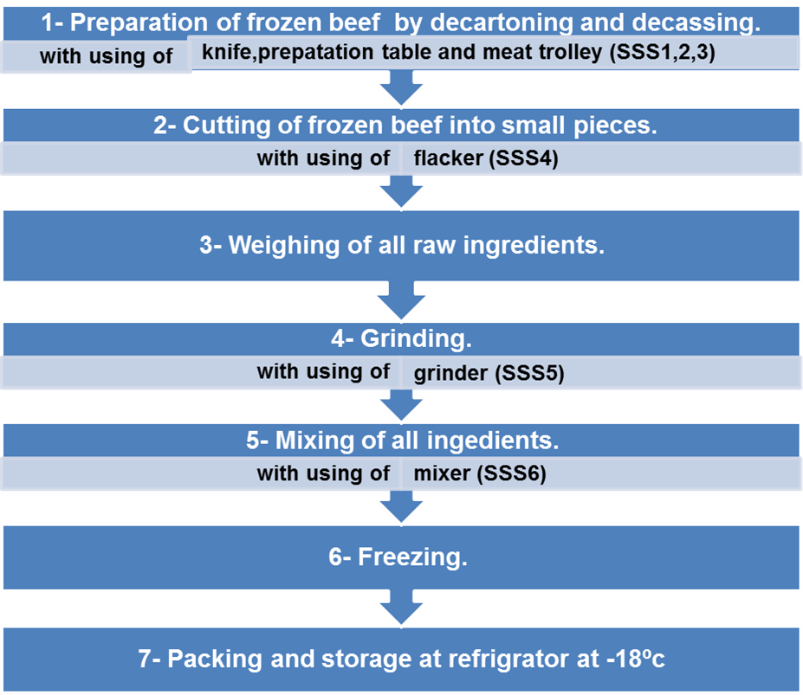
(A)PROCESSING FLOW CHART OF EXAMINED MEAT PRODUCTS:-
1- Processing flow chart for Beef mince and beef "kofta":-
Fig (1): Processing flow chart for Beef mince and beef "kofta".*SSS= site of swab sample.

Slide 16
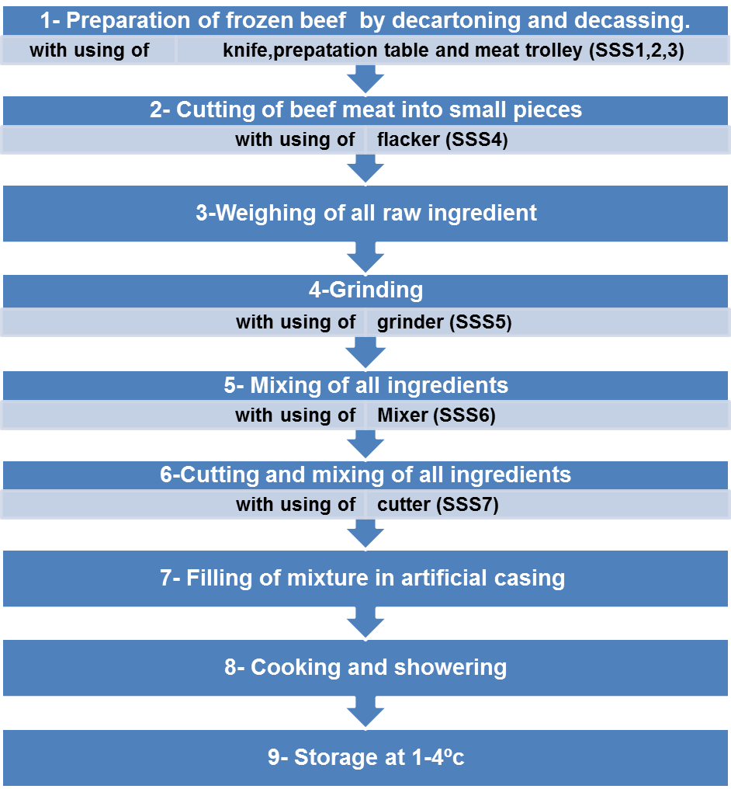
2- Processing flow chart for Beef "luncheon":-
Fig (2): processing flow chart for beef "luncheon" with sampling site. *SSS= site of swab sample.

Slide 17

(B) CLEANING AND SANITATION PROGRAM:-
1. Dry cleaning: to remove of gross debris by dry brushes or manual collection.
2. Rinsing: with water ( 25ºc) to remove coarse organic matters.
3. Detergents application: by using of detergent which
Trade name : Delladet VS2
Composition: Alkyl alcohol ethoxylate (5-15%), Alkyl dimethyl benzyl ammonium chloride (5-15%), and Sodium carbonate (< 5%).
Recommended Concentration: 2% v/v.
Duration of application: About 15 min.
Frequency of application: After the work shift (every 10hr). (According to technical and material safety data sheet of Johnson diversey)
4. Rinsing of equipment with water (25ºc) to remove visible soap.
5. Disinfectant application: by using disinfectant which
Trade name: Divosan forte VT6
Composition: Acetic acid (15-30%), Hydrogen peroxide (15-30%), and Peroxyacetic acid (peracetic acid) (15-30%).
Recommended Concentration: 1% v/v.
Duration of application: About 15 min.
Frequency of application: After the work shift (every 10hr). (According to technical and material safety data sheet of Johnson diversey).
6. Rinsing with water (25ºc) to remove any residual of chemical materials.

Slide 18

[C]COLLECTION AND PREPARATION OF SAMPLES:
1- The samples divided into:-
a. Meat contact surfaces samples (swab samples):
A total of one hundred-forty triple swabbing (one swab moist and two swab dry) from an inside limited area (20cm²) by using a sterile metal template (4×5 cm) from most common used equipment in a meat processing plant (knife, preparation table, trolley , flacker, grinder, mixer and cutter) before (prior to end of day's work) and after (at beginning to the day's work ) application of cleaning and sanitation program during a period of ten working days at El-Hassan and El-Hussein meat plant, port-said, Egypt. The collected swabs were placed in sterile tube containing 10 ml of 0.1% sterile peptone water for obtaining an original dilution of (1:2) after being marked then transferred in ice box with a minimum of delay to microbiological laboratory at a meat processing plant.
b. Processed meat products (tissue samples):
Ten gram from three common meat products (beef mince, beef "kofta" and beef luncheon homogenate) were collected before and after application sanitation program during a period of ten working days. The samples were collected under aseptic condition, placed individually in sterile polyethylene bags after being marked then transferred in ice box with a minimum of delay to microbiological laboratory at a meat processing plant, where in each samples was homogenized with 90 ml of 0.1% sterile peptone water for about 2 minutes by using a sterile stomacher. The resultant homogenate (1/10) was submitted for microbiological examination.

Slide 19
2- Preparation of decimal dilution (AOAC, 1990):
a. For swab samples:
One half ml were transferred from original dilution (1:2) with the use of a separate sterile pipets to a sterile tube containing 9.5 ml of 0.1% sterile peptone water ( Oxoid CM0009) for obtaining a first dilution (1:1) then a tenfold serial dilutions were prepared up to 10 ⁻⁶.
0.5 ml
1 ml
1 ml
1 ml
1 ml
1 ml
20 cm²
0.5 ml represent 1cm
Original dilation
First
dilution
Second dilution
Third dilution
Forth dilution
Fifth dilution
Sixth dilution
1 ml
10 ml of 0.1% sterile peptone water
Metal template
9.5 ml of 0.1% sterile peptone water
9 ml of 0.1% sterile peptone water
b. For tissue samples
One ml were transferred from original dilution (1:1) with the use of a separate sterile pipets to a sterile tube containing 9 ml of 0.1% sterile peptone water then a tenfold serial dilutions were prepared up to 10 ⁻⁶.

Slide 20

(D) MICROBIOLOGICAL ANALYSIS OF HYGIENE INDICATORS
(1) Aerobic plate counts (ISO, 4833-2:2013):
A tenth ml from each prepared serial dilution was transferred and evenly spread over a dry surface of duplicated, previously prepared sterile plate count agar medium (Oxoid CM0325). The surface of inoculated plates was allowed to dry for 15 min before being placed inverted with control plates in the incubator adjusted at 30°c for 72h.the bacterial colonies in the countable plates were enumerated and the aerobic plate per square centimeter of the examined swab samples and per each gram of the examined tissue samples were then calculated and recorded.
(2) Enterobacteriaceae counts (ISO, 21528-2:2004):
Duplicate sets of sterile petri dishes were inoculated with 1 ml of the chosen range of prepared dilutions. A quantity of about 15 ml of violet red bile glucose agar (Oxoid CM0485), melted and cooled to 45°c, was added to each inoculated petri dish, then mixed well and allowed to set. Another 5 ml of the same agar/temperature was finally overlain every plate, which left to solidify, then incubated “inverted” at 30°c for 24 h. Typical colonies of Enterobacteriaceae (red surrounded by precipitation of bile salts in the medium and having 0.5 mm or more in diameter) were enumerated and the Enterobacteriaceae per square centimeter of the examined swab samples and per each gram of the examined tissue samples were then calculated and recorded.

Slide 21
(3) Yeast and Mould counts (ISO 21527-1:2008):
A fifth ml from each prepared serial dilution was transferred and evenly spread over a dry surface of duplicated, previously prepared sterile Dichloran rose Bengal chloramphenicol agar (Oxoid CM0727). The surface of inoculated plates was allowed to dry for 15 min before being placed “ upright position” with control plates in the incubator adjusted at 25 ºC for 5 day. The bacterial colonies in the countable plates were enumerated and the aerobic plate per square centimeter of the examined swab samples and per each g of the examined tissue samples were then calculated and recorded.

Slide 22


Results

Slide 23
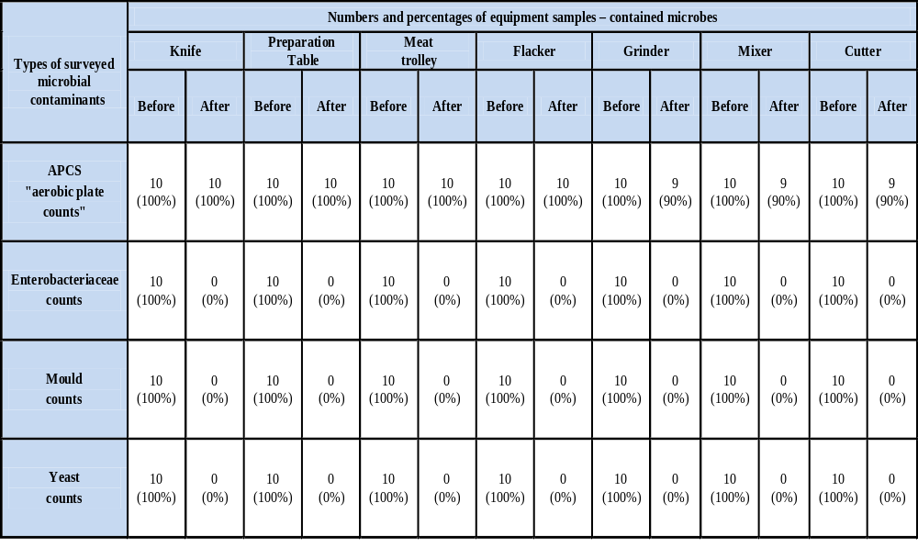
Table (1): Controlling hygienic measures on the equipment surfaces in a meat plant, before and after sanitation program through recognition of the numbers and percentages of microbes-contaminated samples. n* = 20 for each equipment (10 before – and 10 after sanitation program).
n* =number of tested swab samples.

Slide 24
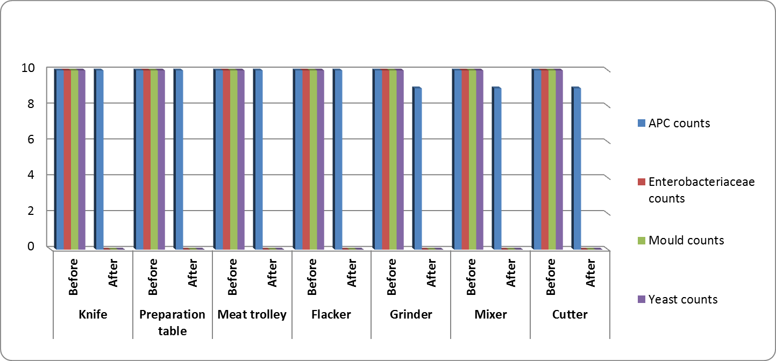
Fig.(1): Controlling hygienic measures on the equipment surfaces in a meat plant, before and after sanitation program through recognition of the numbers and percentages of microbes-contaminated samples

Slide 25
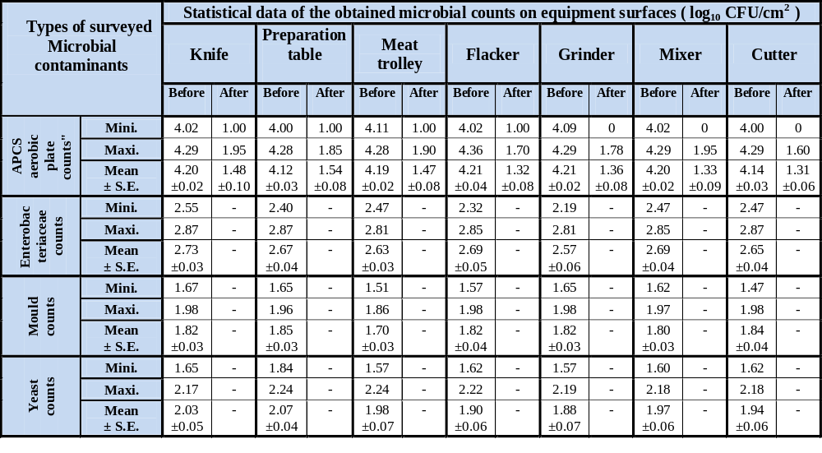
Table (2): Controlling hygienic measures on the equipment surfaces in a meat plant, before and after sanitation program through recognition of the statistical analysis of logarithmic counts of microbes (log₁₀) in contaminated samples. n = 20 for each equipment (10 before – and 10 after sanitation program).
n =number of tested swab sample
S.E= standard error.

Slide 26
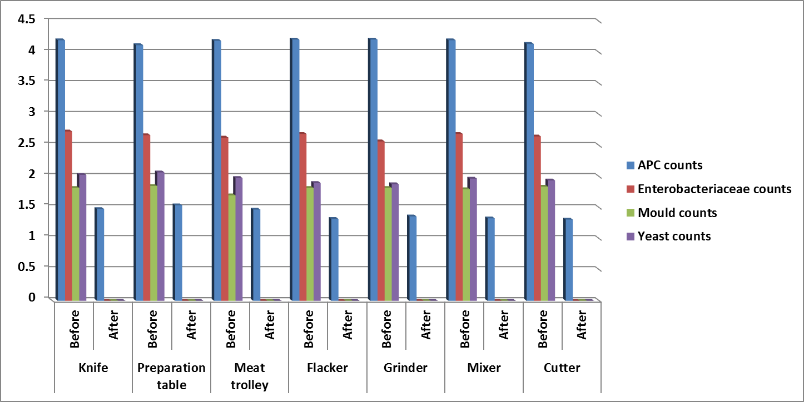
Fig. (2): Controlling hygienic measures on the equipment surfaces in a meat plant, before and after sanitation program through recognition of the statistical analysis of logarithmic counts of microbes (log₁₀) in contaminated samples.

Slide 27

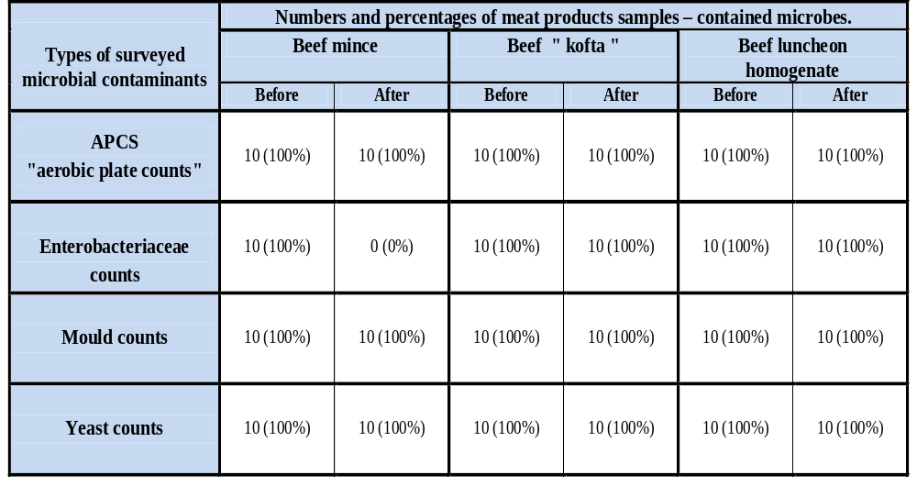
Table (3): Controlling hygienic measures in tissue samples of the common meat products in a meat plant, before and after sanitation program through recognition of the numbers and percentages of microbes-contaminated samples. n = 20 each of meat product (10 before – and 10 after sanitation program).
n =number of tested meat product samples.

Slide 28
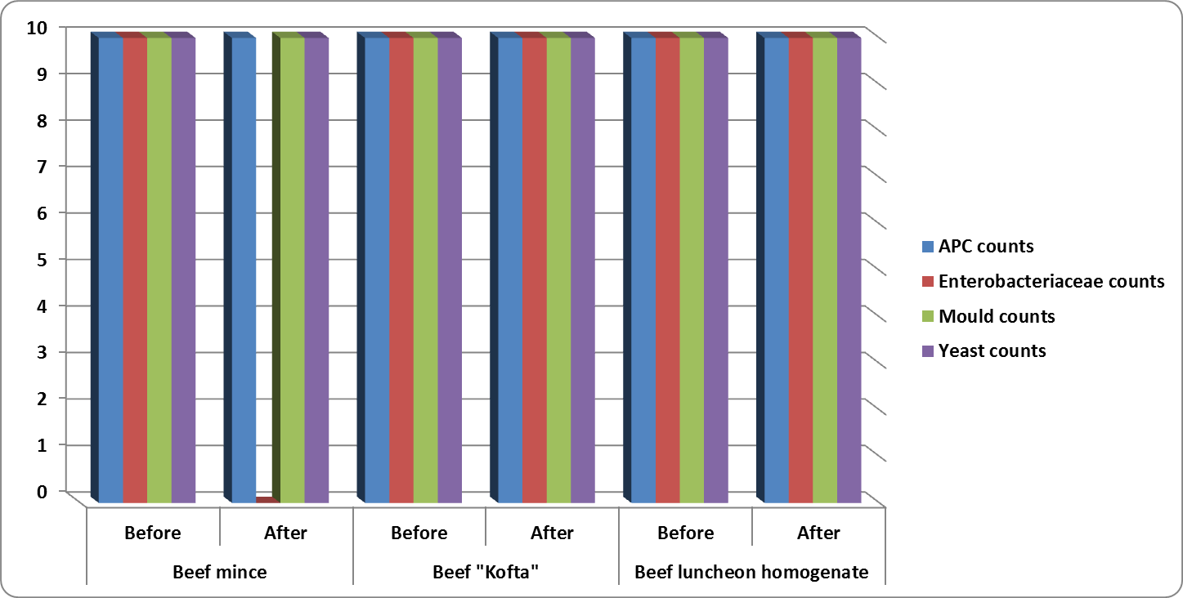
Fig.(3): Controlling hygienic measures in tissue samples of the common meat products in a meat plant, before and after sanitation program through recognition of the numbers and percentages of microbes-contaminated samples.

Slide 29
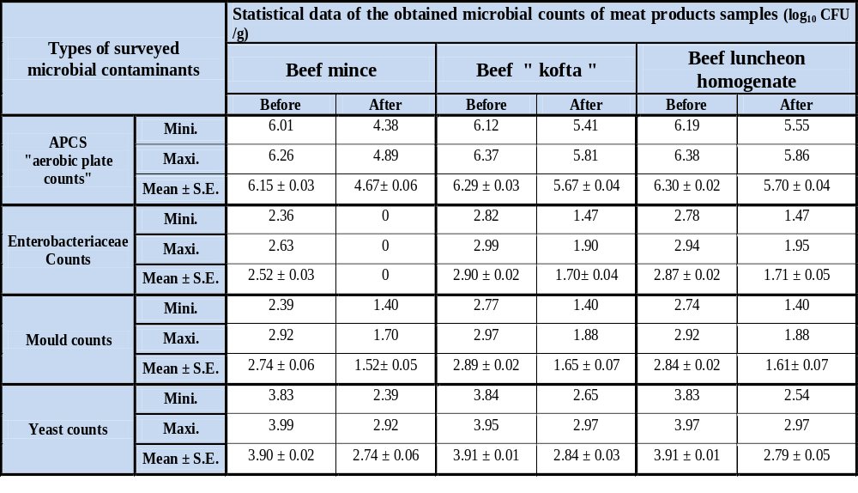
Table (4): Controlling hygienic measures in the tissue samples of meat products in a meat plant, before and after sanitation program through recognition of the statistical analysis of logarithmic counts of microbes (log₁₀) in contaminated samples. n = 20 each of meat product (10 before – and 10 after sanitation program).
n =number of tested swab samples
S.E= standard error.

Slide 30
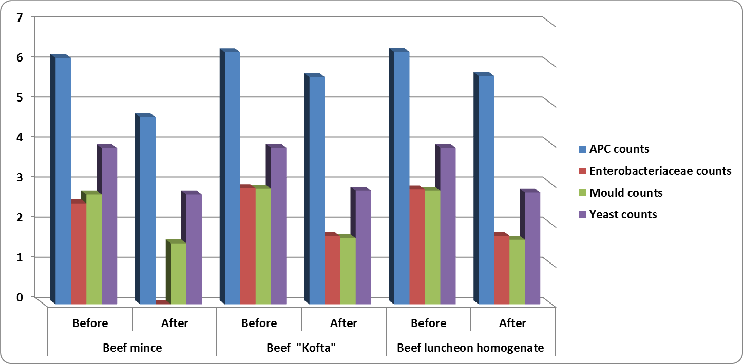
Fig. (4): Controlling hygienic measures in the tissue samples of meat products in a meat plant, before and after sanitation program through recognition of the statistical analysis of logarithmic counts of microbes (log₁₀) in contaminated samples.

Slide 31
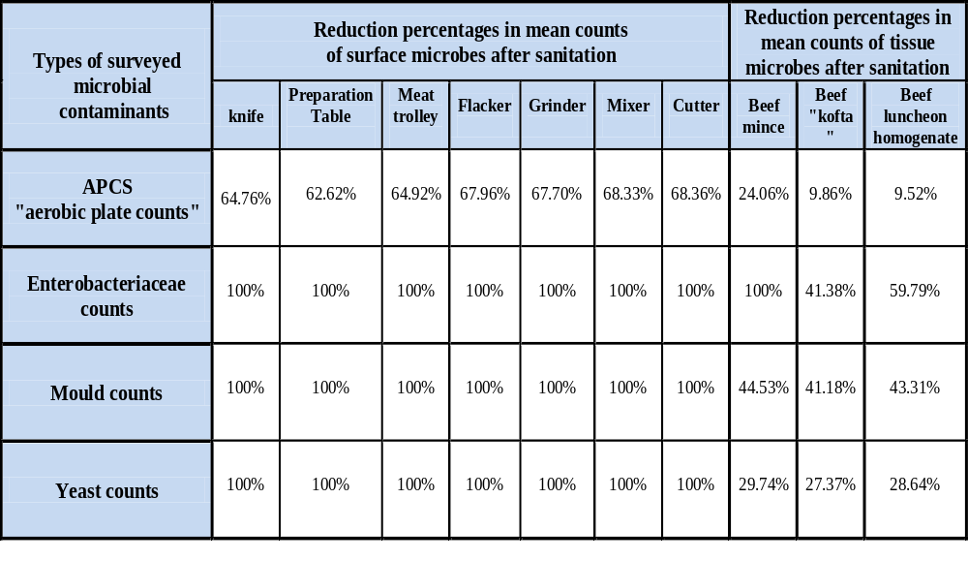
Table (5): Controlling hygienic measures in both swab and tissue samples in a meat plant, before and after sanitation program through reductions in microbial counts.

Slide 32
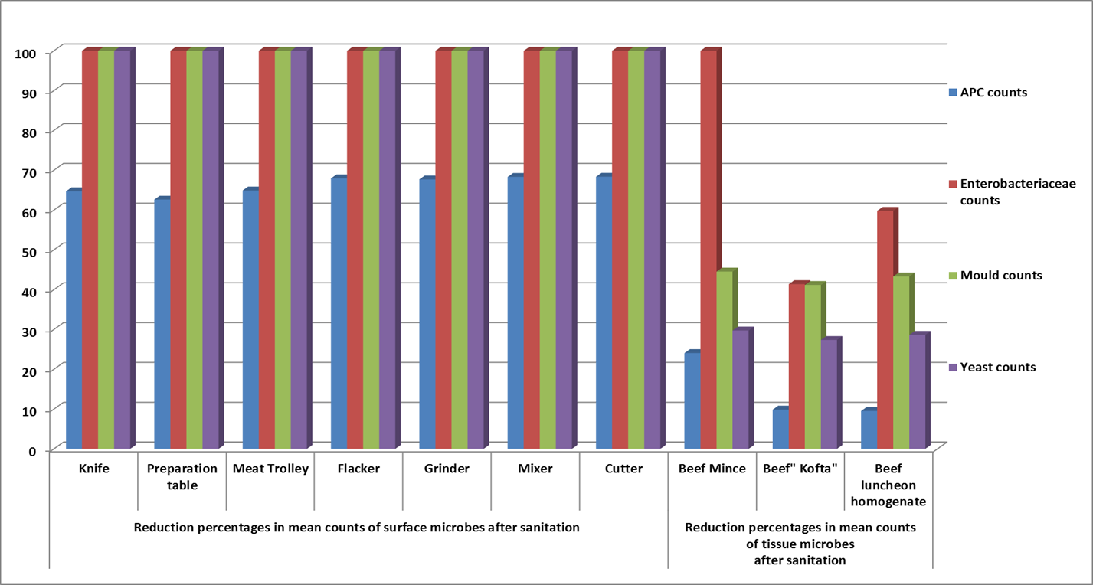

Fig.(5): Controlling hygienic measures in both swab and tissue samples in a meat plant, before and after sanitation program through reductions in microbial counts.

Slide 33
Conclusion and recommendation

Slide 34
It has been concluded that the cleaning and sanitation program applied in the present study has the greatest role in reduction of hygiene indicator microorganisms such as aerobic plate counts, Enterobacteriaceae counts, mould counts and yeast counts whether on meat contact surfaces or examined meat products

Slide 35
Results obtained in this work concluded that sanitation procedures play a major role in controlling of hygienic status at a meat processing plant, and that a sanitation standard operation procedure (SSOP) is a fundamental part of a Food Safety Plan, for the aforementioned reasons we recommend the following points
A. Plant construction and design
B. Hygienic design of equipment and facility
C. Personnel hygiene
D. Sanitary Operations
E. Sanitary Facilities and Controls
F. Control of process

Slide 36

تم بحمد الله
تم بحمد الله
Notes:
36

