Slide 1
Congenital glaucoma
Dr. Basel Alfaaouri
SPECIALIST OPHTHALMOLOGY
ANTERIOR SEGMENT AND GLAUCOMA SURGEON

Slide 2
Case presentation
Female
2’nd day of birth (12/4/2014)
Gestational age :39 week
Normal delivery
Weight at birth : 3.31 kg
Family history : positive ( 2 of her cousins )

Slide 3
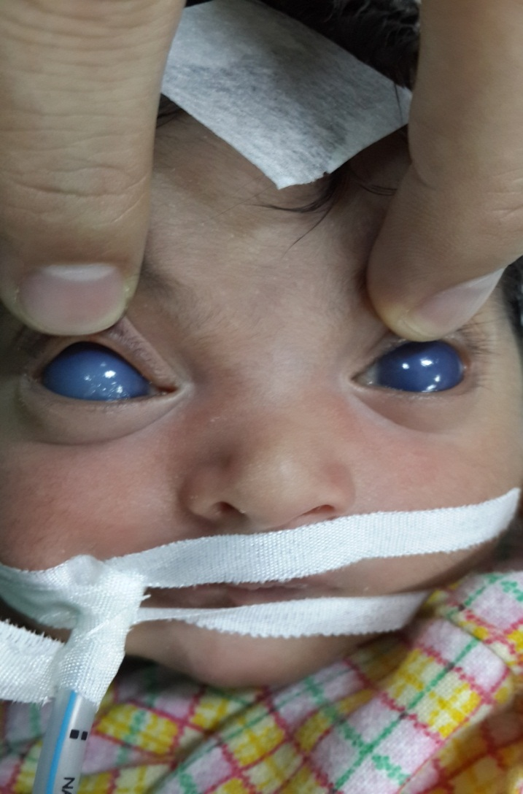
4/4/2014

Slide 4
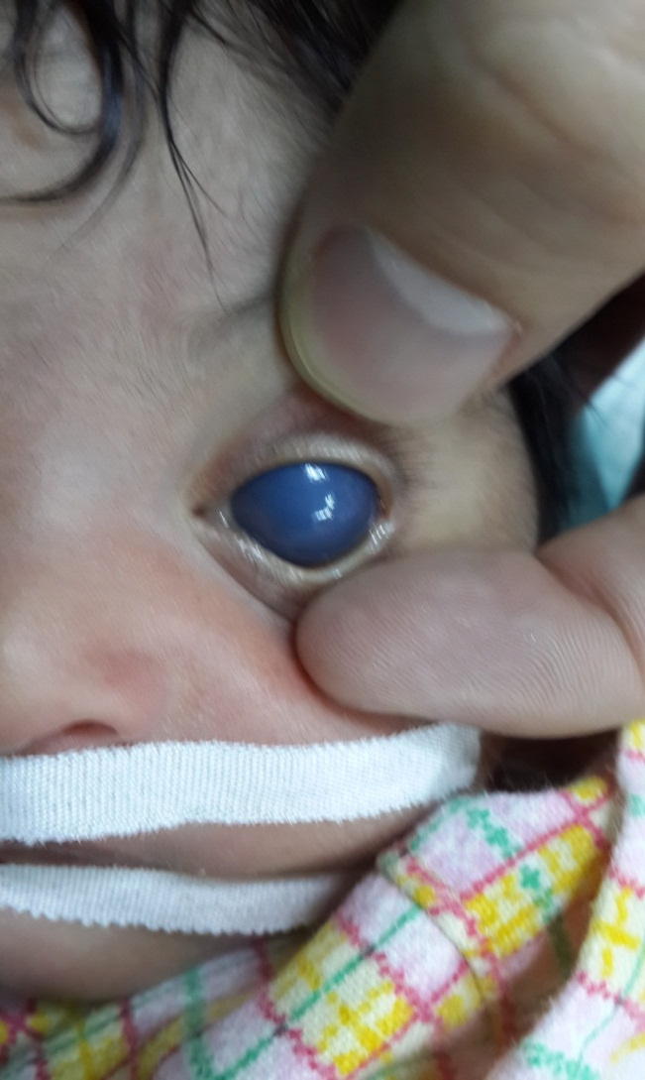

Slide 5
RE : central corneal opacity with peripheral cloudiness .
LE : homogenous cloudiness
hazy view of iris
no fundus view
IOP : RE : 28 mmHg LE : 26 mmHg (after intubation )
HCD : RE 12.50 mm LE : 12.25 mm
B-scan : was normal in both eyes

Slide 6
LE operated on14/4/2014 :
TRABECULOTOMY+TRABECULECTOMY
+MMC
RE operated on 21/4/2014 :
TRABECULOTOMY+TRABECULECTOMY
+MMC

Slide 8
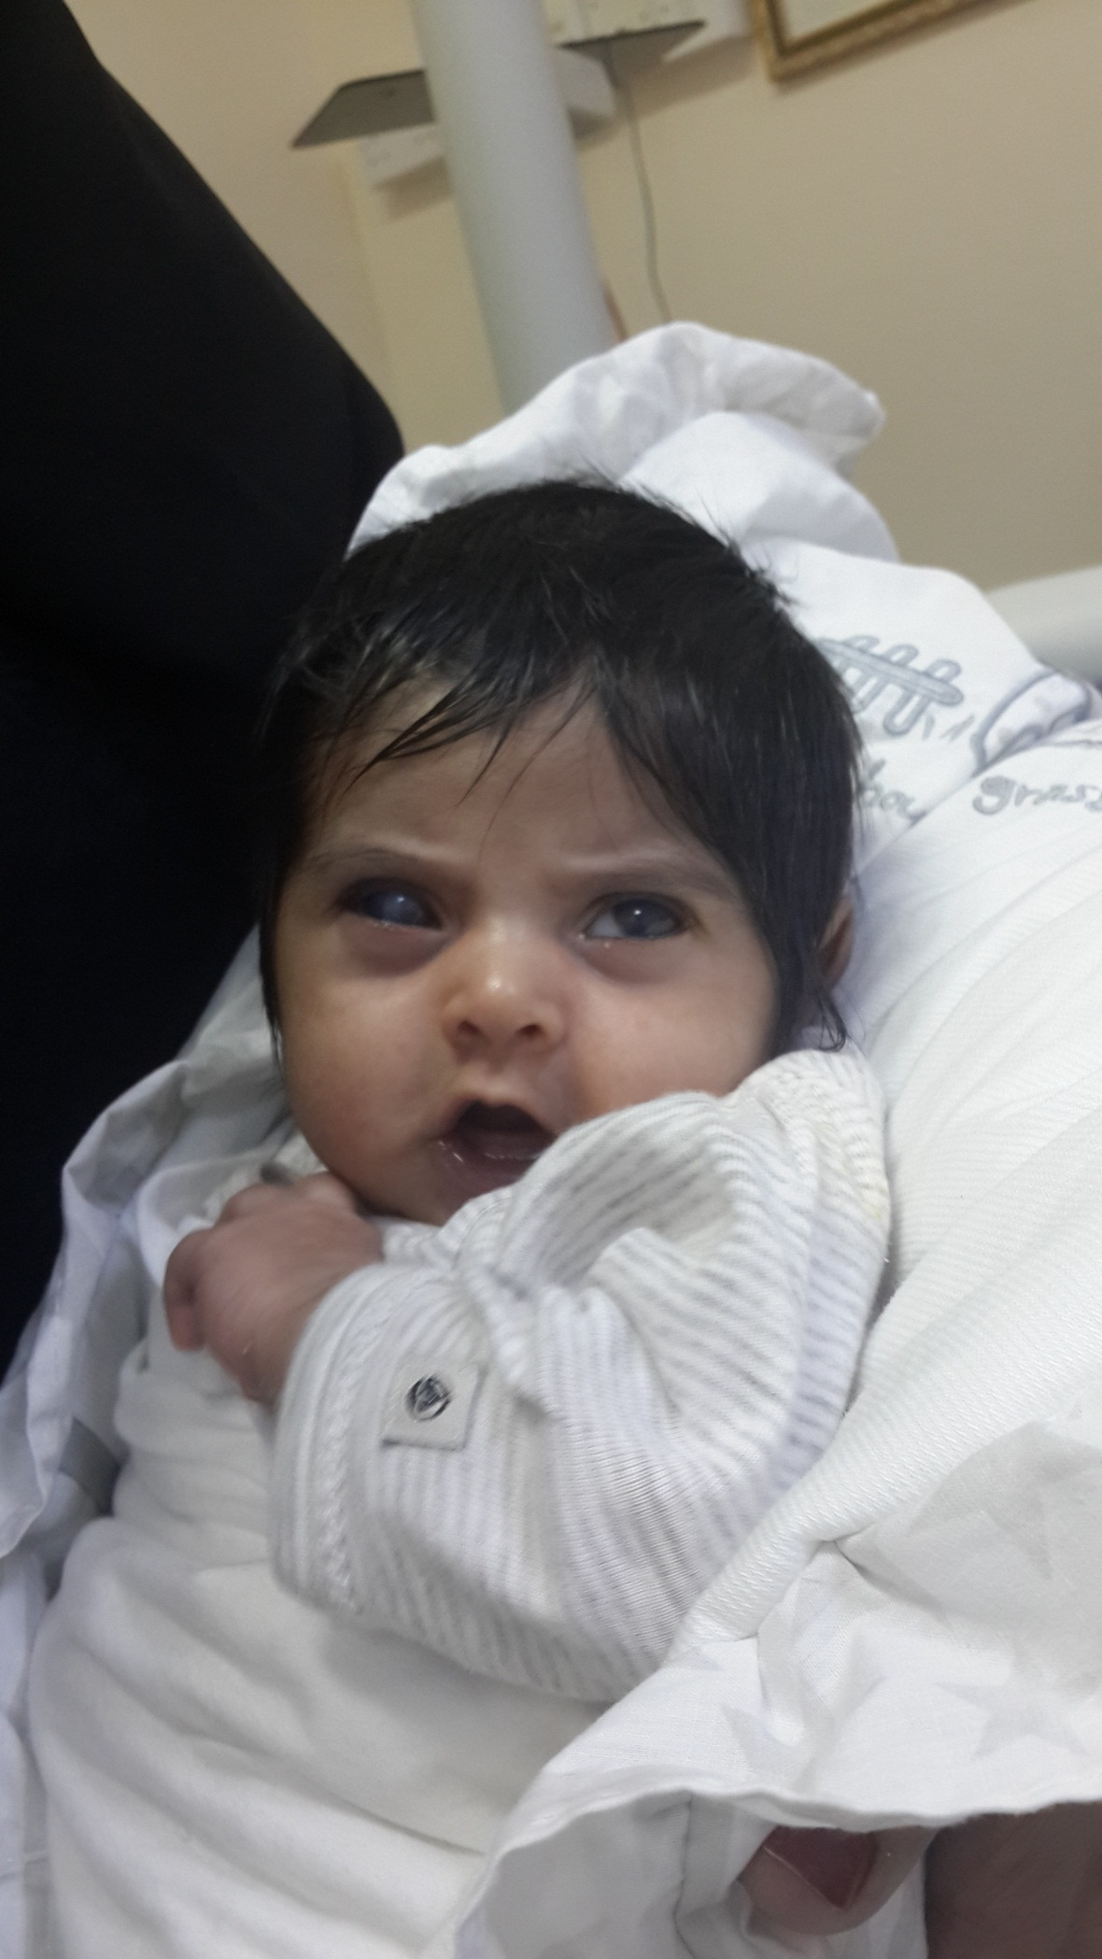
6/5/2014

Slide 9
12/5/2014
EUGA :
RE : CENTRAL CORNEAL OPACITY (SCAR)
CLEAR CORNEAL PERIPHERY
FUNDUS NOT SEEN
IOP : 18mmHg . HCD : 12.50 mm
LE : CLEAR CORNEA (NO EPITHELIAL OEDEMA)
PUPILE DAILATED MEDICALY + PI
CDR: 0.4
FLAT NORMAL RETINA
IOP : 14 mmHg . HCD : 12.25 mm

Slide 10
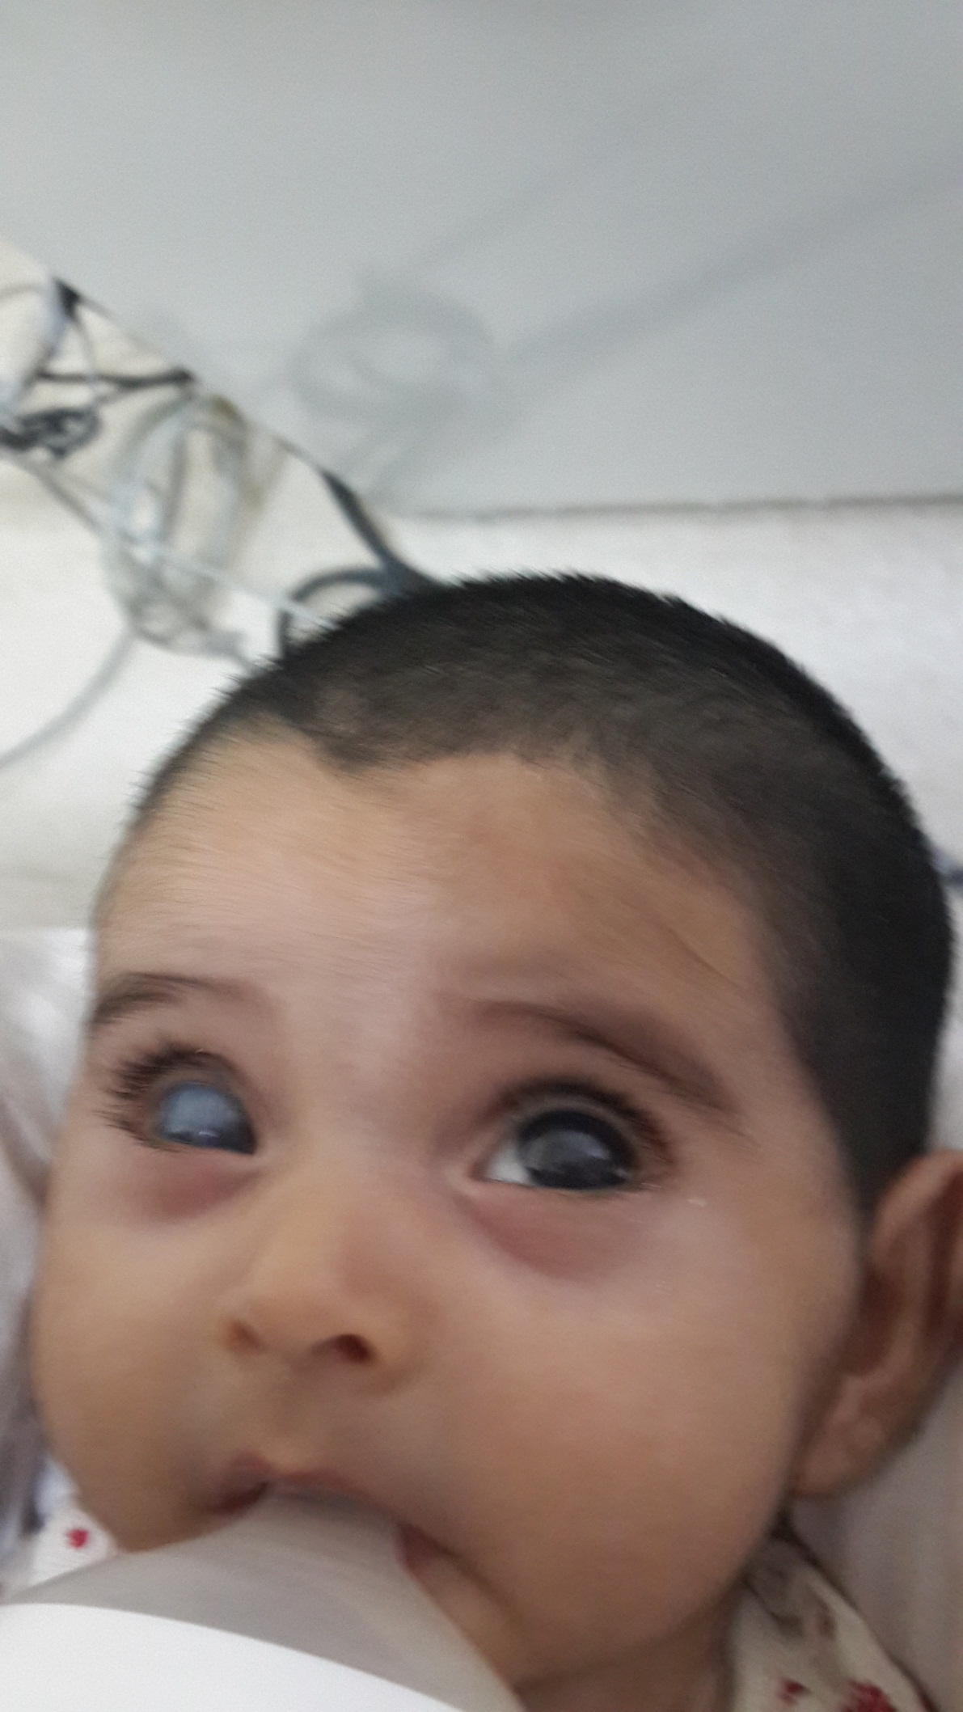
1/6/2014

Slide 11
30/7/2014 (UK)
EUGA :
- IOP : RE : 23mmHg LE : 12 mmHg
- HCD : RE : 12.75 mmHg LE:12.25 mm
Azopt bid for RE

Slide 12
15/9/2015
EUGA :
- IOP: RE : 24 mmHg HCD: 13 mm
LE : 16 mmHg HCD: 12.50 mm
RE operated : TRABECULECTOMY+MMC

Slide 13
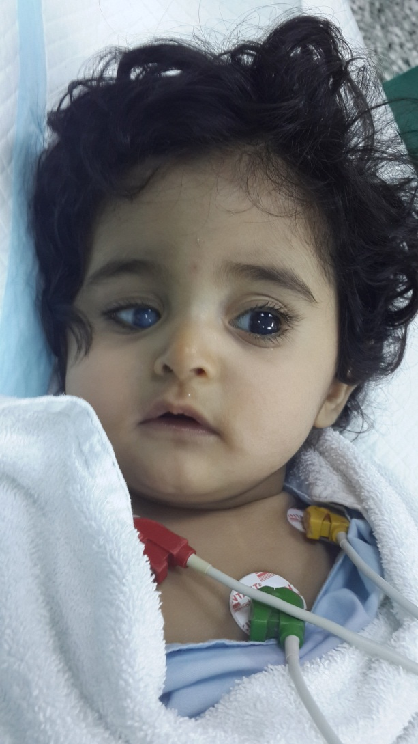
November 2014
EUGA :
RE : 18 mmHg HCD : 13mm
LE : 16 mmHg HCD : 12.50 mm
CDR : 0.4

Slide 14
5/1/2015
EUGA :
RE : 17 mmHg HCD : 13mm
LE : 16 mmHg HCD : 12.50 mm
CDR : 0.4

Slide 15
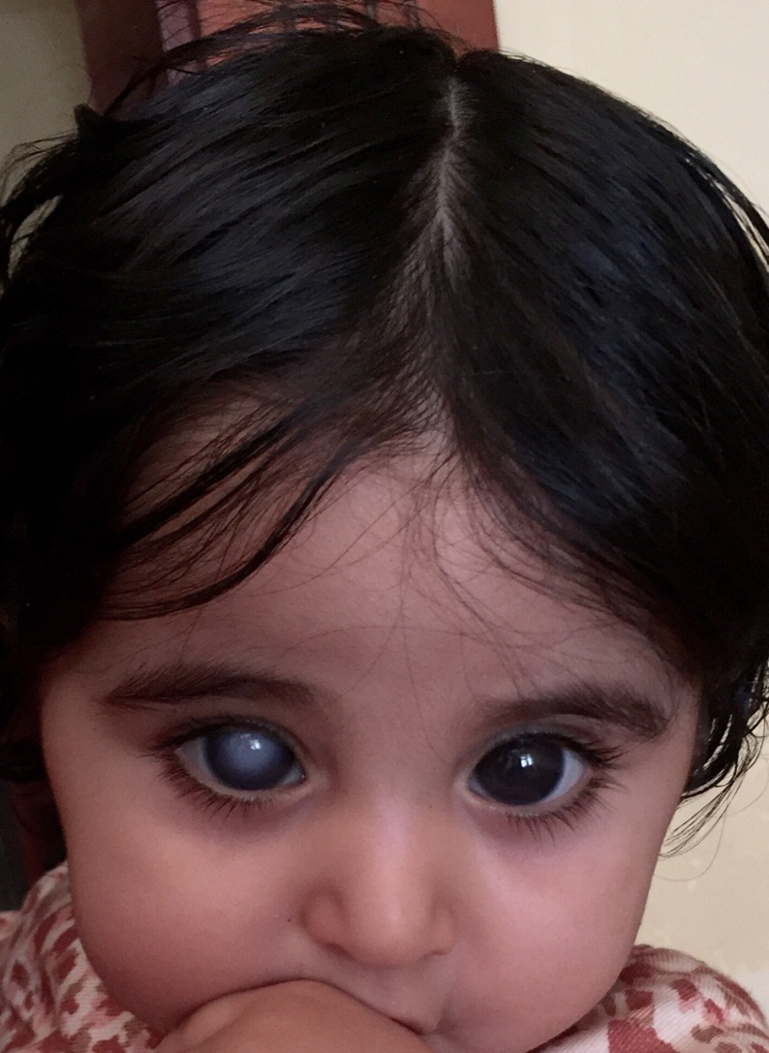
20/7/2015
EUGA :
RE : 18 mmHg
HCD : 13mm
LE : 16 mmHg
HCD : 12.50 mm
CDR : 0.4

Slide 16
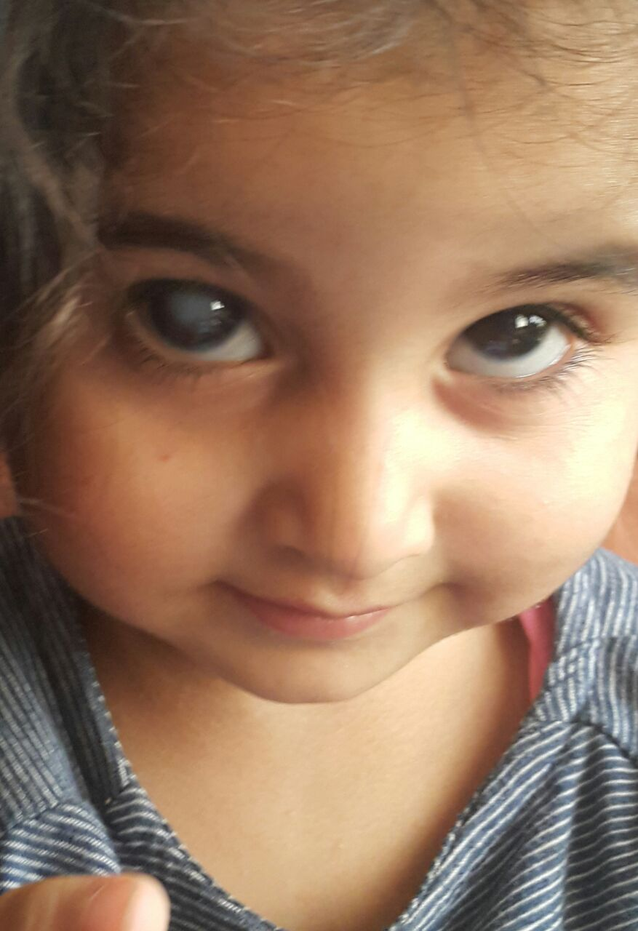
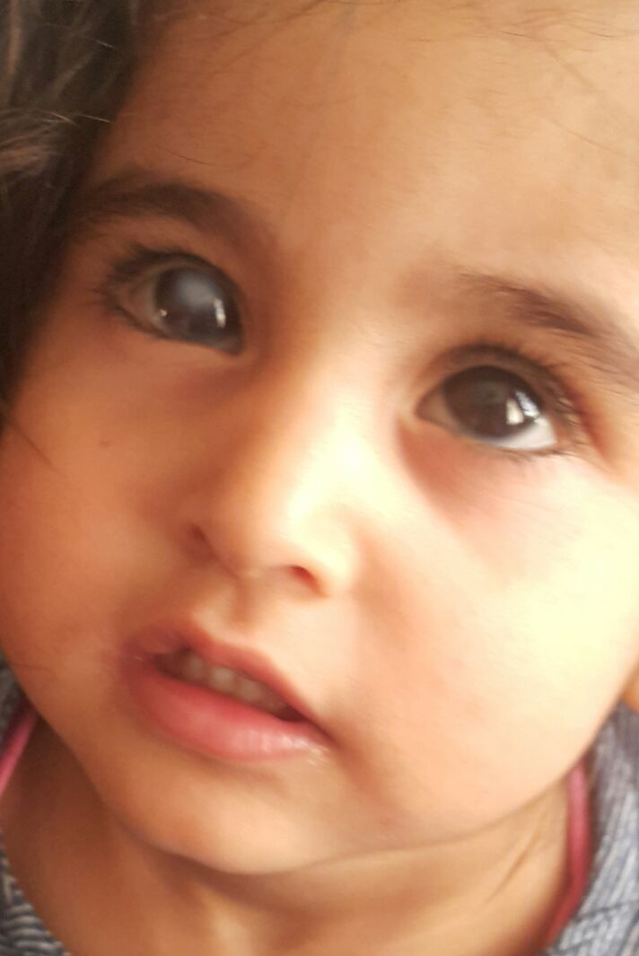
22/03/2016

Slide 17

14/4/2014
22/3/2016

Slide 18
Take home message :
Congenital glaucoma one of the most challenging cases in ophthalmology.
Early diagnosis .
To do the surgery as soon as possible .
To educate the parents of the child ( etiology , procedures , prognosis , recurrence rate , long term follow up ) .
Patience , patience , and patience

Slide 19
Thank you

