Slide 1
Human Sex Trafficking and the Healthcare Professional Role
Jeanann Sousou Coppola, DNP, RN, CNM, CNE
E. Renee Cantwell, DNP, RN, CNE, CPHQ
September 26, 2017

Slide 2
Objectives
Discuss what Human Trafficking is and differentiate among the different types and identify who the victims are
Identify the Global, National and Regional Statistics related to this public health issue and discuss why it is an underreported issue
Analyze the role of the healthcare professional in the identifying victims of human trafficking
Discuss ethical issues related to human trafficking and the role of the healthcare professional and education surrounding this issue
Assess the incidence of HIV and other associated health risks related to Human Trafficking

Slide 3
New Jersey Cases
Aug. 23, 2017: A Union County man, Torrie Fogg, 41, is facing multiple charges, including human trafficking, after he allegedly held a female against her will and forced her to prostitute herself. Hanover Township police responding to a dispute at a local hotel encountered a 31-year old female who told them she was being held against her will.
Aug. 15, 2017: Attorney General Christopher S. Porrino announced that a Burlington County couple was indicted on charges including first-degree human trafficking of a minor. The pair, Christopher White and Adria Regn, allegedly forced a 17-year old girl to prostitute herself and gave her drugs. The victim, who knew White, went to a motel to supposedly babysit Regn’s children. There, she was told she was going to work as an “escort” for them and was allegedly forced to take crystal meth.

Slide 4
New Jersey Cases
July 28, 2017: Atlantic County Prosecutor Damon G. Tyner announced the arrest of three individuals from Massachusetts on human trafficking charges. Galen Spriggs, 34, Jovana Jensen, 37, and Lazara White, 24, were charged with one count of human trafficking and one count of promoting prostitution in connection with the alleged trafficking of a 23-year old
July 18, 2017: Horace Spencer, 23, was indicted in Union County on human trafficking and promoting prostitution charges related to the alleged recruitment of a minor to perform prostitution services. The case of the second person arrested in the investigation, Carisma Snell, 19, has not yet been brought before the grand jury.
July 13, 2017: The Gloucester County Prosecutor’s office announced that two men allegedly involved in sex trafficking a 17-year old have been arrested and a third suspect is being sought. In December 2016, the three suspects allegedly forced a teen runaway into prostitution. They advertised her on Backpage.com. Authorities arrested Brandon Samuel, 26, and Ali Brown, 24.
Notes:
ALL THESE SCENARIOS HAVE A COMMON THEME

Slide 5
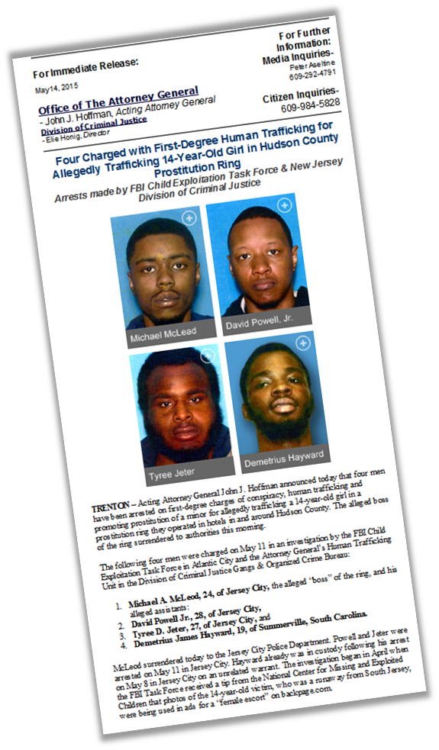
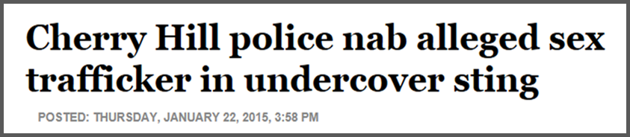
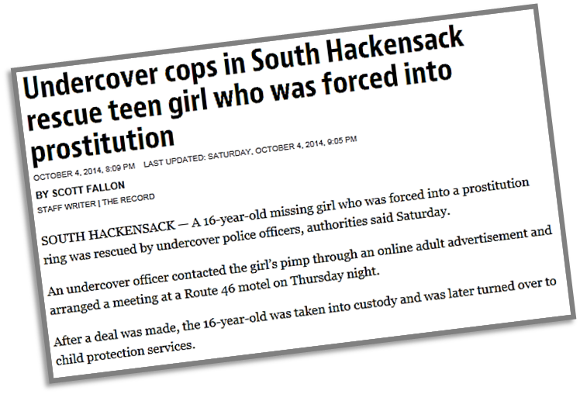
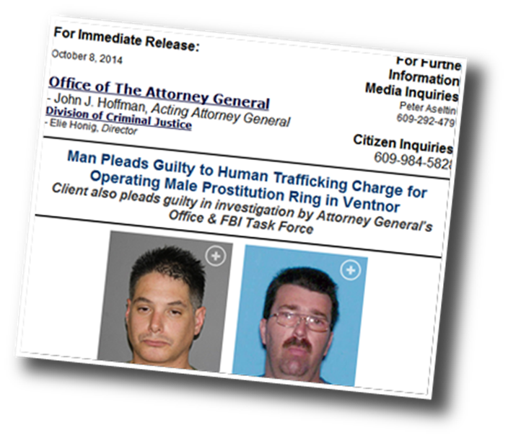
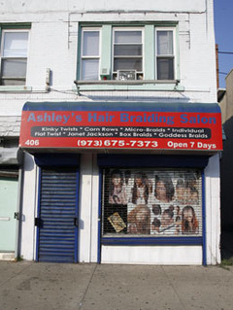
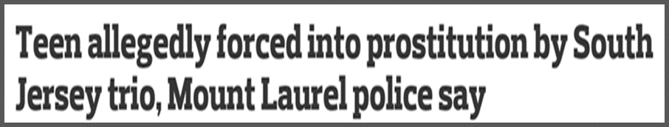
Recent Arrests/Convictions in New Jersey
Three charged in hair salon human trafficking ring
5

Slide 6
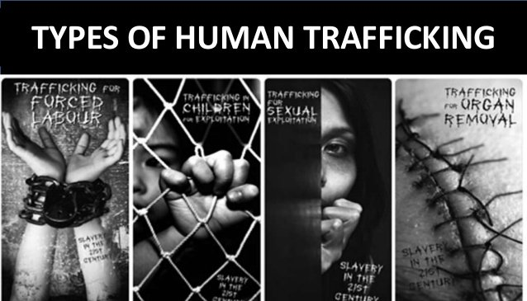
What is Human Trafficking?
It is a form of Modern Day Slavery
Sex Trafficking
Child Sex Trafficking
Forced Labor Trafficking
Bonded Labor or Debt Bondage
Forced Child labor
Unlawful recruitment and use of child soldier
  http://thebronxchronicle.com/wp-content/uploads/2017/01/Types-of-Human-Trafficking.jpg
Notes:
SEX TRAFFICKING
Adult engagement in commercial sex such as prostitution where the individual was forced or coerced by
use of psychological or physical threats. Sex trafficking may also be associated with “debt bondage”
wherein individuals are forced to prostitute themselves as a means of paying back a debt incurred through
their “transportation, recruitment, or “sale.”
CHILD SEX TRAFFICKING
Recruiting of individuals under 18 years of age through enticement, transport, or maintaining of these
children to perform commercial sex. The use of children in the commercial sex trade is prohibited under US
law and in most countries.
FORCED LABOR
Also known as labor trafficking. This terms encompasses the recruitment, transport, providing, or obtaining
individuals for the proposed of forcing the individual to work through deceit, force, physical, or psychological
threats.
BONDED LABOR OR DEBT BONDAGE
A type of coercion that requires the victim to work to pay off his or her own or the ancestor’s debts. US law
prohibits the use of a debt or threats of financial harm as a form of coercion.
FORCED CHILD LABOR
Children who are forced to work in situations that financially benefit someone outside of the child’s family
and does not offer the child the option of leaving.
UNLAWFUL RECRUITMENT AND USE OF CHILD SOLDIERS
Unlawful recruitment and use of children through fraud, coercion, or force by armed forces to be used as
combatants, cooks, guards, servants, messengers, or spies. Boys may also be sexually abused, and girls
may be forced to marry or have sex with the soldiers.

Slide 7
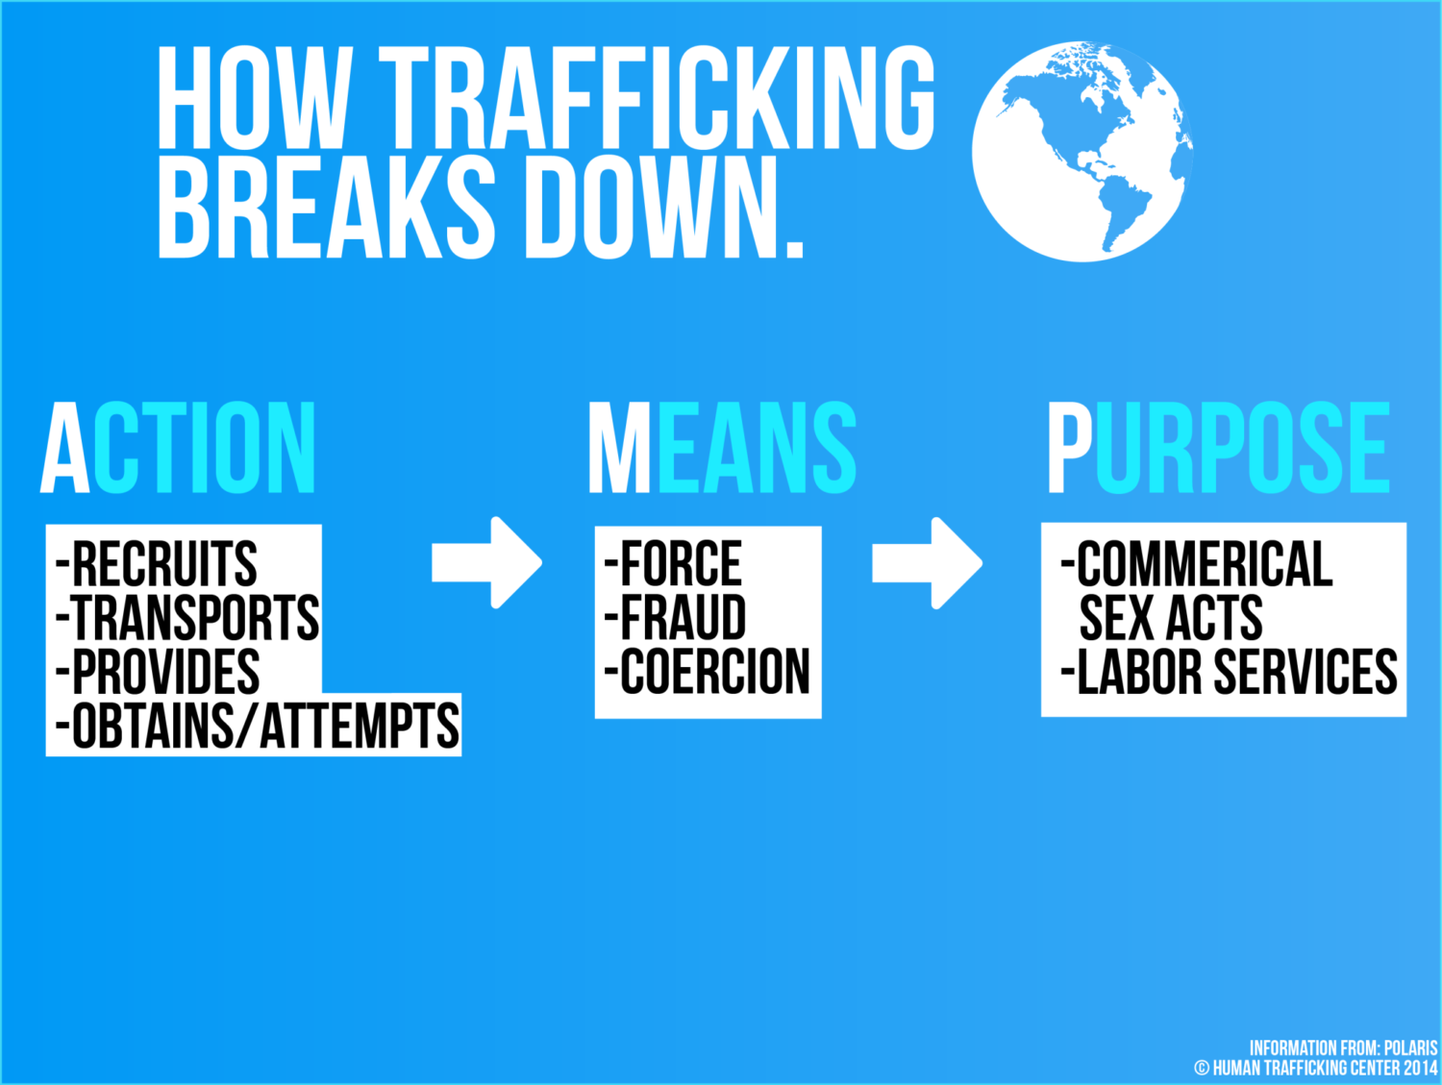
Traffickers use FORCE, FRAUD, or COERCION on victims for the purpose of sexual exploitation or labor; and
Rapidly growing criminal industry second only to drug dealing and equal in scope to arms dealing.
7
Notes:
Human trafficking occurs when a perpetrator, often referred to as a trafficker, takes any one of the enumerated
Actions, and then employs the Means of force, fraud or coercion for the Purpose of compelling the victim to provide commercial sex acts or labor or services. At a minimum, one element from each column must be present to establish a potential situation of human trafficking.
The presence of force, fraud or coercion indicates that the victim has not consented of his or her own free will.
Remember that under federal law, any minor under the age of 18 years induced into commercial sex is considered to be a victim of sex trafficking
—regardless of any indicators of force, fraud, or coercion.
https://humantraffickinghotline.org/sites/default/files/AMP%20Model.pdf

Slide 8

Who are the Victims?
Sexual exploitations are the most commonly identified form, forced labor as the second– 18%
Disproportionate number of women are involved- both as traffickers and those being trafficked
  Often, traffickers were former victims!
Most trafficking is national or regional, carried out by people of same nationality, culture, or ethnicity.
Europe has victims from wide range of origins and victims from Asia are trafficked most widely

Slide 9
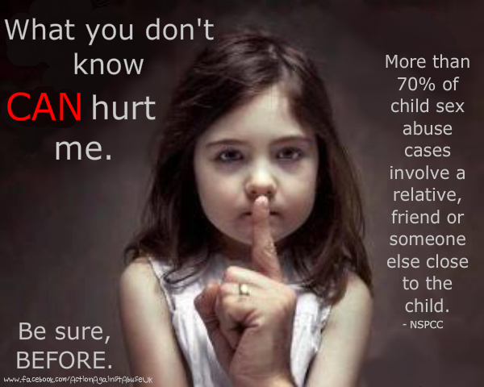
Who are the victims?
Children and Youth are also victims
Usually recruited or exploited into prostitution by family members, friends, or strangers for financial gain
Risk factors include
  Runaways
  History of neglect or familial abuse
  History of coming from a dysfunctional family
  Poverty
  Mental health problems
  Drug use and abuse
National Center for Missing and Exploited Children (NCMEC) indicate about 69% of child pornography victims were abused or exploited by people who were familiar to them
  Usually begins around age 3 through 8
  Donley-Hayes, K. (2014). The Sex Trafficked Child. Contemporary Pediatrics

Slide 10
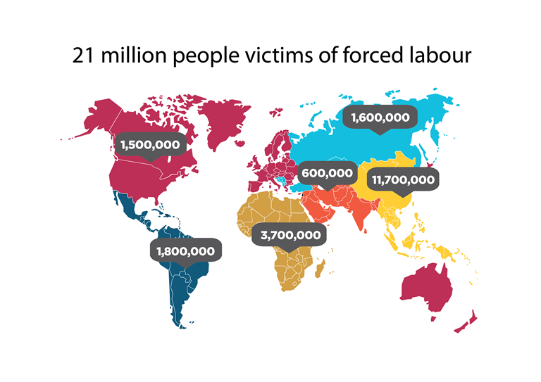
What are the statistics of Human Trafficking?
A global health concern that cuts across all ages, genders, ethnicities, education level, and socio-economic backgrounds
  January 2017, estimated 20.9 million victims internationally
  2007-2012 data
    72% female and girls Global
    85% female and girls in US
Defined as the trade of humans for the purpose of labor, sex, or other forms of human exploitation
  http://www.ilo.org/wcmsp5/groups/public/---ed_norm/---declaration/documents/image/wcms_537694.png

Slide 11
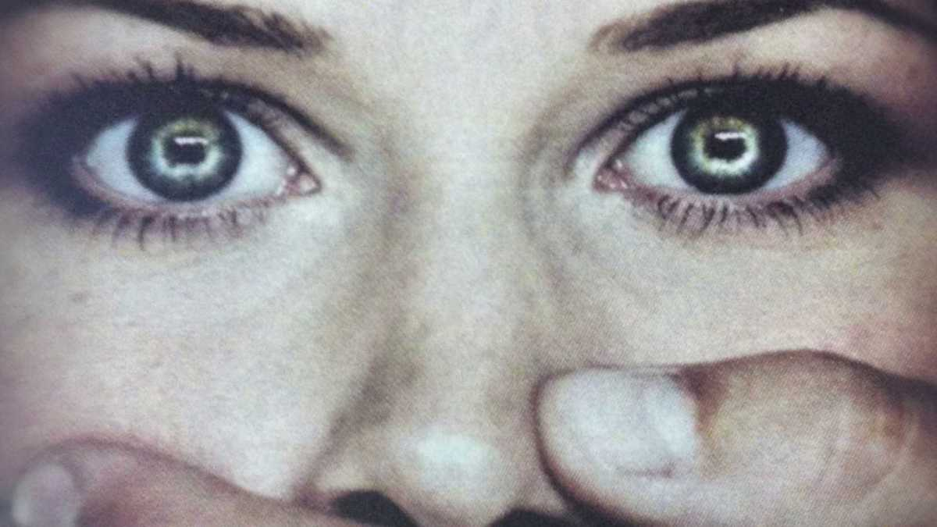
Human Trafficking in the United States
Department of Child and Family Report
November 2013 – August 2016: 372 calls received (multiple victims per call)
**Like most gender or sexually based violence,
human trafficking is under reported**
Notes:
National Human Trafficking Resource Center
All-time US statistics: 25,696 Cases / 51,823 Survivors Identified
2015 US statistics: 5,544 Cases / 75% Sex Trafficking
2015 NJ statistics: 169 Cases / 82% Sex Trafficking (54% minors)

Slide 12
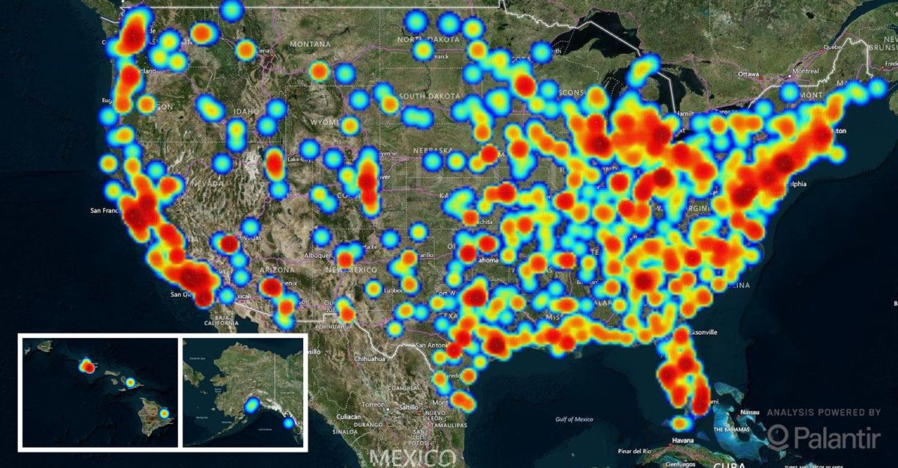
Human Trafficking in the United States
Since 2007 through January 2017, 25,696 cases were reported
  41% Sex trafficking
  20% Labor Trafficking
2015 alone, 5,973 cases were reported

Slide 13
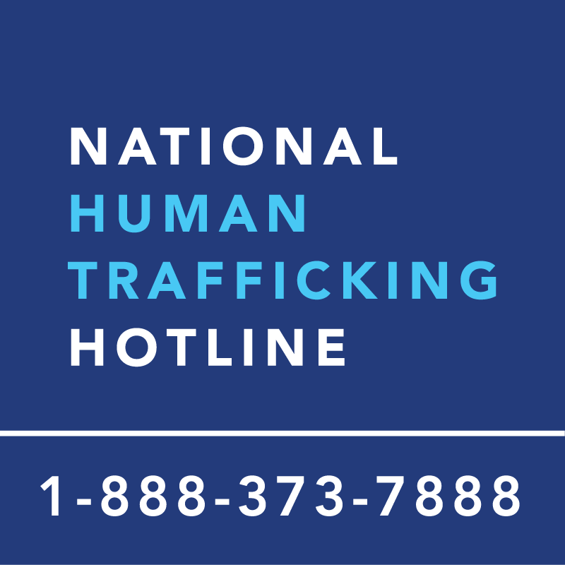
National Human Trafficking Hotline Data
13,897 Actual Calls made to Hotline in 2017
4,460 Human Trafficking Cases were reported
Highest: 705 in California
Lowest: 42 in Iowa
3186 Human Sex Trafficking
689 Human Labor Trafficking
411 Not specified
174 Both Sex and Labor Trafficking
https://humantraffickinghotline.org/states
Notes:
Has been in operation since December 2007.
Our mission is to provide human trafficking victims and survivors with access to critical support and services to get help and stay safe, and to equip the anti-trafficking community with the tools to effectively combat all forms of human trafficking.
We offer round-the-clock access to a safe space to report tips, seek services, and ask for help. We also provide information, statistics, and resources on a wide range of topics related to human trafficking.
https://humantraffickinghotline.org/mission

Slide 14
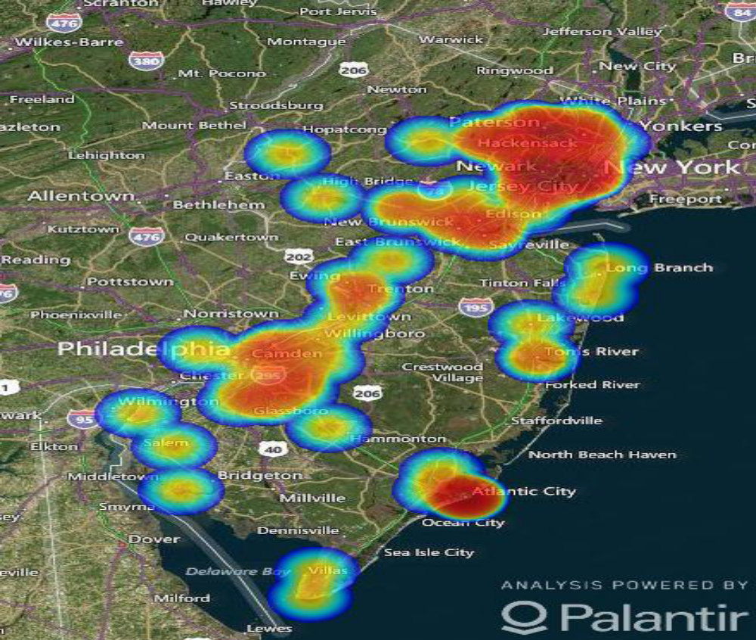
National Human Trafficking Hotline
New Jersey Data
2016 Data
569 Calls to the hotline
  195 Human Trafficking Cases reported
    177 Female; 23 Male
    105 Minors; 100 adults
2017 Data to date
205 calls to the hotline
  83 Human Trafficking Cases reported
    69 Female; 17 Male
    61 Minors; 35 Adults

Slide 15
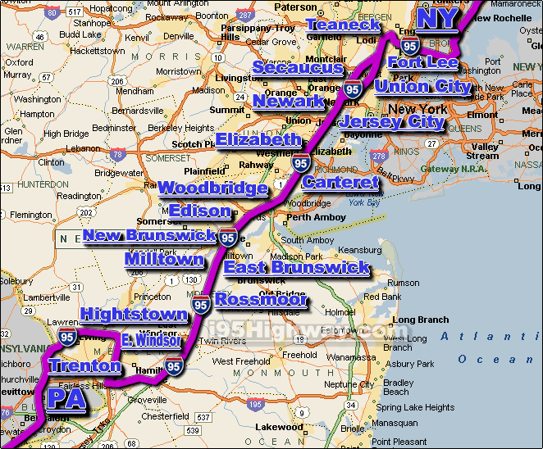
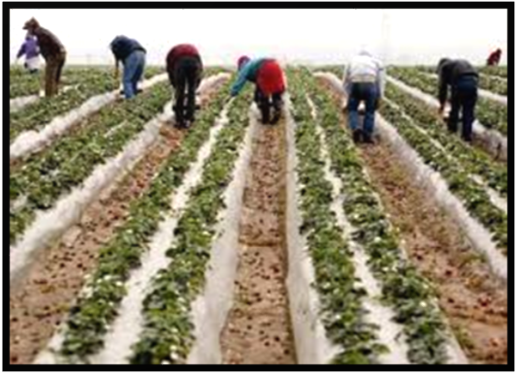
Why is the incidence high in New Jersey?
POPULATION
  Eleventh most populous, but most densely populated
LOCATION
  Prime spot along the I-95 Corridor
INDUSTRY
  Casino
  Farming
EASY ACCESS
  Using one of its many major interstate routes, truck-stops, airports, seaports, and terminals
15
Notes:
Casinos; prostitution

Slide 16
Why it is underreported?
Victims may not cooperate with Law Enforcement
  fear further trauma or retaliation by the perpetrators.
Victims helpers may also not alert law enforcement
  fear that the victim may be harmed by the criminal justice process
They may also fear deportation if they are in this country illegally
Notes:
Victim image not met

Slide 17
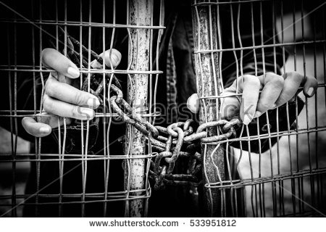
Why it is underreported?
Victims who are coerced into prostitution to pay off smuggling debts,
  may not appear to law enforcement as victims but rather criminals, particularly if they are not physically restrained.
Law enforcement officials may be to reluctant in providing victims with services and support or treat victims as offenders by charging them with crimes related to their trafficking victimization (e.g., prostitution, fraud, illegal residence)

Slide 18
S. 178 Justice for Victims of Human Trafficking Act, 2015
“Authorizes services to victims of human trafficking and sets up a fund to cover the costs of the programs it authorizes, which is paid for by a $5,000 special penalty assessment for convicted sex offenders, human smugglers, and human traffickers. These funds supplement existing Federal resources available for human trafficking victim support.
The legislation strengthens law enforcement tools for prosecuting human trafficking offenses. It also recognizes child pornography production as a form of human trafficking. This legislation includes numerous provisions from ten previous human trafficking measures that the House considered earlier this year”
(https://www.gop.gov/bill/s-178-justice-for-victims-of-trafficking-act-of-2015/)
Notes:
Bipartisan Act Signed into Law by President Obama
S. 178, The Justice for Victims of Trafficking Act works
to fight human trafficking by reducing demand for sex trafficking, providing more services for victims, depriving convicted offenders of criminal assets and using forfeited assets to satisfy restitution orders for victims, and giving law enforcement more and better tools to fight sex trafficking.

Slide 19
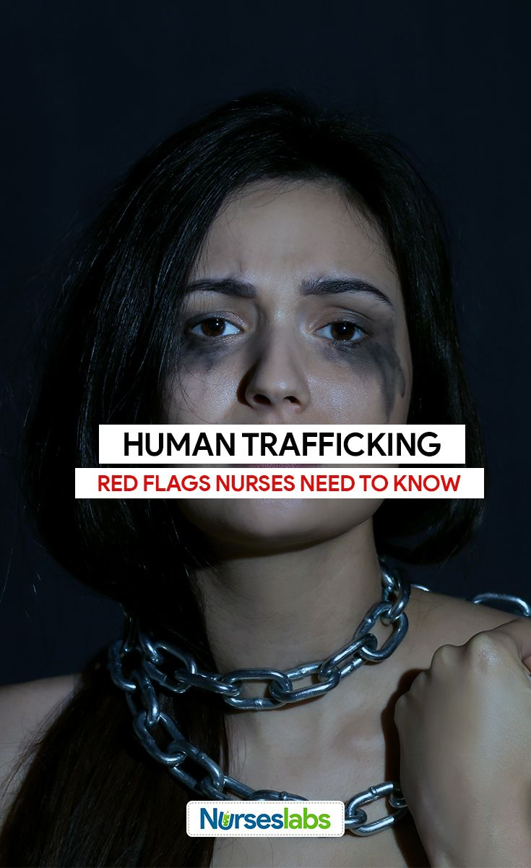
Role of the Health Care Professional
Initial encounter
H E A R
Healthcare professionals need to identify victims based on presentation
  Look for the signs
Examine, collect history, examine body, examine emotions
Ask specific questions
Review all options, refers and report when necessary
Notes:
Signs of Victimization
Physical effects include
inflicted injuries
STD, HIV
Pregnancy and complications related to
Infertility and ectopic risks
Substance use and misuse
Malnutrition and dehydration
Non sexual infections ( TB, wound infections that are not healing properly, UTI- chronic)
Untreated medial conditions requiring more attention
Chronic pain and fatigue
Dental complications related to trauma

Slide 20
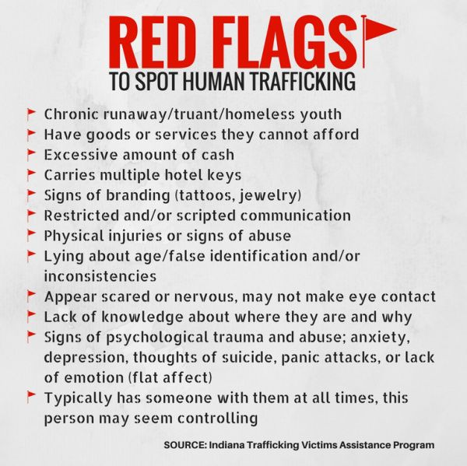
Notes:
RED flags to look for when suspecting victimization of Human Trafficking

Slide 21
Health Care Professionals Questions to Consider
Can you leave your job or situation if you want?
Can you come and go as you please?
Have you been threatened if you try to leave?
Have you been physically harmed in any way?
What are your working or living conditions like?
Where do you sleep and eat?
Do you sleep in a bed, on a cot or on the floor?
Have you ever been deprived of food, water, sleep or medical care?
Do you have to ask permission to eat, sleep or go to the bathroom?
Are there locks on your doors and windows so you cannot get out?
Has anyone threatened your family?
Has your identification or documentation been taken from you?
Is anyone forcing you to do anything that you do not want to do?
Department of Health and Human Services (2017)
Notes:
Important to assess risk for the patient and no place them in additional danger during the interview. At times, the coercer will be in the room with the patient either answer all the questions, or not allowing the patient to divulge any information.
It is important to interview the patient alone in a safe environment. Reinforce that confidentiality will be maintained, however, reporting laws may require you to speak up if they are victimized.
Need to build trust with the victim and maintain a good rapport
Emphasize they are free to not answer any questions that may make them uncomfortable
Monitor for signs of victimization *eye contact, unexplained trauma, tearfulness, tenseness, posture, and sweating
Aggressive attempts to confirm a suspicion about trafficking and obtain an admission or disclosure can be psychologically harmful for the trafficked person, potentially triggering intense stress, anxiety, and fear

Slide 22
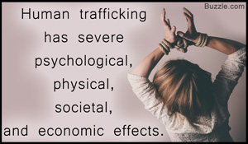
Human Trafficking and
Health-Related Risks
Physical Trauma
  Unexplained cigarette burns or injuries
  Tattoos (unwanted markings)
  Medical conditions that persist and are never addressed
  Evidence of malnourishment, dehydration
  Unexplained gastrointestinal difficulties
  Serious dental problems
Reproductive issues
  Unwanted pregnancy
  Abortion related issues
  STIs
  HIV/ AIDS
  Unexplained rectal and/or vaginal trauma
  GU difficulties- persistent UTIs
  Infertility issues related to chronic reproductive infections
Notes:
Physical effects include
inflicted injuries
STD, HIV
Pregnancy and complications related to
Infertility and ectopic risks
Substance use and misuse
Malnutrition and dehydration
Non sexual infections ( TB, wound infections that are not healing properly, UTI- chronic)
Untreated medial conditions requiring more attention
Chronic pain and fatigue
Dental complications related to trauma

Slide 23

Human Trafficking and
Health-Related Risks
Emotional issues
  Major Depression
  Post traumatic stress disorder (PTSD)
  Suicidal
  Anxiety- unexplained
  Aggression or aggressiveness

Slide 24
Ethical Challenges that Health Professional Face
When and What to Report?
Health care visits represent unique opportunities for health care professionals to provide clinical care and offer assistance to victims and survivors of trafficking.
Like any patient, trafficked persons are deserving of dignified, respectful health care.
Failure to ensure privacy and how to ask questions if the perpetrator will not allow it
If the trafficked patient is a child, it is required by law in all 50 states to report child abuse.
Under Federal Law, anyone under the age of 18 who has engaged in Commercial Sex is considered a Victim of HT
Macias-Konstantopoulos, W.L. (2017). Caring for the trafficked patient: Ethical challenges and recommendations for health care professionals Journal of Ethics, 191, pg.: 80-90.
Notes:
to enlist professional medical interpreters when needed, and to explain the legal limitations of confidentiality (i.e., mandatory reporting requirements) can undermine the autonomy of patients

Slide 25
Ethical Challenges that Health Professionals Face
When and What to Report
If the trafficked patient is an adult, health professionals are required in most states to report injuries caused by weapons or injuries caused in violation of criminal law, suspected abuse, or domestic violence
When the victim is older than 18 years, informed consent should be obtained before reporting to authorities or making referrals.
Macias-Konstantopoulos, W.L. (2017). Caring for the trafficked patient: Ethical challenges and recommendations for health care professionals Journal of Ethics, 191, pg.: 80-90.

Slide 26
Education and Training of the Healthcare Professional
Trafficked victims usually have less access to healthcare services
  Hidden and controlling nature of the crime
Perpetrators tend to prevent the victim from seeking care, or seek care at episodic acute care facilities (urgent centers or minute clinics)
  Usually not the same ones
A study by Lederer, LI & Wetzel CA (2014) on a cohort of survivors
  63 percent reported having received care in an emergency department
  22 percent reported having received care in a primary care office
Healthcare professionals are exposed, and some may not know the signs or recognize the symptoms related to exploitation/trafficking in patients with any consistency
  Lederer, LI & Wetzel CA (2014). The health consequences of sex trafficking and their implications for identifying victims in healthcare facilities. Annals of Health Law, 23, (1) pg.. 61-87.
Notes:
Consequently, health care professionals are at a disadvantage because they can be ill prepared to comprehensively assess and respond to the full and complex spectrum of trafficked persons’ health needs .
This finding and the NJ statistical data led us to conduct a study this year on the ….

Slide 27
New Jersey Knowledge and Awareness of
Human Trafficking
Data analysis in progress
The objectives of this pilot study was four-fold:
  To assess the current state of knowledge and understanding about Human Trafficking by New Jersey nurses who practice in the clinical setting
  To identifying the level of awareness by New Jersey nurses about the health and psychosocial status of HT victims
  To identifying educational needs for New Jersey nurse who encounter victims or suspected victims of HT
  To develop and implement an educational initiatives that arm nurses working in New Jersey with the necessary educational programs and workshops and implement at the state and national level
IRB approved quantitative pilot research survey was distributed online among over 100,000 nurses practicing in the clinical setting in the state of New Jersey in Spring of 2017.
Sousou Coppola, J. & Cantwell, E.R (2017). Identifying Awareness of Human Trafficking among Clinical Nurses in New Jersey, in progress.
Notes:
The purpose of this study is to determine the level of awareness of New Jersey state nurse practitioners of signs and symptoms exhibited by a potential victim of HT, and resource assistance available for suspected HT victims. Through this online survey of New Jersey state nurse practitioners, our intent is to gain insight into the current state of knowledge and understanding of nurse practitioners’ ability to assess HT victims and provide appropriate resource assistance. Armed with this information, the researchers can further determine the HT education needs of New Jersey nurse practitioners and implement a plan to provide the necessary education. Your participation in this study will help to increase the chances that HT victims will be helped. You will be one of approximately 120,000 actively working nurse practitioners in New Jersey.

Slide 28
Preliminary Results
Data analysis in progress
94% of respondents were female,
  greater than 43% were BSN prepared
43% worked in in-patient setting, while greater than 50% worked in out-patient (clinic, urgent care, or homecare facilities)
Greater than 70% work with the adult/older adult population
Mostly identified in Bergen and Camden Counties- the 2 counties closest to NYC and PHIL respectively, but all 21 counties were represented
Sousou Coppola, J. & Cantwell, E.R (2017). Identifying Awareness of Human Trafficking among Clinical Nurses in New Jersey, in progress.
Notes:
Those who are unfamiliar or uneducated about HT don’t see it as a problem

Slide 29
Some interesting findings
Those identified as being very familiar with Human Trafficking also identify it as a problem in their community
Familiarity with Human Trafficking increased as age and years of experienced decreased, an inverse relationship
Responders who reported being familiar with the public health issue, also reported limited or lack of training sessions for healthcare professionals or limited services for victims of Human Trafficking
Responders indicated they desire to have more information on how to identify, help and treat Human Trafficking victims

Slide 30
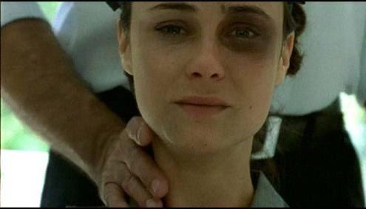
Human Sex Trafficking and
Health Safety
Sex Trafficking is sexual coercion.
Women and girls also are trafficked into industries
other than the commercial sex industry
Sex trafficking victims are modern-day slaves, and thus are unable to make choices about or control some aspects of their lives, including their sexual activity.
Kloer, A. (2010). Sex trafficking and HIV/AIDS: A deadly junction for women and girls. Human Rights, 37, p 8-10.
Notes:
Including agricultural work, factory work, domestic servitude, and the service industry.
Women and girls enslaved in commercial sex also are forced to endure sex
with multiple partners,
many of whom may also have had unprotected sex with multiple partners

Slide 31
Human Sex Trafficking and
Health Safety Risks
Among adolescent sex trafficked victims, rates of condom use may be suboptimal.
Greenbaum et al. (2015) study reported:
  50% of victims reported using condoms “often/always,”
  45% had an STI at the time of the visit and
  31% reported a history of pregnancy.
Counseling on STIs and the importance of condom use may be extremely important for the child's future health.
Victims held in brothels where condoms are made available, may not be encouraged or able to enforce condom usage along with other safer sex practices.
Greenbaum VJ, Dodd M, McCracken C (2015). A short screening tool to identify victims of child sex trafficking in the health care setting. Pediatr Emerg Care
Notes:
The Centers for Disease Control and Prevention has specific recommendations for hepatitis B and human papillomavirus vaccination, as well as HIV prophylaxis

Slide 32
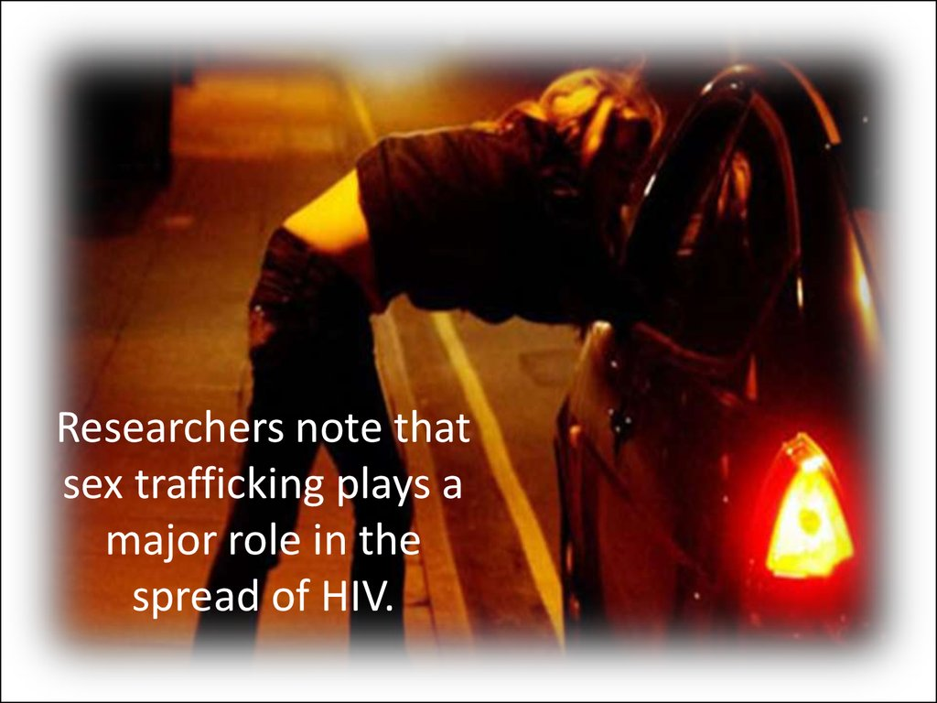
Sex Trafficking and
Risk for HIV
Victims of Human Sex Trafficking must endure the riskiest types of unprotected sex,
  such as anal sex,
  injurious sadomasochism,
  violently abusive sex, which increases their risk of transmission.
Victims are at increased risk of HIV transmission because they are more vulnerable to assault and rape in these settings.
They may also not have or have limited access to testing and treatment for HIV during their enslavement.
Kloer, A. (2010). Sex trafficking and HIV/AIDS: A deadly junction for women and girls. Human Rights, 37, p 8-10.
http://cf.ppt-online.org/files/slide/k/KRLkt5vEdmZfG6o1ipaIxs8BX9TcyFbPgD2MYw/slide-42.jpg
Notes:
Often injuries inflicted don’t heal properly, as traffickers force victims to continue to serve clients without seeking medical attention.

Slide 33
Risks of Sex Trafficking among
Children and Young Teens
Children and young teens have developing bodies more susceptible to the genital tearing
Less likely to be in control of choices than adults, less education on safer practices, and less opportunity to insist on condom use.
Some men seek ever younger children for sex, (believing it would reduce the incidence of HIV transmission)
In turn, today, younger children are being recruited into prostitution, which provides a longer period during which they can become HIV-infected
Kloer, A. (2010). Sex trafficking and HIV/AIDS: A deadly junction for women and girls. Human Rights, 37, p 8-10.

Slide 34
Health Professional Role after identification of health related risks
Identify and treat all conditions with much education and counseling
If consented to testing, when HIV or another STI is suspected, a point of care single-dose treatment modality would be preferable to a recurring-dose, multiple-day treatment plan that carries a higher risk of nonadherence.
Similarly, while pre-exposure prophylaxis (PrEP) can reduce the risk of HIV seroconversion, PrEP requires daily medication adherence and regular follow-up visits for refills to prevent infection and antiviral resistance.
Because many patients do not follow up after the initial visit, the provider should consider offering presumptive treatment of chlamydia, gonorrhea, and trichomonas, as well as emergency contraception (as indicated)- sometimes can be done in the setting

Slide 35
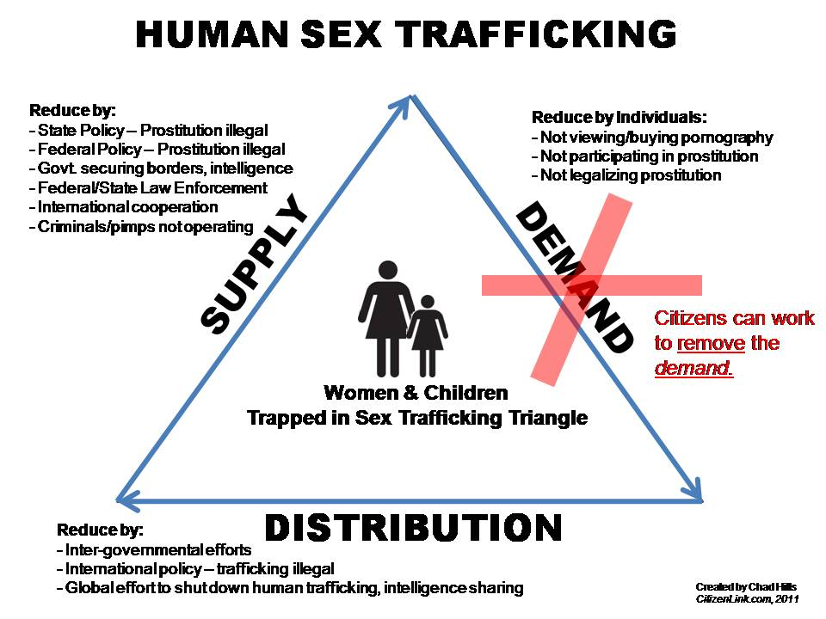
Conclusion
Human Trafficking is a complex issue requiring interventions from many areas to help reduce the incidence
Laws need to be implemented and reinforced to support the victims
Better education for both health care professionals and law enforcement to help increase awareness of the public health issue
Support victims and those at risk on many levels
  Support self esteem and self worth
  Support programs to assist them out of impoverished situations
  Address problems of poverty and lack of education for every child, adolescent and adult

Slide 36
References
    Donley-Hayes, K. (2014). The Sex Trafficked Child. Contemporary Pediatrics, 31. pg. 28-31.
Farrell, A., and Fahy, S. (2009). The problem of human trafficking in the U.S.: Public frames and policy responses.
Journal of Criminal Justice, 37. pg. 617–626
Greenbaum, V., Dodd, M., & McCracken, C. (2015). A Short Screening Tool to Identify Victims of Child Sex Trafficking
in the Health Care Setting. Pediatric Emergency Care, doi:10.1097/PEC.0000000000000602
Greenbaum, J. (2017). Identifying human trafficking victims in the Emergency Department. Clinical Pediatric
Emergency Medicine, 17, pg.. 241-248.
Kloer, A. (2010). Sex trafficking and HIV/AIDS: A deadly junction for women and girls. Human Rights, 37, p 8-10.
Lederer, LI & Wetzel CA (2014). The health consequences of sex trafficking and their implications for identifying
victims in healthcare facilities. Annals of Health Law, 23, (1) pg.. 61-87
Macias-Konstantopoulos, W.L. (2017). Caring for the trafficked patient: Ethical challenges and recommendations for
health care professionals Journal of Ethics, 191, pg. 80-90.
Richards, T. (2014). Health implications of human trafficking. Nursing for Women’s Health, 16,pg. 155-162
Sousou Coppola, J. and Cantwell, E.R. (2016). Health professional role in identifying and assessing victims of human
labor trafficking, The Journal of Nurse Practitioners, 12, e193-e.199.
Sousou Coppola, J. & Cantwell, E.R (2017). Identifying Awareness of Human Trafficking among Clinical Nurses in New
Jersey, in progress.
Wirth, K. E, Tchetgen E.J.T, Silverman, J.G., & Murray, M.B (2013). How does sex trafficking increase th risk of HIV
infection? An observational study from Southern India. American Journal of Epidemiology, 177, pg. 232-241.

