Slide 1
SPERM DNA FRAGMENTATION IN RECURRENT ICSI FAILURE
Prof. ALI METAWIE MSC Degree
Director of Enjab fertility centers in Portsaid and Damietta(EGYPT

Slide 2
Conventional semen analysis remained the only routine diagnostic test for male infertility, despite the lack of capability in discriminating infertile from fertile men.
Up to 40% of infertile men have semen parameters within normal reference ranges.
Sperm DNA fragmentation provides more detailed information than conventional semen analysis.

Slide 3
Items to be discussed in Sperm DNA Fragmentation:
Definition
Pathogenesis
Impaction on fertility
Who should be offered the test?
Available tests
How to reduce SDF ?

Slide 4
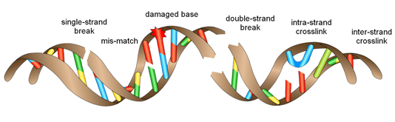
Definition of Sperm DNA Fragmentation
It is the breakage of Sperm DNA into fragments due to alteration in chromatin configuration.
It could be in any of the following forms:

Slide 5
2) Pathogenesis of SDF:
Protamination Failure: The protamines are replaced with histones
Oxidative Stress: Uncontrolled and excessive production of Reactive oxygen species (ROS), this could be through varicocele, leucocytes, immature sperms, or through extrinsic factors
Apoptosis: During sperm maturation (mainly in the epididymis)
Other risk factors: eg. Smoking, Radiation, Infections, Diabetes, Drugs.

Slide 6
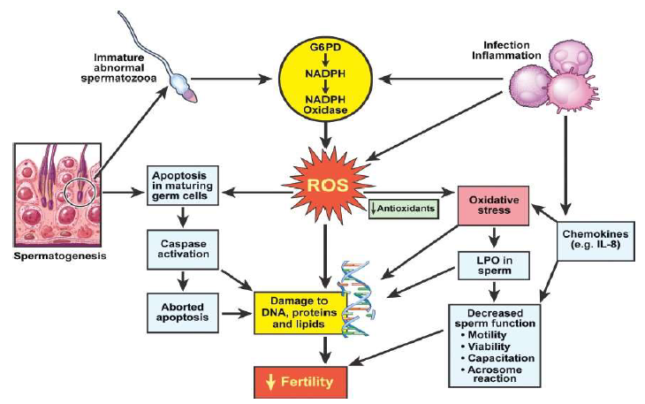

Slide 7
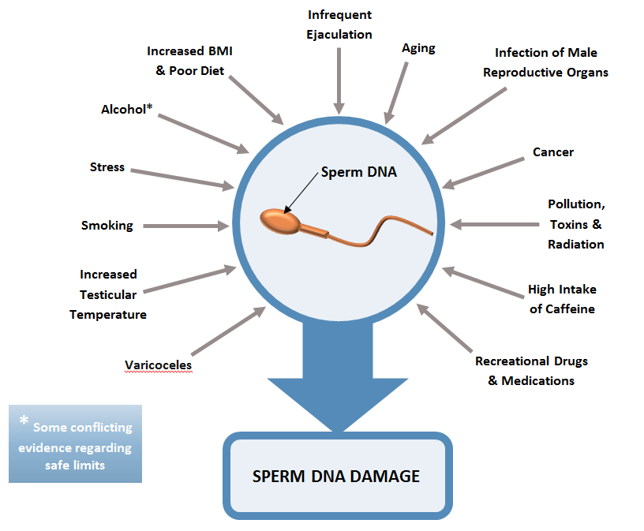
Other Risk factors associated with SDF

Slide 8
3)Sperm DNA fragmentation impaction on fertility:
It is associated with infertility.
It affects clinical pregnancy following ICSI cycles through affecting:
Embryo quality.
Implantation rates.
Increases miscarriage rates, and also it is a cause of recurrent miscarriage.

Slide 9
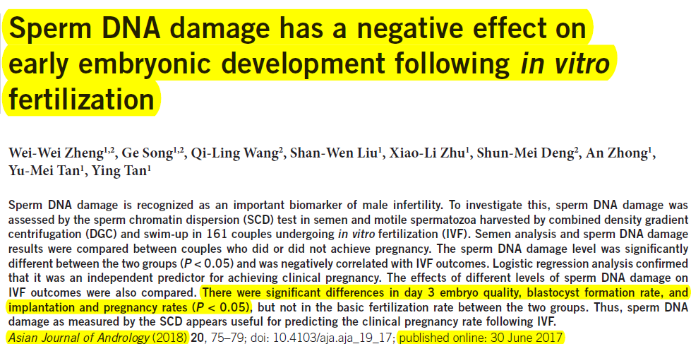

Slide 10
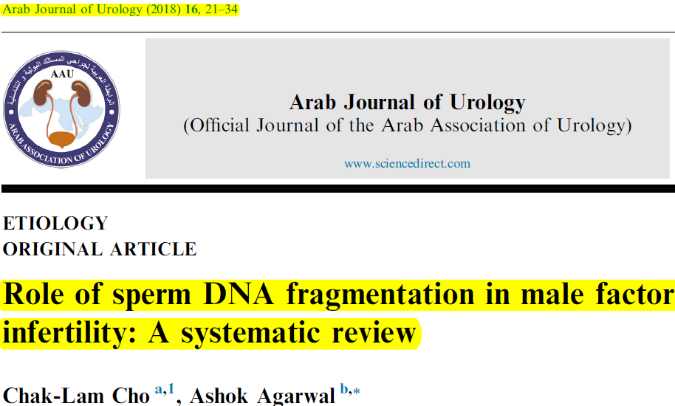
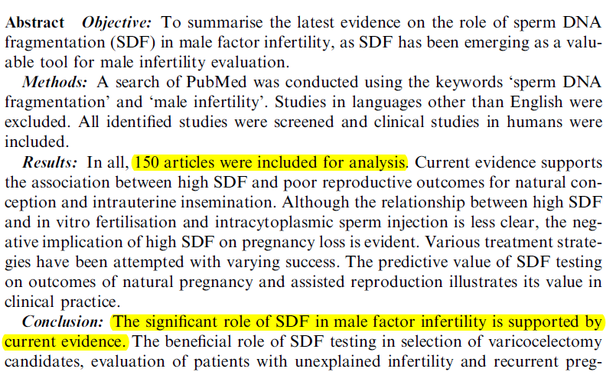

Slide 11
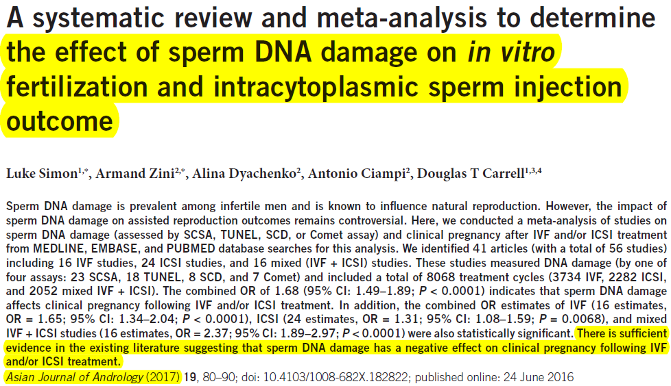

Slide 12
4) Who should be offered SDF testing?
1. Clinical varicocele
Patients with Grade 2/3 varicocele with normal conventional semen parameters.
Patients with Grade 1 varicocele with borderline/abnormal conventional semen parameter results.
2. Unexplained infertility/ Recurrent pregnancy loss/ IUI failure.
3. Recurrent IVF and/or ICSI failure.
4. Abnormal semen analysis, or even normal semen analysis with lifestyle risk factors.
Vandekerckhove, F. (2017). Guidelines on sperm DNA fragmentation testing

Slide 13
5) Sperm DNA Fragmentation testing:
It’s results are more significant, and are complementary to conventional semen analysis.
It reflects the overall sperm quality.

Slide 14
Assessment of Sperm DNA Fragmentation is through:
Direct testing: Measure the extent of sperm DNA damage by using probes at site of damage, eg. TUNEL
Indirect testing: Assess the susceptibility of DNA to denaturation that occurs more commonly in fragmented DNA, eg. Sperm chromatin structure assay “SCSA”; Comet assay; and sperm chromatin dispersion test “SCD”.
Chromatin compaction: Using staining with Aniline blue.
Gosálbez et al 2013

Slide 15
TUNEL Test (Terminal deoxynucleotidyl transferase dUTP Nick End Labelling)
It targets directly the DNA strand breaks in the sperm DNA, therefore, it is highly sensitive, however it is expensive and difficult to be done as it needs flow cytometry and fluorescent microscopy.
Sharma, R., Ahmad, G., Esteves, S. C., & Agarwal, A. (2016)

Slide 16
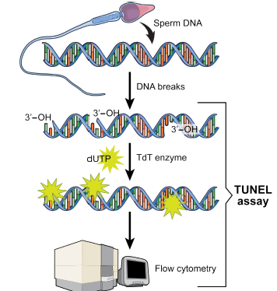

Slide 17
Sperm Chromatin Structure Assay (SCSA)
It detects indirectly the damaged sperm DNA.
It is based on the susceptibility of DNA breaks to acid denaturation.
Low pH treatment opens the DNA strands at the sites of breaks.
This utilizes the metachromatic properties of acridine orange to distinguish Single stranded “damaged” (Red fluorescence) and Double stranded DNA “intact” (Green fluorescence).
The DNA Fragmentation Index (DFI) is the ratio of percentage of sperms showing Red fluorescence/ Total fluorescence (Red + Green)

Slide 18
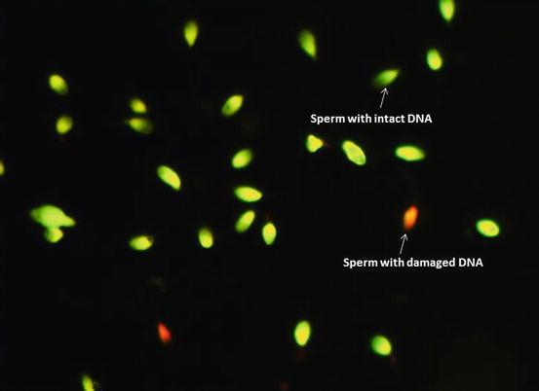
A DNA fragmentation index of ≥25% predicts negative pregnancy outcomes.
Evenson DP (2013)
Sperm Chromatin Structure Assay

Slide 19
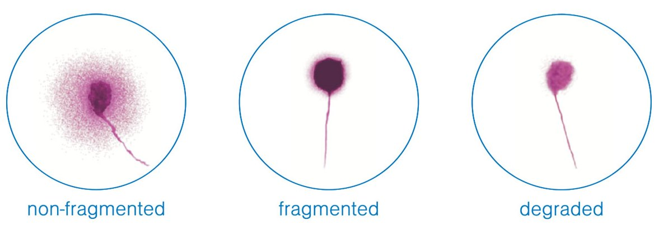
Sperm Chromatin Dispersion test “SCD”
Susceptibility for denaturation of broken strands of DNA.
The difference in the pattern of Halo around lysed and acid treated nuclear membrane reflects the chromatin structure

Slide 20
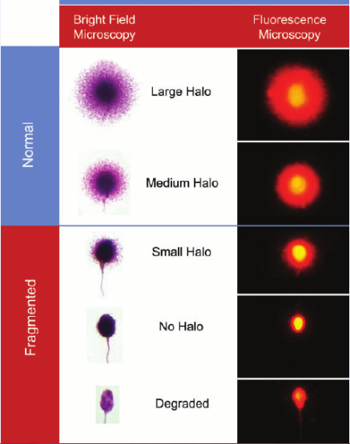
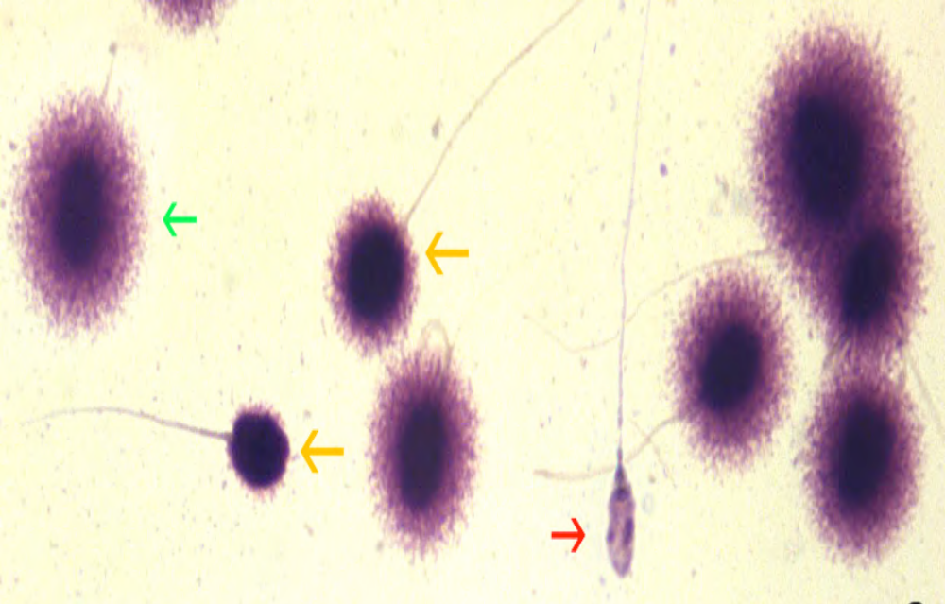

Slide 21
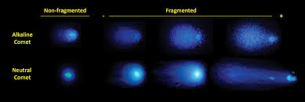
Comet Assay
Sperm DNA breaks move away from the head region to form comets following electrophoresis, while as intact DNA remains in the actual head position.

Slide 22
6) Strategies To Reduce Sperm DNA Fragmentation:
Antioxidants.
Modification of life style
Decrease the incidence of iatrogenic SDF.
Decrease exposure to Reactive Oxygen Species.
Sánchez-Martín et al 2013

Slide 23
Antioxidants
It decreases the percentage of DNA fragmentation; and it improves the rates of clinical pregnancies & live birth rates.
Antioxidants are prescribed for minimum 2 months
Example of antioxidants:
Vitamin C 500 mg
Vitamin E 400 mg
Folic acid 2 mg
Zinc 25 mg
Selenium 26 mcg
Esteves & Agarwal. Int Braz J Urol 2011.

Slide 24
II. Modification of life style: Through cessation of smoking, better diet,…
ΙΙΙ. Decrease the incidence of iatrogenic Sperm DNA Fragmentation:
Avoid iatrogenic SDF during lab sperm handling.
Density gradient centrifugation: 22%-44% reduction in SDF

Slide 25
IV. Decrease exposure to Reactive Oxygen Species:
Decrease Abstinence period: Serial ejaculation every
24 hours for 4 days reduces SDF by 25%.
Treatment of Male Genital Tract Infections
Management of varicocele
Testicular Sperm Aspiration (TESA)
(Gosalbez at al. Fertil Steril 2011)

Slide 26
Management of varicocele patients
According to the American Urological Association (AUA), the varicocele repair should be limited to male patients complaining of infertility with Grade II or III with the presence of significant DNA fragmentation.

Slide 27
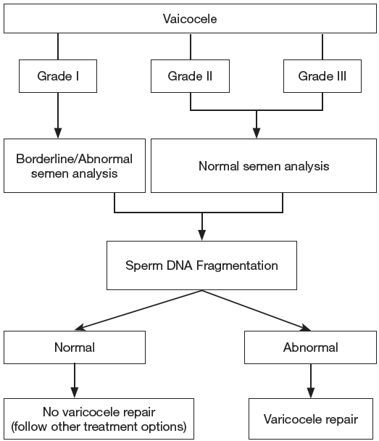


Slide 28
Testicular Sperm Aspiration (TESA)
In cases of high Sperm DNA Fragmentation, the Testicular Sperm Aspiration showed 3 or more less DNA fragmentation than in ejaculate sperms.
TESA avoids the excess exposure of sperms to Reactive Oxygen Species in the epididymis.

Slide 29
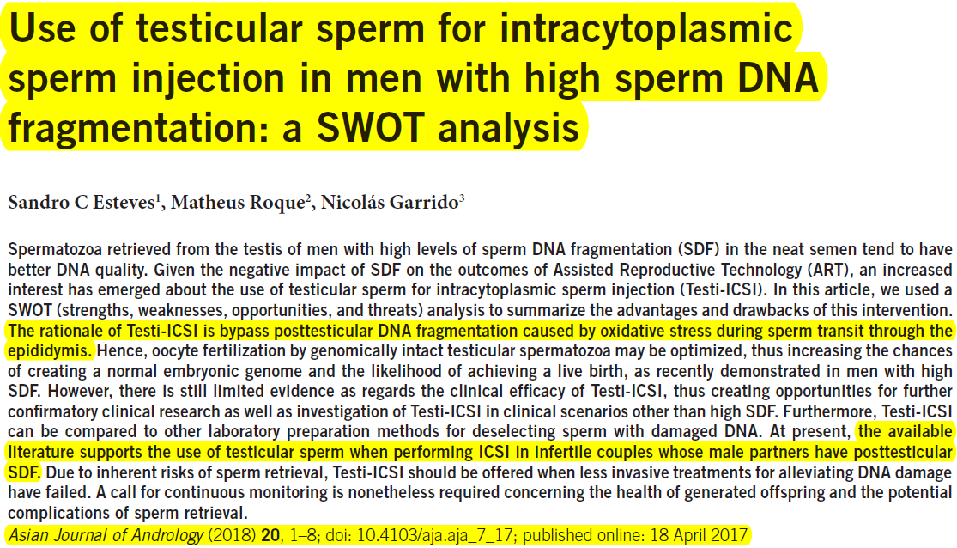

Slide 30
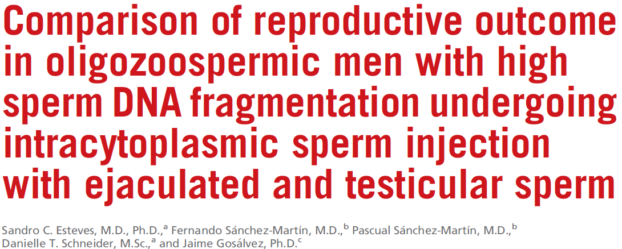
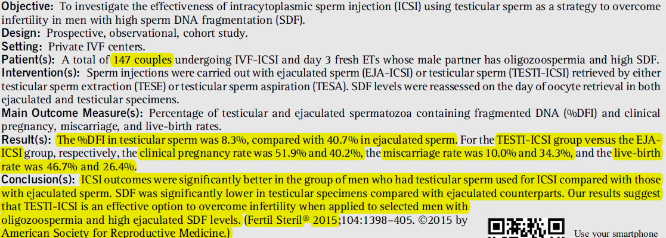

Slide 31
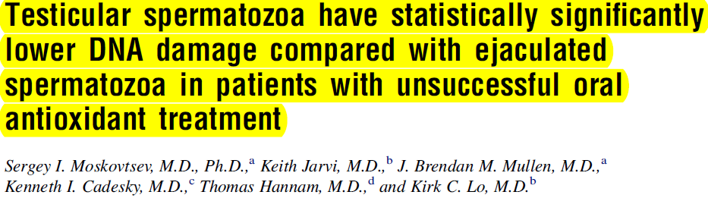
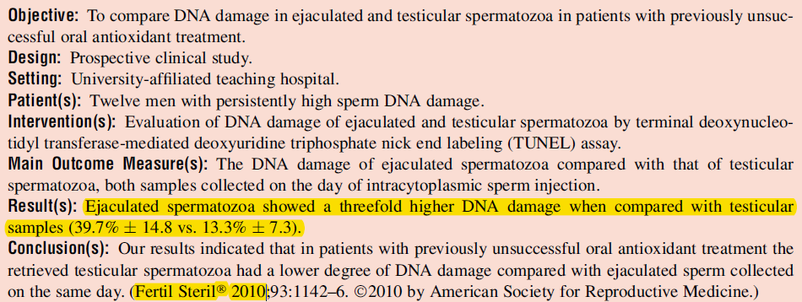

Slide 32
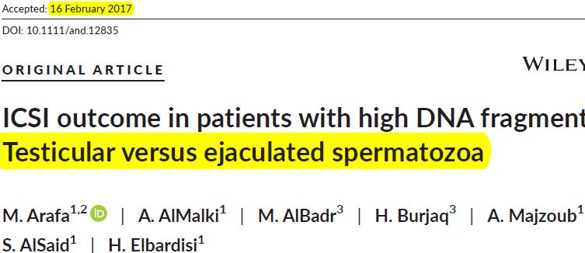
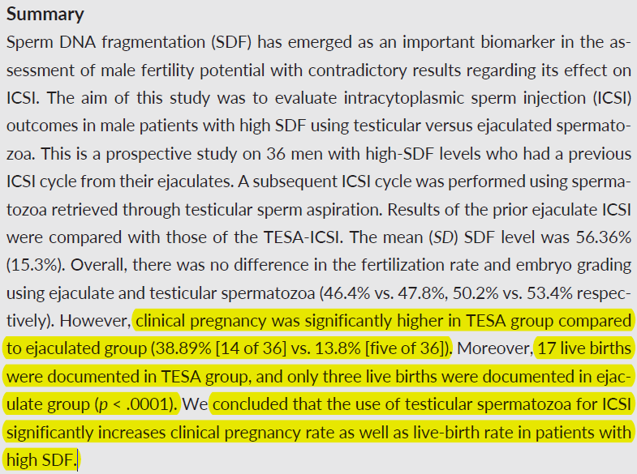

Slide 33
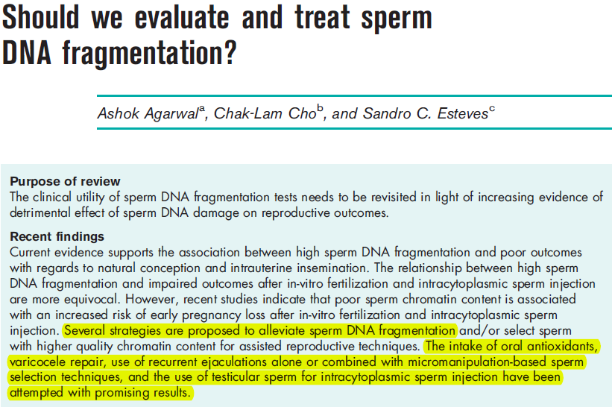
Agarwal et al.2016

Slide 34


