Slide 1
Dynamical Augment in Mining Healthcare Datasets
John Heironimus, Emma Heironimus
Abstract
Statistical processes commonly applied to healthcare datasets can overlook important dynamical relationships. However, understanding dynamicals often involves complex and expensive modeling. We demonstrate a simple approach to “dynamical data mining” using Fourier transform and the Kuramoto model. We compare results from this approach to cross correlations using CDC’s ICD-113 data (1999-2016).
We find that the ICD-113 is a synchronous anti-phase nodal system much like the spontaneous synchrony of pendulum clocks observed by Christiaan Huygens in 1665 (see image). It is a state of order in which ICDs are related phasally about common frequencies. We find that about 20% of these phasal relationships are novel to the statistical approach and corroborated by research findings. Many of these novel insights appear to be complex time series relationships suggesting stronger linkages between initial conditions/care and final causes of death than statistics would typically reveal.
ICD-113’s state of order remains stable even as the mix of ICDs changes. This suggests that declining US healthcare productivity is perhaps more attributable to complex dynamical relationships within the system than to rising obesity or opioid abuse rates as often hypothesized. Given the system’s stable state of order, we can simulate the impact of changing incidence of any one condition on all others without consideration of causality.
As a synchronous system can reflect the influence of external factors, we also consider the possible influence of solar cycles. Using the SILSO dataset, we find consistency with ICD-113 (see image). Each ICD’s phasal relationship to individual solar cycles allows us to infer its most likely time series relationship and possibly forecast future incidence on the same basis.
We offer several detailed examples of all points in our paper and conclude that simple “dynamical mining” offers an important augment to statistical processing of healthcare datasets.
Biography
John Heironimus is an independent consultant in dynamical modeling of human populations and principal of Fleming Scientific. Emma Heironimus is a dual enrollment student at University of Louisville involved in trauma research

Slide 2
CDC ICD-113 (Complex Plane), Anti-phase Avg Order Parameter = 0.9
CDC ICD-113 ( C=1) vs Sun Spot 18 Yr Cycles
CDC ICD-113 ( C=1) vs Sun Spot 18 Yr Cycles
Components:

Slide 3
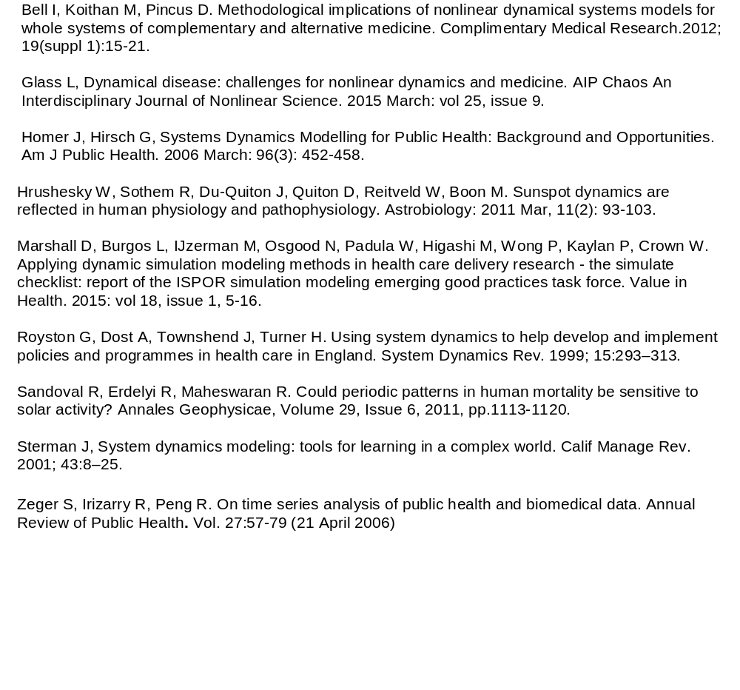
References:

