Slide 1
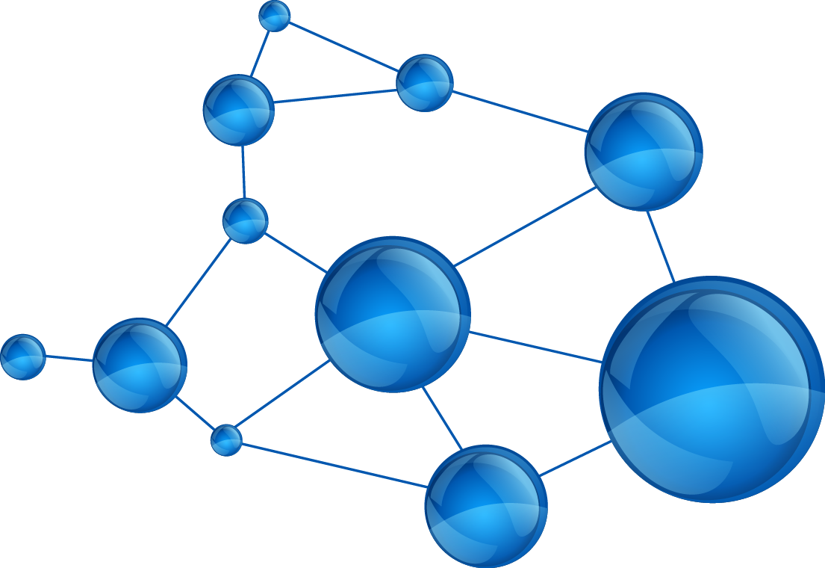
TRANSITION METAL COMPLEXES/ORGANOMETALLIC
COMPOUNDS AS ANTICANCER/ANTI HIV DRUGS
Project Presentation by
Prof. K.M.M.S. Prakash

Slide 2
TRANSITION METAL COMPLEXES/ORGANOMETALLIC
COMPOUNDS AS ANTICANCER DRUGS
Inorganic chemotherapy has been considerably boosted in recent years by the discovery and exploitation of Antitumor compounds based on platinum. Some Gold(III) complexes display similar chemistry.
Pharnmacological activity to cis-platin and its analogues are now the basis of multimillion dollars industry and bring benefit to thousands of cancer patients.
Platinum based anticancer drugs induces normal tissue toxicity particularly to the kidneys and thus alternative metal compounds are presently being evaluated in clinical trials .
General biological uses for Metal containing drugs:
Au, Arthritis, cancer
Ag , Antisceptic agent
Ga, antitumor agent
Pt, Pd, Antitumor agent
Ru, Rh and Os, Antitumor agents

Slide 3
TRANSITION METAL COMPLEXES/ORGANOMETALLIC COMPOUNDS AS ANTICANCER DRUGS
Many metals are waiting in the wings for biomedical applications including organotin polymers and platinum polymers. Many more may emerge in the near future as signaled by the activity of the small molecules containing metals as drugs.
Anti tumorapplcations of Transition Metal complexes:
Platinum complexes are applied in half of all chemotheraupeticschemesainst a wide range of tumors. The best known drug is cis-platin.
The design and testing of gold complexes for antitumor activity over the past several decades is based on two rationales:
  Anologies between square planar complexes of Pt(II)and Gold(III)both of which are d8 ions.
  Complexation of gold(I) and gold(III)with known antitumor agents to form new compounds with enhanced activity.

Slide 4
TRANSITION METAL COMPLEXES/ORGANOMETALLIC COMPOUNDS AS ANTICANCER DRUGS
TRANSITION METAL COMPLEXES/ORGANOMETALLIC COMPOUNDS AS ANTICANCER DRUGS
Some of the gold complexes tested for anticancer activity are:
Auronofin
Au(N-Methylimidazole)Cl3
Au(2-Methylbenzoxazole)Cl3
Au(2,5-dimethylbenzoxazole)Cl3
Au(damp)cl2
Au(damp)(SCN)2
Au(damp)(OAc)2
1. Specific Aims:
Synthesis and Characterisation of Gold and Other Transition Metal complexes- Anti cancer activity studies:
Inorganic chemotherapy has been considerably boosted in recent years by the discovery and exploitation of anti-tumour compounds based on platinum.

Slide 5
TRANSITION METAL COMPLEXES/ORGANOMETALLIC COMPOUNDS AS ANTICANCER DRUGS
The active entities are complexes of platinum(ll) which, after metabolism, bind to guanine residues of DNA and inhibit the catastrophic replication characteristic of tumour growth.
Gold(lll) complexes display similar chemistry and pharmacological activity to cisplatin; it is now intended to explore a greater variety of gold complexes.
My personal views are in (a) expanding this area of co-ordination chemistry, (b) obtaining and screening materials with enhanced biological activity, and (c) examining the organ distribution following administration of the compounds.
The results would certainly be of potential essential scientific, medical and commercial significance.
Cisplatin and its analogues are now the basis of a multimillion-dollar industry , and bring benefit to thousands of cancer patients;
gold compounds may prove equally useful. Gold Analogues of Cisplatin The results are of potential scientific, medical and commercial significance.

Slide 6
TRANSITION METAL COMPLEXES/ORGANOMETALLIC COMPOUNDS AS ANTICANCER DRUGS
Cisplatin and its analogues are now the basis of a multimillion-dollar industry and bring benefit to thousands of cancer patients; gold compounds may prove equally useful.
The compounds mentioned above are the first gold(lll) complexes to have been rigorously shown to have substantial and useful biological activity.
It is therefore necessary to explore the rational synthesis of additional materials of this type, to screen their pharmacological properties, and to investigate the relevant chemistry and biochemistry.
Hence several complexes of Gold, Platinum, Palladium and Ruthenium would be synthesized from various schiff’s bases of Substituted Isatin, SubstitutedIndoles, Chromones and substituted chromones and other extremely novel ligands and Their Anticancer and Anti-HIV studies would be performed.
New antuicancer drugs would be discovered, and If some very important drugs result, they would be patented.
Synthesis and Biological Evolution of Novel Analogues of Flavonoids and Their Metal complexes: Mechanism of Induced apoptosis in Human Cancer Cell Lines : Pancreatic, Breast and Prostrate Cancer.

Slide 7
TRANSITION METAL COMPLEXES/ORGANOMETALLIC COMPOUNDS AS ANTICANCER DRUGS
The main Objectives and Aims of the proposed work are:
Synthesizing analogues of flavonods, polyphenols vizgenestein, curcumin, resveratrol, Flavopiridol and Dim : 3-3-diindolylmethane, docetaxel, drugs like gemcitabine etc and other naturally occurring compounds of extreme interest.
Study their biological properties employing highly advanced techniques.
Combining the flavonoids, Quercetin,genestein, curcumin, gemcitabin, reservatrol, DIM as precursors with the above mentioned ligands like Diamines, Hydraazones, thiosemicarbazones with our structure based focused approach leading to the identification of bioactive pharmacophores appended to the specially interesting and important moieties involved
These are capable of metal conjugation with especially copper, gold, platinum, ruthenium, zinc and cadmium with potent and enhanced antitumor activity more than the parent compounds.
The studies proposed are:
Chemical: synthesis and charecterization of some Organometallic compounds using advanced spectroscopic techniques like Multinuclei NMR, FT-IR, UV-Vis, ESR, Raman, Thermal, Electrochemical, Modelling and Magnetic and X-Ray diffracrtion Studies.
Biological: Anticancer studies, Cytotoxicity, Apoiptosis, DNA binding studies, Structure Activity relationship studies, and other Cancer biology studies and assays.

Slide 8
TRANSITION METAL COMPLEXES/ORGANOMETALLIC COMPOUNDS AS ANTICANCER DRUGS
The studies proposed are:
Chemical: Synthesis and charecterization of some Organometallic compounds using advanced spectroscopic techniques like Multinuclei NMR, FT-IR, UV-Vis, ESR, Raman, Thermal, Electrochemical, Modelling and Magnetic and X-Ray diffracrtion Studies.
Biological: Anticancer studies, Cytotoxicity, Apoiptosis, DNA binding studies, Structure Activity relationship studies, and other Cancer biology studies and assays.
Au(III)ISATIN THIOSEMICARBAZONE COMPLEXES
Gold is one of the most promising metals and its compounds are regarded as promising alternatives in cancer therapy and offer many approaches to innovative Metallopharmaceuticals.
Thiosemicarbazones are a class of compounds whose biological activity is enhanced by the functional groups of the parent aldehyde or ketone [1].
In cancer treatement metal chelates are more potent than the chelating agents[4].

Slide 9
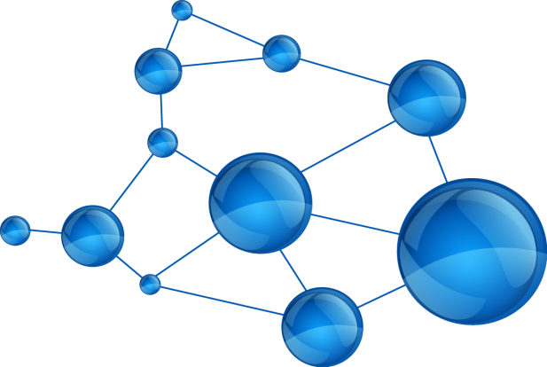
TRANSITION METAL COMPLEXES/ORGANOMETALLIC COMPOUNDS AS ANTICANCER DRUGS
The Isatin molecule (1H-indole-2, 3-Dione) is a versatile moiety that displays diverse biological activities , including anticancer activity. N-alkylated indoles have also been reported to exhibit anticancer activity Indoles derivative vincristine and vinblastine is mainly useful for treating Hodgkin's disease, lymphocytic lymphoma, histiocytic lymphoma, advanced testicular cancer, advanced breast cancer.
The derivatives of Isatin-3-thiosemicarbazones exhibit a broad spectrum of biological activity. A full range of gold compounds have been investigated for their potential as anti-tumor agents toward several human tumor cell lines and evaluated in vitro using a systematic screening strategy for their utilization in cancer therapy.
The structural features from the spectroscopic and other studies qualify Gold(III) compounds as a promising class of cytotoxic agents of outstanding interest or cancer treatment.

Slide 10
TRANSITION METAL COMPLEXES/ORGANOMETALLIC COMPOUNDS AS ANTICANCER DRUGS
Synthesis of Ligands:
Isatin thiosemicarbazones and substituted Isatin Thiosemicarbazones were synthesized by condensing equimolar solutions (0.01M) of Isatin and thiosemicarbazide / 4- substituted thiosemicarbazides in methanol in the presence of few drops of acetic acid.
The solution after mixing was refluxed on water bath for 2hrs , filtered and the filtrate was concentrated to half the volume. Crystals were obtained on cooling the solution . The crystals were separated and recrystallised from Ethanol.
Synthesis of metal complexes :
A Solution of Au cl3 was added to Ligand s( 10-3 mole ) in ethanol and the reaction mixture was refluxed for 3 hrs .The resulting coloured precipitate was washed several times with methanol and the resulting precipitate was dried in a descicator over anhydrous CaCl2.

Slide 11
TRANSITION METAL COMPLEXES/ORGANOMETALLIC COMPOUNDS AS ANTICANCER DRUGS
The analytical data of the synthesized Au(III)-Isatin Thiosemicarbazone complexes is given in Table.1:
S. No | Compound | Mp | % yield | Analytical data %, cate (Found)
 |  |  |  | C | H | N
1 | [Au(L₁)cl₂]cl |  |  | 20.57 (20.55) | 1.51 (1.49) | 10.73 (10.71)
2 | [Au(L₂)cl₂]cl |  |  | 22.50 (22.45) | 1.66 (1.65) | 10.33 (10.31)
3 | [Au(L₃)cl₂]cl |  |  | 23.90 (23.85) | 2.10 (2.09) | 10.30 (10.25)
4 | [Au(L₄)cl₂]cl |  |  | 25.35 (25.32) | 2.45 (2.41) | 9.81 (9.79)
5 | [Au(L₅)cl₂]cl |  |  | 31.05 (31.45) | 2.39 (2.38) | 9.36 (9.31)
6 | [Au(L₆)cl₂]cl |  |  | 31.47 (31.45) | 2.46 (2.41) | 9.25 (9.22)
7 | [Au(L₇)cl₂]cl |  |  | 31.29 (31.25) | 3.15 (3.11) | 8.91 (8.89)

Slide 12
TRANSITION METAL COMPLEXES/ORGANOMETALLIC COMPOUNDS AS ANTICANCER DRUGS
Synthesis of metal complexes :
A Solution of Au cl3 was added to Ligand s( 10-3 mole ) in ethanol and the reaction mixture was refluxed for 3 hrs .The resulting coloured precipitate was washed several times with methanol and the resulting precipitate was dried in a descicator over anhydrous CaCl2.
The analytical data of the synthesized Au(III)-Isatin Thiosemicarbazone complexes is given in Table.1:
S. No | Compound | Mp | % yield | Analytical data %, cate (Found)
 |  |  |  | C | H | N
1 | [Au(L₁)cl₂]cl |  |  | 20.57 (20.55) | 1.51 (1.49) | 10.73 (10.71)
2 | [Au(L₂)cl₂]cl |  |  | 22.50 (22.45) | 1.66 (1.65) | 10.33 (10.31)
3 | [Au(L₃)cl₂]cl |  |  | 23.90 (23.85) | 2.10 (2.09) | 10.30 (10.25)
4 | [Au(L₄)cl₂]cl |  |  | 25.35 (25.32) | 2.45 (2.41) | 9.81 (9.79)
5 | [Au(L₅)cl₂]cl |  |  | 31.05 (31.45) | 2.39 (2.38) | 9.36 (9.31)
6 | [Au(L₆)cl₂]cl |  |  | 31.47 (31.45) | 2.46 (2.41) | 9.25 (9.22)
7 | [Au(L₇)cl₂]cl |  |  | 31.29 (31.25) | 3.15 (3.11) | 8.91 (8.89)

Slide 13
TRANSITION METAL COMPLEXES/ORGANOMETALLIC COMPOUNDS AS ANTICANCER DRUGS
Where L₁ = Istatin TSC, L₂ = Istatin methyl TSC, L₃ = Istatin Methyl TSC, L₄ = Istatin isopropyl T
L₅ = Istatin benzyl TSC L₆ = Istatin Paratolyl TSC L₇ = Istatin cyclohexyl TSC
IR Spectra: Table 2 important bands (cm¹ ) in the IR spectra of the Au (III)-Isatin TSC complexes:
Compound | vNH | vC=0 | vskeleton | vN-N | vCS+CN | vCH+
[Au(L₁)cl₂]cl | 3153 | 1694 | 1620 | 1113 | 1280 968 | 1523 1460
[Au(L₂)cl₂]cl | 3485 | 1696 | 1620 | 1113 | 1384 1041 | 1583 1464
[Au(L₃)cl₂]cl | 3403 | 1699 | 1618 | 1113 | 1295 979 | 1571 1464
[Au(L₄)cl₂]cl | 3428 | 1704 | 1619 | 1118 | 1268 983 | 1560 1488
[Au(L₅)cl₂]cl | 3188 | 1698 | 1615 | 1114 | 1297 977 | 1563 1488
[Au(L₆)cl₂]cl | 3155 | 1689 | 1616 | 1141 | 1339 1189 | 1534 1462
[Au(L₇)cl₂]cl | 3429 | 1692 | 1619 | 1181 | 1263 982 | 1528 1466

Slide 14
TRANSITION METAL COMPLEXES/ORGANOMETALLIC COMPOUNDS AS ANTICANCER DRUGS
In case of all complexes, the spectra reveal that the bond having a maximum at 1740 cm⁻¹ in the free ligand is shifted to lower wave number, the shift being 26-35cm⁻¹. This shift indicates that the carbonyl oxygen atom of the Isatin residue is one of the coordinating sites.
The band due to vNH vibration mode in Isatin having maximum at 3190cm⁻¹ in the free ligand, remains largely unaffected in the chalates indicating thereby the non participation of this group in co ordination.
This shifting of v(c=s ) 874 cm¹ towards lower side by v 20-30cm ⁻¹ suggests the involvement of sulphur in coordination. We can therefore conclude that the ligands act as bidentate , the coordination occurring through v(C = S) and v (C=0).
HNMR Spectra :
Supplementary data have been obtained by 1H and ¹³C NMR Spectra which were recorded for the ligands and their Au(III) complexes.HNMR Spectra of the ligand can be resolved into three distinct region.
The spectra exihibit two multiplets at 6.94-7.68 and 6.3 – 6.8 pm due to the Isatin and amine aromatic rings respectively and one singlet at 10.3 ppm due to the Isatin NH residue.
The only 1H.N.M.R signal displaying a downfield shift incomplex compounds (from 10.3 to 11.24 pm) are those associated with the hydrogen of the Isatin NH residue.

Slide 15
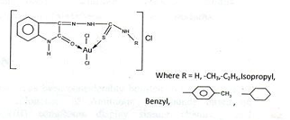
TRANSITION METAL COMPLEXES/ORGANOMETALLIC COMPOUNDS AS ANTICANCER DRUGS
This behavior is related with a decrease of the election density and deshielding of the NH Proton as a result of the participation of the adjacent carbonyl oxygen in co ordination[5,6] .
This behaviour is in good agreement of the >C = 0 vibration mode appear at regular with the corresponding free lignads.
From above discussion it is proposed that all Au (III) TSC complexes are square planner in geometry, and the structure of the complexes have been proposed.

Slide 16
TRANSITION METAL COMPLEXES/ORGANOMETALLIC COMPOUNDS AS ANTICANCER DRUGS
Antiproliferative Effects: In vitro cytotoxicity assays were performed to get an insight into the antitumor activity of the novel gold complexes. All complexes as well as the established antitumor drug cisplatin were screened against MCF-7 and MDA-MB 231 breast cancer cells according to established procedures.^{1,2,3} IC₅₀ values determined after 72 h incubation are shown in Table 1.
Cisplatin characteristically reduced the cell growth of MCF-7 (IC₅₀ = 1.67 μM) and MDA-MB 231 (IC₅₀ = 3.95 μM) cells.
Compound |  | MCF-7 IC₅₀ [µM]ª | MDA-MB-231 IC₅₀ [µM]ª
Cisplatin |  | 1.67 | 3.95
ITAu | H | 5.98 | 1.33
ImAu | Methyl | 1.38 | 1.39
IetAu | Ethyl | 1.79 | 2.46
IIpTAu | Isopropyl | 1.96 | 2.31
IBTAu | Benzyl | 0.79 | 0.93
IPtAu | 4-methylphenyl | 2.48 | 4.45
IcyheAu | Cyclohexyl | 1.10 | 1.22
The IC₅₀ values represent the concentration results in a 50% decrease in cell growth after 72 h incubation.

Slide 17
TRANSITION METAL COMPLEXES/ORGANOMETALLIC COMPOUNDS AS ANTICANCER DRUGS
The lead compound ITAu was distinctly less active than cisplatin at the MCF-7 cell line (IC50 = 5.98 µM), while it was 3 fold more active against MDA-MB-231 cells (IC50 = 1.33 µM).
The cytotoxicity of the isatin gold complexes depended on the substituent at the thiosemicarbazone moiety. An N-methyl group increased the activity against MCF-7 cells (IC50 = 1.38 µM) but did not change activity at the MDA-MB-231 cell line.
Interestingly, N-ethyl or N-isopropyl chains reduced the growth inhibitory effects only at MDA-MB-231 cells (IC50 = 2.46 and 2.31 µM, respectively). However, both compounds are still more effective than cisplatin.
The best results were achieved with the benzyl derivative. IBTAu caused growth inhibition of MCF-7 and MDA-MB-213 cells at nanomolar concentrations (IC50 = 0.79 and 0.93 µM).
Exchange of the benzyl residue by p-toluolyl moiety (IPTAu) strongly reduced the cytotoxic potency to IC50 = 2.48 and 4.45 µM, respectively. It is to metion that IcyheAu with an N-cyclohexyl moiety (IC50 = 1.10 and 1.22 µM) was only marginally less active than IBTAu.
These data clearly document that the in vitro antitumor potency and the terminal N-substituents determine the tumor selectivity.

Slide 18
TRANSITION METAL COMPLEXES/ORGANOMETALLIC COMPOUNDS AS ANTICANCER DRUGS
Cellular and Nuclear Uptake as well as DNA Interaction.
Because the cytotoxic effects of metal complexes in cell culture experiments were strongly influenced by cellular uptake and accumulation, the intracellular drug level in MCF-7 and HT-29 cells was studied on the example of ITAu and IBTAu.
In the present study we used a recently described electrothermal atomic absorption spectroscopy (ETAAS) method, which was developed for the bioanalysis of gold complexes and based on the standard addition method.¹
Experiments were performed using an extracellular concentration of 10 μM and a short exposure period of 4 h to avoid a loss of cell biomass due to toxic effects.
Results were corrected for the respective protein contents of the samples and values are accordingly presented as ng of metal/mg of protein.

Slide 19
TRANSITION METAL COMPLEXES/ORGANOMETALLIC COMPOUNDS AS ANTICANCER DRUGS
 | Cellular uptakeª ng of metal / mg of protein (µM) |  | Nuclear uptake^{b} (ng of metal / mg of nuclear protein)
 | MCF-7 | MDA-MB-231 | MCF-7 | MDA-MB-231
IBTAu | 132.5 ± 53.3 (76.0) | 264.9 ± 53.6 (145.5) | 643.96 ± 1.06 | 429.57 ± 201.63
ITAu | 36.00 ± 6.66 (20.6) | 42.72 ± 11.64 (23.5) | 127.68 ± 13.06 | 136.49 ± 40.23
Cisplatin | 209.0 ± 29.0 (121.1) | 41.18 ± 8.23 (22.8) | 10.00 ± 1.12 | 7.95 ± 1.04
Cellular gold levels in MCF-7 and MDA-MB-231 tumor cells after exposure to 10 μM of the complexes for 4 h (n = 3).
Nuclear gold levels in MCF-7 and MDA-MB-231 tumor cells after exposure to 10 μM of the complexes for 4 h (n = 3).

Slide 20
TRANSITION METAL COMPLEXES/ORGANOMETALLIC COMPOUNDS AS ANTICANCER DRUGS
As listed in Table 2, ITAu and IBTAu differ in the cellular uptake. The gold content in MCF-7 cells incubated with IBTAu was 3 fold higher compared to those incubated with ITAu (IBTAu, 132.5 ng/mg; ITAu, 36.00 ng/mg).
Interestingly, IBTAu was 2-fold higher accumulated in MDA-MB-231 (264.9 ng/mg) than in MCF-7 cells (132.5 ng/mg), while the gold content reached with ITAu was nearly the same in both cell lines (36.00 and 42.72 ng/mg, respectively).
This means that IBTAu showed an accumulation grade of 7.6 in MCF-7 and 14.6 in MDA-MB-231 cells if the individual cellular parameters were taken into account.⁴
To get information if the complexes might reach the major target of metal complexes, the DNA, the nuclei of MCF-7 and MDA-MB 231 cells treated with IBTAu and ITAu or cisplatin were isolated by a short sucrose gradient and investigated for their gold content using ETAAS. The results were calculated as ng of Au/mg of nuclear protein. (Table 2).
Cisplatin caused only a low metal content in the nuclei nearly independent on the used cells (MCF-7: 10.00 ng/mg, MDA-MB 231: 7.95 ng /mg).

Slide 21
TRANSITION METAL COMPLEXES/ORGANOMETALLIC COMPOUNDS AS ANTICANCER DRUGS
In the nuclei of cells treated with IBTAu a 50-60 fold higher metal concentration was detected (MCF-7: 643.96 ng/mg, MDA-MB 231: 429.57 ng /mg). Cells treated with ITAu showed a gold level of 127.68 ng/mg (MCF-7) and 136.49 ng/mg (MDA-MB 231), respectively.
This finding points to DNA targeting with gold complexes bearing an isatin ligand. Furthermore, it is very likely that the substituents at the terminal amino group determine cellular and nuclear uptake. If the DNA binding related to the mode of action of the gold complexes is still unclear, because the nuclear metal contents do not correlate with the growth inhibitory effects.
The marked “soft” character of the gold(I) center makes on the one hand a selective and tight reaction with the nitrogen donors of nucleobases rather unlikely.
On the other hand, recent studies revealing strong interactions with specific protein side chains such as thiols and selenols indirectly support this assumption.^{5,6} However, to make a final statement on the mode of action further investigations are necessary.

Slide 22
TRANSITION METAL COMPLEXES/ORGANOMETALLIC COMPOUNDS AS ANTICANCER DRUGS
Experimental Part Cytotoxicity :-
The human MCF-7, MDA-MB 231 breast and HT-29 colon cancer cell lines were obtained from the American Type Culture Collection.
All cell lines were maintained as a monolayer culture in L-glutamine containing Dulbecco’s modified Eagle’s medium (DMEM) with 4.5 g/L glucose (PAA Laboratories, Austria), supplemented with 5% fetal bovine serum (FBS; Biochrom, Germany) in a humidified atmosphere (5% CO₂) at 37 °C. Calculated as mean of at least two or three independent experiments (OriginPro 8).
Atomic Absorption Spectroscopy (AAS):-
ETAAS measurements were performed according to a previously published standard addition procedure with some minor modifications.1
In short: to 100 μL aliquots of the diluted lysates increasing amounts of aqueous gold standard solutions were added. All probes were adjusted to a final volume of 200 μL using twice distilled water, each 20 μL triton X-100 (1%) and ascorbic acid (1%) were added and the probes were measured as described below.

Slide 23
TRANSITION METAL COMPLEXES/ORGANOMETALLIC COMPOUNDS AS ANTICANCER DRUGS
The gold content of the lysates was accessed by the linear extrapolation method. A Vario 6 electrothermal atomic absorption spectrometer (AnalytikJena AG) was used for the gold measurements.
Gold was detected at a wavelength of 242.8 nm with a bandpass of 0.8 nm. A deuterium lamp was used for background correction. Probes were injected at a volume of 25 μL into regular graphite wall tubes.
Drying, atomization and tube cleaning steps were performed as outlined in more detail in the literature.1 The temperature for pyrolysis was set to 1200 °C.
The mean AUC (area under curve) absorptions of duplicate injections were used throughout the study. The limit of gold detection using biological samples as described above was 1.7 μg/L.

Slide 24
TRANSITION METAL COMPLEXES/ORGANOMETALLIC COMPOUNDS AS ANTICANCER DRUGS
BRIEF INTRODUCTION OF VARIOUS STUDIES AND SYSTEMS:
CANCER:Cancer is an extremely deadlydisease.It is a undoubtedly one of the main health concerns facing our society and one of the primary target regarding medicinal chemistry .Even though platinum based complexes had beenin primary use on research on chemotherapy agents,the interest in this field has shifted to non-platinum based agents, in order to find different metal complexes with less side effects and similar or better cytotoxicity .Thus a variety ofcompels with Gold are being studied with non-platinum based ligands, especially gold and Ruthenium and these could someday become the replacement for platinum based anti-cancer drug.
THIOSEMICARBAZONES:
One of the most promising areas in which thiosemicarbazone compounds are being developed is their use against cancer. Their anti-tumour activity is extremely differentiated and it is very much dependent on the typology of tumour cells.Large number of thiosemicarbazones has been evaluated for their antitumor activity,because of their useful chemotherapeutic properties. In cancer treatment it has been shown that metal chelate are potent than the chelating agent.Metal complexes based on gold are being intensively studied as platinum replacements.There is every need to develop these gold complexes as they are iso-electronics

Slide 25
TRANSITION METAL COMPLEXES/ORGANOMETALLIC COMPOUNDS AS ANTICANCER DRUGS
The redox properties of the Quercetin derivatives has been found to block cell cycle progression in a variety of malignant cell lines including those derived from the prostrate, brain, breast, pancreas and colon. Quercetin derivatives vincristine and vinblasine is mainly useful for treating Hodgkin’s disease, lymphocytic lymphoma, advanced testicular cancer and advanced breast cancer. Scientists of the Henan University, China, concluded that Quercetin could improve therapeutic index of doxorubicin, a drug used in cancer chemotherapy.

Slide 26
SYNTHESIS AND CHARECTERIZATION OF BIOLOGICALLY IMPORTANT NOVEL QUERCETIN THIOSEMICARBAZONE DERIVATIVES OF Pd(II) COMPLEXES.

Slide 27
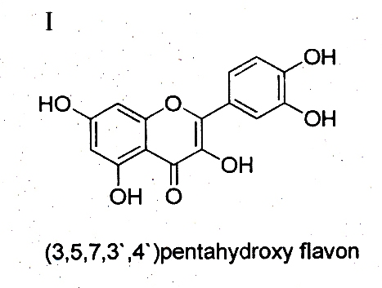
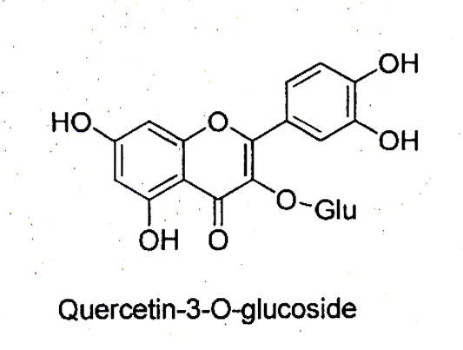
SYNTHESIS AND CHARECTERIZATION OF BIOLOGICALLY IMPORTANT NOVEL QUERCETIN THIOSEMICARBAZONE DERIVATIVES OF Pd(II) COMPLEXES.
Quercetin Derivatives:
A molecule of quercetin contains five hydroxyl groups whose presence determines the compounds biological activity and the possible number of derivatives.
Quercetin 3-0-glycosides occur as mono saccharide’s with glucose, galactose. These quercetin 3-0-glycoside was found in mango fruits.

Slide 28
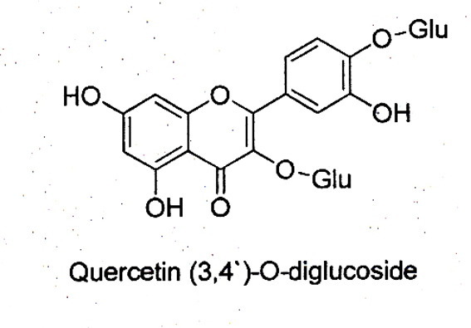
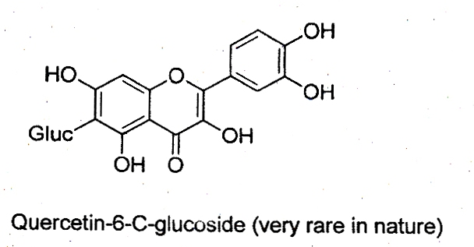
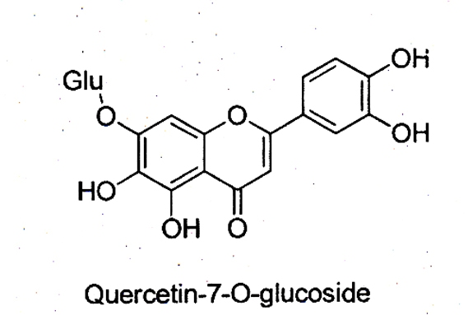
Quercetin 6-c-glycosides are another type of quercetin derivatives, but these compounds occur relatively rarely in nature.
23. Quercetin may contain u

Slide 29
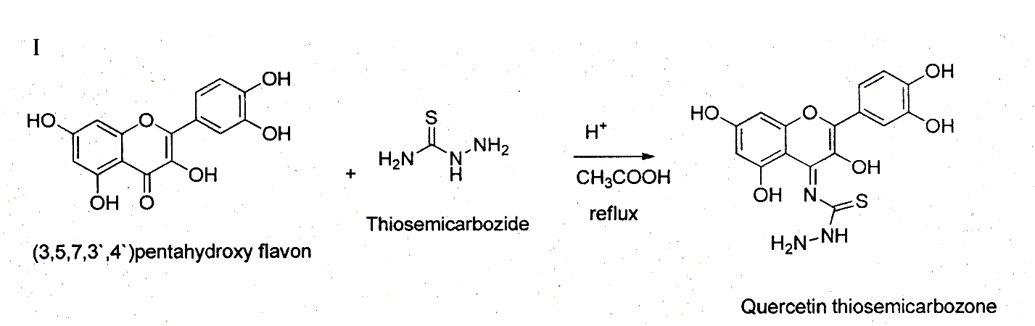
Quercetin may contain up to five ether groups in various configuration. Ether derivatives of quercetin, which also contain sugar substituent.
Synthesis of Ligands:
A 1x10-3 M solution prepared by dissolving appropriate amounts thosemicarbazide in 50ml methanol and 2ml of glycial acetic acid was added drop wise to a 5x10-2 M solution of Quercetin in 50ml methanol while stirring and refluxed for 2-3 hours the product that separated was retrystallized was based on elemental analysis, via, FT-IR HNMR, C NMR, ESR, U.V methods.

Slide 30
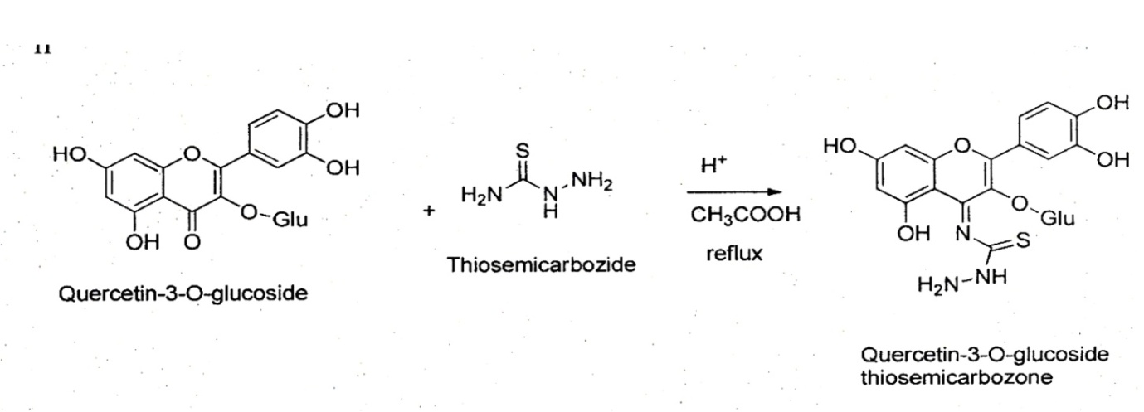
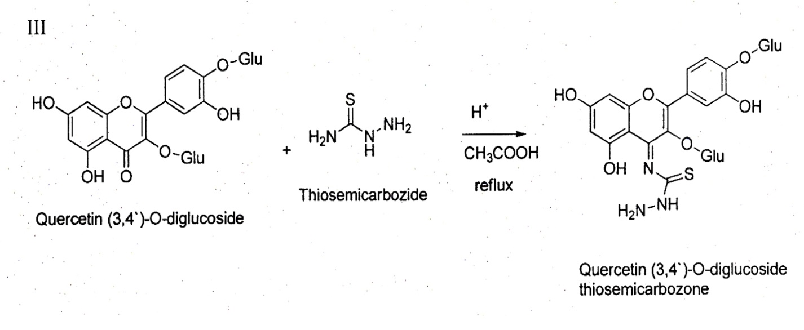

Slide 31
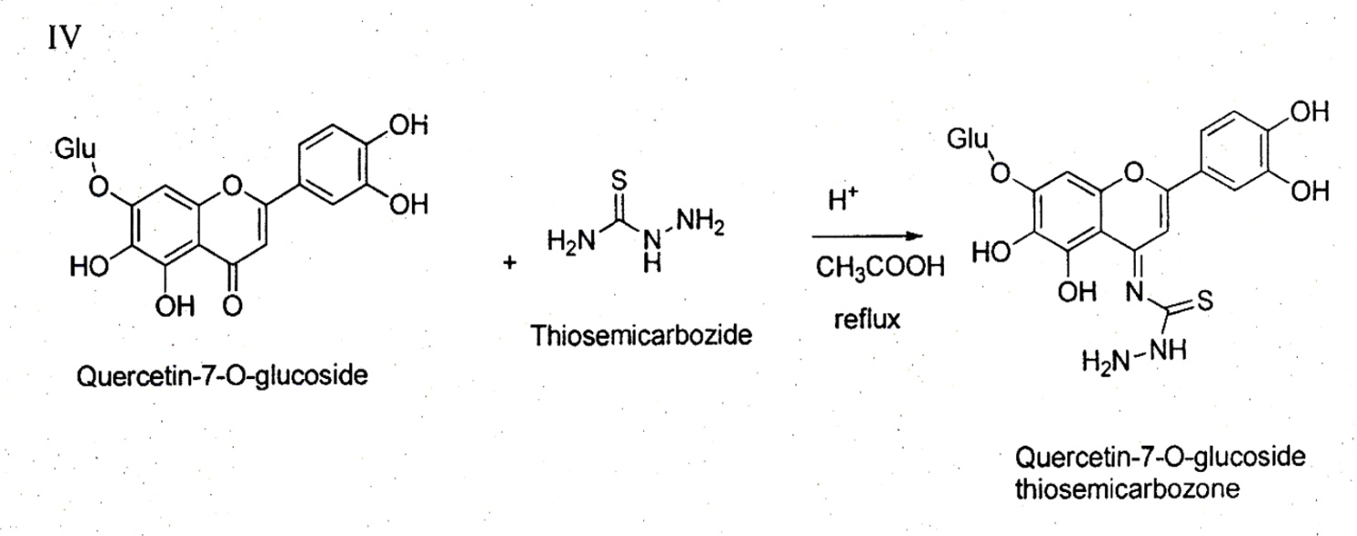

Slide 32
CONCLUSION:
Absorption and metabolism of quercetin and its derivatives has attracted much attention in relation to their pro-healthy value.
The total flavonoid in take from dietary sources is estimated to be from several hundred milligrams to 1g per day. Quercetin derivatives, glycosides in particular, represent a considerable part of these food constituents.
It is common knowledge that having been ingested both quercetin derivatives undergo many metabolic conversions and appear in body tissues.
An investigation on the bio availability and metabolism of quercetin derivatives focused mostly on glycosides which was predominates in diet.

Slide 33
Synthesis of metal complexes:
To 30mL of Pd(II) solution (5x10-2M) in methanol was added (1x10-2M) QTSC in methanol and the mixture refluxed for about 1hour in a separate reflux arrangement. The solid that separated was filtered and washed with water and recrystallized with methanol.
General procedure for substituted thiosemicarbazide and Synthesis, characterization of quercetin thiosemicarbazone metal complexes:
General procedure for substituted thiosemicarbazide:0.2mole of thiosemicarbazide was dissolved in a mixture of 30ml of water and 20g of concentrate sulphuric acid. 0.4mole of corresponding amine was added and further 90g of sulphuric acid was then added dropwise at 500c cooled and poured in to300g of ice. It was twice extracted with chloroformand the aqueous layer was then rendered alkaline by adding sodium hydroxide solution.
The crystalsthat precipitated were filtered off, washed with water and dried methanol/ethanol. Thiosemcarbazide of M.P.1900c (from ethanol) wasobtained. The yield was75%.
All the other substituted thiosemi carbazides were preparedusing the same procedure with the corresponding amine.

Slide 34
These metal complexes have raised considerable interest due to the pharmacological properties. In some cases highest activity is associated with a metal complex.
All the thiosemicabazone metal complexes were synthesized by refluxing the solution of QTSC with metal precursor. Their derivatives possess a great number of biological activities such as antioxidant, antitumor, antifungal and anticancer activities.
Out investigations have been directed towards the preparation of cyclised Quercetin thiosemicarbazone ligands and their metal complexes.
Synthesis of metal complexes:
To 30ml of Pd (II) solution (5x10-2 M) methanol was added (1x10-2 M) Quercetin thiosemicarbazone in methanol and the mixture refluxed for about 1 hour in a separate reflux arrangement.
The solid that separated was filtered and washed with water and recrystallized with methanol.

Slide 35
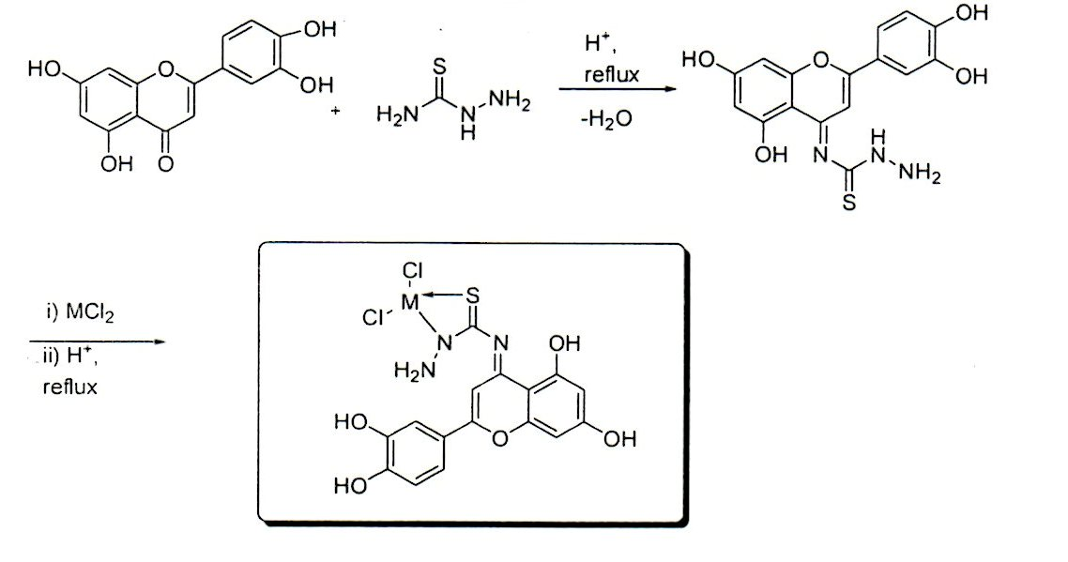

Slide 36
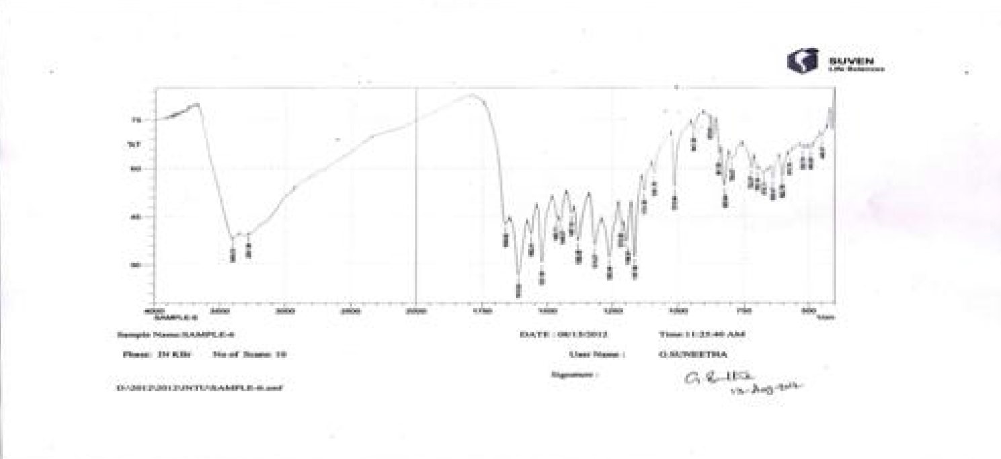

Slide 37
I R spectra:
The compound isolated was characterized using IR (Figure-1) and NMR(Figure-2) spectrophotometer techniques. From the analyses, the compound was identified as 3’,4’,5, 7-tetra hydroxyl flavonol(Quercetin).
IR νmax (Neat) cm–1 3282.40 (w), 1743.70 (w), 1666.75 (w), 1610.96 (w), 1517.55 (w), 1430.18 (s), 1358.18 (s), 1210.93 (w), 1094.07 (w), 1001.94(w), 929.56 (w), 882.18 (w), 808.85 (w), 705.01 (w), 590.36 (w). Quercetin (70eV) m/z 348 [M+], 302(98), 257(15), 228(8), 201(8), 154(8), 136(9), 110(9), 70 (4) and 23 (3).

Slide 38
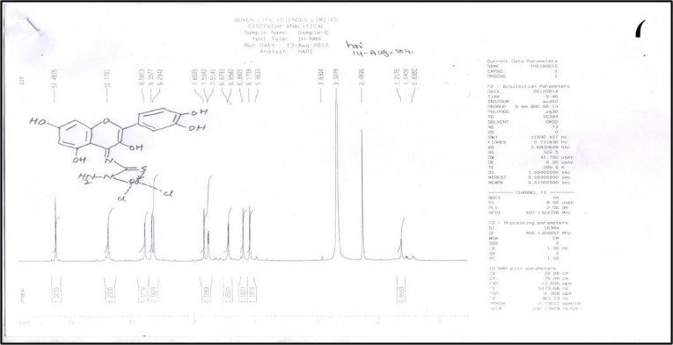

Slide 39
The H-NMR δ (CD3OD), (Figure-2a): 6.18(1H, d, J=1.7Hz), 6.40(1H, d, J=1.7Hz) are due to meta-coupled protons of A-ring (H-6 and H-8) of a flavonoid nucleus. Signals at δ = 6.89 d =8.3Hz, 7.68d, 2.5Hz and δ = 7.55dd, 2.2Hz, 8.3Hz are assigned to H-5’, H-2’ and H-6’ of the ring.
The 1H NMR spectrum showed protons at aromatic regions from 6 – 8ppm, and strong hydrogen bonding at 12.5ppm. These suggest a Quercetin nucleus.
The NMR spectrum of metal chelates confirms the non participation of NH2 group in the coordination with metal ions.
1H NMR signals are well defined and the spectrum of ligand exhibits two resonances for the NH2 protons at 7.8 ppm, a result explained in terms of hindered rotation about the C(S)-4NH2 bond due to its partial double bond character.
The metal complexes show only one resonance due to 4,NH2 protons, upfield for some complexes (at 9.46, 8.30, 8.23) and down field (at 9.72) for some complexes.

Slide 40
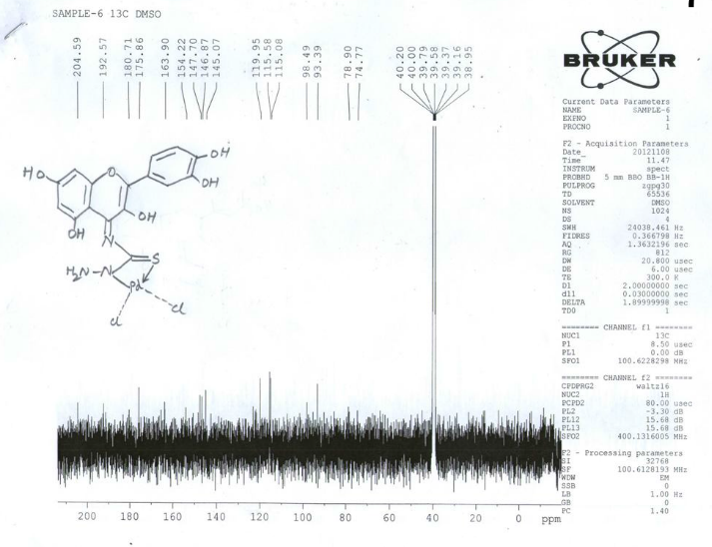

Slide 41
13C-NMR spectra analysis (Figure-2b): 15, carbon signals typical of flavonoid nucleus. Two protons of the NH2 group 11.179ppm (S, 1-H, -NH). 11.824ppm (S, 1-H, - NH). These suggest a Thiosemicarbozone nucleus.
13C-NMR spectral data indicate in all the complexes downfield or up field chemical shifts are obtained for the carbon resonances adjacent to the assumed coordination sites while theothers remain essentially unchanged. The affected carbon resonances in the ligands are shifted or absent, supports coordination.
All the metal complexes are stable at room temperature non hygroscopic, sparingly soluble in methanol or ethanol and fairly soluble in DMSO. The analytical data for ligand and metal chelates are consistent with their proposed molecular formulae.
The signal at 11.90ppm in the spectrum of ligand due to 2, NH is present in most of the complexes with down field shifts (11.40, 11.43, 11.63) and with an up field shift for one complex (12.41) probably indicating a change in the nature of NH resonance. complexes .
The signal at 11.90ppm in the spectrum of ligand due to 2, NH is present in most of the complexes with down field shifts (11.40, 11.43, 11.63) and with an up field shift for one complex (12.41) probably indicating a change in the nature of NH resonance.

Slide 42
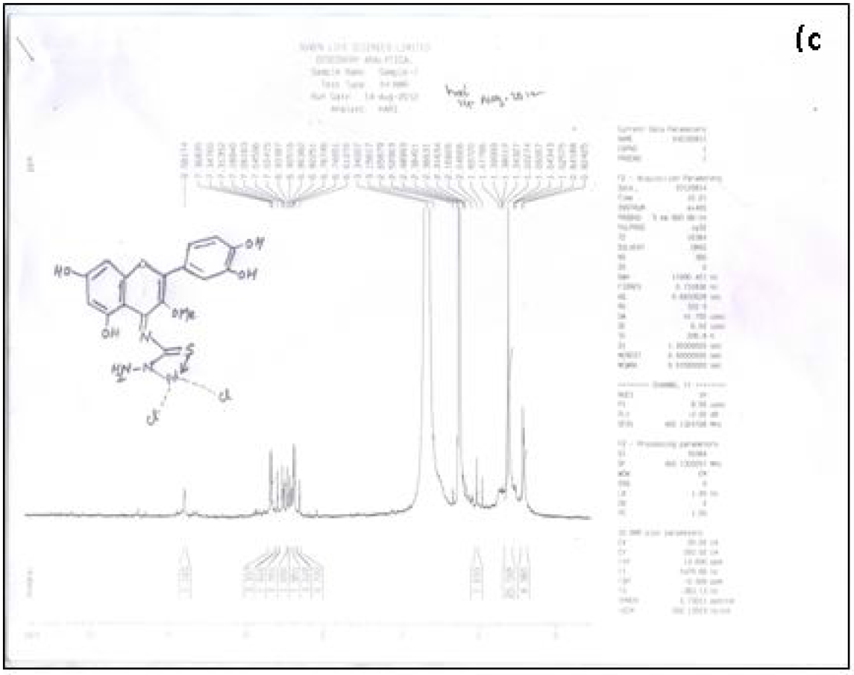

Slide 43
Magnetic studies:
The magnetic moments of metal complexes are found to be subnormal, which may be attributed to the presence of magnetically coupled metal centers in Dimeric complexes.
Biological Studies: The bioactivity of Quercetin derivatives and its impact and human health is still at the developmental stage. Research into the biological properties have found that the Flavonoid derivatives are popular as Antioxidants. As a result, Quercetin derivatives are utilized as ligands for the complexation with transitional metal.
The uniform complexes with highly advance spectroscopic, X-ray diffraction and other techniques and also to test the compounds for their potential use an Anti-cancer, using mammalian cell lines and micemodel.
It is common knowledge that metabolic modification of QTSC derivatives alters their antioxidant properties. A human body needs these substances to absorb and use vitamin-C.
We have also found that QTSC Pd(II)complex and Rutin contribute to the relaxation of smooth muscles in mammals. Similar properties were observed in methoxyl derivatives of Quercetin. Due to its Antioxidant activity, rutin protects liver cells and suppresses hemoglobin oxidation.

Slide 44
Rutin has also Anti-inflammatory properties, which are displayed mostly in respect of chronic diseases. When administered to rats, rutin has also been found to display chemo preventive properties, acting as an agent blocking carcinogenesis induced by heterocyclic amines.
The Formulae of the complexes could be written as: [ML] n Where M = Pd(II) : L=QTSC All complexes show much enhanced nuclease activity in the presence of oxidant, which may be due to free radical reaction (OH*) with DNA.
Nuclease Activity studies:
The production of hydroxyl radicals due to the reaction between H2O2 and the metal complexes. The OH* radical involves oxidation of de-oxy ribose moiety followed by hydrolytic cleavage of sugar phosphate backbone. On the basis of physicochemical and spectral data the metal chelates are assigned to be Octahedral complexes. 4.0 Conclusion We have synthesized Ligands of QTSC and their complexes with Pd(II). All complexe’s plausible structures are supported by IR, NMR, ESR, Electronic spectral data. The ligands and their complexes would be screened for their anti-cancer activity against certain cancer cell lines.
We have developed a simple, convenient and effective method for the synthesis of complexes. To our knowledge, this is the first report of an efficient general method for the synthesis of different Pd(II)complexes of Quercetin Thiosemicarbazone .

Slide 45
Biological Studies:
The bioactivity of Quercetin derivativesand its impact and human health is still atthe developmental stage.
Research into thebiological properties have found that theFlavonoid derivatives are popular as Anti-oxidants.
As a result, Quercetin derivativesare utilized as ligands for the complexationwith transitional metal.
The uniform complexes with highly advanced spectroscopic, X-ray diffraction and othertechniques and also to test the compounds for their potential use an Anti-cancer,using mammalian cell lines and mice model. It is common knowledge thatmetabolic modification of QTSC derivatives alters their antioxidantproperties.
We have also found that QTSC Pd(II)complex and Rutin contribute to the relaxation of smooth muscles in mammals.
Similar properties were observed in methoxyl derivatives of Quercetin. Due to its Anti-oxidant activity, rutin protects liver cells and suppresses hemoglobin oxidation.
Rutin has also Anti-inflammatory properties, which are displayed mostly in respect of chronic diseases.

Slide 46
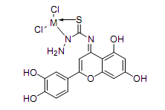
When administered to rats, rutin has also been found to display chemo preventive properties, acting as an agent blocking carcinogenesis induced by heterocyclic amines.
The Formulae of the complexes could be written as: [ML] n:Where M = Pd(II) :L=QTSC
All complexes show much enhanced nuclease activity in the presence of oxidant, which may be due to free radical reaction (OH*) with DNA.
On the basis of physicochemical and spectral data the metal chelates are assigned to be Octahedral complexes.

Slide 47
Conclusion
We have synthesized ligands of QTSC and their complexes with Pd(II).
All complexes’plausible structures are supported by IR, NMR, ESR, Electronic spectral data.
The ligands and their complexes would be screened for their anti-cancer activity against certain cancer cell lines.

Slide 48
SYNTHESIS AND STRUCTURAL DETERMINATION OF NOVEL CURCUMIN OXIME GOLD(III)COMPLEX:POTENCIAL CHEMOPREVENTIVE DRUG

Slide 49
l.
SYNTHESIS AND STRUCTURAL DETERMINATION OF NOVEL CURCUMIN OXIME GOLD(III)COMPLEX:POTENCIAL CHEMOPREVENTIVE DRUG
Cancer is a deadful disease and any practical solution in combating this disease is of paramount importance to public health. Cancer patients have burdened by drug induced toxic side effects, and no turned to seek help from the complementary and alternative medicine hoping for a better cure.
Cancer is a class of diseases characterized by out-of-control cell growth. Cancer harms the body when damaged cells divide into uncontrollably to form lumps or masses of tissue called tumors. Tumors that stay in one sport and demonstrate limited growth are generally considered to be benign.

Slide 50
Cancerous cell manages to move throughout the body using the blood systems, destroying healthy tissue in a process called invasion.
Cur cumin is a natural polyphenol. It is highly potential molecule capable of preventing and treating various cancers. The anticancer potential of cur cumin is severely affected by its limited systemic and target tissue bioavailability and rapid metabolism.
Various dietary chemo preventive agents, turmeric powder or its extract are broadly used as therapeutic preparations in Indian System of medicine.
In the present research work, we provide a summarized synthesis and structural determination of Curcumin Oxime derivative of Gold(III)complex.
The use of these analogs for prevention of cancer tumor progression and treatments of human malignancies.
The herbal traditional medicinal plants are important raw material to synthesis the phytochemicals[1].
The phytochemical, curcumin is one of the major dietary flavonoid, belonging to a group of flavonol[2].
Flavonoids have a long history of use in traditional medicines in many cultures [3].

Slide 51
Research in recent years has focused on several possible helpful effects of curcumin, including its potential role in preventing cancer. Recent studies suggest that curcumin can slow the growth of cancer cells because they have anti-tumor and anti-oxidant properties[4].
Curcumin and its analogs, we would like to provide a brief survey on phytochemicals in general because phytochemicals are becoming the novel backbone of medicinal chemistry, and having broad variety of biologically active compounds produced by plants such as β-carotene, ascorbic acid, folic acid, vitamin E and many others that possess either antioxidant capable of scavenging out certain reactive oxygen radicals or anti-toxicity actions.
Several dietary phytochemicals are recommended for prevention of carcinogenesis. Aggarwal et al. have recently reviewed the cell signaling pathways in cancers that are disrupted by agents isolated from natural origins curcumin.
Curcumin is a simple symmetrical β-diketone and incorporates several functional groups. The two aromatic rings containing phenolic groups are connected by two α, β-unsaturated carbonyl groups.
.

Slide 52
A large number of oximes have been evaluated for their anti-malarial and anti-tumor activities, because of their useful chemotherapeutic properties. In cancer treatment it has been shown that the metal chelates are more potent than the chelating agents.
Metal complexes of Gold containing nitrogen and oxygen donor ligands is found to be effective catalysts for oxidation, reduction, hydrolysis and other organic transformation[5].
The red ox properties of the curcumin derivatives has been found to block cell cycle progression in a variety of malignant cell lines including those derived from the prostrate, brain, breast, pancreas and colon.
A stable crystalline form of
.
curcumin.
Figure: 1

Slide 53
Identification of the product was based on elemental analysis viz., FT-IR, HNMR, Mass Spectroscopy, ESR etc.,
.
Structure of curcumin oxime(ligand) fig.2
Synthesis of metal complexes:
To 30 ml.of Gold(III) solution(5X10-2M ) in methanol was added (5x10-2 M) curcumin oxime/curcumin in methanol and 2 ml. of glycial acetic acid was added drop wise to the mixture refluxed for about one hour in a separate reflux arrangement. The solid(orange) that separated was filtered and washed with water and recrystallized with methanol.

Slide 54
Structure of curcumin oxime gold(III)complex fig.3
Structure of curcumin gold(III)complex fig.4

Slide 55
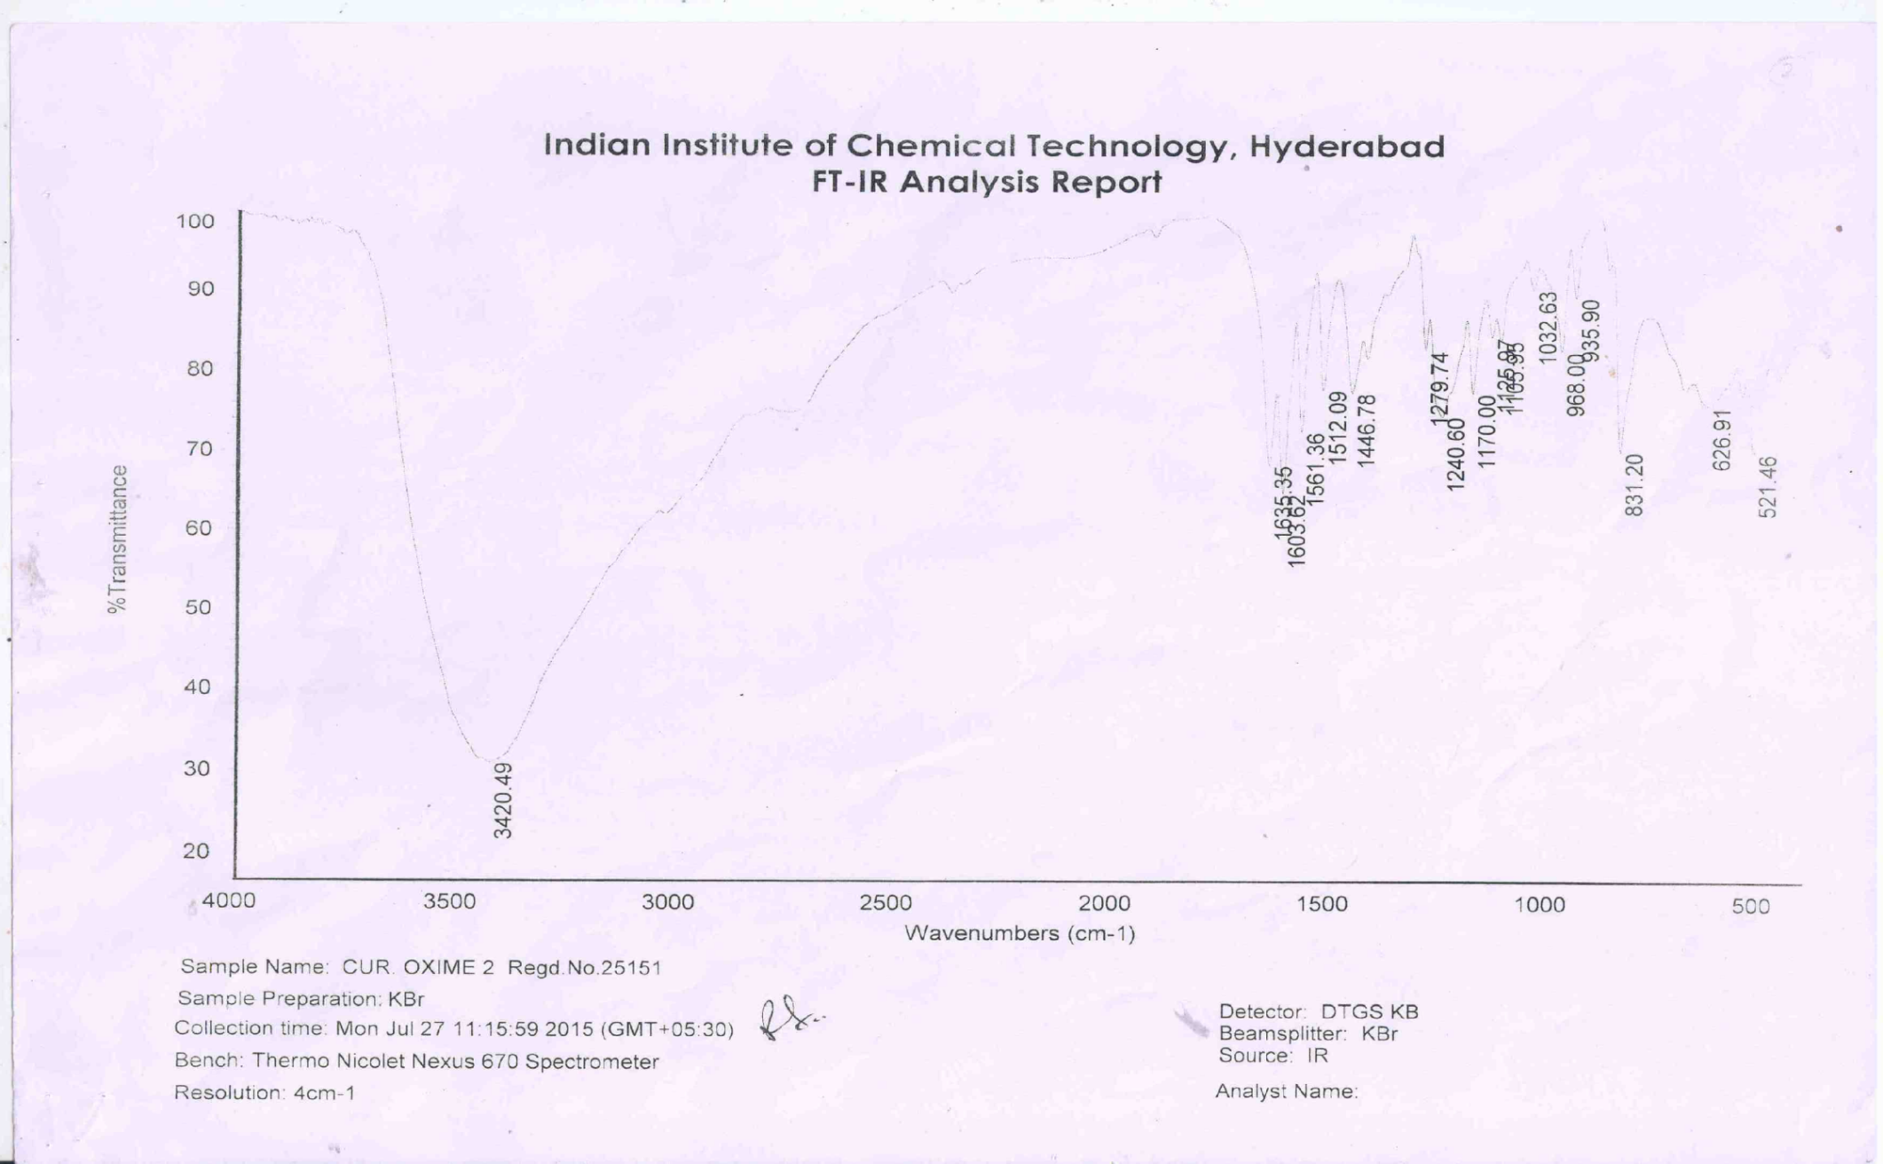

Slide 56
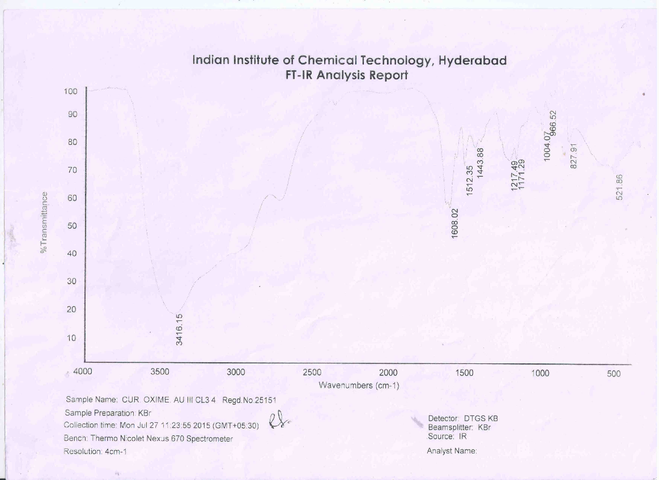

Slide 57
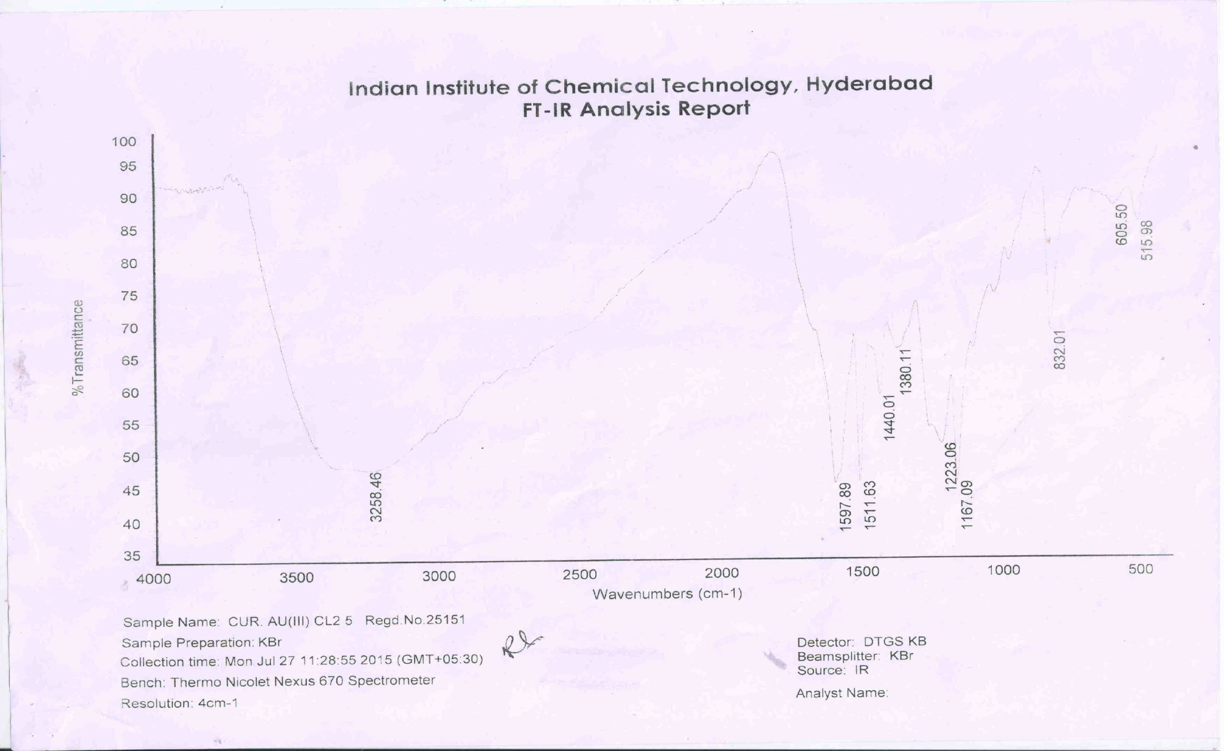

Slide 58
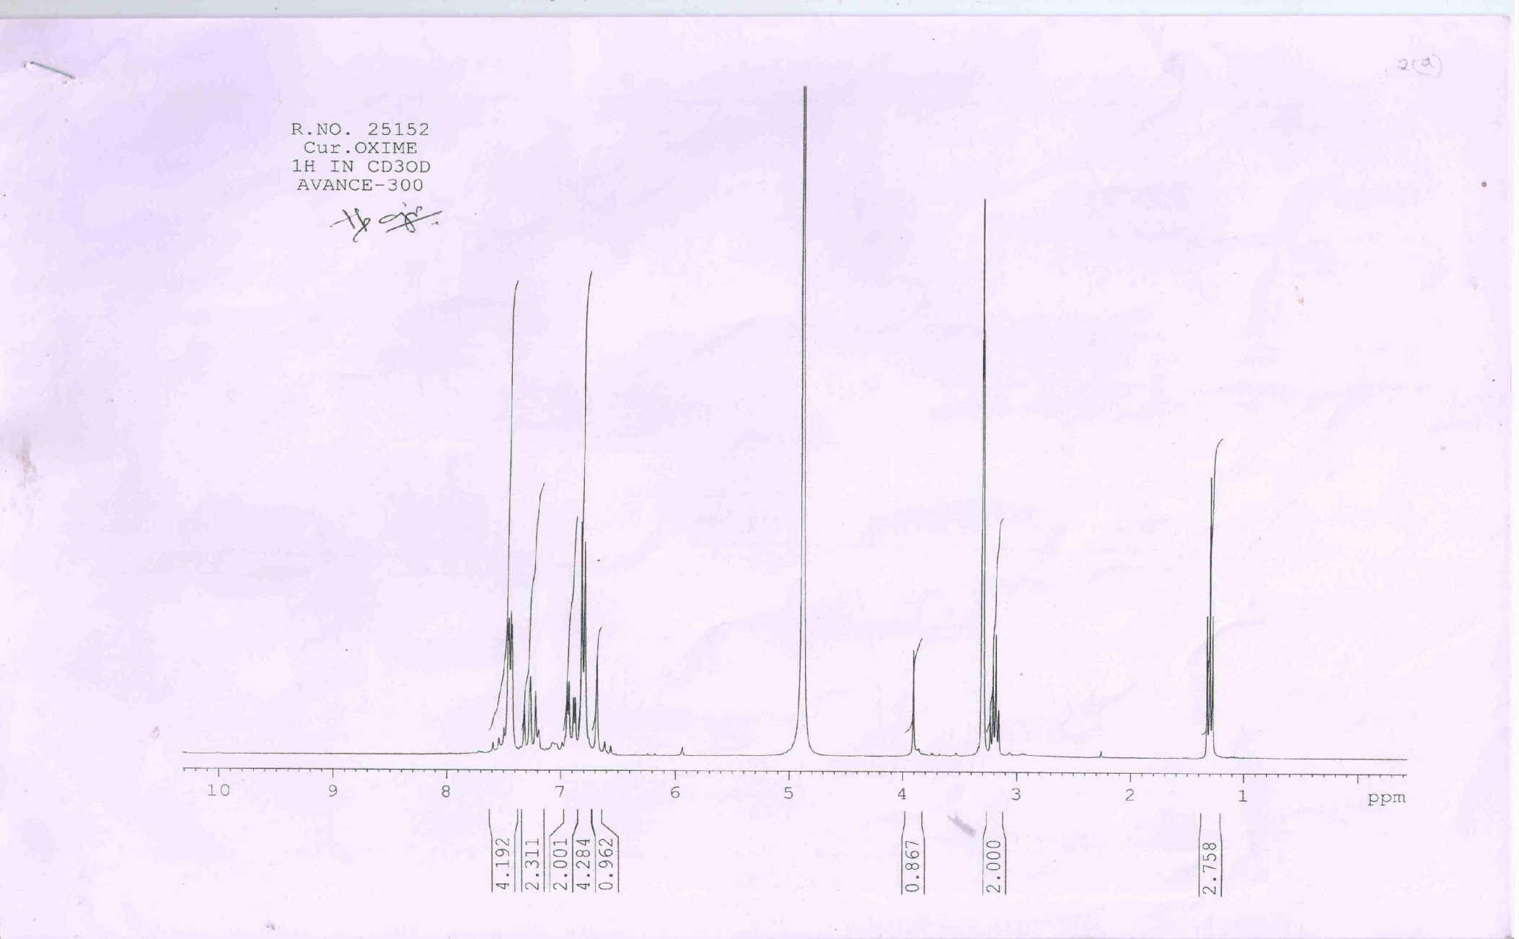

Slide 59
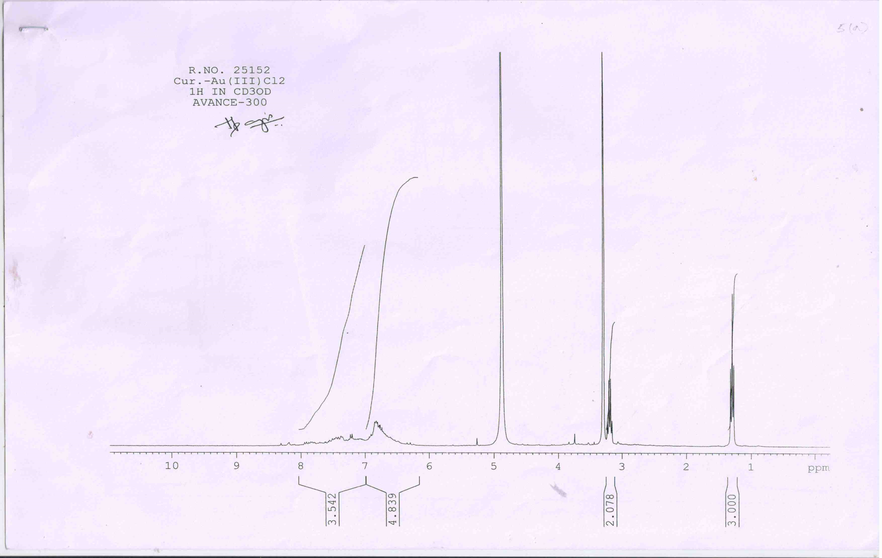

Slide 60


Slide 61
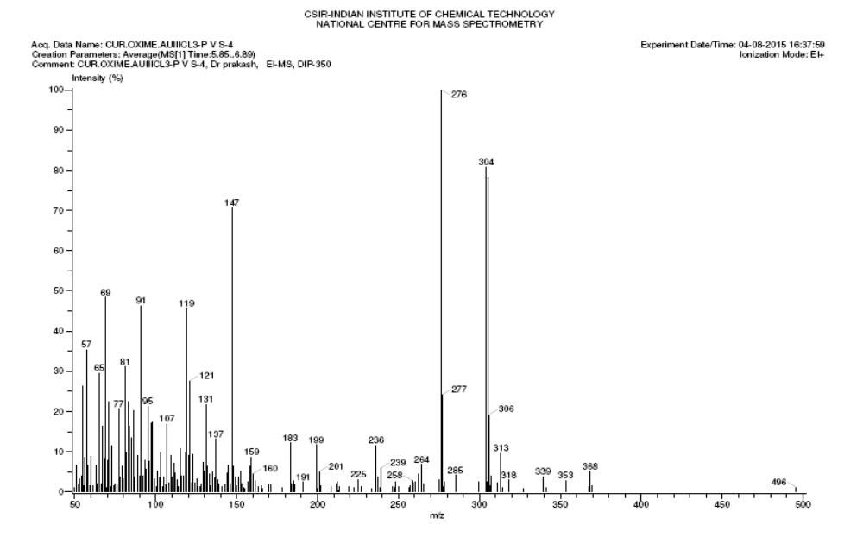

Slide 62
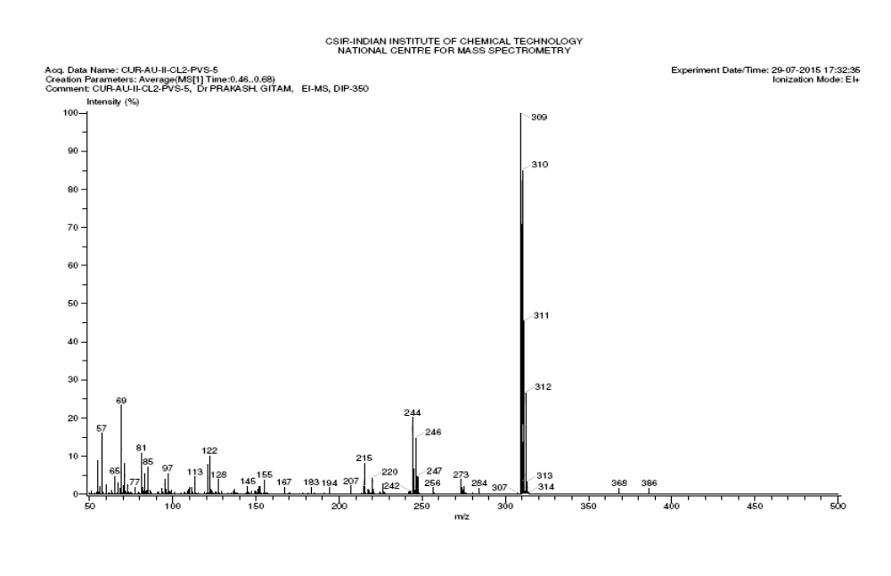

Slide 63
The compound was characterized using IR, 1HNMR, and Mass spectrophotometric techniques. From the analysis the compound was identified.
Curcumin oxime: From fig.5,8
IR Spectra: IR: 3420.49(labile e), 1635.35(c=o), 1603.62 & 1561.36(aromatic), 1240.60(c=o),
831.20 cm-1 ( ligand). HNMR: 1.2 – 1.4(t,3H), 3.2 – 3.4(q,2H), 3.9(s,1H), 6.6 – 7.0(m,7H), 7.2 – 7.3(m,2H), 7.4 – 7.5(dd,4H). These suggest the curcumin oxime(ligand)
Curcumin gold(III)chloride: From fig.7,9
IR: 3258.46(labile e), 1597.89 & 1511.63(aromatic), 1223.06(c=o), 1167.09(c=o),
832.01 cm-1 (metal complex). 1 HNMR: 1.2 – 1.4(t , 3H), 3.1 – 3.3(q,2H), 6.2 – 7.0(m,5H), 7.0 – 8.0(m,4H).
These suggest the curcumin gold complex.
Curcumin oxime gold (III)chloride: From fig.6
IR Spectra: 3416.15(labile e), 1608.02 & 1512.35(aromatic), 1217.49 & 1171.29(c=o),
521.86 cm-1(metal complex). HNMR Spectra: 1.3( t,3H ), 3.2( q,2H ), 3.5 – 4.0 (br, 1H), 6.7( s, 1H ), 6.8 (d, 5H), 6.8 – 7.0( dd,3H), 7.2 – 7.4( t,3H), 7.5( dd,5H). These suggest the Cur.Oxime gold complex

Slide 64
Mass spectra: 276, base peak (removal of 2 –OCH 3 and 2 –OH): 304,by removal of four “O” atoms got this peak and 368, indicates the curcumin. From 11 & 12
The interaction of AuCl3 with ligand yields compounds having composition. All complexes are found to be diamagnetic at 312 K indicating essentially a planar geometry for these compounds.
The IR spectra of ligand are characterized by the presence of a single strong band at 1635 cm-1 due to the central carbonyl absorptions functionalities which are equivalent. The generation of the oxime functionality at one of the carbonyls can be ascertained from the presence of band at 1561 cm-1 and strong carbonyl absorption at 1512 cm-1.
On metal complexation both the bands are shifted to lower frequency indicating their involvement in gold complexation.
The introduction of oxime functionalities in the curcumin nucleus is best diagnosed from the symmetric and asymmetric bands near the 3416 cm-1

Slide 65
ESR Spectral analysis: Electronic Spin Resonance spectra of Gold(III)complex was recorded in DMF at liquid nitrogen temperature value equal to 26.
Magnetic studies: The magnetic moments of metal complexes were found to be subnormal, which may be attributed to the presence of magnetically coupled metal centres in dimeric complexes.

Slide 66
BIOLOGICAL ACTIVITY:
The nuclease activity of present ligand and their complexes has been investigated on pBR 322 plasmid DNA by agarose gel electrophoreses in the presence of H2O2.
At micro molar concentration, the ligands exhibit no significant activity in absence and in the presence of the oxidant. The nuclease activity was greatly enhanced by incorporation of metal ions and the ligands.
All complexes shows much enhanced nuclease activity in the presence of oxidant, which may be due to free radical reaction with DNA.
Conclusion:
We have synthesized the curcumin/curcumin oxime gold(III)complexes. All complexes plausible structures were supported by LSI mass spectral data along with physico-chemical and IR, HNMR,MASS,ESR spectral data.
The ligands and their complexes would be screened for their anti-cancer activity against certain cancer cell lines. We have developed a simple, convenient and effective method for the synthesis of complexes. To our knowledge, this is the first report of an efficient general method for the synthesis of different gold complexes of curcumin

Slide 67
Synthesis and Characterization of Novel Curcumin thiosemicarbozone Gold(III)complex:potential chemopreventive drug
Curcumin is a natural polyphenol. It is highly potential molecule capable of preventing and treating various cancers. The anticancer potential of cur cumin is severely affected by its limited systemic and target tissue bioavailability and rapid metabolism. Various dietary chemo preventive agents, turmeric powder or its extract are broadly used as therapeutic preparations in Indian System of medicine. In the present research work, we provide a summarized synthesis and characterization of Curcumin thiosemicarbozone derivative of Gold(III)complex. The use of these analogs for prevention of cancer tumor progression and treatments of human malignancies.

Slide 68
Methodology:
Synthesis of Ligands
A 5 X10- 2 M solution prepared by dissolving appropriate amounts of thiosemicarbazide in 50 ml.
methanol and 2 ml. of glycial acetic acid was added drop wise to a 5 X10-2 M
Solution of curcumin in 50 ml. methanol while stirring and refluxed for 2 hour and the product that separated was recrystallized in methanol
Identification of the product was based on elemental analysis viz., FT-IR, HNMR, Mass Spectroscopy, ESR etc.,

Slide 69
Synthesis of metal complexes:
To 30 ml.of Gold(III) solution(5X10-2 M ) in methanol was added (5x10-2 M) curcumin thiosemicarbazone in methanol and 2 ml. of glycial acetic acid was added drop wise to the mixture refluxed for about one hour in a separate reflux arrangement.
The solid(orange) that separated was filtered and washed with water and recrystallized with methanol.
Curcumin thiosemicarbazone Gold(III)complex

Slide 70
IR AND NMR SPECTRA:
The compound was obtained as a crystalline orange solid. The compound isolated was characterized by using IR(fig.1), and HNMR(fig.2) spectrophotometer techniques. From the analysis, the compound was identified as Cur.TSC.
(a) IR 3133.26(labile e), 2064.88(C=N), 1600.13, 1510.77(Aromatic),
1442.12(C-H), 1137.65cm-1 (C=O)
HNMR 7.4 – 7.7(m,5H), 7.1 – 7.2(d,1H), 6.7 – 6.9(m,6H), 6.5 – 6.6(d,1H),
5.9(bs,1H), 3.9(s,1H), 3.2(q,2H),1.3(t,2H)
(b) From the analysis, the compound was identified as Cur.Au(III)complex.
IR: 3258.46(labile e), 1597.89and 1511.63(Aromatic),
1223.06 and 1167.09(C=O), 832.01 cm-1 (Metal ligand).
HNMR: 6.2 – 7.5(b,8H), 3.2(q,2H), 1.3(t,3H)
© From the analysis, the compound was identified as Cur.TSC.Au(III)complex.
IR : 3382.27(labile e), 1638.23, 1602.68 and 1511.98(Aromatic),
1243.52 cm-1 (C=O)
HNMR: 7.2 – 7.6(6H), 6.6 – 7.1(8H), 3.4(OCH3,6H), 3.7 – 3.9(bs,3H), 3.0 – 3.2(d,2H)
All the metal complexes are stable at room temperature non hygroscopic, sparingly soluble in methanol or ethanol. The analytical data for ligand and metal chelates are consistent with their proposed molecular structure.

Slide 71

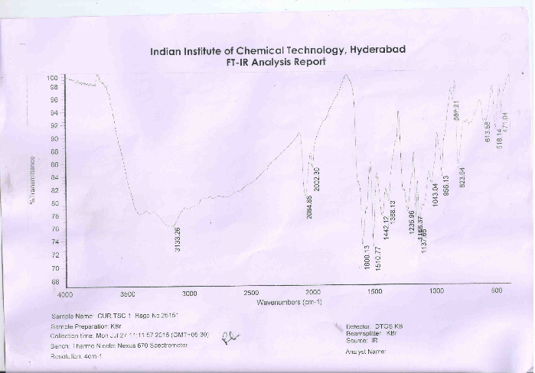
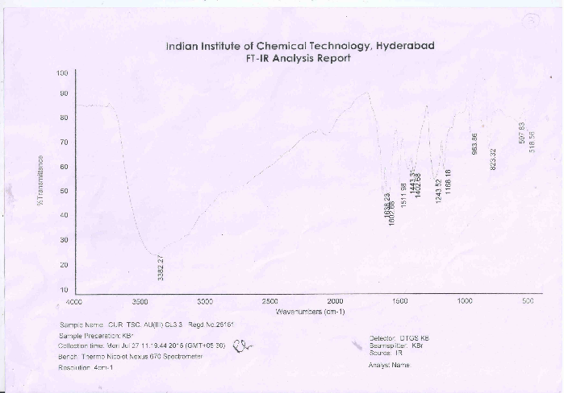
Figure-1: FT-IR spectra showing
(a) curcumin thiosemicarbazone
(b) curcumin gold(III)complex
(c) curcumin thiosemicarbazone gold(III)chloride complex

Slide 72
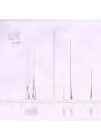
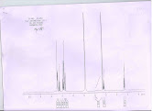
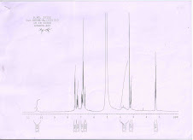
Figure-2 showing HNMR spectra of
(a) curcumin thiosemicarbazone
(b) curcumin gold(III)chloride
(c) curcumin thiosemicarbazone gold(III)chloride complex

Slide 73
ESR Spectral Analysis:
Electronic Spin Resonance(ESR) spectra of Gold(III)complex was recorded in DMF at liquid nitrogen temperature value equal to 30
Electronic spectra:
The structure of the CurTSC Gold(III)complex is Octahedral. By the recent study of X-ray and polarized single crystal spectral studies of the Au(III) ions, these complexes are diamagnetic. They did not show any bands in the electronic spectra.

Slide 74
Nuclease Activity Studies:
The nuclease activity of present ligands and their -complexes has been investigated on pBR 322 plasmid DNA by agarose gel electrophoresis in the presence of H2O2. At micro molar concentration, the ligands exhibit no significant activity. The nuclease activity is greatly enhanced by incorporation of metal ions in the ligands.
In absence of oxidants , the Gold(III)Complexes of all CURTSC cause discernible DNA cleavage as evidenced by increase in intensity in form 11 (nicked) and form III (linear) with decrease in intensity in form 1 (super coiled) which is attributed to step-wise conversion of form I to form II and to form III Similar observations were also evident in the Gold(III)-Complexes of all CURTSC.
The Nuclease Activity of the Gold(III)complexes is more. All complexes show much enhanced nuclease activity in the presence of oxidant, which may be due to free radical reaction (OH*) with DNA.
The production of hydroxyl radicals due to the reaction between H202 and the metal complexes. The OH* radical involves oxidation of deoxyribose moiety followed by hydrolytic cleavage of sugar phosphate backbone.

Slide 75
Conclusion:
We have synthesized Ligands of CURTSC and their complexes with Au(III). All complexes plausible structures are supported by IR, HNMR, ESR and Electronic spectral data. The ligands and their complexes would be screened for their anti-cancer activity against certain cancer cell lines. We have developed a simple, convenient and effective method for the synthesis of complexes. To our knowledge, this is the first report of an efficient general method for the synthesis of different Au(III) complexes of Curcumin thiosemicarbazone.

Slide 76
Isoflavonoidanalogs and their metal complexes as anti-cancer agents:
A pharmacologic agent for treating and/or preventing cancer, among other diseases and conditions, and particularly breast, prostate, and pancreatic cancer, in humans and animals. The novel pharmacologic agent is an isoflavonoid or isoflavonoid mimetic covalently attached to a cytotoxic pharmacophore that, preferably has the ability to conjugate with a metal salt to form a more potent metal complex, particularly a Au(III) complex.
Effective chromoneanalogs include the thiosemicarbazone and hydrazoneanalogs of 4-oxo-4H-chromene-3-carboxaldehyde and their Au(III) complexes.
Selected from the groupconsisting of 4-oxo-4H-chromene-3-carboxaldehyde-thiosemicarbazone ,4-oxo-4H-chromene-3-carboxaldehyde-benzoylhydrazone,and their transition metal complexes

Slide 77
Field of Research
This relates generally to novel analogs of isoflavone and metal complexes thereof, and more particularly to isoflavonoid or isoflavonoid mimetics that are useful for preventing and/or treating diseases, such as cancer.
Naturalchemoprotective agent. Isoflavones in soy, including genistein, daidzein, glycitein, and others, active agents in this regard. Indole-3-carbinol, curcumin, resveratrol, and green or black tea polyphenols,
genistein is a promising agent for cancer prevention and/or treatment., NF-κB, Akt, and MAPK pathways, Sarkar, et al., The Role of Genistein and Synthetic Derivatives of Isoflavone in Cancer Prevention and Therapy, Mini-Reviews in Medicinal Chemistry, genistein causes a pleiotropic effect on cancer cells. However, genistein alone may not be potent enough to treat and/or prevent cancers.
There is, therefore, a need for synthetic analogs or derivatives oftheisoflavonegenistein that have more robust biological properties.
genistein also exerts its own biological effects that are distinct from estrogen. Since biological activity is related to molecular structure, changes in molecular structure have been shown to cause extensive changes in biological activity.
Therefore, derivatives of genistein (and consequently hormone mimetics) based on the structural motifs of genistein, and other naturally-derived known phytochemicals, may have greater ability to prevent and/or treat cancers than the natural products themselves.
Certainly, synthetic derivatives ofthese natural phytochemicals maybe easier to produce on a commercial scale.

Slide 78
Many of these chemical entities are consumed by humans in nutritional sources which help provide the physiologically active constituents needed for maintenance of life and health .
Some of these chemicals are inert, some are toxic or carcinogenic, while others may have positive effects on physiologic function acting as protective agents countering the risk of acute toxicity and diminishing the onset of chronic diseases including cancer.
There is, thus, a need for synthetic analogs or derivatives of isoflavone and other naturally-occurring dietary agents that are more potent than the naturally-occurring product and that can be synthesized on a commercial scale.
There is also a need for a method of rapidly screening the many possible combinations of small molecule analogs of these naturally-occurring compounds for efficacy and toxicity.
The foregoing and other objects are addressed by this invention which provides active pharmacologic agents for treating and/or preventing cancer, among other diseases and conditions, and particularly breast, prostate, and pancreatic cancer, in humans and animals.

Slide 79
The active pharmacologic agents of the present invention selectively target receptors of the type over-expressed in malignant cells and comprise ligands of a cytotoxic pharmacophore covalently attached to a carrier.
The carrier may be an isoflavonoid or an isoflavonoid mimetic. As used herein, the term “isoflavonoid mimetic” refers to a molecule that has a steroidal motif derived from isoflavone, and in particularly preferred embodiments, from the isoflavonegenistein.
The isoflavonoid mimetic may be, in some embodiments, a non-fragmented steroidal hormone, such as progesterone or estrogen, or in other embodiments, a small molecule analog of isoflavone, such as 3-formylchromone.
The ligand is preferably conjugated to a transition metal ion. The resulting metal complexes have an overall lipophilic nature that is greater than the parent ligand from which they are derived and therefore, their cellular internalization is improved.

Slide 80
The pharmacophores have been chosen for their ability to conjugate with metals, such as transition metal ions that may have affinities for steroidal receptors (and others), as well as for their known ability to be cytotoxic to cancer cells; or to otherwise exert biological effects on signal transduction intermediates such as epidermal growth factor receptor (EGFR), Akt, or NF-κB, or on the enzymes obligatory for DNA synthesis.
In the specific embodiments presented herein, the pharmacophores are thiosemicarbazone, benzoyl hydrazide, isonicotinoyl hydrazide, and salicylic hydrazide.
particularly preferred compounds are metal complexes of transition metal ions, such as Gold,Platinum, Palladium, Ruthenium, Copper, Cobalt etc.
Preferred metals are copper, nickel, and platinum, which are particularly known for their therapeutic effects. Most preferred, however, is Gold(III)which has two distinct advantages over other metals, including platinum, specifically its easily tunable redox potential through appropriate ligand framework with its potential intrinsic affinity for the estrogen receptor , inverse relationship between IC50 values and the half-wave potentials.

Slide 81
Metal conjugates of the ligands of the present invention were found to exhibit synergistic enhancement in their antiproliferative activities with, in preferred embodiments, IC50 values around ≦5 μM. Thus, these compounds are highly likely to achieve effectiveness under in vivo conditions. A synergistic effect is also expected in the pro-apoptotic activity of the metal conjugates.
In a second embodiment, non-steroidal pharmacologic agents are provided that are isoflavonoid mimetics based on a smaller molecule that is an analog of a naturally-occurring molecules, such as the isoflavone genistein.
In a particularly preferred embodiment, the isoflavonoid mimetic is chromone. The structure-activity correlations for the isoflavonoid compounds have indicated that certain features, desirable for the anti-tumor properties of these compound include a benzopyran motif, with a double bond between the C2-C3 positions, and a side chain containing a phenyl ring having metal chelating ability.
These features can be built into 3-formylchromone by condensing it with various amines in an alcoholic medium to form a Schiff base ligand.
The Schiff base chelates easily with a salt of a transition metal to form a conjugate with potent radical scavenging properties.

Slide 82
Preferred derivatives are analogs of the flavonoid genistein, and in particular, the thiosemicarbazone and hydrazoneanalogs of 4-oxo-4H-chromene-3-carboxaldehyde (herein designated as chromone) and theirAu(III) complexes. Specific preferred embodiments include:
4-oxo-4H-chromene-3-carboxaldehyde-thiosemicarbazone;
4-oxo-4H-chromene-3-carboxaldehyde-benzoylhydrazone;
4-oxo-4H-chromene-3-carboxaldehyde-isonicotinoylhydrazone; and
4-oxo-4H-chromene-3-carboxaldehyde-salicylhydrazone.

Slide 83
In a preferred exemplary embodiment, cancer, such as breast, prostate, and pancreatic cancer, is treated by selectively targeting steroidal hormone receptors of the type over-expressed in malignant cells with the pharmacologic agents of the present invention.
In, the term “therapeutically-effective” refers to an amount of pharmacologic agent that pro
Making embodiment, a simple synthetic protocol, a ligand comprising the Schiff base of the desired carrier moiety is synthesized by condensing equimolar amounts of the carrier and various amines.
The ligand is combined, in a stochiometric ratio, with a solution of a salt the desired transition metal, which in specific illustrative embodiments, may be halides of copper, nickel, or platinum. The metal conjugate precipitates from solution and is easily purified by standard chromatographic work-up
steroidal scaffold of the hormonessuch as flavonoids, indoles and others, 3-formyl chromone, respectively. The columns these pharmacophores, include the pharmacophores used in the specific illustrative embodiments described hereinbelow:

Slide 84
Thiosemicarbazole (SC1), benzoyl hydrazide (SC3), isonicotinoyl hydrazide (SC4), and salicylic hydrazide (SC6). The resulting compounds are then coordinated with metal ions (not shown in this figure).
Typically, the pharmacophores are covalently attached to the carrier scaffold at the equivalent of benzene ring A in the isoflavone motif.
Each of these compounds will be tested in a cellular assay to determine its ability to inhibit proliferation of specific cancer cell lines based on concentration and time dependence.
Compounds showing consistent results and lowest IC50 values, preferably in the range of nanomols to 10 μM, and preferably less than 5 μM, were considered suitable for further studies in vivo using validated animal models. Compounds having an IC50 value of greater than 20 μM were considered to be not useful. Molecules showing statistically valid responses, without apparent toxicities to animals, are considered as lead compounds.
The promising compounds are structurally characterized by a variety of physical methods including elemental analyses, spectroscopy, magnetism, EPR, NMR, cyclic voltammetry and single crystal x-ray diffraction studies.
This matrix has provided lead compounds capable of killing tumor cells efficiently and selectively, especially in breast, prostate and pancreatic cancers.
Synthesis of Schiff Base
Schiff base analog of progesterone, specifically 17-acetyl-10,13-dimethyl-1,2,6,7,8,9,11,12,13,14,15,16,17-tetradecahydrocyclopenta[a]phenantnren-3-thiosemicarbazone (hereinafter designated Compound )

Slide 85
Synthesis of Metal Conjugates :
Stoichiometric amounts of the Schiff base Ligand Compound FPA-101 and halides of Gold,Palladium, Copper or platinum were mixed together in methanol:chloroform solvent (1:1) and stirred at 40° C. for four hours resulting in brown-colored complexes. The reaction mixture was filtered, washed with cold acetonitrile solvent, and dried in a vacuum over anhydrous CaCl2 (60% yield).
Spectroscopy
The IR spectrum of the Schiff base ligand exhibits strong absorption bands at 3220 and 3120 cm−1 due to asymmetric and symmetric stretching modes of the terminal NH2 group in the thiosemicarbazone side chain, which are practically unaffected upon metal complexation.
A shoulder absorption around 3380 cm−1 is due to the protonated hydrazinic NH group suggesting that the ligand is coordinating to the metal as a neutral moiety. In the mid-IR region the strong absorptions at 1625 and 1590 cm−1 are due to the C═O (C-3 carbonyl) and C═C (ring A) stretches. Upon metal complexation a broad band appears around 1610 cm−1 which could be due to displacement of the former absorption resulting in its overlap with the latter. The absorptions due to ν N—N stretch (1060 cm−1) and the thiocarbonyl stretch (850 cm−1) are also found to be affected upon complexation indicating their involvement in metal coordination. The assignment of the C═S absorption was difficult due to its mixing with other frequencies over a wide range. However, on the basis of intensity reduction, the absorption at 865 cm−1 was probably the purest v(C═S) vibration. Taken together the IR data confirms the bidentate nature of the Schiff base ligand.

Slide 86
Docking experiments
The IC50 of the Schiff base ligand.
Fluorescence MTT cell viability assay IC50 (μM) polarization
Apoptosis Assays
Fluorescence Polarization Assay and Western Blot Assay
In Vitro Expression of VEGF.
Molecular Modeling Studies
In Vitro Cell Growth and Proliferation Assays
Synthesis of 3-formylchromone Schiff Bases :
A schematic representation of a chemical reaction scheme for synthesizing a non-steroidal embodiment of a pharmacologic agent in accordance with the invention, and its metal conjugate. In the specific embodiment discussed herein, the thiosemicarbazone and hydrazoneanalogs of 4-oxo-4H-chromene-3-carboxaldehyde (herein designated as chromone) and their Au(III) complexes are synthesized.

Slide 87
Synthesis of Schiff Base
The Schiff base ligands were synthesized by mixing equimolar amounts of chromone with various amines in methanolic solvent and maintaining the reaction mixture at reflux temperature for 1 hr. The products obtained were filtered off, recrystallized from (1:1) DMF-methanol and finally dried in vacuum desiccator over anhydrous CaCl2.
Pale yellow crystals of the Schiff base ligand, suitable for single crystal X-ray diffraction studies, would be grown from (1:1) DMF-methanol by slow evaporation.
The selected amines, in the examples reported herein, thiosemicarbazide hydrochloride, benzoyl hydrazide, isonicotinoyl hydrazide, and salicylic hydrazide, respectively, are effective pharmacophores found in many therapeutic compounds currently used in the clinical practice and serve as spacers in the present design, keeping the cytotoxic metal conjugates away from the isoflavonoid moiety.
This strategy has been found to be useful for retaining pharmacological properties of both the carrier and cytotoxic moieties.
The following compounds would be synthesized:
4-oxo-4H-chromene-3-carboxaldehyde-thiosemicarbazone
4-oxo-4H-chromene-3-carboxaldehyde-benzoylhydrazone
4-oxo-4H-chromene-3-carboxaldehyde-isonicotinylhydrazone
4-oxo-4H-chromene-3-carboxaldehyde-salicylichydrazone

Slide 88
WHY METAL CONJUGATES:
A synergistic enhancement in the anti-proliferative activities was observed upon metal conjugation compared to their corresponding parent ligands (data not shown) as well as to the parent genistein which has IC50 values >40 μM in these multiple carcer cell lines.
Metal conjugation confers a pleiotropic characteristic to the organic ligands which is essential for treating a heterogenous disease like cancer. Compounds with well-defined, but singular targets, have been found to have limited therapeutic value due to associated but unanticipated side effects and rapidly-built resistance.
In addition to pleiotropic effects, metal conjugates are able to assert effects on multi-target sites (whether in intact or dissociated configurations) and, hence, exhibit superior activity and comparatively less frequency of resistance. A comparison of the IC50 values of present metal conjugates with those of genistein revealed substantial decrease indicating therapeutically achievable efficacy .

Slide 89
Since all Gold compounds are redox active metal conjugates, we believe that redox triggered oxidative stress may be one of the underlying mechanisms for the observed apoptotic cell death in the present case. The quantitative evaluation of the apoptosis by ELISA
Referring to the IC50 values of these compounds as presented in Table exhibited the lowest IC50 value compared to the other copper conjugates in inhibiting Akt kinase activity. It is interesting to note, however, that while Akt kinase activity could be inhibited with 100 nM (IC50) of FPA-124, the IC50 for inhibiting cell growth is 70-100 fold greater than the inhibition of kinase activity.
Activation of NF-κB in cancer cells has been shown to attenuate apoptosis induced by chemotherapeutic agents resulting in lower cell-killing and drug resistance. Since the NF-κB pathway is regulated by Akt protein, the effects of the FPA-124 on NF-κB activity was studied in an in vivo experiment, specifically the well-established orthotopic pancreatic tumor model using COLO 357 cells.
The parent genistein compound has been shown to inhibit the activity of NF-κB and the growth of hormone dependent (LnCaP) and hormone independent (PC3) human prostate cancer cell lines in vivo without causing systemic toxicity

Slide 90
NANO MEDICINE: QUANTUM DOTS
Two Novel Ternary Dicopper(II) μ‑Guanazole Complexes with Aromatic Amines Strongly Activated by Quantum Dots for DNA Cleavage
In recent years, different types of inorganic nanoparticles (iNPs) with unique physicochemical properties have emerged.1−4 Among these, quantum dots (QDs) have proved to be very versatile,finding applications in electroluminescent displays, quantumcomputing, photovoltaics , solar cells,transistors,and biological imaging.
The useful physicochemical properties of QDs include ;
their broad excitation bands with very high extinction coefficients and narrow emission bands that can be tuned across a region of the visible or near-infrared spectrum by varying the size and composition of the QD with high photostability. For biological imaging applications, QDs are now excellent alternatives to organic chromophores.

Slide 91
given that they can have similar sizes, shapes,and surface functional groups. In this context, some studies have shown that nanosized QDs can be considered generic curved surfaces that DNA can wrap around.
This is important because bending may open and close certain sites along the double helix, making certain regions of the DNA more or less accessible.
Potentially, this could have widespread implications and applications because it could lead to artificial regulation of a wide array of cellular processes for therapeutic and biotechnological applications, much like protein−DNAinteractions do naturally.
In addition to enabling different applications, the effects of DNA−QD interactions need to be considered also from a toxicological point of view. However,there are contradictory reports concerning the ability of QDs to damage DNA in the absence and presence of light as well as their toxicity to cells.
A potentially prolific new direction in inorganic chemistry and nanochemistry could be to combine NPs with small metal complexes to seek synergistic and/or cooperative effects. In this context, combining QDs with coordination complexes is being explored as a new strategy to obtain cooperative systems with improved properties for applications in sensing, biological imaging, and molecular therapy.
A prominent area of research in coordination chemistry is the development of metal complexes that can act as artificial nucleases. Overall, these synthetic DNA-cleaving reagents
operate using one of two distinct mechanisms:

Slide 92
(I) oxidative scission of deoxyribose residues through redox chemistry and
(ii) hydrolysis of the phosphodiester sugar backbone.
The most classical example of oxidative DNA-cleavage activity is exemplified by the Cu(II)-1,10-phenanthroline (1,10-phenantroline = phen) system, which has been utilized as a footprinting reagent for the evaluation of protein−DNA interactions as well as a probe for DNA and RNA secondary structure.In this intensively investigated system, [Cu(phen)2]+ generated in the presence of a reducing agent and molecular oxygen afford activated oxygen species for DNA cleavage, whereas the intercalation of phen into the DNA minor groove allows for DNA targeting.
Recently, we discovered that QDs cooperate and synergize with the Cu(II)-1,10-phenanthroline system for DNA cleavage, providing both the first example of cooperative DNA cleavage between NPs and a small-molecule-based synthetic metallonuclease and a potentially new approach to develop more efficient DNA-cleaving systems.

Slide 93
Many ligand systems and approaches have been tested with varying degrees of success to increase both the DNA scission capability and the affinity of copper metallonucleases for DNA.
A popular strategy is to use bimetallic agents because of the potential cooperative effects that can arise between the two metal centers. However, an emerging way to design more powerful synthetic catalysts for a wide range of transformations,including DNA cleavage, utilizes ligands with hydrogen bonding features resembling those found in the active sites of metalloenzymes.
we have combined the advantages of dinuclear copper catalysts with those of hydrogen-bonding ligands, and we exploit QDs as a redox-active protein-like nanostructure to activate strongly the copper catalysts for DNA cleavage.

Slide 94
***Two novel (μ-guanazole)-bridged binuclear copper(II) complexes with 1,10-phenanthroline (phen) or 2,2′- bipyridine (bipy), [Cu2(μ-N2,N4-Hdatrz)(phen)2(H2O)(NO3)4] (1) and [Cu2(μ-N1,N2-datrz)2(μ-OH2)(bipy)2]-(ClO4)2 (2) (Hdatrz = 3,5-diamino-1,2,4-triazole = guanazole), have been preparedand characterized by X-ray diffraction, spectroscopy, and susceptibility measurements.
Two mono(phen)-CuII fragments have been attached in the same compound by means of a single μ-triazole bridge using the ligand guanazole (guanazole= 3,5-diamino-1,2,4-triazole = Hdatrz,thus yielding two copper centers with labile coordination sites of facile substitution and a structure suitable for DNA intercalation.
The analogous bipy (2, 2′-bipyridine = bipy) ternary compound was been prepared, resulting in a dinuclear compound that contains a bis(guanazolate) bridge.
In addition to providing a bridge between the two copper centers, the X-ray crystal structures reveal that the guanazole/guanazolato provides N−H groups for hydrogen-bonding interactions with the DNA. To effect DNA cleavage efficiently, these new copper complexes are combined with water-soluble micelles filled with CdSe-ZnS core−shell QDs.

Slide 95
Synthesis of [Cu2(μ-Hdatrz)(phen)2(H2O)2(NO3)4] : An aqueous solution of Cu(NO3)2·2.5H2O (1.148 g, 5 mmol, 20 mL) was mixed with an aqueous solution of guanazole (0.248 g, 2.5 mmol, 5 mL).
A green solution was formed to which an aqueous suspension of phenantroline·H2O (0.993 g, 5 mmol, 10 mL) was added dropwise. A dark turbidity was almost immediately observed. After 2 h of stirring, a black−green precipitate was filtered off, and the resulting dark green solution was allowed to stand at room temperature covered with Parafilm. Within ca. 1 month, a few large black−green crystals, not suitable for X-ray, appeared; they were separated by filtration.
Synthesis of [Cu2(μ-datrz)2(μ-OH2)(bipy)2](ClO4)2: An aqueous suspension of bipy (0.156 g, 1 mmol, 20 mL) was slowly added (drop by drop) to an equimolar aqueous solution of Cu(ClO4)2·6H2O (0.37 g, 1 mmol, 20 mL). To this mixture, an aqueous solution of guanazole (0.02 g, 0.25 mmol, 5 mL) was slowly added. The reaction mixture was stirred for 2 h. A light blue precipitate was formed and filtered off. The remaining dark green solution was allowed to stand at room temperature. After 1 day, dark green single crystals of 2 appeared .
Synthesis of Micelles Filled with QDs and SPIONs: Micelles core−shell CdSe-ZnS QD were synthesized, characterized, and purified as described previously.The CdSe-ZnS QD have an average diameter of 5.2 nm (4.0 nm CdSe core diameter and 0.6 nm ZnS shell thickness).
The MQDs were prepared by self-assembly process of PEGylated phospholipids around hydrophobic CdSe-ZnS core−shell QDs.The water-soluble micelles with encapsulated superparamagnetic iron oxide nanoparticles of 6 nm as core material were prepared in the same way.

Slide 96
DNA−Copper Complex Interaction Studies.
For QD−CT-DNA interaction studies, a working solution containing 600 nM QD in cacodylate buffer (0.1 M, pH 6.0) was prepared. The experiment entailed the addition of serial aliquots of a CT-DNA stock solution. After each addition, the samples were excited at 400 nm, and emission was recorded between 580 and 700 nm.
Samples were treated as described above in the presence of MPA. To test for the presence of reactive oxygen species (ROS) generated during strand scission in the presence of QD, various reactive oxygen intermediate scavengers were added to the reaction mixtures.
In addition, a chelating agent of copper(I), neocuproine (100 μM), was also assayed. Samples were treated as described above in the presence of MQD. All of the results are the average of experiments performed at least in triplicate.

Slide 97
DNA-Cleavage Experiments.
DNA-Binding and DNA-Cleavage Properties: The study of the DNA-binding properties was carried out for 1 and 2 through a series of techniques: thermal denaturation, viscosimetry, and fluorescence-based assays.
Both complexes were prepared and isolated as solid products and then dissolved in water for the biological experiments. biological experiments. The existence of the dinuclear unit of 1 and 2 in solution was tested by mass spectrometry.
DNA Binding Properties.
The shift in melting temperatures (ΔTm) resulting from the association of 1 and 2 with CT-DNA. The ΔTm produced by 1 is high and notably larger than by 2 (20 vs 5 °C), which implies that the stabilization of the DNA double strand produced by 1 is more pronounced.

Slide 98
DNA-Cleavage Activity
Mechanism of DNA Cleavage and Role of the QDs.
To clarify the mechanism (i.e., oxidative vs hydrolytic) of the nuclease activity of complexes 1 and 2, electrophoresis assays with ROS scavengers.
***These findings signal the minor groove of the DNA as the nuclease binding site, but in compound 1, this specificity is lower than, for instance, in [Cu(phen)2] 2+, presumably because 1 can interact through electrostatic interactions and hydrogen bonding when the minor groove is inaccessible (vide supra).
*** In the presence of MQDs (Figure 10B), a clear inhibitory effect was found for the superoxide scavenger Tiron, which indicates that the DNA damage produced under these conditions occurs by an oxidative mechanism.
To identify further the chemical processes involved in the QD-mediated DNA-cleavage process, we carried out X-ray photoelectron spectroscopy (XPS) studies.

Slide 99
FUTURE SCOPE AND AIMS:
DNA binding and cleavage studies reveal that Transition Metal Complexes/compounds can be used as efficient nucleases because of the cooperative effect of the two Cu(II) centers and the guanazole ligand, which in addition to providing a bridge between the two metals can participate in hydrogen-bonding interactions.
Of the two complexes, 1 shows the highest affinity for DNA and binds via intercalation of the phen ligands. In the presence of oxygen and micromolar concentrations of MPA or H2O2 as activators, only 1 is capable of causing DNA cleavage.
***However, in the presence of nanomolar concentrations of water-soluble QD-filled micelles, both systems are highly efficient at cleaving DNA.

Slide 100
Photoinduced Electron Transfer from PbS Quantum Dots to
Cobalt(III) Schiff Base Complexes
Recent advances in the development of therapeutic antitumor and antiviral agents have focused on compounds that bind to the biological active site of an enzyme. Although these reversibly bound drugs are susceptible to nonspecific and potentially undesirable reactions, the success of transition metal therapeutics, such as cisplatin, has refocused efforts aimed at investigating new complexes in this broad class.
This research has facilitated an improved understanding of the interactions between complex biological systems and inorganic coordination complexes.
To further enhance the efficacy of transition metal inhibitors in research and clinical applications, it is crucial that precise spatial and temporal control of the activity of the agent be realized.
Strategies for designing prodrugs, drugs that are administered as inactive compounds but are triggered by some controllable stimulus, have exploited differences in biological environments, such as pH, redox status, and protein expression,in achieving a higher level of specificity and efficacy.

Slide 101
***Nanomaterials have been studied extensively in prodrug applications using energy deposition strategies Recently,
***colloidal quantum dots (QDs) have been shown to initiate photoreduction of Pt(IV) complexes to form potentially cytotoxic Pt(II) complexes through photoinduced electron transfer (PET) following photoexcitation at 615 nm.10 The wavelength of light that initiates PET and subsequent Pt(IV) reduction is within a favorable range (600−1300 nm) for maximal tissue depth penetration for in vivo applications.
***QDs possess highly tunable electrochemical and spectroscopic properties with excitonic transitions in the lowenergy visible and near-infrared (NIR) regions.
***QDs have high two-photon cross-sectional efficiencies that surpass those of traditional organic dyes. Properties such as water solubility, cellular uptake, and selective accumulation in malignant tumors have been tuned to achieve superior biocompatibility.
***These attributes make QDs favourable candidates as photosensitizers for accessing multiple redox states of metal-based therapeutics in prodrug designs.
Cobalt(III) Schiff base [Co(III)-SB] complexes of the equatorial tetradentate ligand bis(acetylacetone)-ethylenediimine (acacen) are known to be potent inhibitors of a wide array of zinc-dependent proteins, including thermolysin, α-thrombin.Modification of the acacen backbone to incorporate biomolecular targeting moieties (such as oligonucleotides) has been shown to selectively target zinc finger transcription factors.

Slide 102
***Evidence suggests the inhibition activity is due to disruption of the protein structure by coordination of Co(III) to active-site histidine residues.
***This coordination event occurs via a dissociative ligand exchange and is strongly dependent on the nature of the axial ligands present on the Co(III)-SB complex.
Selective enzyme inhibition is observed when the axial positions are occupied by either sterically hindered 2-methylimidazole or labile amine ligands. In general, the coordination behavior of cobalt Schiff base complexes is dependent on the oxidation state of the metal ion.
***Because of the redox properties of cobalt, axial ligand coordination of Co(II)-SB complexes has an increased propensity for dissociation.

Slide 103
SYNTHESIS:
Several batches of NIR light-absorbing PbS were synthesized.We selected PbS QDs .
The Co(III)-SB complexes were synthesized and characterized according to literature.
To prepare the PbS QD/Co(III)-SB complex samples, we transferred a methanolic solution of the Co(III)-SB complex into a scintillation vial and dried itunder nitrogen before adding 1.4 × 10−5 M PbS QDs in CHCl3. The vial was shaken until the Co(III)-SB complex was dissolved, and the solution was allowed to equilibrate for 24 hbefore measurements were taken.

Slide 104
***In summary, It has been shown that that selective photoexcitation of PbS QDs within mixtures of the QDs and Co(acacen)(Im)2 increases the axial ligand reactivity of the Co(III)-SB complex. It is proposed that the mechanism for this observation is electron transfer from the PbS QDs to Co(III), given that
the dissociation of axial ligands is a documented and well-understood consequence of reduction of Co(III) to Co(II) in this Co(III)-SB complex,
(ii) electron transfer from the bottom of the conduction band of PbS QDs of this size to Co(III) is energetically favorable by ∼100 meV while energy transfer is not ermodynamically possible,
(iii) addition of the Co(III)-SB complex to the QDs quenches their PL while exposure of the QDs to the acacen molecule without the redox-active Co(III) center does not
quench their PL, and
***(iv) increasing the reduction potential of the Co(III) center within the Co(III)-SB complex by changing the axial ligand makes the Co(III)-SB complex a less efficient quencher of the PL of the QDs.

Slide 105
***We can improve the electronic coupling between the QD and the Co(III)-SB complex by using a QD coating that minimizes steric repulsion at the surface of the QD or by functionalizing the Co(III)-SB complex such that it can more closely approach the QD.
*** Results of such studies offer a unique route for light activation of a Co(III)-SB protein inhibitor via NIR excitation and suggestthat the development of inorganic therapeutic agents may be specifically coupled to a biologically active site by cooperative redox binding ligation.
*** Future studies will focus on fine-tuning the system to achieve biocompatibility through improving water solubility, cellular uptake, and selective accumulation in malignant tumors.

Slide 106
A new quantum dot–platinum conjugate for self-assembled nanoconjugates by coordination bonding mediated recognition†
A new binding strategy of linking quantum dots (QDs) to magneticnanoparticles (MNPs) using DNA interaction with metal coordination bonding was developed.
Platinum was selected for binding QDs to DNA. This novel self-assembled nanoconjugate would be a new probe for diagnosing a specific disease more accurately with its double modalities, fluorescence and magnetic property.
Owing to the high quantum yield and excellent photostability, QDs have been intensively investigated as a new probe for bioimaging and biosensor applications.
***The high potential medical utility of QDs in the areas of imaging and diagnosis has led to extensive exploration of methods to functionalize these nanoparticles. This effort has generated improvedmethods for surface modification and bioconjugation of QDs with various bioactive molecules, including small molecules,DNA and antibodies,and the mployment of the functionalized QDs for visualizing biological events in vitro and in vivo. In addition, because of the excellent optical properties of QDs, they have been utilized in approaches to create novel biologically interesting nanoconjugate probes.

Slide 107
***Various probes of this type, exemplified by gold nanoparticle (AuNP)–QD conjugates,have been devised to detect specific DNA, RNA,and peptides, as a part of new techniques for cancer diagnosis.
***Nanomaterials comprised of conjugates betweenMNPs and QDs,which have both fluorescent and magnetic properties, have been investigated in the context of tools for the diagnosis of multiple cancers.
***A new strategy has been explored for binding QDs and MNPs taking advantage of metal coordination of DNA molecules as the key bonding component. This choice was inspired by platinum-based cisplatin, one of the most widely used anticancer drugs for the treatment of ovarian, testicular, and head and neck cancers.
The studies aimed at understanding the mode of action of this drug have shown that a cisplatin 1,2-intrastand d(GpG) cross link occurs on DNA to cause apoptosis of cancer cells. The central platinum (Pt)(II) of cisplatin, which possesses two ammonia and two chloride ligands coordinated with square planar geometry, forms stable coordination bonds with guanine N7 sites of DNA.
Studies have shown that the nanoconjugates are more stable in vivo than are simple Pt complexes.

Slide 108
Only a few approaches using strong coordination bonding character of the Pt(II) complex to generate nanoconjugates or nanoassemblies have been reported.
*** It is known that the nature and specificities of reactions of metal–ligand complexes depend greatly on the properties of both the metal and chelating ligands. As a result, the strength of the coordination bond and the related ease of ligand substitution can be easily tuned using specific ligands.
***Studies would be aimed at developing a new approach for conjugating QDs and MNPs.
Studies have used cis-dichlorobis-(dimethylsulfoxide)-platinum(II) (cis-PtII(DMSO)2Cl2), which contains a weakly bonded DMSO ligand that serves as a leaving group in a substitution reaction with a diamine, forming a (diamine)-QD–PtCl2 complex. The key proposal is that the N7 nitrogen of guanine bases in DNA linkedMNPs would then substitute for the chloride ligands in the resulting complex to form a QD–Pt(II)–MNP–DNA nanoconjugate.

Slide 109
Synthesis of Porphyrin−CdSe Quantum Dot Assemblies: Controlling Ligand Binding by Substituent Effects
Cadmium selenide quantum dots of 2.2−2.3 nm diameter were prepared by phosphorus-free methods using oleic acid as stabilizing surface ligand. Ligand exchange monitored quantitatively by 1H NMR spectroscopy gave an estimate of 30−38 monodentate ligands per nanocrystal, with a ligand density of 1.8−2.3 nm−2. The extent of ligand exchange with macrocycles carrying one or more functional groups was investigated, with the aim of producing nanocrystal−macrocycle conjugates with a limited number of coligands. Metal-free porphyrins are able to sequester the Cd2+ ions from the Cd(oleate)2 outer layer of the nanocrystals. Zinc porphyrin complexes carrying one carboxylate function displace oleate efficiently to give porphyrin/CdSe composites with porphyrins stacked upright on the crystal surface.

Slide 110
Porphyrins with four potential ligating sites are able to bind to the crystal surface only if the donors are at the end of sufficiently long and flexible tethers. High-dilution methods allowed the synthesis and isolation of well-defined composites of composition [CdSe{porphyrin}2], where porphyrin = 5,10,15,20-tetrakis{3- (carboxy-n-alkyloxy)phenyl}porphyrinato zinc (n = 5 or 10) and 5,10,15,20-tetrakis{3-(11-undecenyloxythiol)phenyl}-
porphyrinato zinc. Comparison
The arrangement of nanosized objects into more complex structures remains a challenging target.1−3 One of the preconditions for such higher level organization is the introduction of a limited number of attachment points. This offers the opportunity to link up spherical nanoparticles using covalent bonds or specific donor−acceptor interactions to generate, for example, divalent4 or trivalent nanoparticles that can be the building blocks for linear or branched arrangements.
For gold nanoparticles monofunctionalization and binary linkers have been realized in a number of cases.5
We were especially interested in the functionalization of colloidal semiconductor quantum dots (QDs), in particular CdSe, and were looking for ways of restricting the number of surface ligands by macrocyclic attachments, using coordination chemistry principles for the construction of stable nanocrystal− organic conjugates. The successful functionalization of nanoparticles requires an understanding of their surface chemistry.

Slide 111
Semiconductor nanocrystals are stabilized by surfactant-type surface ligands which determine the growth rate, stability, and solubility of the nanocrystals.6 For example, while CdSe prepared using trioctylphosphine (TOP) and trioctylphosphine oxide (TOPO) are frequently represented with a surface coverage of TOPO, it is now known that the surface is mainly covered by TOP oxidation products, alkyl phosphinates and phosphonates,7−10 which coordinate to metal surface sites as bridging ligands.
11 As such they can be difficult to displace in ligand exchange reactions.
11−13 Nanocrystals prepared under phosphorus-free conditions using long-chain carboxylic acids such as stearic or oleic acid are stabilized by a layer of metal carboxylate.
14 The nature of ligand binding has been explored mainly by NMR spectroscopy,15,16 as well as luminescence17 and isotopic labeling18 methods.

Slide 112
These carboxylate ligand spheres show dynamic behavior in solution and undergo a multitude of ligand exchange reactions,15,19,20 although the preparation of heteroligated nanocrystals at the synthesis stage has also been reported.
21 Macrocyclic compounds with a rigid aromatic framework, such as phthalocyanines, subphthalocyanines, and porphyrins, are synthetically readily accessible and can easily be derivatized to give compounds with a predetermined number of anchor points (usually 0−4). Such ligands are expected to bind to nanocrystal surface sites by substitution of the surfactant ligands present from the synthesis stage. For a given concentration, due to the chelate effect polydentate ligands should bind to the surface of a nanocrystal significantly more strongly than monodentate ligands. In continuation of our synthetic and structural investigations of porphyrin and phthalocyanine systems, 22 we decided to focus on ligands of types I−IV for the present study (Chart 1). Subphthalocyanines I possess a cup-shaped structure,23 which suggested a
good geometric match with nanocrystals with diameters in the 2−3 nm range; in addition they contain a functional group perpendicular to the macrocyclic core which offers the possibility of connecting to other ligand-decorated nanoparticles by covalent bonds. Porphyrins of type II would be expected to act as monodentate ligands oriented perpendicular to the nanocrystal surface. On the other hand, although the
central ring in porphyrins of type III is flattened, there is sufficient flexibility both in the ring and in the functionalized substituents X to allow these compounds to attach themselves to nanocrystals flat-on, i.e., parallel to the crystal surface. Alternatively these ligands may adopt a perpendicular orientation bridging between two adjacent quantum dots.

Slide 113
The structures and properties of the CdSe−macrocyclic constructs have been evaluated using a combination of 1H NMR, absorption, and fluorescence spectroscopies.
CdSe Nanoparticle Preparation. Although CdSe quantum dots are frequently synthesized using rioctylphosphine (TOP)/trioctylphosphine oxide (TOPO) as coordinating solvent and surfactants, as discussed in the Introduction,6−10 the surface chemistry of these nanoparticles is not well-defined.
We therefore favored a modified octadecene (ODE)/oleic acid (OA) method,24,25 especially because there were fewer uncertainties concerning the composition of the ligand surface.
The CdSe nanocrystals used in this study were prepared using CdO, oleic acid in octadecene (ODE), and Se powder, following the method of Jasieniak et al. 24 This method produced highly monodisperse particles, coated exclusively with oleate ligands. The particles are readily soluble in chloroform, and all ligand exchange reactions described here were carried out in that solvent.

Slide 114
The diameter of the nanoparticles (d = ca. 2.2−2.3 nm, confirmed by TEM, Figure 1b)26 and the solution concentration were calculated from the UV absorption maximum using the method by Yu et al.27 A fluorescence quantum yield (QY) of ca. 3% was measured by a comparative method described by Williams et
al.28 using quinine sulfate in 0.1 N H2SO4 as reference (QY =54.6%).
Relative Ligand Binding Strength. Oleic acid (octadec-9- enoic acid) possesses a cis-vinylene moiety which acts as a convenient 1H NMR marker. Because of the inhomogeneity of surface binding sites and enhanced relaxation times, the vinylene signal of surface-bound oleate is broad,15,21 without a detectable coupling pattern, but sharpens when oleate is released. Preliminary qualitative experiments served to establish
the relative binding preference of carboxylic acids, phosphonic acids, and thiols in our system and showed the sequence.
Number of Ligands per Nanoparticle. The number of oleate ligands per nanoparticle and hence the ligand density was evaluated using a combination of UV−vis and 1H NMR spectroscopies. The 1H NMR spectrum of the pure nanoparticles shows a broad signal at ca. δ 5.3 assigned to the cis- CHCH protons of the bound oleate ligands. When attached to a solid particle, the resulting slow motion and the diverse chemical environments the molecules experience lead to broadening of the peaks.

Slide 115
The effect is especially pronounced for the atoms closest to the surface whose signals can sometimes be shifted or disappear.21,30 Several methods were employed for monitoring and measuring surface coverage and
exchange. For the as-prepared nanoparticles, introduction of a known quantity of an NMR integration standard (ferrocene, sharp singlet at δ 4.16, CDCl3) allows direct calculation of surface coverage by integration of the broad δ 5.3 ppm signal.
Reactions of Subphthalocyanines with CdSe QDs. In a series of initial reactions, the binding behavior of subphthalocyanine I (Chart 1) was explored. This ligand is decorated with three meta-pyridyl substituents which give a bite angle that should be geometrically well-matched for binding to nanocrystals of 2−3 nm diameter, provided there are accessible Lewis acidic surface sites. Treatment of a solution of CdSe QDs
in chloroform gave a deeply colored solution.

Slide 116
Quenching of theQDs fluorescence was observed. The nanoparticles were precipitated with methanol, isolated by centrifugation, and repeatedly washed with acetone until the washings were free of subphthalocyanine by UV/vis spectroscopy. Subsequent analysis by 1H NMR spectroscopy showed, however, that the peaks of the residual SubPc contained in the sample were neither broadened nor shifted, indicating that the SubPc was not bound but probably trapped in the forest of aliphatic chains of oleic acid. Unsubstituted SubPc also induced quenching of QDs fluorescence (vide infra).
Reaction of Metal-Free Porphyrin Derivatives with CdSe Nanoparticles. The interaction of pyridine-substituted
free-base porphyrins as well as their metal complexes with CdSe and Cd/ZnS core−shell particles made by the TOPO route has been intensively studied, especially by Zenkevich and others.35−37 We were therefore interested in the interactions of carboxylate-type CdSe nanocrystals with carboxylate-substituted porphyrins.

Slide 117
Preliminary studies were carried out with 5,10,15,20-tetra(4- decyloxyphenyl)porphyrin38 (1) (Figure 3), which carries only alkyl substituents but no surface-binding functional groups. It quickly became evident that metal-free porphyrins become metalated in the presence of CdSe nanoparticles over time at room temperature. The insertion of Cd2+ into the ring system was evidenced by a visible color change; this was confirmed by the UV−vis spectra. Figure 3 shows the conversion of the metal-free 1 into 5,10,15,20-tetra(4-decyloxyphenyl)- porphyrinato cadmium as a typical example. In fact all metalfree porphyrins in this work behaved similarly, whether these were designed to bind to the nanoparticles or not. The Soret band shifts from 420 to 433 nm, and this is accompanied by the characteristic Q-band reduction from 4 to 2 absorption peaks that can be seen in the inset. It was further established that only the excess Cd2+ on the surface of the nanoparticles reacts in this way, as the reaction stops when these are depleted, even though excess porphyrin-H2 is present.

Slide 118
The metalation of tetraphenylporphyrins by metal films has been observed before; in these cases the macrocycle was obviously able to bind face-on to the metal surface.39 This is evidently not possible in this case. Metal sequestration by porphyrins that are not capable of coordinating directly to the nanoparticle surface is possible only if surface-bound CdX2 is part of a solution equilibrium, which is shifted by Cd2+ uptake by the macrocycle (eqs 2 and 3), in line with observations by Anderson et al.16c
Monodentate Porphyrin Ligands and CdSe Nanoparticles.
The binding of monodentate porphyrin ligands was first examined (Figure 4). The macrocycles were unctionalized with a single carboxylic acid function that would act as the anchoring point. 5-(4-Carboxyphenyl)-10,15,20-triphenylporphyrinato zinc (2) was synthesized using a modified literature
procedure.
Tetradentate Porphyrin Ligands and CdSe Nanoparticles. While monodentate porphyrin ligands were readily
able to substitute oleate ligands, their steric requirements are moderate since they bind to the nanoparticle surface in “upright” position.

Slide 119
Polydentate ligands, on the other hand, have the potential of covering large sections of the nanocrystal surface by lying flat, and we were interested in the question whether or not a nanoparticle could be essentially encapsulated
by porphyrins and what binding mode would be adopted. The tetrasubstituted porphyrins 5−9 (Figure 8) were therefore synthesized (see Supporting Information for details). In addition to the carboxylate functionalities, porphyrins 5 and 6 carry long chain alkenyloxy substituents to aid solubility, each equipped with a terminal CHCH2 moiety that acts as an additional 1H NMR marker. The metalation with Zn had to be achieved as the last step in the synthesis as demetalation occurred during the ester hydrolysis. The use of weakly coordinating organic solvent such as THF or CH2Cl2 led to the formation of an insoluble material, probably resulting from the formation of coordination polymers from the interaction of Zn with the carboxylate functions.
Consequently, pyridine was used as solvent in the metalation reaction as it appeared to suppress this behavior.

Slide 120
Porphyrins were chosen due to the flexibility of the molecule.
It is well-known that, in the case of tetraphenylporphyrins, the phenyl groups in the meso positions lie perpendicular to the tetrapyrrolic ring. Such a ligand is therefore able to bind parallel to the nanoparticle surface, as in Figure 9a. Of course, the phenyl substituents are free to rotate, and geometries b, c, and d
will also be present.

Slide 121
Preparation of CdSe Nanocrystals. CdSe nanocrystals were produced by a modification of a literature procedure.24 To cadmium oxide (300 mg, 2.34 mmol) in octadecene (20 mL) was added oleic acid (2 mL). The mixture was stirred under vacuum for 10 min, and then N2 was introduced. The mixture was heated to 250 °C and stirred at this temperature until a clear solution was obtained, which was then left to cool to ca. 120 °C. Selenium powder (100 mg, 1.27 mmol) was added and the mixture heated to 240 °C, causing the color to change from yellow to orange. Heating was stopped when the color of the solution was deemed the right shade of orange for the desired nanocrystal size (after various experimental trials). The solution was
immediately cooled on an ice bath, and toluene (10 mL) was added.
The solution was then transferred to two large centrifuge tubes with filtration (syringe filter: 0.22 μL). The volume of both tubes was adjusted to 30 mL with toluene. The addition of acetone (20 mL) caused the formation of a white precipitate of unreacted starting material. The tubes were centrifuged (1400 rpm), the orange solutions were collected, and the white precipitate was discarded. The solution (25 mL) was again placed in a large centrifuge tube. Methanol (25 mL) was added, followed by centrifugation. An orange oil separated at the bottom, which was collected; the clear top solvent layer was discarded

Slide 122
This process was repeated until all the solution was processed in this way. The separated orange oils were combined and transferred to a smaller centrifuge tube with toluene (total volume 7 mL). Methanol (7 mL) was added and the tube centrifuged. Again the orange oil was decanted. The volume was made up to 7 mL in
dichloromethane, and the same volume of ethanol was added, followed by centrifugation. This process was repeated until a thick orange oil or powder was obtained. Finally, acetone (14 mL) was added, and the tube was sonicated for several minutes and then centrifuged. This was repeated five times. A free-flowing orange powder was finally obtained after drying under vacuum and stored under N2. Yield of CdSe.

Slide 123
Preparation of Coated [CdSe{(7−9)}] Nanoassemblies. A sample of CdSe QDs (ca. 20 mg) was dissolved in dichloromethane (500 mL) in a volumetric flask. The concentration was established from the UV absorption spectrum. The solution was then transferred to a round-bottom flask, and nitrogen was bubbled through thes
solution with stirring for 10 min. A solution of porphyrins (7, 8) in dichloromethane (1 mL) was prepared and slowly added over 24 h by the use of a syringe pump (0.7 μL/min). When addition was complete, the content of the flask was transferred to a volumetric flask and the volume adjusted to 500 mL. A UV spectrum was obtained. Most of the solvent was then removed under reduced pressure. The remaining solution was transferred to a centrifuge tube, methanol added to flocculate the nanoparticles, and the tube centrifuged. The solid was separated. Acetone was added and the tube sonicated for 5 min, followed by centrifugation. This was repeated as necessary until the UV spectra of the washing were free of porphyrin. The solid sample
could then be redissolved in a suitable NMR solvent.

Slide 124
Porphyrin (9) bearing thioacetate chains must be deprotected prior to addition to the nanoparticles. The following procedure was used. All solvents and reagents were degassed and placed under N2 before use.
The porphyrin was dissolved in dichloromethane under N2. A few drops of an aqueous solution of NaOH (2 M) and methanol were added to the porphyrin with stirring at room temperature. A precipitate formed. When no porphyrin remained in solution, the solvent was removed via a syringe. Acetic acid was added and the mix stirred for 5 min. The acid was removed via a syringe. Methanol was added and the mix stirred for 5 min. The solvent was removed via a syringe. The methanol wash was repeated. Finally CH2Cl2 (1 mL) was added. The deprotected porphyrin dissolved, and the solution was transferred to a syringe and was slowly added to CdSe nanoparticles as described above.

Slide 130
COMPLEXES/COMPOUNDS IN PIPELINE:
Au(III)-Thiosemicarbazone Complexes of CURCUMINS:
1.Acetoxy curcumin 2.Benzyloxy curcumin
3.Dimethoxy curcumin
4.Desmethoxy curcumin 5.Diacetyl bis demethoxy curcumin
6.Didemethoxy curcumin 7.Curcumin dimethyl ether
8.Dimethoxy curcumin 9.Dimethyl curcumin
10.Hexa hydroxyl curcumin 11.Hexamethoxy curcumin
12.Di hydroxyl curcumin 13.Trimethyl curcumin
14.Rubrocurcumin 15.Tetrahydroxy curcumin
16.Methyl curcumin 17.Tetrahydroxy curcumin
Au(III)-Thiosemicarbazone Complexes of:
1.Genestein 2.Gemcitabin 3.Resveretrol
4.Doxorubicin 5.Docetaxel 6.Pterostilbine
7.Nimesulide 8.Ifosfamide 9.Phenaxodiol
10.Piceatanol 11.vinblestine 12.vincristine
13.Fludarabine 14.Geldamycin 15.vitronectin

Slide 131
Organoselenium Gold Complexes as Potential Anticancer Drugs
The phenomenon of Gold in Medicinedates back tom antiquitywith both Arabic and Chinese physicians using goldpreparations to treat variety of ailments.Several gold thiolates have been used in the treatement of Rhumatid Arthritis.
Some of the gold thiolates are Aurothioglucose,Aurothiomalate, AurothiosulphateAurofin.A number of Gold(III) complexes have been reported.
Glutathione peroxidase enzyme(GSH-Px)catalyzes the reaction of many organic peroxides to alchohol and water with the use glutathione as reducing agent.
It is a member of important class of Selenium containing enzymes.The active site for peroxide reduction is selenocystineresidue.Because selenium is more polarizable than sulphur and hence softer in its charectarestics , selenium ligands are expected to be better ligands for the soft gold atom.
During the past decade , a lot of efforts have been directed towards the development of stable organoselenium compounds as antitumor agents.
After the discovery of Ebselen , several other mimetics have been reported viz.benzoselenazolines,selenamide, diaryldiselenides,tellurides and ditellurides etc.
Therefore it would be of immense intrest to study the biological effects of Gold(I) and Gold(III)derivatives of these mimetics.

Slide 132
We propose to take up an indepth study of synthesis and bioactivity of various gold-selenium compounds.Some of the important areas in the gold chemistry include the generation of gold compounds that display selectivity in their activity including the activity in cisplatin resistant cancers band those with affinity for the specific biological targets like DNA.
We would explore the antitumor activityofheterometallicspecies,ex. Compounds containgferrocene and phosphines(Triphenyl and Tritolyl).we would study various Gold(I) and Gold(III)complexes of ISOSELENAZOLES and BENZISOSELENAZOLES,SELENAIMIDAZOLES.

Slide 133
SALIENT FEATURES:
The compounds mentioned above are the first gold(lll) complexes to have been rigorously shown to have substantial and useful biological activity.
It is therefore necessary to explore the rational synthesis of additional materials of this type, to screen their pharmacological properties, and to investigate the relevant chemistry and biochemistry.
Gold(lll) is generally thought to be more reactive than platinum(II).,
This work is therefore both novel and timely, since it represents a new area of significant, biologically relevant, inorganic chemistry .
The intention of this work is, firstly, to extend the organometallic and co-ordination chemistry of gold, and thus to benefit the inorganic chemistry community.
The main focus of the current research is to :
synthesize the study extensively the transition metal complexes
of different shapes and geometrie with a view to understand both
their DNA srecognition characteristics and their chemistry of
strand scission.

Slide 134
They illustrate the relationship between shape, selective
recognition and the mechanism of DNA cleavage, since most of
the synthesized complexes are expected to display vastly
different DNA recognition properties owing to subtle
differences in shape, with an aim to synthesize probes of the
major (minor) groove.
Electrostatic charge interactions are to be elucidated by varying the nature of the metal complex, since the structure, size and relative dispositions of the ligands on the coordination sphere of the metal ions help direct their binding.
These studies would give an idea of the model for the preferred metal complex binding to DNA and define fundamental DNA binding interactions, and would be extremely useful in our attempts of generating new and better inorganic drugs (for cancer), usually involved in the synthesis of derivatives of compound.

Slide 135
Platinum -DNA Binding Studies:
Other important examples of inorganic-based pharmaceuticals include metallocene platinum complexes, gold compounds, and lithium antidepressants.
In all these cases, research largely focused on elucidating the currently unknown mechanisms of action of these complexes.
Attempts could be made on generating new and better inorganic drugs usually involved in synthesis of derivatives of the compounds known to be active with several coordination compounds,
the extensive examples being the numerous platinum and other late transition metal analogues of Cis-DPP in the treatment of cancer.
In principle, coordination compounds offer a great variety of shapes a reactivates for use in drug design.
Exploring this potential however requires an understanding, at . molecular level, of how the inorganic complexes can recognize, bind, and perturb biologi macromolecules.
These studies would enable us to understand the intercalations of the class coordination compounds.
195 Pt NMR spectroscopy would be used to study the binding of Cis I Trans-DPP to short duplex DNA fragments.

Slide 136
1HNMR Spectroscopic Investigation of DNA Binding:
The tris (phenanthroline) metal complexes and their derivatives share several features that make them amenable to a systematic exploration of DNA site recognition.
The complexes are coordinatively saturated and inert to substitution. Hence, binding to DNA can be determined by a sum of noncovalent interactions rather than through metal-nucleotide coordination.
The complexes are rigid in structure. Once some information regarding the orientation of the molecule with respect to the helix is available,
information could be known with respect to the relative orientation of all the atoms of the molecule an the DNA helix.
Various tris(phenanthroline) metal complexes would be prepared with a range ( central metal ions.
The metal center would therefore be varied to obtain a host of spectroscopic probe of the DNA complex interactions, and phenanthroline derivatives would be substituted while still preserving synthetic and spectroscopic parameters.
The foundation has been laid by Barton for the new design by characterizing in detail (spectroscopically) the interactions of the parent tris (phenanthroline) metal complexes with DNA, apart from the photophysical studies.

Slide 137
1HNMR spectroscopy provides another tool with which to characterize binding interactions of small molecules to oligonucleotides, both dynamically and structurally.
Mixed ligand complexes:
Given that the tris (phenanthroline) metal complexes and their interactions with DNA have provided the basis for their design of a host of derivatives that recognize different local DNA confirmations based upon structural considerations,
it appears important to explore these interactions with NMR spectroscopy as a structural compliment to the photophysical studies already performed.
Furthermore, this system has represented the single extensive examination of interactions of molecules with DNA on the basis of chirality and
hence it appears, to explore the different consequences of such enantioselective associations in NMR parameters.
The various systems being studied for the spectroscopic investigation are [M(lig)3] and [M(lig)2] (where M = series of transition metal ions like Au,Pt,Pd, Ru, Rh, etc. and Lig = Phenanthroline: substituted phenanthrolines like dap, damp etc.
and mixed ligand complexes of the type [M(L)2L1]2+ (where L = bipy, phenanthroline, and LI = Diamines viz ppz, dpp, DPPZ, phi, etc.) with a series of metal ions viz , Ru, Rh, etc.

Slide 138
The results of these proposed studies would be of great significance because they illustrate how sensitive the emission spectrum is to the mode of DNA binding and because they illustrate the profound influence reaction kinetics can have in shaping the course of DNA binding,
which in turn could give a clear view of how the coordination compounds offer a great variety of shapes and reactivates for use in the design of anticancer drugs.
Metalloporphyrins with substituents on periphery Ru(Il) Rh(Il) complexes with polypyridines and I, 10- phenanthroline ligands also are of the same type of DNA-binding agents,
where the structure, size, and relative dispositions of the ligands on the coordinated sphere of the metal ions help direct the binding.
These systems are widely used to probe DNA structure, and such studies that are proposed would help identify factors that shape the binding phenomenon.
The NMR studies of these complexes would yield interesting information about the mode of interaction (via the minor groove or otherwise), the elongation of DNA,
the extension of penetration space between base pairs and the changes in the transition metal complex, whether it behaves as a classical intercalator or if it binds in another fashion, e.g. by forming bridged adducts.

Slide 139
XRAY CRYSTAL STUDIES:
Study of the molecular structures of nucleic acid components is of considerable interest in developing a clear understanding of the macromolecular nucleic acids.
Very few new single crystal studies have beer reported until now. X-ray analysis of the platinum complexes with DNA are another important subject of the undergoing work.
X-ray analysis has determined unambiguously several geometric detail- concerning the molecules.
Studies have shown that it is possible to crystallize self-complimentary ribonucleoside phosphates as double-helical fragments which crystallize with planar molecule: intercalated between their base pairs.
Attempts are being made to obtain detailed x-ray structural information about the reaction products with DNA and RNA.

