Slide 1


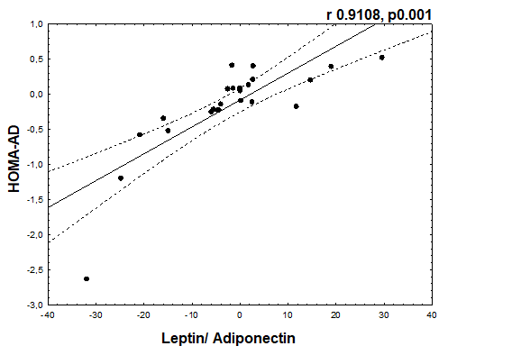
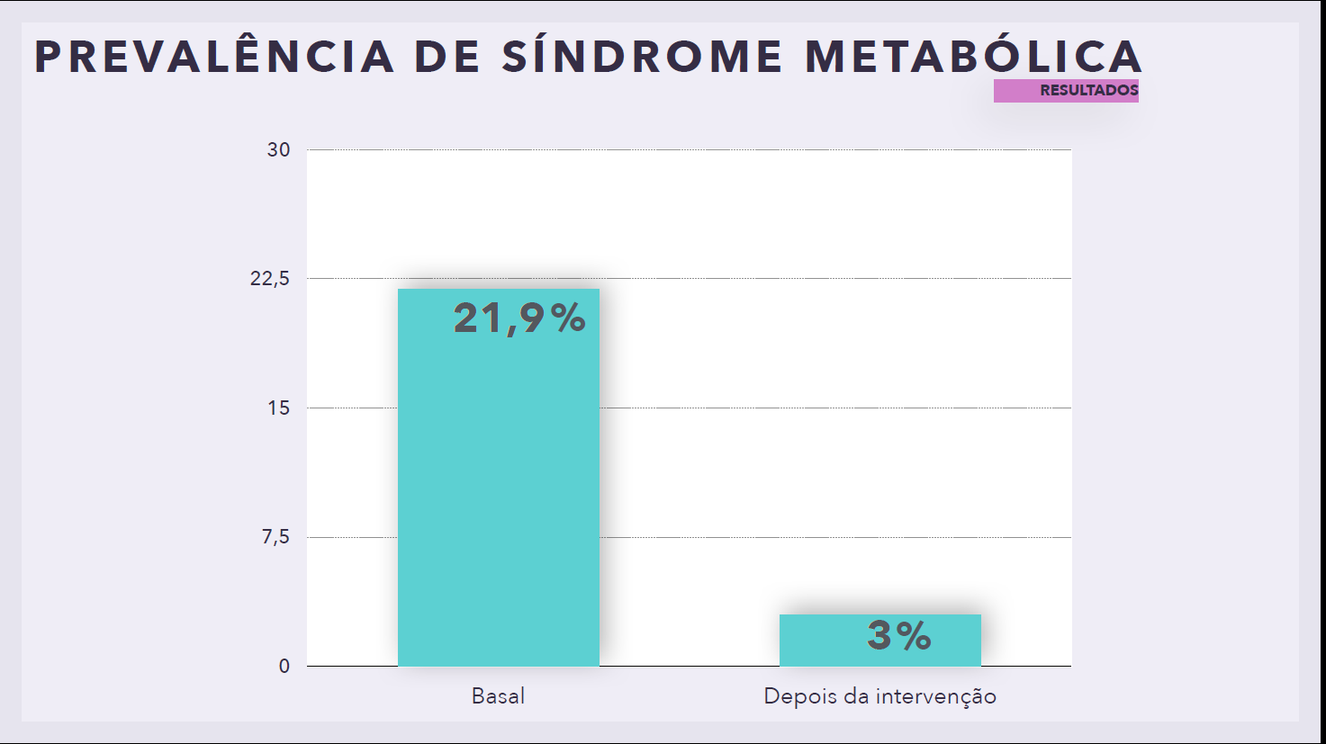



.
Figure 2. Correlations between HOMA-AD and Leptin/ Adiponectin ratio. Values of Delta Analyses. .
Interdisciplinary Therapy was Effective to Reduce the Metabolic Syndrome Prevalence in Women with Obesity
Paola Próspero Machado^{1,5}, Raquel Munhoz da Silveira Campos², Deborah Cristina Landi Masquio³, Aline de Piano Ganen³, Danielle Arisa Caranti², Samantha Ottani Rhein¹, Carolina Kim Shiba¹, Lila Missae Oyama^{1,4} Valter Boldarine^{1,4}, Lian Tock⁵, Leonardo Lo Duco⁵, Gabriela Iervolino de Oliveira⁵, David Thivel ⁶, Ana Raimunda Dâmaso¹
¹Programa de Pós-Graduação em Nutrição – Escola Paulista de Medicina, Universidade Federal de São Paulo (UNIFESP), Rua Marselhesa, 650 – Vila Clementino, São Paulo, SP 04020-050, Brasil
²Departamento de Biociências, Universidade Federal de São Paulo – UNIFESP; Programa de Pós-Graduação Interdisciplinar em Ciências da Saúde – UNIFESP, Campus Baixada Santista, Santos, Brasil
³Centro Universitário São Camilo, São Paulo, Brasil
⁴Departamento de Fisiologia da Escola Paulista de Medicina, Universidade Federal de São Paulo, São Paulo, SP, Brasil
⁵Centro Brasileiro de Nutrição e Esportes (CBNE), São Paulo, SP, Brasil
⁵Clermont Auvergne University, EA 3533, Laboratory of the Metabolic Adaptations to Exercise under Physiological and Pathological Conditions (AME2P), Clermont-Ferrand, France; CRNH-Auvergne, Clermont-Ferrand, France
Introduction: metabolic syndrome is a constellation of altered parameters that coexist with obesity increasing risks for cardiovascular disease.
Objective: To evaluate 1) the effects of the clinical multicomponent therapy in the prevalence of metabolic syndrome; and 2) if the leptin and adiponectin can modulate its response in women with obesity.
RESULTS
Table 1: Parameters analysed in metabolic syndrome and non-metabolic syndrome groups.
Variables | All (n=32) |  |  |  |  |  |  | non-Metabolic Syndrome (n=25) |  |  |  |  |  |  | Metabolic Syndrome (n=7)
 | baseline |  |  | after therapy |  |  |  | baseline |  |  | after therapy |  |  |  | baseline |  |  | after therapy
age (years) | 31.06 | ± | 4.70 |  |  |  |  | 31.36 | ± | 4.88 |  |  |  |  | 30.00 | ± | 4.16
height (m) | 1.63 | ± | 0.06 |  |  |  |  | 1.64 | ± | 0.06 |  |  |  |  | 1.59 | ± | 0.05
body weighth (kg) | 93.16 | ± | 16.96 | 88.36 | ± | 16.23 |  | 96.14 | ± | 17.66 | 91.91 | ± | 16.02 ª |  | 82.54 | ± | 8.37 | 75.66 | ± | 9.64 ^{a, b}
BMI (kg/m²) | 34.01 | ± | 4.00 | 33.30 | ± | 5.52 |  | 34.41 | ± | 4.26 | 34.24 | ± | 5.72 ª |  | 32.70 | ± | 2.86 | 29.93 | ± | 3.08 ª
neck circumference (cm) | 36.41 | ± | 1.97 | 35.32 | ± | 1.76 |  | 36.55 | ± | 1.79 | 35.56 | ± | 1.72 ª |  | 35.90 | ± | 2.61 | 34.46 | ± | 1.77 ª
waist circumference (cm) | 95.47 | ± | 8.91 | 90.22 | ± | 8.16 |  | 95.54 | ± | 9.57 | 91.23 | ± | 8.71 ª |  | 95.21 | ± | 6.63 | 86.61 | ± | 4.62 ª
abdominal circumference (cm) | 107.13 | ± | 8.84 | 103.03 | ± | 10.06 |  | 107.69 | ± | 9.85 | 104.25 | ± | 10.65 ª |  | 105.21 | ± | 3.63 | 98.66 | ± | 6.39 ª
hip circumference (cm) | 120.05 | ± | 9.73 | 116.96 | ± | 11.28 |  | 121.88 | ± | 9.80 | 119.77 | ± | 10.66 ª |  | 113.79 | ± | 6.82 | 106.90 | ± | 7.22 ^{a, b}
waist/hip ratio | 0.79 | ± | 0.07 | 0.77 | ± | 0.06 |  | 0.78 | ± | 0.05 | 0.76 | ± | 0.06 |  | 0.84 | ± | 0.09 | 0.81 | ± | 0.06 ª
fat mass (%) | 38.25 | ± | 5.05 | 36.13 | ± | 5.00 |  | 38.80 | ± | 5.36 | 37.40 | ± | 4.39 |  | 36.29 | ± | 3.30 | 31.59 | ± | 4.61 ^{a, b}
lean mass | 57.26 | ± | 7.38 | 56.66 | ± | 9.17 |  | 58.28 | ± | 7.64 | 57.81 | ± | 9.66 |  | 53.63 | ± | 5.32 | 52.73 | ± | 6.26
RMR | 1740.97 | ± | 224.72 | 1731.74 | ± | 274.51 |  | 1771.64 | ± | 232.67 | 1758.00 | ± | 293.78 |  | 1631.43 | ± | 162.63 | 1641.71 | ± | 183.67
Glucose (mg/dL) | 97.13 | ± | 10.44 | 92.94 | ± | 6.79 |  | 98.46 | ± | 10.60 | 93.20 | ± | 7.63 ª |  | 92.57 | ± | 9.11 | 92.00 | ± | 2.00
Total Cholesterol (mg/dL) | 196.16 | ± | 34.78 | 183.53 | ± | 43.14 |  | 198.00 | ± | 37.74 | 189.64 | ± | 44.14 ª |  | 189.57 | ± | 22.06 | 161.71 | ± | 33.36 ^{a, b}
HDL - Cholesterol (mg/dL) | 52.55 | ± | 13.30 | 51.32 | ± | 11.37 |  | 55.75 | ± | 13.29 | 53.21 | ± | 11.88 ª |  | 41.57 | ± | 5.06 | 44.86 | ± | 6.47 ^{b}
non-HDL Cholesterol (mg/dL) | 142.00 | ± | 30.05 | 133.69 | ± | 35.41 |  | 140.32 | ± | 32.26 | 134.40 | ± | 37.98 |  | 148.00 | ± | 21.24 | 131.14 | ± | 26.43 ª
LDL - Cholesterol (mg/dL) | 114.91 | ± | 26.98 | 111.63 | ± | 31.81 |  | 116.24 | ± | 28.93 | 114.32 | ± | 33.57 |  | 110.14 | ± | 19.51 | 102.00 | ± | 24.08
VLDL - Cholesterol (mg/dL) | 27.13 | ± | 12.40 | 22.06 | ± | 8.55 |  | 24.12 | ± | 11.81 | 20.08 | ± | 8.23 ª |  | 37.86 | ± | 8.05 ^{c} | 29.14 | ± | 5.61 ^{a, b}
Tryglicerides (mg/dL) | 135.88 | ± | 61.21 | 110.75 | ± | 43.09 |  | 120.96 | ± | 58.13 | 100.56 | ± | 41.42 ª |  | 189.14 | ± | 40.09 ^{c} | 147.14 | ± | 27.48 ^{a, b}
TGO enzyme (U/L) | 16.03 | ± | 5.26 | 15.71 | ± | 5.03 |  | 15.84 | ± | 4.85 | 16.64 | ± | 5.11 |  | 16.83 | ± | 7.19 | 11.83 | ± | 2.04 ª
TGP enzyme (U/L) | 17.26 | ± | 9.64 | 17.77 | ± | 10.32 |  | 15.17 | ± | 7.79 | 16.96 | ± | 8.92 |  | 24.43 | ± | 12.42 | 20.43 | ± | 14.58
GGT enzyme (U/L) | 23.53 | ± | 15.02 | 21.19 | ± | 11.25 |  | 19.92 | ± | 11.24 | 19.32 | ± | 9.47 |  | 36.43 | ± | 20.30 | 27.86 | ± | 15.15 ª
Insulin (uIU/mL) | 13.00 | ± | 5.45 | 11.29 | ± | 4.85 |  | 12.51 | ± | 5.14 | 10.37 | ± | 4.25 ª |  | 14.76 | ± | 6.57 | 14.44 | ± | 5.76
HOMA-IR | 3.20 | ± | 1.51 | 2.60 | ± | 1.14 |  | 3.12 | ± | 1.46 | 2.39 | ± | 1.02 ª |  | 3.46 | ± | 1.79 | 3.29 | ± | 1.34
HOMA-AD | 1.00 | ± | 0.96 | 0.88 | ± | 0.67 |  | 0.82 | ± | 0.63 | 0.79 | ± | 0.57 |  | 1.58 | ± | 1.54 | 1.17 | ± | 0.91
Resistin | 35.57 | ± | 16.20 | 29.06 | ± | 11.12 |  | 32.77 | ± | 13.78 | 27.93 | ± | 12.40 |  | 44.64 | ± | 22.27 | 32.72 | ± | 4.56
Adiponectin | 4.76 | ± | 2.66 | 4.06 | ± | 2.23 |  | 4.85 | ± | 2.39 | 4.05 | ± | 2.26 |  | 4.47 | ± | 3.64 | 4.09 | ± | 2.32
Leptin | 68.51 | ± | 22.38 | 58.16 | ± | 30.53 |  | 71.03 | ± | 23.46 | 63.24 | ± | 30.98 |  | 60.92 | ± | 18.18 | 42.94 | ± | 25.19 ª
leptin/adiponectin ratio | 20.47 | ± | 14.23 | 18.26 | ± | 12.18 |  | 20.45 | ± | 14.91 | 20.34 | ± | 13.13 |  | 20.52 | ± | 13.26 | 12.02 | ± | 5.69
atrial natriuretic peptide | 315.13 | ± | 290.61 | 303.97 | ± | 214.46 |  | 354.94 | ± | 312.70 | 304.97 | ± | 240.29 |  | 155.89 | ± | 60.90 | 299.98 | ± | 50.75
Material and methods
Ethical Committee
0305/2017 – UNIFESP
Statistical difference: a – effect of therapy; b – difference between the groups in final condition; c – difference between the groups in baseline condition.
Media
(project disclosure recruitment of volunteers)
Inclusion Criteria
20-46
years old
BMI
≥ 25 kg/m²
Women
Volunteers Selected
(n=40)
dropout
(n=8)
Metabolic Syndrome Prevalence in Women with Obesity
Interdisciplinary Intervention
12 weeks
Clinical
Approach
Nutritional
Counseling
Physical Exercise
Orientations
*
Figure 1. Experimental design.
Pre -Therapy Pós- Therapy
Statistical analysis
Statistical analysis was performed using the program STATISTICA version 7.0. Significance was set as p<0.05. Data normality was verified by Shapiro Wilks test. Parametric data were expressed as mean ± SD, and non-parametric data were expressed as median, minimum and maximum values. ANOVA two-way test was applied to compare delta variables among the groups.
Figure 3
Conclusions
Clinical approach associated with health education was effective in reducing the MS prevalence mediated by leptin and adiponectin avoid the development of cardiovascular disease in women with obesity.
FUNDING: CAPES; CNPq 301322/2017-1 and 409943/2016-9; FAPESP 2011/50414-0 and 2017/073702-1.

