Slide 1
Understanding
Oral Cancer
Presented by:
Corinne E Jameson-Kuehl, RDH, BS, OMT

Slide 2
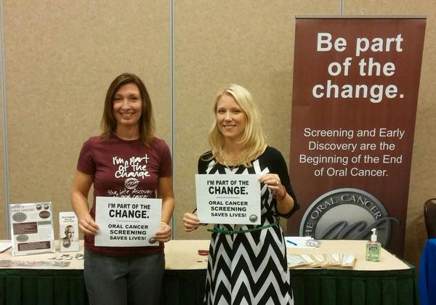
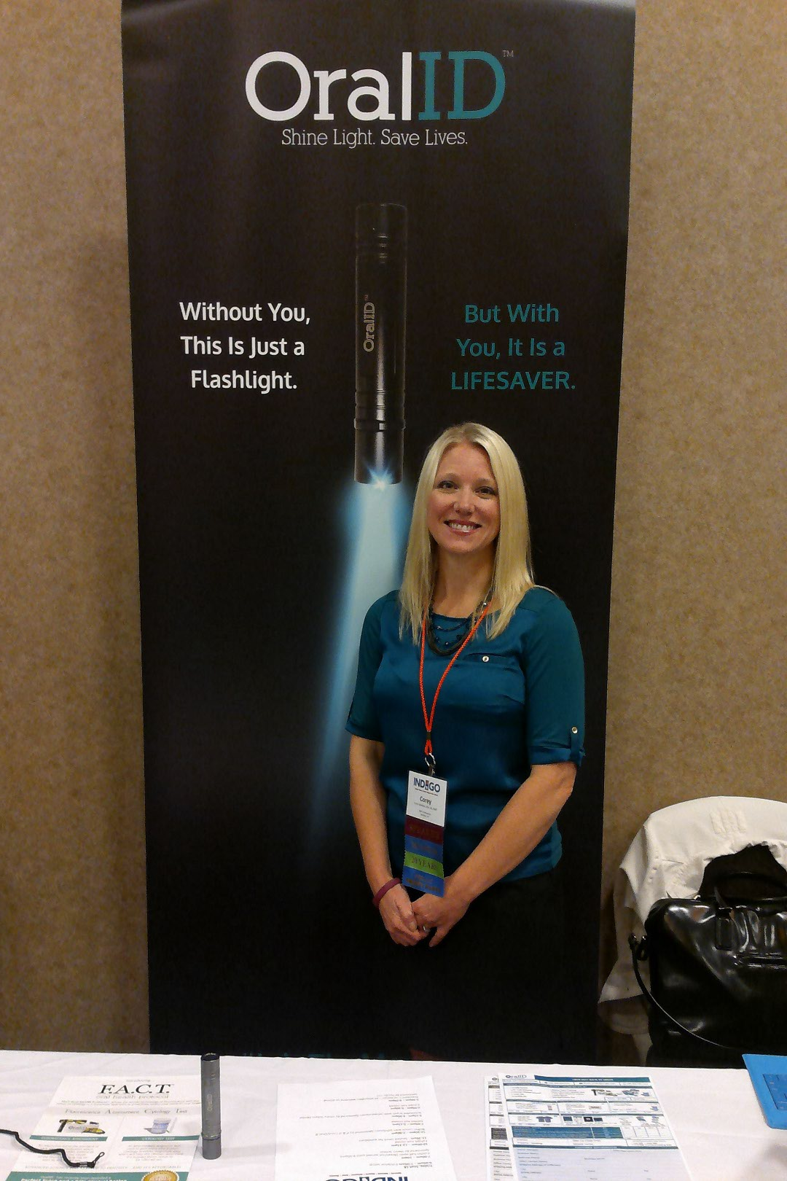
https://www.facebook.com/Corinne-E-Jameson-Kuehl-225669804243935/?ref=hl
happywisconsinfaces@gmail.com

Slide 3

40,000-45,000 Americans will be diagnosed with Oral Cancer this year.
Notes:
Over the next 20 years, the WHO predict more then a 50% increase in the incidence of Oral Cancer.

Slide 4
Oral Cancer Statistics
90% of all cancers originate in the body’s epithelial tissue that line the body cavity. Including the Oral Cavity.
Sixth most common cancer in the World
Oral Cancer is more deadly than:
    Breast cancer
    Cervical Cancer
    Colon Cancer
    Skin Cancer
    Bone Cancer

Slide 5
Oral Cancer Statistics
The casual link between HPV (16+18) and OC is becoming better understood.
1.2 Million active HPV (16+18) cases in the U.S with an estimated 275,000 new cases each year
The fastest growing segment of The Oral Cancer population in the U.S are non-smokers under 50.
8-15% of all Erythroplakias and Leukoplakias when followed transform to cancer
Early detection survival cases of oral cancer exceed 90%

Slide 6
5 year survival rate at 50%....WHY???
  25% of diagnosis have no known risk factors….
Dental professionals ignore lesions that appear suspicious….and then pre-cancer cells develop into cancer cells…
LATE DETECTION and many too many “opinions” over a long period of time. NO STANDARD PROTOCOL.

Slide 7
Exploring Reasons for Delay
Lack of Appreciation of Symptoms
Primary DDS or MD
Referral to community specialist (bx initiated)
Referral to treating specialist
Initiation of staging
Head and Neck Tumor Board
Treatment
35
11
17
104
18
21
Mean 206 Days

Slide 8

Survivors experience extreme difficulties with consistent head and neck pain, permanent disfigurement, and loss of eating and speaking

Slide 9
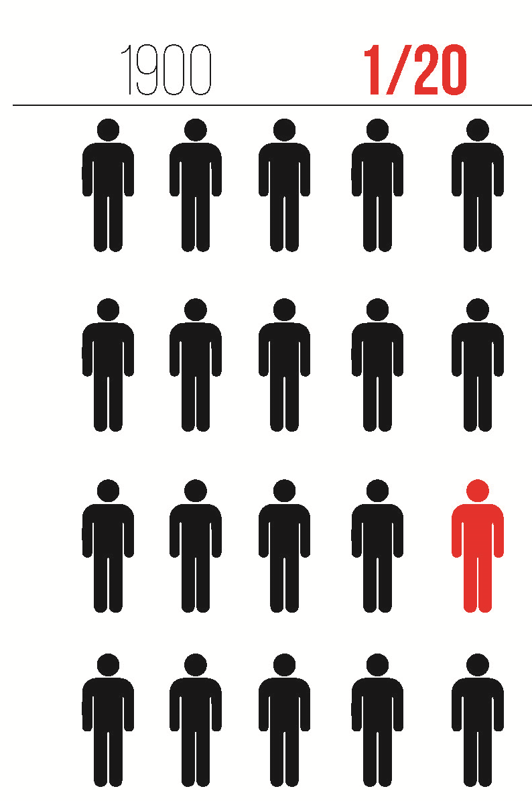
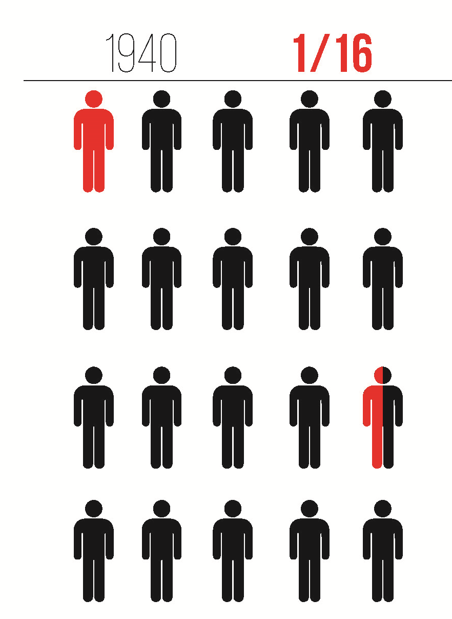
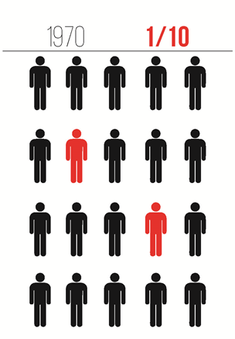
Cancer in America

Slide 10
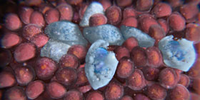
Creation of Cancer
Notes:
What Is Cancer?
In the most basic terms, cancer refers to cells that grow out-of-control and invade other tissues. Cells become cancerous due to the accumulation of defects, or mutations, in their DNA. Certain inherited genetic defects (for example, BRCA1 and BRCA2 mutations) and infections can increase the risk of cancer. Environmental factors (for example, air pollution) and poor lifestyle choices -- such as smoking and heavy alcohol use -- can also damage DNA and lead to cancer.
Most of the time, cells are able to detect and repair DNA damage. If a cell is severely damaged and cannot repair itself it undergoes so-called programmed cell death or apoptosis. Cancer occurs when damaged cells grow, divide, and spread abnormally instead of self-destructing as they should.
Source: Medicine.net

Slide 11
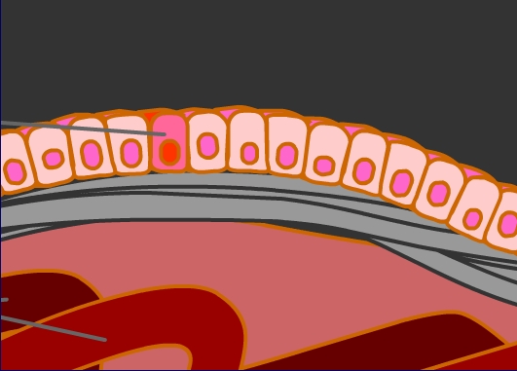
Mutated Cell
Carcinomas originate in the body’s epithelial tissues, which are thin cell layers, often a single cell deep, that line body cavities.
Epithelial basement membrane
Blood Vessel

Slide 12
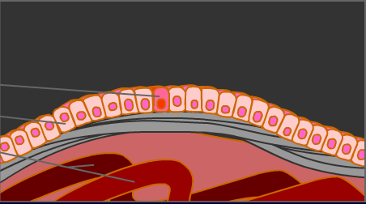
Mutated Cell
Normal Cell
Blood Vessel
Cells replicate periodically, but normal cells replicate only to replace other cells.
Mutated cells reproduce even though replacement cells are not needed.

Slide 13
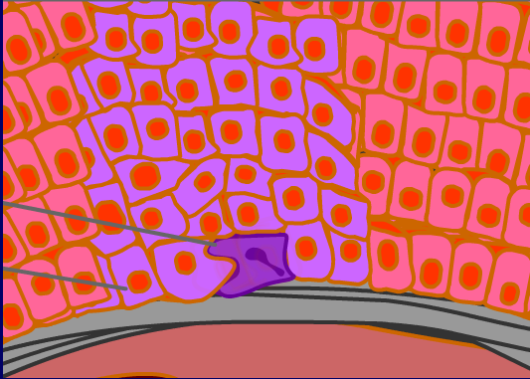
Additional Mutation
Prior Mutations
A mutation may simply cause a cell from self destructing. Normal cells have surveillance mechanisms that look for damage or problems with their own control systems. If such problems are found, the cell destroys itself.
Over time additional mutations may occur. If the mutation gives the cell some further advantage, that cell will grow more vigorously and thus speed up the growth of the tumor.

Slide 14
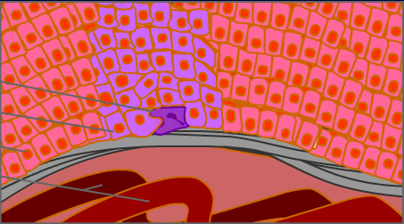
More Aggressive Mutation
Additional Mutation
First Mutation
Blood Vessel
The more aggressive mutation paves the way for the development of an even more aggressive cancer.
At this point the tumor is still contained.

Slide 15
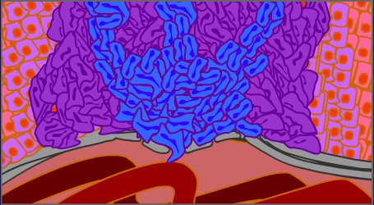
The newer, more aggressive cells are able to push their way through the epithelial tissue’s basement membrane. The invasive cells in the tumor are no longer contained.

Slide 16

Individual cells from the tumor enter the blood stream and travel to other parts of the body.
Cells also invade vessels of the lymph stem.
A tumor as small as a grain of rice can send out a million tumor cells a day.

Slide 17


Slide 18




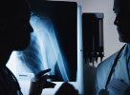

What Causes cancer?
Notes:
Low Vitamin C
Pollution
Poor diet and lifestyle
Excessive alcohol use and smoking
Persistant infections and disease
Gentics
Chemical exposure
Sun exposure

Slide 19
specific risk factors for Oral cancer

Slide 20
Tobacco in all forms; cigarettes, snuff, and gutkha, a combination of betel quid and tobacco (aceta nut) found in Indian and Asian cultures.
Excessive Alcohol use.
Family history and genetic predispositions.
Chronic Lichen Planus, Leukoplakia, Erythroplakia and tissue abrasions and infections.
Persistent HPV particularly strain 16 and 18.
Notes:
~discuss the Hmong community of gutkha use
~More males are diagnosed then females.

Slide 21


90% of people diagnosed with oropharyngeal cancer use tobacco
Tobacco use is the leading cause for cancer and death.
There are over 7,000 harmful chemicals in a cigarette; and at least 28 known cancer-creating chemicals in smokeless tobacco.

Slide 22
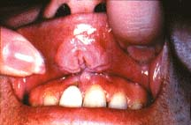
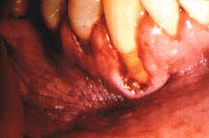
“After a careful examination of the relevant epidemiologic, experimental, and clinical data, the committee concludes that the oral use of smokeless tobacco represents a significant health risk.
It is not a safe substitute for smoking cigarettes. It can cause cancer and a number of noncancerous oral conditions and can lead to nicotine addiction and dependence” US Surgeon General Report

Slide 23
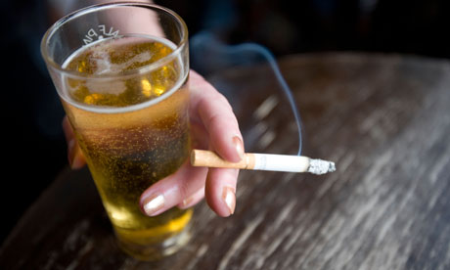
Tobacco and alcohol work synergistically to increase oral cancer risk
Notes:
Ethanol enhances the permeability of tobacco carcinogens in the mucosa; especially the floor of the mouth.
Source: “Effect of alcohol on mucosal penetration of tobacco carcinogens” Emore, JG 1991
OCF

Slide 24

Level of consumption is important!
Notes:
All three forms of alcohol (beer, hard liquor, and wine) have been associated with oral cancer, (29-34) although hard liquor and beer have a higher associated risk. Studies that have found alcohol use to be a factor for oral carcinogenesis have usually concluded that the level of consumption was important; one study found elevated risk only if 56 or more glasses of wine per week were (34) consumed. Another study showed a significant increase only if the average daily consumption of (30) alcohol exceeded 120 grams. That evidence is contradictory about the role of alcohol in oral cancer may relate to the difficulty in measuring intake or to alcohol's effect on other variables (or both), but it is reasonable to assume that any form of alcohol taken in excess may promote oral cancer. - See more at: http://www.oralcancerfoundation.org/cdc/cdc_chapter3.php#sthash.3a9YYY3V.dpuf

Slide 25
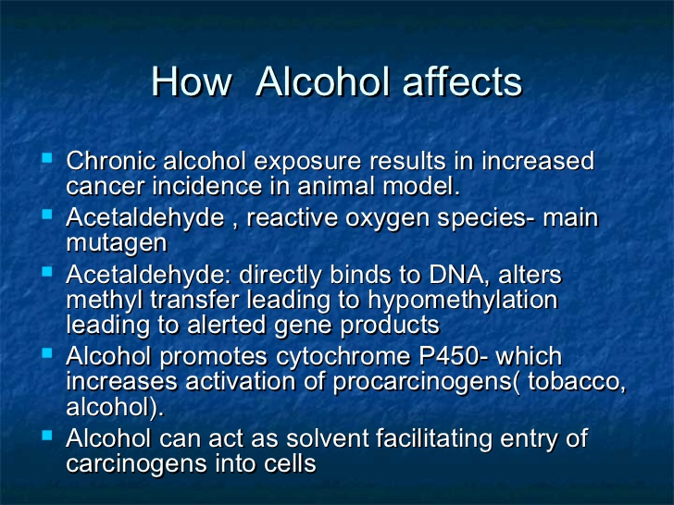
Excessive Alcohol use
Notes:
Source: BDA 2011

Slide 26
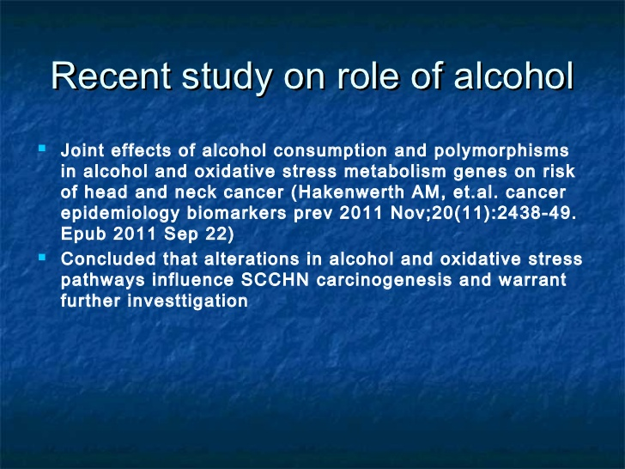

Slide 27
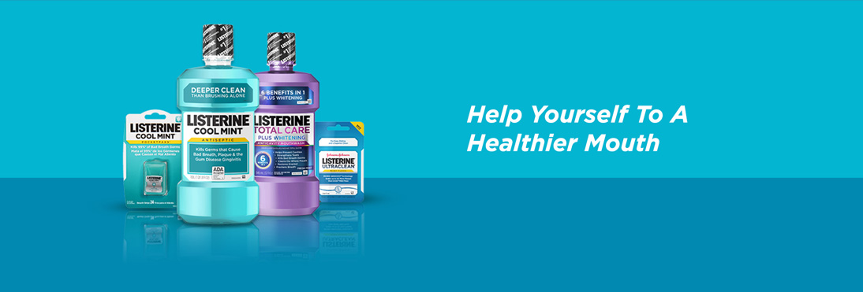
What about the alcohol content in mouth wash?
Notes:
Although there is no certain link between oral cancer and mouth wash; excessive use should be discouraged. Those with potentially malignant lesions should refrain from use.
Source: Mouthwash and the Oral Cancer Rick-Quanative Meta-analysis of Epidemiologic studies 2012, vol 19 pages 173-180

Slide 28
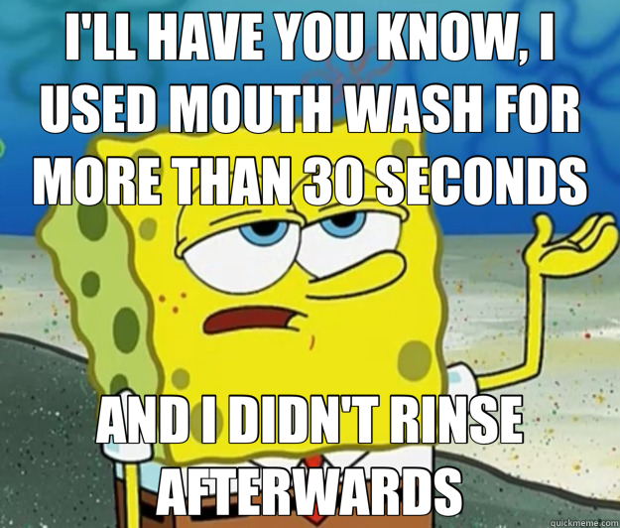

Slide 29
Genetic and gender risks

Slide 30
Family History:
-2013 ICARE Research article concluded that family history of head and neck cancer IS a marker of an increased risk of oral cavity cancer and should be taken into account to target prevention efforts and screenings.
www.biomedcentral.com/1471-2407/13560
Gender and Race:
-Higher in Hispanic and black males
www.nidcr.nih.gov/dataStatistics
*This is changing due to the significant increase of HVP related diagnoses.
Previous History of Cancer:
-A slight risk of developing a secondary cancer and previous chemotherapy drugs.
www.cancerresearchuk.org

Slide 31
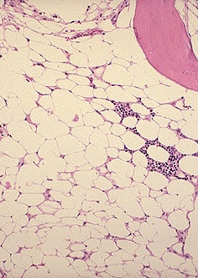
Genetic syndromes
Fanconi anemia is a condition that can be caused by inherited defects in several genes that contribute to repair of DNA. People with this syndrome often have blood problems at an early age, which may lead to leukemia or aplastic anemia. They also have a very high risk of cancer of the mouth and throat.
Dyskeratosis congenita is a genetic syndrome that can cause aplastic anemia, skin rashes, and abnormal fingernails and toenails. People with this syndrome also have a very high risk of developing cancer of the mouth and throat at an early age.
Notes:
Source: www.cancer.org/cancer/oralcavityandoropharyndealcancer/detailedguide/oral-cavity-and-oropharyngeall-cancer-risk-factors

Slide 32
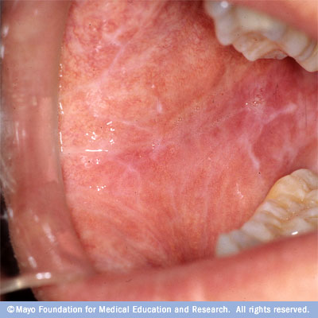
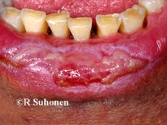
Lichen Planus
Classic Reticular
Chronic Erosive
Notes:
Will my lichen planus turn into cancer? Answer: This association remains controversial and reinforces the need for an accurate diagnosis through biopsy. Lichen planus has been classified as a pre-cancerous lesion with reported cases of carcinoma occurring. However, the percentage is very small and most reported cases have involved the erosive, plaque, and atrophic types of lichen planus. Periodic evaluation and follow up is important so that any change in the tissue may be evaluated and treated early. Any changes should be reported to your healthcare provider and further evaluation should occur. Patients should be encouraged to keep regularly scheduled appointments and be made aware of the importance of consistent evaluations of the lichen planus.

Slide 33
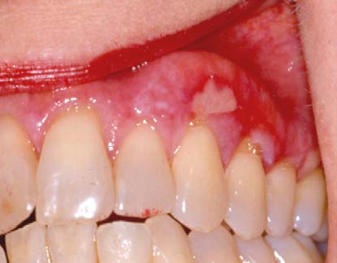
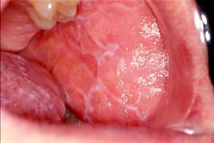
Other Chronic Irritations
Notes:
Apthus Ulcers included.
Desquamus gingivtius
UK story

Slide 34
Long-term irritations of the mouth
Poor fitting dentures possibly create a risk factor for Oral Cancer trapping tobacco and alcohol. Also leading to poor diet lacking quality nutritious foods.
Dental appliances and restorations that have a continual abrasion on oral tissues need to be evaluated for optimal tissue health. There is some speculation these chronic irritations are now a risk factor for Oral Cancer.

Slide 35
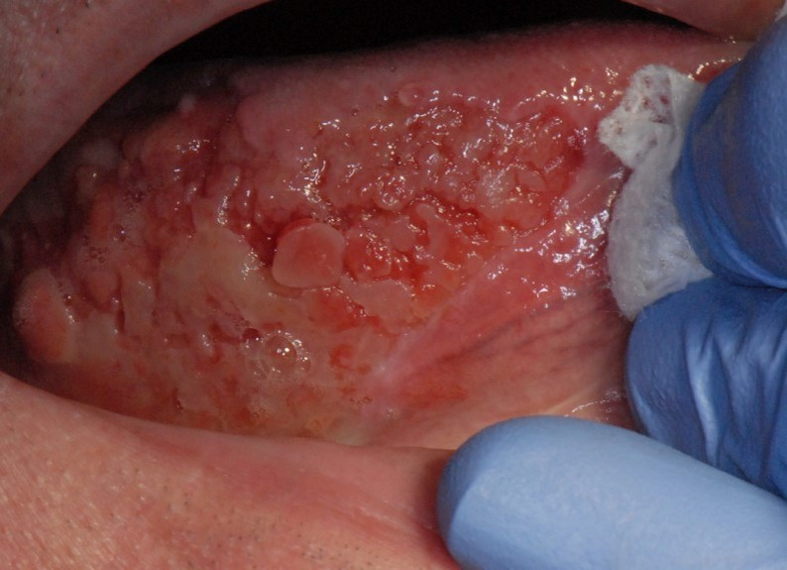
Notes:
It was “watched” for 3 years by a DDS, who told the patient to stop “chewing on his tongue”
This is squamous cell carcinoma (90% of oral cancers are squamous cell carcinoma)

Slide 36

HPV-The Oral Cancer Connection

Slide 37
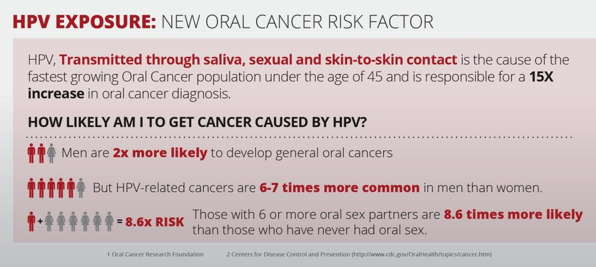

Slide 38
How do you know if your infected?
--Most people with HPV do not know they are infected and never develop symptoms or health problems from it. There is no current oral testing, however there are some companies working on a salivary test to use chairside.
--Some people find out they have HPV when they get genital warts.
---Women may find out they have HPV when they get an abnormal Pap test result (during cervical cancer screening).
--Others may only find out once they’ve developed more serious problems from HPV, such as cancers.
Notes:
Source: CDC

Slide 39
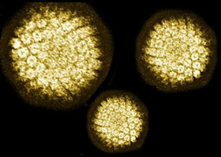
HPV-over 200 strains; but #16 and #18 Are the Oral Cancer connection

Slide 40
How common is HPV infection of the throat?
A recent study found that 7% of Americans 14 to 69 years old are infected with tonsillar HPV. The same study found that the prevalence has increased significantly over the past three decades, and that more men than women have oral HPV infection.
The most frequent subtype of tonsillar HPV detected is HPV-16, a high-risk subtype of HPV for oropharyngeal (mouth and pharynx) cancer. About two thirds of oropharyngeal cancers have HPV DNA in them. Infection with HPV-16 occurs in about 1% of men and women.
https://my.clevelandclinic.org/health/diseases_conditions/hic_Oral_Human_Papilloma_Virus_HPV_infection
Notes:
Source: Cleveland Clinic 2013

Slide 41
HPV Vaccination
Who should get vaccinated?
-All boys and girls ages 11 or 12 years should get vaccinated.
-Catch-up vaccines are recommended for males through age 21 and for females through age 26, if they did not get vaccinated when they were younger.
-The vaccine is also recommended for gay and bisexual men (or any man who has sex with a man) through age 26.
-It is also recommended for men and women with compromised immune systems (including people living with HIV/AIDS) through age 26, if they did not get fully vaccinated when they were younger.
Notes:
Source: CDC 2016

Slide 42
Available HPV Vaccines
There are three licensed HPV vaccines available in the United States. HPV vaccines are given as a series of three shots over 6 months to protect against HPV infection and the health problems that ongoing HPV infection can cause.
Gardasil 9: FDA approved Gardasil 9 for use in 2014. The safety of Gardasil 9 was studied in clinical trials with more than 15,000 participants before it was licensed and continues to be monitored. Gardasil 9 protects against HPV types 6, 11, 16, 18, 31, 33, 45, 52, and 58.
Gardasil: FDA approved Gardasil for use in 2006. The safety of Gardasil was studied in clinical trials with more than 29,000 participants before it was licensed and continues to be monitored. Gardasil protects against HPV types 6, 11, 16, and 18.
Cervarix: FDA approved Cervarix for use in 2009. The safety of Cervarix was studied in clinical trials with more than 30,000 participants before it was licensed and continues to be monitored. Cervarix protects women and girls against HPV types 16 and 18.
Notes:
Source: CDC 2016

Slide 43
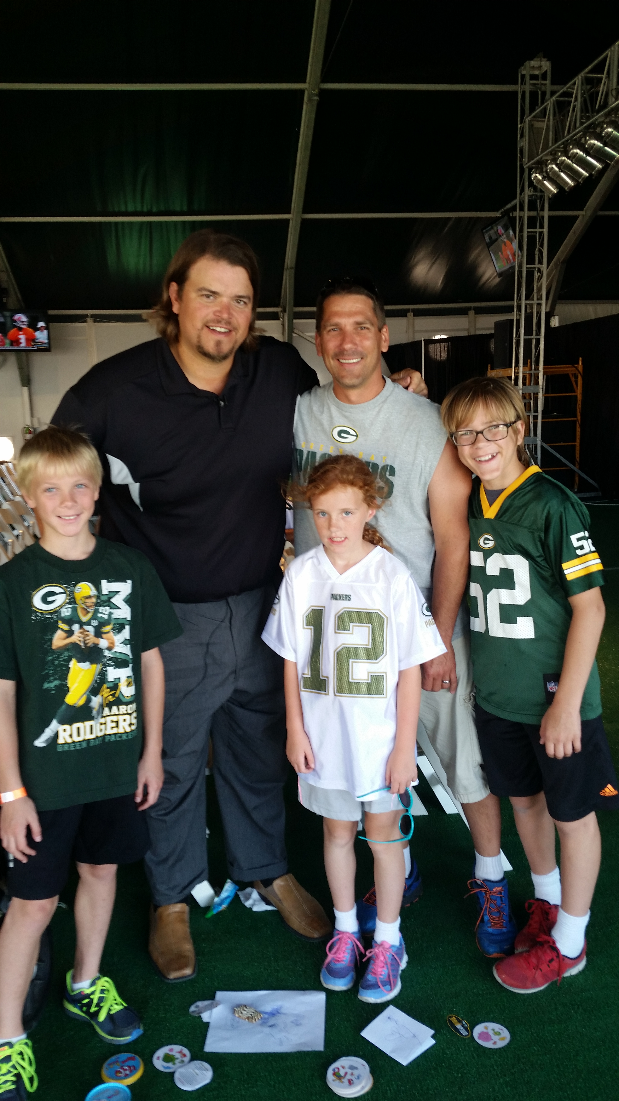
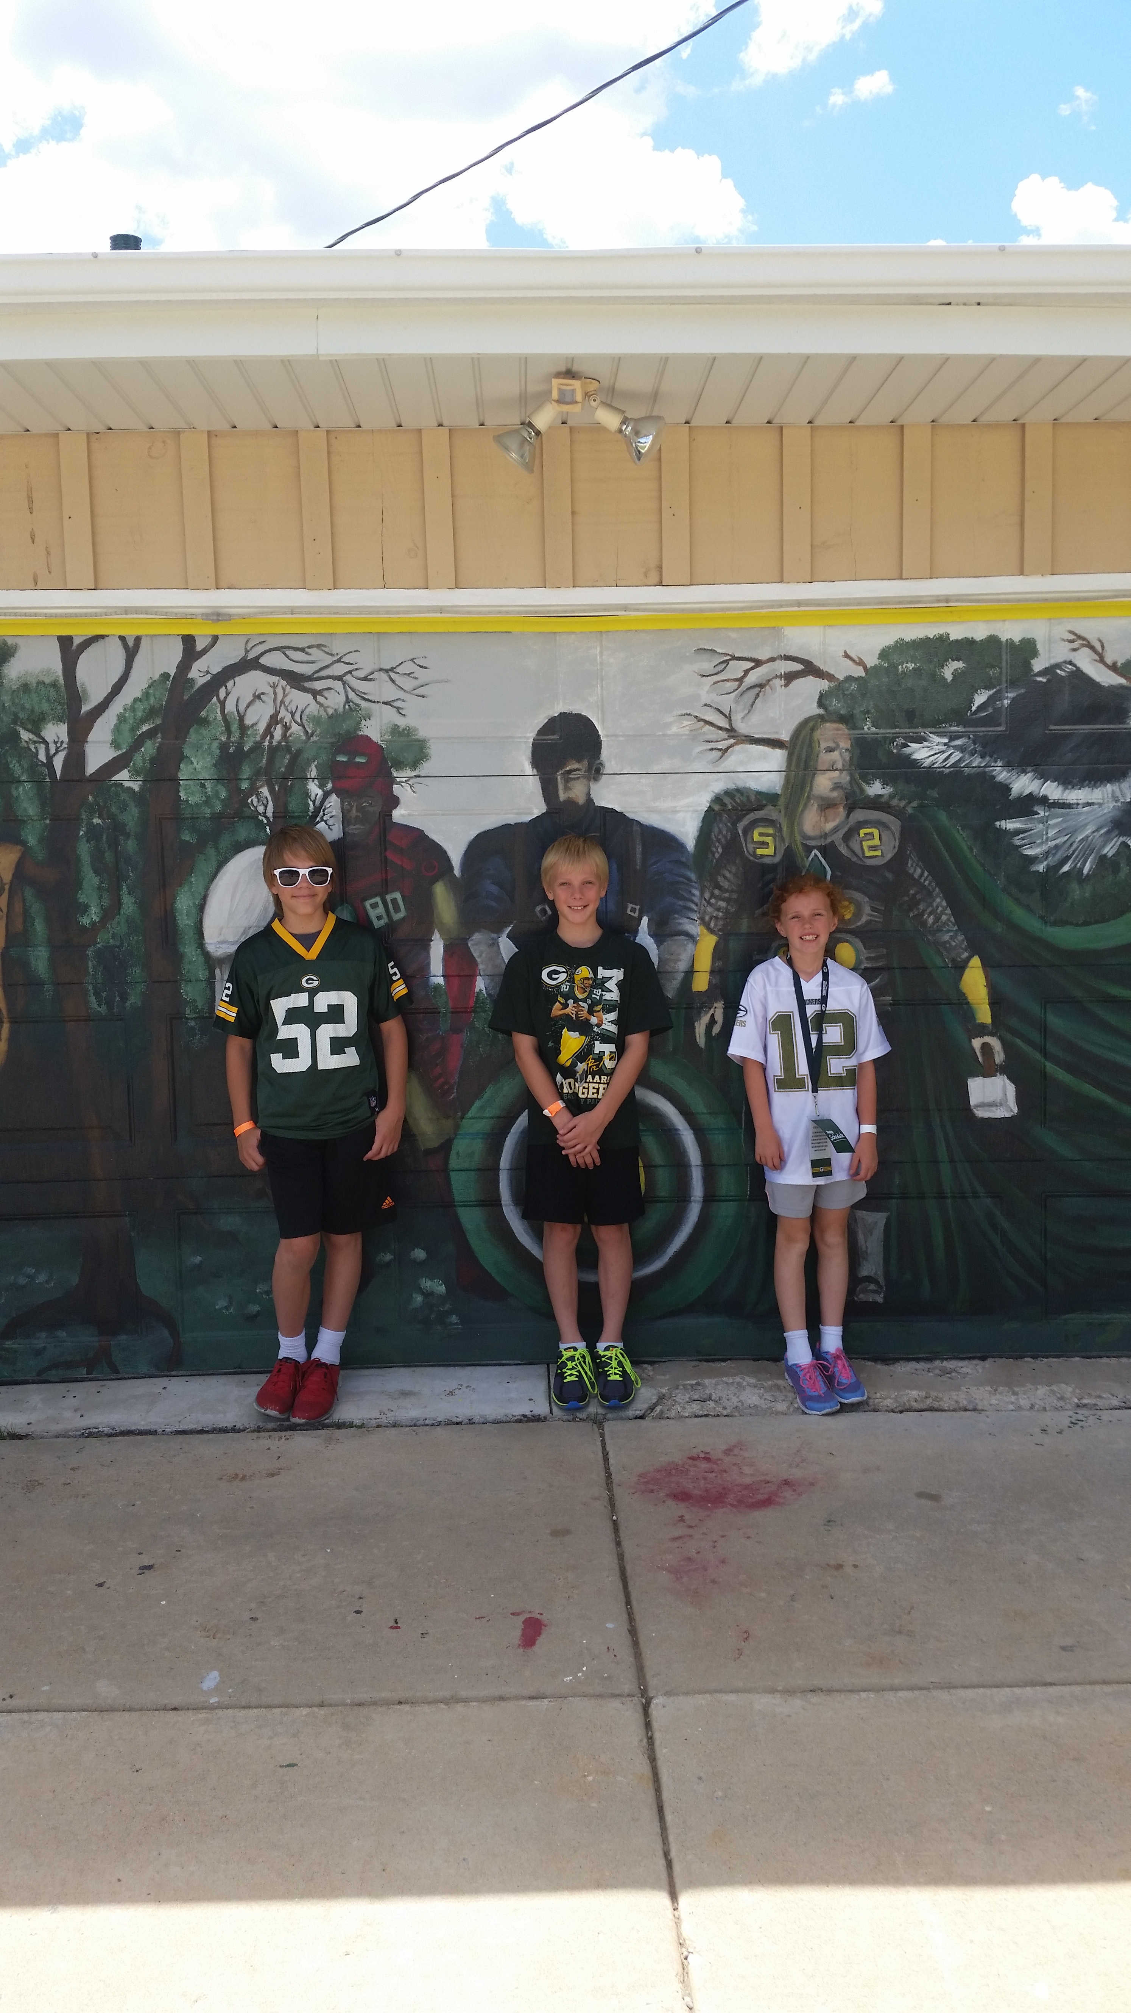

Slide 44
Suspicious Lesions
The term “pre-cancerous” has been replaced with “Potentially Malignant Lesion”
https://www.dentalaegis.com/special-issues/2011/09/potentially-malignant-lesions-of-the-oral-cavity#sthash.N5FffnnB.dpuf
Notes:
The term precancerous is being replaced by Potentially Malignant Lesion (The terminology "precancerous lesion" implies that the lesion will follow an irreversible and inevitable progression to OCSCC. Research shows that, while there is statistical evidence to predict particular clinical and microscopic changes that are associated with development of OCSCC, for any individual lesion clinicians can only estimate the likelihood of progression.3 Thus, rather than precancerous lesion, a term that more accurately reflects current understanding is preferred: potentially malignant lesion. - See more at: https://www.dentalaegis.com/special-issues/2011/09/potentially-malignant-lesions-of-the-oral-cavity#sthash.N5FffnnB.dpuf)

Slide 45


Slide 46
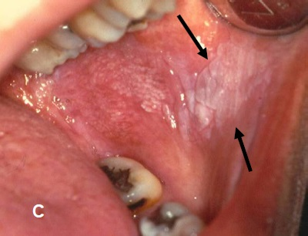
Leukoplakia

Slide 47
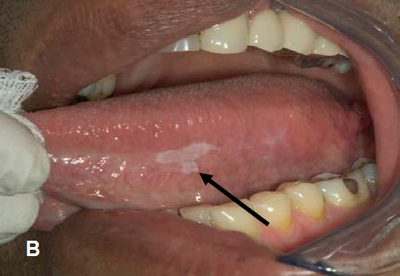
Leukoplakia

Slide 48
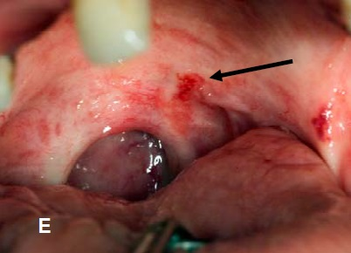
Erythroplakia

Slide 49
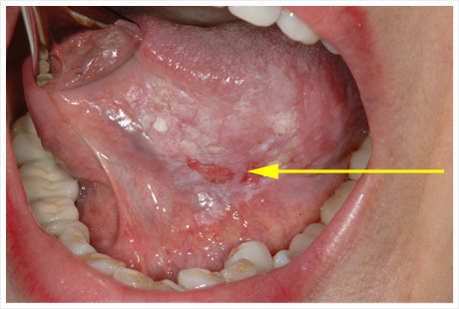
Mixed spot lesion

Slide 50
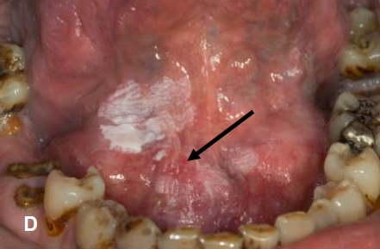
Carcinoma In Situ

Slide 51
Stages of Oral Cancer
The Stage of Cancer means how big it is and whether it has grown or spread:
  Mild Dysplasia Precancer
  Moderate Dysplasia Precancer
Stage 0 (Carcinoma in situ) – CIS
  Most severe stage of Dysplasia
  They are cancer cells but they are contained and have not spread.
Stage 1
  Earliest stage of invasive cancer.
  Cancer has begun to grow through the tissue layer.
  The cancer is no more than 2cm and has not spread to nearby tissues, lymph nodes or organs.
Stage 2
  The tumor is larger than 2cm but less than 4cm.
  The cancer has not spread to lymph nodes or other organs.
Stage 3
  The cancer is bigger than 4cm but has not spread to any lymph nodes or other organs.
  Or
  The tumor is any size but has spread to one lymph node on the same side of the neck.
Stage 4
  4A - Has grown through the tissues around lips and mouth.
    Lymph nodes in the area may or may not contain cancer.
  4B – Any size and has spread to multiple lymph nodes.
  4C – The cancer has spread to other parts of the body.
5yr survival
68-85%
5yr Survival
53-66%
5yr Survival
37-41%
5yr Survival
21-27%

Slide 52
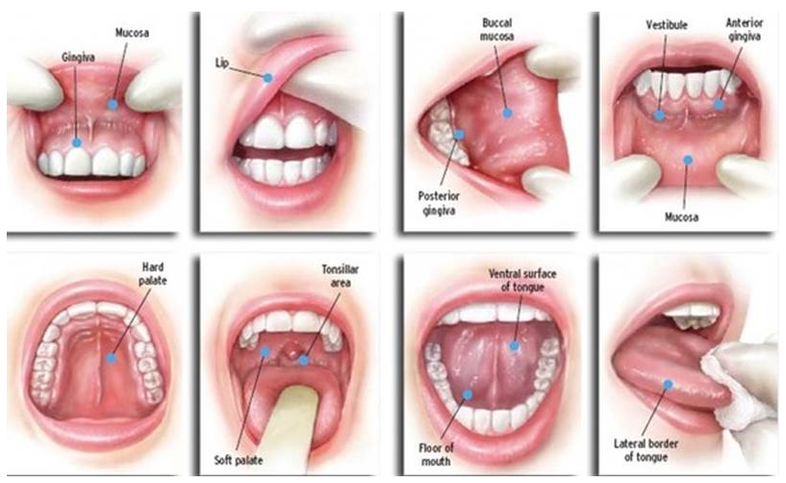
Areas of Oral cancer Expression
Site of Cancer | %
Lip | 35
Lateral/Vertical Tongue | 25
Floor of Mouth | 20
Soft Palate | 15
Gingiva | 4
Buccal Mucosa | 1

Slide 53
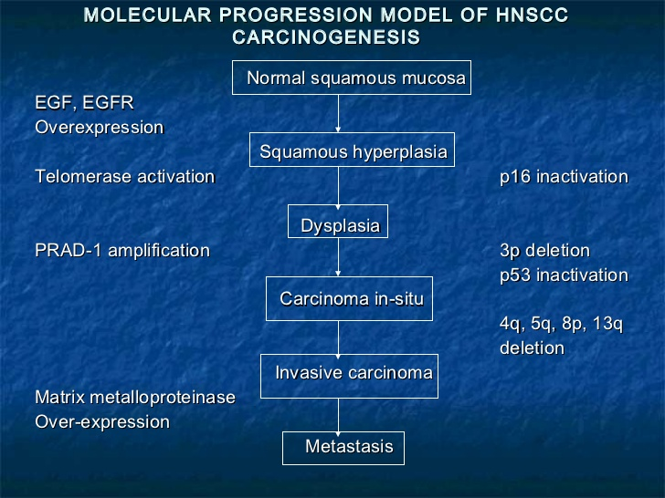
Notes:
Source: BDA 2013

Slide 54


OCF Event 2015
Battle for Blazo team
Start of race

Slide 55

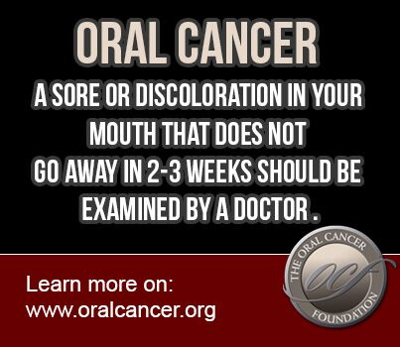

Slide 56

How do we prevent oral cancer?

Slide 57
So….any “Medical Changes” since I saw you last?
DO NOT just breeze through this question! You have a responsibility to assist the patient with any health changes and awareness!
  Notice any speech changes
  Engage in conversations regarding persistent coughs, sore throats, anything that “doesn’t seem quiet right.”
  Also, update your patients on the rise of HPV related oral cancers.
  Establish a relationship with providers in your area.
Notes:
Encourage to get that patient to the right provider. YES! Educate yourself on what/where your patient can go to!

Slide 58
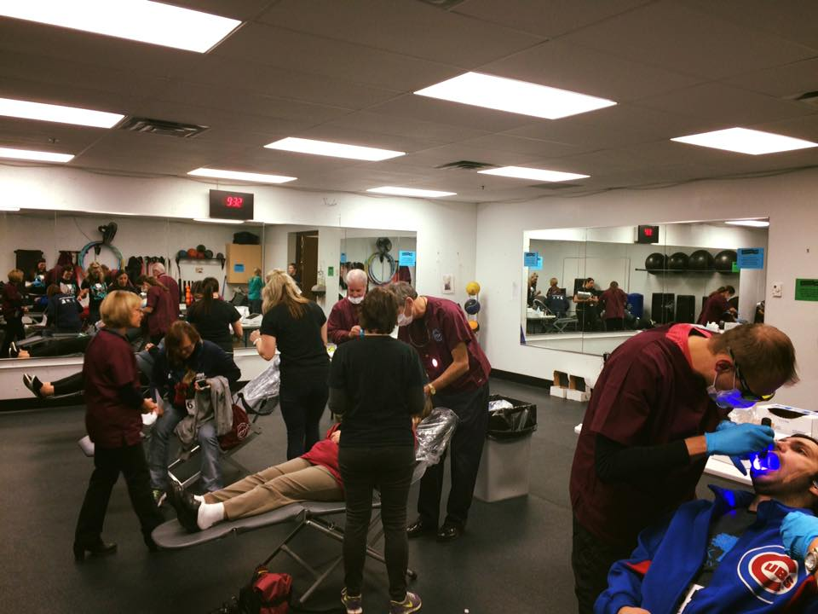
6 Simple Patient questions
Notes:
Wisconsin’s First Oral Cancer screening event 10/17/16

Slide 59
Have you noticed any changes in swallowing?
Do things seem to stick or catch in your throat when you swallow?
Have you had any chronic hoarseness (a condition that has lasted for over two weeks)
Have you noticed/felt any small lumps when feeling the side of your neck putting on makeup or shaving? (painful swollen nodes are usually a sign of an infection not cancer-- painless ones are the red flags).
Have you had any ear aches that seem to persist, particularly unilateral (only on one side)?
(6) Have you or any of your friends noticed a change in your voice?
See more at: http://oralcancer.org/discovery-diagnosis/how_do_you_know.php#sthash.4ebGYBSZ.dpuf
Notes:
Source: OralCancer.org

Slide 60
Conducting an extraoral
Head and Neck Exam
Observe Facial Symmetry
Check exposed skin for suspicious lesions
Evaluate Eyes and tissues around the eyes
Palpate Lymph Nodes
View the ears and question discolorations.
Check for swelling around Nose and nares
Palpate Thyroid Glands-Discuss any changes to medications.

Slide 61
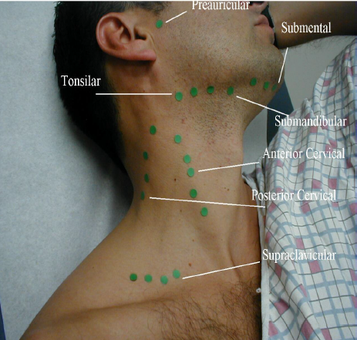
What is the Lymph? why do we palpate it?

Slide 62
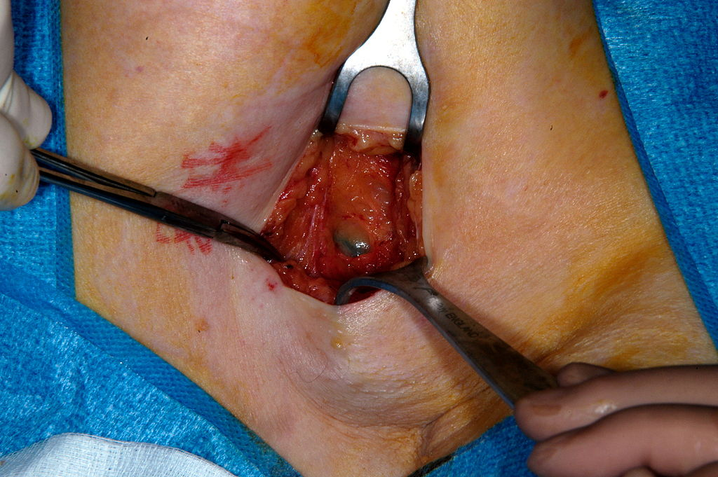
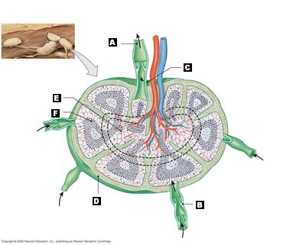
Efferent lymphatic
vessel
Lymph node
Lymph
Afferent lymphatic
vessel
Lymph nodes are important part of immune system
Located throughout the body but only palpable when enlarged
Regional, each group corresponds to a particular region of the body and reflects abnormalities in that region.
Contain certain kinds of immune cells, that fight viruses, and other unhealthy cells.
Filters the blood and performs immunologic functions
Fluid from the lymphatic system eventually feeds into the venous system.
Enlarge due to infection or malignancy.
Notes:
First line of defense to tell the body something is not right.

Slide 63

What to evaluate while
Patient is seated:

Slide 64
Examine the Face
Inspect the face for asymmetry, swelling, discoloration or ulceration.
The entire face should be examined with an external light source (overhead light or headlight) to evaluate for pigmented (red, brown, black), raised, ulcerated, or firm areas of the skin, including the hair bearing regions of the face and scalp.
The facial bones, skeleton and soft tissue should be palpated particularly noting asymmetry or masses.
- See more at: http://www.oralcancerfoundation.org/discovery-diagnosis/screening.php#sthash.yFzvGPAO.dpuf

Slide 65
Ears
Carefully inspect the outside of the ear noting any pigmented, erythematous, or ulcerous lesions.
* Examine the external auditory canal for masses or lesions.
Physicians will examine the inner ear at the patient’s physical.
Note: skin cancers often appear on the superior, sun-exposed portion of the auricle.
- See more at: http://www.oralcancerfoundation.org/discovery-diagnosis/screening.php#sthash.yFzvGPAO.dpuf

Slide 66
Look into my Eyes……
Any swelling or pain of the eye or periorbital area should be noted and can be a late sign of a cancer which may have started in the palate, maxillary or ethmoid sinuses.
Drainage, may be a sign of an obstructing mass in the maxillary sinus, nose, or facial soft tissue.

Slide 67
Nose
Routine nasal examination should include palpation of the external nose and paranasal region overlying the maxilla and maxillary sinus.
Be careful not to mistake a nasal turbinate for a polyp or tumor when looking into the nares.
Physicians DO check the nasal cavity at general physicals….you are looking and feeling for anything that is not normal.
GPAO.dpuf- See more at: http://www.oralcancerfoundation.org/discovery-diagnosis/screening.php#sthash.yFzv

Slide 68
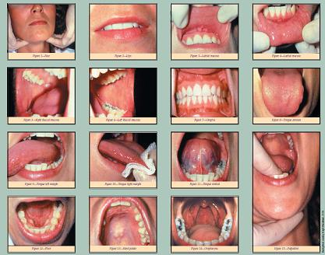
www.sixstepscreening.org
                /

Slide 69
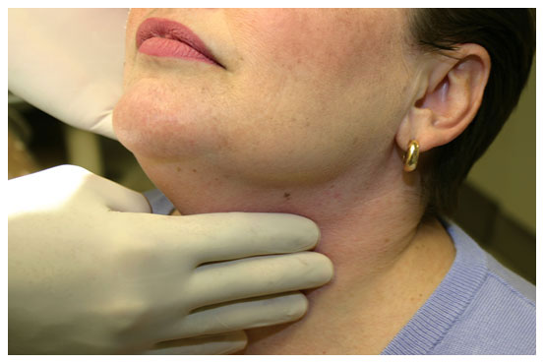
Neck caress and palpate Lymph nodes
Notes:
Palpating lympnodes. I

Slide 70
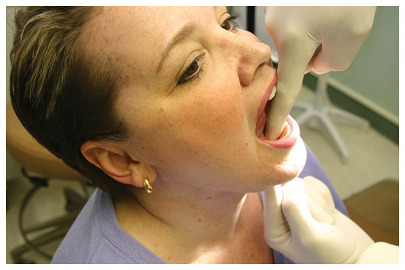
Floor of the mouth double digit palpitation

Slide 71
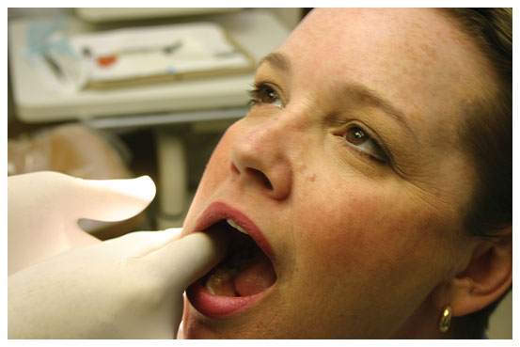
Check roll
Notes:
Also checking for check chews and Lina Alba

Slide 72
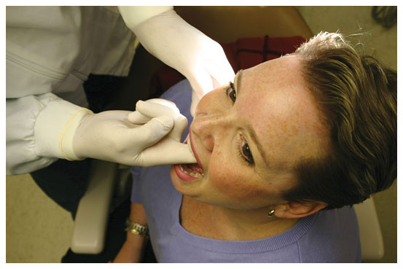
Palate tickle

Slide 73
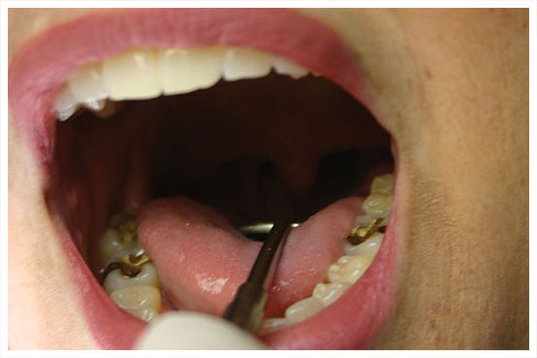
Tonsil and Pillar check

Slide 74
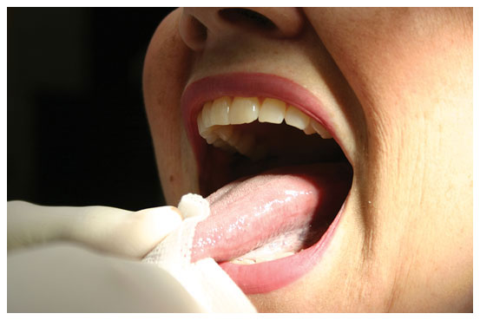
Tongue in gauze

Slide 75
Oral Cancer: What are you doing about it?
Preventing Oral Cancer begins by detecting dysplasia!
Identifying white, red and mixed spot lesions, chronic irritations areas via white light exam and adjunctive light.
96% of these spots are benign…..however how do we know for sure?

Slide 76
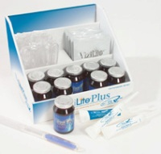
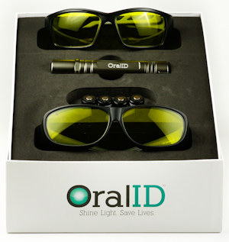




Adjuncts for Detection

Slide 77
Oral Cancer Testing Metrics
Sensitivity
  The ability of the test to correctly identify all patients with the disease in a population of patients.
Specificity
  The ability of the test to correctly exclude those patients without the disease from the population.
Positive Predictive Value (PPV)
  How likely is it that a patient has the disease given that the test result is positive?
Negative Predictive Value (NPV)
  How likely is it that a patient does not have the disease given the test result is negative?

Slide 78




Auto-fluorescent Devices
Pros
Easy to use
Quick Screening Time
Cost effective
Lesion enhancing device
Cons
Low sensitivity and specificity
Lack of clinical data to support
Late Stage cancers
High false negatives (miss cancers)

Slide 79


White light Fluorescence

Slide 80



Brush Biopsy
Pros
No lights, filters, or solutions
Cons
Technique sensitive, multistep process
Low sensitivity and Specificity
Inability to detect precancerous lesions
Expensive $200-300 Patient Cost
 | Cancer Sensitivity | Specificity
OralCDx³ | 52% | 29%
Notes:
NOT a Biopsy replacement!

Slide 81

Cytology
Pros
Quick and easy chair side.
Comfortable swab/specimen gathering.
Cons
Expensive to patient $200-300.00
Wait 2 weeks.
Notes:
Not a Biopsy replacement!

Slide 82

Chairside Salivary Diagnostics
Pros
Easy to use
  (no light, filters, or solutions)
Reasonable Sensitivity
Cons
Lack of Clinical data to support.
Inability to detect precancerous lesions.
Inability to determine location of disease.
Not chairside

Slide 83
How to implement An Excellent oral cancer exam into your practice
Protocols—White light and Discovery Device methods
Patients—Understand Lifestyles.

Slide 84
Referral to Specialists
Find a supportive physician or specialist that will be your 2nd opinion, and BACK up your concerns and confirm to your patients they are in an amazing dental office.
~get details: do they charge for a 2nd opinion?
~Can you send your report/pictures via e-mail?
~Are you taking PANS and CEPHS/Cone Beam?
Be pro-active, not re-active! What is your office protocol?
“When I see something suspicious; I send them to the Oral Surgeons”

Slide 85



“But you’ve never done this before”

Slide 86
• ‘
1. We have always screened the soft tissues as part of your routine check-up’ • ‘
2. We are now working to increase your own awareness of the importance of oral cancer screening’
•
‘
3. Evidence suggests that the incidence of oral cancer is increasing and we believe we should be taking a more active role in increasing your awareness of the importance of complete oral health and oral cancer screening’ • ‘
We need to keep more detailed records, including information about
your lifestyle, so that we can offer you a more comprehensive oral health
care service’ • ‘
5. We are extending the range of healthcare provided at this practice’
3.

Slide 87

To charge or not to charge
Should the screening be protocol?
Notes:
Average price 32.00 per screening annually

Slide 88

Does my insurance cover this?

Slide 89

Submit to Dental or Medical?
Refer to insurance handout
Notes:
See handouts

Slide 90
so what If I do nothing different concerning Oral cancer?

Slide 91

Failing to detect oral pathology is the 2nd most common lawsuit in dental!

Slide 92

According to National Practitioner Data Bank, there were 20,545 actions taken against dentists between the years 2002-2012. That amounts to an average of 2,054 actions per year against dentists.
CNA HealthPro states:
“The only tangible benefit a patient can gain from a malpractice claim is money. A malpractice claim cannot turn back the clock to prevent the alleged injury from occurring. Nor can it ensure that any corrective treatment for the alleged injury will return the patient to the way he or she used to be. So, the law permits the award of monetary damages to compensate for the inability to be made "whole" again, or otherwise returned to the way they were before.
Notes:
80% of dental lawsuits are because the patient is irate and want money; but don’t give them a reason!

Slide 93

Do you have Malpractice insurance?
www.adha.com
Annual premiums can be as low as $90.00.
Do not rely fully on the DDS/Practice Malpractice.
Between 2002-2012; there were 2,260 actions taken against dental hygienists or assistants (http://www.npdb-hipdb.hrsa.gov/resources/npdbstats/npdbStatistics.jsp#contentTop)
Notes:
226 per year against DA/RDH

Slide 94

Go! And do great things!

