Slide 1
Implant abutments & screws
Procedures
Complications
solutions

Slide 2
introduction
Materials
Biologic response
No comprehensive source

Slide 3
Mucosal seal
Biologic width
Junctional epithelium & C.T

Slide 4
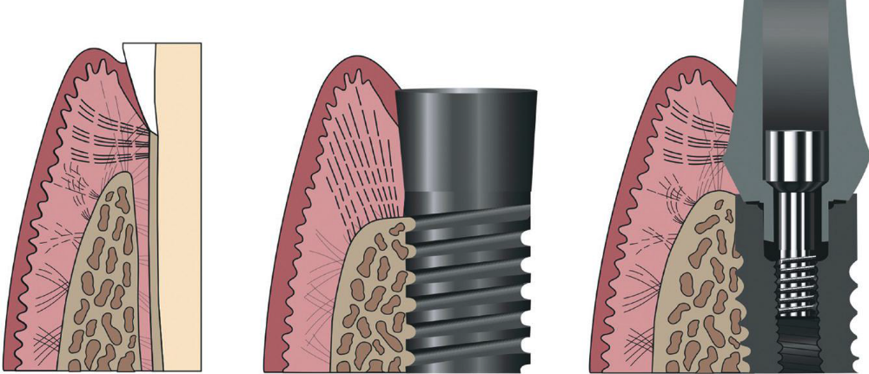

Slide 5
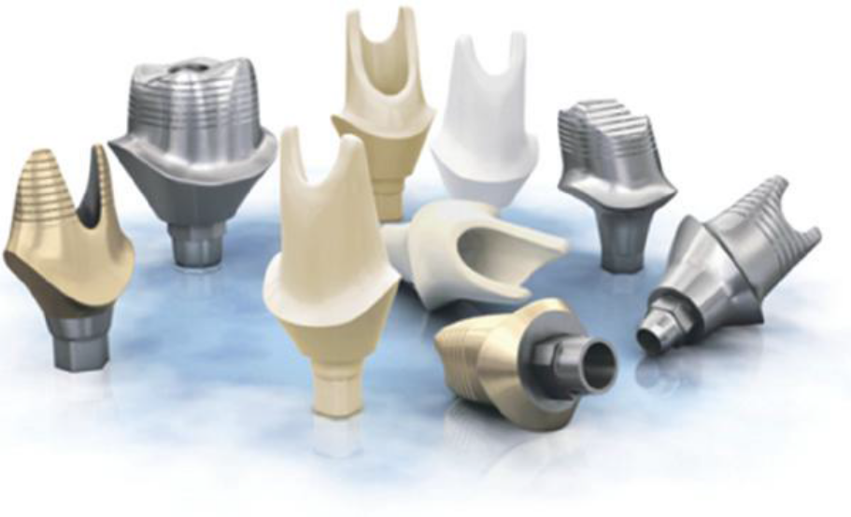
Abutment materials
Ti
S.S
Cast gold
Zirconia
Poly ethylene ether ketone ( PEEK)

Slide 6
Ti
Ti
Light weight
Biocompatible
Durable
Strong
Corrosion resistant

Slide 7
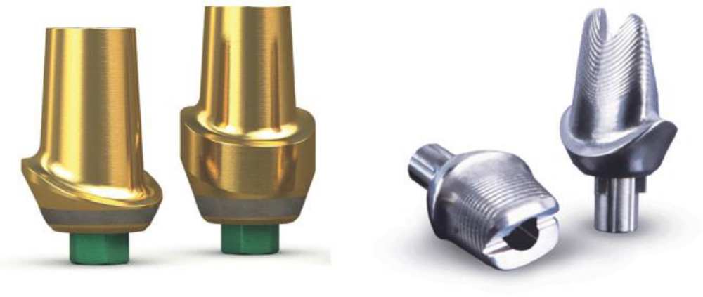
Ti abutments
silver
gold

Slide 8
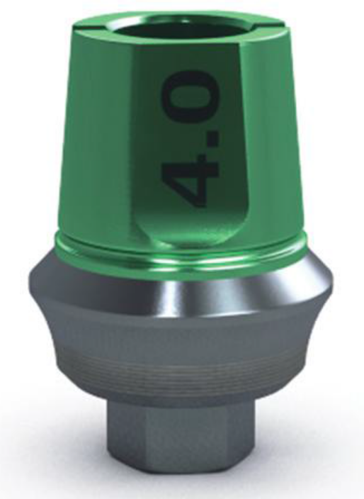
Laser lock Ti

Slide 9
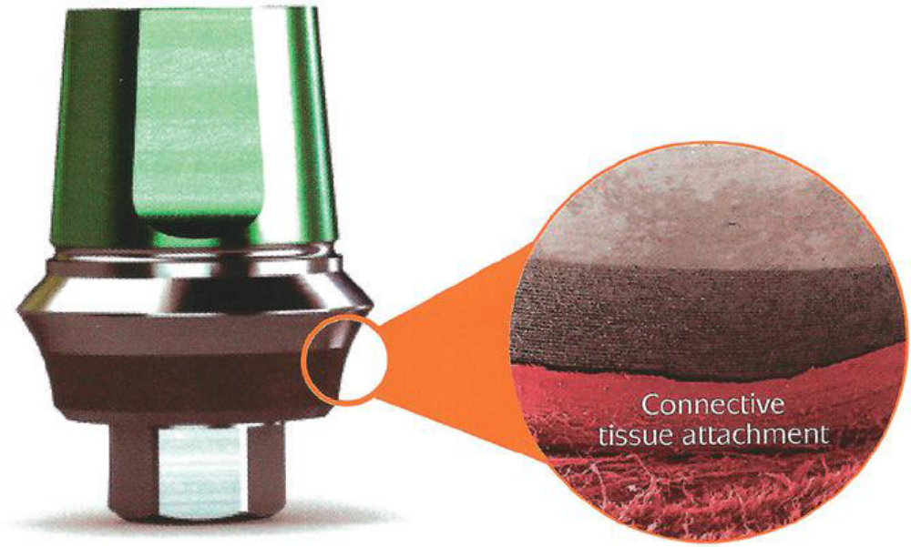
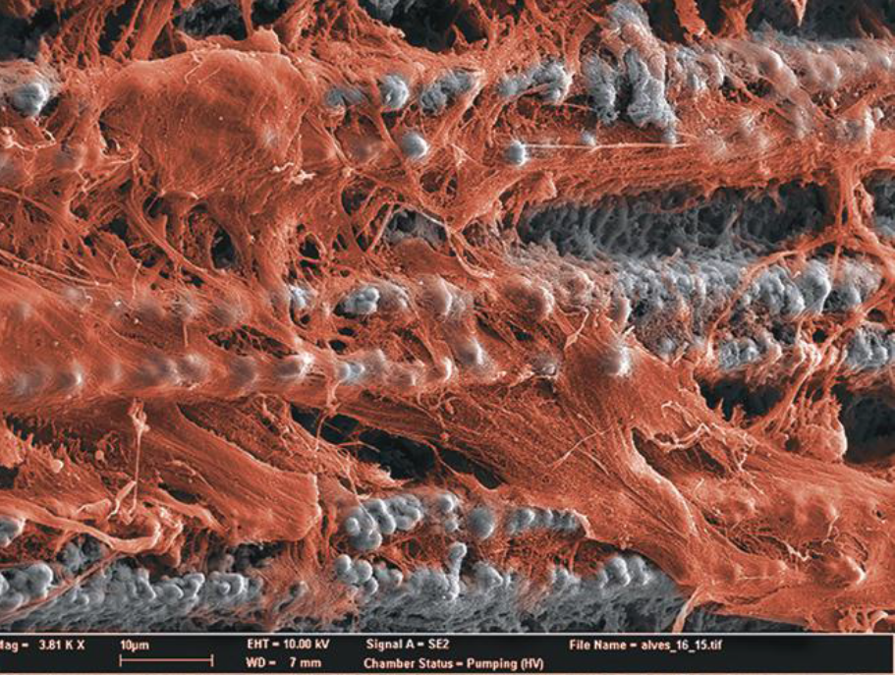

Slide 10
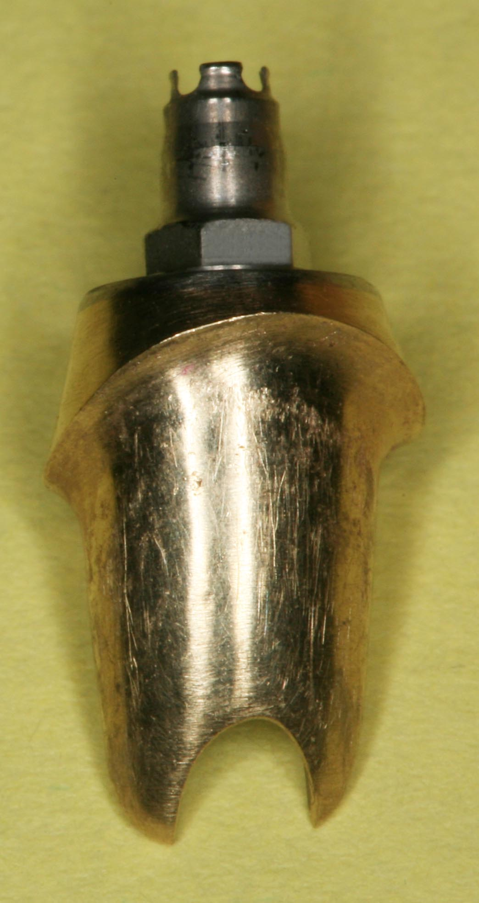
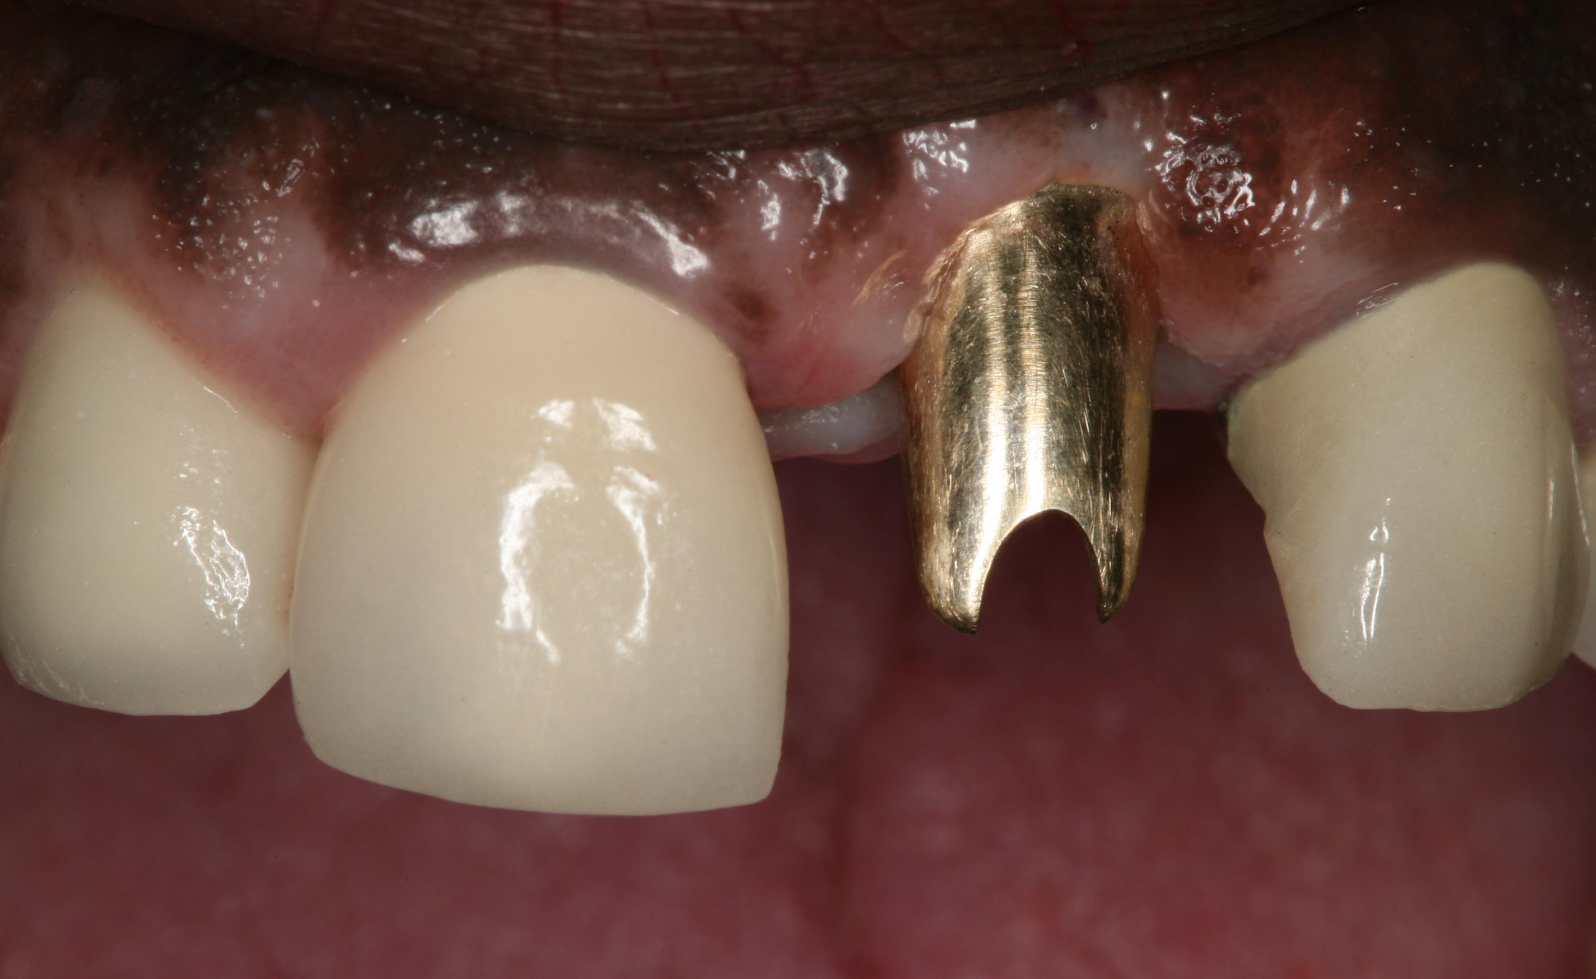
Cast cold abutments

Slide 11
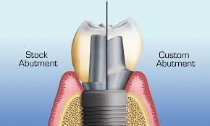

Slide 12
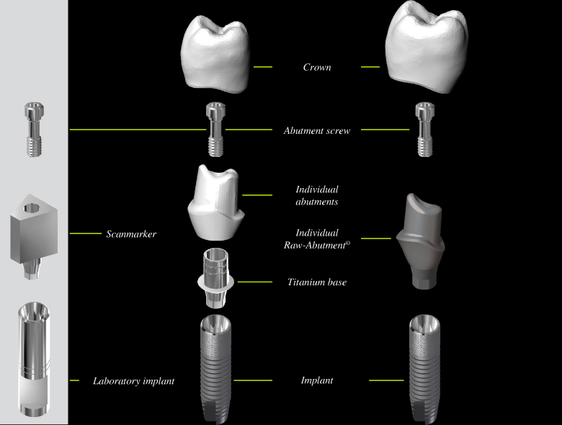

Slide 13
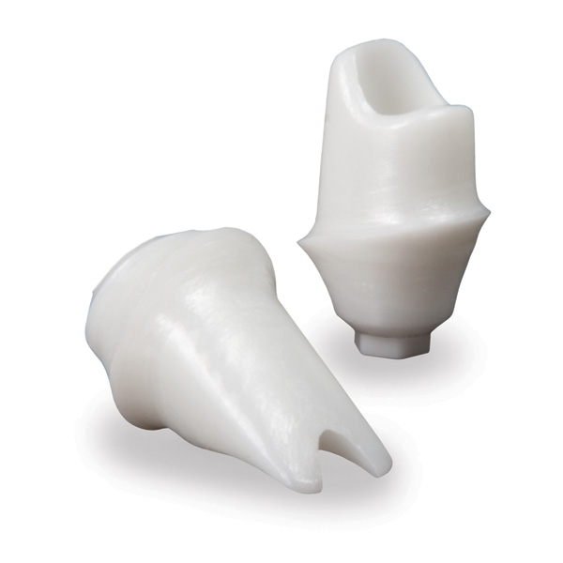
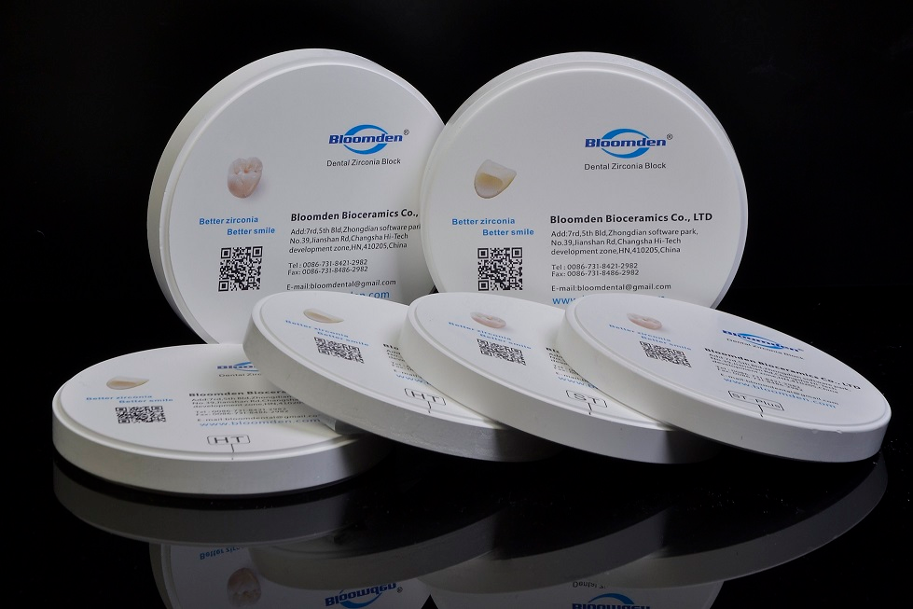
Zirconia zro2

Slide 14
summery
Ti : strength : first choice for Post. Implants
Stainless steel : temporary
Laser lock Ti : Ant . Esthetic region , thin gingival biotype
Gold : Ant . Esthetic region , thin gingival biotype
Zirconia : the most hygienic : Ant. Esthetic cases , thin gingiva , compromised oral hygiene : overdentures in old patients

