Slide 1

COSMETOLOGY CONGRESS 2019
ABSTRACT
BY
UCHE GLORIA OKOYE
TOPIC: COSMETOLOGY AND SKIN CARE
DATE: 06/5/19
RIGHT CLICK (X2) ON POWER POINT IMAGE (.JPG 1) TO VIEW SLIDE 2 DOCUMENT
RIGHT CLICK (X2) ON POWER POINT IMAGE (.JPG 5) TO VIEW SLIDE 3 DOCUMENT

Slide 2
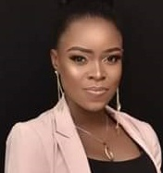
ePosterBoards Template
UCHE GLORIA OKOYE
AENIA’S BAY; NATURAL PLACE FOR HOUSEHOLD, FOOD AND COSMETICS
NNAMDI AZIKIWE UNIVERSITY AWKA ANAMBRA STATE NIGERIA
NATIONAL AGENCY FOR FOOD AND DRUG ADMINISTRATION AND CONTROL YABA, LAGOS BRANCH NIGERIA
IIPMR U.S.A, PORT HARCOURT BRANCH NIGERIA
INTRODUCTION
Cosmetology is the treatment of the skin,hair and nails –MERRIAM WEBSTER
Cosmetology of the skin refers to the use of various types of cosmetic materials,clinical expertise,therapeutic dermatologic interventions, and proper diagnosis to enhance the beauty and well being of the skin.
Skin care as a branch of cosmetology is the deliberate treatment to improve the human skin,a practice which has over the years emerged very successful across the world.More advanced measures is being taken to suit the massive demands of the prospective consumers in the cosmetics channel.Adequate research is also being carried out by capable scientists in order to harness and support this sophisticated venture with assured health benefits that ranges from natural products,synthetic products,healthy oriented manufacture of cosmetic instruments and series of careful measures that may be employed to curtail and eliminate the common hazards that could be associated with the cosmetic materials and practices.
BACKGROUND
Appearance and beauty have always been a major aspect of womens’ lives,regardless of the era,century,or decade.Changes were slow and less prominent in the earliet centuries,but by the 20th century, trends and styles changed faster and faster from decade to decade.However,the changes in cosmetology,clothing styles,accessories and hair styles throughout the times uncover much more than a skin-deep history
Max Factor,while being in cosmetic line to this day,is also a man who is generally credited for inventing modern day make-up,because he successfully marketed the make- up he created for both movie actresses and everyday women in the first couple decades of the 20th century.Also during that time,Maybeline was created by 19years old entrepreneur,T.L Williams,who came up with the name by fusing the name of his older sister Mabel,and Vaseline-the main product used in the company’s first mascara.
Madam C.J. Walker was not only the first black female entrepreneur in the U.S., but she was the first female self-made millionaire who built her business upon cosmetics,hair,and beauty products for black women.
OBJECTIVES OF SKIN CARE
Dermatologists posses a defined body of knowledge,clinical skills,procedural skills and professional attitudes,which are directed to effective patient-centered care.They apply these competences to collect and interpret information,make appropriate clinical decisions,and carryout diagnostic and therapeutic interventions.They do within the boundries of their discipline,personal expertise,the health care setting and the patient’s preferences and context.Their care is characterized by up-to-date,ethical,and resource efficient clinical practice as well as with effective communication in partnership with patients,other health care providers and the community.
SOME OF THESE OBJECTIVES MAY INCLUDE;
(1) To establish and maintain clinical knowledge skills and attitudes appropriate to dermatologic practice
(2) Perform a complete and appropriate assessment of a patient
(3) Use preventive and therapeutic dermatologic interventions effectively
(4) Demonstrate proficient and appropriate use of procedural skills,both diagnostic and therapeutic
(5) Seek appropriate consultation from other health professionals, recognizing the limit of one’s expertise

Slide 3
METHODS
Numerous basic dermatologic methods are done as office strategies to test for a wide assortment of infections or to treat regularly minor dermatologic illness or condition in a snappy and noninvasive way.
Some normal dermatologic systems used to test for ailments are biopsies,including punch,shave,and extraction biopsy.The outcomes from these tests can be utilized to either affirm or preclude a conclusion,for example,skin disease or a contagious skin contamination.
SOME OTHER METHODS OF SKIN TREATMENTS ARE LISTED BELOW;
-Acne scar expulsion, Chemical peel, Dermaplanning, Treatment of Sun-Hammed skin
-Laser skin resurfacing, Endocrinological treatments for skin maturation, General techniques
FRACTIONAL LASER SKIN RESURFACING INFORMATION
Fractional laser skin resurfacing (ablative and non-ablative) appears to achieve skin improvements that can get close to conventional ablative laser skin resurfacing but with fewer potential side effects.
The process of directing a light source to target a selected area of the skin to damage it is technically known as ‘’selective photothermolysis’’.Unlike with the selective photothermolysis, where the whole of the selected target area is damaged; Fractional Photothermolysis seeks to only damage certain zones, (producing tiny dot-like treated areas on the skin),leaving the other zone within it perfectly intact; hence only causing fractional damage.This allows the skin to heal much faster than if the whole areas was treated. The cost for fractional laser skin resurfacing depends on the areas being treated and the type of device being used plus any additional single patient disposable items required by some systems.Examples of branded devices include Fraxel and Pixel, but there are many others not listed.
LASER SKIN RESURFACING RESULT
It’s possible that your skin may stay red or pink for up to several months after laser skin resurfacing. You may also be extra sensitive to sunlight for up to a year.Make efforts to minimize sun exposure and use the sunscreen liberally,everyday.
Some people who have laser resurfacing may see an immediate difference in the treated skin.That will continue to improve for up to a year.While the effects of laser resurfacing can last for many years,the normal aging process means that winkles and expression lines will reoccur.One may repeat laser resurfacing as necessary.
CONCLUSION
On the basis of conclusion of this Abstract, an overview of the potential profuse demands of cosmetologic practices,beauty products and skin care requires proper market analysis,further improvement of scientific capabilities,cost management,polite moderations and behaviours towards customers,environmental remedies and so on in order to meet the unique needs of the clients.
Some of the recommendations is to enhance the potency of the beauty products, buttress the effectiveness of the cosmetologic practices, as well as mandate the expertise of dermatologic personnels.
The need to balance the strategy of response given to the different demands of the consumers will in the process improve public confidence and will make the current state assessment of new techniques or developments increasingly challenging.
LIMITATIONS
Some of the disadvantages of cosmetology is cost oriented,while others may include environmental risks.
Cosmetologists have to be patient and friendly with all types of customers,even the difficult and surly ones.They must pay proper attention to what clients want in order to cultivate repeat customers.Some services requires precise timing.The risk of making a mistake,displeasing clients and losing them adds to a cosmetologist’s job stress.
REFRENCE
LESLIE BAUMANN.DERMATOLOGY PRINCIPLES AND PRACTICE,SECOND EDITION.
MERRIAM WEBSTER DICTIONARY.
HTTPS://WWW.PLASTICSURGERY.ORG/COSMETIC-PROCEDURES/LASER-SKIN-RESURFASING/RESULTS
HTTP://WWW.CONSULTINGROOM.COM/TREATMENT/FRACTIONAL-LASER-SKIN-RESURFACING
WWW.STATECE.COM/BLOG/COSMETOLOGY
HTTPS://WWW.BYRDIE.COM/BEST-SKIN-CARE-TIPS (+441234982406)
HTTP://DERM.MED.UBC.CA/EDUCATION/POSTGRADUATE/GOALS.OBJECTIVES/

Slide 4
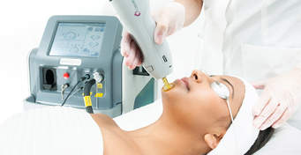
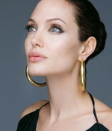
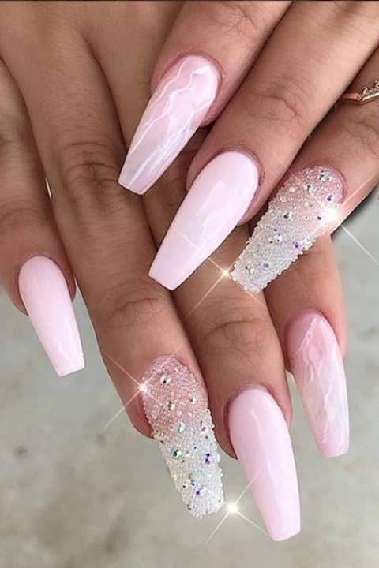
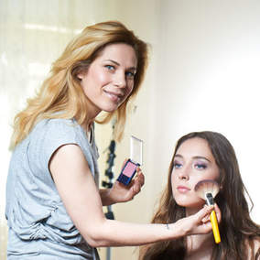
INTRODUCTION
Cosmetology is the treatment of the skin,hair and nails –MERRIAM WEBSTER
.JPG 1
.JPG 4
.JPG 2
.JPG 3

Slide 5
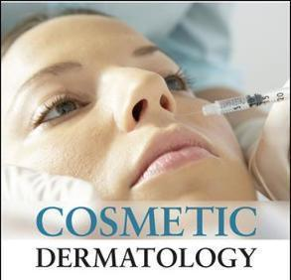

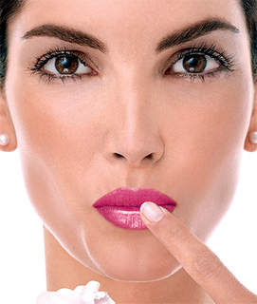
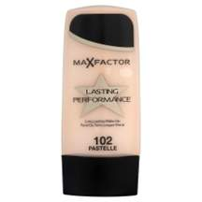
BACKGROUND
FIRST KNOWN USE 1926
OBJECTIVES
.JPG 5
.JPG 7
. JPG 8
ESTABLISH AND MAINTAIN CLINICAL KNOWLEDGE,SKILLS AND ATTITUDES APPROPRIATE TO DERMATOLOGIC PRACTICE
PERFORM A COMPLETE AND APPROPRIATE ASSESSMENT OF A PATIENT
USE PREVENTIVE AND THERAPEUTIC DERMATOLOGIC INTERVENTIONS EFFECTIVELY
DEMONSTRATE PROFICIENT AND APPROPRIATE USE OF PROCEDURAL SKILLS,BOTH DIAGNOSTIC AND THERAPEUTIC
INVENTORS
MAX FACTOR
T.L WILLIAMS
C.J WALKER
.JPG 6

Slide 6
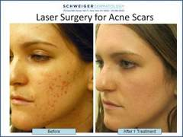
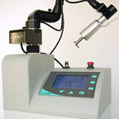



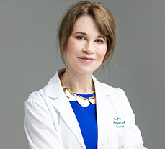

METHOD TREATED
FRACTIONAL LASER SKIN RESURFACING
CONCLUSION
RESULT
PERFECT
EXCELLENT
“I BELIEVE THAT CONSUMERS NEED AND DESERVE A MEDICALLY TRAINED AND UNBIASED SKIN CARE ADVOCATE”
DR. IRWIN

Slide 7
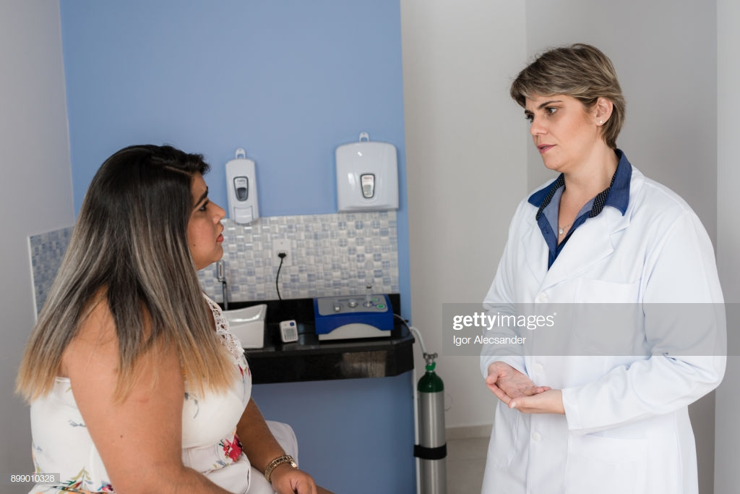


LIMITATIONS
DERMATOLOGIC COSMETOLOGY IS COST ORIENTED
THERE IS THE MANDATORY NEED OF A COSMETOLOGIST TO MEET UP WITH THE UNIQUE DEMANDS OF DIFFERENT CLIENTS
ALSO THERE ARE SOME FEW ENVIRONMENTAL RISKS ATTACHED TO THESE PRACTICES,SUCH AS EXPOSURE TO INTENSE SUNLIGHT AND SO ON

