Slide 1
Health Promotion Research Group- University of Sharjah
Prevalence of overweight and obesity and its correlates among adolescents:
Representative sample from private and public schools in the United Arab Emirates

Slide 2



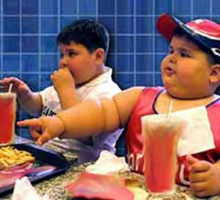

Slide 3
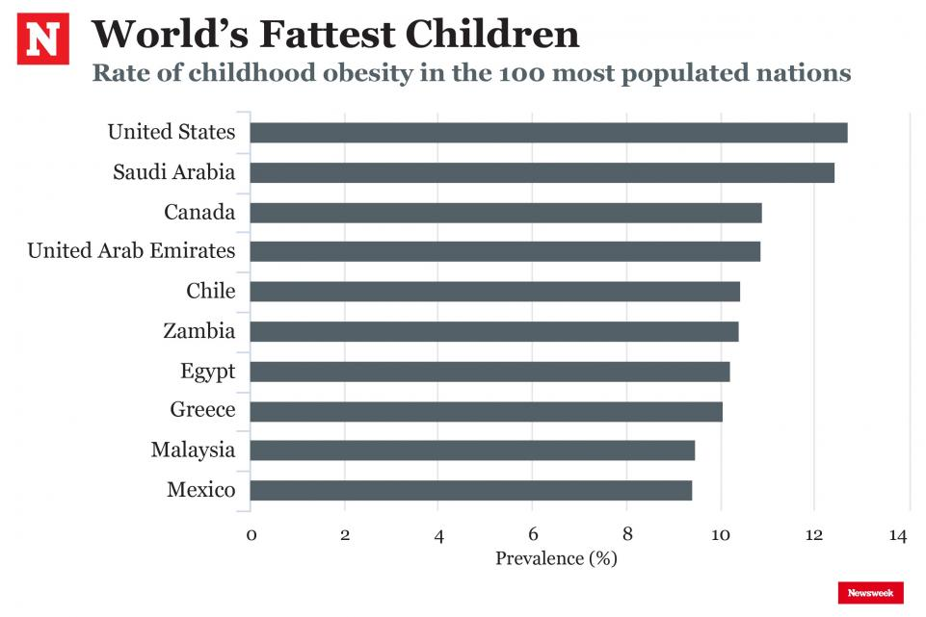
Obesity Collaborators. Health Effects of Overweight and Obesity in 195 Countries over 25 Years. N Engl J Med. 2017 Jul 6;377(1):13-27. doi: 10.1056/NEJMoa1614362.

Slide 4

Background
The adolescent years are critical for teens’ current and future health.
Good health enables adolescents to learn and grow.
A recent study conducted in UAE schools (n = 44,942) among children aged 3–18 years during year 2013-2015, showed that 1/3rd of subjects were either overweight or obese.
For each additional year , 2.36% and 0.28% of the students became obese and morbidly obese respectively.

Slide 5
Objectives
To investigate the prevalence of overweight and obesity in adolescents attending public versus public schools.
Identify risk factors (correlates) of overweight and obesity in adolescents.

Slide 6
Design and Methods
Cross sectional research design
Collected data from 1224 adolescents (age 13-19 years old)
Two-stage sampling
Statistical software SAS was used for analysis
Self-administered questionnaires
  General Demographics
  Fruit and Vegetable Consumption
  Physical Activity
Anthropometric measurements
  Height and Weight
  Waist and Hip
  %Body fat
  Other measurements
  Blood Pressure
  Random Blood Glucose

Slide 7


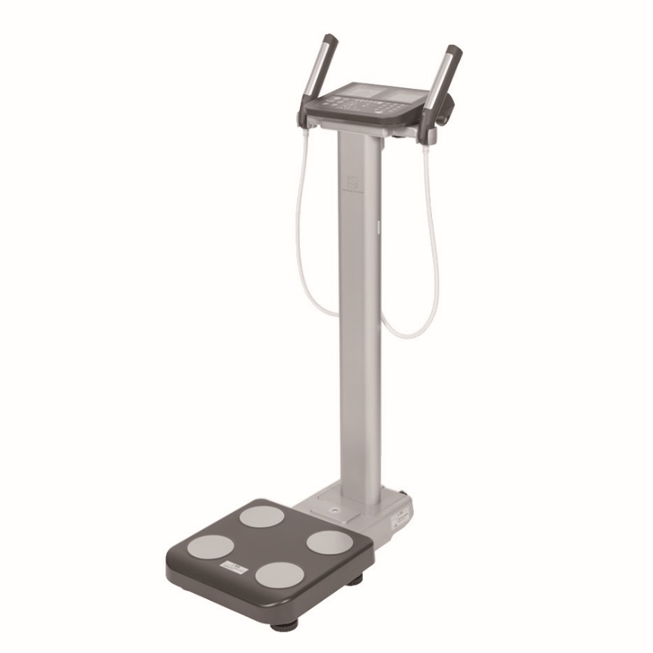
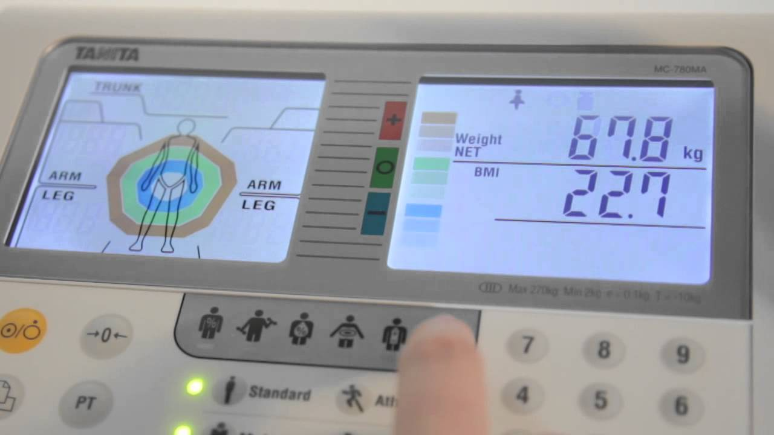
Project Equipment
Segmented Body Fat Analyzer

Slide 8
Phase I – Ethical Approval, school selection and access
Obtained approval from MOHAP, MOE and UoS
Random selection of schools & classes
Phase II – Pilot testing, recruitment and data collection
Pilot testing; adjustments to the data collection process
Surveys and anthropometric measurements were done in schools
Phase III – Data cleaning and analysis
Data collection from 1224 students
Analysis of data was done on SAS.

Slide 9
Results: Cut-offs
Categories | Male |  | Female
Waist circumference
Age (years)
12 | 71.3 |  | 68
13 | 74.2 |  | 69.7
14 | 76.4 |  | 70.9
15 | 77.9 |  | 71.3
16 | 79 |  | 71.3
17 | 79.8 |  | 71.3
18 | 80.4 |  | 71.2
Waist-height | 0.5 |  | 0.5
Waist-hip | 0.9 |  | 0.85
BMI percentiles
Normal |  | 3th ≤BMI ≤85th
Overweight |  | 85th <BMI ≤97th
Obesity |  | BMI> 97th
Waist Circumference and Waist-Hip Ratio (2008). Report of a WHO Expert Consultation Geneva, 8–11 December 2008. Retrieved 15.06.2017

Slide 10
Study results

Slide 11


Results: Sample characteristics (n= 932)

Slide 12
Results: Sample characteristics
BMI percentiles according to WHO

Slide 13
Results: (AO) Indicators and % Body fat
Prevalence of high Abdominal Obesity (AO) And % Body Fat in Adolescents Attending Schools in The UAE
Determinants | Prevalence
Waist Circumference | 441 (47.4%)
Waist-Hip Ratio | 212 (22.8%)
Waist -Height Ratio | 253(27.2%)
% Body Fat(mean ± SD) | 27.6 ±12.0

Slide 14




Number of students in private and public schools by BMI and AO indicators
p=0.283
p=0.001
p= 0.001
BMI
Waist*
Waist-hip
Waist-height

Slide 15
Results: Bp and % Body Fat
Table 2. Blood pressure(Bp) and %body Fat of adolescents attending schools in the UAE by school
 | Public Schools Frequency, (%) or mean (±SD)(N=498) | Private Schools (Frequency, (%) or mean, ±SD)(N=434) | p-value
Blood pressure (mmHg)
Systolic Blood Pressure (SBP) | 119.4(±12.3) | 116.5(±12.4) | 0.001†
Diastolic Blood Pressure (DBP) | 75.6(±10.1) | 73.7(±9.1) | 0.002†
Percent Body Fat | 27.6(±10.4) | 25.3(±8.9) | <.001†

Slide 16

Results: Fruits & Vegetables
p=0.232

Slide 17
Results: Physical activity

Slide 18
Correlates of obesity in the study sample

Slide 19
Results
Table 1a. Simple logistic regression analysis for the associations of sample characteristics with overweight/obesity
Sample characteristics (N=932) | OR(CI) | p-value
Gender |  | 0.231
Male | Ref
Female | 0.84(0.63-1.12)
Nationality |  | 0.052
UAE National | Ref
Non-UAE National | 0.76(0.57-1.00)
Mother Employment |  | 0.800
Unemployed | Ref
Employed | 0.96(0.71-1.30)
Economic Status |  | 0.154
Below average | 0.83(0.62-1.11)
Average | Ref
Above Average | 1.60(0.77-3.23)
Type of School |  | 0.034†
Private | Ref
Public | 1.34(1.02-1.76)
Fruits and Vegetables Score (FV) | 0.79(0.72-0.86) | <.001†
Physical Activity Questionnaire (PAQ) |  | 0.001†
Low Intensity | Ref
Moderate High Intensity | 0.54(0.38-0.78)
Random blood Glucose
Normal | Ref
Abnormal | 1.44(0.81-2.58) | 0.217
Blood pressure (mmHg)
Systolic | 1.03(1.02-1.04) | <.001†
Diastolic | 1.02(1.00-1.03) | 0.009†

Slide 20
Results: AO indicators & % BF
Table1b . Simple logistic regression analysis for the associations of AO indicators
& %BF with overweight/obesity
Sample characteristics (N=932) | OR(CI) | p-value
Waist Circumference (cm) |  | <.001†
Normal | Ref
Abnormal | 9.49(6.83-13.03)
Waist-Hip Ratio (cm) |  | 0.001†
Normal | Ref
Abnormal | 1.71(1.25-2.33)
Waist-Height Ratio (cm) |  | <.001†
Normal | Ref
Abnormal | 20.3(14.0-29.5)
% Body Fat | 1.19(1.16-1.22) | <.001†

Slide 21
Conclusions and Recommendations
Obesity prevalence in adolescent in UAE is still alarming
Specific attention must be given to public schools
Abdominal Obesity indicators (WC,WHR,WHtR) and %BF must be considered in addition BMI in health and weight management programs as visceral obesity increases the risks of morbidly and mortality
Health promotion models in schools must incorporate educational programs targeting lifestyle factors as determinants of health in adolescents

Slide 22
Recommendations
Reinforcing governmental nutritional policies that promote healthy environment which encourage increased intake of F/V and improve physical activities must be adopted in both private and public UAE schools
Collaborative model between schools and parents are needed most
Utilization of technology to empower adolescents toward healthy lifestyle is recommended

Slide 23
Challenges
Accessing geographically far schools
Transportation of equipment from one school to another
Refusal of granting access to school to the research team
Schedules of classes and activities within schools

Slide 24
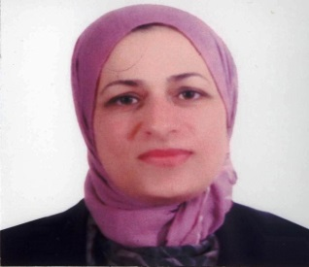






Special Thanks: Health Promotion research group members
Dr. Wegdan Bani issa, CHS
Dr. Manal Awad CoD
Dr. Nabil Al-Yateem, CHS
Assoc. Professor Rachel Rossiter, Charles Sturt University, Australia
Dr. Hadia
Radwan,
CHS
Dr. Sana Enayah
Dr. Randa Fakhry, CHS

Slide 25



Dr. Soultana Macridis, University of Alberta
Dr. Maria Walton, COHS
Prof. AB Rani Samsudin, COD

Slide 26
Funding and grants
Research institute for Medical and Health Research, University of Sharjah
Amount of funds (5000,000 AED) over 5 year period

Slide 27










Collaborative targets

Slide 28
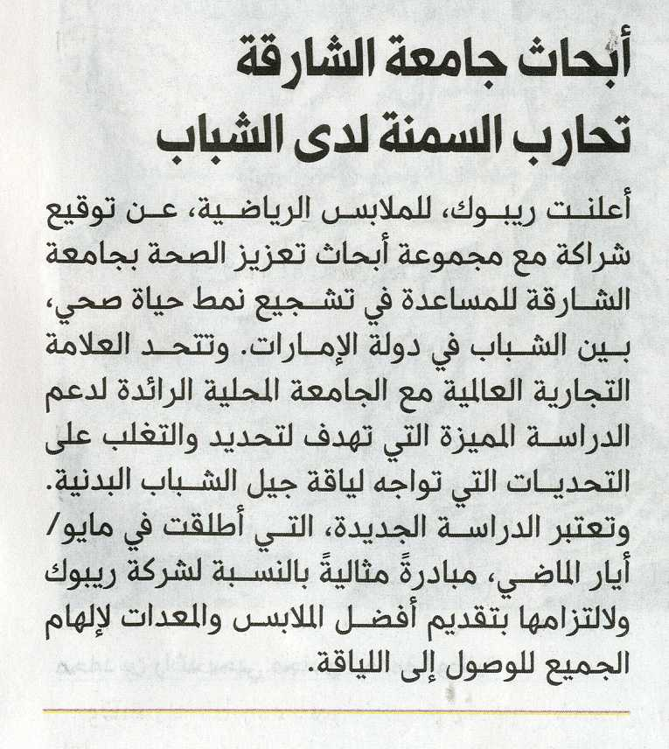
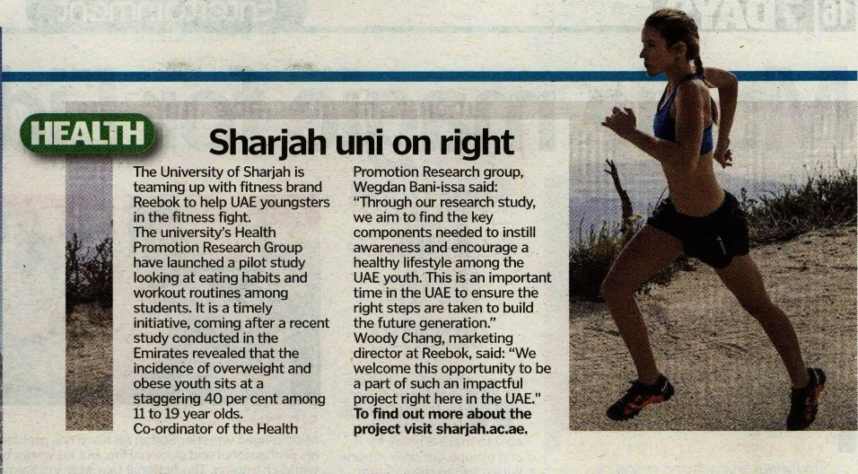
In the news
Collaboration with Reebok

Slide 29
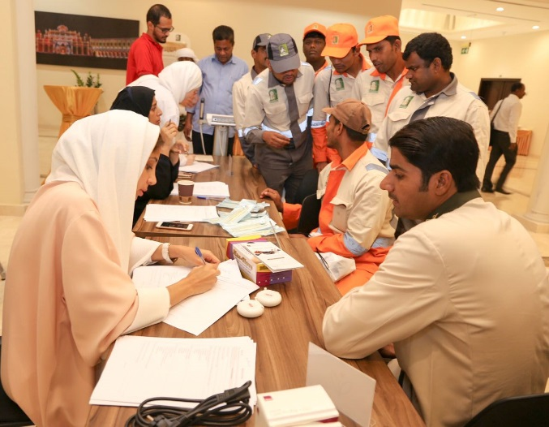
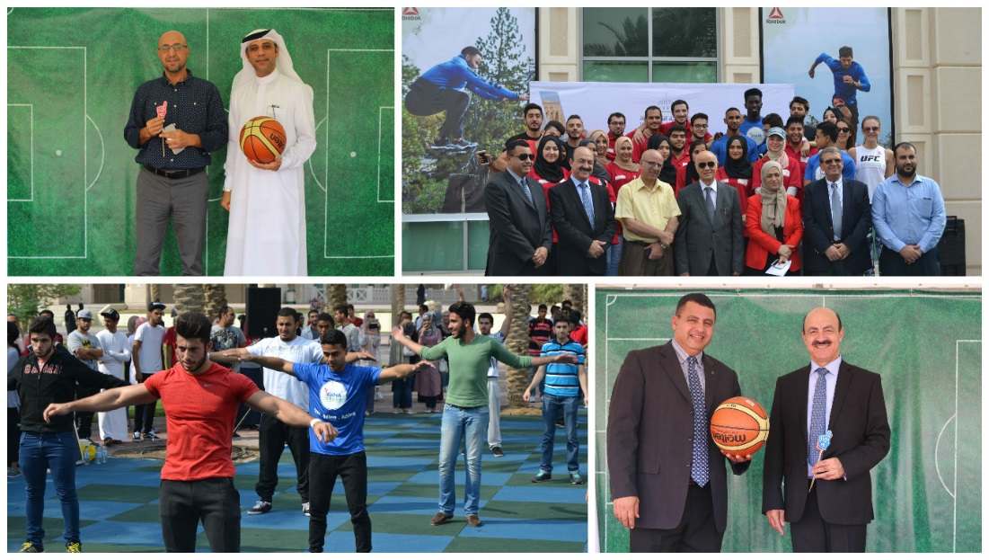
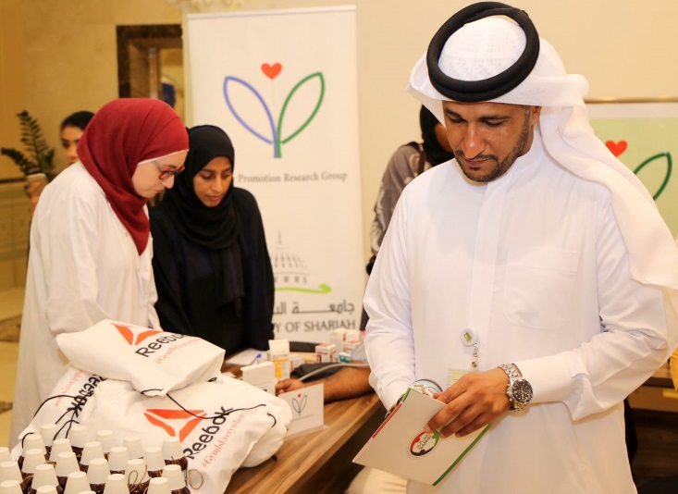
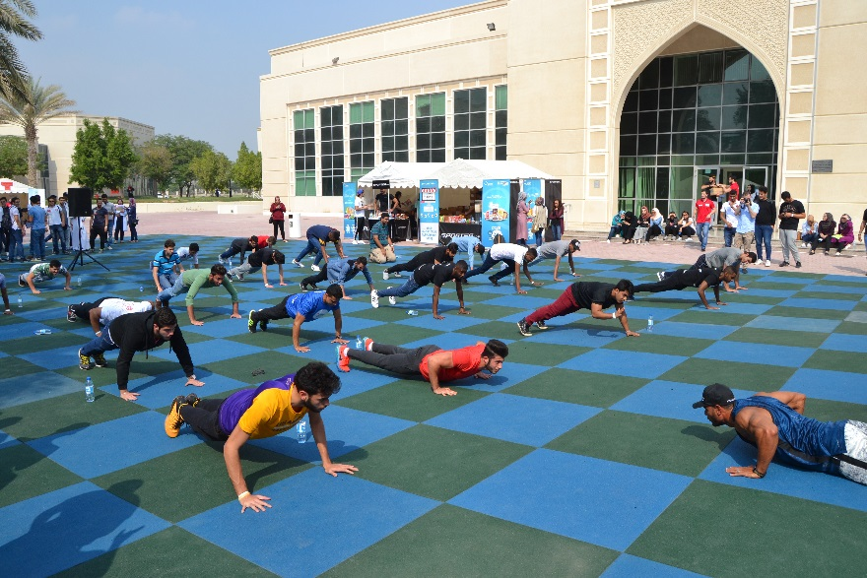
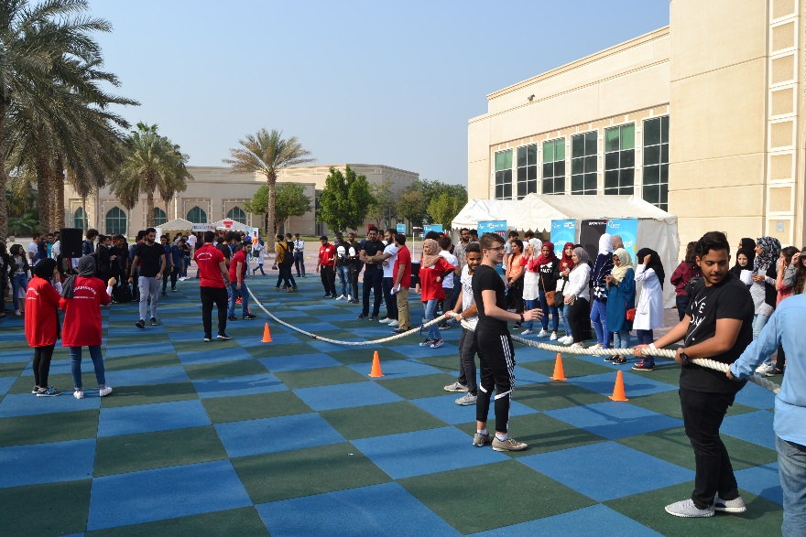
Community activities
Sports Day at UoS
Labor Day in collaboration with Sharjah Municipality

Slide 30
Acknowledgment
Arwa Al Shujairi, Reearch assistant, project manager
Talia Mohsen, Research assistant
Jamila Abdul-haq, Research assistant

Slide 31

Visit us
http://www.sharjah.ac.ae/en/Research/SIMHR/Pages/default.aspx

Slide 32
References
Al Junaibi, A.,Abdulle, A.b, Sabri, S.c, Hag-Ali, M.d, Nagelkerke, N.e. The prevalence and potential determinants of obesity among school children and adolescents in Abu Dhabi, United Arab Emirates. International Journal of Obesity. Volume 37, Issue 1, January 2013, Pages 68-74
World health organization. Tenfold increase in childhood and adolescent obesity in four decades: new study by Imperial College London and WHO. file:///C:/Users/10780/Documents/Tenfold%20increase%20in%20childhood%20and%20adolescent%20obesity%20in%20four%20decades_%20new%20study%20by%20Imperial%20College%20London%20and%20WHO.html
Bin Zaal, A. A., Musaiger, A. O., & D'Souza, R. (2009). Dietary habits associated with obesity among adolescents in Dubai, United Arab Emirates. Nutricion Hospitalaria, 24(4).
AlBlooshi, A., Shaban, S., AlTunaiji, M., Fares, N., AlShehhi, L., AlShehhi, H., ... & Souid, A. K. (2016). Increasing obesity rates in school children in United Arab Emirates. Obesity science & practice, 2(2), 196-202.

