Slide 1
Comparative study of sildenafil versus tadalafil for management of early post-operative pulmonary hypertension in pediatric cardiac surgery patients by
Dr Ahmed Fouad Halima

Slide 2
Items
1
2
3
5
4
1
2
3
Introduction
Study design
Results
5
4
Conclusion
Recommendations

Slide 3
11
Introduction

Slide 4
Introduction
Pulmonary Arterial hypertension (PAH) in children, defined as mean pulmonary artery pressure(mPAP) >20 mm Hg , PAWP < 15mm Hg or PVR > 3WU beyond the first few months of life.
The main target of PDE5-I is NO- cGMP signaling pathway.
In 2011, sildenafil received EMA approval for use in children >1 year of age. (Sharma et al., 2016).
Tadalafil, another oral, selective PDE-5 inhibitor with a longer duration of action than sildenafil, was EMA & FDA-approved for use in adults with PAH in 2009

Slide 5
continued
There is no published RCT data on the use of tadalafil in pediatric PAH, So still not FDA nor EMA approved in pediatrics.
Several studies have been conducted for this issue with different application schedules that demonstrated variable degrees of efficacy and clinical outcome.
To the best of our knowledge our study is a pioneer one in comparing the efficacy of sildenafil versus tadalafil for management of early post-operative pulmonary hypertension in pediatric cardiac surgery patients

Slide 6
22
Study Design

Slide 7
Our study included 75 patients with left to right shunts and pulmonary arterial hypertension referred to Bahteem specialized center for undergoing corrective surgeries.
Study population was randomly divided into 3 equal sub-groups; CONTROL, SILDENAFIL and TADALFIL groups ; 25 patients for each.
All patients are subjected to; history taking , physical examination, CXR, ECG and the corner stone of the study Echocardiography.

Slide 8
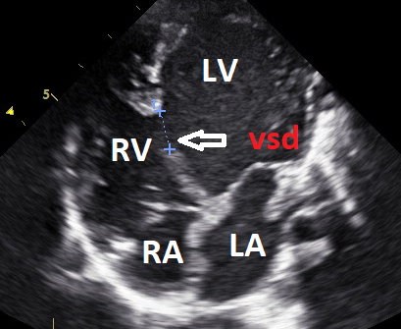
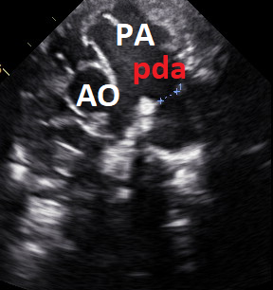
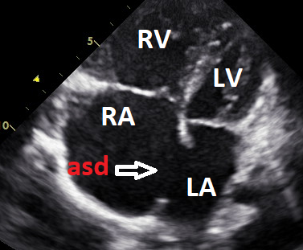
3 Main Pathologies of our study

Slide 9
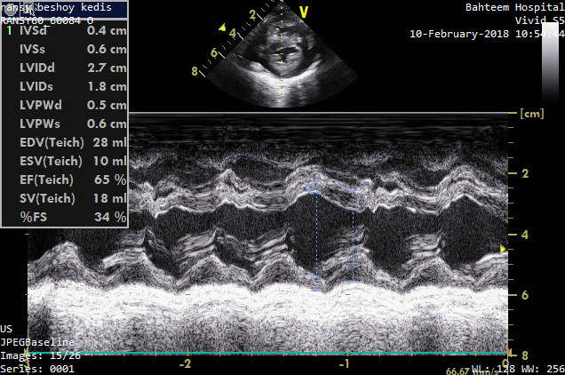
Each case was subjected for 3 full echocardiographic studies; pre-operative, early post-operative (within 1weak after surgery) and follow up (within 3 months after surgery) studies following American Society of Echocardiography guidelines .
We measured:
1- LV end-systolic and
end-diastolic dimensions.

Slide 10
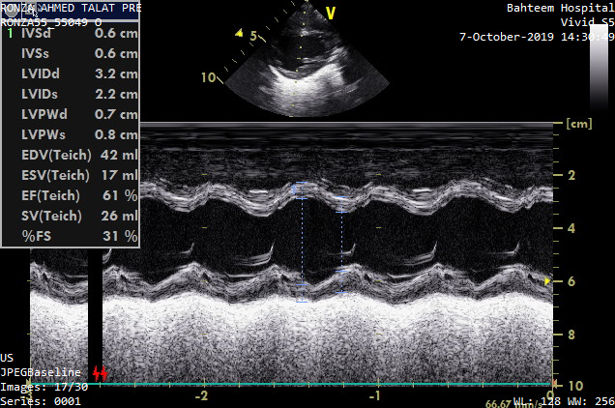
2- Fractional shortening and ejection fraction using Teichholz method( M mode)

Slide 11
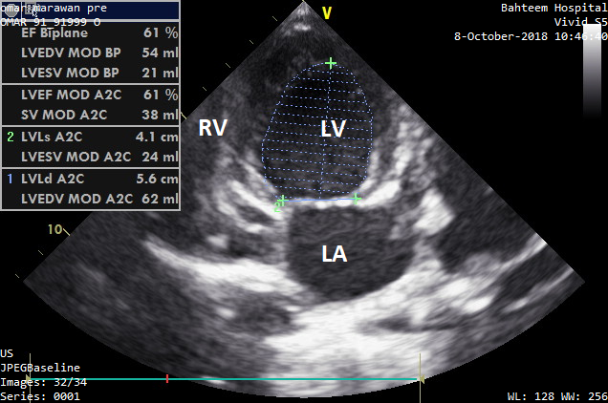
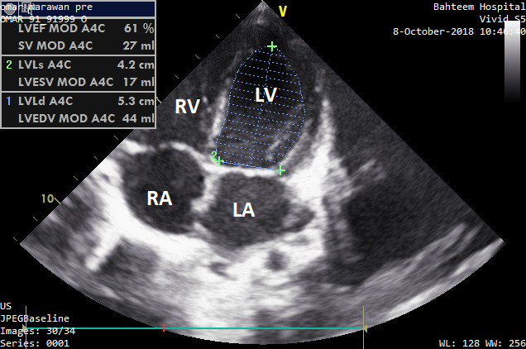
3- LV end systolic and end diastolic volumes.

Slide 12
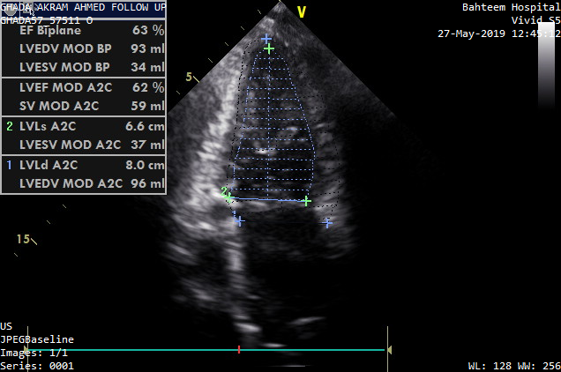
4-Ejection fraction and Stroke Volume Using modified Simpson method.

Slide 13
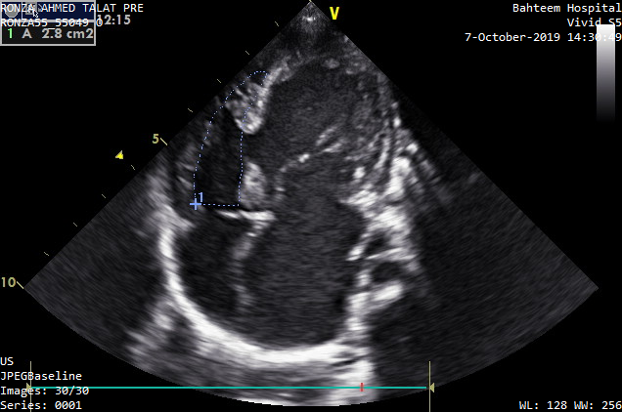
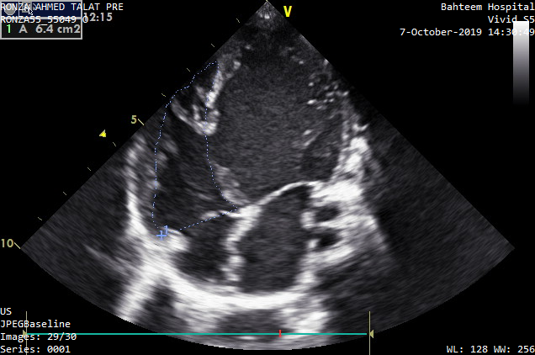
5-Right ventricular end-diastolic and end-systolic areas to calculate FAC using this equation (RVAd -RVAs)/ RVAd.

Slide 14
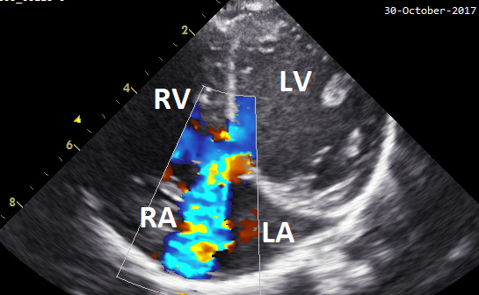
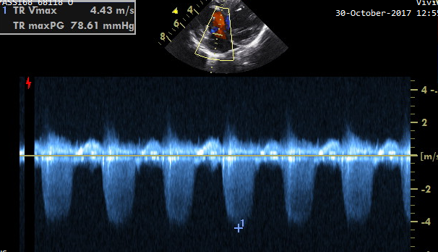
6-Peak Tricuspid Regurge velocity (TRV) and ERVSP.

Slide 15
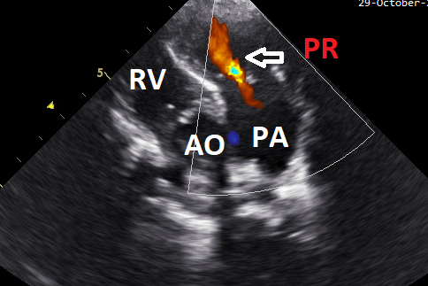
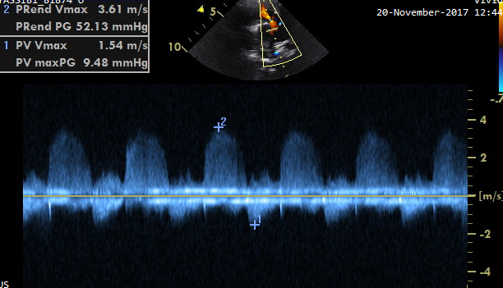
7-Early diastolic PR velocity and mean pulmonary artery pressure.
.

Slide 16
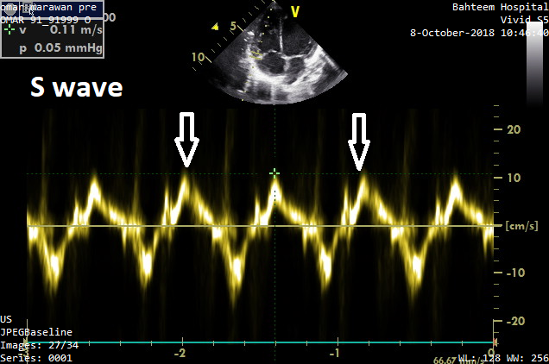
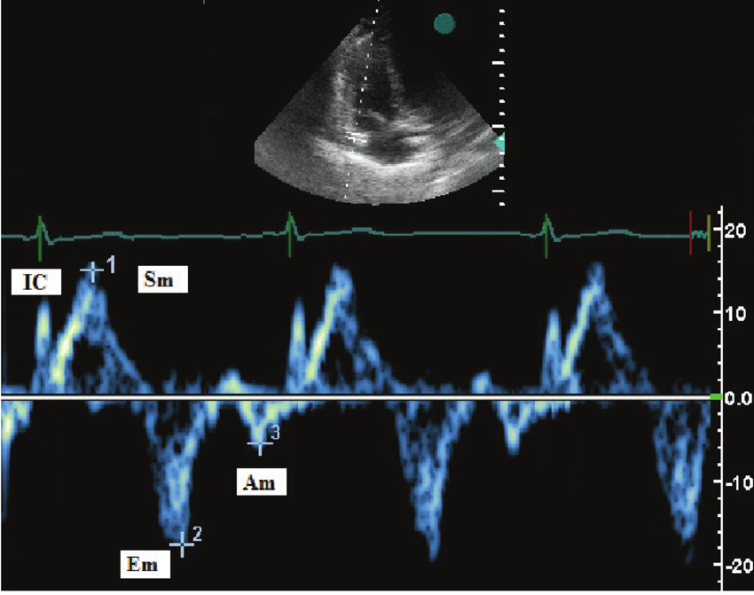
8-Pulsed tissue Doppler S wave (Sʹ) velocity on lateral tricuspid annulus.

Slide 17
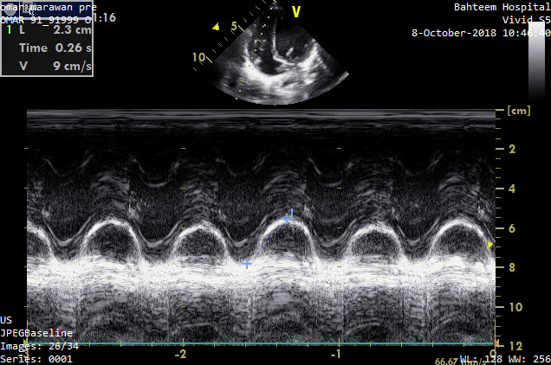
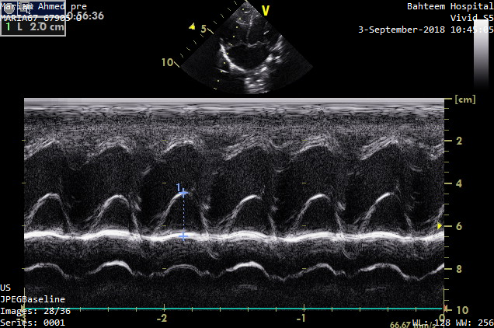
9-Tricuspid Annular Plane Systolic Excursion (TAPSE).

Slide 18
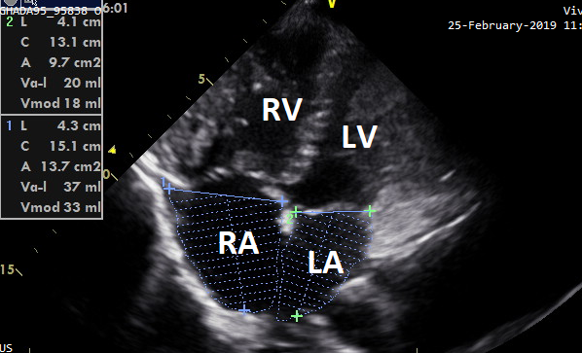
10-Right and Left atrial areas.

Slide 19
3
RESULTS

Slide 20
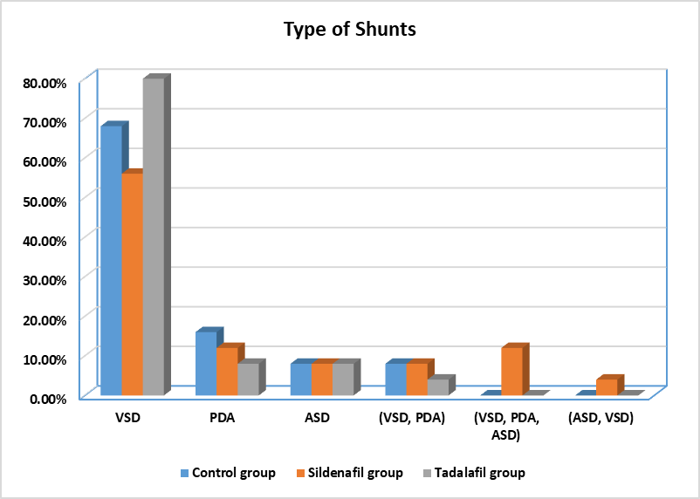
P.Value 0.80

Slide 21
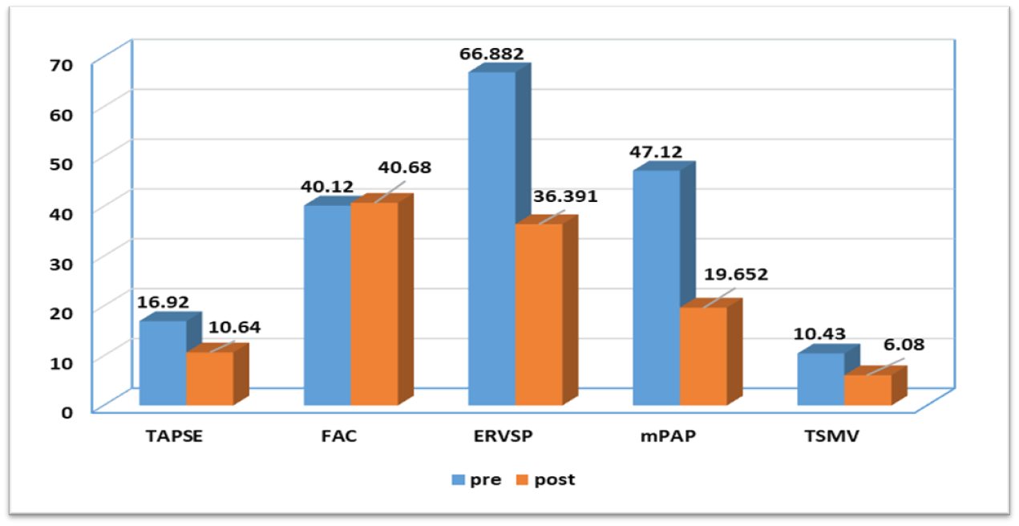
RV function and pulmonary artery pressure parameters before and one week after surgery in control group
P values , TAPSE= 0.001 / FAC= 0.08 / ERVSP= 0.016
m PAP =0.001 / TSMV= 0.001

Slide 22
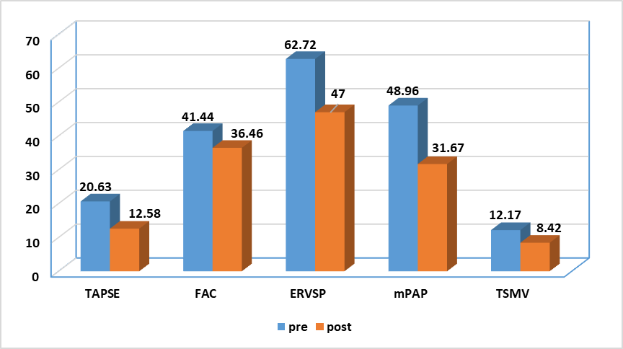
RV function and pulmonary artery pressure parameters before and one week after surgery in sildenafil group
P values , TAPSE= 0.001 / FAC= 0.82 / ERVSP= 0.001
m PAP =0.001 / TSMV= 0.001

Slide 23
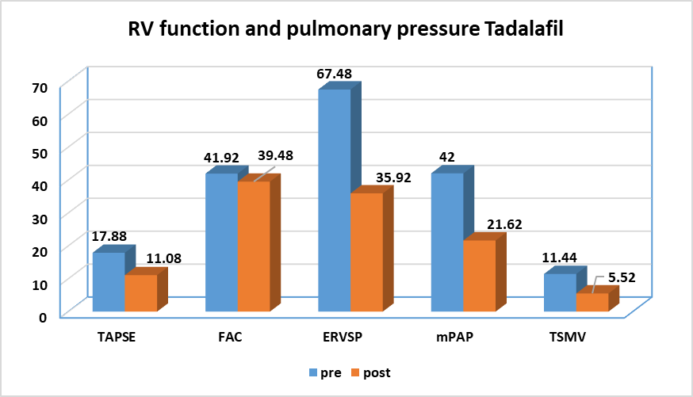
RV function and pulmonary artery pressure parameters before and one week after surgery in tadalafil group
P values , TAPSE= 0.001 / FAC= 0.32 / ERVSP= 0.001
m PAP =0.001 / TSMV= 0.001

Slide 24
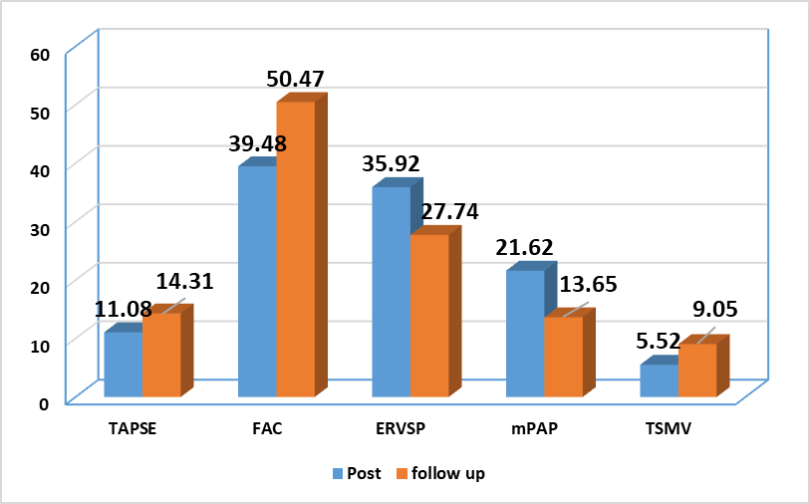
RV function and pulmonary artery pressure parameters one week and 3 months after surgery in control group
P values , TAPSE= 0.02 / FAC= 0.001 / ERVSP= 0.05
m PAP =0.011 / TSMV= 0.001

Slide 25
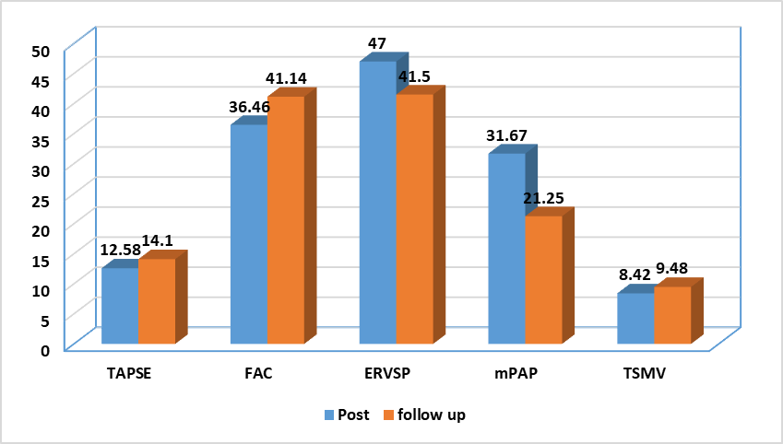
RV function and pulmonary artery pressure parameters one week and 3 months after surgery in Sildenafil group
P values , TAPSE= 0.25 / FAC= 0.11 / ERVSP= 0.41
m PAP =0.006 / TSMV= 0.31

Slide 26
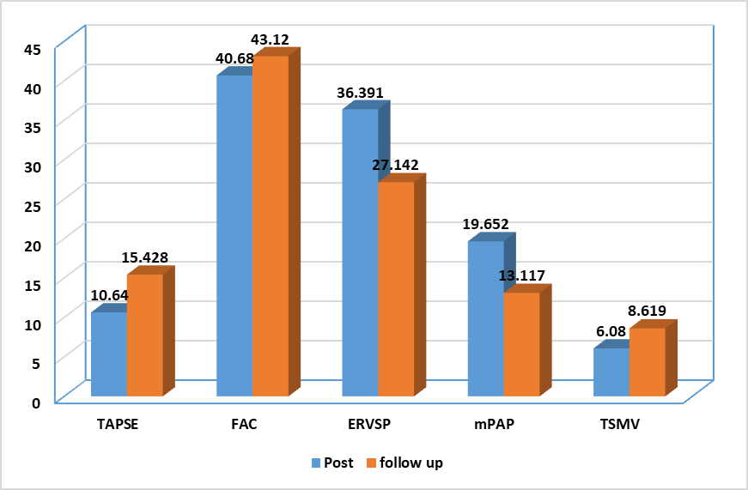
RV function and pulmonary artery pressure parameters one week and 3 months after surgery in Tadalafil group
P values , TAPSE= 0.001 / FAC= 0.403 / ERVSP= 0.005
m PAP =0.015 / TSMV= 0.001

Slide 27

Conclusion
4

Slide 28
We concluded that routine use of phosphodiesterase 5 inhibitors (PDE5-I) for peri-operative management of pulmonary hypertension secondary to CHDs does not affect the pulmonary artery pressure readings nor the morbidity or mortality of those children and does not shorten the length of hospitalization.
Tissue doppler is a gold standard non-invasive tool for assessing pulmonary artery pressure and RV dysfunction after cardio-pulmonary bypass especially in children.

Slide 29
5
Recommendations
5

Slide 30
  We don't recommend the routine use of PDE5-Is in management of pulmonary hypertension 2ry to CHDs with Lt to Rt shunts.
  We reiterates the need for additional well-planned, prospective, comparative studies of the safety and efficacy of PDE inhibitors and placebo controls in infants and children with PH on larger number of patients.

Slide 31


