Slide 1
Acupuncture Approach the Successful of ART during Treating Female Fertility
Hui Yan Cai MD (China), PhD
Professor of NUHS, USA

Slide 2


Slide 3
  Definition of Fertility
WHO defines
Primary infertility
Inability to conceive after trying 12 months of unprotected regular intercourse
Secondary infertility
Inability in the present times despite having conceived and/or had a child in the past
In US
Female age under 34: Inability to conceive a child after 12 months of contraceptive-free intercourse
Female age over 35: Couples has not conceived after 6 months of contraceptive-free intercourse
Infertility from congenital abnormalities are not effectively treated with either medicinal or alternation therapy, and are not covered here.

Slide 4
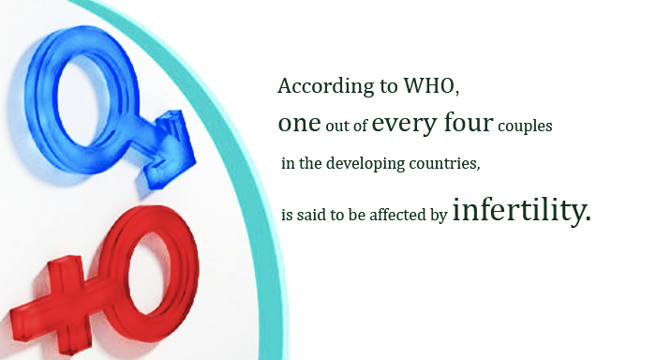
Infertility Stats

Slide 5
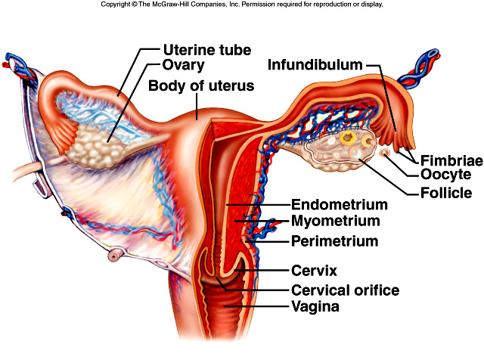

Slide 6
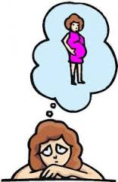
FEMALE INFERTILITY
Biomedical Etiology
General factor lead to infertility
  Endocrine
  nervous
  psychological factors may all play a part in the onset of infertility
Certain biomedical conditions, including:
  anemia
  tuberculosis
  heart disease
Other factory
  Chromosome abnormalities
  Endocrine disorder: diabetic,
  hyper/ hypo-thyroidism, Cushing’s syndrome
  Immunology
  Unexplained Infertility

Slide 7
FEMALE INFERTILITY
Biomedical Etiology
Four Compartment Theory
  Compartment I: Disorders of outflow tract or uterine target organ
  Compartment II: Disorders of the ovary
  Compartment III: Disorders of the anterior pituitary
  Compartment IV: Disorders of CNS (hypothalamic) factors
Environment → CNS & Hypothalamus ( 4th of Com.) → Anterior Pituitary / GnRH ( 3th of Com.) → Ovary /FSH &LH ( 2nd of Com.) → Uterine /E2 & P4 (1st of Com) → menstruation → Infertility

Slide 8
FEMALE INFERTILITY
Biomedical Etiology
Hypothalamic factors (Hypothalamic factors → an-ovulation/ infertility)
  Ovulation failure => Functional amenorrhea
  Amenorrhea with anorexia → Hypothalamic – Pituitary axis → effect of LH release / Low level of estrogen
  Athlete's amenorrhea: Hypothalamic suppression / Hypo-estrogenic state
Pituitary disorders → an-ovulation/ infertility
  Hyper- prolactin Syndrome
    Hyper-prolactinemia (Prolactine inhibits release GnRH from Hypothalamic)
    Prolactin-secreting adenomas
    Idiopathic hyper-prolactinemia

Slide 9
FEMALE INFERTILITY
Biomedical Etiology
Pituitary disorders ( continue)
  Hypogonadotropic (hypogonadism)
  Ovarian failure
  Hypothyroidism
  Drug-induced hyper-prolactinemia: domamine
  Pituitary lesions : Pituitary ischemia & infraction (Sheehan’S syndrome)
Disorders of the Ovary and Hormone
  Premature ovarian Failure
  Luteal Phase defects
  Polycystic Ovarian Syndrome
  Excess androgen production

Slide 10
FEMALE INFERTILITY
Biomedical Etiology
Pelvic, Tubes and Uterine Factors
  Endometriosis
  Tubes factors
  Uterine factors
    Asherman’s syndrome: mutiple D&C → Damage of endomitrum
    Structural abnormalities → primary infertility
    Congenital underdevelopment
    Malformation of the reproductive organs
    Organic injury to the reproductive organs
    Those above uterine factors cannot be affected by herbal medicine or acupuncture-moxa therapy, and also are not included in this discussion

Slide 11
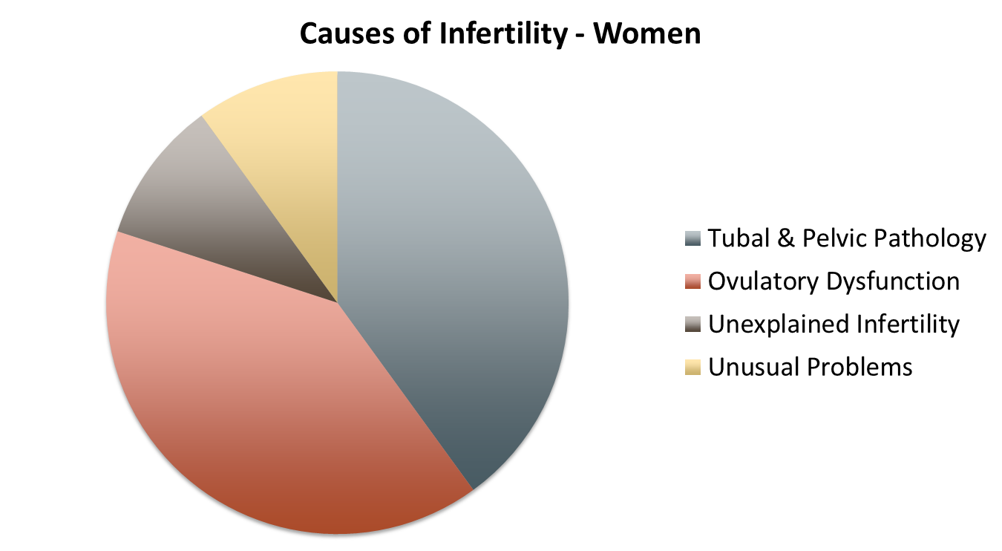

Slide 12
Common Infertility Factors
Incidence and Basic Investigations

Slide 13
Age related issues on female
(egg quality)

Slide 14
Aging on the Oocyte

Slide 15
Common Infertility Factors
Alternative Treatment Strategies and Method
Endometriosis
  TCM ( Acupuncture + Herbal): stage 1 & 2
  Hormone:
  Surgery
  Assisted Reproductive Technologies (Art)
Uterine-tubal factors:
  Partial uterine-tubal blockage
    TCM ( Acupuncture + Herbal)
    Surgery
    Assisted Reproductive Technologies (Art)
  Total uterine-tubal blockage
    TCM ( Acupuncture + Herbal)
    Assisted Reproductive Technologies (Art)

Slide 16
Common Infertility Factors
Alternative Treatment Strategies and Method
Ovulation problems
  TCM ( Acupuncture + Herbal)
  Ovulation Induction – Hormone treatment
  Assisted Reproductive Technologies (Art)

Slide 17

Assisted Reproductive Technologies (ART)
ART offers greater opportunity to conceive
ART includes:
  GIFT: Gametes Intra Fallopian Tube transfer
  ZIFT: Zygote Intra Fallopian Tube transfer
  Intra-Uterine Insemination (IUI)
  IVF: In-Vitro Fertilization
    IVF technique is one of the most widely used ART
    Has higher rates of success than other treatments

Slide 18
Assisted Reproductive Technologies (IUI)
Intra-Uterine Insemination (IUI)

Slide 19
Assisted Reproductive Technologies (IVF)
Pre-paration
Stimulation
Retrieval
Transfer
Progesterone phase
Notes:
Side effects like bloating,

Slide 20
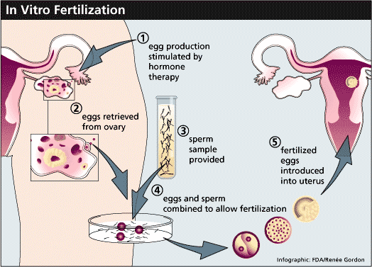

Slide 21
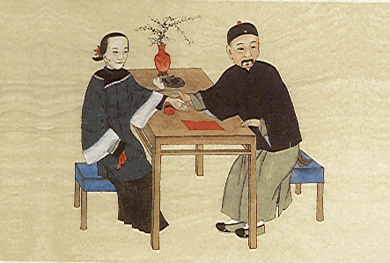
Physiology of pregnancy of
Traditional Chinese Medicine (TCM) and Treatment

Slide 22
Physiology of pregnancy of
Traditional Chinese Medicine (TCM)
Kidney and Essence=> First importance for pregnancy
Mentioned In chapter 1 of Yellow Emperors Canon of Internal Medicine,
For a woman
her kidney energy becomes prosperous when she is seven
her Taingui appears at the age of fourteen (2 x 7), at this time her Ren channel begins to put through, and her chong channel becomes prosperous and her menstruation begins to appear as all her physiological conditions being mature, she can become pregnant an bear a child. …
After the age of forty-nine (7 x 7) her Ren and Chong channel are both declining, her menstruation severs as her Taingui being exhausted, her physique turns old and feeble, and by then, she can no longer conceive

Slide 23
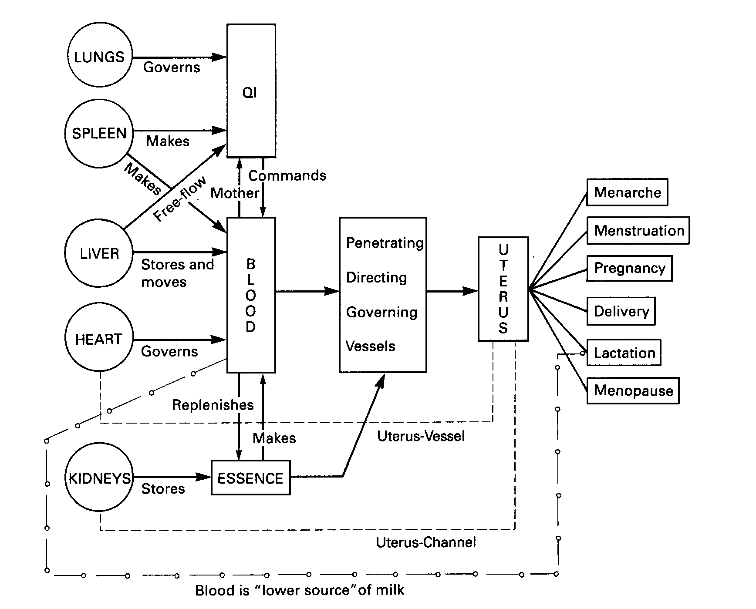
Physiology of pregnancy of TCM

Slide 24
Female Fertility Relative main Organs (TCM)
Kidneys
Liver
Spleen/Stomach
Heart
Lung

Slide 25
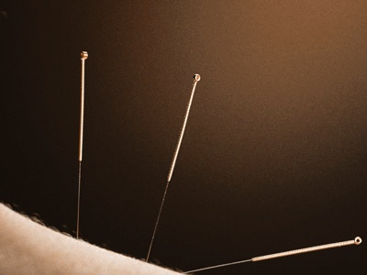
Acupuncture Channel Theory Related to female Infertility and Reproduction

Slide 26
Female Fertility Relative Channels (TCM)
Kidney
Liver
Spleen
Heart
Chong Mai
Ren Mai
Du Mai
Dai Mai
Bao Mai and Bao Luo

Slide 27
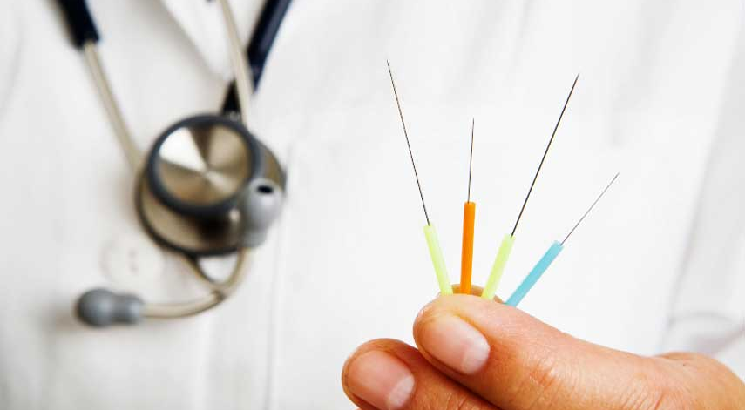
Acupuncture Research in
Female Infertility

Slide 28

Acupuncture Research Finding
In EA group
  ↓ Testosterone levels
  ↓ in ovarian and adrenal sex steroids
  ↓ in acne
  ↑ Ovulatory/menstrual frequency
Notes:
Androsterone glucuronide is a marker of adrenal hyperandrogenism in hirsute women
Metabolism of dihydrotestosterone to 5 alpha-androstane-3 alpha, 17 beta-diol glucuronide

Slide 29

Research Findings on Acupuncture and Female Infertility

Slide 30
Infertility of TCM Treatment Strategies

Slide 31
TCM Principle of Inducing Ovulation
(TCM Treatment Strategy)

Slide 32

Alternative (TCM) Treatment
Strategies during ART

Slide 33
IUI Procedure of Influence with TCM Treatments

Slide 34
Process of IUI and Integrated with TCM I
Step 1: preparation
Step 2: Before IUI
Non- medication stimulation ovulation IUI process

Slide 35
Process of IUI and Integrated with TCM II
Step 3
Step 4
After IUI

Slide 36
Preparation prior to IVF I
Pathogenesis of TCM =>Spleen and Kidney deficiency and dys- hemonry of Chong and Ren.
For prevention of Chemical miscarriage is more important to treat the patient before the next pregnancy. (3 mo to 1 year)
Combining Western Medication
Western Medication
Immunology
  Antigen: HLA, A, B, C. (A11, A26, B14)
  Serum: IgG, IgM, C3, C4
  Immune reject or protect function
Virus
Abnormality of chromosome
Endocrinology
Micro-ion Mineral level of body: Zinc, Manganese, Copper, and Iron.

Slide 37
Preparation prior to IVF II
Negative influence on prenatal heath
Stress
Smoking→ DNA damage, ▼oxygen & nutrients→ slow grow fetus
Alcohol intake→ alcohol syndrome
Drug
Toxic chemicals/ heavy metals/ minerals
  Lead
  Cadmium (Cd)
  Mercury
  Aluminum
  copper

Slide 38
Preparation prior to IVF III
Female Nutrients
Copper: Excess high level→ embroy-toxin→ birth defects (IUGR –Inrauterine Growth Retardation)
Vitamin C: ▼ Lead/ Copper / Cadmium / Arsenic →birth defects
Vitamin E: ▲ ovuration function
Zinc: ▲ restarting ovulation/ men’s cycle
Manganese (Mn)/ w Megnesium: def→ high copper level
Folic acid: def→ birth defects
Selenium (Se): def.→ birth defects (IUGR)
Avoid allergy:
Allergy→ asthma, eczema, hay fever, migraine, epilepsy, hyper-activity, depression→ drugs→ defects
Food allergy→ ▼zinc def./ poor absorption of vital nutrients
Allergy→ pass to offspring→ impairing fetus development
Allergy→ excess mucus→ block fallopian tubes

Slide 39
Process of IVF
Pre-paration
Stimulation
Retrieval
Transfer
Progesterone phase
Notes:
Side effects like bloating,

Slide 41
Process of IVF with TCM I
Prior to preparation IVF Procedure

Slide 42
Process of IVF with TCM II
First step (Preparation) - Regulation of hormones

Slide 43
Process of IVF with TCM III
Second Step: stimulation of ovulation

Slide 44
Process of IVF with TCM V
Second Step (cont. 1)

Slide 45
Process of IVF with TCM VI
Second Step (cont. 2)

Slide 46
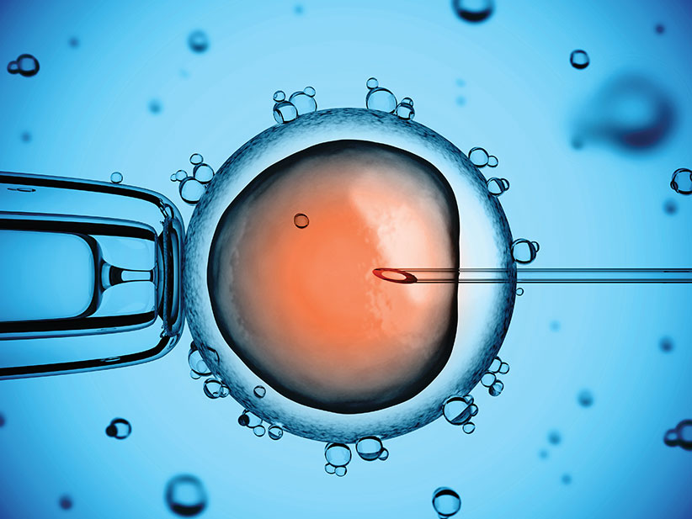

Slide 47
Process of IVF with TCM VII
Step three: Retrieval
After ovarian stimulation, the oocytes are extracted from the ovaries
Before retrieval:
After retrieval:

Slide 48
Process of IVF with TCM VIII
Step Four: Transfer
Oocytes fertilized with sperms either naturally or with intracytoplasmic sperm injection (ICSI)
Once the fertilization takes place, the embryos are kept for a number of days (usually 3-5 days)
Embryos are transfer back into uterus

Slide 49
Process of IVF with TCM VIII
After the transfer (Progesterone phase)
Use acupuncture until 12 weeks.
Acupuncture: ST-36, KD-3, KD-6, Yin Tang or Si Shen Chong, DU-20, PC-6, LV-8, beginning from the day of the Embryo Transfer.
Auricular: Kidney, Ear Shen Men,. Relax Muscles (Half way between Liver and Spleen)
Herbs: Follow the TCM treatment strategies to prevention of chemical miss AB

Slide 50
Process of IVF with TCM IX
Before transfer of embryos for IVF: After retrieval until before a day of transfer or the morning of transfer
  Treatment: Free Course Liver, Tonify Qi and Blood, Calm Shen.
  Acupuncture: 4 gates, ST-36, Yin Tang,, KD-3, KD-6, SP-6, SP-9 CV-4, Zi Gong (E-S)
  Auricular: Ear Shen Men. (Before the day or morning of the day of Embryo transfer)
  Formula: Xiao Yao San (modify), Not using in Illinois
Chai Hu, Dang Gui, Bai Shao, Fu Shen, Bai Zhu, Xiang Fu, Dang Shen, Gan Cao, Xiang Fu

Slide 51
Process of IVF with TCM frozen embryo transfer (FET) I
Medicated or natural FET

Slide 52
Process of IVF with TCM frozen embryo transfer (FET) II
Acupuncture following:
Step three: Retrieval
Step Four: Transfer

Slide 53
Prevention of Chemical Miscarriage from IVF
(TCM treatment Strategies)
Patient with Chemical Miscarriage from IVF
After Miscarriage
Step I: Counseling and Examining with Western Medicine
Step II: Root Treatment
Step III: Prevent Miscarriage, early treatment of problems if threatening of miscarriage occurs.

Slide 54

Polycystic Ovarian Syndrome
(PCOS)

Slide 55
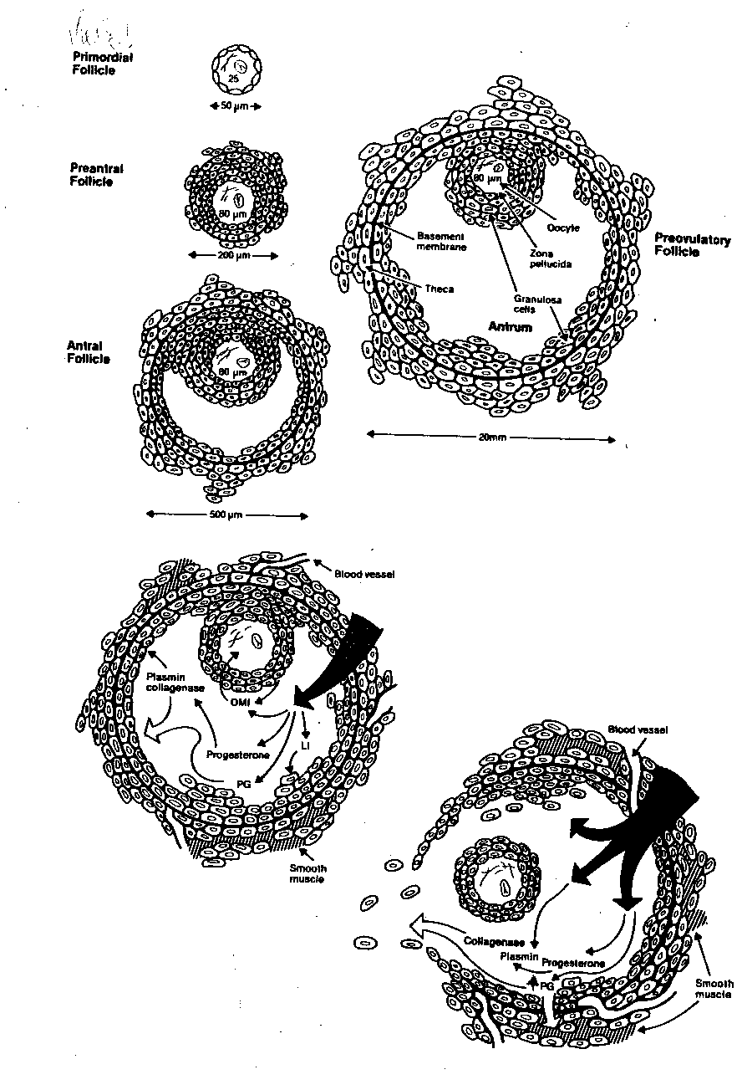

Slide 56
Polycystic Ovarian Syndrome
Introduction
Surface area of PCOS is double, increase 2.8 times of average volume
Same number of primordial follicles
Double of growing/ atretic follicles ( up to secondary follicle stage), about 20 to 100 cystic follicles in each ovary
50% increase in thickness of the tunica
One third increase in cortical stroma thickness
5- fold increase in sub-cortical stroma ( due to hyperplasia & increase formation subsequent to excessive follicular maturation & atresia)
Four times hyperplasia cell

Slide 57
Polycystic Ovarian Syndrome
Introduction
Menstrual disorders: 80% (anovulatory bleeding meaning less than 6 menses per year and delayed menstrual regularity. endometrial cancer
infertility seen in 74%
androgenic features seen in 69% (hyperandrogenism, anne vulgaris, hirsutism, or alopecia, male sweat changes, and clitoris swelling.
central obesity and : 49% (starts in teens and twenties, include Central obesity and is a BMI over 27, which is seen in 65% of patients
psychiatric disorders mood disturbances: depression and anxiety. eating disorders.
Cardiovascular disease is a risk factor
Domino, F. (2010).The 5-minute clinical consult 2011. (19th ed.). Philadelphia, PA: Lippincott Williams & Wilkins
Gaby, A. (2011).Nutritional medicine. Concord, NH: Fritz Perlberg Publishing
Moses, S. (2013). Poltcystic ovary disease.Family Practice Notebook, Retrieved from http://www.fpnotebook.com/Gyn/Endo/PlycystcOvryDs.htm
Rotstein, A. (2011). Polycystic ovarian syndrome (pcos).Nat Rev Endocrinol., 7(4), 219-31. Retrieved from http://www.pathophys.org/pcos/
Wissenburg, L. (Designer). (2006). Hormone Metabolism [Web Graphic].

Slide 58
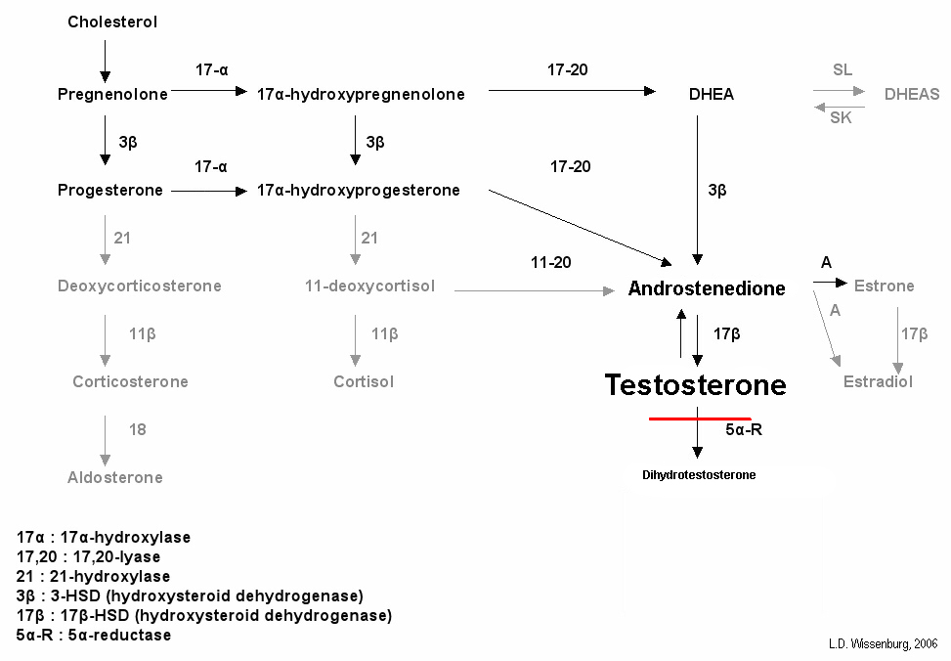

Slide 59
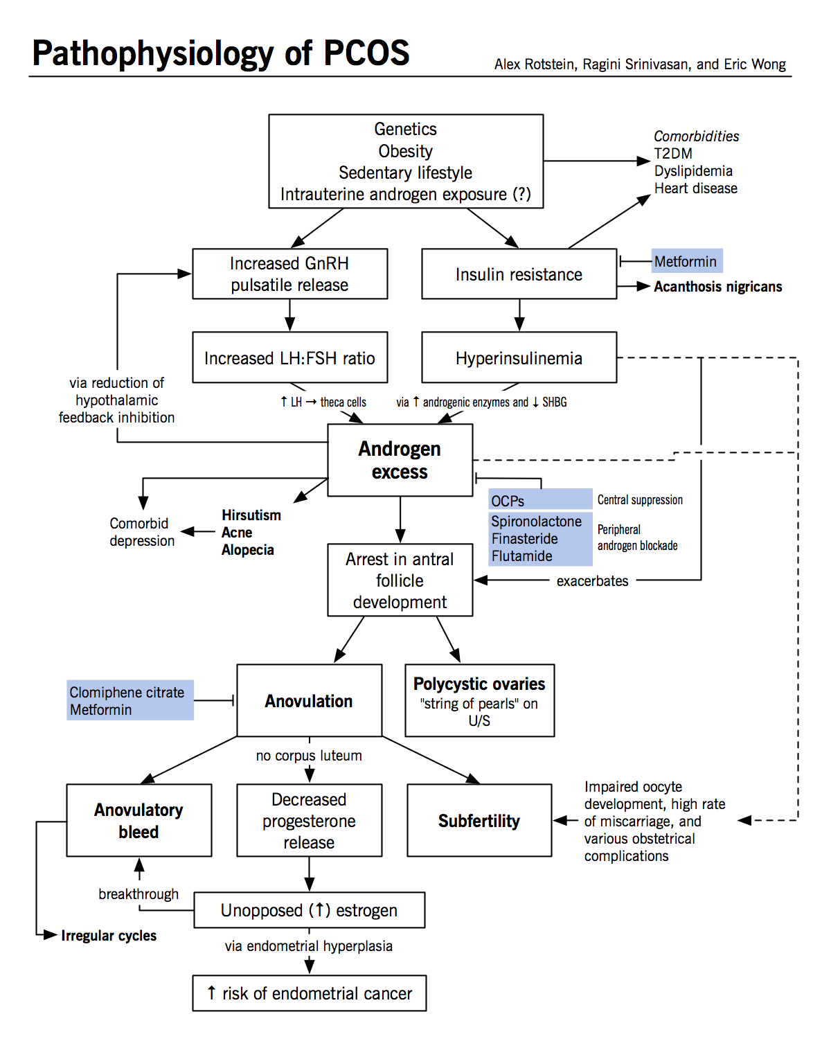

Slide 60
Polycystic Ovarian Syndrome
Symptoms
Dysfunctional bleeding or irregular menstruation cycle
Amenorrhea
Hirsutism (excessive hair growth)
Infertility
weight gain Obesity
Enlarge ovary covered with cysts
Endometrial hyperplasia
acne,
glucose intolerance, insulin resistance
mood swings and irritability

Slide 61
Polycystic Ovarian Syndrome ( test)
Blood hormone test:
Increase of
serum levels of androgens to see whether testosterone levels are elevated.
  LH ( Luteinizing Hormone)
  LH: FSH ratio
  A: (Androstenedione)
  DHA (dehydroepiandrsterone)
  DHAS (dehydroepiandrsterone sulfate)
  T (Testosterone)
  E (Estrone)
Decrease of
  FSH( Follical stimulating hormone)
  SHBG (Sex Hormone Binding Globulin)
Laparoscopy
Endometrial biopsy
Ultrasound

Slide 62
Polycystic Ovarian Syndrome
Treatment Strategiesand Method
Medication
Diabetes Medication: eg; Metformin
Hormone induce ovulation
  Clomiphene citrate (clomid)
  Ovaries are stimulated by FSH and LH Hormone:
    choice follius: e.g. Follistim, Conal-F, Repronex, Pergonal → produce more follicles
Surgery of follicular cysts
Hormone with Surgery
IUI/ IVF

Slide 63
Polycystic Ovarian Syndrome
TCM Treatment Strategies and Method

Slide 64
Acupuncture and PCOS Studies
Many studies were conducted by Stener-Victorin et al
Mainly using low frequency (2-10 Hz) electro-acupuncture to the lower abdomen, lower back and medial legs - acupuncture points such as CV-3, CV-4, CV-6, ST-28, ST-29 along with SP-6 and SP-9
treatments were administered about 2 x per week anywhere from 2-6 months

Slide 65
Acupuncture and PCOS Studies

Slide 66
Acupuncture and PCOS Studies

Slide 67
Infertility with Endometriosis
Defined
Presence of functional endometrial tissue outside uterine cavity.
Affect 5 to 20 % of all women of reproductive age.
Mean age at diagnosis is 25 to 29 years.
No racial differences in the prevalence of the disease.
There is a familial tendency toward endometriosis with no specific pattern of inheritance.

Slide 68
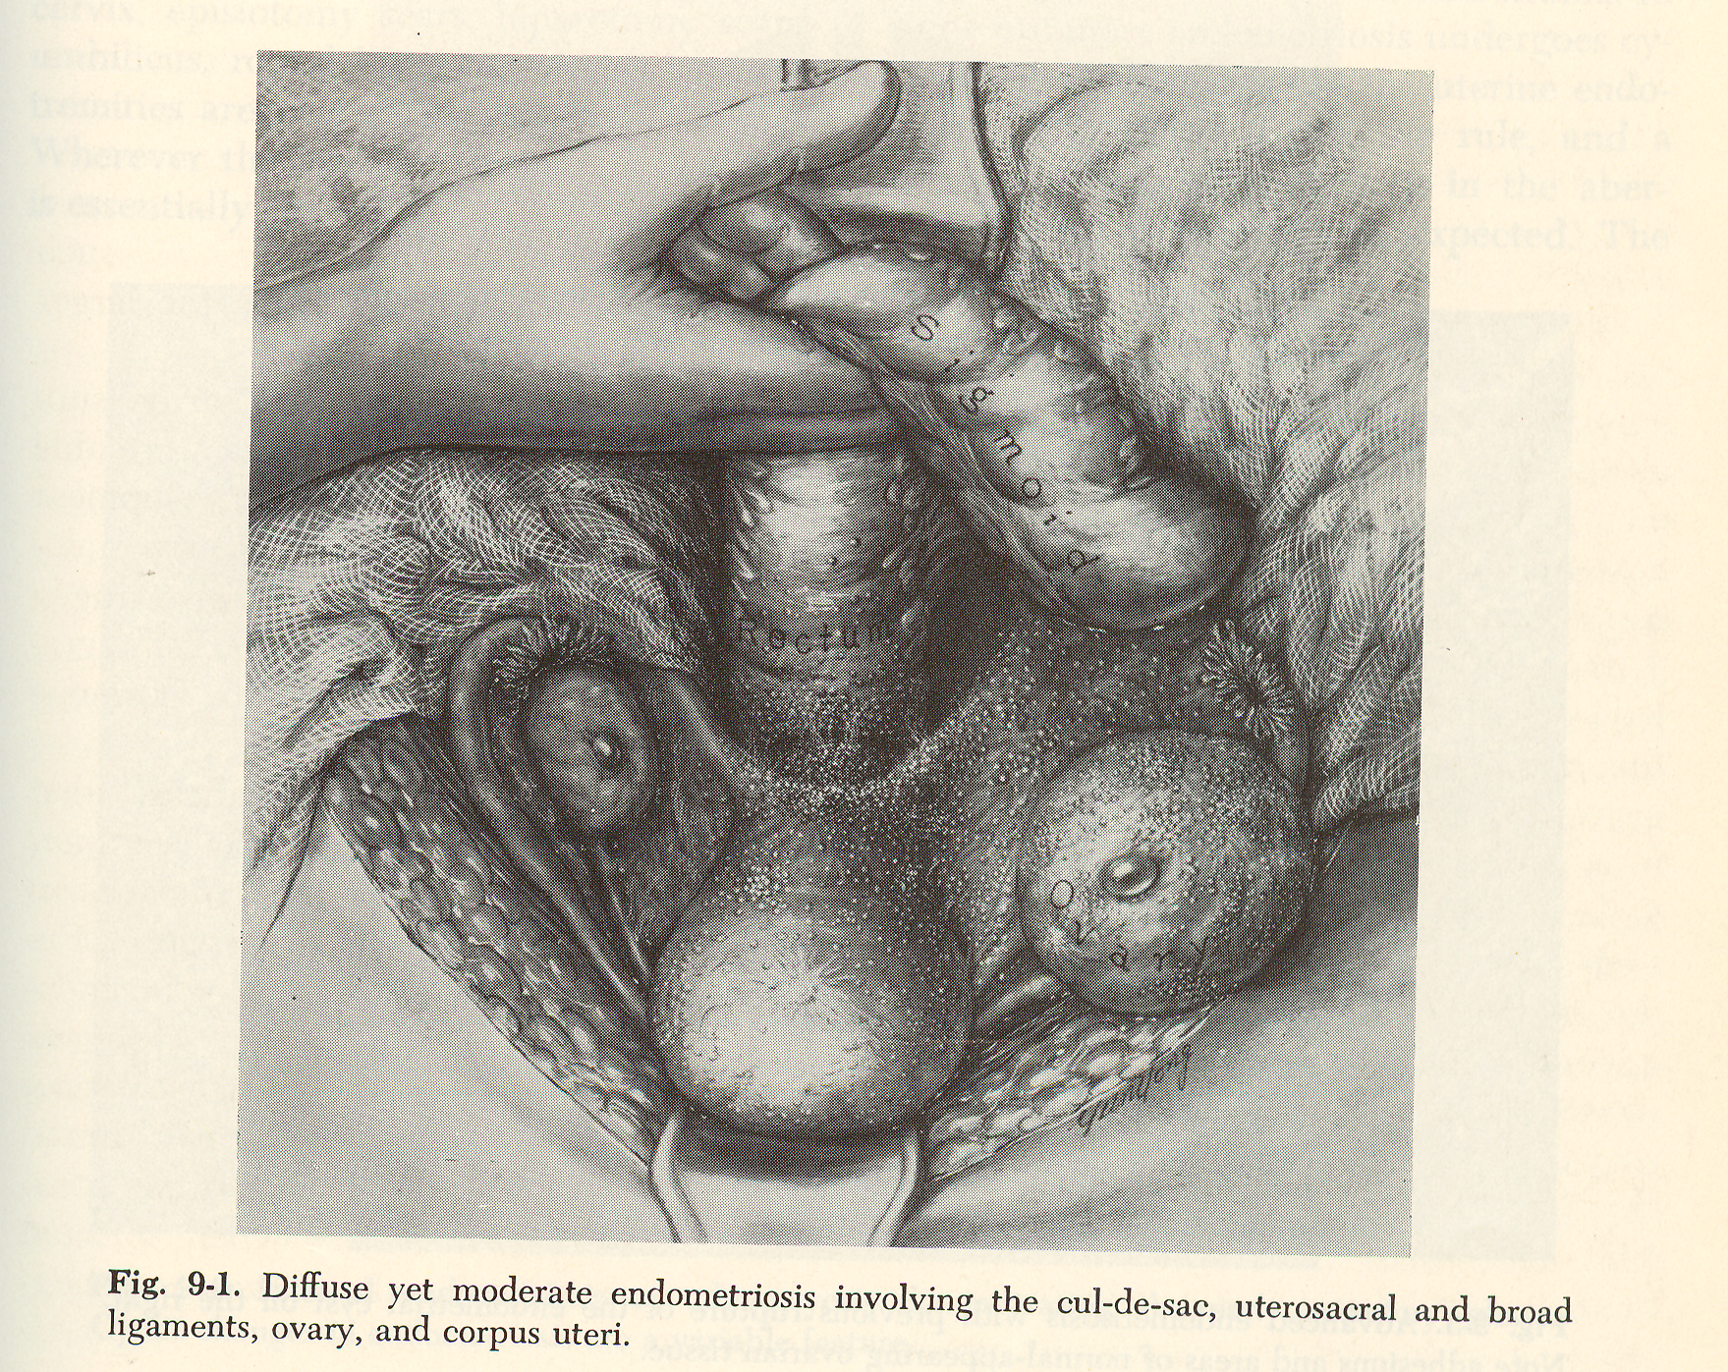

Slide 69
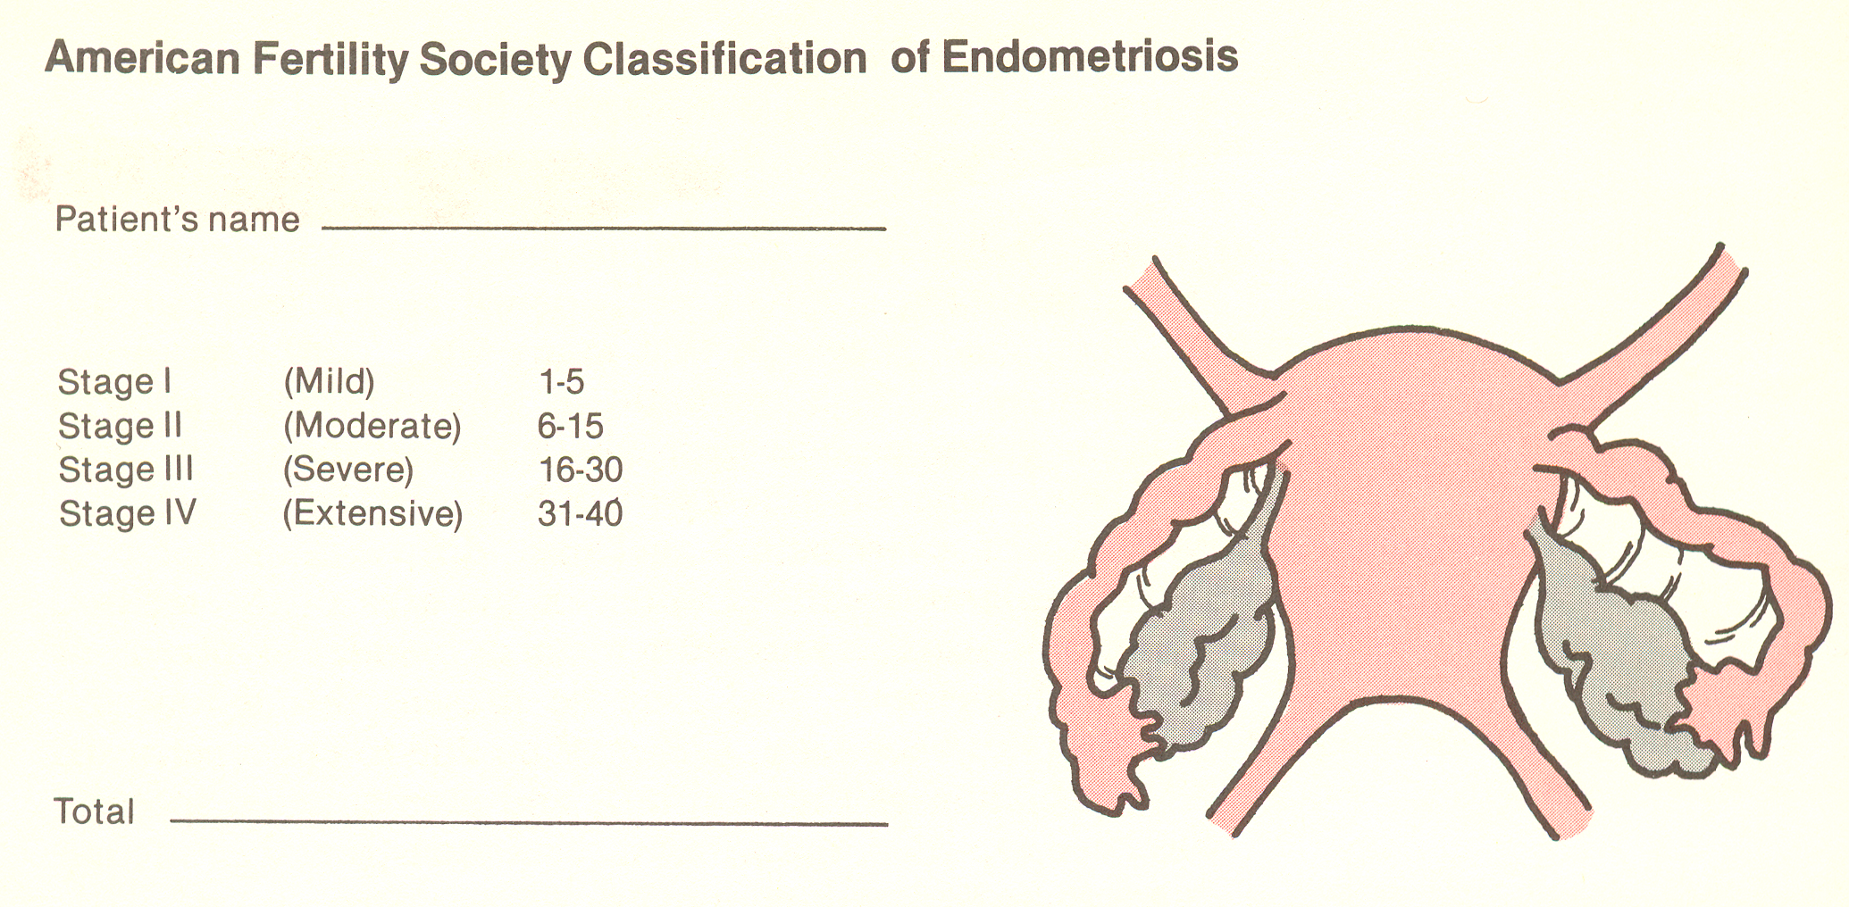

Slide 70
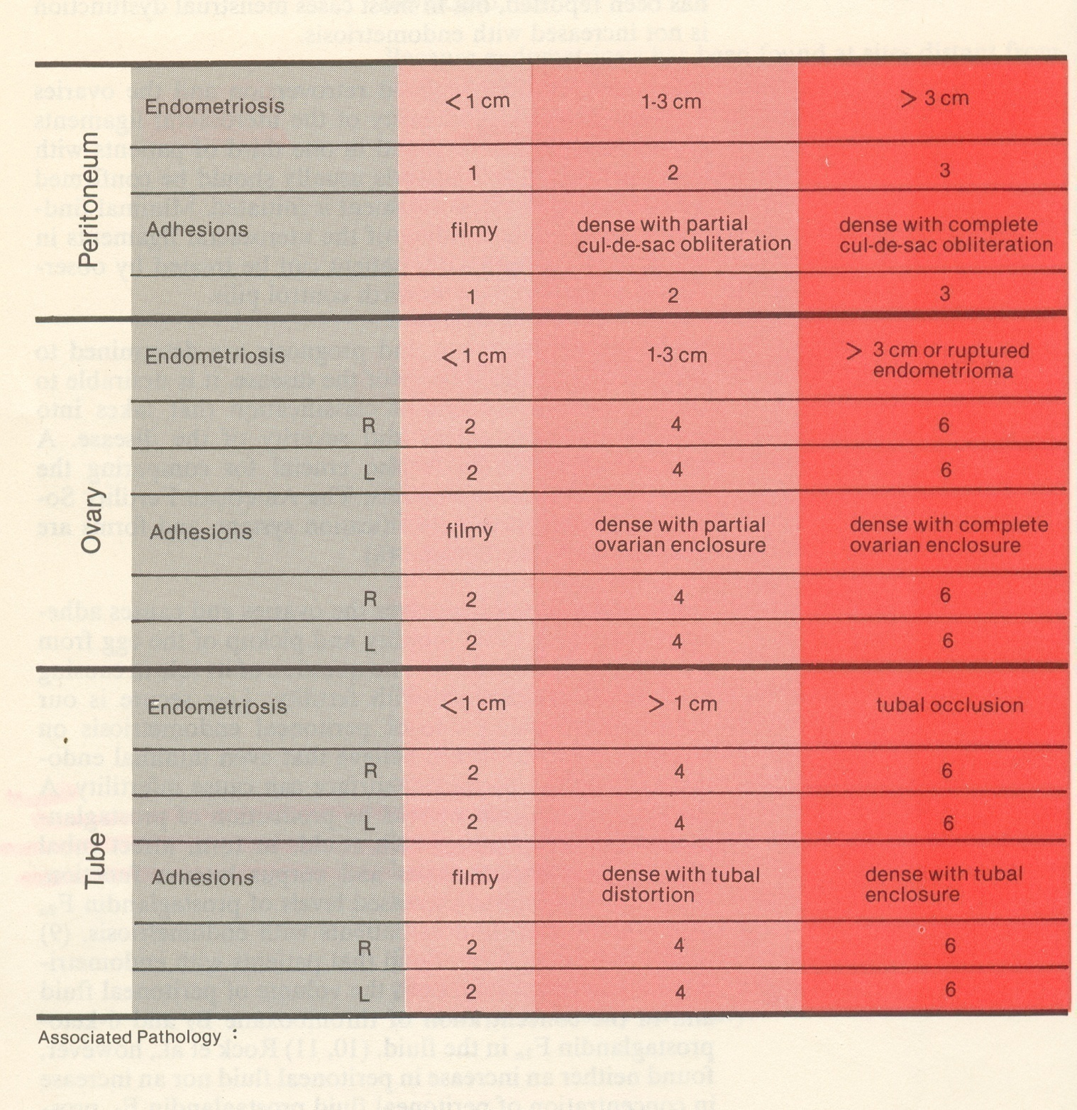

Slide 71
Etiology of Endometriosis
Three main theories of pathogenesis:
  Retrograde transport of endometrial tissue:
  Tissues=> through the fallopian tubes at menstruation=> seeding of the peritoneal cavity.
  Meta-plastic transformation of coelomic epithelium => functioning endometrial tissue at extra-pelvic sites (e.g., umbilicus, appendix, dia­phragm, pleural peritoneum).
  Spread of endometrial tissue through lymphatic and vascular channels.
Autoimmune cause: exposure to toxic chemicals in development of endometriosis

Slide 72
Endometriosis (Symptoms)
Scarring of the ovary => menstrual irregularities => an­ovulation
Unusual symptoms may relate to
  Extra-pelvic sites of endometrial tissue
  Cyclic nose/ vomiting blood
  painful defecation,
  cyclic headaches or seizures, sciatica, or cyclic scar pain.
Presence and severity of symptoms correlate poorly with degree of endometriosis seen at laparoscopy.
Many women are asymptomatic despite the presence of significant pathology at the time of surgery.

Slide 73
Endometriosis (Symptoms)
Pain is the most common complaint
manifested as secondary dysmenorrhea, worsening primary dysmenorrhea, chronic pelvic pain, backache.
Infertility may be due to anatomic distortion of the reproductive organs or other factors.
Difficulty sexaul is usually secondary to fixed retroversion of the uterus from scar tissue.
Key Symptoms
Dysmenorrhea
Dyspareunia ( Pain/ difficulty intercourse)
Infertility
Menstrual irregularities
Chronic pelvic pain

Slide 74
Endometriosis (Clinical Findings )

Slide 75
Treatment
Pelvic problems (Endometriosis, Peritoneal)
Out come of treatment
Pain relief
fertility
Treatment method
Surgery
Use for
  Adhesive disease associated with endometriosis
  Large (> 1cm) endometriosis
Method:
  laparoscopy
  Conservative: preserves reproductive function is maintained

Slide 76
Endometriosis (Treatment)
Hormone
  Danazol
  GnRH agonists (Gonadotropin-releasing hormone
  Progestogens
  Estrogen-progestin oral contraceptive pills
TCM combine with Biomedicine
  Acupuncture
  Herbal medicine

Slide 77
Endometriosis TCM I
Endometriosis
Etiology & Pathology from TCM
TCM patters: Blood Stasis (branch)
  Excesses:
    Qi & Blood Stasis
    Coagulant of Cold
    Heat & Blood Stasis Obstruction
  Deficiency/ Excesses:
    Qi / Blood Def. w/ Stagnation
    Spleen / Kidney Def. with Blood Stasis

Slide 78
Endometriosis TCM II
TCM patters:
Excesses:

Slide 79
Endometriosis TCM III
Deficiency

Slide 80
Endometriosis TCM IV
Acupuncture
    Sp-6, 10; ST- 29, 25 (or CV3,4,6 ,SP 6 )+ Moxa CV-8, 4
    Pain : CV-6 ,3, SP-8, 10, UB-32, LV-2
  Enema: bai hua she she cao, pu gong ying, san leng, e zhu, wu yao
Abdominal Masses: choose fowling herbs
  San leng, e zhu, dang gui, chi shao, dan shen, bie jia, zhe bei mu, mu li, mu dan pi, shan zha, xia ku cao, ji nei yin. Hai zao, ku bu
Excesses Bleeding: heavy or long time spotting
  Pu huang, san qi, qian cao gen, hai piao xiao, yi mu cao,
Release Pain: combination
Infertility

