Slide 1

7th International conference on
Ayurveda, Homeopathy and Chinese Medicine
TRACK 9: HOMEOPATHY
By Dr. FEMEGNE MOTCHEYE Innocent
Tel : 00237 97 30 21 39 Mail : femegneinnocent@yahoo.fr web : www.alternatives-medicales.com
May 18-19, 2017 Munich, Germany

Slide 2
part One
RESEARCH CONCEPTS AND BENEFITS IN HOMEOPATHY

Slide 3
CONCEPTS AND BENEFITS
CONCEPTS
It is a form of holistic medicine that helps the body to heal itself , so homeopathy is fundamentally different from allopathy , which administers external remedies to counter the effects of the symptoms. Homeopathy maintains that it is not useful to treat the physical manifestations of the disease (eg . Hypertension ), because these are only symptoms of an underlying condition . To cure the underlying disease ,

Slide 4
CONCEPTS (Continued)
homeopathy aims to stimulate the vital force of the body ( in terms of Hahnemann, Wesen - the spark, it is assumed equivalent to the modern concepts of the immune response ) . In homeopathic treatment , this is not the remedy that heals. Rather the remedy stimulates the body's natural defenses . Hahnemann believed that the disease is caused at the energy level , it is an imbalance that makes the person susceptible.

Slide 5
CONCEPTS (Continued)
Note that allopathic medicine has drifted far from the concern with respect to the susceptibility of the patient, to treat people after they become sick.
Known for millennia homeopathy , Samuel Hahnemann (1755-1844) formalized the modern perspective. He became known in successfully treating cases of typhus after the Battle of Leipzig in 1813.

Slide 6
CONCEPTS (Continued)
Homeopathy treats according to the " law of similars " as immune reactions can be triggered by inoculations and substances that cause symptoms in healthy people can be used to treat the same symptoms when they are the result of disease . There are thousands of homeopathic remedies, as used in homeopathic preparations diluted in infinitesimal quantities . Most homeopathic remedies are prepared from plants or animals. Usually , diluted one part in 99 parts of water or alcohol , it was vigorously shaken liquid , and then takes a portion for further diluted in 99 parts of water or alcohol ( 0.1 % ) ; diluted again (0.01%) , and repeatedly .

Slide 7
CONCEPTS (Continued)
It is important to shake the preparation, which is said to transfer energy to the solution. Paradoxically, the more dye is diluted , the more powerful it is , it can even be diluted beyond Avogadro's number , so there are more molecules of the starting material and this is what produces the most powerful cures. The remedy is taken as drops , or is absorbed in a powder and then swallow it.
Homeopathic therapist carefully consider the patient's symptoms, because they indicate the type of imbalance in the patient's defenses . Different patients have different the same underlying disease and will therefore require different remedies. Diagnostician set carefully all the symptoms (location, intensity , diurnal variation , factors that intensify ... ) in order to decide on treatment .

Slide 8
CONCEPTS (Continued)
The therapist prescribed a remedy for the individual patient , so that people with apparently similar symptoms may receive different treatments , depending on their constitutional type , physical , and even their attitudes. Could prescribe medication , or more , the homeopath can use software to help find the right remedy for the complexity of the symptoms presented . Number of patients treat themselves with homeopathic remedies over the counter in health food stores, pharmacies, etc. .
Generalizes , homeopathy particularized . Attack , struggle and war are the metaphors of allopathy , support and vital force are metaphors of homeopathy.

Slide 9
CONCEPTS (End)
Because homeopathy uses highly diluted natural extracts , often prepared by the therapist , the big pharmaceutical companies see no economic interest. Thus, in the late 1800s, there was a fierce competition between the two perspectives. The American Medical Association was founded in part as a defense against homeopathic medicine. The pharmaceutical industry has sided with the AMA to oppose homeopathy, which, at the time, knew much more uniformly successful than pharmaceuticals to treat disease .
Homeopathic remedies are inexpensive and have very few side effects . They can be effective to treat conditions (allergies , hay fever , asthma) who do not respond well to conventional therapies. Ideally , homeopathy should be a complementary therapy : allopathy treats the germ and symptom homeopathy helps the body resist infection . Lumpectomy , for example, does not cure cancer, but it gives the body time to heal

Slide 10
BENEFITS
• A thorough treatment , a complete diagnosis , it addresses the causes , natural, can be suitable for children ;
• No secondary and adverse effect;
• It works ;
• Suitable for mild disease ;
• It is natural ;
• A "soft" medicine can be very effective .
• Concrete results ;
• Takes into account the individual as a whole, natural ;

Slide 11
part Two
HOMEOPATHIC PERSPECTIVE ON AUTOIMMUNE DISORDERS AND INFECTIOUS DISEASES

Slide 12
HOMEOPATHIC PERSPECTIVE ON AUTOIMMUNE DISORDERS
Homeopathic products balance fundamentally cell mutation .
They reorganize the cell reduces the acidity of the blood .
Reorganize the internal environment of the body.

Slide 13
HOMEOPATHIC PERSPECTIVE ON INFECTIOUS DISEASES
Homeopathic products destroy all stem of virus ,bactiries and funger infections , re-form the immune system and establish self-healing

Slide 14

part Three
HOMEOPATHIC MEDICINE PREPARATION, MODE OF ACTION AND ADVANTAGES

Slide 15
HOMEOPATHIC MEDICINE PREPARATION

Slide 16
The principle of similarity
This is the basic principle of homeopathy,
which asserts the similarity between the toxic potency of a substance and its therapeutic power.
According to homeopaths, some substances can cause symptoms in a healthy person, then qu'utilisées in very low doses, they are able to cure those same symptoms in a sick person. In the "popular jargon", this principle could be translated as the "cure evil with evil."

Slide 17
The principle of division:
As substances capable of healing must be prescribed in infinitesimal doses, homeopathic remedies are prepared from a very rigorous dilution system.
Schematically, it always operates with a solvent (water or distilled spirits) that the product itself is added. The resulting mixture is diluted once more in water or distilled alcohol ... we obtain a mixture No. 2, which is distilled again with a solvent ... A true work of patience!

Slide 18
The principle of individualization
Homeopathy is finally characterized by the principle of individualization of treatment.
Indeed, for a homeopathic doctor, there are no diseases but sick. This means that for the same symptoms, a doctor may prescribe two patients two different treatments.
Why such a difference? Because the doctor always analyze the symptoms of the disease (and therefore common to all patients) and also to their specific symptoms that reflect an individual reaction to a given disease (it is common for the same evil that some patients have, for example, high fever, and others not at all, because each organization has its own defense systems).

Slide 19
MODE OF ACTION AND ADVANTAGES

Slide 20
How homeopath heal
?
In fact, a visit to a homeopath is often longer and more "thorough" than a visit to a conventional doctor.
Indeed, as the individualization of treatment is one of the foundations of healing,
the homeopath Doctor will listen carefully to his patient, not only about her illness but also about his lifestyle, which will provide him with "clues" about the general health of the patient, and therefore predispositions to such and such diseases.

Slide 21
How homeopath heal ? (continued and end )
"Traditional" medicine is often criticized for its "anti" side: you are prescribed antibiotics, anti-inflammatories, antidepressants, leaving aside factors as essential as hygiene, nutrition, sleep ...
The homeopathic doctor, he shall, with the prescribed treatment, make sure you cure your disease, but also allow you to "build" your general condition, in order to guard against any relapse.

Slide 22
ADVANTAGES
Homeopathy is part of alternative medicine , as well as herbal medicine, and energy medicine such as acupuncture , osteopathy, etc. . Its action is to restore the vital energy of the person in a state of equilibrium which gives health.
This is because there is , at any given time , an imbalance in vital energy, for any reason ( grief, job loss, grief ... ) , the disease can enter and perform his misdeeds within the body.

Slide 23
ADVANTAGES (Continued and end)
Since its preparation , homeopathy has the advantage of being free from side effects. It can be used both in adults ( including pregnant women ) than in children , and safely
The use of homeopathy to treat animals is obviously entirely appropriate , of course !

Slide 24
part fourth
ROLE OF HOMEOPATHY IN ALLERGY, MALIGNANCY, HIV/AIDS AND NEURAL DISORDERS

Slide 25
ROLE OF HOMEOPATHY IN ALLERGY
On allergies homeopathic products eliminate free radicals and detoxify the blood

Slide 26
ROLE OF HOMEOPATHY IN CANCER
On the cancer they destroy bad cells , stop the disorder proliferation of cells and stimulate the regeneration of new tissue

Slide 27
ROLE OF HOMEOPATHY IN NERVOUS SYSTEM DISORDERS
In the nervous system, they purify , stimulate neurons , activate the nerve centers (brain , spinal cord, brain means ... )

Slide 28
ROLE OF HOMEOPATHY IN HIV
On HIV, they block reverse transcriptase , inhibited the virus , promote reform immune stimulating the production of CD4 cells reorganize through a well mechanism preparing the body seroconversion

Slide 29
part fifth
CLINICAL HOMEOPATHY

Slide 30
The teaching of clinical homeopathy (Continued)
medical
He puts homeopathy , ethical and aware of its limitations , amid other therapies.
clinical
It is based on the richness and clinical precision in the center of medical practice.
Hippocratic He stressed the need to consider the patient as a psychosomatic unity and its history.
pragmatic
It highlights the priority of observation and experience in relation to systems and classifications which enclose in dogma or simplification.

Slide 31
The teaching of clinical homeopathy (Continued)
pragmatic
It highlights the priority of observation and experience in relation to systems and classifications which enclose in dogma or simplification.
Charter ECHR our core values.
Homeopathy is built on experience and observation : she was a pioneer in the birth of the concept of clinical . It is , as such , a natural part of medicine today .
• Homeopathy is , in medicine , therapy among all other possible treatments.

Slide 32
The teaching of clinical homeopathy (Continued)
• The method of prescribing homeopathic medicines is the clinical method .
• The clinical indications included in medical materials are those considered :
o reliable , verified by practice.
o consistent with current medical knowledge and capabilities of other therapies.
• The clinical and paraclinical that guide the prescription of homeopathic medicines are not limited to those of the disease. They include all the signs found on clinical observation, including :

Slide 33
The teaching of clinical homeopathy(Continued and end)
o those specific to the individual response of the patient.
o those describing the characteristics of the patient and his story outside of his illness.
• No system , no method or classification may not accurately reflect the specificity of each patient nor supplant the necessary experience of each physician.
The values ​​that underpin the teaching of ECHR therefore respect both the achievements of medical science - the intellectual rigor, clinical priority - and experimental sources of Homeopathy - careful observation of diseases and patients.

Slide 34
part Sixth
SIMILARITIES AND DIFFERENCES WITH OTHER FORMS OF ALTERNATIVE/ORIENTAL MEDICINE

Slide 35
SIMILARITIES
Homeopathic medicine views the body, health and disease differently. Complementary and Alternative Medicine :
• Be interested in the patient and assess the disease in a comprehensive manner taking into account the physical and mental aspects , predisposition , environment , etc. . This approach earned them the common name " holistic medicine " ;
•

Slide 36
SIMILARITIES (Continued)
• To focus on the causes of the disease;
• Use natural means such as diet , exercise, herbal and homeopathic remedies to help the body heal itself ;
Will give great importance to the relationship between or doctor and the patient or the patient , which means that consultations are longer ;
• Aim consultations through education, prevention, self-health and " healing " in its entirety ;
•

Slide 37
SIMILARITIES (Continued and end)
Often based in the selection of treatments and medications on TK or millennia old which have not necessarily been the subject of scientific research. However, a growing number of studies are performed on treatments and "medicines" practiced by these medicines . Since approaches to complementary and alternative medicine and those of official medicine are complementary, collaboration and partnership contribute to overall improved health and more greatly reduce the cost of care.

Slide 38
DIFFERENCES WITH OTHER FORMS OF ALTERNATIVE/ORIENTAL MEDICINE
Chinese pharmacopoeia
Pharmacopoeia is the preferred method in China, because it is considered more powerful than acupuncture. Back more than 3,000 years , Chinese medicine has thousands of substances among which 300 commonly used plants .
Chinese formulas and classical counter preparations are not indicated for self-medication . It is best to consult Chinese medicine, acupuncture or herbalism . The choice of
Plants or Chinese formula is based on the analysis of the particular situation of the person. The risk of interactions with other drugs should also be considered .

Slide 39
DIFFERENCES WITH OTHER FORMS OF ALTERNATIVE/ORIENTAL MEDICINE(Continued)
acupuncture
The flow of vital energy , qi , circulates in a network of channels called the " meridians " through body . The acupuncture points are located on these meridians to regulate the flow of energy. The treatment is carried out using acupuncture fine needles inserted at these points.
The vital energy
According to this medicine, the fundamental element in humans is the vital energy , called the " qi " (pronounced " chee " ), which supports both the functions of the body than of the mind. The primary goal of TCM is to maintain the harmony of this energy within the body and between the body and the external environment.

Slide 40
DIFFERENCES WITH OTHER FORMS OF ALTERNATIVE/ORIENTAL MEDICINE(Continued)
In Chinese medicine , health is the ability of the organism to cope with attacks. When the body has lost the ability to adapt , the disease occurs . Several factors can influence this inter vital energy. The causes of the disease can be internal , such as anger , grief , sadness, fear , fear , joy or concerns, or external , such as wind , cold , dampness, heat, heat wave or drought. Other causes of the disease within various levels , such as a weak constitution , overwork, excessive or frustrated sex life , injuries and accidents , parasites and poisons and poor diet . ( Network Proteus , Traditional Chinese Medicine, 2002. )

Slide 41
DIFFERENCES WITH OTHER FORMS OF ALTERNATIVE/ORIENTAL MEDICINE(Continued and end)
Chinese medicine does not seek to identify the disease , but its causes. She wondered disturbances responsible for disharmony of vital energy . In addition, the constitution of each person is important . The same symptom , experienced in two different people, not necessarily the same causes. That is why the therapist will try to determine the particular imbalance to each person.
In Chinese medicine, the human body is a complex whole whose parts are interdependent and interconnected.

Slide 42
Part Seventh
MYTHS OF HOMEOPATHY

Slide 43
MYTHS AND TRUTH
Homeopathy: myths explained
The status of homeopathy in terms of alternative medicine gives this branch of medicine multiple speculations. Some are facts while others are nothing but hearsay.
Slow or fast action?
In the medical community , it is certainly the speed of healing that determines the effectiveness of treatment. Some consider homeopathy as being faster than allopathic medicine while others say it is a slow-acting therapy . It takes more time to return to action the effect of analgesics, anti -inflammatory drugs and steroids. However, since it is chronic and complex disease, the course of treatment may seem slow and long.

Slide 44
MYTHS AND TRUTH(Continued)
Psoriasis , for example, takes a long time to process , based on the treatment of diseases related thereto, homeopathy has been labeled as a form of slow-acting remedy . Prescribe the appropriate homeopathic remedy takes longer than conventional medicine - several factors must be considered before making a prognosis and to establish a treatment plan. Homeopathy is rapidly under conditions such as eczema , acute infections , allergies , fevers , diarrhea , asthma , arthritis , migraine . Although the comparison is between homeopathy and conventional medicine.

Slide 45
MYTHS AND TRUTH(Continued)
Homeopathy worse disease
Since the clouds hovering over the operation of homeopathy fashion - darkness that is the direct result of a lack of information or at best a lack of willingness to acquire information - it is not surprising to find erroneous beliefs about the practice . One of these beliefs is that homeopathy initially increases the disease , making potential concern and ill prepared to begin treatment patients. It is not true to say that homeopathy led to an initial aggravation of complaints. Some people attest that they feel ill shortly after starting homeopathic remedies.

Slide 46
MYTHS AND TRUTH(Continued)
Homeopaths interpret this worsening ' as the instinctive reaction of the body opposite the stimulation symptoms , make an effort to recover. It is also common that the worsening qu'expériencent patients after taking the drugs coincides with the progression of the disease: deterioration result of the natural course of the disease in question before the homeopathic remedy had time to action.
permanent cure
Homeopathy is seen as the ultimate solution as any other mode of treatment has failed . And hope, helped a little misplaced beliefs , advance the notion that homeopathic remedies can permanently cure the disease. Homeopathy gives lasting results for sure.

Slide 47
MYTHS AND TRUTH(Continued)
Permanence is theoretical and can not be promised in difficult conditions.
Acute illness and chronic disease
Some seem to think that conventional treatment is most appropriate to administer acute diseases, while homeopathy is more effective for chronic diseases. Acute illnesses ( such as colds and teething problems ) are those that will eventually resolve independently of drug intervention . Chronic diseases ( such as cancer , AIDS and diabetes ) are more serious illnesses requiring medical supervision and formed over a long period of time.

Slide 48
MYTHS AND TRUTH(Continued)
Homeopathy is also operative for the treatment of acute diseases as well as chronic diseases. Homeopathy appears clearly effective for a wide range of chronic diseases such as migraine , psoriasis , arthritis , asthma , allergies , ulcerative colitis , warts, and urticaria example. It heals as well cough , cold fever , otitis media , pneumonia , tonsillitis, sinusitis and hepatitis , etc. . As with any disease , if a chronic disease is treated using homeopathy , medical diagnosis and monitoring are still essential .
The myth comes from the fact that those with acute diseases do not usually turn to homeopathy to heal , thus combining the effectiveness of homeopathy for chronic diseases.

Slide 49
MYTHS AND TRUTH(Continued)
Homeopathy is dangerous
The mother tincture or the original substance ( concentrated ) is the leading cause calling homeopathy ' dangerous ' . Homeopathy uses multiple herbs , mineral and animal substances such as mother tincture. These include substances such as carcinogenic genes ( to treat fibromyalgia , for example) , snake venom or Lach ( to treat ailments related to the nervous system ), milk or dog lake caninum (to treat sore throat , diphtheria, and rheumatism ) . This tincture can be classified into three specific categories: nosodes , the sarcodes and impondarablia .

Slide 50
MYTHS AND TRUTH(Continued and end)
Nosodes are drugs prepared from sources of disease such as bacteria producing organisms , viruses , and particles of diseases such as pulmonary tuberculosis genes . The sarcodes are medicines prepared from healthy organs or body tissues such as the thyroid , pituitary and pancreas. The impondarablia includes drugs from energy sources such as X-rays, sunlight and electricity.
These concentrated substances ( mother tinctures) are strictly toxic . They are only used as a raw material and are then highly diluted ( 100-1000 degree , depending on the stage of the disease) , being non- toxic but retaining their medicinal properties. The homeopathic remedy is therefore understood that the footprint of the mother tincture : these are the energies pharmacopoeia thereof are taken as healing agent. In addition , homeopathic remedies guarantee almost no side effects and risks of accidents are reduced almost to zero. So there is no danger to swallow a whatever its raw material homeopathic remedy .

Slide 51
Presentation of some products Vitale range of Office
Vitale Thousand Wonders
Homeopathic essences, a versatile drug.
Vitale Para sympathic
Homeopathic essences chrono therapy for deep affection memory and nerves.
Vitale Immunoplexe: Green Light
For immune power immunizing gifted a broad spectrum of activity.

Slide 52
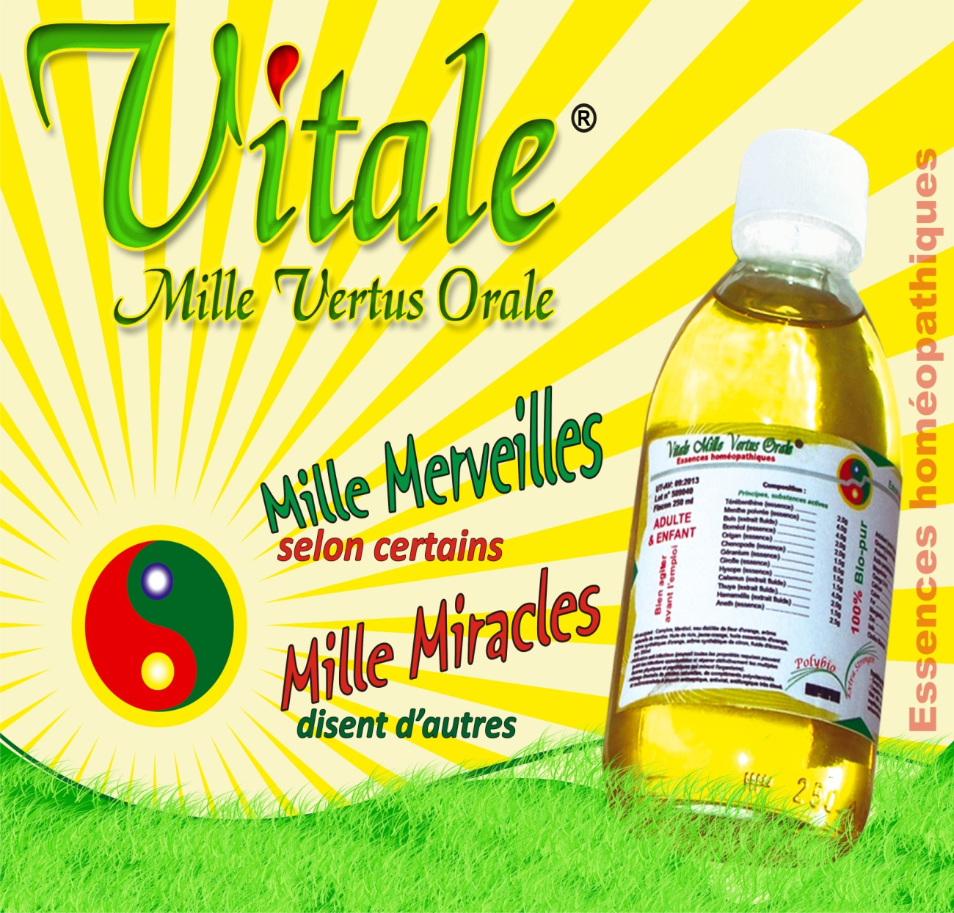
Indications (continued)
Vitale Thousand Wonders
Has powerful stimulating and toning properties that act against the disease by restoring the body's energy.
By its energy replenishing fluids is a multidimensional latent cure.
Through its active therapeutic poly: is a broad-spectrum medication.
Its complexity is a positive immune boosting auto body

Slide 53

Indications (continued)
Vitale Thousand Wonders
It is a universal remedy, an active energy symbiosis, a synthetic broad spectrum synergistic
which continuously explores the body, systematically identify causes and pathological factors and eliminate them.
Its liquefying diversity, it scans the body by deploying its plural therapeutic, makes harmonious facilitates self healing, recycles alternatives forces reorganized the physical, recreates the alchemical harmony of body reshaping morphology, nourishes the mind, balance the energies and welfare grants.

Slide 54
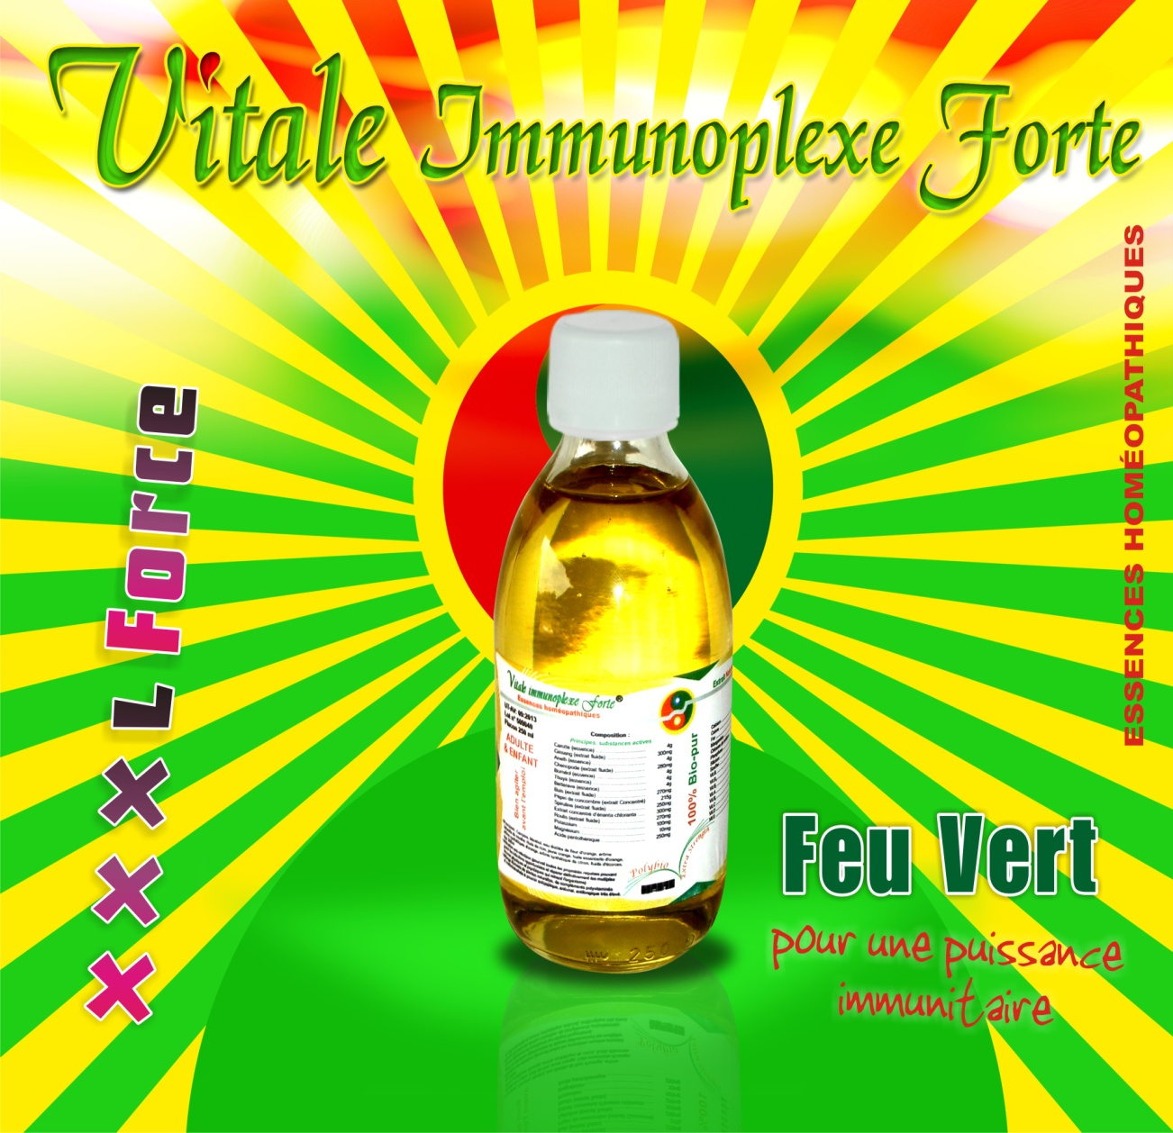
Vitale Immunoplexe Green Light
Indication
has powerful stimulating and toning properties that act against the disease by restoring the body's energy.
By its energy replenishing fluids is a multidimensional latent cure.
Through its active therapeutic poly: is a broad-spectrum medication.
Its complexity is a positive immune stimulant self from the body.

Slide 55

Vitale Immunoplexe Green Light
properties
Fungal:
- Esophageal Candidiasis
- Pulmonary Cryptococcosis, neuro-miningée, disseminated
- Pulmonary aspergillosis, cerebral, disseminated.
Parasitic:
- Crytosporidiose with diarrhea
- Pulmonary Pneumonia
- Pulmonary Strongyloidiasis, cerebral, disseminated
- Pulmonary Toxoplasmosis, cerebral
Viral:
- Cytomegalovirus pulmonary, digestive, brain
- Herpes Viral disease chronic mucocutaneous, disseminated
- Leucoencéphalique progressive multifocal, disseminated mycobacteriosis Bacterial.

Slide 56
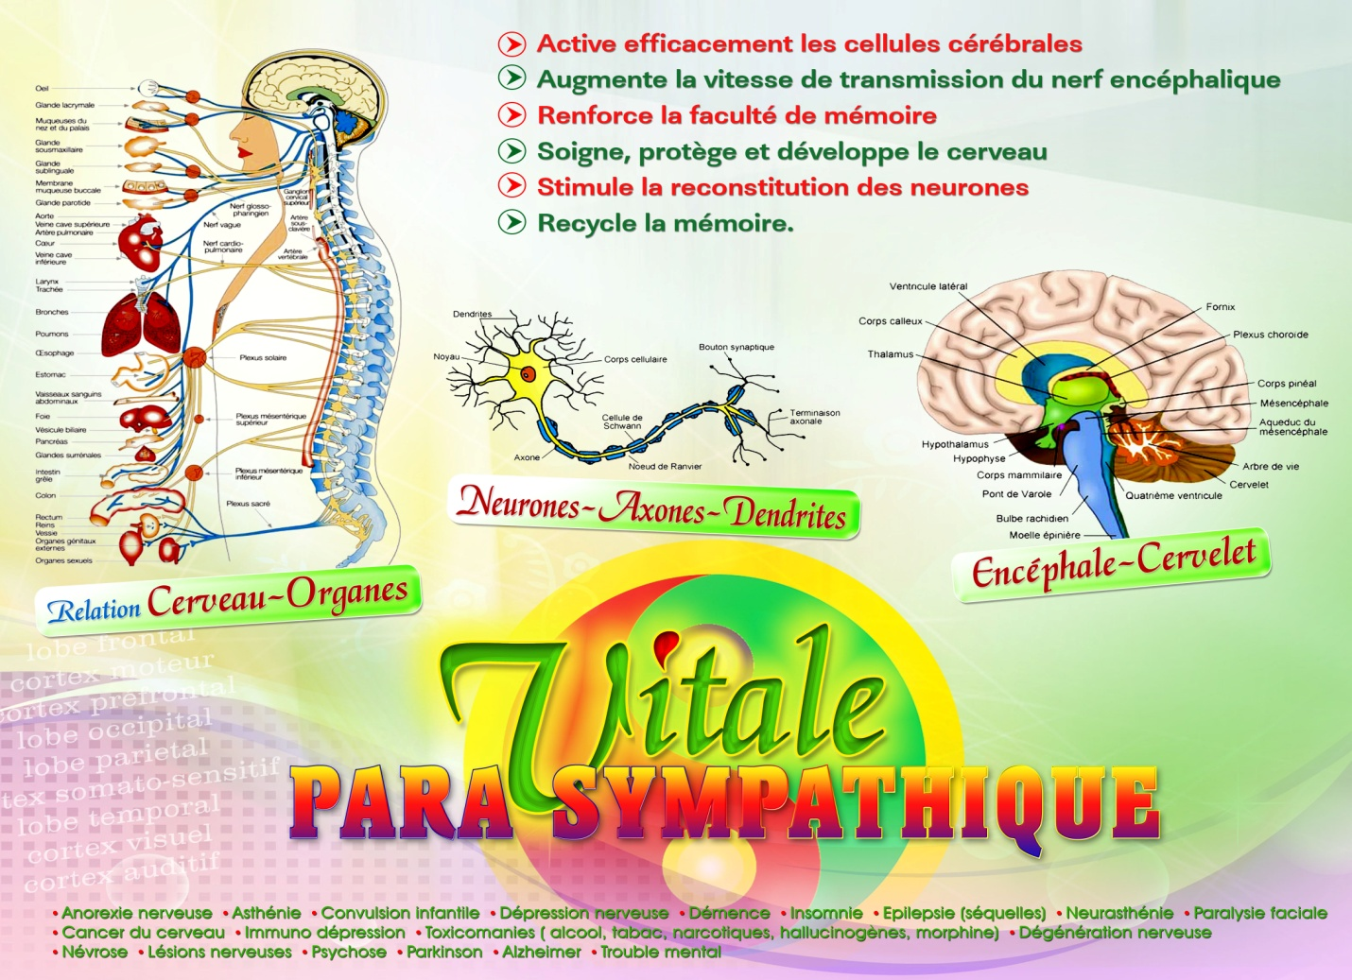
Vitale Para sympathic
INDICATIONS
anorexia nervosa
Asthenia
infantile convulsion
nervous breakdown
Dementia
Insomnia
Epilepsy (sequelae)
Neurasthenia
facial paralysis
Brain Cancer

Slide 57

Vitale Para sympathic
INDICATIONS (continued)
properties
immune depression
Substance abuse (tobacco, alcohol, narcotics hallucinogens, morphine)
nerve degeneration
Neurosis
nerve damage
psychosis
Parkinson
Alzheimer
mental disorder
active brain cells effectively
Increases the speed of transmission of brain nerve
Strengthens the power of memory
Heals, protects and develops the brain
Stimulates the recovery of neurons
Recycle memory.

Slide 58
conclusion
Now you know how to pass a homeopathic treatment, in which case it may be useful to you. Do not hesitate to switch your visits to a doctor in a traditional homeopath. So you can make your own opinion on the effectiveness ...

Slide 59
Questions & Anwsers
?

