Slide 1

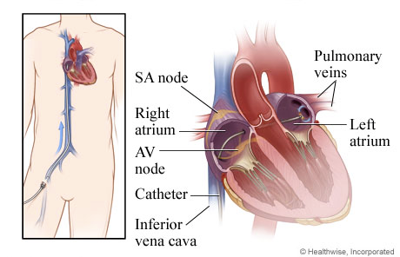
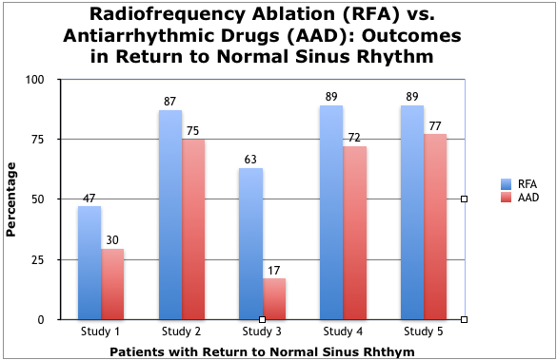
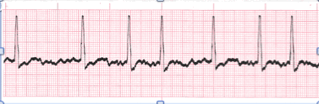
Comparison of Treatment Efficacy and Complications of Paroxysmal Atrial Fibrillation: Catheter Ablation versus Antiarrhythmic Pharmacotherapy
Sarah Heins, Courtney Lundin, Sarah Maass, Madison Murphy, Brooke Taylor, Sarah Violetta
School of Health Professions, Physician Assistant Studies (August 2016)
The University of Texas Medical Branch, Galveston, Texas
Background
Conclusion
Atrial fibrillation (AF) is a rapid, irregular rhythm causing desynchronization between the atria and ventricles.
Paroxysmal atrial fibrillation (PAF) resolves spontaneously or with treatment within 7 days of onset. Persistent atrial fibrillation (PeAF) lasts more than 7 days.
PAF is associated with significant morbidity and mortality, including heart failure, sudden cardiac death, and stroke.
Research indicates longer duration of PAF is a risk factor for conversion to PeAF, greater cardiac structural damage, and increased treatment complexity.
Recent evidence suggests antiarrhythmic drugs (AAD) and catheter ablation are used interchangeably, however ablation can provide lasting results by eliminating the causative mechanism.
The current study seeks to confirm the advantages of ablation as first-line treatment in restoring sinus rhythm in PAF.
Analysis supports superiority of catheter ablation compared to AAD therapy in maintaining NSR in patients with PAF.
Catheter ablation provides patients with a lower rate of recurrent PAF, and a decreased risk of PAF complications such as stroke, sudden cardiac death, and heart failure.
While catheter ablation is not the current gold standard for PAF due to patient qualifications or conditions, it represents an important advancement in maintaining normal sinus rhythm.
Using flexible wires, RFA uses energy to destroy localized areas of malfunctioning tissue from which arrhythmias, like atrial fibrillation originate.
Results
Future Research
Additional randomized controlled trials and retrospective studies including treatment naïve patients are needed to examine the long-term efficacy of catheter ablation, as up to 50% of patients experience a PAF recurrence two years after the initial ablation.
Research Question
In the 5 studies focused on PAF, patients experienced a greater decrease in PAF symptoms and significantly more returned to NSR after RFA as compared to patients on AADs.
Patients had a mean of 1.6 to 1.8 RFA procedures to complete treatment, as measured in 2 studies.
In the 2 studies over PeAF, RFA lead to increased ejection fraction in heart failure and improved quality of life.
Adverse events (AEs) of RFA include cardiac tamponade, stroke, and groin hematomas and they occur slightly more often than recorded AEs in AAD use (such as intracranial hemorrhage or sudden cardiac death).
References
In patients with PAF, is catheter ablation procedure more effective in maintaining normal sinus rhythm (NSR) compared to AAD therapy?
Aronsson, M., Walfridsson, H., Janzon, M., Walfridsson, U., Nielsen, J., & Hansen, P. et al. (2014). The cost-effectiveness of radiofrequency catheter ablation as first-line treatment for paroxysmal atrial fibrillation: results from a MANTRA-PAF substudy. Europace, 17(1), 48-55. http://dx.doi.org/10.1093/europace/euu188
Cosedis Nielsen, J., Johannessen, A., Raatikainen, P., Hindricks, G., Walfridsson, H., & Kongstad, O. et al. (2012). Radiofrequency Ablation as Initial Therapy in Paroxysmal Atrial Fibrillation. New England Journal Of Medicine, 367(17), 1587-1595. http://dx.doi.org/10.1056/nejmoa1113566
Dorn, L., Kranzburg, A., Saumell, A., Gregory, T., & Reich, S. (2015). Radiofrequency catheter ablation for atrial fibrillation. Journal Of The American Academy Of Physician Assistants, 28(5), 40-45. http://dx.doi.org/10.1097/01.jaa.0000464275.36493.2d
Jais, P., Cauchemez, B., Macle, L., Daoud, E., Khairy, P., & Subbiah, R. et al. (2008). Catheter Ablation Versus Antiarrhythmic Drugs for Atrial Fibrillation: The A4 Study. Circulation, 118(24), 2498-2505. http://dx.doi.org/10.1161/circulationaha.108.772582
Morillo, C., Verma, A., Connolly, S., Kuck, K., Nair, G., & Champagne, J. et al. (2014). Radiofrequency Ablation vs Antiarrhythmic Drugs as First-Line Treatment of Paroxysmal Atrial Fibrillation (RAAFT-2). JAMA, 311(7), 692. http://dx.doi.org/10.1001/jama.2014.467
Pappone, C., Radinovic, A., Manguso, F., Vicedomini, G., Ciconte, G., & Sacchi, S. et al. (2008). Atrial fibrillation progression and management: A 5-year prospective follow-up study. Heart Rhythm, 5(11), 1501-1507. http://dx.doi.org/10.1016/j.hrthm.2008.08.011
Raatikainen, M., Hakalahti, A., Uusimaa, P., Nielsen, J., Johannessen, A., & Hindricks, G. et al. (2015). Radiofrequency catheter ablation maintains its efficacy better than antiarrhythmic medication in patients with paroxysmal atrial fibrillation: On-treatment analysis of the randomized controlled MANTRA-PAF trial. International Journal Of Cardiology, 198, 108-114. http://dx.doi.org/10.1016/j.ijcard.2015.06.160
Wilber, D., Pappone, C., Neuzil, P., De Paola, A., Marchlinski, F., & Natale, A. et al. (2010). Comparison of Antiarrhythmic Drug Therapy and Radiofrequency Catheter Ablation in Patients With Paroxysmal Atrial Fibrillation. JAMA, 303(4), 333. http://dx.doi.org/10.1001/jama.2009.2029
Design and Methods
A review of existing literature on the efficacy and complications of AAD and catheter ablation was performed to identify the potential advantages of catheter ablation as first-line treatment of PAF.
Final conclusions were based on articles that encompassed randomized controlled trials (RCTs).
A total of 7 RCTs (1,190 patients), all with sample sizes under 300, were included.
Atrial Fibrillation

