Slide 1

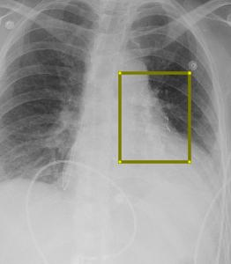
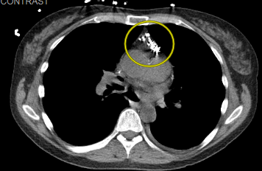
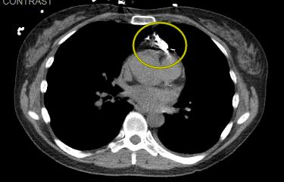
Idiopathic Chylopericardium; a rare entity
Seema Jaga, M.D., Joseph Namey, D.O., Christiano Caldeira, D.O.
Introduction
Imaging
Discussion
Idiopathic chylopericardium is a rare entity in which the acculumation of chylous fluid surrounds the pericardial space. Herein, we present a case of a 50 year old healthy female patient with no known past medical history that was diagnosed with idiopathic chylopericardium and was successfully treated using a pleurX catheter drainage for two and a half weeks and a low fat diet.
Chylopericardium is a rare disorder in which chylous fluid accumulates in the pericardial activity. It may be primary (idiopathic) or secondary due to injury to the thoracic duct by trauma (blunt or penetrating), thoracic or cardiac surgery, or congenital lymphangiomatosis.
Idiopathic chylopericardium was first reported in 1954 by Groves and Effler. This is such a rare condition that a computerized Medline search from 1960-2003 identified fewer than 35 cases of primary idiopathic chylopericardium. Its etiology is indeteriminate. Diagnosis is confirmed following pericardial fluid analysis which will show high triglyceride level, negative cultures and cytology, cholesterol/triglyceride ratio of less than 1, lymphocyte predominance on cytologic examination, and fat globules seen on Sudan 111 staining.
The first attempt to better define the connection between the thoracic duct and the pericardium was done by Akamatsu and colleagues using a combination of lymphangiography and CT, which is the method we used for our patient.
When the diagnosis of chylopericardium has been established, further investigation should take place to rule out secondary causes such as malignancy, Tuberculosis, and trauma. In our case, the patient did experience a ground level fall, however it was not severe.
There are two ways to proceed with treatment, either non surgical or surgical. Non surgical methods include pericardiocentesis and dietary support with low fat diet and surgical methods include thoracic duct ligation and pericardectomy.
To conclude, the success of treating chylopericardium should initially consist of conservative treatment before advancing to surgical treatment.
Contrast around the heart during lymphangiography
Case report
A 50 year old healthy female with no known past medical history started experiencing exertional and non extertional dyspnea for 3 weeks. She was referred to a Cardiologist who diagnosed her with pericardial effusion seen on TTE and she was subsequently started on Colchicine and Prednisone. Thereafter, she went to New York for a few days and her dyspnea progressively worsened with minimal activity. She did experience a ground level fall, however it was not severe. Subsequently, when she came back, she was hospitalized because a TTE revealed a larger pericardial effusion with some right ventricular diastolic collapse. She underwent pericardiocentesis in which 450 ml of milky fluid was removed and the chylous nature of the fluid was confirmed by fluid analysis that revealed triglyceride level of 2288 and a cholesterol/triglyceride ratio of 0.04. Thereupon, she was transferred to our facility for a pericardial window. Clinical examination showed elevated jugular venous pressure. Electrocardiography showed low-voltage QRS complexes. CXR revealed enlarged cardiac silhouette. She underwent subxiphoid pericardial window in which large amounts of mucus secretion was seen and drained. The early postoperative course was uneventful and the patient was kept nil-per-mouth with TPN as nutrition and pharmacological therapy with somatostatin analogues (Octreotide) was started.
The patient underwent extensive evaluation to find the cause of chylopericardium. Routine laboratory tests demonstrated normal blood counts, electrolytes, liver function, serum urea, serum creatinine, serum calcium, and lactate dehydrogenase. Total leukocyte remained normal throughout the hospital stay. Cultures excluded bacterial or Tuberculosis as being one of the causes. Cytology revealed lymphocyte-dominant cell count with no malignant cells. An average of 150 ml – 200 ml of fluid was drained daily for around 8 days. The second post op week, her diet was advanced to a vegetarian diet.
Bilateral inguinal lymphangiography was performed in which a 25 gauge needle was inserted into the hilum of both right and left inguinal lymph nodes and Ethiodol was injected into the lymph node via slow continuous infusion at 2 mmHg. A communication was seen between the thoracic duct and pericardial space, however ligation was not performed. Instead, the decision was made to proceed with placement of PleurX catheter and to follow up in 2 weeks outpatient. She was discharged and the drain was removed 2 weeks later. It has only been a month since discharge.
Contrast around the heart during lymphangiography
References
https://www.ncbi.nlm.nih.gov/pmc/articles/PMC1524687/pdf/20060600s00034p249.pdf
https://www.ncbi.nlm.nih.gov/pmc/articles/PMC4465719/
https://cardiothoracicsurgery.biomedcentral.com/articles/10.1186/1749-8090-8-28
https://www.uptodate.com/contents/chylopericardium-and-cholesterol-pericarditis
Contrast around the heart during lymphangiography
This research was supported (in whole or in part) by HCA and/or an HCA affiliated entity. The views expressed in this publication represent those of the author(s) do not necessarily represent the official views of HCA or any of its affiliated entities.

