Slide 1
MY CARDIAC SARCOIDOSIS EXPERIENCE
From Heart Failure to Heart Transplant

Slide 2
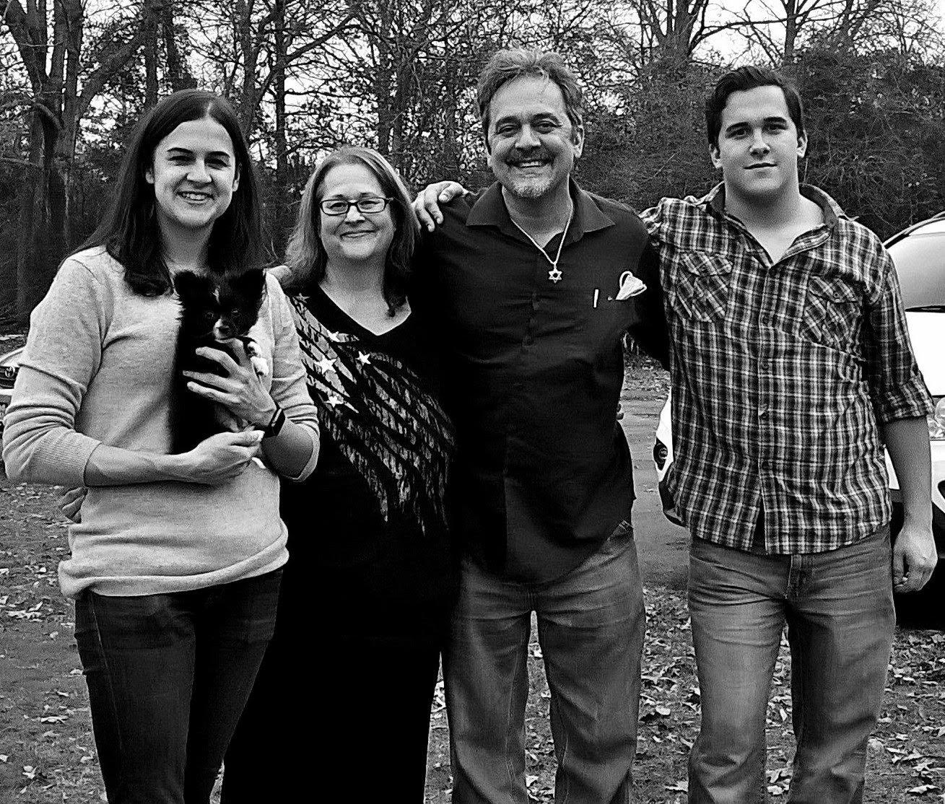
Notes:
65 years old, married for 35 years to my wife and have two children who are grown now.
Some of my hobbies are reading, writing, singing, fishing, hiking, composing music, and learning new languages.
I have a background as a Paramedic, Registered Nurse, and College Instructor.
I am a survivor of cancer, heart failure, and have had a heart transplant.

Slide 3

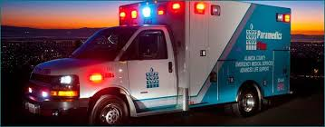
HOW MY HEART TROUBLES ALL BEGAN
Notes:
It all started when I noticed I was becoming short of breath with fatigue. The first year late 2009, I began experiencing episodes of chest pain, shortness of breath, tachycardia, and hypertension. By the spring of 2010, I had taken two or three trips to the ER, with one of those by ambulance. Then April 1 of 2010, I walked into ER with bradycardia of 36 beats per minute. Time for a pacemaker.
What’s your medical history that could have led up to or contributed to this event?
Prior to this event I had been relative healthy except for cancer for which I had had surgery correct back in April of 2003.
Did you think you were healthy up to this point?
HOWEVER, there was a time around 2006 while in California that I experienced chest pain, with hypertension, slight shortness of breath, and bizarre cardiac rhythms. I attributed this to guarana from GNC.

Slide 4
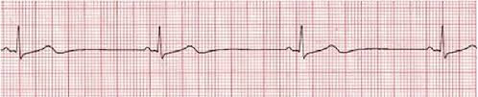
FIRST CARDIOVASCULAR EVENT - APR 2010
SYMPTOMATIC BRADYCARDIA
Notes:
What was causing this bradycardia? The cause at that time was unknown.
Diagnosis:
– it is important to discuss what this is; as a coder we cannot code this condition after the pacemaker has been implanted – it appears you received a pacemaker in 2010
Bradycardia R00.1 (ICD-10-CM) – codes that start with an “R” are considered signs and symptom codes – do not code signs and symptoms when a diagnosis has been established (i.e. SSS)Sick Sinus Syndrome I49.5 (ICD-10-CM)

Slide 5
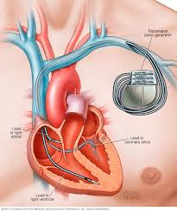
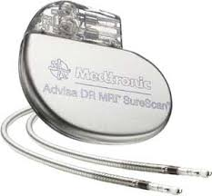
PACEMAKER IMPLANTED

Slide 6
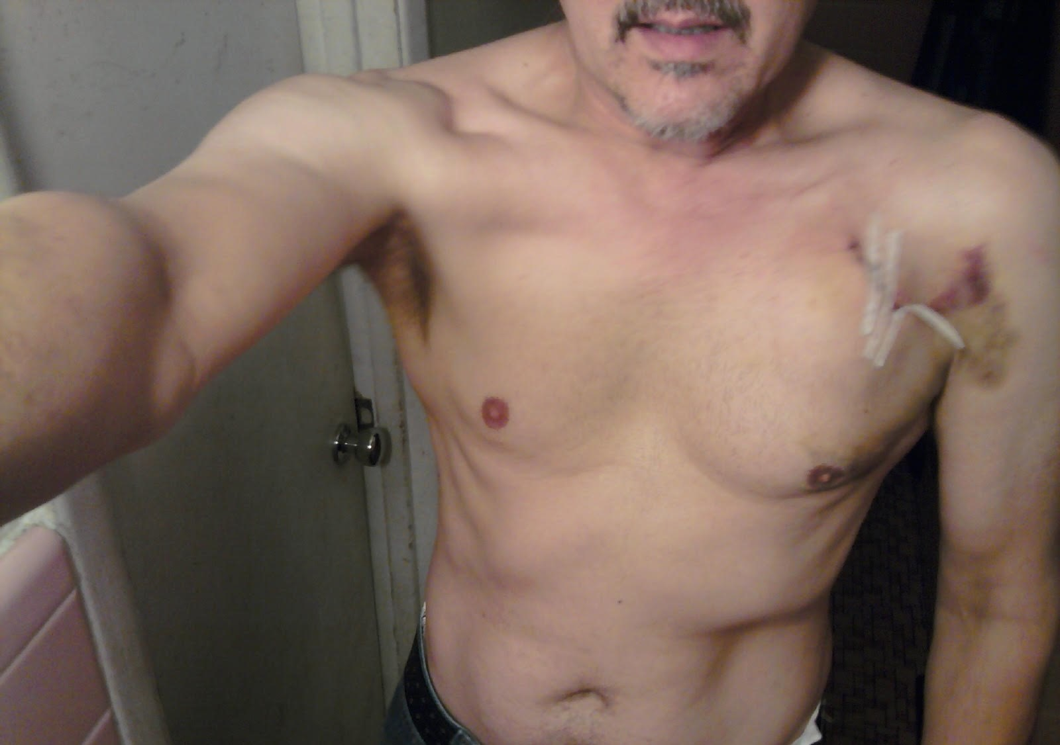

Slide 7
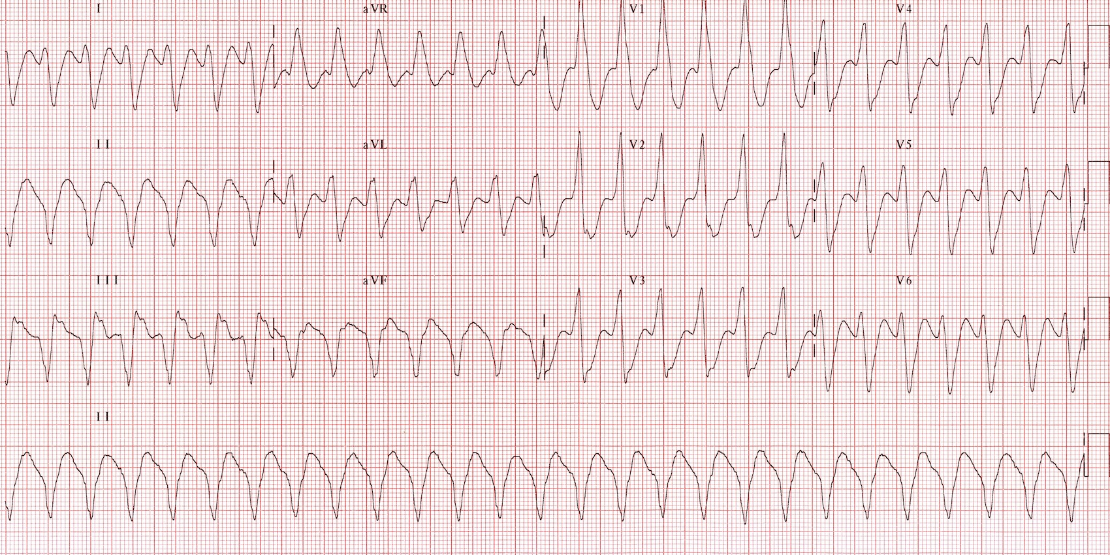
SECOND CARDIOVASCULAR EVENT - APR 2012
SYMPTOMATIC MONOMORPHIC VENTRICULAR TACHYCARDIA
Notes:
Phoned an ambulance for palpitations and very fast heart rate above 180’s. Arrived at ER in Ventricular Tachycardia. Point out difference in pulseless vs with a pulse. And potential to quickly deteriorate into Ventricular fibrillation. April 2012 underwent surgery to have AICD implanted.

Slide 8
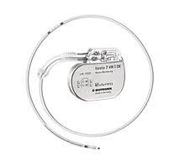
DEFIBRILLATOR IMPLANTED
SORIN AICD

Slide 9
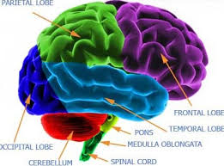
THIRD CARDIOVASCULAR EVENT - SEPT 2012
BRAIN ATTACK
Notes:
Next or 3rd cardiovascular event was a brain attack!
Sudden onset left leg numbness and weakness while at a gas station – admitted to Trinity Mother Frances Hospital
Diagnosis: Ischemic Cerebellar Stroke (while on aspirin therapy) – I63.9 – elaborate on if this was due to aspirin or not
Can you summarize in bullets what you plan on talking about in detail? Was this due to the Ventricular Tachycardia Storms you were experiencing?
No, it was due to a hole in the atrium through which a clot passed. PATENT FORAMEN OVAL (PFO)

Slide 10
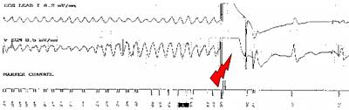
FOURTH CARDIOVASCULAR EVENT - DEC 2012
VENTRICULAR TACHYCARDIA INTERRUPTED BY AICD SHOCK DELIVERED
Notes:
Received my first defibrillation while on the job visiting a home health patient on December 20, 2012.
Received another shock about weeks later and then began experiencing more frequent shocks as the weeks wore on.
January 16, 2013, had first endocardial ablation procedure performed. Unsuccessful result. Recommended an epicardia. ablation performed at that time in only 22 centers in the United States with UT Southwestern being one of them.
After the ablation, had two or three more ER visits for defibrillation events and then;

Slide 11
ENDOCARDIAL ABLATION - JAN 2013
•Ventricular tachycardia ablation with electrophysiology study, 3D mapping, LV pace and record
•Intracardiac echo, programmed stimulation and IV drug infusion, periprocedural ICD programming, and pericardiocentesis
Notes:
Diagnosis:
Ventricular Tachycardia I47.2
Ventricular Fibrillation I49.01
Cardiomyopathy I49.2
Chronic Systolic Heart Failure I50.32
Complete AV Block I44.2
s/p CRT-ICD Z95.810
Cardiogenic Shock R57.0
Hypoxic Respiratory Failure J96.91

Slide 12

TRANSFER TO UT SOUTHWESTERN - FEB 2013

Slide 13
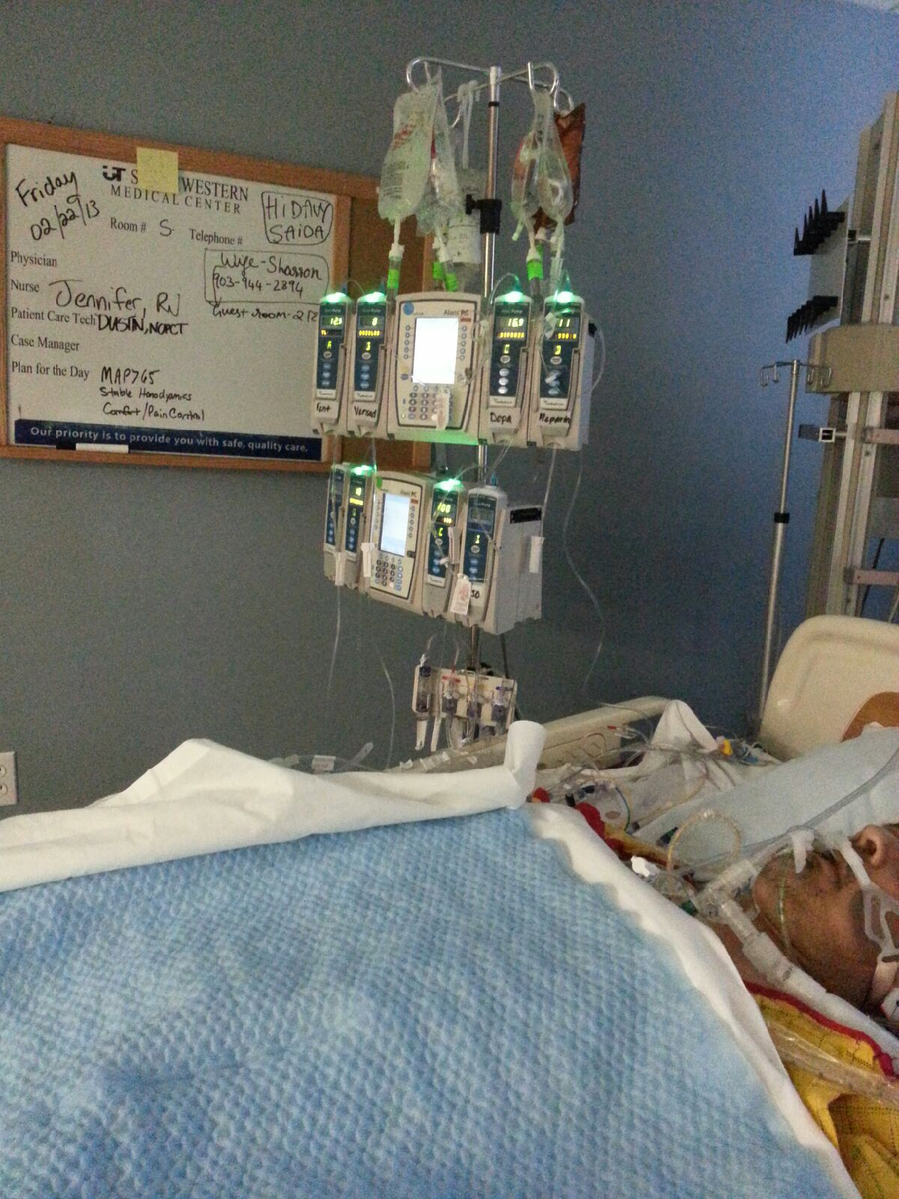
DYING DAYS IN CVICU - FEB 2013
WEEKS OF CRITICAL CARE

Slide 14
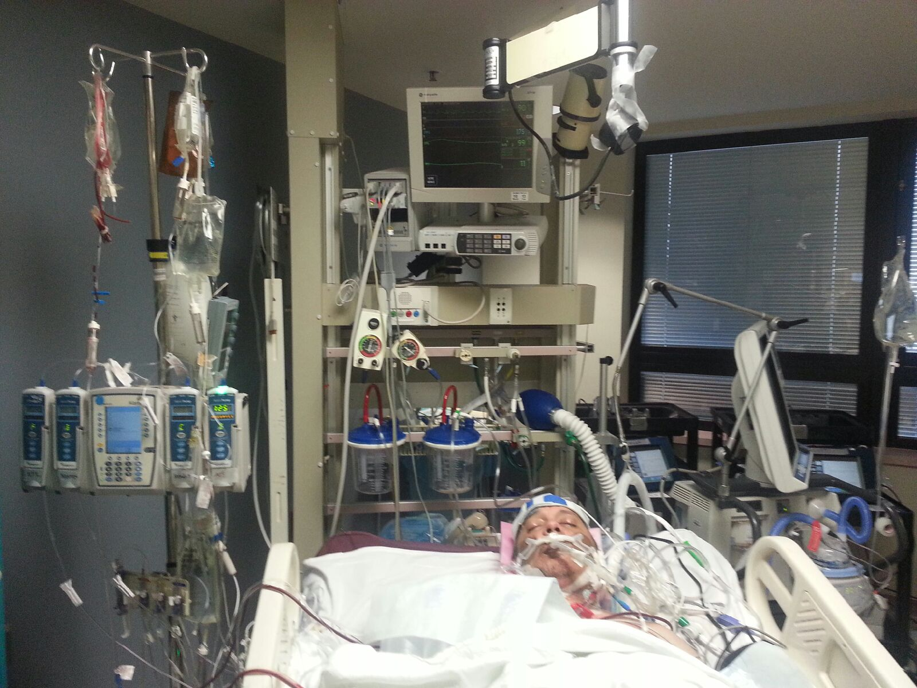

Slide 15
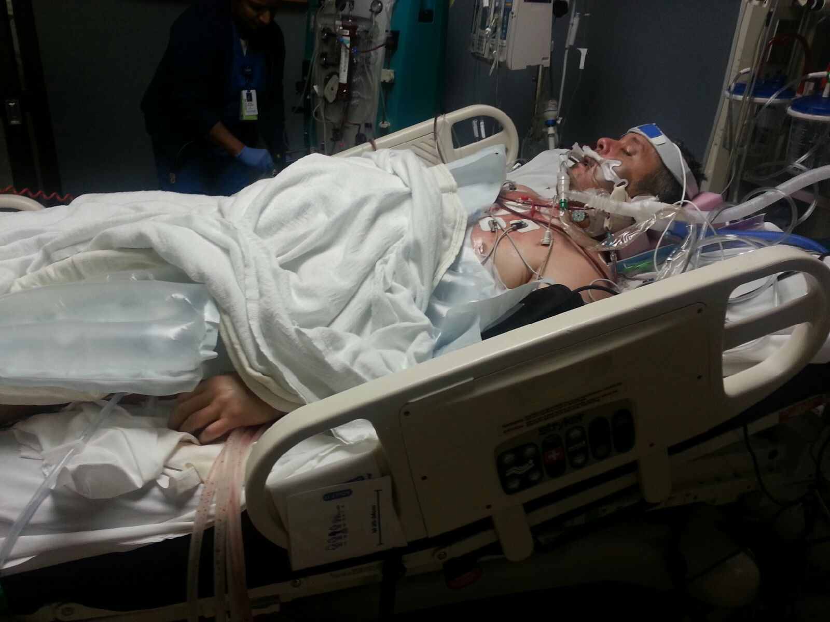

Slide 16
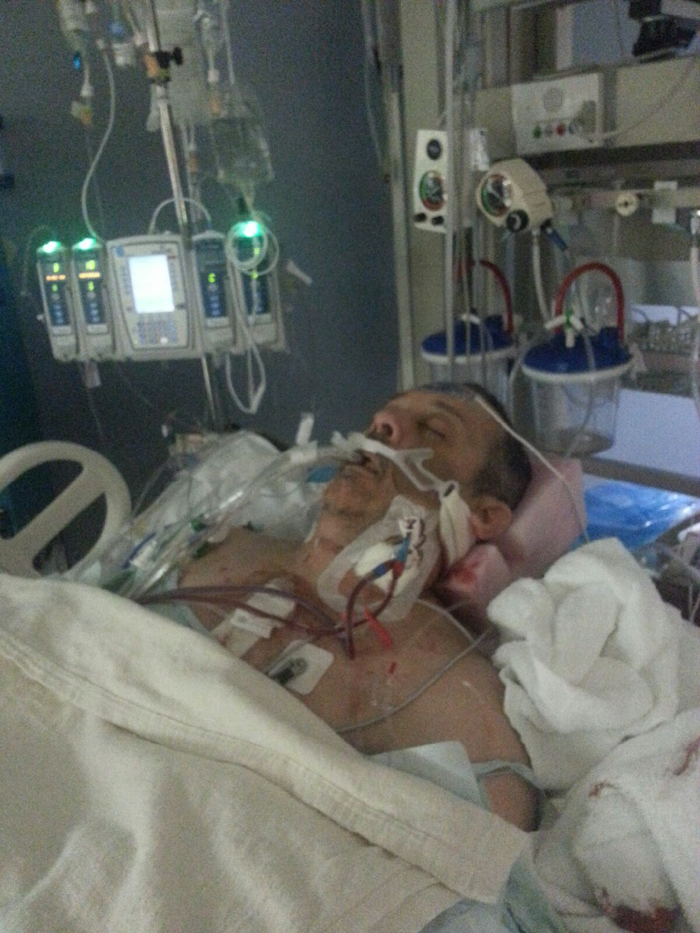

Slide 17
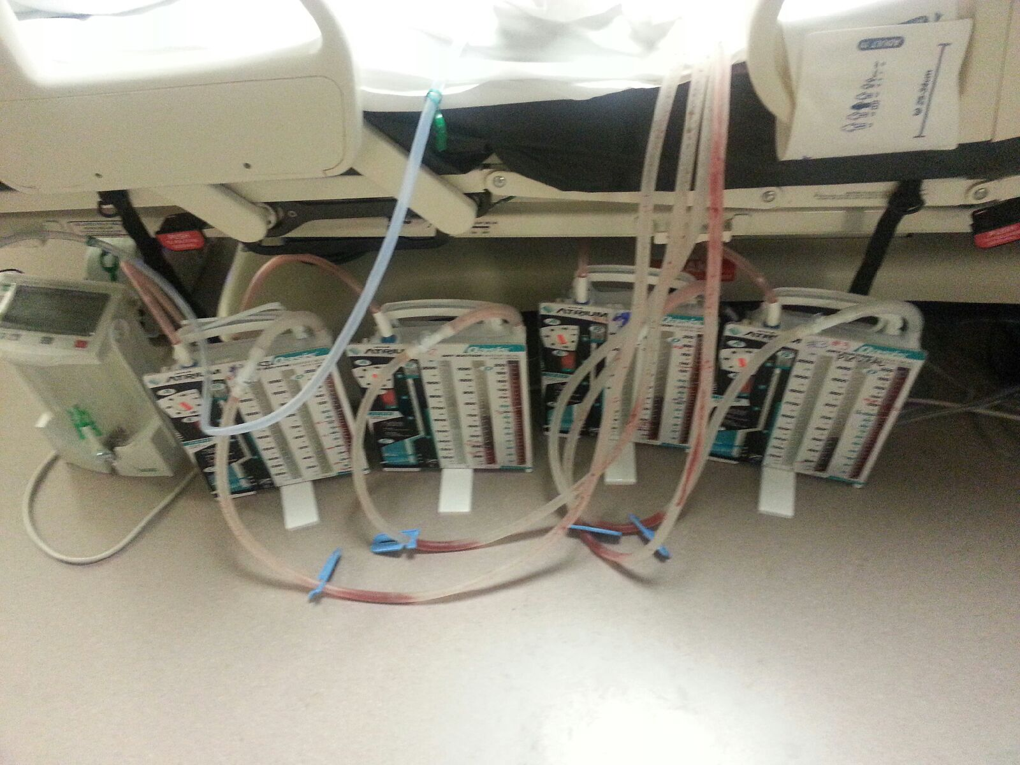

Slide 18
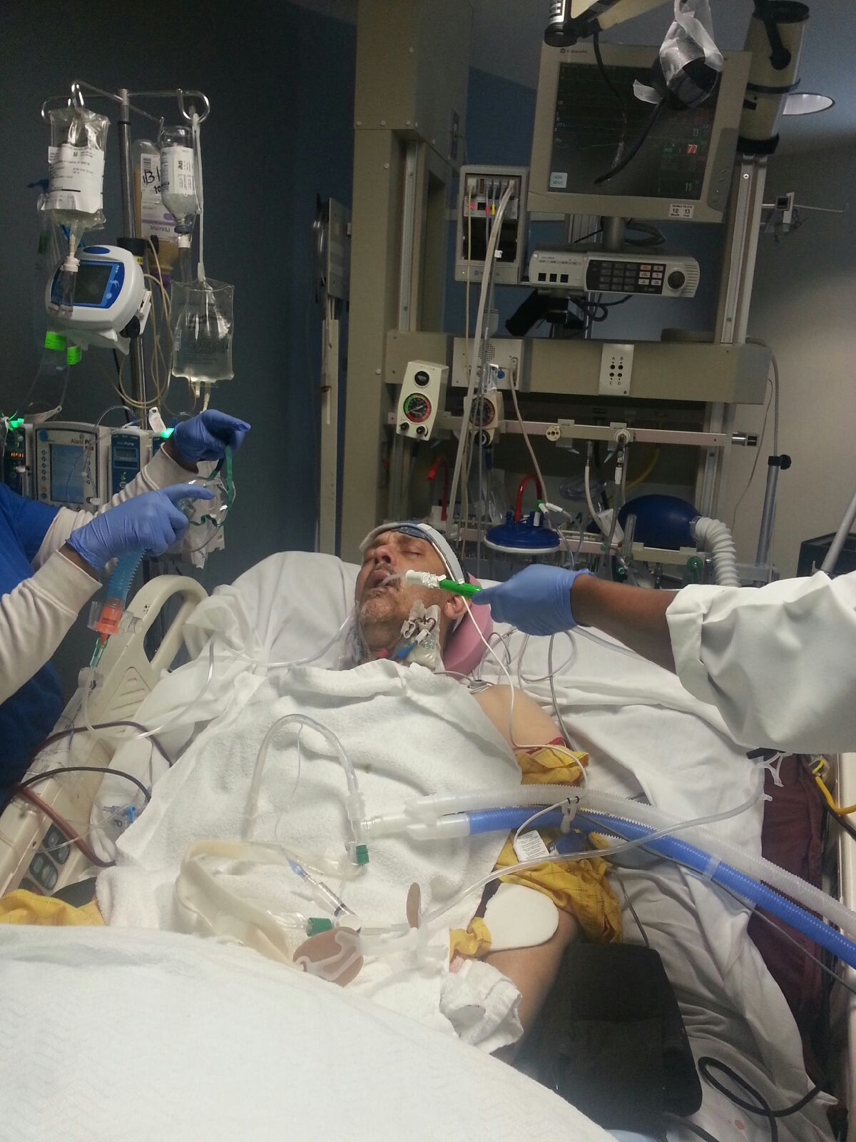

Slide 19
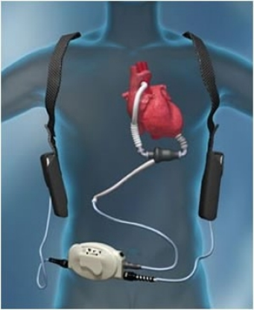
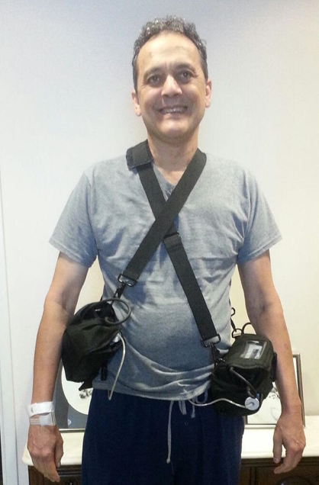
BIVADS
LVADS

Slide 20
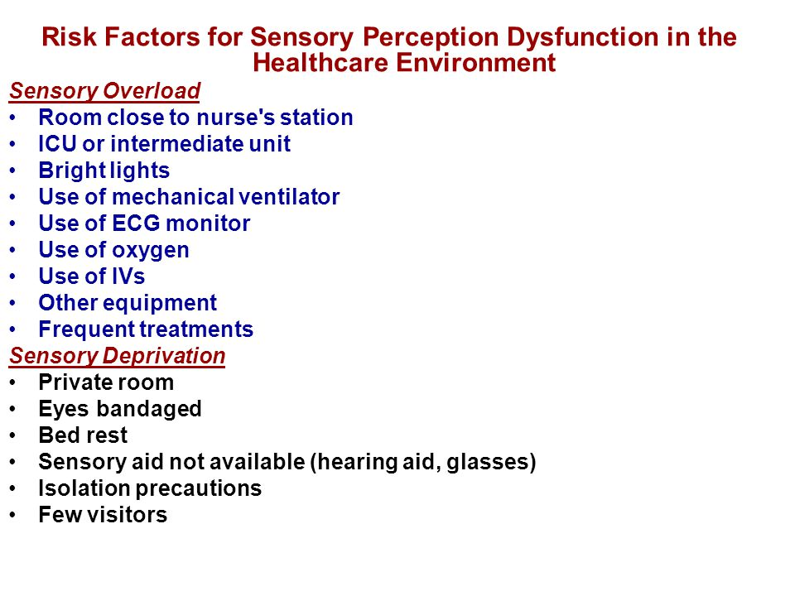

Slide 21

HEART TRANSPLANTATION
June 24, 2013

Slide 22
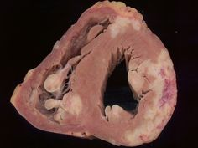
CARDIAC SARCOIDOSIS

Slide 23
Final Diagnosis:
Cardiac Sarcoidosis
Cardiac sarcoidosis is a rare disease in which clusters of white blood cells, called granulomas, form in the tissue of the heart.
Symptoms include:
•Chest pain
•Shortness of breath (dyspnea)
•Fainting (syncope)
•Fatigue
•Irregular heartbeats (arrhythmias)
•Rapid or fluttering heart beat (palpitations)
•Swelling caused by excess fluid (edema)
Notes:
Cardiac Sarcoidosis D86.89

Slide 24
POST HEART TRANSPLANT (IMMUNO-SUPPRESSION THERAPY)
Wear mask for 90 days at all times in public.
After 90 days, wear in elevators, ER, crowded places, and wear two masks on an airplane
Avoid, turtles, cat litter, soil or gardening, aviaries or birds and their droppings, lakes and rivers.
At 30 times the risk for skin cancer and 50 times the normal person’s risk for TB
First year is ROUGH!
Appointments for follow up will become less and less as well as medication adjustments.
Routine labs, procedures such as colonoscopies, cardiac echos, etc etc
The anti rejection drugs are toxic and feed and cause cancers.
Constant surveillance and consistent followups very important for the post heart transplant patients. Most die from kidney failure and skin cancer.

Slide 25
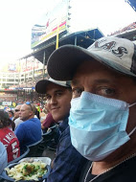

Slide 26


Slide 27
Consider donation of organs if you have not done so and decide if life is something you want to give back to someone.
Notes:
THIS IS THE MOST IMPORTANT TAKEAWAY THAT EVERYONE HAS TO REMEMBER

Slide 28
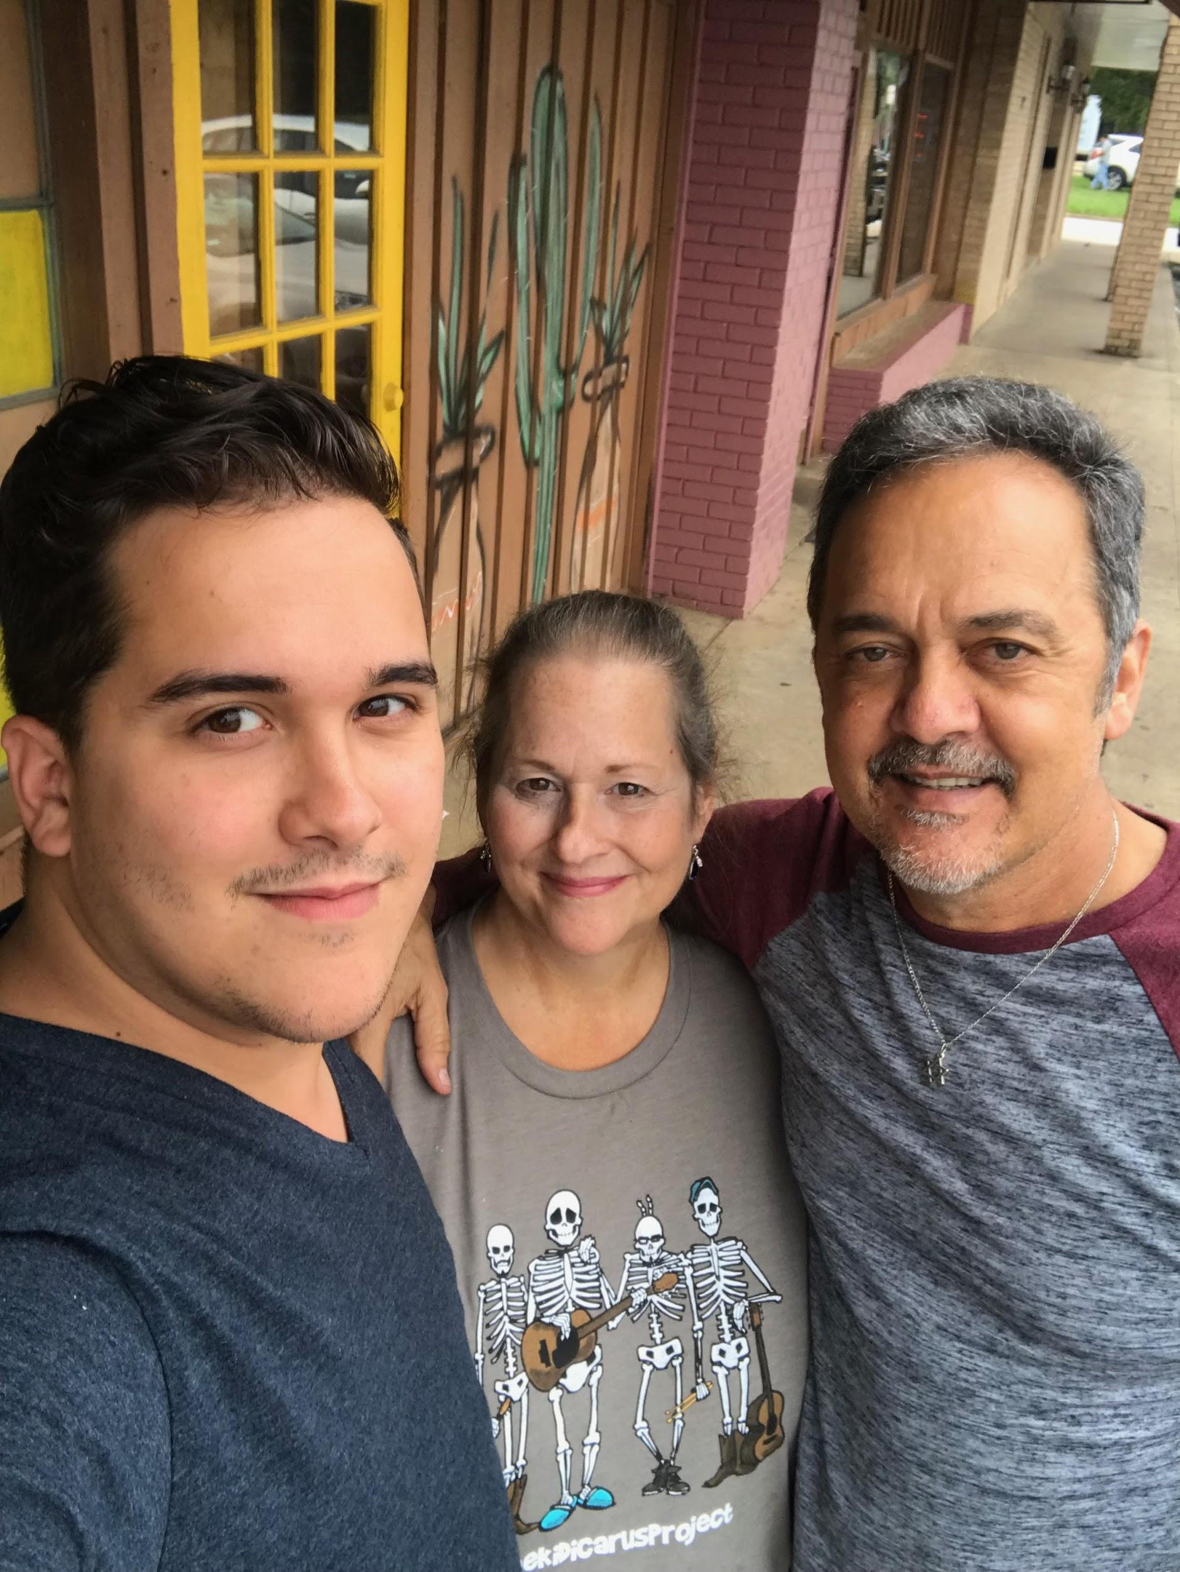
Thanks!
Contact information;
Davy Hobson
Cell: 903 787 1171
davyhobson@gmail.com
www.shirapromotions.com

Slide 29
WEBSITES & INFO
https://news.heart.org/after-heart-stopped-valentines-day-texas-man-needed-new-heart/
https://www.google.com/search?q=davy%20hobson%20heart
http://davy-davyhobson.blogspot.com/2016/05/davy-d-hobson-bio.html?m=1
http://www.easttexasmatters.com/news/local-news/valentines-day-holds-special-place-in-tyler-mans-new-heart/974159008
http://www.cbs19.tv/news/local/more-than-just-a-day-of-love-/518993816
http://www.kltv.com/story/37508672/couple-celebrates-a-new-heart-for-valentines-day
https://vimeo.com/78946357
http://journals.co-action.net/index.php/mcs/article/view/22638/html
http://www.ketknbc.com/news/etx-man-awaits-heart-transplant-community-helps-pa

Slide 30
ENDOCARDIAL ABLATION - JAN 2013
•Ventricular tachycardia ablation with electrophysiology study, 3D mapping, LV pace and record
•Intracardiac echo, programmed stimulation and IV drug infusion, periprocedural ICD programming, and pericardiocentesis
Diagnosis:
Ventricular Tachycardia
Notes:
Diagnosis:
Ventricular Tachycardia I47.2
Ventricular Fibrillation I49.01
Cardiomyopathy I49.2
Chronic Systolic Heart Failure I50.32
Complete AV Block I44.2
s/p CRT-ICD Z95.810
Cardiogenic Shock R57.0
Hypoxic Respiratory Failure J96.91

Slide 31
ENDOCARDIAL ABLATION - JAN 2013
•Ventricular tachycardia ablation with electrophysiology study, 3D mapping, LV pace and record
•Intracardiac echo, programmed stimulation and IV drug infusion, periprocedural ICD programming, and pericardiocentesis
Diagnosis:
Ventricular Tachycardia I47.2
Notes:
Diagnosis:
Ventricular Tachycardia I47.2
Ventricular Fibrillation I49.01
Cardiomyopathy I49.2
Chronic Systolic Heart Failure I50.32
Complete AV Block I44.2
s/p CRT-ICD Z95.810
Cardiogenic Shock R57.0
Hypoxic Respiratory Failure J96.91

Slide 32
ENDOCARDIAL ABLATION - JAN 2013
•Ventricular tachycardia ablation with electrophysiology study, 3D mapping, LV pace and record
•Intracardiac echo, programmed stimulation and IV drug infusion, periprocedural ICD programming, and pericardiocentesis
Diagnosis:
Ventricular Tachycardia I47.2, Ventricular Fibrillation
Notes:
Diagnosis:
Ventricular Tachycardia I47.2
Ventricular Fibrillation I49.01
Cardiomyopathy I49.2
Chronic Systolic Heart Failure I50.32
Complete AV Block I44.2
s/p CRT-ICD Z95.810
Cardiogenic Shock R57.0
Hypoxic Respiratory Failure J96.91

Slide 33
ENDOCARDIAL ABLATION - JAN 2013
•Ventricular tachycardia ablation with electrophysiology study, 3D mapping, LV pace and record
•Intracardiac echo, programmed stimulation and IV drug infusion, periprocedural ICD programming, and pericardiocentesis
Diagnosis:
Ventricular Tachycardia I47.2, Ventricular Fibrillation I49.01
Notes:
Diagnosis:
Ventricular Tachycardia I47.2
Ventricular Fibrillation I49.01
Cardiomyopathy I49.2
Chronic Systolic Heart Failure I50.32
Complete AV Block I44.2
s/p CRT-ICD Z95.810
Cardiogenic Shock R57.0
Hypoxic Respiratory Failure J96.91

Slide 34
ENDOCARDIAL ABLATION - JAN 2013
•Ventricular tachycardia ablation with electrophysiology study, 3D mapping, LV pace and record
•Intracardiac echo, programmed stimulation and IV drug infusion, periprocedural ICD programming, and pericardiocentesis
Diagnosis:
Ventricular Tachycardia I47.2, Ventricular Fibrillation I49.01, Cardiomyopathy
Notes:
Diagnosis:
Ventricular Tachycardia I47.2
Ventricular Fibrillation I49.01
Cardiomyopathy I49.2
Chronic Systolic Heart Failure I50.32
Complete AV Block I44.2
s/p CRT-ICD Z95.810
Cardiogenic Shock R57.0
Hypoxic Respiratory Failure J96.91

Slide 35
ENDOCARDIAL ABLATION - JAN 2013
•Ventricular tachycardia ablation with electrophysiology study, 3D mapping, LV pace and record
•Intracardiac echo, programmed stimulation and IV drug infusion, periprocedural ICD programming, and pericardiocentesis
Diagnosis:
Ventricular Tachycardia I47.2, Ventricular Fibrillation I49.01, Cardiomyopathy I49.2
Notes:
Diagnosis:
Ventricular Tachycardia I47.2
Ventricular Fibrillation I49.01
Cardiomyopathy I49.2
Chronic Systolic Heart Failure I50.32
Complete AV Block I44.2
s/p CRT-ICD Z95.810
Cardiogenic Shock R57.0
Hypoxic Respiratory Failure J96.91

Slide 36
ENDOCARDIAL ABLATION - JAN 2013
•Ventricular tachycardia ablation with electrophysiology study, 3D mapping, LV pace and record
•Intracardiac echo, programmed stimulation and IV drug infusion, periprocedural ICD programming, and pericardiocentesis
Diagnosis:
Ventricular Tachycardia I47.2, Ventricular Fibrillation I49.01, Cardiomyopathy I49.2
Chronic Systolic Heart Failure
Notes:
Diagnosis:
Ventricular Tachycardia I47.2
Ventricular Fibrillation I49.01
Cardiomyopathy I49.2
Chronic Systolic Heart Failure I50.32
Complete AV Block I44.2
s/p CRT-ICD Z95.810
Cardiogenic Shock R57.0
Hypoxic Respiratory Failure J96.91

Slide 37
ENDOCARDIAL ABLATION - JAN 2013
•Ventricular tachycardia ablation with electrophysiology study, 3D mapping, LV pace and record
•Intracardiac echo, programmed stimulation and IV drug infusion, periprocedural ICD programming, and pericardiocentesis
Diagnosis:
Ventricular Tachycardia I47.2, Ventricular Fibrillation I49.01, Cardiomyopathy I49.2
Chronic Systolic Heart Failure I50.32
Notes:
Diagnosis:
Ventricular Tachycardia I47.2
Ventricular Fibrillation I49.01
Cardiomyopathy I49.2
Chronic Systolic Heart Failure I50.32
Complete AV Block I44.2
s/p CRT-ICD Z95.810
Cardiogenic Shock R57.0
Hypoxic Respiratory Failure J96.91

Slide 38
ENDOCARDIAL ABLATION - JAN 2013
•Ventricular tachycardia ablation with electrophysiology study, 3D mapping, LV pace and record
•Intracardiac echo, programmed stimulation and IV drug infusion, periprocedural ICD programming, and pericardiocentesis
Diagnosis:
Ventricular Tachycardia I47.2, Ventricular Fibrillation I49.01, Cardiomyopathy I49.2
Chronic Systolic Heart Failure I50.32, Complete AV Block
Notes:
Diagnosis:
Ventricular Tachycardia I47.2
Ventricular Fibrillation I49.01
Cardiomyopathy I49.2
Chronic Systolic Heart Failure I50.32
Complete AV Block I44.2
s/p CRT-ICD Z95.810
Cardiogenic Shock R57.0
Hypoxic Respiratory Failure J96.91

Slide 39
ENDOCARDIAL ABLATION - JAN 2013
•Ventricular tachycardia ablation with electrophysiology study, 3D mapping, LV pace and record
•Intracardiac echo, programmed stimulation and IV drug infusion, periprocedural ICD programming, and pericardiocentesis
Diagnosis:
Ventricular Tachycardia I47.2, Ventricular Fibrillation I49.01, Cardiomyopathy I49.2
Chronic Systolic Heart Failure I50.32, Complete AV Block I44.2
Notes:
Diagnosis:
Ventricular Tachycardia I47.2
Ventricular Fibrillation I49.01
Cardiomyopathy I49.2
Chronic Systolic Heart Failure I50.32
Complete AV Block I44.2
s/p CRT-ICD Z95.810
Cardiogenic Shock R57.0
Hypoxic Respiratory Failure J96.91

Slide 40
ENDOCARDIAL ABLATION - JAN 2013
•Ventricular tachycardia ablation with electrophysiology study, 3D mapping, LV pace and record
•Intracardiac echo, programmed stimulation and IV drug infusion, periprocedural ICD programming, and pericardiocentesis
Diagnosis:
Ventricular Tachycardia I47.2, Ventricular Fibrillation I49.01, Cardiomyopathy I49.2
Chronic Systolic Heart Failure I50.32, Complete AV Block I44.2, s/p CRT-ICD
Notes:
Diagnosis:
Ventricular Tachycardia I47.2
Ventricular Fibrillation I49.01
Cardiomyopathy I49.2
Chronic Systolic Heart Failure I50.32
Complete AV Block I44.2
s/p CRT-ICD Z95.810
Cardiogenic Shock R57.0
Hypoxic Respiratory Failure J96.91

Slide 41
ENDOCARDIAL ABLATION - JAN 2013
•Ventricular tachycardia ablation with electrophysiology study, 3D mapping, LV pace and record
•Intracardiac echo, programmed stimulation and IV drug infusion, periprocedural ICD programming, and pericardiocentesis
Diagnosis:
Ventricular Tachycardia I47.2, Ventricular Fibrillation I49.01, Cardiomyopathy I49.2
Chronic Systolic Heart Failure I50.32, Complete AV Block I44.2, s/p CRT-ICD Z95.810
Notes:
Diagnosis:
Ventricular Tachycardia I47.2
Ventricular Fibrillation I49.01
Cardiomyopathy I49.2
Chronic Systolic Heart Failure I50.32
Complete AV Block I44.2
s/p CRT-ICD Z95.810
Cardiogenic Shock R57.0
Hypoxic Respiratory Failure J96.91

Slide 42
ENDOCARDIAL ABLATION - JAN 2013
•Ventricular tachycardia ablation with electrophysiology study, 3D mapping, LV pace and record
•Intracardiac echo, programmed stimulation and IV drug infusion, periprocedural ICD programming, and pericardiocentesis
Diagnosis:
Ventricular Tachycardia I47.2, Ventricular Fibrillation I49.01, Cardiomyopathy I49.2
Chronic Systolic Heart Failure I50.32, Complete AV Block I44.2, s/p CRT-ICD Z95.810
Cardiogenic Shock
Notes:
Diagnosis:
Ventricular Tachycardia I47.2
Ventricular Fibrillation I49.01
Cardiomyopathy I49.2
Chronic Systolic Heart Failure I50.32
Complete AV Block I44.2
s/p CRT-ICD Z95.810
Cardiogenic Shock R57.0
Hypoxic Respiratory Failure J96.91

Slide 43
ENDOCARDIAL ABLATION - JAN 2013
•Ventricular tachycardia ablation with electrophysiology study, 3D mapping, LV pace and record
•Intracardiac echo, programmed stimulation and IV drug infusion, periprocedural ICD programming, and pericardiocentesis
Diagnosis:
Ventricular Tachycardia I47.2, Ventricular Fibrillation I49.01, Cardiomyopathy I49.2
Chronic Systolic Heart Failure I50.32, Complete AV Block I44.2, s/p CRT-ICD Z95.810
Cardiogenic Shock R57.0
Notes:
Diagnosis:
Ventricular Tachycardia I47.2
Ventricular Fibrillation I49.01
Cardiomyopathy I49.2
Chronic Systolic Heart Failure I50.32
Complete AV Block I44.2
s/p CRT-ICD Z95.810
Cardiogenic Shock R57.0
Hypoxic Respiratory Failure J96.91

Slide 44
ENDOCARDIAL ABLATION - JAN 2013
•Ventricular tachycardia ablation with electrophysiology study, 3D mapping, LV pace and record
•Intracardiac echo, programmed stimulation and IV drug infusion, periprocedural ICD programming, and pericardiocentesis
Diagnosis:
Ventricular Tachycardia I47.2, Ventricular Fibrillation I49.01, Cardiomyopathy I49.2
Chronic Systolic Heart Failure I50.32, Complete AV Block I44.2, s/p CRT-ICD Z95.810
Cardiogenic Shock R57.0
Hypoxic Respiratory Failure
Notes:
Diagnosis:
Ventricular Tachycardia I47.2
Ventricular Fibrillation I49.01
Cardiomyopathy I49.2
Chronic Systolic Heart Failure I50.32
Complete AV Block I44.2
s/p CRT-ICD Z95.810
Cardiogenic Shock R57.0
Hypoxic Respiratory Failure J96.91

Slide 45
ENDOCARDIAL ABLATION - JAN 2013
•Ventricular tachycardia ablation with electrophysiology study, 3D mapping, LV pace and record
•Intracardiac echo, programmed stimulation and IV drug infusion, periprocedural ICD programming, and pericardiocentesis
Diagnosis:
Ventricular Tachycardia I47.2, Ventricular Fibrillation I49.01, Cardiomyopathy I49.2
Chronic Systolic Heart Failure I50.32, Complete AV Block I44.2, s/p CRT-ICD Z95.810
Cardiogenic Shock R57.0
Hypoxic Respiratory Failure J96.91
Notes:
Diagnosis:
Ventricular Tachycardia I47.2
Ventricular Fibrillation I49.01
Cardiomyopathy I49.2
Chronic Systolic Heart Failure I50.32
Complete AV Block I44.2
s/p CRT-ICD Z95.810
Cardiogenic Shock R57.0
Hypoxic Respiratory Failure J96.91

Slide 46
ENDOCARDIAL ABLATION - JAN 2013
•Ventricular tachycardia ablation with electrophysiology study, 3D mapping, LV pace and record
•Intracardiac echo, programmed stimulation and IV drug infusion, periprocedural ICD programming, and pericardiocentesis
Diagnosis:
Ventricular Tachycardia I47.2, Ventricular Fibrillation I49.01, Cardiomyopathy I49.2
Chronic Systolic Heart Failure I50.32, Complete AV Block I44.2, s/p CRT-ICD Z95.810
Cardiogenic Shock R57.0, Hypoxic Respiratory Failure J96.9, Bradycardia
Notes:
Diagnosis:
Ventricular Tachycardia I47.2
Ventricular Fibrillation I49.01
Cardiomyopathy I49.2
Chronic Systolic Heart Failure I50.32
Complete AV Block I44.2
s/p CRT-ICD Z95.810
Cardiogenic Shock R57.0
Hypoxic Respiratory Failure J96.91

Slide 47
ENDOCARDIAL ABLATION - JAN 2013
•Ventricular tachycardia ablation with electrophysiology study, 3D mapping, LV pace and record
•Intracardiac echo, programmed stimulation and IV drug infusion, periprocedural ICD programming, and pericardiocentesis
Diagnosis:
Ventricular Tachycardia I47.2, Ventricular Fibrillation I49.01, Cardiomyopathy I49.2
Chronic Systolic Heart Failure I50.32, Complete AV Block I44.2, s/p CRT-ICD Z95.810
Cardiogenic Shock R57.0, Hypoxic Respiratory Failure J96.9, Bradycardia R00.1 (Codes that start with an “R” are considered signs and symptom codes. Do not code signs and symptoms when a diagnosis has been established. (ie SSS) I49.5
Notes:
Diagnosis:
Bradycardia R00.1 (ICD-10-CM) – codes that start with an “R” are considered signs and symptom codes – do not code signs and symptoms when a diagnosis has been established (i.e. SSS)Sick Sinus Syndrome I49.5 (ICD-10-CM)
Ventricular Tachycardia I47.2
Ventricular Fibrillation I49.01
Cardiomyopathy I49.2
Chronic Systolic Heart Failure I50.32
Complete AV Block I44.2
s/p CRT-ICD Z95.810
Cardiogenic Shock R57.0
Hypoxic Respiratory Failure J96.91

Slide 48
ENDOCARDIAL ABLATION - JAN 2013
•Ventricular tachycardia ablation with electrophysiology study, 3D mapping, LV pace and record
•Intracardiac echo, programmed stimulation and IV drug infusion, periprocedural ICD programming, and pericardiocentesis
Diagnosis:
Ventricular Tachycardia I47.2, Ventricular Fibrillation I49.01, Cardiomyopathy I49.2
Chronic Systolic Heart Failure I50.32, Complete AV Block I44.2, s/p CRT-ICD Z95.810
Cardiogenic Shock R57.0, Hypoxic Respiratory Failure J96.9, Bradycardia R00.1 (Codes that start with an “R” are considered signs and symptom codes. Do not code signs and symptoms when a diagnosis has been established. (ie SSS) I49.5
Cardiac Sarcoidosis
Notes:
Diagnosis:
Bradycardia R00.1 (ICD-10-CM) – codes that start with an “R” are considered signs and symptom codes – do not code signs and symptoms when a diagnosis has been established (i.e. SSS)Sick Sinus Syndrome I49.5 (ICD-10-CM)
Ventricular Tachycardia I47.2
Ventricular Fibrillation I49.01
Cardiomyopathy I49.2
Chronic Systolic Heart Failure I50.32
Complete AV Block I44.2
s/p CRT-ICD Z95.810
Cardiogenic Shock R57.0
Hypoxic Respiratory Failure J96.91

Slide 49
ENDOCARDIAL ABLATION - JAN 2013
•Ventricular tachycardia ablation with electrophysiology study, 3D mapping, LV pace and record
•Intracardiac echo, programmed stimulation and IV drug infusion, periprocedural ICD programming, and pericardiocentesis
Diagnosis:
Ventricular Tachycardia I47.2, Ventricular Fibrillation I49.01, Cardiomyopathy I49.2
Chronic Systolic Heart Failure I50.32, Complete AV Block I44.2, s/p CRT-ICD Z95.810
Cardiogenic Shock R57.0, Hypoxic Respiratory Failure J96.9, Bradycardia R00.1 (Codes that start with an “R” are considered signs and symptom codes. Do not code signs and symptoms when a diagnosis has been established. (ie SSS) I49.5
Cardiac Sarcoidosis D86.9
Notes:
Diagnosis:
Bradycardia R00.1 (ICD-10-CM) – codes that start with an “R” are considered signs and symptom codes – do not code signs and symptoms when a diagnosis has been established (i.e. SSS)Sick Sinus Syndrome I49.5 (ICD-10-CM)
Ventricular Tachycardia I47.2
Ventricular Fibrillation I49.01
Cardiomyopathy I49.2
Chronic Systolic Heart Failure I50.32
Complete AV Block I44.2
s/p CRT-ICD Z95.810
Cardiogenic Shock R57.0
Hypoxic Respiratory Failure J96.91

Slide 50
ENDOCARDIAL ABLATION - JAN 2013
•Ventricular tachycardia ablation with electrophysiology study, 3D mapping, LV pace and record
•Intracardiac echo, programmed stimulation and IV drug infusion, periprocedural ICD programming, and pericardiocentesis
Diagnosis:
Ventricular Tachycardia I47.2, Ventricular Fibrillation I49.01, Cardiomyopathy I49.2
Chronic Systolic Heart Failure I50.32, Complete AV Block I44.2, s/p CRT-ICD Z95.810
Cardiogenic Shock R57.0, Hypoxic Respiratory Failure J96.9, Bradycardia R00.1 (Codes that start with an “R” are considered signs and symptom codes. Do not code signs and symptoms when a diagnosis has been established. (ie SSS) I49.5)
Cardiac Sarcoidosis D86.9 (For sarcoidosis in ICD-10-CM, D86.0 is the code for sarcoidosis of the lung andD86.2 is the code for sarcoidosis of the lung and lymph nodes (Table Two). D86.1should be used for sarcoidosis of the lymph nodes seen in stage I sarcoidosis.)
Notes:
Diagnosis:
Bradycardia R00.1 (ICD-10-CM) – codes that start with an “R” are considered signs and symptom codes – do not code signs and symptoms when a diagnosis has been established (i.e. SSS)Sick Sinus Syndrome I49.5 (ICD-10-CM)
Ventricular Tachycardia I47.2
Ventricular Fibrillation I49.01
Cardiomyopathy I49.2
Chronic Systolic Heart Failure I50.32
Complete AV Block I44.2
s/p CRT-ICD Z95.810
Cardiogenic Shock R57.0
Hypoxic Respiratory Failure J96.91

