Slide 1


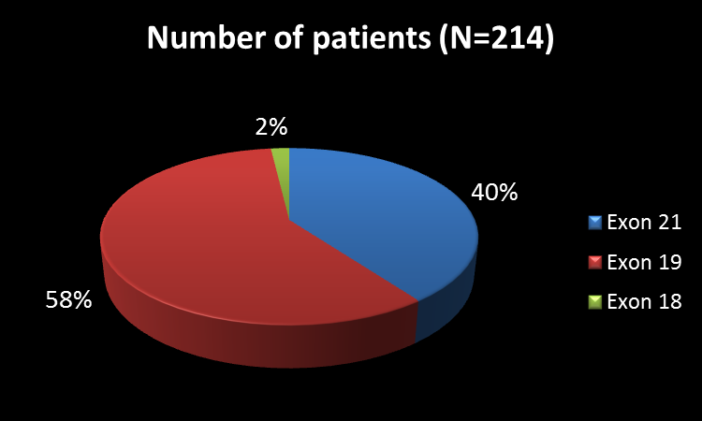
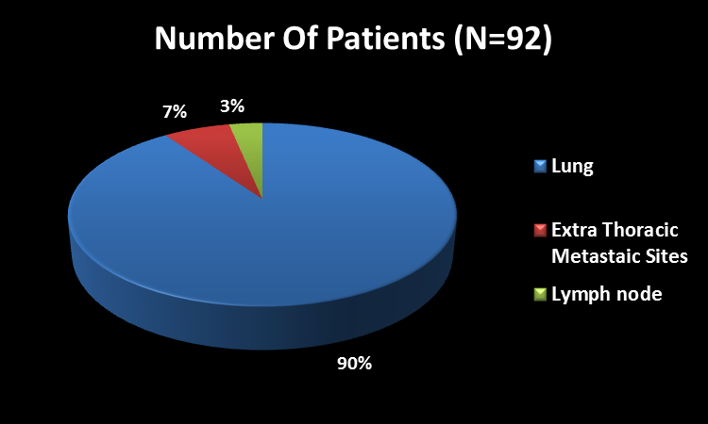
Rebiopsy Post Progression In EGFR Mutated Lung Cancer
Arun Chandrasekharan, Vijay Patil, Vanita Norohna, ,Amit Joshi, Anuradha Chougule, Rajeev Kumar, Abhishek Mahajan, Amit Janu, Supriya Goud, Sucheta More, Ashay Karpe , Anant Ramaswamy, Nikhil PAnde, Alok Goel, Vikas Talreja , Kumar Prabhash
Tata Memorial Hospital, Mumbai
BACKGROUND
Fig :1 Distribution Of Mutations
92 (43%) patients underwent rebiopsy at first progression
The site of biopsy were lung in 83 (90.2%) patients, extrathoracic metastatic sites in 6 (6.5%) patients and lymph nodes in 3 (3.3%) patients (Figure 3)
Adequate tissue for histopathological examination were available in 84 patients (91.3%)
Post progression on treatment with chemotherapy/TKIs , adenocarcinoma of the lung may transform histologically or gain /lose receptor function.
4 most common reasons for not doing the biopsy following progression were
  biopsy not offered in 57 patients
  no measurable or biopsiable lesion in 13 patients
  poor PS in 13 patients
  measurable lesion in the sanctuary site (brain) in 12 patients (Figure 2)
MATERIALS AND METHODS
Fig :3 Sites Of Rebiopsy
This was a post hoc analysis of a phase 3 randomized study where
Classic activating EGFR mutation positive patients warranting palliative chemotherapy were enrolled in this study and randomized to either gefitinib or pemetrexed carboplatin double
The data regarding rebiopsy post progression on first line was collected for this analysis and descriptive analysis was performed
Fig :2 Reasons for no doing a rebiopsy after progression
The histopathology was adenocarcinoma in 81 (96.4%, n=84 ) patients and it was SCLC, squamous cell carcinoma and poorly differentiated carcinoma in one patient each (1.2%)
RESULTS
We had 290 patients out of which 214 patients had progressed
The initial EGFR mutation has been shown in Figure 1
CONCLUSIONS
Nearly half of the patients underwent repeat biopsies in this prospective setting. The commonest reason for non biopsy was physician reluctance and histopathological transformation to SCLC was seen in 1.2% of patients

