Slide 1
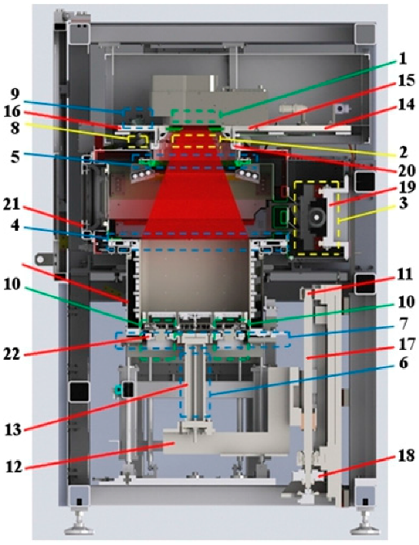

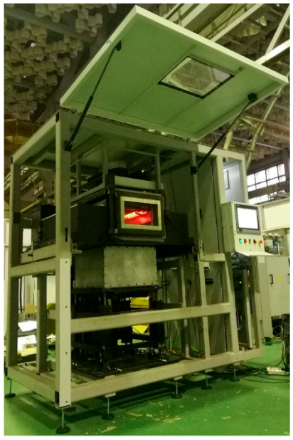
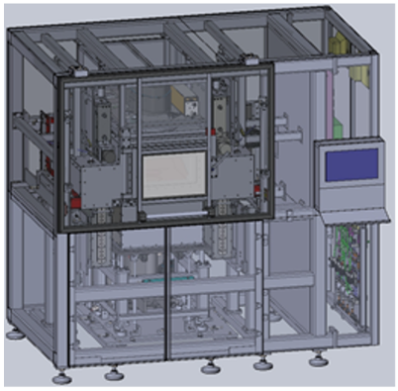
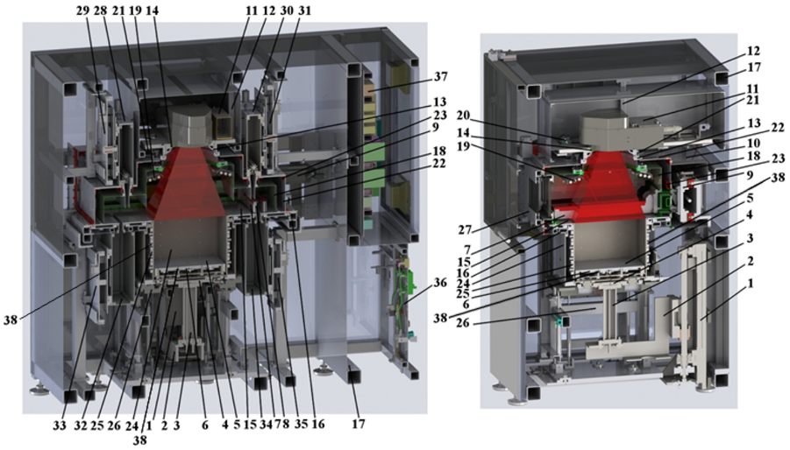
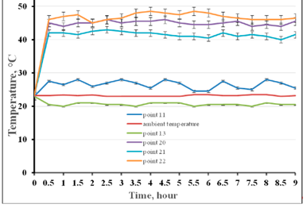
Design of the SLS-machine for PEEK
COOLING CIRCUITS
CREATED INSTALLATION
Nazarov A., Skornyakov I.
1 air cooling of the protective ZnSe-glass;
2 nitrogen cooling of protective ZnSe-glass;
3 nitrogen cooling of recoater drive;
4 water cooling of the main plate;
5 water cooling of the flange of the ring of the laser-optical unit, on which the protective ZnSe glass is mounted;
6 water cooling of the cooled rod for moving the lower transition table;
7 water cooling of the plate of the clamping device of the changeable frame;
8 nitrogen cooling of the optical part of the pyrometer;
9 water cooling of the pyrometer case;
10 air cooling of electrical connectors of the lower transition table and building platform;
11-22 temperature control points.
nazarovstankin@mail.ru
MSTU “STANKIN”, Moscow
BACKGROUND
The parts manufactured by the selective laser sintering (SLS) technology from some types of powders based on polyetheretherketone (PEEK) are of great interest. They have high strength values, high heat resistance, as well as excellent biocompatibility and dielectric properties. A set of these properties in combination with the capabilities of the SLS method allows creating unique parts. These parts are increasingly used in the aerospace industry, medicine, and motorsport.
RESULT
We present the original design of the SLS machine for PEEK, which includes the following main units, systems and parts:
CHARACTERISTICS
the possibility of using the SLS technology for various types of the PEEK-based powders;
the workspace of 500 × 500 × 300 mm³;
preheating of the applied powder layer to 385 °С with an accuracy ±2 °C (over the entire area of 500 × 500 mm²);
nitrogen protective atmosphere (nitrogen purity: up to 99.8%);
the accuracy of the applied powder layer ±10 μm;
the capability to maintain controllable slow cooling of the entire volume of the manufactured part together with the unsintered powder from 385 °C to 20 °C;
the capability of automated control of the powder recoater alignment;
the possibility of changing the intensity distribution into the spot of laser radiation from “gauss” to “reverse gauss” or “top hat”, which in the opinion of some researchers, can improve the quality of the components produced by the SLS method.
TEMPERATURE CURVES
Shows the time course of temperature changes at mentioned points. Temperature dependence testifies to the operation reliability of all the protective cooling circuits during the SLS process of the designed unit. Pyrometric control showed that in points 11–19, the heating temperature does not exceed the ambient temperature by more than 5 °C. At points 20–22 during the unit operation, the temperature ranges from 40 to 50 °C, which does not exceed the permissible values.
1-4 lower transition table parts;
5 building platform;
6 building platform heating system;
7-10 recoating system;
11-14 laser-optical unit;
15 powder depositing main plate;
16 main plate frame;
17 main frame of the SLS machine;
18 airtight inner chamber;
19 top heaters;
20 pyrometer;
21 illumination lamp;
22 protective external chamber;
23 external chamber frame;
24-26 changeable frame with heating system;
27 double-protective door;
28-35 powder delivery and collection hoppers;
36 air-gas system;
37 electric control device;
38 thermocouple.
REFERENCES
1. EOS Plastic Materials for Additive Manufacturing. [online] Retrieved January 10, 2018, from https://www.eos.info/material-p
2. VICTREX™ PEEK Polymers. [online] Retrieved January 10, 2018,
from https://www.victrex.com/~/media/datasheets/victrex_tds_450g.ashx
3. PEEK (Polyarylethe-Retherketone). BPF. [online] Retrieved January 10, 2018,
from http://www.bpf.co.uk/plastipedia/polymers/peek.aspx
4. EOS Systems and Equipment for Plastic Additive Manufacturing. [online] Retrieved January 10, 2018,
from https://www.eos.info/systems_solutions/plastic/systems_equipment
5. Nazarov A, Skornyakov I, Shishkovsky I (2018) The Setup Design for Selective Laser Sintering of High-Temperature Polymer
Materials with the Alignment Control System of Layer Deposition. Machines 2018, 6, 11; doi:10.3390/machines6010011

