Slide 1
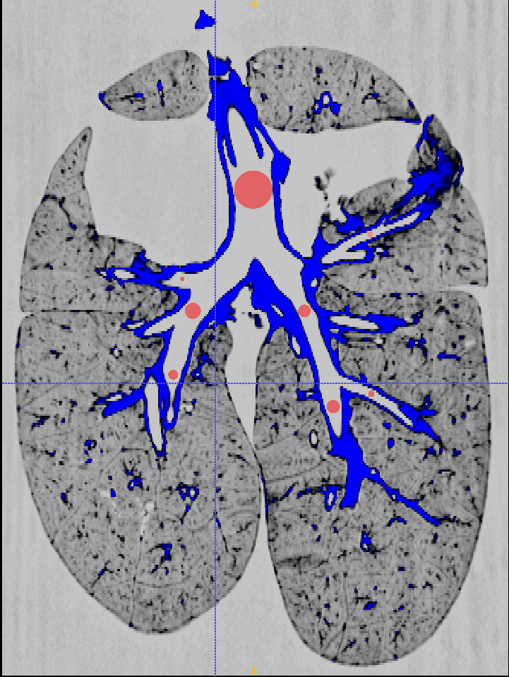
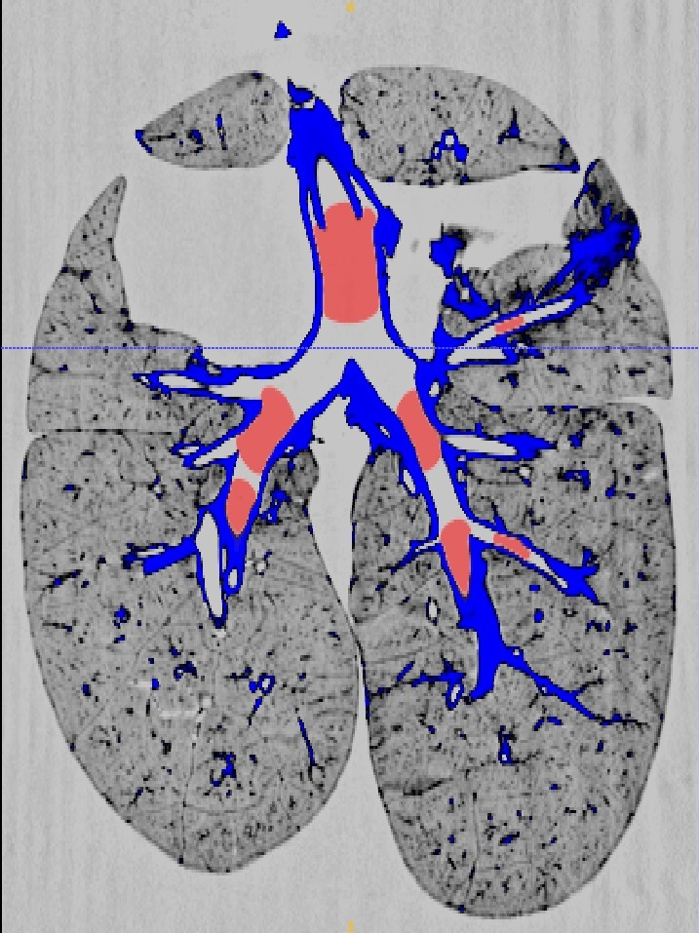
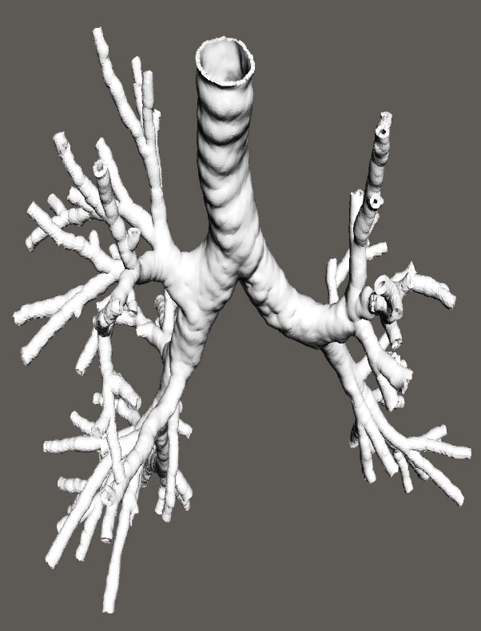
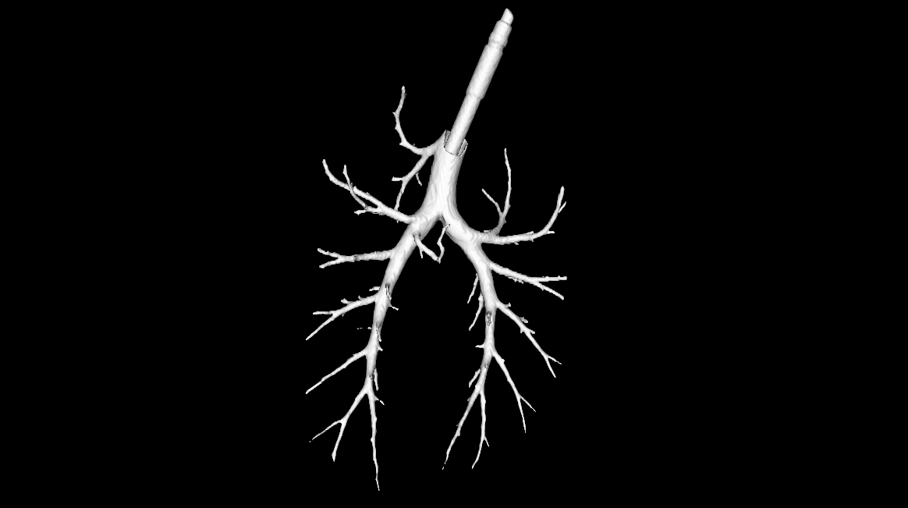
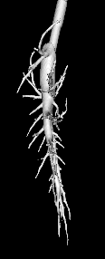
Building Realistic Models of the Airway Tree Using Computed Tomography
Mansy JH, Najarro P, McMurry B, Meguid I, Azad, MK
University of Central Florida, Orlando, FL
Objective Extract the geometry of an airway tree to help build accurate computer models of the airways.
Approach: Scan the airways of a human and a pig using CT. Use segmentation software to extract the geometry. Measure the diameter, length and bifurcation angles. Convert the geometry to a computer aided design file then construct the physical model by 3D printing.
Results: The geometric details of the pig airways were noticeably different between humans and pigs. Building a realistic hollow airway model was possible. Empirical rules describing the pig airway geometry were developed.
CT scan slices during segmentation
Hollow CAD model and 3D printed human airways
Abstract
          Pig airway computer model created using empirical rules
(a)
(b)
Fig 1: An example of extracting pig airways geometry from CT using segmentation software (a) Placement of virtual “bubbles” inside the Pig airways (b) Bubbles growing within the airways using the “volume filling” algorithm to form the airway geometry.
Introduction
Numerical modeling of sound propagation in the airways requires accurate knowledge of the airway geometry [Ping 14, Azad 16]. These models are often validated using animal and human experiments. Many studies documented the geometric details of the human airways, but details on the geometry of pig airways are scarce.
(a)
(b)
Pig airway solid geometry extracted from CT
Fig 3: The hollow human airways model: (a) Computer aided design (CAD) model (b) The 3D printed model.
(a)
(a)
(b)
Fig 5: A computer model of the pig airways created using empirical rules (a) Anterior view, (b) Side view.
Hollow 3D printed pig airway model
Conclusions
Methods
The geometric details of the airways can be efficiently extracted and 3D printed.
Empirical rules can be developed and used to generate models of the pig airways
IACUC approval
Acquire CT (computed tomography) scans of the pig and human chest.
Use ITK-SNAP software to extract 3D airway geometry. This is done automatically by the software.
Extrude the resulting surface to create a wall thickness.
Convert data to printable format and use 3D printing to create a physical model of the airways
Assign airway “generations” based on diameter starting with zero generation at the trachea
Determine general empirical rules that describe the geometry of pig airways as function of generation.
Create a computer model of the pig airways using the general rules.
References
Peng Y, Dai Z, Mansy HA, Sandler RH, Royston TR, Sound transmission in the chest under surface excitation-An experimental and computational study with diagnostic applications, Medical & Biological Engineering & Computing, 52:695–706; 2014
Azad MK, Mansy HM, Generation of pig airways using rules developed from the measurements of physical airways, Journal of Bioengineering & Biomedical Science, 2016
Azad MK, Mansy HM, Geometric features of pig airways using computed tomography, Physiological Reports, 2016
(a)
(b)
Fig 2: An example of the “solid” pig airways that were extracted from CT images using automatic segmentation. (a) Anterior view. (b) Side view. Bifurcations down to about the 10th airway generation can be seen. There is an early airway branching that feeds the top right lung lobe, which was consistently seen in the study pigs but not normally seen in humans. In addition, the two main bronchi tended to have monopodial morphology where airways tended to remain in the same general direction after several bifurcations.
(a)
(b)
Fig 4: An example of the hollow pig airways that were 3D printed (a) Anterior view. (b) Side view. Bifurcations down to about the 10th airway generation can be seen..
Acknowledgement
This work was supported by NIH grant R01 EB012142

