Slide 1
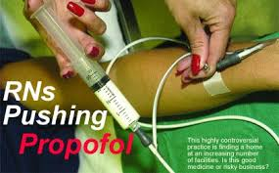
Is Propofol Safe If Given by Non-anesthesia Providers?
By
Dr. Ali Saad

Slide 2

INTRODUCTION

Slide 3
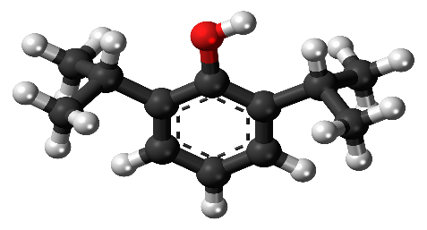
Propofol is a sedative–hypnotic that was commercially introduced into U.S. anesthetic practice in 1989.
Released under the trade name of Diprivan, it rapidly gained acceptance in the anesthesia community as an induction agent because of its rapid onset of action and other favorable pharmacokinetic properties.
Because Propofol undergoes a two-phase distribution, with the first phase lasting only 4 to 6 min, the sedative effects of a single bolus dissipate rapidly.
Thus it was soon recognized that the “rapid-on, rapid-off ” profile of propofol also made it an ideal agent for sedation either as a continuous infusion or in small boluses.

Slide 4
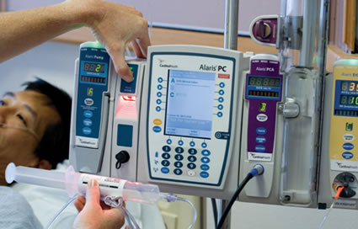
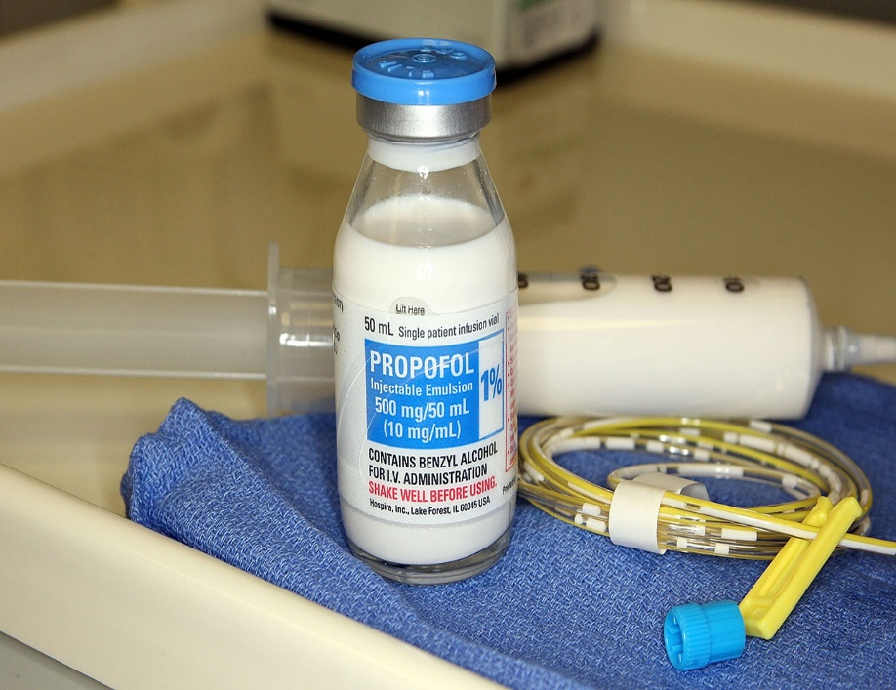
OPTIONS

Slide 5
Even before its commercial release in the US, specialties outside anesthesiology began to report on the use of propofol for procedures requiring sedation.
Standard agents for procedures occurring in radiology and endoscopy suites, dental offices, and emergency departments were opioids and long-acting sedatives such as benzodiazepines.
However, recovery from the prolonged effects of these medications was troublesome, and clinically significant side effects such as respiratory depression limited the amounts administered.
The rapid redistribution properties of propofol and its minimal effects on most patients’ hemodynamic variables made it appear to be a much safer alternative.

Slide 6
The pharmacokinetic properties of propofol allow patients to emerge more quickly after administration, and they appear less sedated compared with other barbiturate or benzodiazepine combinations, even though complete elimination from the body can take hours or even days.
It also may produce amnesia and has a dose-dependent, mood-altering effect that can be euphorogenic.
Studies have shown that mood and psychomotor function return to baseline within an hour or less after brief infusions of the medication are stopped in healthy volunteers, which is similar to other modern general anesthetics.
Propofol also has an antiemetic effect that further supports its selection for procedures in an outpatient setting.

Slide 7
Unfortunately, the ideal anesthetic agent does not exist, and propofol has its share of undesirable side effects.
Most notable is the dose-dependent respiratory depression that can abruptly result in apnea or airway obstruction.
This effect ends quickly when administration is stopped, which gives a false sense of safety to those providing or directing the sedation.
Another commonly encountered effect is the decrease in mean arterial pressure that is similar or somewhat more pronounced when compared with other sedative– hypnotics.
Again, these observed effects end quickly when dosing stops.

Slide 8


EVIDENCE

Slide 9
Investigators in three medical specialties and dentistry have compared propofol with other traditional options and currently recommend propofol as a safe addition to everyday practice, supporting its administration by practitioners who are not anesthesia professionals.
In nearly every instance, studies conclude that propofol is associated with minimal post-procedural sedation, which results in a faster recovery, provides amnesia and comfort to the patient, delivers better procedural conditions, and has a better safety profile than traditional choices.
Evaluation of the data on propofol use by non-anesthesia providers is complex because of several factors, the foremost of which is the lack of adequately powered studies that statistically support the conclusions made.
In addition, a direct comparison among the different specialties cannot be made.

Slide 10
Procedural needs, patient presentation, and defined endpoints are quite different for each specialty.
Gastroenterology has evolved from simple procedures such as colonoscopy and diagnostic EGD that require only moderate sedation, to more invasive and stimulating ones such as ERCP and EUS.
The diagnostic and therapeutic value of these newer endoscopic methods has led to a substantial increase in annual procedural numbers, but by their very nature, they require deeper sedation for patient acceptance and optimal conditions.

Slide 11
The traditional approach has been to combine a benzodiazepine with or without an opioid, and this is the combination against which propofol-based sedation protocols with or without adjuvants are compared.
Similarly, physicians in the specialty of emergency medicine are often faced with the need for deep sedation and analgesia to perform short, painful procedures such as the reduction of a dislocated joint or closed fracture.
The specialty of radiology has supported the development of pediatric sedation units (PSUs) primarily for radiologic procedures.
The sedation teams are supervised at times at a distance by pediatric intensivists or emergency department physicians.

Slide 12
Because these cases can require hours of sedation, propofol is one of several options used.
Finally, dentistry has long been associated with painful procedures.
Although local infiltration or nerve blocks remain the techniques of choice, patients may receive supplemental sedation to accompany the procedure, especially at the time of the nerve block or local infiltration.
Current studies report sedation being maintained throughout the entire procedure, albeit at a more responsive level.

Slide 13
ASA House of Delegates approved a document in 1999 describing the continuum of depth of sedation.
However, the aforementioned specialties had already begun to report on sedation with Propofol against other traditional medications and, in so doing, used the definitions for sedation depth to which they were accustomed.
This makes comparisons between fields difficult (Table 47-1)---Sedation Scales
Ramsay Sedation Scale | ASA Continuum of Depth of Sedation (Responsiveness) | OAA/S
6 5 4 3 2 1 | No response Sluggish to light glabellar tap/noise Response to light glabellar tap/noise Responds to commands only Cooperative, oriented, calm Anxious, agitated, restless | GA Deep sedation/analgesia Moderate sedation/analgesia Minimal sedation to awake Not defined | 0 1 2 3 4 5 6* | -No response to pain -No response to mild prodding/shaking -Responds to mild protruding/shaking -Responds to loud noise or repeated name -Lethargic response to name called -Responds to name, alert -Anxious, agitated, restless
*The Modified Observer’s Assessment of Alertness/Sedation (MOAA/S) includes level 6

Slide 14
Studies often report the use of basic monitors such as a pulse oximeter and automated blood pressure cuff (except in dentistry), but supplemental oxygen and capnography are not standard.
Even though propofol is commonly used for sedation in ICU, there is often input from the available anesthesiology service and patients receive ventilation under heightened monitoring conditions; therefore the critical care unit setting will not be considered in this chapter.

Slide 15
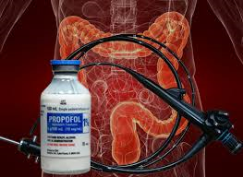
Gastroenterology

Slide 16
There are two meta-analyses and a Cochrane Database review on the administration of Propofol by non-anesthesia personnel for moderate sedation in endoscopic procedures.
Of these, the Cochrane review discusses the use of Propofol for colonoscopy only; one meta-analysis reviews the use of Propofol for diagnostic EGD and colonoscopy but not for those procedures requiring deep sedation such as ERCP, enteroscopy, or EUS; and the other analysis reviews studies that included colonoscopy, EGD, and ERCP.
The Cochrane Review analyzed 22 studies published since 1989, of which most were small, RCTs of limited power.

Slide 17
The review’s primary objective was to appraise studies that evaluated the safety and efficacy of Propofol, either alone or in combination with adjuvants, in comparison with the traditional medications of benzodiazepines, opioids, or both.
A secondary objective was to assess studies that compared the administration of Propofol by non-anesthesia personnel to that by anesthesia professionals, but only one study reported that comparison.
Although several of these studies show similar outcomes between providers, they do not have sufficient power to detect a statistical difference in the outcomes of interest.

Slide 18
The Cochrane review authors noted that the studies were generally of poor quality and concluded that studies of better design, sufficient power, and standardized outcome reporting are needed, as well as comparative data about Propofol administration by non-anesthesia personnel versus anesthesia professionals.
The meta-analysis by Qadeer et al evaluated 12 studies that specifically compared the incidences of hypoxia (defined as SaO2 less than 90%), hypotension (defined as SBP less than 90 mm Hg), arrhythmias, and apnea from sedation with the use of Propofol against traditional techniques for colonoscopy, EGD, and ERCP.

Slide 19
Anesthesiologists administered the sedation in two of the studies; in one of these, the Propofol arm was a patient-controlled design that was compared with traditional sedation by the anesthesiologist.
Two other studies did not specify the sedation administrator, one used a nurse directed by the endoscopist, and the remaining seven used an endoscopist dedicated to the sedation.
Hypoxia and hypotension occurred frequently with both sedation techniques, and arrhythmias and apnea were rare but of equal frequency when reported, which makes a statistical comparison of frequency not possible.

Slide 20
One study of the 12 markedly favored Propofol, and when the authors removed that study in a sensitivity analysis, they acknowledged an implied influence.
Nonetheless, they reported that the pooled analysis demonstrated a 26% lower incidence of the defined complications when Propofol was used, which led them to conclude that Propofol had a lower risk profile than traditional methods for colonoscopy but not for EGD or ERCP.
Of note, they added that better studies are needed to prove its superiority.

Slide 21
The meta-analysis by McQuaid et al compared sedation techniques used for diagnostic EGD and colonoscopy.
Inclusion criteria were studies in which protocols included both traditional and propofol-based practices used in healthy, adult, outpatient populations with the goal of moderate sedation.
Thirty-six RCTs, systematic reviews, and the Qadeer et al meta-analysis were included for assessment, in which the primary goal was to evaluate patient satisfaction, physician satisfaction, and efficiency metrics.
In this analysis, who administered the sedation was not specifically reported other than to state it was a health care professional.

Slide 22
It also rated the methodologic quality of each study using a tool called the Jadad scale.
This scale assigns a score of 0 to 5, and a score of 3 or less means the study is of relatively poor quality.
Of the studies meeting inclusion criteria, 23 of the 36 rated a 3 or less on the Jadad quality scale.
The authors concluded that traditional sedation protocols and those that use propofol have similar outcome profiles when the goal is moderate sedation; the only exception is that recovery times for propofol-based methods are significantly shorter.

Slide 23
Moreover, they acknowledged that higher quality RCTs are needed to better assess the role of propofol either alone or with adjuvants for moderate sedation.
Earlier RCTs focused on the safety of propofol as an alternate sedation strategy in endoscopy units and whether non-anesthesia personnel could safely administer it either under endoscopist direction, by protocol, or via patient-control.
These studies tended to use healthy patients undergoing routine procedures requiring moderate sedation.
Trained nurses were identified as the most cost-effective providers of propofol.
Hypoxia was the most common complication, yet supplemental oxygen was not given in one study and only 2 L/min was delivered in four.

Slide 24
Among the prospective, non–evidence-based studies reviewed, several trends are apparent.
Within the endoscopy literature, depth of sedation is most often assessed with the use of either (OAA/S) scale or its modified version (MOAA/S).
The ASA sedation continuum scale is not used.
The deepest sedation level on the OAA/S scale is 0, defined as no response to painful stimulation.
This corresponds to the ASA definition of general anesthesia.
A frequently studied and reported variable in both the RCT literature and nonrandomized articles is the use of nurse-administered propofol sedation (NAPS).

Slide 25
Too recent to be included in the Cochrane review or meta-analyses, two studies compared anesthesiologist-administered propofol sedation with that by non-anesthesia personnel; an endoscopist administered propofol in one study, and PCS was used in the other.
Both studies reported that the anesthesiologist-based sedation resulted in larger propofol amounts given, which resulted in unnecessarily greater sedation that was without benefit yet did not produce any negative outcomes.
In contrast, a cohort study using a large national database comparing anesthesiologist-provided sedation with that given by endoscopists for colonoscopies and EGDs found that the adjusted relative risk of a significant adverse event was 0.5 if an anesthesia professional rather than the endoscopist provided sedation.

Slide 26
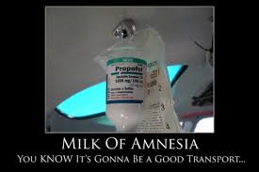
Emergency Medicine

Slide 27
Multiple RCTs have been published comparing the use of propofol with traditional and nontraditional medications for sedation and analgesia since 1999.
The conclusion by all these studies is that propofol has an equivalent or improved safety profile over traditional choices after measurement of the incidence of adverse events such as hypoxia and hypotension.
The focus of more recent studies is on sedation-to-recovery times, suitability of procedural conditions, and patient satisfaction.
The most common types of emergency department procedures used in these studies are major lacerations and fracture and dislocation reductions.

Slide 28
Of the RCTs published, an early study in 1999 evaluated closed fracture reduction and casting in a pediatric population ranging in age from 2 to 18 years.
Patients were randomly assigned to receive propofol or midazolam, and all received morphine before the procedure.
Hypoxia, defined as an SpO2 less than 93%, occurred at similar rates for both propofol and midazolam (11.6% and 10.9%, respectively), and over-sedation, as defined by a Ramsay score of 6 for 10 minutes or more was the most common complication, occurring at rates of 32.6% for propofol and 34.8% for midazolam.

Slide 29
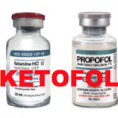
Emerging in the more recent literature of protocol comparisons for procedural sedation is the use of ketamine.
Investigators also studied ketamine compared with propofol as single agents62 and ketamine plus another medication compared with propofol.
When ketamine was compared with propofol, patients had longer recovery times with more agitation and a higher rate of subclinical respiratory depression, as noted by capnography.

Slide 30
Unique to emergency medicine is the issue of the patient with a full stomach requiring deep sedation for painful, albeit short, procedures.
Few articles report an occurrence of peri-procedural emesis.
Of three recent reviews that included emesis as an adverse event, the reported incidences ranged from a high of 8.4% in one pediatric population to a combined low of 1.5% to 1.6%.
Despite this significant frequency, propofol is considered safe because it produces the same or a lower incidence of vomiting as other sedation protocols.

Slide 31
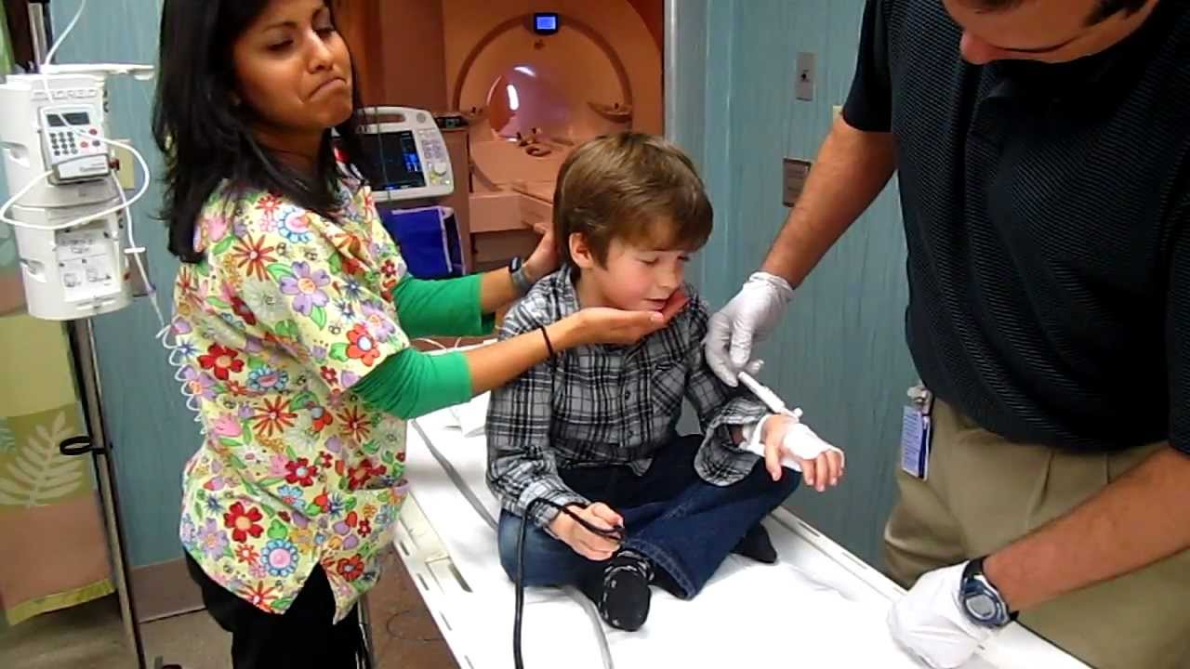
Radiology and Pediatric Sedation Units

Slide 32
The first report of a PSU that provided services for radiologic procedures without direct anesthesia professional involvement occurred in 1998.
Within this body of literature, only one RCT is published, all other studies are of a retrospective and observational nature.
The RCT compared Propofol sedation with a protocol using pentobarbital–midazolam–fentanyl for MRI scans of the brain in the pediatric population.
All patients had pulse oximetry, nasal capnography, and blood pressure monitoring, and all received supplemental oxygen.
Both a specially trained nurse and a pediatric emergency medicine physician were present through the sedation period, and the desired level of sedation to achieve was more than 4 on the Ramsay scale.

Slide 33
The mean total dose of propofol given throughout the procedure was 7.6 mg/kg. For the pentobarbital, midazolam, and fentanyl group it was 4.1 mg/kg, 0.089 mg/kg, and 0.3 mcg/kg, respectively.
All adverse events were considered minor and were too few to compare.
The authors concluded propofol has a favorable induction and recovery profile while demonstrating efficacy equal to the pentobarbital–midazolam–fentanyl protocol.
Of the early non-RCT literature, two descriptive articles used propofol as a component of the sedation regimen along with opioids, benzodiazepines, and ketamine, and one used only propofol.
In all three, the physicians involved in drug selection and administration were pediatric intensivists or emergency department physicians.

Slide 34
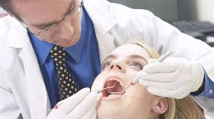
Dentistry

Slide 35
The RCT studies reported in the dentistry literature compared propofol with other traditional medications or focused on the effectiveness of different patient delivery modes for sedation using propofol.
Patients having simple outpatient tooth extraction procedures comprised the study groups in all four articles reviewed, and patients served as their own comparison over two separate sessions.
The goal of each design was to achieve satisfactory sedation before local infiltration or a nerve block.

Slide 36
Either the patient using a device or a baseline infusion initiated by the practitioner then determined further sedation.
The delivery systems compared for dental sedation used propofol only.
A continuous infusion was evaluated against two patient-controlled techniques.
Variables measured were HR, RR, ABP, O2 SAT., sedation levels, recovery time, and patient satisfaction.
No cardiopulmonary complications were reported with similar recovery.
All patients receiving the continuous infusion of propofol achieved a moderate sedation level where they could be aroused to command.

Slide 37

AREAS OF UNCERTAINTY
It is evident from the literature that propofol use is growing among non-anesthesia professionals.
It is equally evident from the more recent literature that propofol is considered a safe alternative with an acceptable profile, and adverse events are no longer the focus of these newer studies.
This raises concern because the majority of the studies reviewed are not powered well enough to support the conclusions, and this lack of power is cited frequently in the meta-analyses as well as the Cochrane review.

Slide 38
Such confidence in the safety of Propofol and growing pressure from payers to justify the increased cost of an anesthesia professional prompted the American College of Gastroenterology (ACG) to petition the U.S. Food and Drug Administration (FDA) to lift the ban on Propofol administration by non-anesthesia professionals in 2010.
Areas of controversy within the anesthesia community continue to revolve around the acceptability of outcomes, adequate monitoring, consistent definitions of sedation depth, and whether the individual administering the medications and monitoring the patient has the necessary education and skills to identify developing problems and implement corrections.

Slide 39
The types and quantities of procedures requiring sedation and analgesia are increasing, and economic and social pressures are mounting for non-anesthesia specialties to provide procedural sedation without an anesthesia professional present.
Whether with sedation by Propofol or by traditional medications, these studies reported periods of apnea, hypotension, hypoxia, and the loss of response to stimulation as acceptable intra-procedural conditions.
Anesthesia professionals believe that well-defined monitoring is the key to maintaining patient safety, and intra-procedural variations in cardiopulmonary variables should be treated promptly.

Slide 40
Unfortunately, other specialties differ on which cardiopulmonary variables are monitored, how changes are defined as significant, and whether they are treated.
Another area of concern is the many ways by which sedation depth is defined, definitions are loosely similar among the scales used, but the numeric designations may cause confusion when comparing the literature.
To avoid such confusion, it would be helpful if only one scale describing the range of sedation, including the extremes of no sedation and general anesthesia, were universally accepted among the specialties.
Who is actually administering the medications and how they decide when and what dose is another area of concern to the professional anesthesia community.

Slide 41
GUIDELINES
The ASA has published a number of documents on the use of propofol by non-anesthesia professionals.
The most relevant here are “Continuum of Depth of Sedation,” “Statement on the Safe Use of Propofol,” “Statement on Respiratory Monitoring during Endoscopic Procedures,” “Statement for Basic Anesthetic Monitoring,” Statement on Granting Privileges for Administration of Moderate Sedation to Practitioners Who Are Not Anesthesia Professionals,” “Advisory on Granting Privileges for Deep Sedation to Non-Anesthesiologist Sedation Practitioners,” and “Practice Guidelines for Sedation and Analgesia by Non-Anesthesiologists.”

Slide 42

Although these documents have not yet gained universal acceptance outside anesthesiology and competing documents are promoted by other specialties, the ASA classifications and guidelines are being acknowledged in the more recent non-anesthetic literature.

Slide 43

AUTHORS’ RECOMMENDATIONS
It is unlikely that the use of propofol by non-anesthesia professionals will cease.
In many ways, propofol may be as safe or safer than more traditional medications.
However, education of non-anesthesia professionals, especially those responsible for the patient, is needed to advance patient safety.
Understanding the risks for nonfasted patients and providing the training to avoid and rescue from deep levels of sedation are essential.

Slide 44
(ASA) provides documents to assist in the educational and credentialing process, and these should be at the core of any training program.
Monitoring must be standardized and adequate.
Given their training, experience, and everyday environment, anesthesiologists should be at the forefront to determine protocols, initiate training, perform or oversee competency reviews, and set up quality assurance programs.
All data should undergo periodic review, and appropriate responses should be given about sentinel events.
All specialties using sedation should agree on a consistent set of definitions of sedation depth.

Slide 45

This would help to advance research and develop evidence-based recommendations on patient safety.
The ASA has published a document defining the continuum of depth of sedation that describes physiologic changes, as well as responsiveness at different depths, including general anesthesia.
The use of such a document should be universal as it would promote discussion and provide comparison of data between fields.
Anesthesiologists did not anticipate such ready acceptance of a new anesthetic medication outside the specialty.

Slide 46

Anesthesia professionals need to be better prepared to address the use of such potent drugs by non-anesthesia professionals in a more proactive manner.
The ASA has started to establish the necessary documentation to address future events.

Slide 47
References
McCallum R. Hoyt, MD, MBA • Beverly K. Philip, MD-Evidence based Ch. 47
Smith I, White PF, Nathanson M, Gouldson R. Propofol: an update on its clinical use. Anesthesiology 1994;81(4):1005–43.
MacKenzie N, Grant IS. Propofol for intravenous sedation. Anaesthesia 1987;42:3–6.
Smith I, Monk TG, White PF, Ding Y. Propofol infusion during regional anesthesia: sedative, amnestic, and anxiolytic properties. Anesth Analg 1994;79:313–9.
Gepts E, Claeys MA, Camu F, Smekens L. Infusion of propofol (“Diprivan”) as sedative technique for colonoscopies. Postgrad Med J 1985;61(Suppl. 3):120–6.
Zacny JP, Lichtor JL, Coalson DW, Finn RS, Uitvlugh AM, Glosten B, et al. Subjective and psychomotor effects of subanesthetic doses of propofol in healthy volunteers. Anesthesiology 1992;76:696–702.
MacKenzie N, Grant IS. Comparison of the new emulsion formulation of propofol with methohexitone and thiopentone for induction of anaesthesia in day cases. Br J Anaesth 1985;57:725–31.
Tarazi EM, Philip BK. A comparison of recovery after sevoflurane or desflurane in ambulatory anesthesia. J Clin Anesth 1998;10:272–7.
Rolly G, Versichelen L, Huyghe L, Mungroop H. Effect of speed of injection on induction of anaesthesia using propofol. Br J Anaesth 1985;57:743–6.
Chan VWS, Chung FF. Propofol infusion for induction and maintenance of anesthesia in elderly patients: recovery and hemodynamic profiles. J Clin Anesth 1996;8:317–23.

Slide 48

Thank You

