Slide 1
Presenting
“Dr. Bhim Engine”
A next generation engine
Developed
By
Rahul kumar

Slide 2
Contents
Introduction.
What is conventional IC engine.
Types of conventional IC engine.
Electric vehicles.
Others attempt by other developer.
Future of IC engine.
Why new engine.
Abstract.
Principle.
Working.
Advantages.
Scopes.

Slide 3
Introduction
Since the advent of engine. two type engine works mostly one is reciprocating Engine other is Rotary engine and no alternative of these engine has been successfully developed. so far effort to develop a new system has been going on but no system should be superior or at least equally good to those engine. All above mechanism have several merits or demerits.
In this engine a humble try has been made taking a new approach. whose suitability and efficiency has been to developed.

Slide 4
Introduction cont…
On the positive side the arrangement is simple, low cost, low maintenance and economically
With the advent of electric vehicle survival of IC engine become critical but most top scientific journal said’ “not dead yet – ever evolving internal combustion engine power train”. All other efforts made by various developer has given rise to brilliant idea but conservative engine industry has not adopted those for which are partial technical and partial commercial.

Slide 5
Introduction cont…
Hence the better arrangement of this is awaited and here the role of this engine stands. this is the regeneration of the IC engine to complete the electrical vehicles.

Slide 6
What is conventional IC engine
An internal combustion engine is a heat engine where the combustion of fuels occur with an oxidizer (usually air) in a combustion chamber that is integral part of the working closed circuit. In internal combustion engine, the expansion of high temperature and high pressure gases is produced by combustion applies direct force to some component of engine. the force is applied typically to Piston. This force moves component over a distance, transforming chemical energy into useful mechanical energy

Slide 7
Types of ic engine
Reciprocating engine
Rotary engine

Slide 8
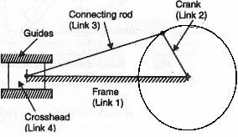
Reciprocating engine
A conventional reciprocating engine works on crank mechanism which consist many parts like Piston, connecting rods, crankshaft etc.
It become most complex combination of parts and increase more friction that reduce overall efficiency of the IC engine.

Slide 9
Reciprocating engine demerits
Due to reciprocating parts unwanted vibration occur.
Inconsistency of fuel make it more costly.
It gives low power output due to friction.
Size of engine is very large.
Due to incomplete combustion more emission occur.
Complicate balancing.

Slide 10
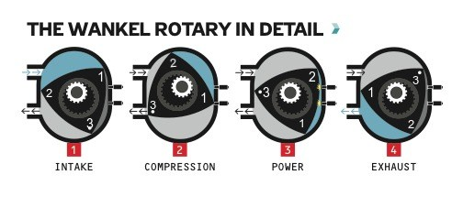
Rotary engine
Wankel engine is a type of internal combustion engine using eccentric Rotary design to convert pressure into rotary motion. The wankel engine has a equilateral triangular orbiting rotor . The rotors turns in a closed chamber and three Apex of the rotor maintain a continuous sliding contact with curved inner surface of the casing.

Slide 11
Rotary engine demerits
Problems of sealing.
difficult to lubricate the engine.
slow combustion and more fuel consumption.
low thermal efficiency comparison to reciprocating engine.

Slide 12
Electric vehicle
A vehicle propelled by an electric motor rather than a traditional petrol engines. the electric motor is powered by rechargeable batteries that can be charged using household main electricity via an EV charge point at home or at the more powerful EV charging station at the work or in the street.
Electrical vehicle uses one or more electrical Motors or traction to run the vehicle. it contains winding stator, winding rotor and alternator to run the vehicle.

Slide 13
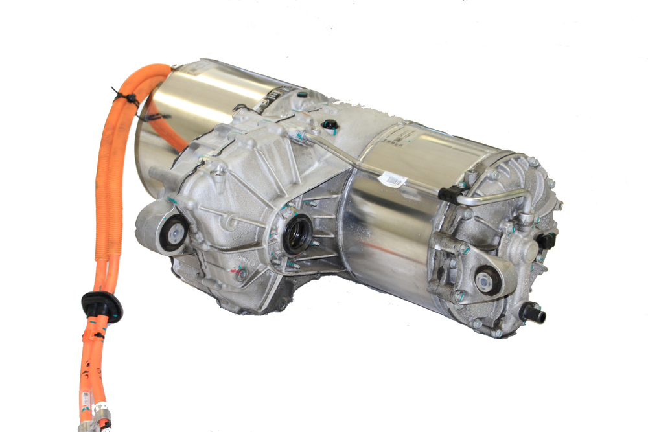

Slide 14
Electric vehicle demerits
shorts range of running.
recharging takes more time to complete charge.
charging station in availability.
electricity is not free.
silence is a disadvantage.
normally two seated or expensive.

Slide 15
Rajan crankless engine
rajan Crank less engine replace the connecting rod and crankshaft of the conventional engine using a rack. two segmental wheels and Middle gear built with the integral cam. the integral cam on the middle gear, the segment gears and Rack engagement are not show properly in the simulation as to not disclose the confidential feature of the engine. the integral cam is the heart of engine. that helps piston and rack assembly to decelerate, dwell and accelerate at TDC and BDC. it also helps to run the engine to without much vibration and damaging teeth on Rack and Segmental wheels.

Slide 16
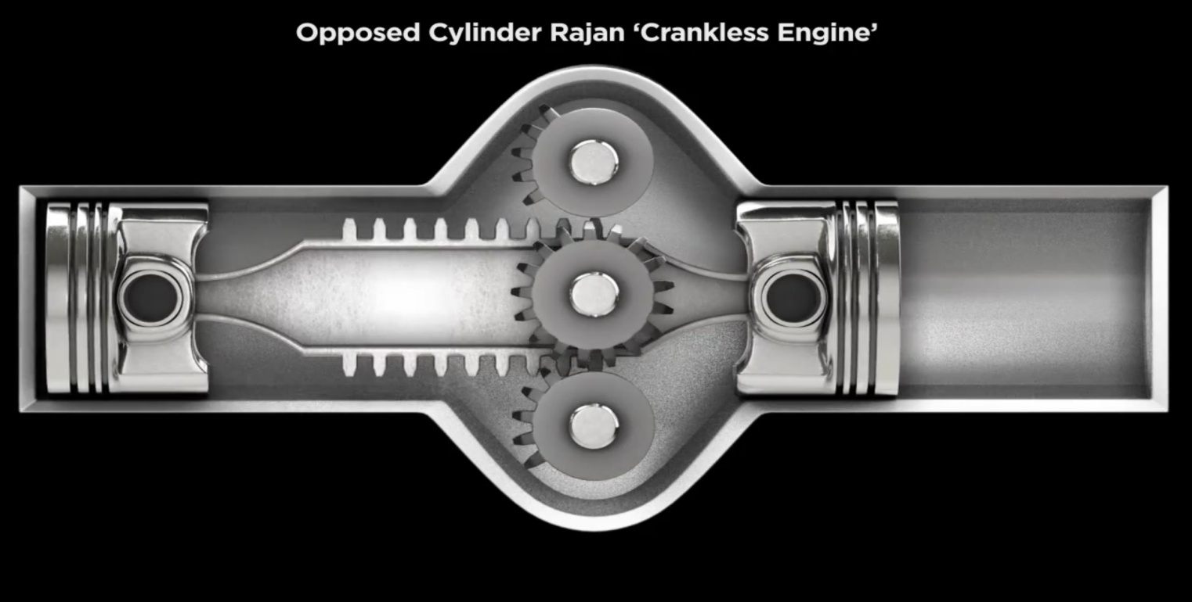
Rajan engine demerits
It has only two Piston at one time.
It is a complex mechanism compared to my engine.

Slide 17
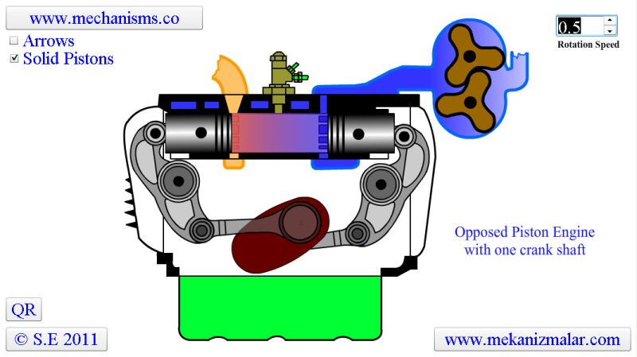
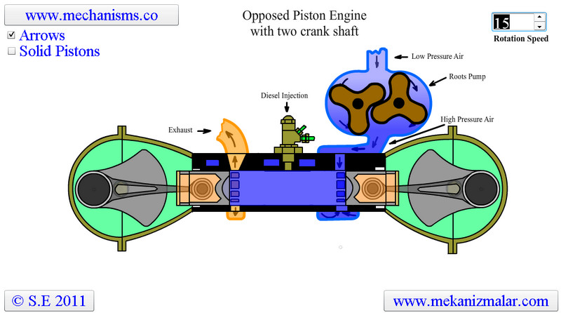
Opposed Piston engine
In this type of engine two Piston opposed on one combustion chamber with two crankshafts and one crankshaft.

Slide 18
Opposed piston demerits
Traditionally conventional technology used.
Occasionally two crankshaft used.
Complex arrangement of engine.

Slide 19
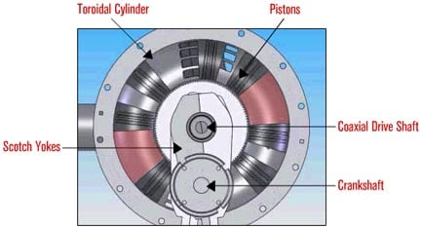
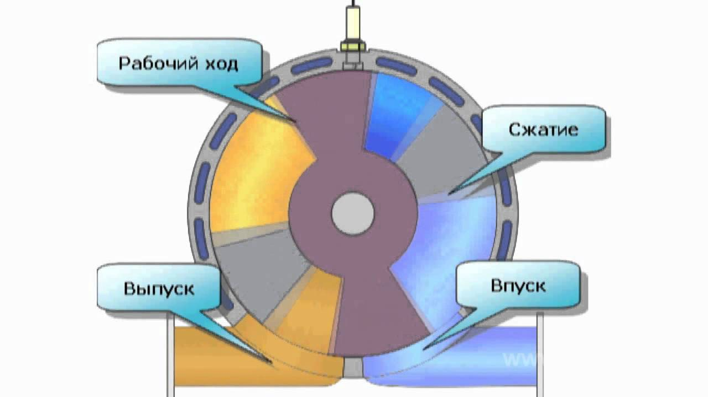
Russian Rotary vane engine
A surging Piston engine is a type of internal combustion engine in which Piston move in circular motion on inside a ring shaped cylinder. moving closer a further from each other to provide compression and expansion generally two sets of distance are used to move in a fixed relationship as the rotate around the cylinder

Slide 20
Future of IC engine
professor heywood is recognized as a one of the world preeminent expert on internal combustion engine.
Various projection for us suggest that by 2030 some 10 to 25% of vehicle might be electrified .what about 90 to 75% what about long truck and ships that run on diesel fuel.
There are, as yet no convincing electric option for those vehicle that is why it is still so important to continue working on internal combustion engine and make them clean and efficient as we can.

Slide 21
Future of ic engine cont…..
Mazda said it had made a big advance in the combustion method commonly known as homogeneous change compression ignition, which would result in gasoline engine than 20 to 30% more efficient than the company best existing engine.
Definitely professor heywood project dead in 2050, 60% light duty vehicle will still have combustion chamber engine after working with electric motor in hybrid system and largely equipped with turbocharger vehicle powerful battery, he estimates, will make up 15% of sales.

Slide 22
Future of ic engine cont…..
Holding a gas nozzle you can transfer 10 megawatt of energy in 5 minutes
Direct fuel injection.
Variable valve timing
And cylinder shutdown system in now widespread
Along with innovation in light weight body material and dual clutch transmission, mileage has steadily improve, so naturally further gain are now harder to come by - usually in single-digit percentage

Slide 23
Why new engine
Higher efficiency .
Higher power output.
Less fuel consumption.
Low weight.
Less friction.
Low lubrication consumption.
Low cooling consumption.

Slide 24
Abstract
This new types engine is used to power generation to run the automobile and big machinery. It consist curved shaft with teethed on one side attached two piston at both ends. A circular shaft attached to curved shaft to get output power.

Slide 25
Principal
When arc of circle make symmetry it gives a ellipse and this ellipse gives a trajectory points to movement if we divide this ellipse in three parts of 120 degree it give two curves to trajectory points to movements

Slide 26
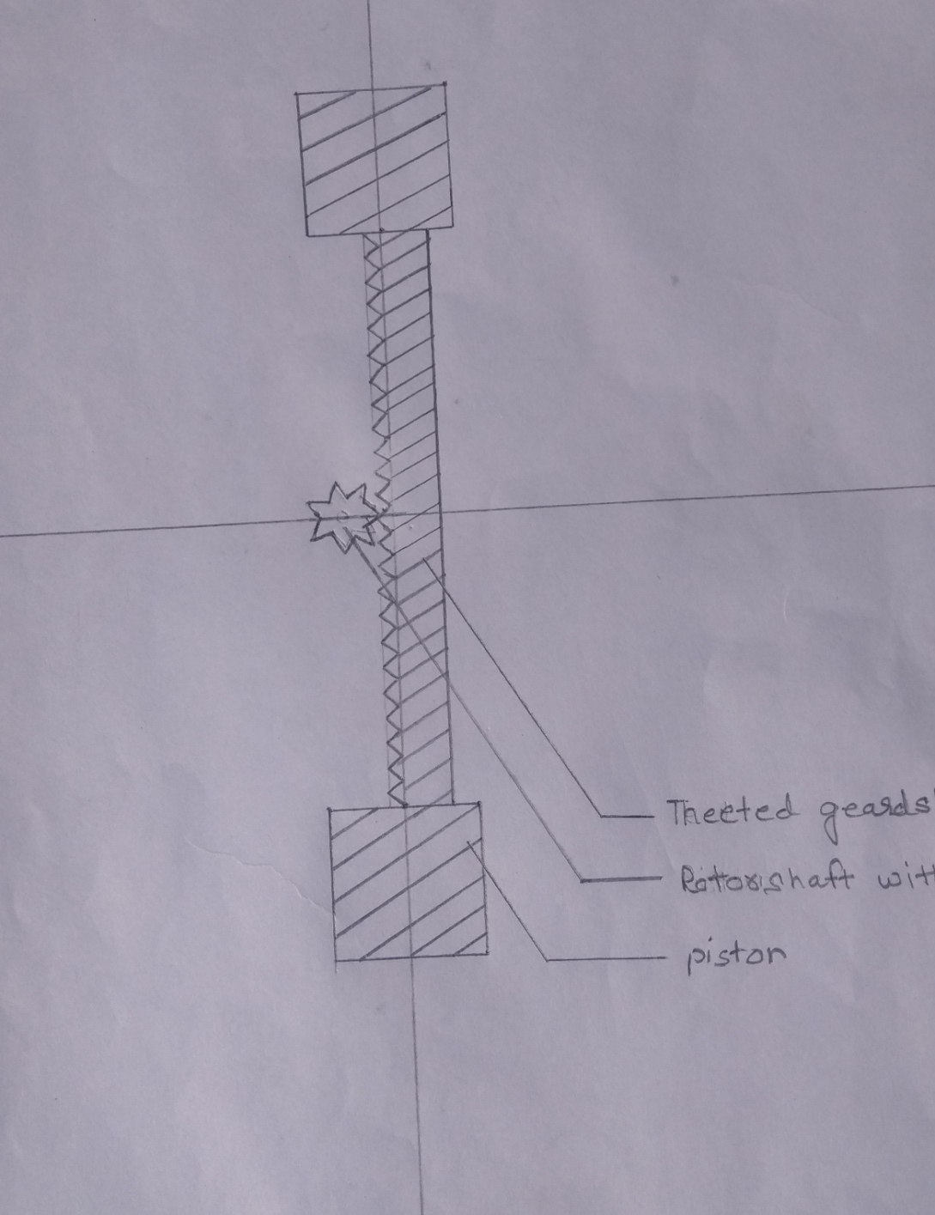

Slide 27
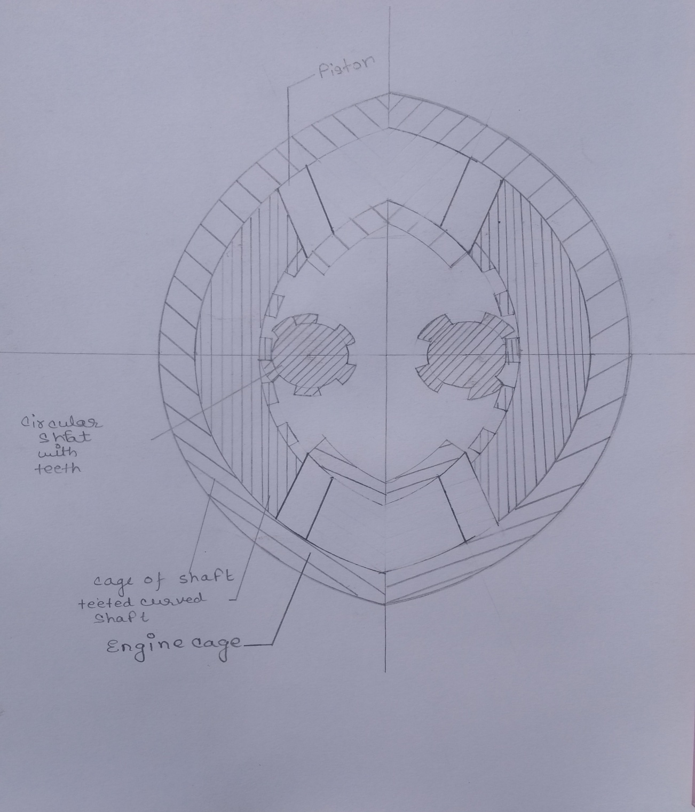

Slide 28
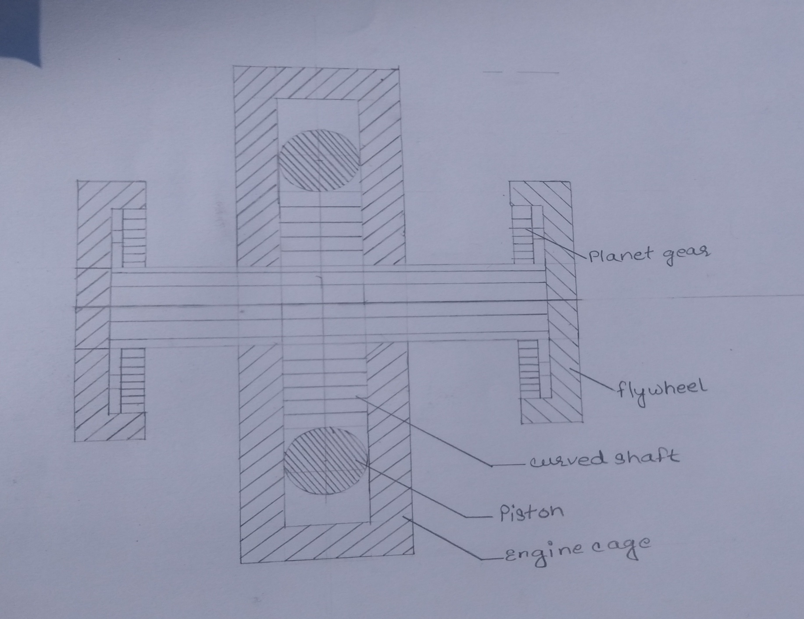

Slide 29
Working
When shaft on medium position . Suction occurs in top combustion chamber.When Piston moves medium position to top combustion chamber .
It compressed air fuel mixture same time suction occur on bottom combustion chamber
When firing occur in top combustion chamber powerstroke starts it moves piston downward direction at the same time compression occurs on bottom combustion chamber.

Slide 30
Working cont….
When firing occurs in bottom combustion chamber power stroke start and Piston moves upward direction at same time exhaust occurs in top combustion chamber and cycle repeat again.
It gives two way rotary motion and converted to one way direction with the help of sun planet gear and ratchet gear.

Slide 31
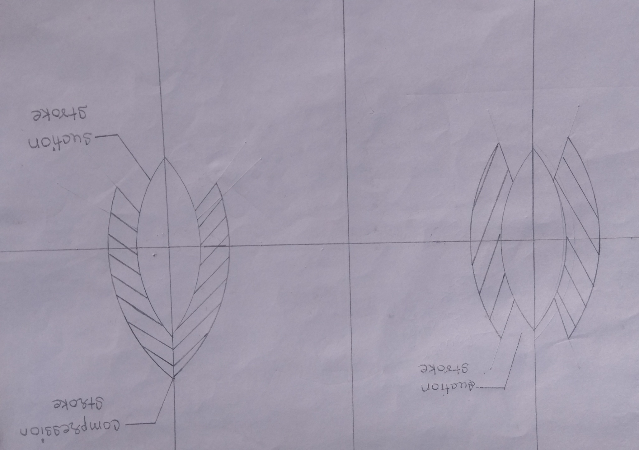

Slide 32
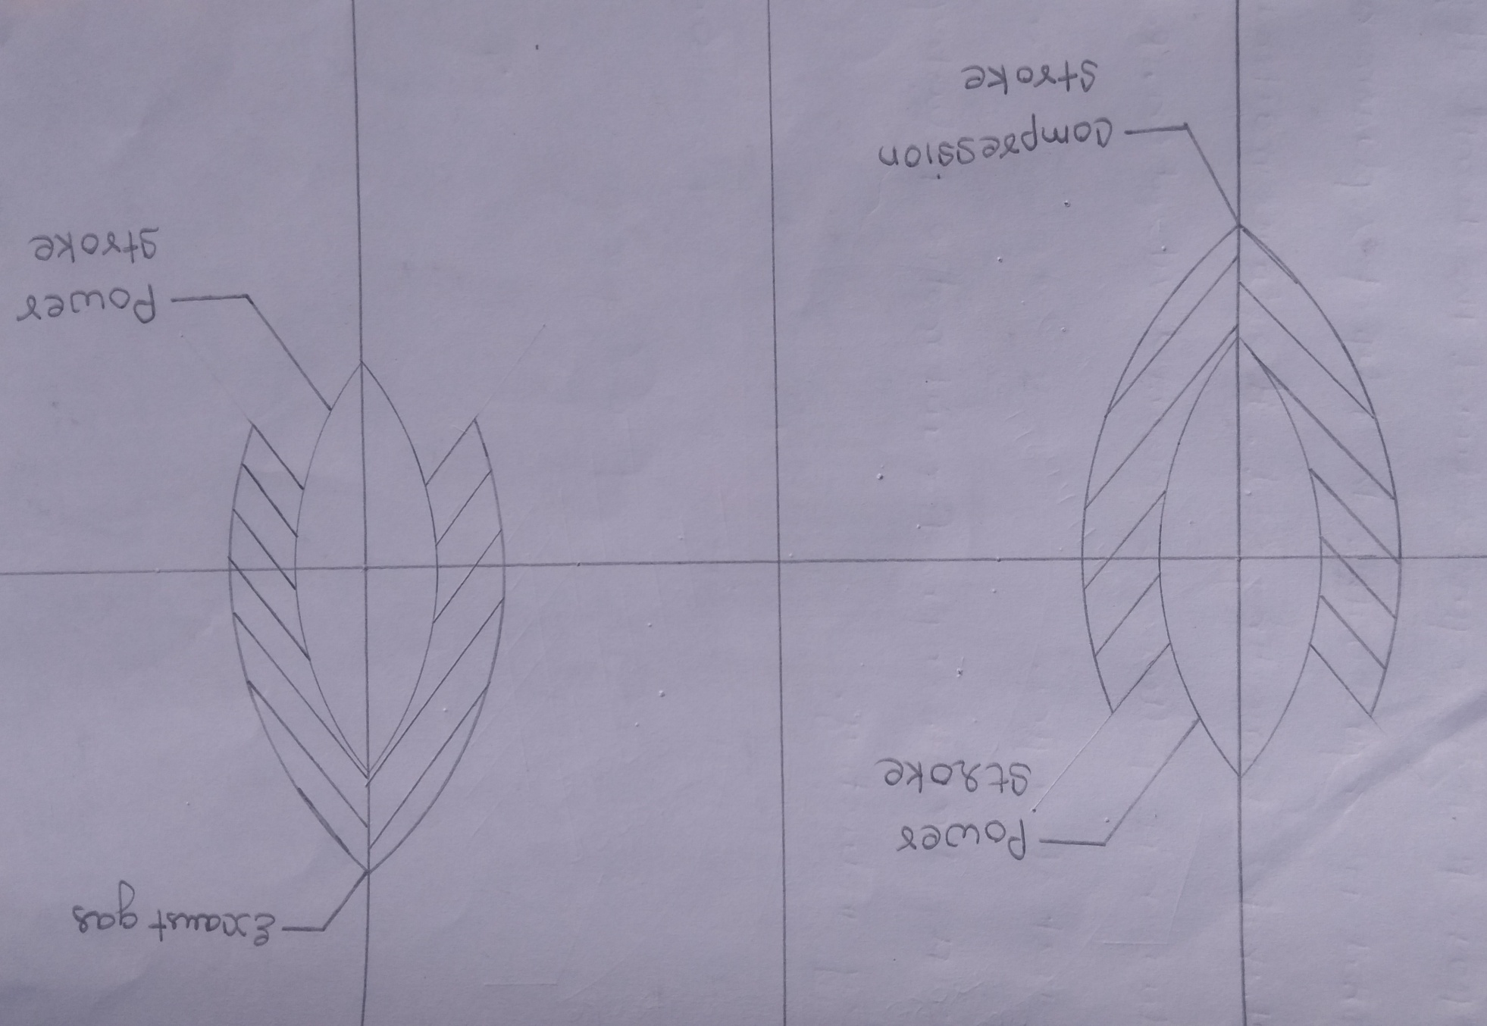

Slide 33
Advantages
higher efficiency due to fewer parts.
higher power output.
Reduces size and weight.
less friction due to two parts only.
low lubrication consumption.
Low cooling liquid required due to fewer parts.

Slide 34
scope
This new engine has multiple application due to its benefits and simplest mechanism and can be used in different industries with less fewer parts and make the engine simple.
Shipping industry
automobile industry
aircraft Industries big
machinery engine hybrid automobiles

Slide 35
Bibliography
https://en.wikipedia.org/wiki/Internal_combustion_engine
https://www.bartleby.com/essay/The-Conventional-Internal-Combustion-Engine-PKL5DBXYLJ5Q
http://www.vssut.ac.in/lecture_notes/lecture1429900545.pdf
https://www.toyota-europe.com/world-of-toyota/feel/environment/better-air/conventional-engines
https://www.toyota-europe.com/world-of-toyota/feel/environment/better-air/conventional-engines
http://web.iitd.ac.in/~ravimr/courses/mel345/classification.pdf
https://www.popularmechanics.com/cars/g195/5-alternative-engine-architectures/
https://www.popularmechanics.com/home/tools/reviews/a3119/cordless-drill-driver-vs-impact-driver-whic https://www.popularmechanics.com/space/moon-mars/a25995626/meteorite-moon-lunar-eclipse/
https://www.popularmechanics.com/space/moon-mars/a25995626/meteorite-moon-lunar-eclipse/
h-do-you-need-14583956/
https://www.popularmechanics.com/home/a26012711/diy-shelves/
https://energyeducation.ca/encyclopedia/Reciprocating_engine
https://www.sciencedirect.com/topics/chemistry/reciprocating-engines
https://www.petropedia.com/definition/8613/reciprocating-engine
https://nptel.ac.in/courses/101101001/downloads/Intro-Propulsion-Lect-25.pdf
https://www.wartsila.com/energy/learning-center/technical-comparisons/combustion-engine-for-power-generation-introduction

Slide 36
Special thanks
Col. Syamal datta sir
Prof. R. P. Sinha sir
Prof. mohd. Arif sir

Slide 37


