Slide 1

GAS TURBINE JET ENGINE (GTJE)
Khristianovich Institute of Theoretical and Applied Mechanics SB RAS

Slide 2
2
Advantages of conventional gas turbine engine over piston ICE:
High specific power;
Favorable torque characteristics;
Full expansion of the working body;
The relative simplicity of construction, well balanced, a great resource;
Insensitive to type of fuels;
Good starting properties.
Disadvantage:
Low fuel economy (low thermal efficiency)
The purpose of the project - increasing the thermal efficiency of the gas turbine engine
Notes:
Low fuel economy. This is due to the limitation of the temperature at the turbine inlet to the level of 1500 degrees due to the insufficient heat resistance of the turbine blades.

Slide 3
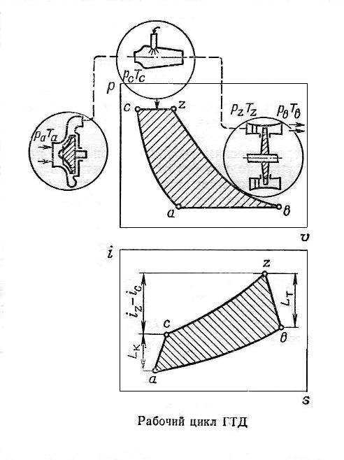
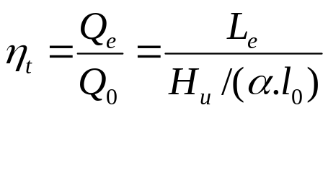
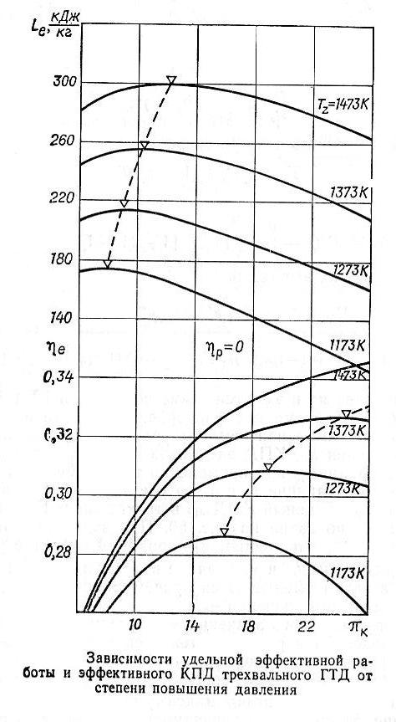
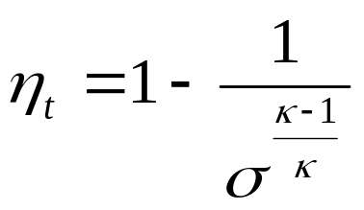
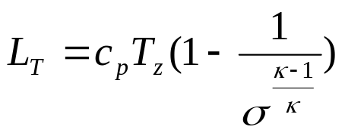
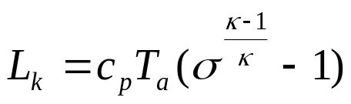
Engine operating cycle
3
Thermal efficiency
σ = pc /pa
The specific operation of the turbine
The specific operation of the compressor
Increasing the temperature of the gases at the turbine inlet for every 50° increases thermal efficiency η_{t} by 2%. [R.M. Yablonik]

Slide 4
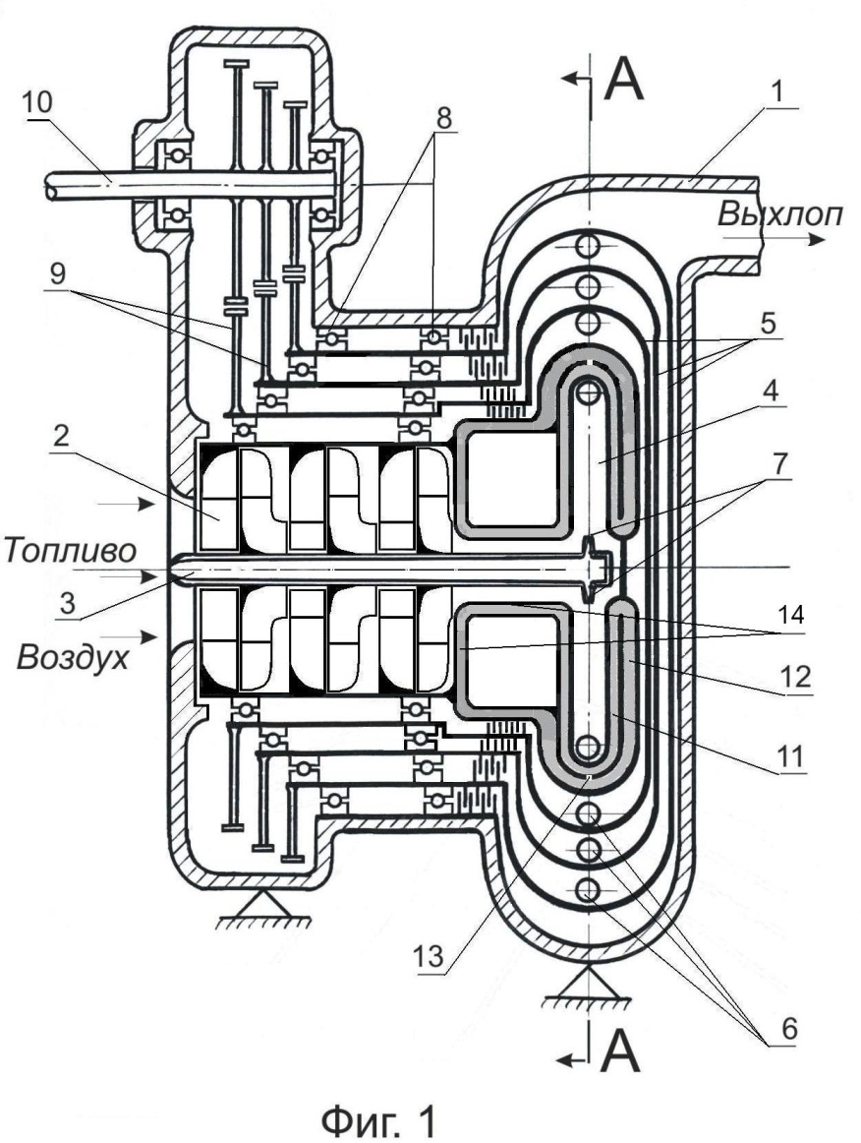
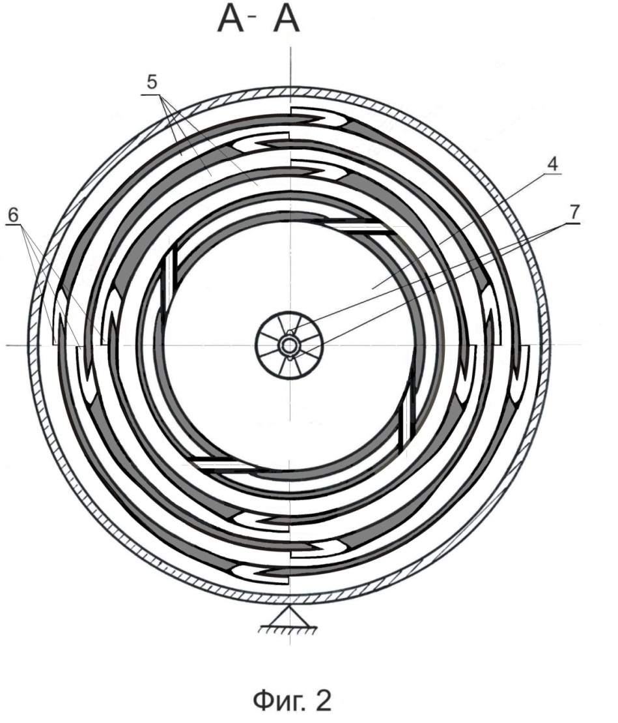
Scheme a gas turbine jet engine (GTJE)
4
Absence of turbine blades allowed to increase temperature of the working fluid to 2300K and thereby increase the estimated thermal efficiency.

Slide 5
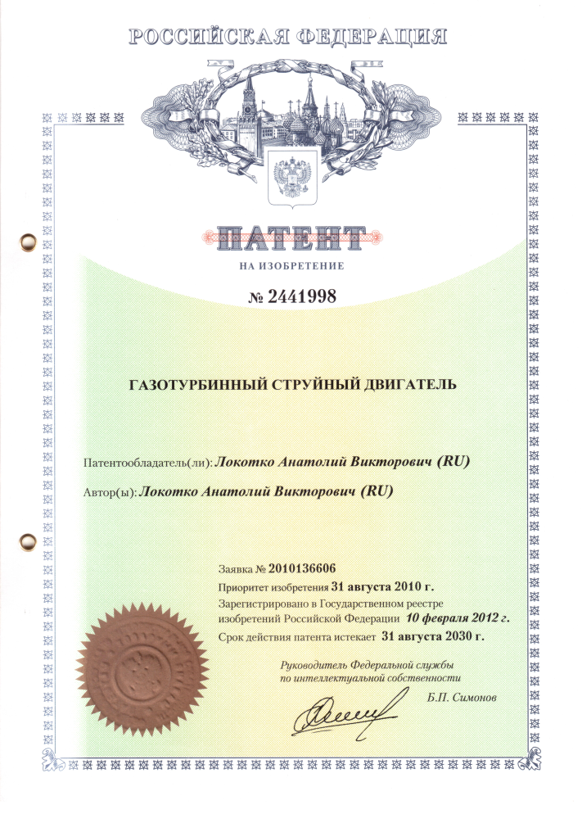
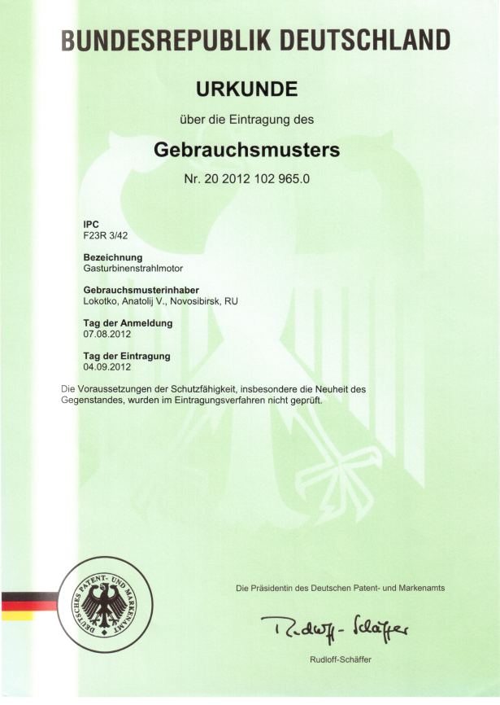

Engine concept was protected by patents:
5
The patent for the invention of Russia
German patent for utility model
Degree of innovation projects
competition “Tehnostart"

Slide 6
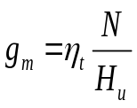




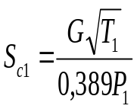



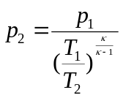
The outline of gas-dynamic calculation of the engine
6
Based on the given power and a typical efficiency of a heat engine (ηt ∼ 40%) are defined the mass flow of fuel gт and air (G).
Ask the combustion temperature and the degree of pressure
of the compressor: (T₁= 2300K, σ = 20)
Determined
ratio of useful work
outflow velocity from the nozzle (critical)
the kinetic energy of the jet
nozzle throat area
total thrust nozzle
power from the expiry of the jets N₁ = Р_{c1}⋅C_{с1} = E_{c1}
the circumferential speed of the nozzle
the revolution number of rotor
lowering the temperature in the process of expiration
pressure in the space of jet flow
P_{с1} = p_{0c1} F_{c1} f(λ) – p₂⋅F_{c1}

Slide 7

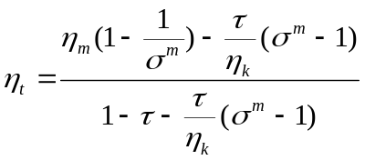
7
The thermal efficiency of an ideal cycle
η_{t} = 0,467
The thermal efficiency of the real cycle
η_{t} = 0,473
ŋ_{т} = 0,9, ŋ_{к} = 0,86.
Net power = sum of powers 2 - 4 steps : 35,64 + 29,99 + 25,2 = 90,83 kWt
Air flow : G = 0,11 kg/sec;
The combustion temperature : Тz = 2300°K;
Specific fuel consumption : g = 0,258 kg/kWth = 0,19 kg/hp∙h;
The results of the gas-dynamic calculation
Parameter 1 stage 2 stage 3 stage 4 stage
(the comb. chamb.)
Temperature °К 2300 1935 1628 1370
Pressure, bar 20 10,7 5,7 3,0
Outflow velocity, m/sec 870 805,0 738,4 677,4
Мощность ступени, кWt 41,6 35,64 29,9 25,2
The area of Crete. Sec. amounts, sm² 0,678 1,162 2,00 3,432
Diameter of a one nozzle, mm 4,64 6,1 8,0 10,5
Momentum of jets, N 167,3 153,2 140,8 129,2
The strength of the thrust nozzles, N 95,55 88,2 82,03 74,68
Ratio: thrust / momentum 0,575 0,576 0,582 0,578
Circumference diam. of nozzles installation, m 0,25 0,30 0,35 0,40
Peripheral speed m/sec 435,7 336,6 261,4 211,3
Number of turns 1/min 33063 25717 19969 16142
The remaining parameters of the gas for the fourth stage : Temperature T_{out} = 1152°К, pressure 1,62 bar.

Slide 8





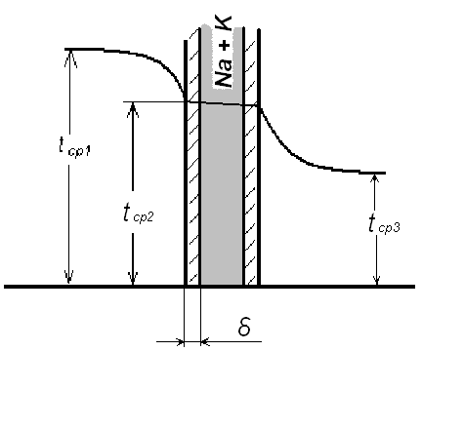


Thermal calculation procedure
8
The calculation is performed in the form of criteria :
The coefficient of heat transfer from the hot gases to the combustion chamber wall :
Heat transfer in the flow of molten metal in the pipes, is determined
of Nusselt number, dependent on the Peclet number (Pe)
Nu = a + bPe
U =0,25 m/sek
^{Pe ≈1000 Nu = 14}
The coefficient of heat transfer to the metal:
α₂ = 3000 Wt/m² grad
The pressure in the liquid p, occurs when rotation of the BC
by centrifugal force:
When the temperature difference in the "hot" and "cold" cavity shirts
100°C, the pressure drop will be: Δр = 4,7 МPа
The temperature of the liquid metal coolant : Т_{ср2} = 608°С provided that the area heat dump = 10 (surface area of the combustion chamber)
Super alloys for rotors: ВН2A based on niobium, molybdenum ЦМ3, tungsten BB2 - retain strength to 1200°С; for сombustion chamber - bronze alloys.
Heat-resistant ceramics: boron nitride and tungsten carbide allow the temperature to 3000°C.

Slide 9
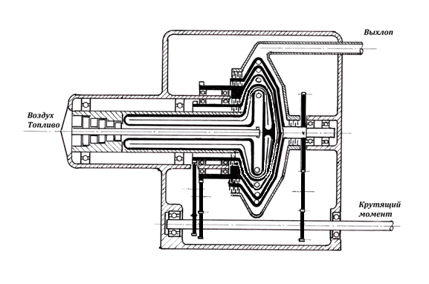
Application
9
Approximation to real construction
Exhaust
Air + fuel
Twisting
moment

Slide 10
10
Estimates show that the proposed gas turbine jet engine has an efficiency ηt ~ 47% - comparable to the performance for Internal combustion engines. The engine is "keenly attuned" on working on certain mode calculations, so its use appears to be most appropriate under a constant load, such as cars hybrid schemes - to drive the generator to charge the batteries, in the systems of the distributed power energy, on small vessels - as the main engine.
CONCLUSION

Slide 11
AREAS OF USE,
ECONOMIC JSTIFICATION

Slide 12
GTJE Applications
12
The drive generators to charge batteries in vehicles of the hybrid circuits;
The drive generators in systems of the distributed power with possibility of cogeneration, including:
Electricity production from associated gas in the oil industry, biogas in the livestock;
Improving the efficiency of urban sewage treatment plants,
utilization of landfill gas;
Compact and lightweight self-contained source of electricity and heat for the Ministry of Emergency Situations and Disaster Medicine;
The main engines for small vessels and small-size aircraft.

Slide 13
Business model
13
Source of income - sale of licenses and design documentation for production GTJE Russian, and in the future - foreign machine-building enterprises.

Slide 14
Market
14
Potential customers in the Russian Federation:
Perm. Motors
OAO "Kaluga Turbine Works"
JSC "Proletarian Plant", St. Petersburg
JSC "Ural Turbine Plant"
PPI of "Energy"
Distribution: direct contact with consumers.
Market size: the world - $ 4 billion. (Reference IEIE SB RAS)
RF - $ 10 million. to 2020. (http://www.energyland.info/analitic-show-9588),
market growth in the year: 5-10%.

Slide 15
FINANCIAL PLAN
15
Required investment amount: $ 620,000
The distribution of investments: 100% - investor
Out of investors: sale of a stake to a strategic investor.
Thousands $
 | 1 year | 2 year | 3 year | 4 year | 5 year
Realization |  |  |  | 1500 | 2500
The gross profit |  |  |  | 1370 | 2350
Investments | 87 | 287 | 246

Slide 16
Competitive advantages
16
The main competitor: Capstone Turbine Corporation (USA) - an efficiency = 35%
Aerosila, NPP, OAO - efficiency = 28%
Kaluga engine (KADVI)
Engines: 9I56 - efficiency = 11%
9I56M - efficiency = 16%
OKA-1 - efficiency = 16%
proposed GTJE - efficiency = 47%

Slide 17
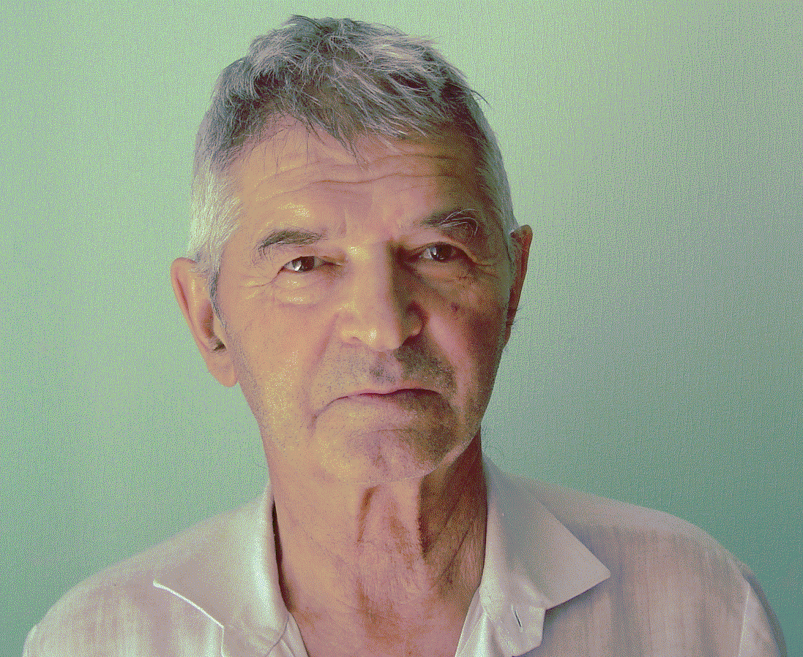
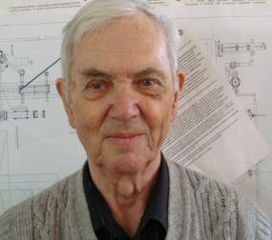
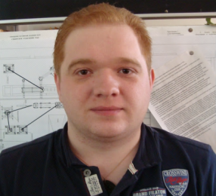
COMMAND
17
    CEO - Lokotko Anatoly Viktorovich - leading researcher ITAM SB RAS, Dr., graduated from the Tomsk Polytechnic Institute with a degree in "Internal combustion engine" in 1961. Work experience: 1961-63 - Head of the diesel shop Petropavlovsk-Kamchatsky city Power, 1963-65 - engineer Bureau reliability of the power plant Aviation Plant name V.P. Chkalov (Novosibirsk), 1965 at the present time the employee of ITAM, a specialist in the field of applied gas dynamics and experimental aerodynamics. It has 135 registered works, 7 patents.
    STO - Shushpanov Mikhail - the leading designer of ITAM SB RAS, NETI graduate, experience in ITAM 56 years. Under his leadership, a number of gas-dynamic systems was creating, designed two supersonic wind tunnels. He has 5 patents.
    STO – Troshin Pavel - senior designer of ITAM SB RAS, he graduated from the NGTU in 2012. He designed more complex models for special tests in supersonic wind tunnels.
Mentor on the economy - Averkin Pavel, Ph.D.
The total amount of team members at present - 3 people. In the case of support for the project number of the team members will be increased.

Slide 18
Contact Information:
Локотко Анатолий Викторович,
Lokotko Anatoly Viktorovich
630090, Новосибирск, ул. Институтская 4/1 ИТПМ СО РАН;
630090, Novosibirsk, st. Institutskaya 4/1 ITAM SB RAS
lok@itam.nsc.ru
Моб. тел: +7 923 706 68 71; Сл. тел. +7 (383)330 39 06.
Thank you for attention!

Slide 19
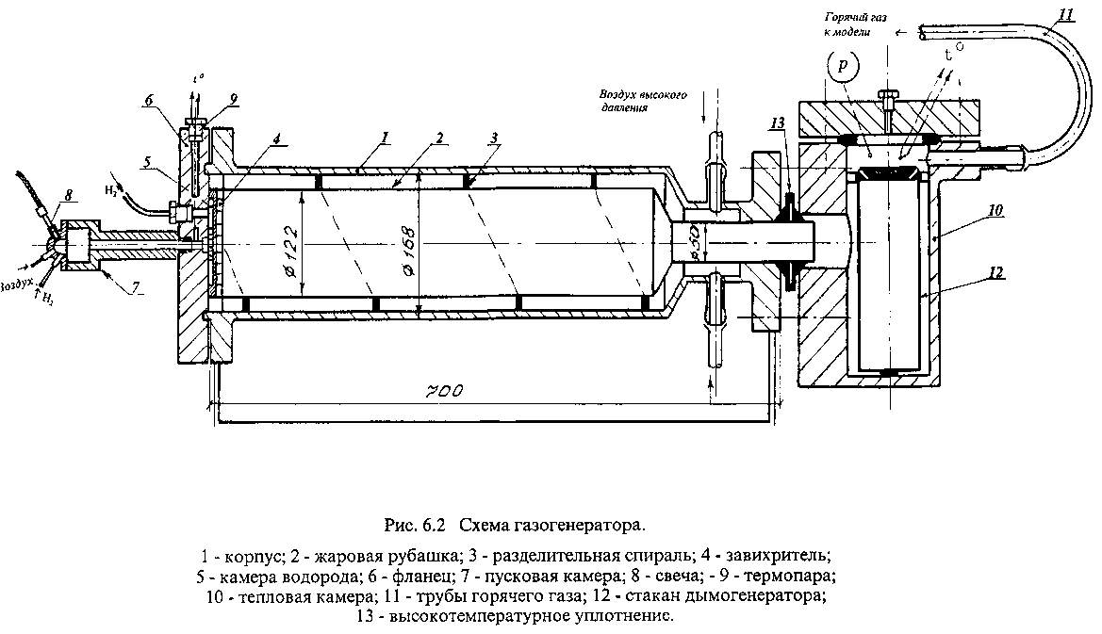
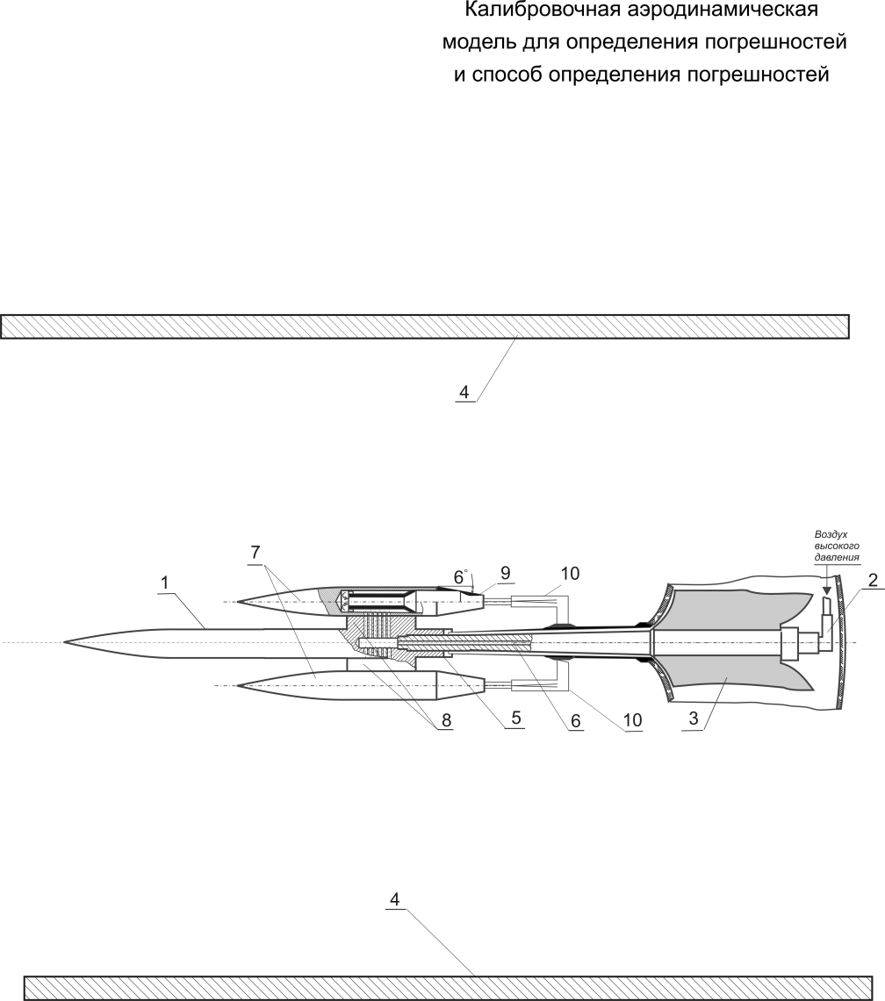
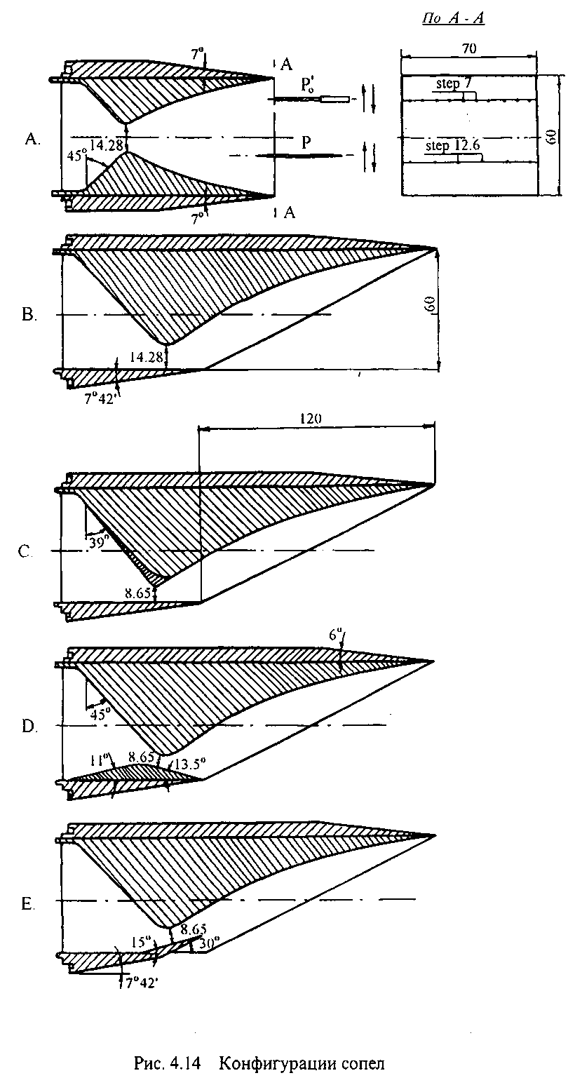
Опыт разработок, предшествующих струйному ГТД
Experience of developments prior to the GTJE
Газогенератор р≤ 20МПа, Т ≤ :600°С
Патент RU 2339928C1 G01M 9/08 Локотко А.В.
M
8
Research traction
characteristics of nozzles in the external supersonic flow
Device for assessing the accuracy of measuring thrust in the external flow

Slide 20

Крыльевое устройство судна. Патент SU № 1609034 A1 Локотко А. Wing device of the vessel. Patent SU No. 1609034 A1 Lokotko A.V.
This is the creative potential of the author of the project.

