Slide 1


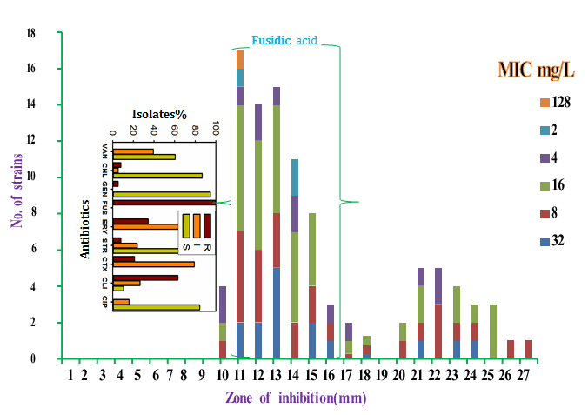
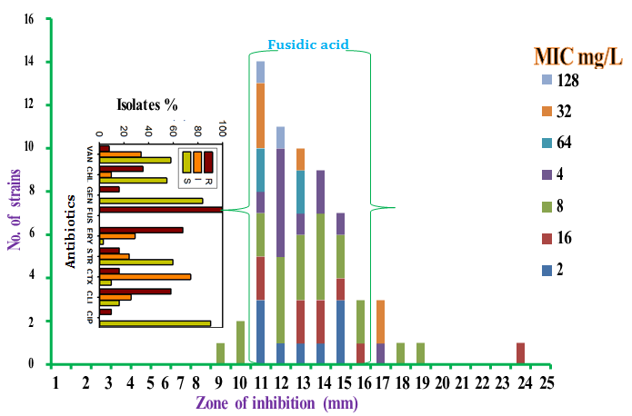
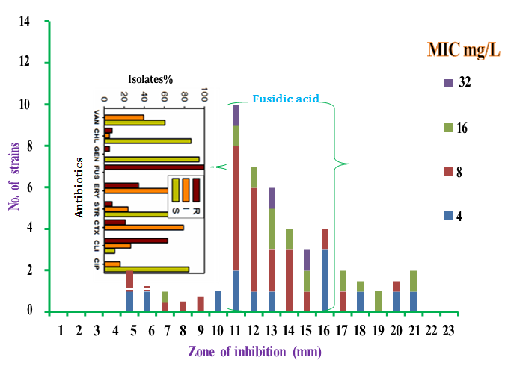
Multi-drug resistance of MRSA isolated strains from healthcare, community and the distribution of fusidic acid MIC and zone of inhibition : Wareg S E ¹, ², Daw M A², Agnan M.M ªDepartment of Medical Microbiology, Faculty of Medicine, University of Tripoli,
Libya/ ^{b}Faculty of Medical Technology, University of Nalut ӿCorresponding author: Dr. Said E Wareg: s_warrag@yahoo.com
Multi-drug resistance
The evolution of resistance to antibiotics is one of the most significant problems in modern medicine, posing serious threats to human and animal health. The early work on the use of antibiotics to treat bacterial infections gave much hope that infectious diseases were no longer a problem, especially in the human field. However, as their use, indeed overuse or abuse progressed, resistance which was transferable between different strains and species of bacteria emerged. Multidrug-resistant organisms (MDROs), including MRSA, Vancomycin-Resistant Enterococci (VRE) and certain Gram-negative bacilli have important infection control implications that either have not been addressed or received only limited consideration (Jom et al. 1998). In a routine ward environment study by Tan et al. 2013 clinical isolates recovered from the hands of healthcare professionals showed that MDROs were recovered from 79% of sampled surfaces, predominantly MRSA (74% of all tested surfaces), Acinetobacter baumannii (29%), VRE (2%) and Klebsiella pnuemoniae (1%). Although the names of certain MDROs describe resistance to only one agent (e.g. MRSA-VRE), these pathogens are frequently resistant to most available antimicrobial agents. MRSA and VRE, other β-lactamase producing organisms resistant to multiple classes of antimicrobial agents, are of particular concern (Mahgoub et al. 2002). Although antimicrobials such as linezolid, telavancin, daptomycin and oxazolidines are now available for treatment of MRSA and VRE infections, resistance to each new agent has already emerged in clinical isolate (Skov et al. 2012)
7th World Congress and Exhibition on
Antibiotics and Antibiotic Resistance
March 16-17, 2020 London, UK
No. of strains
INTRODUCION
The evolution of resistance to antibiotics is one of the most significant problems in modern medicine, posing serious threats to human and animal health. The early work on the use of antibiotics to treat bacterial infections gave much hope that infectious diseases were no longer a problem, especially in the human field. However, as their use, indeed overuse or abuse progressed, resistance which was transferable between different strains and species of bacteria emerged. Multidrug-resistant organisms (MDROs), including Methicillin-Resistant S. aureus( MRSA), Vancomycin-Resistant Enterococci (VRE) and certain Gram-negative bacilli have important infection control implications that either have not been addressed or received only limited consideration (Jom et al. 1998). Although antimicrobials such as linezolid, telavancin, daptomycin and oxazolidines are now available for treatment of MRSA and VRE infections, resistance to each new agent has already emerged in clinical isolate (Skov et al.2012)
MATERIALS & METHODS
Figure 1. Distribution of the number of IPHA-MRSA strains compared with MIC and zone of inhibition for fusidic acid. Key. MIC= minimum inhibitory concentration. R= Resistance, I= Intermediate and S= Susceptible, VAN= vancomycin, CHL= chloramphenicol, GEN= gentamicin, FUS= fusidic acid ERY= erythromycin, STR= streptomycin, CTX= cefotaxime, CLI= clindamycin and CIP= ciprofloxacin.
Bacterial strains:
From a previous study held between April 2015 to December 2016, in-patient health acquired-MRSA(IPHA-MRSA) isolates were isolated from 100/ 43% of clinical samples, out-patient health acquired-MRSA (OPHA-MRSA) were isolated from 62/ 37% and for community carried-MRSA (CC-MRSA) strains isolated from 38/ 34% of clinical samples
Antimicrobial susceptibility testing:
Susceptibility tests were performed by the disc diffusion method of Bauer et al. (1966) with Mueller-Hinton agar (Oxoid-CM0337) supplemented with 20 g1-1 NaCl. Cefoxitin was used as an indicator of methicillin susceptibility.
Antibiotic discs used were vancomycin (VAN) 30 µg, chloramphenicol (CHL) 30 µg, gentamicin (GEN) 10 µg, fusidic acid (FUS) 10 µg, erythromycin (ERY) 15 µg, streptomycin (STR) 10 µg, cefoxitin (as an indicator of methicillin-resistance) (FOX)30 µg, cefotaxime (CTX) 30 µg, clindamycin (CLI) 2 µg and ciprofloxacin (CIP) 5 µg.
Zones of inhibition were measured after 18 and 24hs. incubation at 35°C. S. aureus ATCC25923 (Biosafety level /BSL) was the control strain used in every run. Tests were performed in duplicate. Six discs were accommodated on a 13.5 cm plate for each run.
Interpretative zone of inhibition for fusidic acid which is not stated in the CLSI guidelines were reported as resistant ≤ 29 mm and susceptible ≥30 mm according to the British Society for Antimicrobial Chemotherapy(BSAC) (Anon-2010/2013) guidelines.
Minimum inhibitory concentration:
Antibiotic stock solution: Stock solution was prepared using the formula 100/P X V X C = W, where: P= potency given by the manufacturer (µg/mg), V= volume required (ml), C= final concentration of solution (multiplies of 1000) (mg/L), W= weight of antibiotic(mg) to be dissolved in volume V(ml).
Figure 2. Distribution of the number of OPHA-MRSA strains compared with
MIC and zone size for fusidic acid.
Working stock solutions were prepared as follows: 20 ml of water =10,000 mg/L stock solution.
Preparation of antibiotic dilution range:
Antibiotic dilutions prepared in the range 0.25-128 mg/L were prepared
RESULTS
Fusidic acid resistant strains
This study also revealed that all MRSA strains that were isolated from healthcare and the community facilities in Libya were resistant to fusidic acid when tested using British Society for Antimicrobial Chemotherapy (BSAC)-version (2010/2013) guidelines.
MIC range for fusidic acid was ≥ 4-32 mg/L for 82-97% of IPHA-MRSA, OPHA-MRSA and CC-MRSA isolates.
The distribution of MIC values for IPHA-MRSA, OPHA-MRSA and CC-MRSA for each zone size (figures 1, 2, 3) showed that the highest number of isolates were distributed about the highest MIC values for IPHA-MRSA ( 16, 8, 4mg/L) OPHA-MRSA (8, 4, 2mg/L) and CC-MRSA (8, 4mg/L) respectively.
These MIC and number of isolates were distributed in the vicinity of the zone size range of (11-15/16mm) for the three groups.
Figure 3. Distribution of the number of CC-MRSA strains compared with MIC and Zone size for fusidic acid.
REFERENCES
DISCUSSION AND CONCLUSIONS
Anonymous. march 2013, available at [online]: bsac.org.uk/wp-content/uploads/2012/02/version- 9.1_March_2013_final-V2.pdf.
Buzaid N, e t al. J Infect Dev Ctries (2011); 5: 723-726.
Bauer AW, et al. Am J Clin Pathol (1966); 45: 493-496.
Jom, eds. Harrison, PF & Lederberg J (National Academy Press) (1998), Washington DC. PP 8-74.
Skov R, et al. Int J Antimicrobial Agents (2012); 39: 193-200.
Wylie G, et al. Scott Med J. (2011); 56:1
The isolated strains of MRSA displayed full resistance to fusidic acid and multiple drug resistance (MDR) to 2-9 antibiotics for IPHA-MRSA, 2-7 antibiotics for OPHA-MRSA and 2-6 antibiotics for CC-MRSA. The most frequent MDR resistance to fusidic acid, was ciprofloxacin, streptomycin, cefotaxime and clindamycin, which is in agreement with previous study by (Buzaid et al.2011). The distribution of MIC values for IPHA-MRSA, OPHA-MRSA and CC-MRSA for each zone size showed that the highest number of isolates were distributed about the highest MIC values for IPHA-MRSA ( 16, 8, 4mg/L) OPHA-MRSA (8, 4, 2mg/L) and CC-MRSA (8, 4mg/L) respectively ( figures 1, 2, 3).
This study has shown that MRSA is prevalent with similar rates for IPHA-MRSA, OPHA-MRSA and CC-MRSA strains. Withdrawal of topical fusidic acid in dermatology department (Southern General Hospital/UK) led to a statistically significant fall in fusidic acid resistance rates (Wylie et al., 2011).
Standard international interpretation criteria for zone size for fusidic acid should be addressed.

Slide 2

Wylie G, Dancer SJ, Bilsland D. Effect of withdrawing topical fusidic acid on
Staphylococcus aureus resistance rates. Scott Med J. (2011); 56:1
Buzaid N et al.( 2011) J Infec Dev Ctri : 5(10): 723-726. Mclaws, F.B et al. (2011) Antimicrobial Agents and Chemotherapy. 55:1173-1176.
Ghenghesh et al.(2013) Libyan J of Med vol 8: 20567 Toma E, Barriault D. (1995) J Clin Microbiol 33:1712-1715.
Kronvall G. (2001). Clin Microbiol Infect 6:483-489. Traub WH, Kleber J, (1974) Chemother (Basel) 20:92-96.

Slide 3
University of Nalut
Buzaid N et al.( 2011) J Infec Dev Ctri : 5(10): 723-726
Ghenghesh et al.(2013) Libyan J of Med vol 8: 20567
Kronvall G. (2001). Clin Microbiol Infect 6:483-489.
Mclaws, F.B et al. (2011) Antimicrobial Agents and Chemotherapy. 55:1173-1176.
Toma E, Barriault D. (1995) J Clin Microbiol 33:1712-1715.
Traub WH, Kleber J, (1974) Chemother (Basel) 20:92-96.

Slide 4


