Slide 1


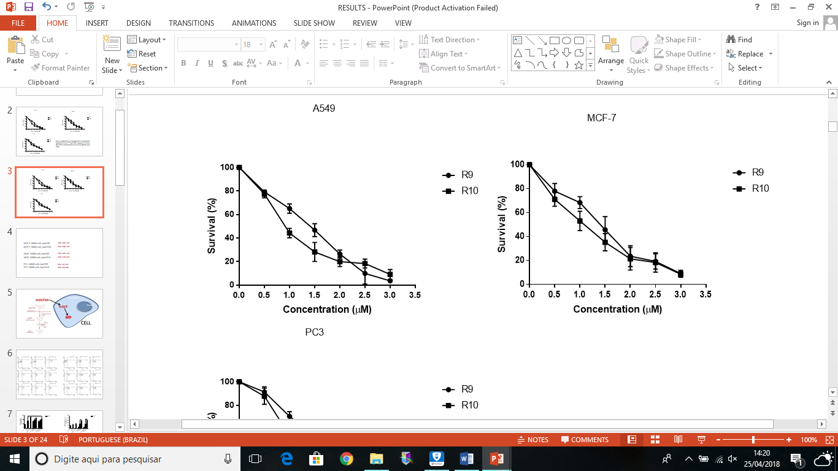
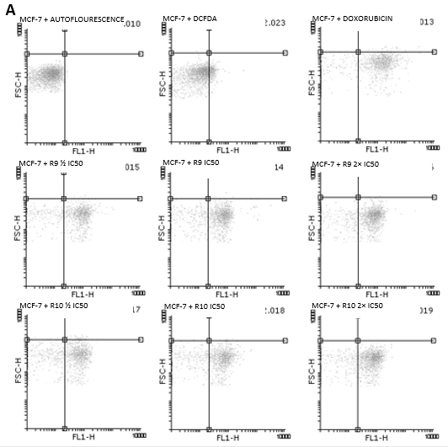
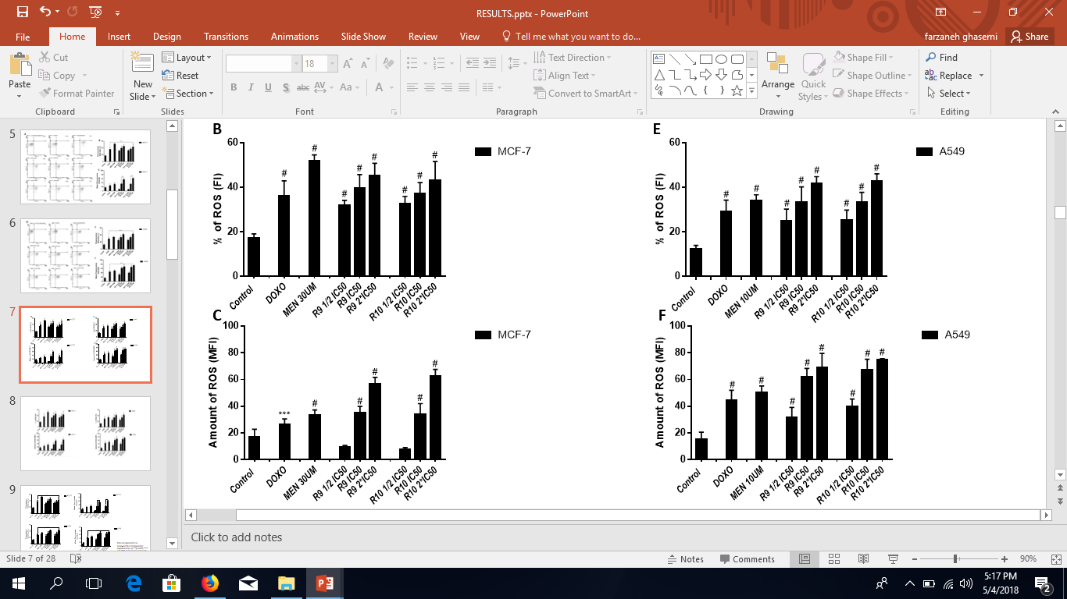
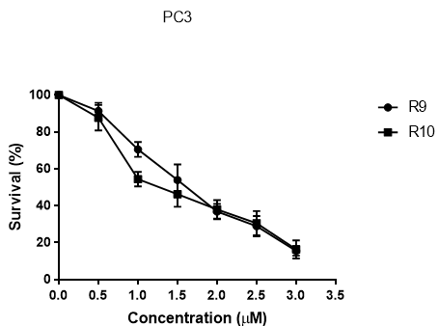
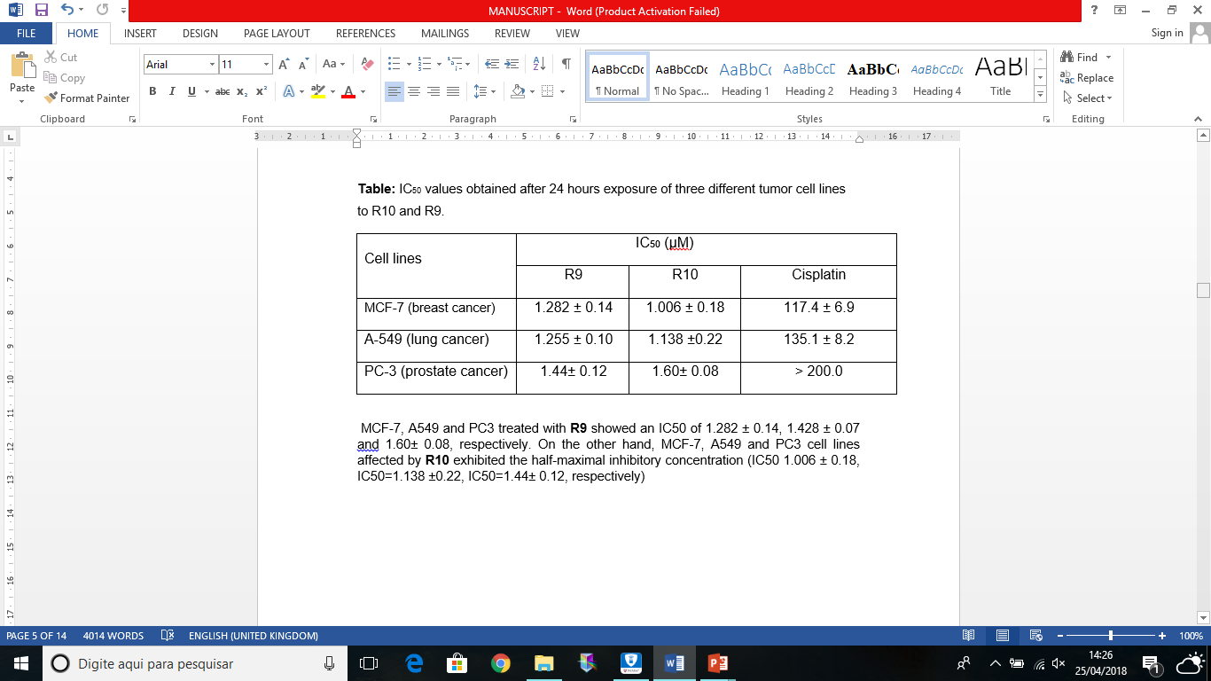
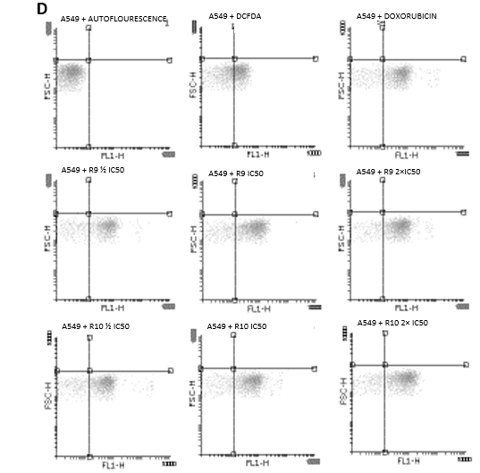
Evaluation of the Antitumoral Effects and Mechanisms of Action of Novel Dinuclear Cu(II) Complexes on Tumorigenesis
Zeinab Ghasemishahrestani¹, Simone Santiago Carvalho de Oliveira², Diana Mariani³, Nicolás A. Rey⁴, Andre Luis Souza dos Santos² , Marcos Dias Pereira¹
¹Laboratório de Citotoxicidade e Genetoxicidade (LCG), Departamento de Bioquímica Centro de Tecnologia (CT) Universidade de Federal do Rio de Janeiro.
²Laboratório de Investigação de Peptidases (LIP), Centro de Ciências da Saúde (CCS), Universidade Federal do Rio de Janeiro (UFRJ).
³Laboratório de Virologia Molecular, UFRJ
⁴Laboratório de Síntese Orgânica e Química de Coordenação Aplicada a Sistemas Biológicos (LABSO-BIO), Departamento de Química da Pontifícia Universidade Católica do Rio de Janeiro
INTRODUCTION
RESULTS AND DISCUSSIONS
Cancer is one of the major causes of death across the world. Hence, development of chemotherapeutic strategies involving novel antitumor agents has been the focus area of cancer treatment. The anticancer activities of copper complexes have been the focus of much research to discover novel anticancer agents. The main mechanism of action of these complexes is thought to involve interaction with DNA and the generation of reactive oxygen species (ROS). Current study deals with the effects of two novel dinuclear copper(II) complexes (R9 and R10) on cytotoxic effects on breast (MCF-7), lung (A549) and prostate (PC3) cancer cell lines.
MCF-7, A54MCF-7, A549 and PC3 treated with R9 showed an IC50 of 1.282 ± 0.14, 1.428 ± 0.07 and 1.60 ± 0.08, respectively. On the other hand, the cell lines MCF-7, A549 and PC3 affected by R10 exhibited half of the maximal inhibitory concentration (IC 50 1.006 ± 0.18, IC 50 = 1.138 ± 0.22, IC 50 = 1.44 ± 0.12, respectively) (table 1).
The Flow cytometry assay for MCF-7 and A549 at three different concentrations ½ IC50 (0.5μM), IC50 (1μM) and 2×IC50 (2μM) illustrated that cells tested with R9 and R10 presented ROS accumulation in a dose-dependent manner (Fig2A ,Fig 3 D).
Although In case of testing compounds R9, R10, at the concentration of 1μm (IC50) in MCF-7, the percentage of cells that affected by ROS was lower than the Menadione (Fig2-B), but the amount of ROS produced by these compounds was the same as the ROS produced by Menadione (Fig2-C). On the other hand, in A549, the percentage of ROS-affected cells and the amount of ROS was almost equal to Menadione at the concentration of IC 50 (Fig 3 E, F).
Both R9 and R10 trigger generation of ROS, resulting in cell death. It was confirmed that the level of ROS increased in MCF-7 cells to 57.43% after R9 and 55.10% after treatment with R10. and A549 cells to 72.42% and 72.12 after treatment with R9 and R10 respectively. Fig. 2,3-B, C, E, F)
AIM
Figure 2. Cell viability and ROS production by MCF-7 cells treated with R9 and R10. Cells were plated in 24-well plates and treated for 24 hours in presence of ½ IC50,IC50,2× IC50 of each compound or DMSO (0.2% v/v), used as control. Results were obtained by flow cytometer as described in Materials and Methods. Panels A is representative results of a series of three independent experiments. In Panel B and C, bars are represented as mean±S.E.M of 3 independent experiments (n=3). ***p<0.001, # p<0.0001 compared to control. All statistics were performed by two-way ANOVA using Dunnet.
The current study deals with the effects of novel Cu(II) derivatives in 3 different cancer cell lines for their cytotoxic effects on the cancer cell lines MCF-7,A549,PC3 to find their mechanism of action.
Figure 1. MTT assay of MCF-7,A549 and PC3 cells treated for 24 hours in presence of the products R9 and R10 (panel A) and Experiments were performed as described in Materials and Methods. Data are represented as mean±S.E.M of 3 independent experiments (n=3).****p<0.0001 compared to control. All statistics were performed by two-way ANOVA using Dunnet.
.
MATERIAL AND METHODS
CONCLUSION
MCF-7, A549 and PC3 cell lines were analyzed using MTT assay and Flow Cytometry intracellular ROS production assay.
Cells. The human breast cancer cell line MCF-7 was obtained from the Cell Bank of Hospital Universitário Clementino Fraga Filho, UFRJ, Brazil, and was maintained in DMEM (Dulbecco’s modified Eagle’s medium; Invitrogen, São Paulo, SP, Brazil) supplemented with 10% (v/v) FBS (fetal bovine serum; Invitrogen) and L-glutamine.
MTT assay. Cells were seeded in 96-well plates (1 x 10⁴ cells/well) and grown to confluence. After 24 h, the cells were incubated with 5 mg/mL MTT reagent (3,4,5-dimethiazol-2,5-diphenyltetrazolium bromide for 3 h. Thereafter, the formazan crystals were dissolved in DMSO, and the absorbance at 560 nm was evaluated using a Microplate reader PowerWave HT.
Cell viability and ROS production. Cells were seeded in 24-well plates (1 x 10⁵ cells/well)and treated with compounds for 24 hours. After this period, 10 µM DCFDA was added and cells were incubated for 30 minutes. Then, the medium was removed, the cells were hashed, and suspended in phosphate buffer solution containing 1% bovine serum albumin. Fluorescence analysis was performed on a flow cytometer (BD FACSCalibur ™) where 10,000 events were counted per sample.
MCF-7, A549 and PC3, all presented high cytotoxicity effect against R9 and R10 with IC50 around 1µM.
Percentage of ROS and the amount of ROS produced by R9 and R10 was high when compared to control.
Cytotoxicity and induction of high amount of ROS may considered R9 and R10 a potential therapeutic agent for breast, lung and prostate cancer.
We will further work on these compounds to understand the exact mechanism of action of these novel complexes to pursue our investigation on their effects in vitro and in vivo.
Table 1: IC₅₀ values obtained after 24 hours exposure of
three different tumor cell lines to R10 and R9.
Figure 3. Cell viability and ROS production by A549 cells treated with R9 and R10. Cells were plated in 24-well plates and treated for 24 hours in presence of ½ IC50,IC50,2× IC50 of each compound or DMSO (0.2% v/v), used as control. Results were obtained by flow cytometer as described in Materials and Methods. Panels D is representative results of a series of three independent experiments. In Panel E and F, bars are represented as mean±S.E.M of 3 independent experiments (n=3). ***p<0.001, # p<0.0001 compared to control. All statistics were performed by tow-way ANOVA using Dunnet.
REFERENCES
1-Marzano C, Pellei M, Tisato F, Santini C (2009) Copper complexes as anticancer agents. Anti Cancer Agents Med Chem 9(2):185–211
2-Copper (II) complexes of bidentate ligands exhibit potent anti-cancer activity regardless of platinum sensitivity status Mohamed Wehbe1,2 & Cody Lo1 & Ada W. Y. Leung1 & Wieslawa H. Dragowska1 & Gemma M. Ryan1 & Marcel B. Bally1,2,
3-Desoize B (2004) Metals and metal compounds in cancer treatment. Anticancer Res 24(3A):1529–1544
Email:
Farzaneh.ghasemi.sha@gmail.com
marcosdpufrj@gmail.com
andre@micro.ufrj.br

