Slide 1
Asthma Management According to
BTS (British Thoracic Society) guidelines
at Ealing Hospital
Audit Number: IM.EH.17.016
Audit Team
Dr.Soresi Simona, Consultant (Respiratory)
Dr.Tahira Adnan, Speciality Registrar (Respiratory)
Sue Langley, CNS (Respiratory)
Dr.Saira Zafar, Clinical Fellow(Buckingham)
BY
Dr.suryateja chekuri
MD clinical fellow
University of Buckingham

Slide 2
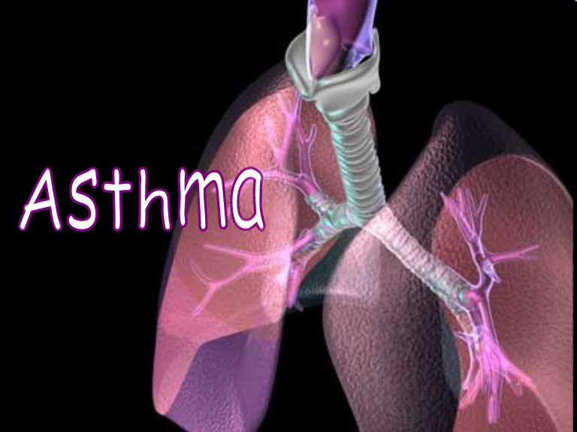

Slide 3
Reason for audit
1)To assess whether patients with acute asthma are been managed according to BTS guidelines.
2)To reduce the number of patients who are readmitted following discharge.

Slide 4
Criteria/Standards being audited
All patients should have their inhaler technique assesses prior to discharge.
All patients have their medications assessed. The importance of medications adherence to good asthma control should be reinforced to patients prior to discharge.
A written asthma action plan for how to manage care should be provided to patients and families/carers.
Triggering and exacerbating factors in the patients overall environment should be considered.
Subsequent care: follow-up in the community to be arranged within 2 working days plus specialist care according to criteria within 2 weeks.
Methodology and Sampling
A retrospective data collected for the patients admitted with asthma from 1st Jan 2017 till 31st Jan 2017
Patient notes collected from medical records department.
The results compared with the previous audit conducted in Sep-Oct, 2016 and National audit.
Total number of patients for the months of Sep-Oct, 2016 Previous Audit : 41 and National Audit : 40
Total number of patients for the month of jan-17 : 29
4 patients were excluded as they were in paediatric age group and 5 patients were excluded as the data was not available. So total patients considered for the month of Jan -17 : 20

Slide 5
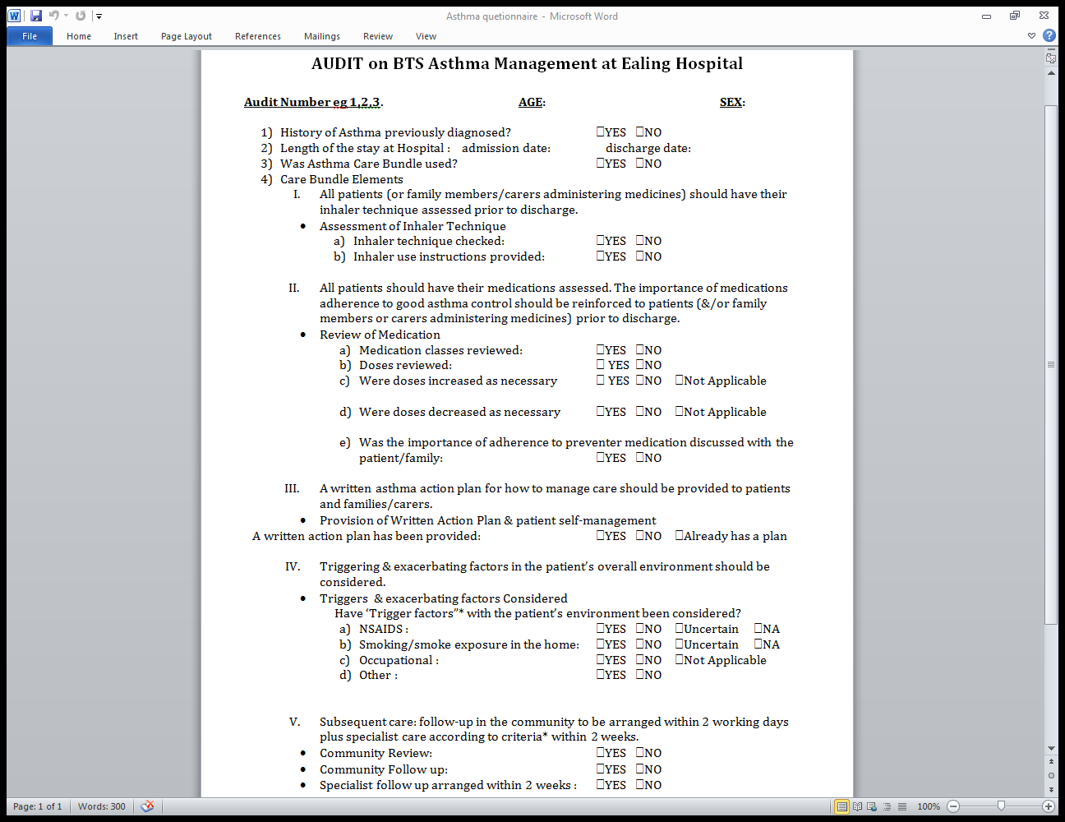
Questionnaire

Slide 6
INTRODUCTION
Asthma is a common condition which produces a significant workload for general practice, hospital outpatient clinics and inpatient admissions.
Much of this morbidity relates to poor management particularly around the use of preventative medicine.
In 1999 the British Thoracic Society (BTS) and the Scottish Intercollegiate Guidelines Network (SIGN) agreed to jointly produce a comprehensive new asthma guideline.
Between 2004 and 2012 sections within the guideline were updated annually. Subsequently, updating moved to a biennial basis, beginning with the 2014 update.
The new guideline was issued in 2016.
All updates were made available on both the BTS (www.brit-thoracic.org.uk) and SIGN (www.sign.ac.uk) websites. Any updates to the guideline in the period between scheduled updates will be noted on the SIGN and BTS websites.

Slide 7
This guideline provides recommendations based on current evidence for best practice in the management of asthma.
The guideline considers asthma management in all patients with a diagnosis of asthma, although there is less evidence available for people at either age extreme.
The guideline does not cover patients whose primary diagnosis is not asthma, for example those with chronic obstructive pulmonary disease or cystic fibrosis, but patients with these conditions can also have asthma.
This guideline will be of particular interest to healthcare professionals involved in the care of people with asthma including general practitioners, consultants and specialists in respiratory medicine, nurses and pharmacists.
The guideline will also be of interest to people with asthma, their parents and carers; those who interact with people with asthma outside of the NHS, such as teachers; voluntary organisations with an interest in asthma; and those planning the delivery of services in the NHS in England, Wales, Northern Ireland and Scotland.

Slide 8
Epidemiology
Key Facts
5.4 million people in the UK are currently receiving treatment for asthma: 1.1 million children (1 in 11) and 4.3 million adults (1 in 12).
Asthma prevalence is thought to have plateaued since the late 1990s, although the UK still has some of the highest rates in Europe and on average 3 people a day die from asthma.
In 2015 (the most recent data available) 1,468 people died from asthma.
The NHS spends around 1 billion a year treating and caring for people with asthma

Slide 9
Asthma across the UK
In Northern Ireland 182,000 people (1 in 10) are currently receiving treatment for asthma. This includes 36,000 children and 146,000 adults.
In Scotland, 368,000 people (1 in 14) are currently receiving treatment for asthma. This includes 72,000 children and 296,000 adults.
In Wales 314,000 people (1 in 10) are currently receiving treatment for asthma. This consists of 59,000 children and 256,000 adults.
In England, 4,500,000 people (1 in 11) are currently receiving treatment for asthma. This consists of 932,000 children and 3,600,000 adults.

Slide 10
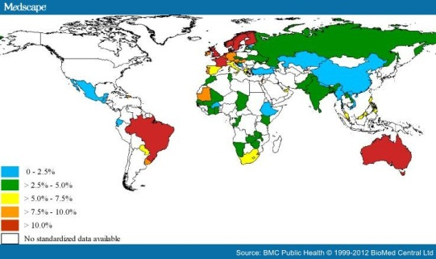
Asthma Globally

Slide 11
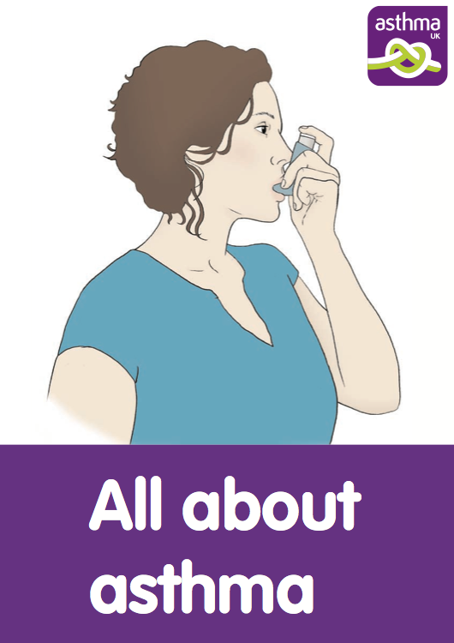
ASTHMA
Presence of symptoms (more than one of wheeze, breathlessness, chest tightness, cough) and of variable airflow obstruction.
Airway hyper -responsiveness and airway inflammation
Asthma was recognized as early as Ancient Egypt.
The word asthma is from the Greek ἅσθμα, asthma which means "panting

Slide 12
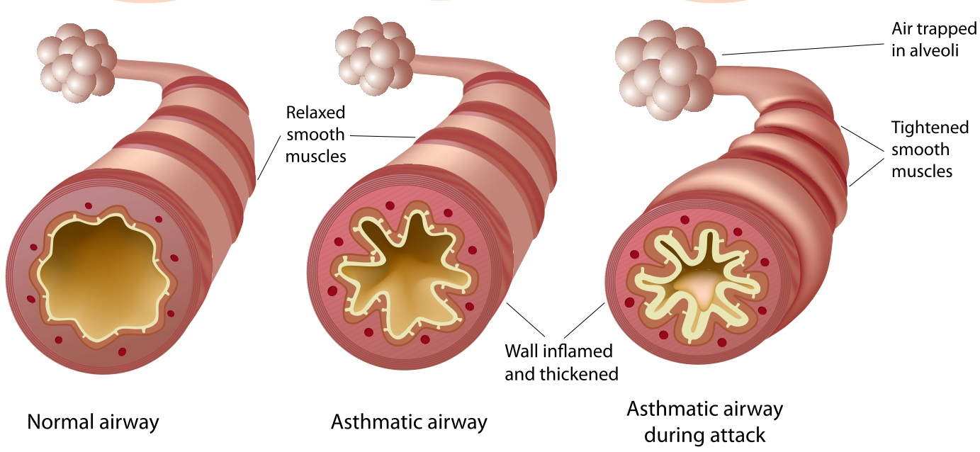
ASTHMA

Slide 13
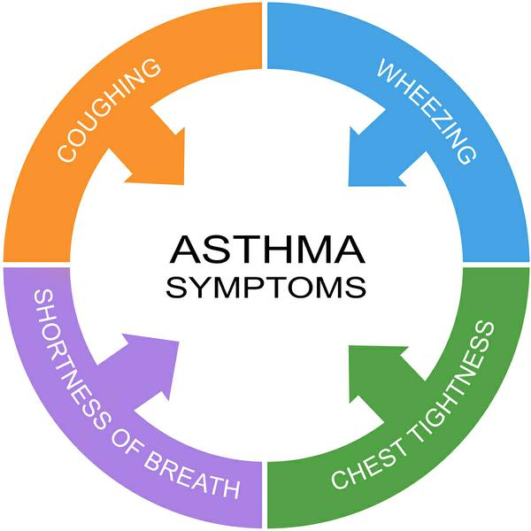

Slide 14
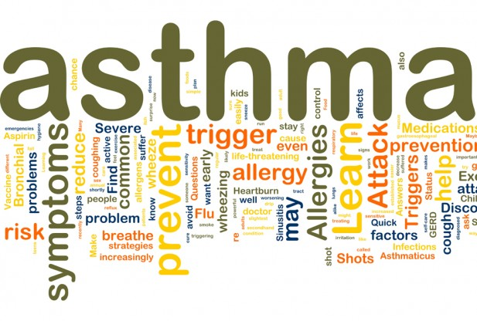
causes
Environmental
Genetic
Medical conditions

Slide 15
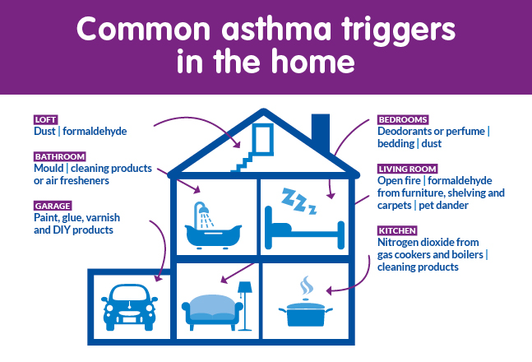

Slide 16
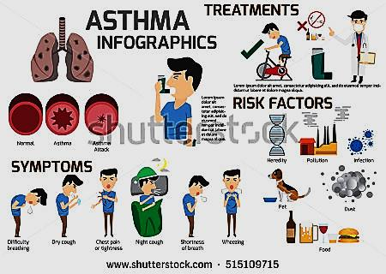

Slide 17
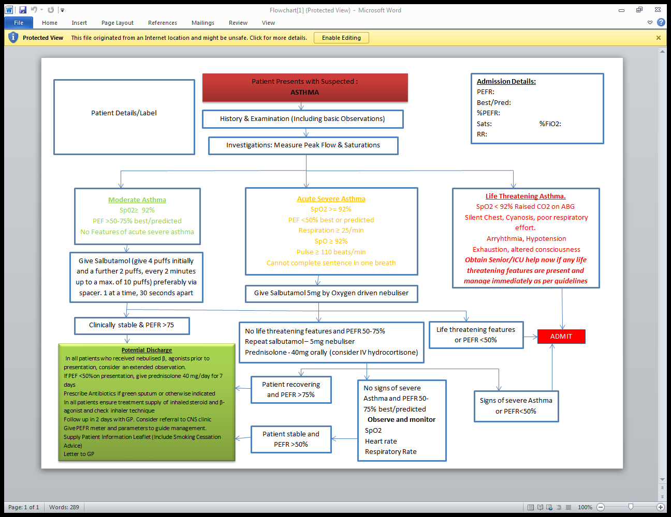
ASSESSMENT

Slide 18
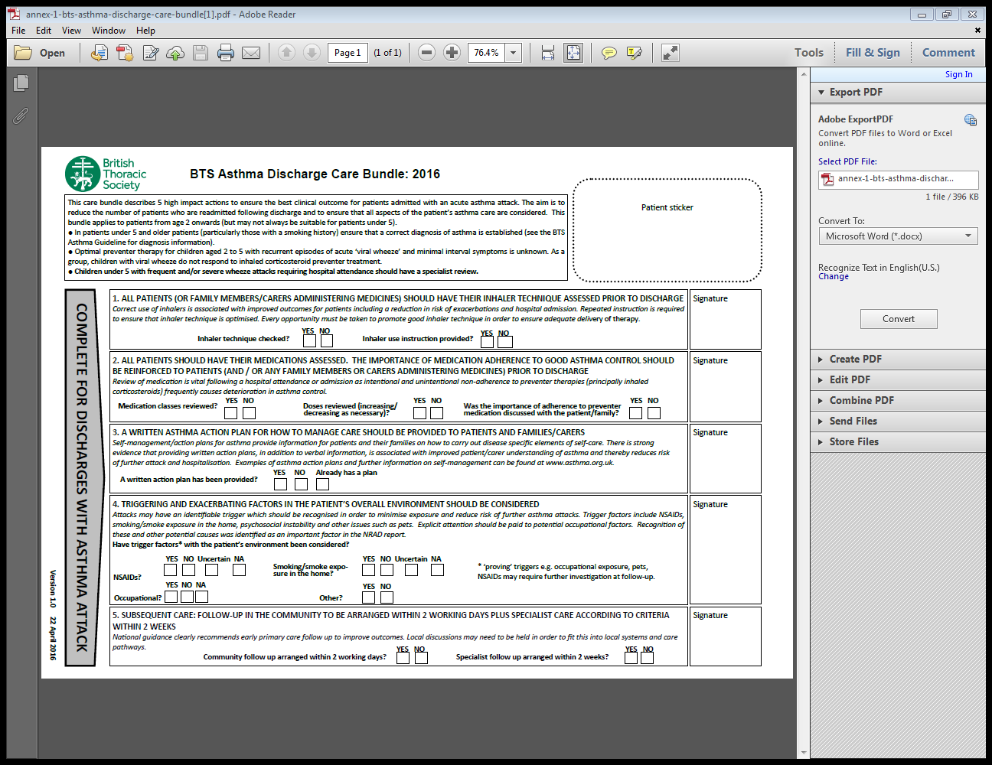
BTS Care Bundle

Slide 19
Results/Findings

Slide 20
Gender

Slide 21
Previous History of Asthma

Slide 22
Asthma Care Bundle

Slide 23
Inhaler Technique Assessment Prior to Discharge

Slide 24
Length of Stay (days)

Slide 25
Medication Assessment

Slide 26
Written Asthma Action Plan

Slide 27
Subsequent Care (community)

Slide 28
Triggering & Exacerbating Factors

Slide 29
 | Ealing (sep-oct,16) | National | Ealing (Jan,17)
Gender | Male 49% | Male 31% | Male 30 %
 | Female 51% | Female 69% | Female70%
Length of stay | Median 2days (1-5) | Median 2days (1-4) | Median 4days (1-7)
Previous asthma diagnosis | Yes 98% | Yes 89% | Yes 95%
 | No 2% | No 11% | No 5%
Asthma care bundle used | Yes 80% | Yes 28% | Yes 65%
 | No 20% | No 72% | No 35%
Care bundle elements:
Inhaler Technique | 73% | 49% | 70%
Medications review | 73% | 54% | 70%
Written action plan | 20% | 31% | 35%
Triggers considered | 68% | 59% | 60%
Community review | 37% | 46% | 35%
Specialist follow up (CNS) | Yes 66% | Yes 64% | Yes 55%
 | No 34% | No 36% | No 45%

Slide 30
Conclusion
There has been a significant increase in female asthmatic patients from 51% in Sept, 2016 to 70% in Jan, 2017 which is keeping up with the national statistics.
*The Median stay duration in the hospital has increased from 2 days to 4 days in the same duration compared to the national statistics of 2 days.
There has been increased detection of new cases of Asthma as 5% new cases were detected compared to 2% in the previous audit conforming to the national statistics of 11%.
There has been significant decrease in the Asthma care bundle used which has dropped to 65% from 80% in the previous audit but still is significantly better than the national statistics of 28%.

Slide 31
Of the care bundle elements noted, the following data has been collected.
Inhaler techniques: There has been a significant decrease from 73% in the previous audit to 70% in current practice but is still better than the national statistics of 49%.
Medication review: There has been consistency in the review of medications from the previous audit from 73% to 70% and is significantly better than the national statistics of 54%.
Written action plan: There has been improvement from 20% to 35% but is still below the national statistics of 31%.
Community review: There has been a decrease from 37% to 35% and is still below the national statistics of 46%.
Community follow up: There has been a decrease in the follow up from 66% to 55% which is still significantly lower than national statistics of 64%.

Slide 32
Rag rate the Audit Results
RAG Rate Your Audit Results
Please state the rag rating for your audit results. You can establish this by considering if the results are acceptable for your service and if not what risks these results pose. You are establishing if the care is safe and effective for your audit results
Green = Care is safe and effective (but you should still have an action plan to improve the quality).
Amber = There is an issue with clinical care and your action plan must include a re-audit within 6 months
Red = There is a serious clinical issue and this must be reported on the Divisional Risk Register and discussed at Divisional Clinical and Risk Meetings.
Rating: | Amber

Slide 33
Recommendations
Based on the data collected, the following are the recommendations:
The stay in the hospital needs to be reduced from 4 days to the national average of 2 days.
The community follow up and review for these patients need to be improved significantly.
Need for continuing the audit on asthma care bundle.

Slide 34
Clinical Audit Action Plan
Issue identified | Action to be taken | Name of person responsible | Date action to be completed by | Progress with implementing action
Use of Asthma care bundle | Teaching of Asthma care bundle and new Asthma guidelines | Dr.Soresi Simona, Consultant Dr. Tahira Adnan, Registrar Sue Langley, Resp CNS | From August 2017 till Dec 2017 Different teaching sessions for A&E AMU Wards | Re audit Jan 2018
Community Review | Business proposal for community Respiratory Nurse | Respiratory Lead Prof Mathur | Ongoing | Ongoing

Slide 35
Acknowledgement
I acknowledge with gratitude my indebtedness to Consultant Dr. Rajat Matur for introducing me to the respiratory department and giving me the opportunity to work on this project and gave valuable guidance for preparing this project.
My sincere thanks and appreciation also goes to Dr. Tahira Adnan, whose contribution in thought- provoking suggestions and support helped me to organize my work especially in writing the findings of the outcome, she is one of the best doctors I have ever worked in as a team.
Furthermore I would also like to acknowledge with much appreciation the supportive role of staff at Ealing Hospital, who granted me the access to all the available resources and the permission to use all required information to finish the audit.
This is being my first effort, the possibilities of errors and omissions in its contents and presentation cannot be completely ruled out. I shall, however, grateful to my supervisor from Ealing Hospital, Dr. Vijay Manglam from his suggestions for its improvement.
While I have taken efforts in completing the audit, it would not have been possible without the relative support of my parents and my brothers, whom I would like to extend my sincere thanks.

Slide 36

Thank You

