Slide 1

Course seminar
On
INTERCROPPING AND INTEGRATED NUTRIENT MANAGEMENT IN PULSES
Mr. Rajesh Kumar Doutaniya
Reg.No.-R16150001
Supervisor
Prof.Y.K. Ghilotia
DEPARTMENT OF AGRONOMY
School of Agriculture,
OPJS University, Churu (Rajasthan)

Slide 2
Contents
Introduction
Intercropping ; it benefits and practices
Current Scenario of INM
Integrated Nutrient Management
Constraints
Conclusion

Slide 3
INTRODUCTION

Slide 4
Intercropping :
Intercropping is a multiple cropping practice involving growing two or more crops in proximity. The most common goal of intercropping is to produce a greater yield on a given piece of land by making use of resources or ecological processes that would otherwise not be utilized by a single crop.
Types of intercropping practices :
1. Multi-intercropping :
2. Relay intercropping :
3. Row intercropping :
4. Strip intercropping :

Slide 5
Benefits of Intercropping :
Reduces the insect pest populations and diseases.
Reduces soil erosion.
Reduces the weed population
Conservation of soil moisture
Utilizes the farm area more efficiently
Provides two or more different food crops
Use of space between main crop
Improve the soil fertility

Slide 6
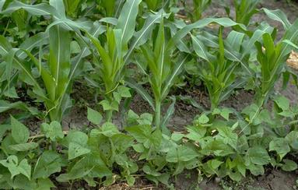
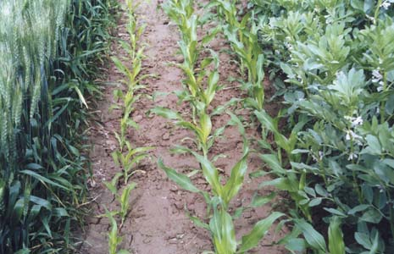
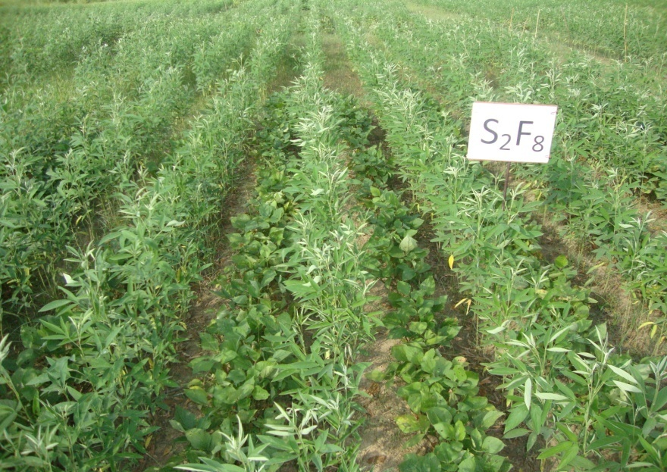
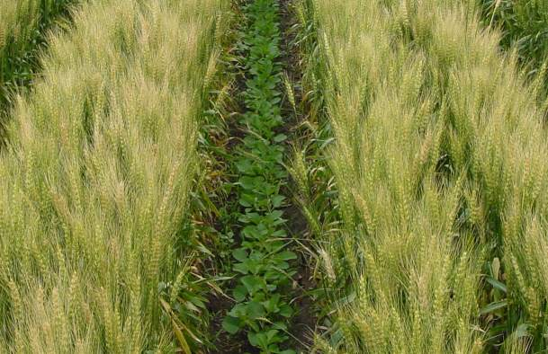
Some pictures of intercropping systems

Slide 7

Scenario of INM

Slide 8
Potential & Present Utilization of Organic nutrients in India (Million Tonne)
Organic Manures | Achievable Potential |  | Present Utilization
 | Product | Nutrient (NPK) | Product | Nutrient (NPK)
FYM | 250 | 3.75 | 100 | 1.5
Crop residue / Rural Compost | 150 | 2.25 | 100 | 1.5
City Compost | 14 | 1.87 | 1.5 | 0.2
Biogas Slurry | 28 | 1.20 | 7.0 | 0.3
Bio Fertilizer | 0.03 | 0.72 | 0.01 | 0.24
Green manuring | 230 lakh ha | 1.16 | 20.51 lakh ha | 0.01
Total | 442.03 | 10.75 | 208.51 | 3.75
Jain (2007)

Slide 9
Fertilizer Consumption in India
(NPK)
Year | Consumption (in lakh tones) |  |  |  | Per hectare consumption (kg/ha) | Food production (mt)
 | N | P | K | Total
2006-07 | 137.73 | 55.43 | 23.35 | 216.51 | 111.8 | 217.30
2007-08 | 144.19 | 55.15 | 26.36 | 225.70 | 116.5 | 230.78
2008-09 | 150.9 | 65.06 | 33.13 | 249.09 | 127.2 | 233.88
2009-10 | 155.8 | 72.74 | 36.32 | 264.86 | 135.3 | 218.20
Economic survey, 2011

Slide 10
Fertility Status of Indian Soils
Nutrient
Extent of deficiency
(low to medium soil available nutrient status)
Nitrogen
89%
Phosphorous
80%
Potassium
50%
Sulphur
40%
Micronutrients
Zinc
48%
Boron
33%
Iron
12%
Manganese
5%
Jain (2007)

Slide 11
WHAT IS INM ?
Integrated Nutrient Management (INM) involves tapping of all the major sources of plant nutrients be it soil nutrient reserve, mineral fertilizers, bulky organic manures, compost, green manures, biological inoculants etc.; in a judicious way and to ensure their efficient use without sacrificing the soil productivity for the future generations.
Biofertilizer and Organic Farming, 2004

Slide 12
NEED OF INM IN PULSES
Nutrient uptake in pulses has been a naturally occurring integrated phenomena owing to Rhizobium symbiosis and VAM associations. In present context following situations may be visualized for INM in pulses.
Intensive agriculture (replenishing soil health).
Low and imbalance fertilizer application.
Wide spread responses of P,S and micronutrients like
Zn, Fe, B and Mo.
Deterioration of native soil property( fear of nutrient
mining in pulses).
Pulses are important crop component in diversification

Slide 13
The key objectives of INM
To maintain or enhance soil productivity through balanced use of mineral fertilizers combined with organic and biological sources of plant nutrients.
To improve the stock of plant nutrients in the soil.
To improve the efficiency of plant nutrients, thus limiting losses to the environment.
To improve physical conditions of soils.

Slide 14

1. Improving resource use efficiency
2. Enhances food grain production
3. Maintains soil fertility and soil health (Physical, Chemical & Biological)
4. Restore organic matter and enhance nutrient use efficiency
5. Sustain crop productivity
6. Increases farmer’s income

Slide 15
Components of the INM
Soil nutrients.
Chemical fertilizers.
Organic manure, soil amendments and crop residues.
Green manure.
Biological nitrogen fixation.
Biofertilizers.

Slide 16
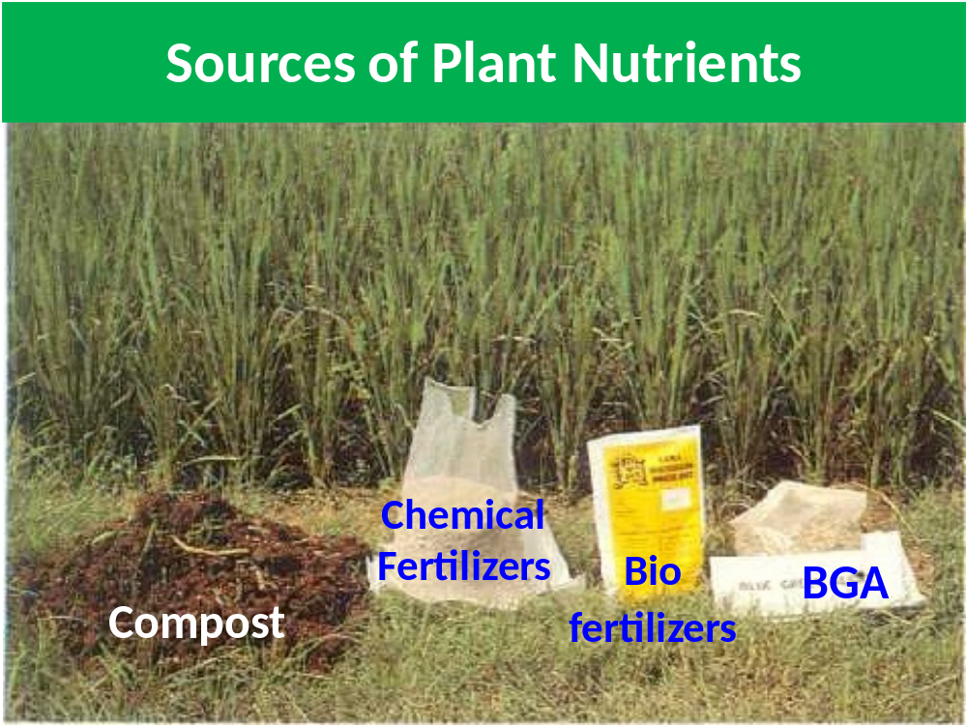

Slide 17
Constraints

Slide 18
Common constraints encountered by the
farmers in adoption of INM technology
are as follows
Non
-
•
availability of FYM
•
Difficulties in growing green manure crops
Non
-
•
availability of biofertilizers
Non
-
•
availability of soil testing facilities
•
High cost of chemical fertilizers
Non
-
•
availability of water
•
Lack of knowledge and poor advisory services
Non
-
•
availability of improved seeds
•
Soil conditions

Slide 19
CONCLUSION
Scientific approach of intercropping increases the total productivity per unit area and time, besides equitable and judicious utilization of land resources and farming inputs including labour. One of the main reason for higher yield in intercropping is that the component crops are able to use natural resources more than grown separately.
Integrated nutrient management (INM) improves the growth, yield and quality of pulses along with increasing nutrient uptake and its availability in soil and also giving better economic return. There is an urgent need to demonstrate the technology, strengthening extension, distribution channels and administrative manageability for the successful promotion of the technology under existing structure.

Slide 20
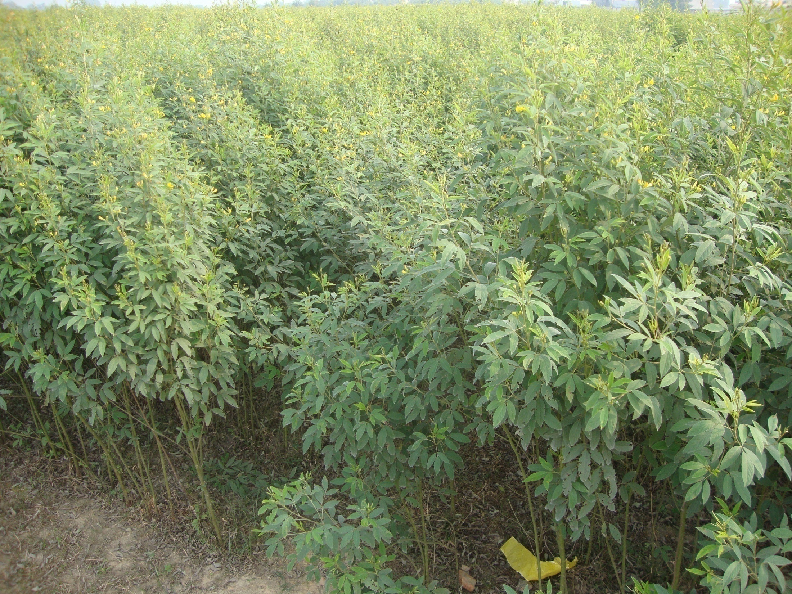
Thanks

