Slide 1


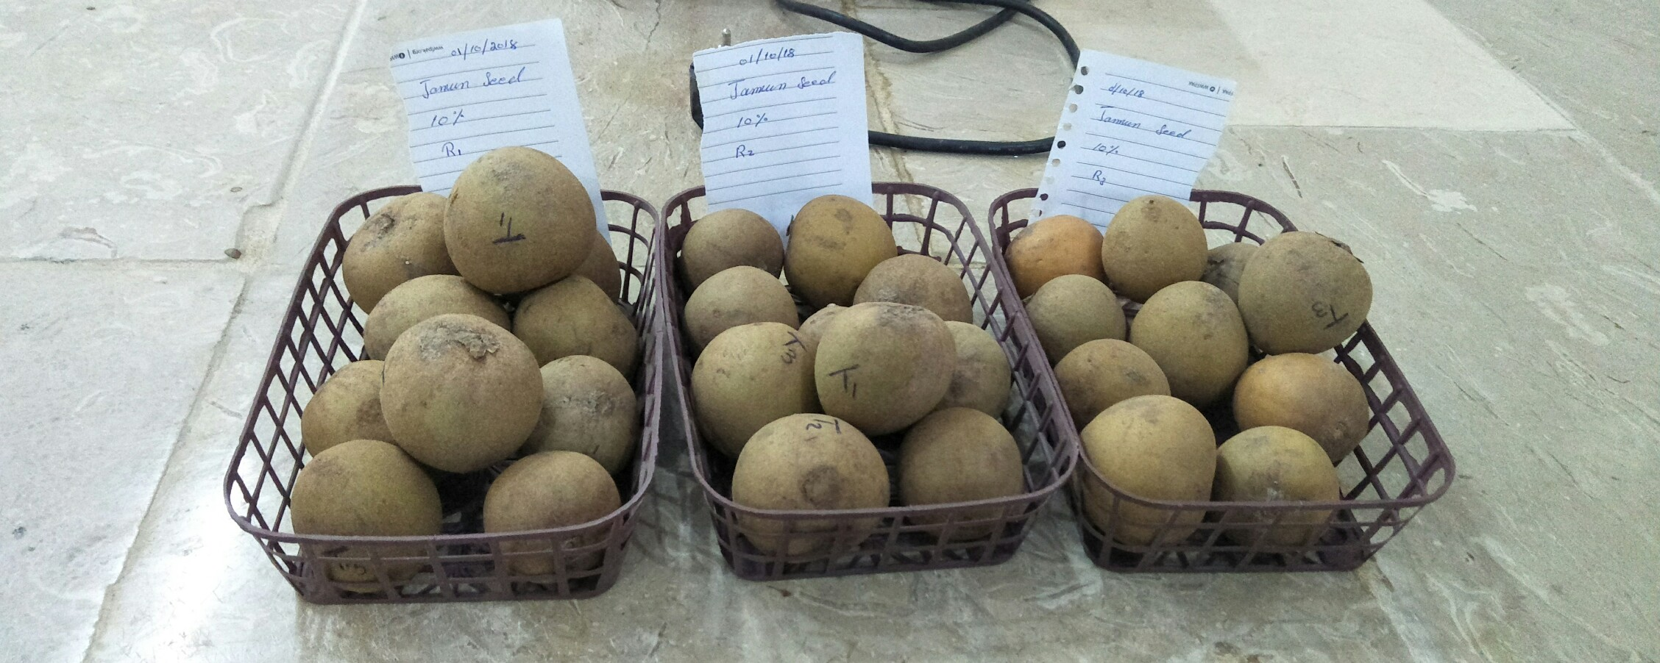
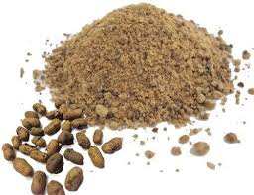
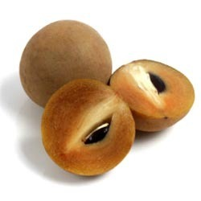
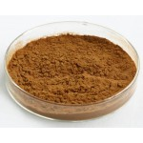
Effects of jaman seed and pomegranate peel extracts on physico-chemical and post-harvest qualities of chiku (Manilkara zapota L.) fruit during storage.
Shahzad Sabir, Ghulam Khaliq, Atrif Saleh, Mohaib ullah
Lasbela University of Agriculture, Water & Marine Sciences Uthal Balochistan
Abstract
Effect of jaman seed and pomegranate peel extract were studied on physico-chemical characteristic of chiku fruit during storage. The aim of this study was to enhance the shelf-life of economically important fruit of Lasbela district. Jaman seed extract and pomegranate peel extract significantly reduced the weight loss and decay incidence of chiku fruit. Moreover, the same treatments potentially decreased the soluble solid concentration of chiku fruit. These treatments increased the shelf-life and improved quality of chiku during storage. Pomegranate peel treatment was the most effective in preservation of chiku. These results revealed that jaman seed and pomegranate peel extracts can be used for maintaining the postharvest life of chiku fruit during storage.
Introduction
Sapodilla (Manilkara zapota L.) is an economically important species of the Sapotaceae family native to tropical America. As a rainforest tree known as the chickle tree, it has a long history of human use (Simpson et al., 1995). The name Sapodilla is derived from the Spanish word zapotilla, meaning "small sapote." It is a popular fruit crop presently and widely cultivated in most tropical countries across the globe. It is an important adjunct in ice cream and milk shakes in its fresh form. Also fruits in general are important sources of antioxidants, vitamins and minerals, and usually have industrial and medicinal applications. Physiologically, sapodilla fruit exhibit a climacteric behavior in postharvest. Ripening occurs rapidly and is characterized by a significant increase in the respiration rate and ethylene production, all of which classify it as a highly perishable fruit with a short shelf life, making its commercialization more difficult. Depending on the variety and the agro-climatic conditions of production, the fruit ripens at 26 °C between 8 and 10 days after harvesting (Morais et al., 2006).
Materials and Methods
Chiku fruit in hard mature stage were collected from the coconut farm agriculture research station Uthal. Jaman seeds were collected from Quetta and pomegranate peel from District Panjgur Balochistan.Fruit were washed with 0.01% sodium hypochlorite for 2 min. The chiku were randomly divided into five lots. The first lot were dipped in distilled water containing Tween-20 and were used as a control. The other four lots were dipped in the corresponding solutions. Chiku fruit were dipped in the solutions for 5 min. After dipping treatments, fruit were air-dried for 1 h. All fruits were packed in plastic boxes and then stored at 6 ± 1ºC for 28 days and after that the samples transferred to 25± 2 ºC for additional 5 days shelf life. The data were collected before treatment (day 0) and at 7 day intervals.
Results and Discussion
Fig. 1. Effect of jaman seed and pomegranate peel extracts on weight loss and soluble solid concentration of chiku fruit during storage.
Vertical bars indicate standard error of means for three replicates.
The results in figures 1 and 2 indicated that the chiku fruits (M. zapota) stored for four consecutive weeks at 6 ºC remained firm when treated with pomegranate peel and jaman seeds extract compared to the control fruit. Similarly, different concentration of pomegranate peel and jaman seeds extract at (10 and 20%) significantly (P ≤ 0.05) inhibited the weight loss compared with chiku fruits treated with control treatment. Moreover, the results of present study are in agreement with the results of Anitescu et al., (1997). who reported that plant extracts reduced weight loss. It is suggested that soluble solid concertation may decreased the permeability of chiku fruits that resulted into enhancing the firmness which resulted into increases in firmness and shelf-life of fruit. Beside these soluble solid concentration is also reduced when fruits of chiku fruit treated with pomegranate peel (10 and 20%), that resulted into significant differences in quality of these fruits compared with jaman seed extract and controlled treatments (Figs. 1 and 2). Saltveit et al.,, (2002).explained that weight loss and soluble solid concentration affect the fruit quality during storage. To our knowledge, it is the first study in which chiku fruits treated with pomegranate peel and jaman seeds extract for enhancing the shelf-life of chiku fruit.
Conclusions
In conclusion, both treatment pomegranate and jaman seed extract have the ability to preserve and extend the shelf life of chiku fruit by reducing weight loss, decay incidence and soluble solid concentration. Pomegranate peel extract is useful to prolong the shelf life and protect the fruit from quick deterioration.
Acknowledgements
Shahzad Sabir gratefully acknowledges the Lasbela University of Agriculture Water and Marine Sciences, Uthal Balochistan, Pakistan for financial support and during his M.Phil studing.
References.
Simpson, B. B., & Ogorzaly, M. C. (1995). Spices, herbs, and perfumes. Economic Botany Plants in our World. 2nd Ed. New York. McGraw-Hill, 278–301.
Morais, P. L. D. D., Lima, L. C. D. O., Alves, R. E., Alves, J. D., & Alves, A. D. P. (2006). Ripening of sapodilla (Manilkara zapota L.) submitted to 1methylcyclopropene. Revista Brasileira de Fruticultura, 28(3), 369– 373.

