Slide 1
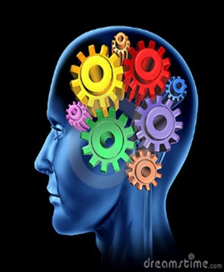
Emotional Intelligence for Nurses
Presented by
John Ray Broussard

Slide 2
Introduction
Gaining the skill of TOTAL THOUGHT/EMOTION CONTROL 24/7 ON OR OFF THE JOB.
Gaining control of your repetitive thoughts due to Pre & Post catastrophic events, by simply changing the pattern of one individual thought or mental picture at a time.
Mission Statement: My Mission is to inspire others to happiness within and peace of mind body and soul connection through EI, and Paradigm shifts in thinking.
Notes:
How presentation will benefit audience: Adult learners are more interested in a subject if they know how or why it is important to them.
Presenter’s level of expertise in the subject: Briefly state your credentials in this area, or explain why participants should listen to you.

Slide 3
Disclosure
Owner and Manager of Inner-Works, LLC
All content of this presentation will be educational-based and will not promote or represent my commercial relationship

Slide 4

Principles of Emotional Intelligence
Self – Awareness
Self – Regulation
Self – Motivation
Social Awareness
Social Skills

Slide 5
SOCIAL SKILLS
INFLUENCE - Wielding effective tactics for persuasion We are skilled at persuasion Fine-tune presentations to appeal to the listener Use complex strategies like indirect influence to build co COMMUNICATION - sending clear and convincing messages. Are effective in give and take, registering emotional cues in attuning your message Deals with difficult issues straight forward LEADERSHIP - inspiring and guiding groups and people Articulate and group enthusiasm for a shared vision and mission Step forward to lead as needed regardless of position Guide the performance of others while holding time accountable Lead by example

Slide 6
EMOTIONAL INTELLIGENCE
Objective - to grasp the latest proven changes of brain functions.
Dr. Daniel Goleman, is the leading pioneer in Emotional Intelligence studies and training.
EI has been proven with a designed skull cap tied to MRI machine and has discovered some amazing things about the brain.
Empathy - being able to feel and since what others are feeling.
Contrast causes you to focus
Notes:
Through this lesson we will have a much better understanding of how Emotions and thoughts enter the brain giving just enough time as a practitioner of the lessons will result in a happier you.

Slide 7
Emotional Intelligence for Nurses
Emotional Intelligence provides a framework to think about all the non-technical skills you need in order to be a good nurse. It’s often described as the potential to feel, use, communicate, recognize, remember, describe, identify, learn from, manage, understand, and explain emotions.
Your ability to preform patient care tasks will certainly impact your success in a job. However, how you work with others and how you incorporate Self-Awareness into your role may play an even larger part than the nursing skills. You not only need to communicate with other members of the health care team, but you also need to sense your patients emotions, weather you are in a hospital, primary care setting, clinic, or nursing home.

Slide 8
SELF - AWARENESS
Emotional Awareness – Recognizing one’s emotions and their effects.
Know which emotions we are feeling and why
Realize the links between your feelings and what you think, do and say
Recognize how your feelings affect your performance
Have a guiding awareness of your values and goals
Accurate Self – Assessment – Knowing one’s strengths and limits.
Aware of your strengths and weaknesses
Reflective, Learning from experience
Open to candid feedback, new perspectives, continuous learning, and self development
Able to show a sense of humor and perspective about yourself
Self- Confidence – Sureness about one’s self-worth and capabilities.
Present yourself with self-assurance; have “Presence”
Can voice views that are unpopular and go out on a limb for what is right
Are decisive, able to make sound decisions despite uncertainties and pressures

Slide 9
SELF - REGULATION
SELF CONTROL – MANAGING DISRUPTIVE EMOTIONS AND IMPULSES
Manage your impulsive feelings and distressing emotions well
Stay composed, positive, and unbreakable in trying moments
Think clearly and stay focused under pressure
Trustworthiness –Maintaining standards of honesty and integrity
Act ethically and above disapproval
Build trust through reliability and authenticity
Admit your own mistakes and confront unethical actions in others
Adaptability – flexibility in handling change.
Smoothly handle multiple demands, shifting priorities and rapid change
Adapt your responses and tactics to fit fluid circumstances
Take fresh perspectives and risks in your thinking in difficult situations
Quickly seek out fresh ideas from a wide variety of sources in timely manner

Slide 10
SOCIAL – AWARNESS
Empathy – sensing others feelings and perspective, and taking an active interest in patient concerns
Be attentive to emotional cues by listening and intuition
Show sensitivity and understand others perspectives, see through their eyes not yours
Help based on understanding other people’s needs and feelings
Service orientation – anticipating, recognizing and meeting patients needs.
Understand patients needs and match them to services or products
Seek ways to increase patients satisfaction and loyalty
Enthusiastically offer appropriate assistance
Grasp a patients perspective acting as a trusted advisor
Successfully navigate relationships in work and life.
Identify emotions in one’s thought process more intelligently
Understand emotions in transitional situations – such as anger leading to rage
Manage one’s emotions and those of others to achieve our goals

Slide 11
Classic , each student given a practice sermin, half was given the pararble of the good semeritan, as they were going to speech, what mattered what time pressure they were under
Attention is under siege- example driving texting on my way. Texting while driving is bad as drinking and driving..
We are all is same boat, computers, phones, ect. Attention has been besieged
2007 time small article, pizzeld, puzzled and pissed off

Slide 12
SELF – MOTIVATION
Initiative – readiness to act on opportunities
Always ready to seize opportunities beyond what’s required of you
Cut through the red tape when necessary to get the job done with confidence
Mobilize others through unusual, enterprising efforts thinking outside the box
Optimism – Persistence in pursuing goals despite obstacles and setbacks
See obstacles and setbacks as opportunities to better accomplish the task at hand
Operate from hope of success rather than fear of failure
See setbacks as due to manageable circumstance rather than personal flaws
Examples of nurses-

Slide 13
Questions to ask yourself about the Principles of EI
How can EI Skills relate to what you want in your nursing career?
How can you increase EI Skills through clinical or work experiences?
How would you rate yourself in EI Skills?
How do these competencies help you develop your nursing practice

Slide 14
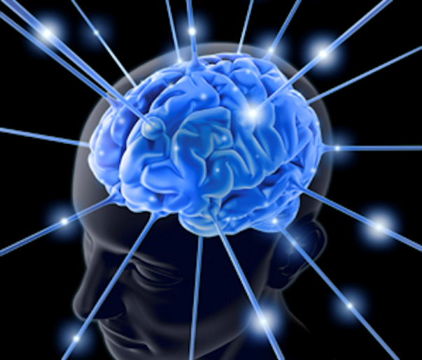
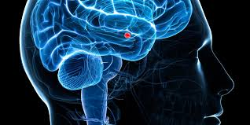
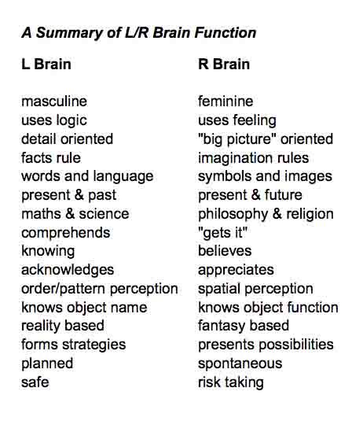
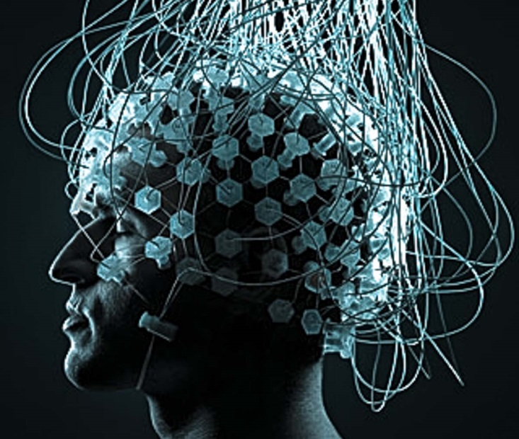

Slide 15
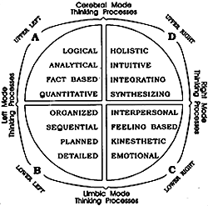
Right and Left Brain
4 –A, B, C, D THINKING PROCESS
R & L BRAIN FUNCTION

Slide 16
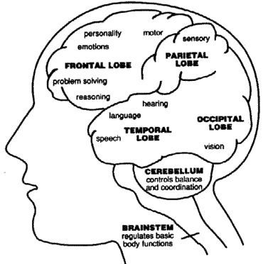
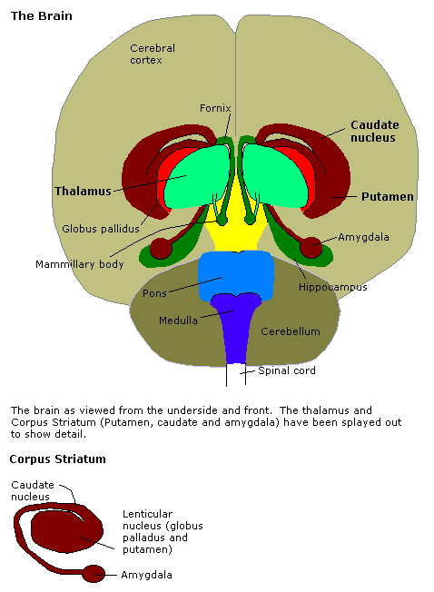

Slide 17
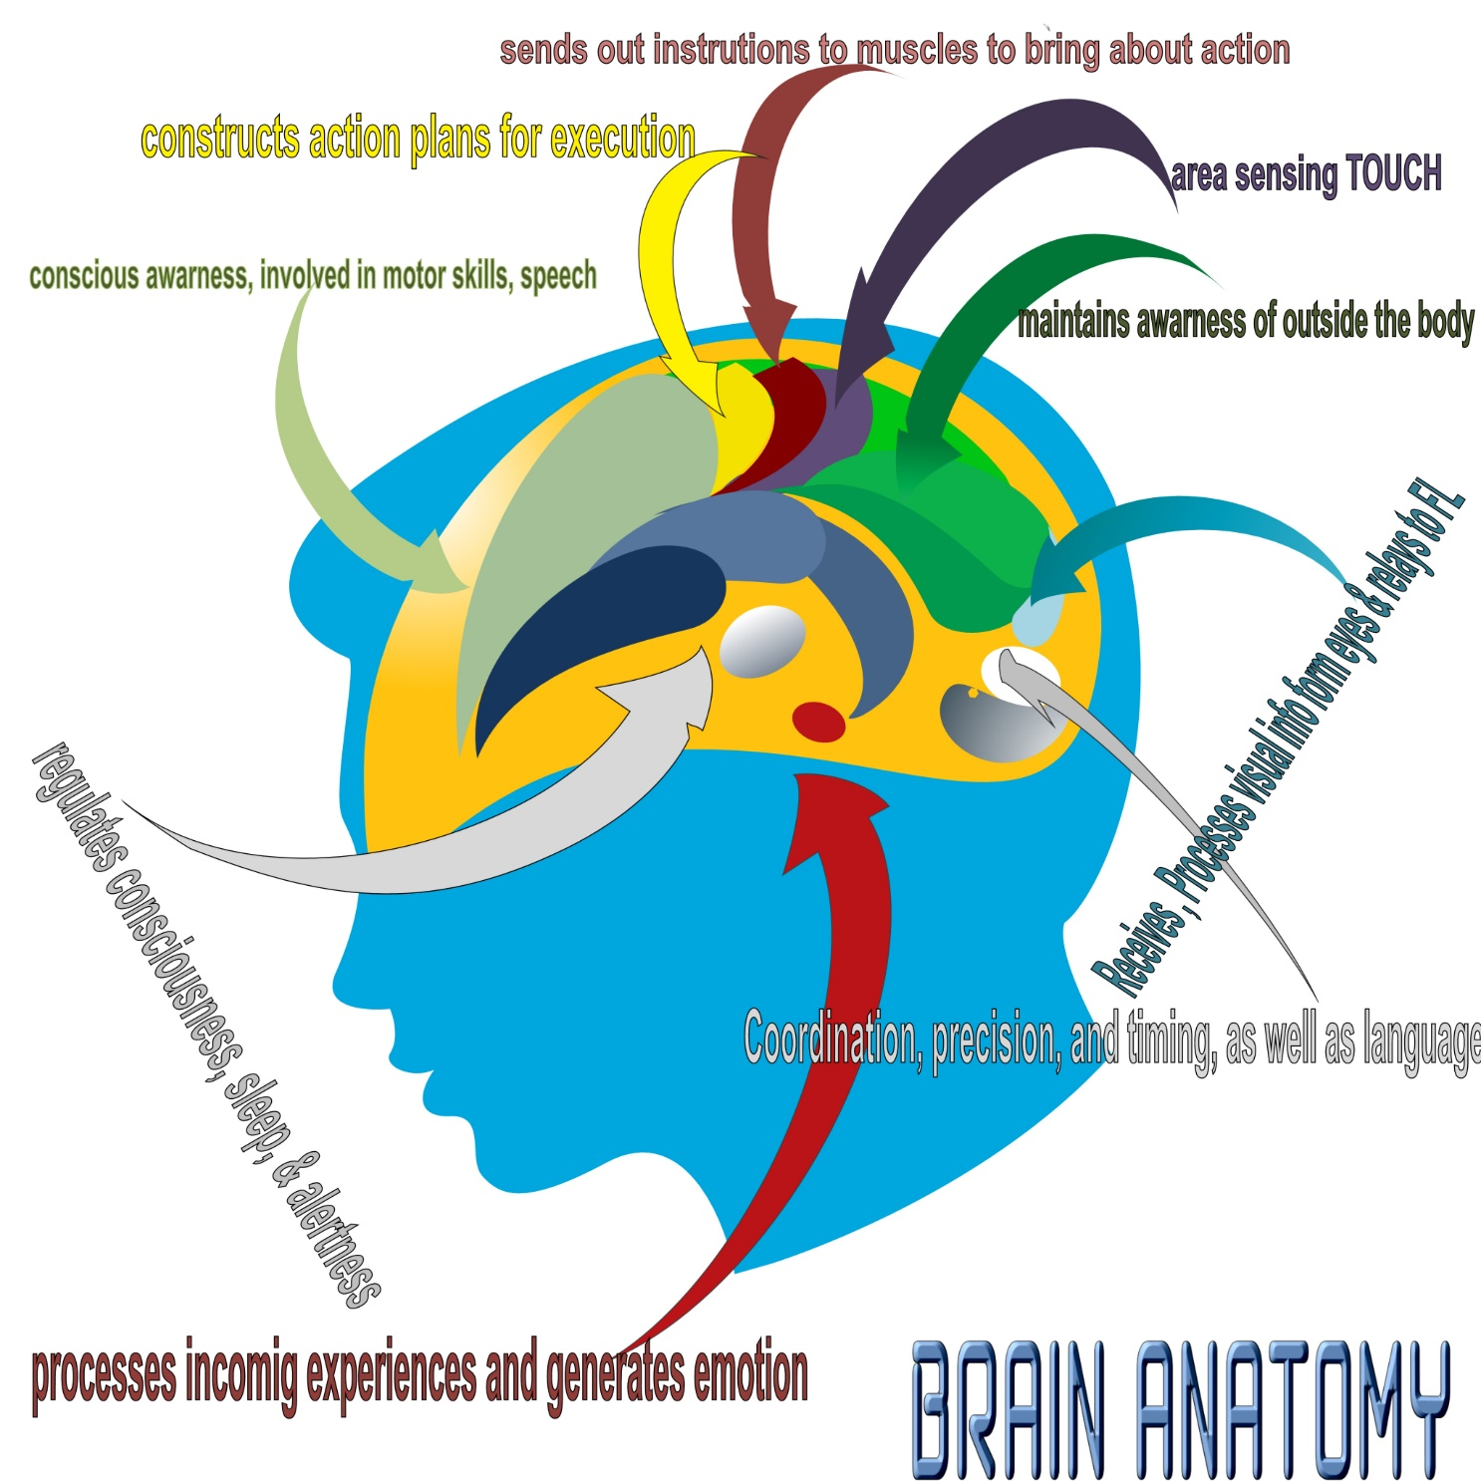

Slide 18
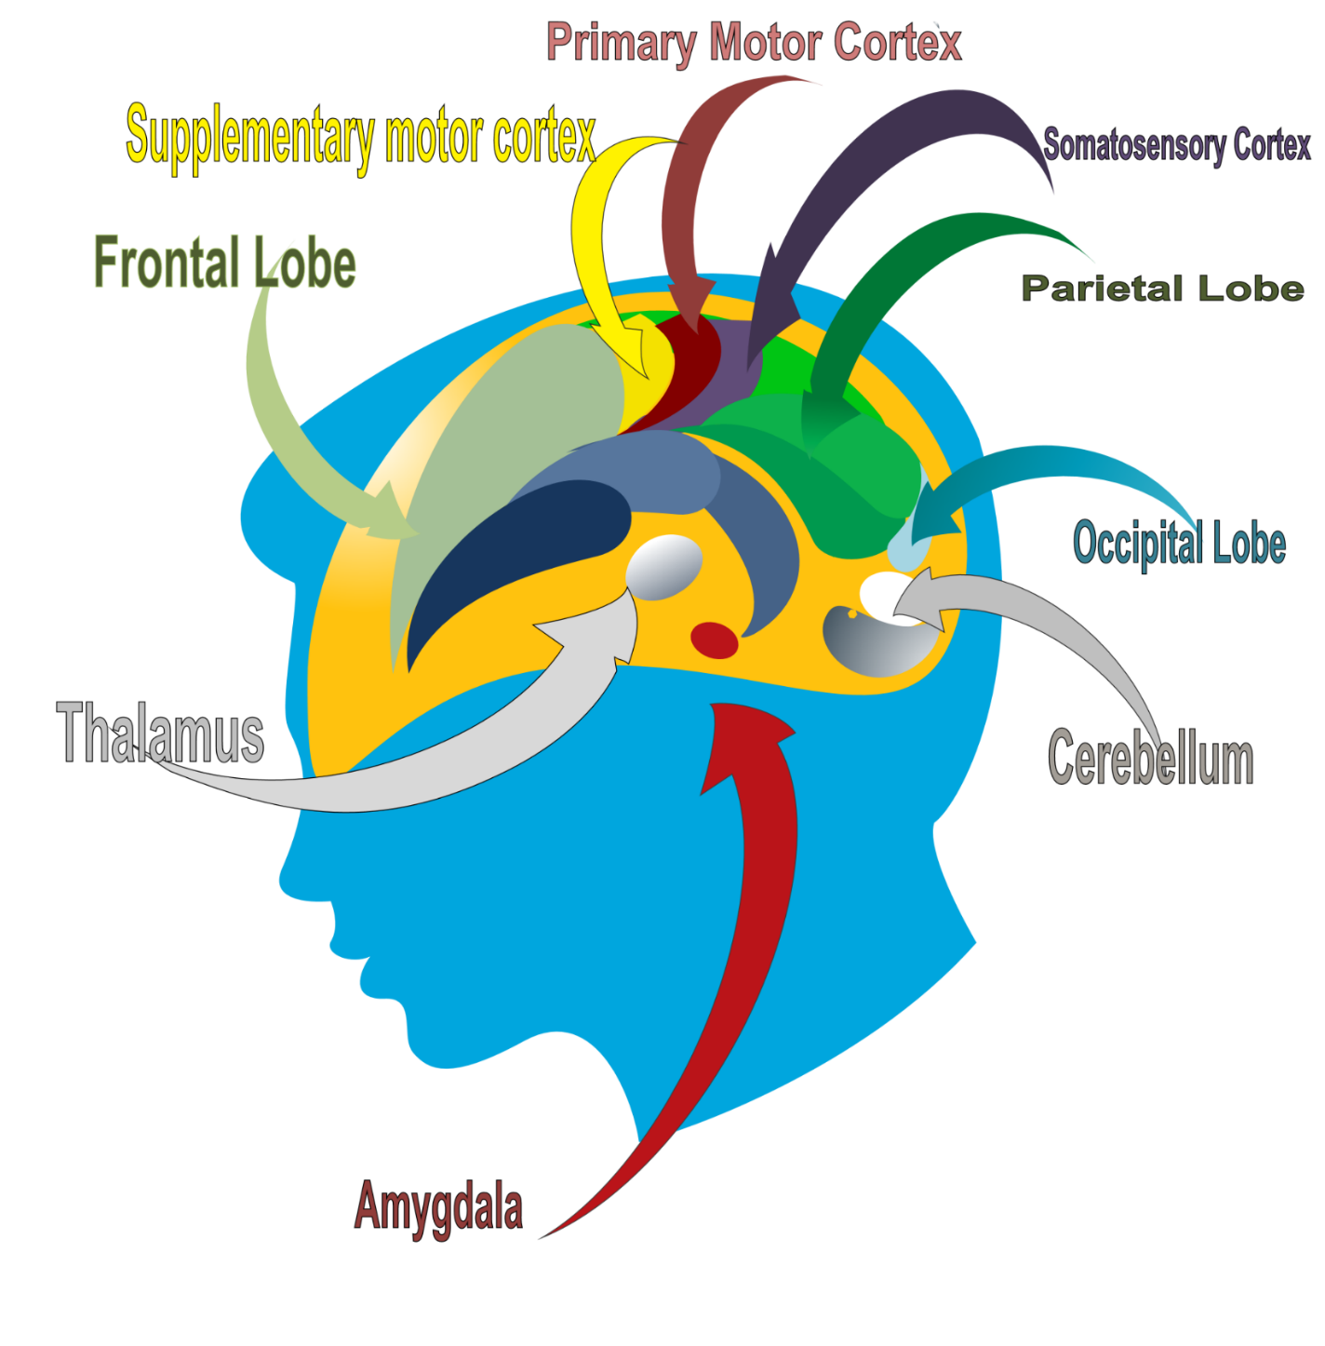

Slide 19
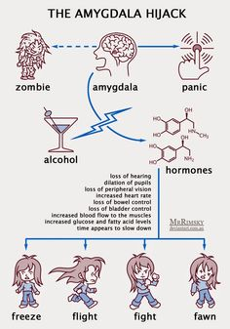
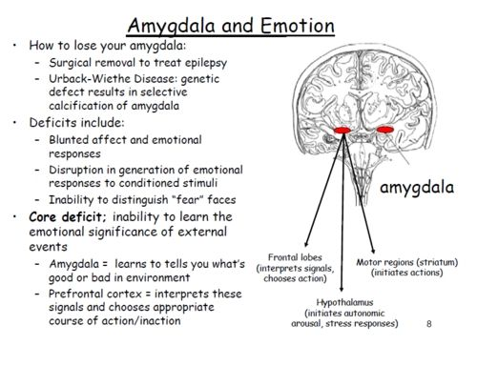

Slide 20

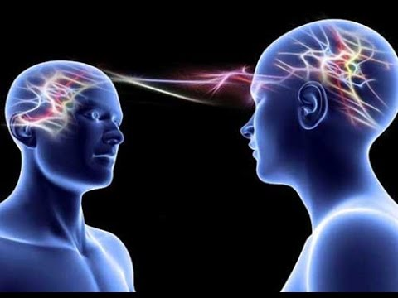
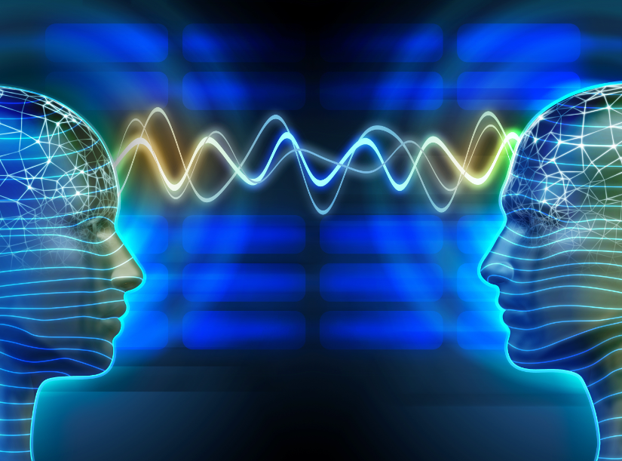
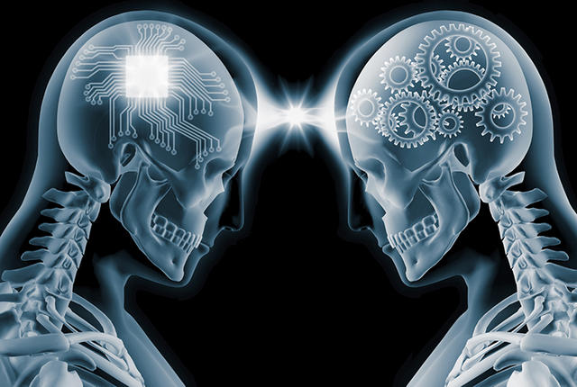

Slide 21
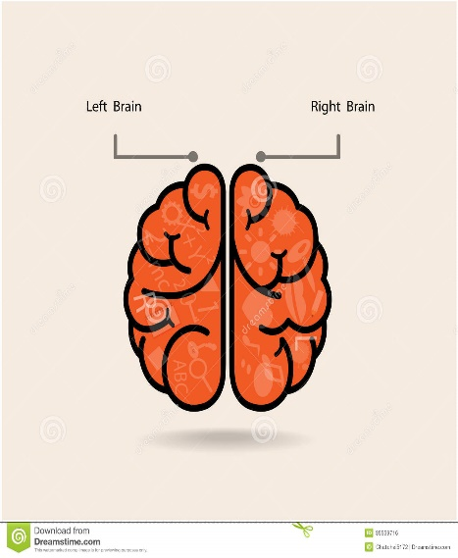
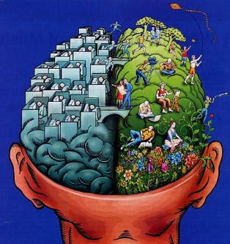
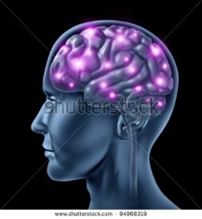
LEFT BRAIN THINKING VS RIGHT
We now have enough studies to prove left and right brain thinking.
Left brain thinking is where peace, calm, love, reside, the right is where worry, doubt, fear, reside.
You can take a thought of worry and doubt and turn to confidence and resolve, buy simply seeing your brain triggers fire from right to left, you can heal and calm any situation.
Exercise by taking each uneasy thought
Vision you must imagine the purple lights
Transfer to the left side of brain, and rest.
RIGHT BRAIN THINKING RESULT
LEFT BRAIN THINKING RESULT

Slide 22
EI Self Mastery
•Self awareness - knowing what I'm feeling why I'm feeling it. A study by Antonio Damasio, an expert on circuitry, took a lawyer
who had a severe brain injury which they sniped the circuitry from frontal lobe and amygdala because the lawyers life was
collapsing. He seemed to be able to function as before, but could not control his moods, temper, and reactions. He still had a
high IQ. He could not keep a job. Being a lawyer could give him rational work, but he no longer had emotional prioritization,
how should this guy vs that guy. He could not draw on base brain thinking which observes every action, what works and didn’t
work, but has zero connectivity in words.
-It tells with feelings, i.e. go with your gut, tells us this is right or wrong with gut feeling , EI is being able to tune into emotional
feelings which comes to us through non verbal, feeling only not yes or no.
-How good we are going to feel when a goal is accomplished.
-Ability difference between emotionality, example:
Kids with marsh mellows, you can have this marsh mellow now but if you wait till I get back you can have 2,
1/3 ate right away and 1/3 waited . . . pay off came years later upon graduating high school, the kids who waited, got along
better and scored 200 pts higher than kids who did not wait. All children of very high 1q families, impulsivities' no control.
•When amygdala, fixates on:
Bother vs solution or reward, occupies working memory, if 6 bits of info are concentrating on problems, and only 2 for
teacher: Not be able to learn

Slide 23
Neural Basis EQ vs IQ
The brain in evolution was developed from the bottom upward. The brain is basically an elegant machine for survival.
When it came to animals they needed to have a brain that registered emotions. Emotions have the primary survival function, One part in mid brain known as the Amygdala is the sentinel, small portion goes to Amygdala, answers one question, do I eat it or does it eat me. Has a trigger, the HPA- Hypo Polemic Pituitary adrenal axis. Once triggered, i.e. fear, once that which scares us, stress response, sends energy to limbs, classic flight fight freeze signal. We no longer operate like survival animalistic mode, Now we operate in a complex symbolic reality, symbolic threats, i.e. he’s not treating me fairly, she’s dissing me, what ever it may be to trigger HPA, when we are caught in the HPA axis Amygdala, caught in the grips of a distressing emotion, our attention narrows and fixates, makes sub optimal for most of life that are impactful.
When its really triggered it may cause an Amygdala Hijack-very strong emotional response, sudden and intense, you so something or say something, or send an email, that when the dust settles, we really regret (tell bank story) happens to really intelligent people as we become very childlike and really dumb, being run by our fears and anger learned in childhood. Good new is When we have an impulse from the amygdala it goes to the pre frontal cortex, the PFC draws information form all over the brain, its very important it’s the brains executive center, like when we get so pissed off, goes into center and googles brain, and tells you that crucial fact that we really need to know, like oh this is my boss I’m pissed at, I’m not going slug him, I'm going to smile instead and that is exactly the diff between cortical which operate in the center of the brain, where IQ resides, amygdala and EI, PFC draws information form all over the brain which integrate between the frontal cortex or lobe and the amygdala very widely connected throughout the brain.
When the amygdala, is hijacked it takes over the right side of the brain. Resting ration Right to left, most are in the middle, when someone is mostly far right they are clinically depressed, when far to Left, happy just let things roll off their back, hardly ever have a bad day, what the Left has that the right doesn't have is an inhibitory circuit to the amygdala, so when thoughts are sent to amygdala that provoke stress or anxiety it tell brain to shut up! It calms the amygdala, so people who have this ability have more good days, better moods, more self control.

