Slide 1


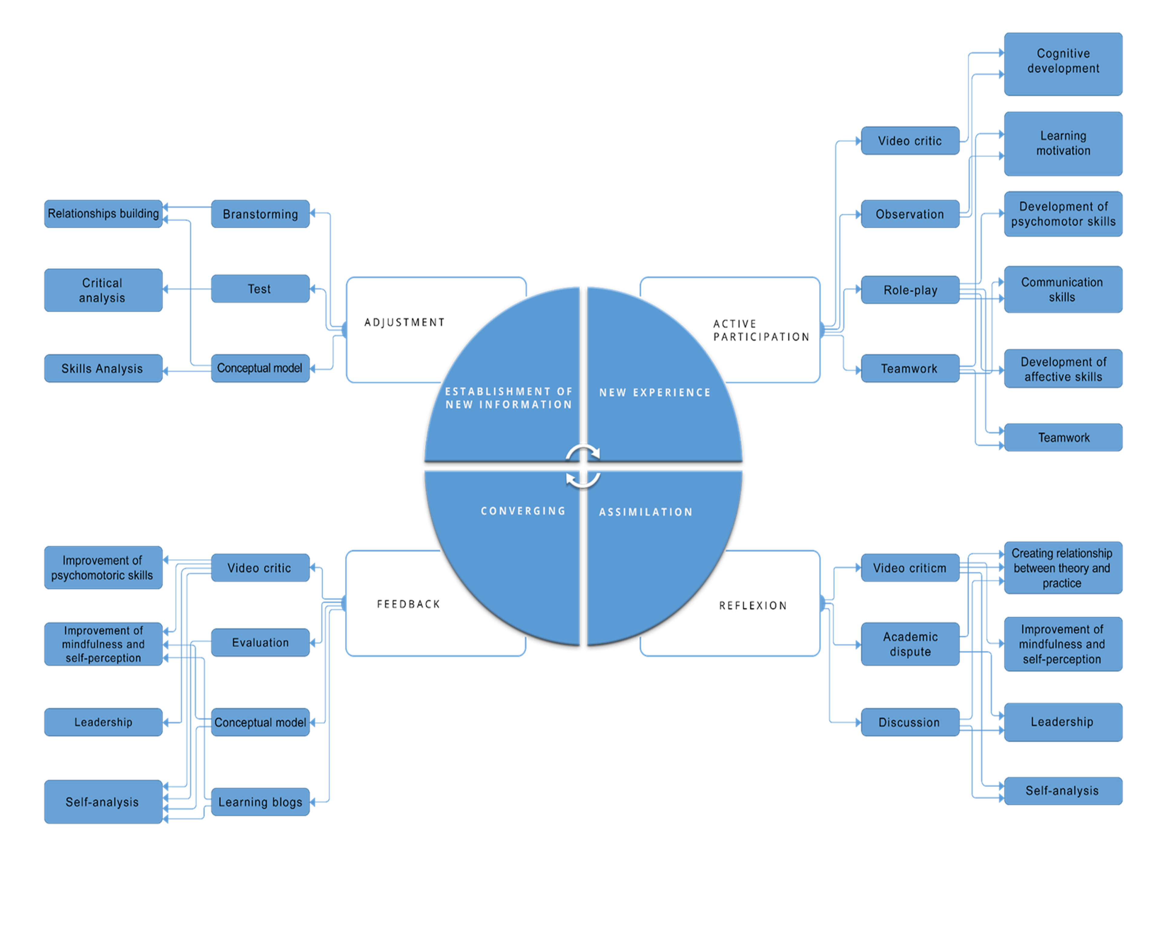
Teaching Methods Used in Simulation and Their Efficiency in Nurses´Training: an Integrating Literature Overview
Jandra Ristikivi ª, RN, MSc, Kristi Puusepp ª, RN, MSc, Ere Uibuᵇ, RN, MSc. ª Tallinn Health Care College, Estonia ᵇ University of Tartu, Institute of Family Medicine and Public Health, Estonia
Background: At the same time, the choice of teaching methods is highly important in relation to achieving productivity in learning and teaching. In this ariticle´s thesis topical scientific literature has been searched, combined and integrated to give an overview of the topic and create a conceptual model to describe the efficiency of teaching methods used in simulation learning in nursing studies.
Aim: Simulation learning is considered to be the most used teaching strategy in teaching nursing skills and an integral part of acquiring nursing education. The topic was chosen due to a lack of comprehensive overview of learning and teaching methods used in simulation and their efficiency.
Method: The search for the materials to be investigated was conducted in databases MEDLINE and Science Direct for the first time in October, 2013, the search was repeated in September, 2014 and in May, 2015. The check search was conducted in January, 2016. Alltogether 488 topical sources were found from which 15 met the selection criteria of the article’s thesis. In analysing data firstly the thought units were gathered, then different approaches were grouped and finaly compared.
As a result, 39 substantive codes were formed which in turn were divided into 15 subcategories and 4 general categories.
Results: The outcome is a conceptual model which gives an overview of teaching methods used in simulation learning and of their efficiency in different stages of simulation.
Conclusions: As a result it was confirmed that different teaching methods are used in simulation and the choice of a specific method depends on the objectives of the learning and simulation stage. The efficiency of learning methods is evident in development of students affective, cognitive and psychomotoric skills. To develop a specific skill it is possible to choose the most suitable learning method.
Contact: For further information please contact jandra.ristikivi@ttk.ee

