Slide 1


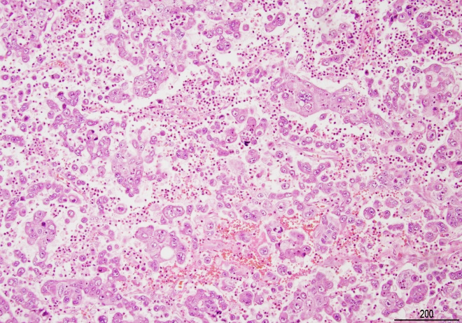
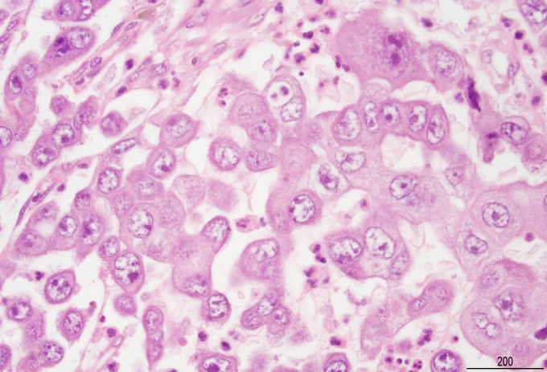
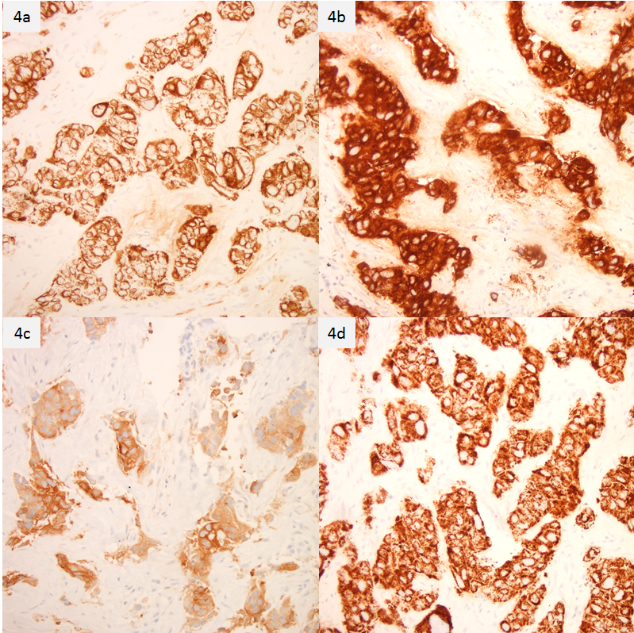
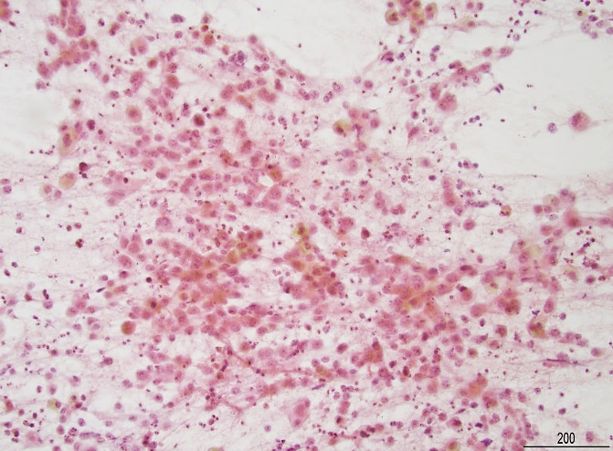
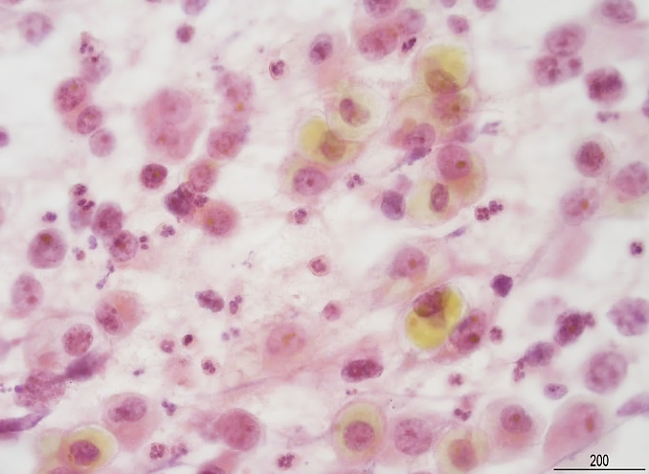
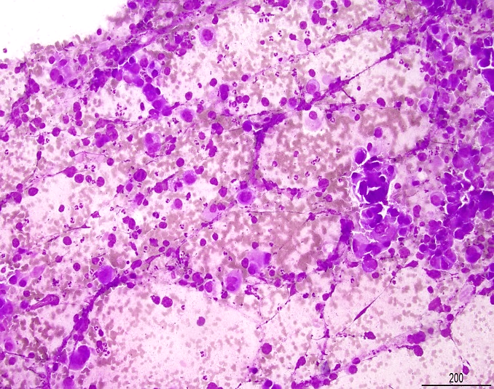
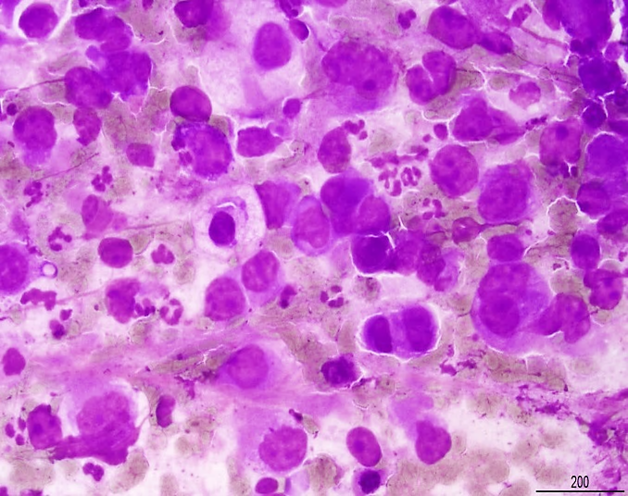
Hepatoid Adenocarcinoma of The Lung:
A Cause of Diagnostic Pitfall
Kevin Kuan, MD, Siba El Hussein, MD, Samer Khader, MD
Department of Pathology, Leopold G. Koss Division of Cytology, Montefiore Medical Center/Albert Einstein College of Medicine, Bronx, NY 10467
BACKGROUND
Hepatoid adenocarcinoma of the lung (HAL) is a rare form of malignant lung cancer that is recently described in the literature.
Histologically, HAL greatly resembles metastatic hepatocellular carcinoma to the lung.
Immunohistochemical (IHC) profile of HAL has overlapping features of both pulmonary adenocarcinoma and hepatocellular carcinoma.
Establishing the diagnosis of HAL can be difficult, especially on surgical biopsy due to the scarcity of the acquired tissue.
Figure 1a-b-: Hematoxylin and eosin stained core biopsy of the lung mass showing polygonal tumor cells arranged in trabecular pattern. Cells have abundant eosinophilic granular cytoplasm, centrally placed nuclei and prominent nucleoli, consistent with adenocarcinoma with hepatoid differentiation.
CASE REPORT
A 47 year-old male with no known medical history presented to emergency department complaining of a sharp, localized chest pain x 3 weeks.
Computer Tomography scan (CT) of the thorax showed a right upper lobe bulla with air-fluid level and adjacent dense nodule.
CT-guided core biopsy and fine needle aspiration of the lung nodule demonstrated an adenocarcinoma with hepatoid morphology.
IHC staining revealed that the tumor cells are positive for CK7, EMA, polyclonal CEA (pCEA), HepPar-1, cytoplasmic TTF-1 and MOC31, while negative for NapsinA, CK5/6, CK20, AFP, Glypican-3, and CD34.
Repeated laboratory work-up of liver function tests and multiple imagining studies revealed an unremarkable liver, with no suspicion of malignancy.
Based on the morphology and IHC pattern of staining, along with the clinical findings, the diagnosis of HAL was made.
Figure 4a-d: Immunohistochemical stains of the core biopsy of the lung show diffuse positivity for : 1) CK-7 (4a), 2) EMA (4b), 3) pCEA (4c), and 4) HepPar-1 (4d).
CONCLUSION
Clinico-pathological correlation along with the use of IHC markers can help distinguishing HAL from metastatic hepatocellular carcinoma.
Figures 2a-b: Pap-stained smears showing poorly cohesive adenocarcinoma cells with abundant cytoplasm with focal intra-cytoplasmic bile pigments, binucleation and prominent nucleoli.
REFERENCE
H. Ishikura, M. Kanda, M. Ito et al. Hepatoid adenocarcinoma: a distinctive histological subtype of alpha-fetoprotein-producing lung carcinoma. Virchows Archiv A Pathol. Anat. 1990; 417(1): 73-80.
K. Grossman, M. Beasley, and S. Braman. Hepatoid adenocarcinoma of the lung: review of a rare form of lung cancer. Respir. Medicine. 2016; 119:175-179.
D. Haninger, g. Kloecker, M. Bousamra et al. Hepatoid adenocarcinoma of the lung: report of five cases and review of the literature. Mod. Pathology J. US Can. Acad. Pathology. 2014; 27(4): 535-542.
Figures 3a-b: Diff-Quick smears shows poorly cohesive adenocarcinoma cells with abundant eosinophilic cytoplasm, pleomorphic nuclei, focal binucleation and prominent nucleoli.

