Slide 1
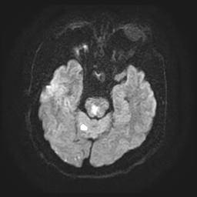
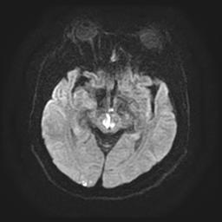
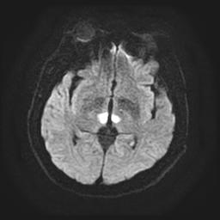
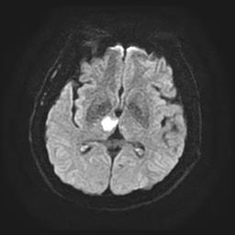
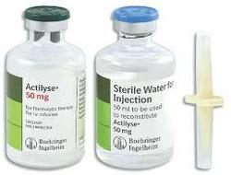
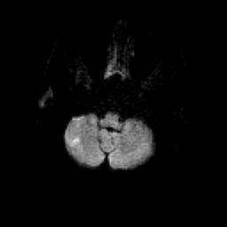
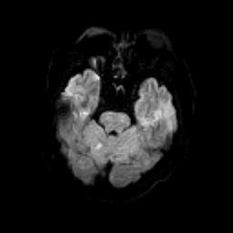
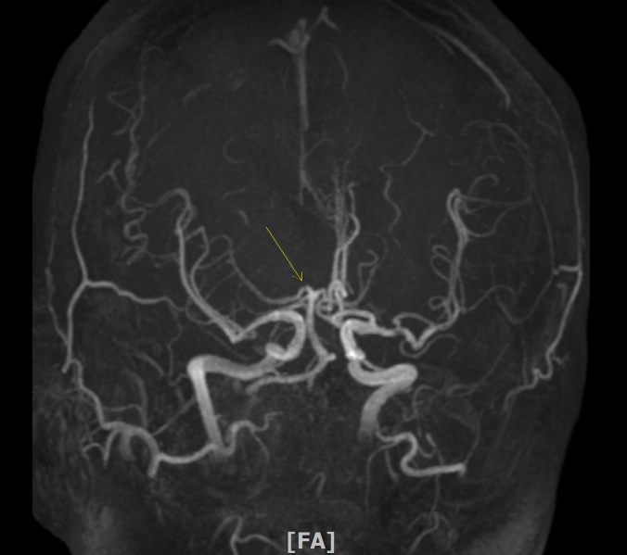
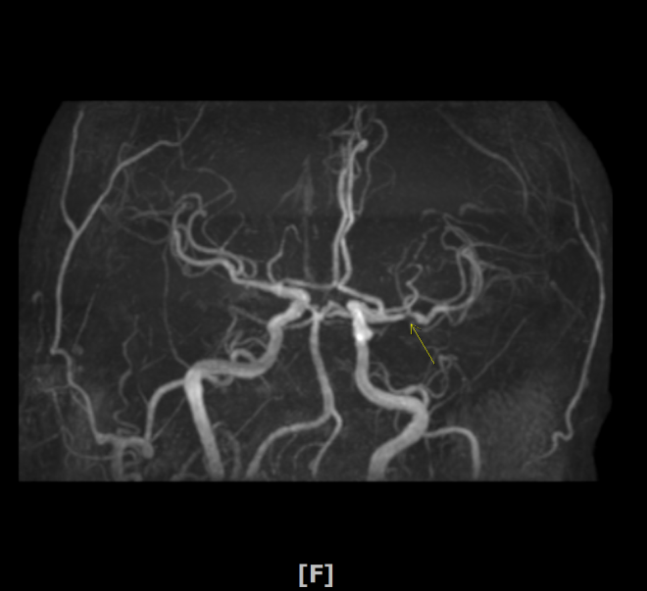
Hyperacute bilateral thalamic infarction undetected on initial diffusion weighted magnetic resonance imaging: A case report
Jin Eun, Min-hyung Lee, Byeong-rae Cho, Sang-hyuk Im, Won-il Joo,
Do-sung Yoo, Jae-kun Ahn, Hae-kwan Park
Department of Neurosurgery, Eunpyeong St. Mary’s hospital, The Catholic University of Korea
Introduction
Earlier this year, an otherwise healthy geriatric male patient presented to the emergency department (ED) with signs of stupor, and an initial diffusion-weighted magnetic resonance imaging (DW MRI) was inconclusive. The patient was administered a tissue plasminogen activator (tPA) within an hour of presentation, which did not resolve his symptoms. As his neurological condition continued to deteriorate, additional imaging studies were performed. This demonstrated several mid and hind brain infarcts that were not detectable upon initial imaging. Because the initial imaging was performed so quickly after symptoms-onset, it is likely that the infarcts were not mature enough to be detectable. Perfusion issues in this patient may be directly related to stenosis in the posterior cerebral artery (PCA).
On the follow-up DW MRI, an acute infarction was noticed on the right cerebellum, right pons, bilateral thalamus, and midbrain. Although the presence of the artery of percheron was not clearly identifiable on the MRA, acute infarctions on the bilateral thalamus and right pons with midbrain involvement suggested the possibility of an acute infarction on the artery of percheron associated with stenosis of P1 (Fig. 3).
Fig 3. Follow up MRI of the patient showed acute infarctions on the right cerebellum, right pons, bilateral thalamus, and midbrain.
Case presentation
By hospital day 5, the patient’s neurological status had slightly improved, and he could partially obey motor commands. His GCS was 226 with a motor grade of IV, but both eyes were fixed without any movement and with ptosis. Pupil light reflex was confirmed as 4F/2S. Intermittent left-eye opening was achieved on the seventh hospital day, as well as lateral gazing of the left eye.
In this case, acute infarction occurred within 30 minutes of arriving to the ED. The patient was treated with tPA within 1 hour of symptoms-onset. Despite relatively benign initial MRI findings, including a minimal infarction without vessel occlusion, the patient had poor initial neurologic status. Acute infarction on the right midbrain and bilateral thalamus observed on follow up MRI could account for the initial neurologic status of the patient. Based on this, and that the initial imaging studies could not explain the neurologic status of the patient, acute infarction of the brainstem and bilateral thalamic infarction, or infarction of the artery of percheron should have been actively considered.
The right pupil reflex was fixed at 4F and the ptosis was not improved until discharge to the rehabilitation hospital. Even after voluntary eyeball movement became possible after the patient recovered consciousness, right eye movement continued to be absent. Because the infarction occurred along the right abducens nucleus and the medial longitudinal fasciculus (MLF), right eye movement was fixed permanently (Fig. 1). After the patient’s neurological improvement, the movement of the left pupil was sluggish, but left lateral gaze became possible. There was no left pons damage, but the left upper midbrain infarction occurred at the left oculomotor and trochlear nucleus. Initial neurologic examination confirmed the fixation of eye movement bilaterally, though it is possible that a right pontine infarction with brain edema could interrupt the function of the left abducens nucleus temporarily.
On January 3 2019, a 67-year-old male with no underlying disease presented to the ED with mental stupor that came shortly after lunch. At the time of his initial examination, his Glasgow coma scale (GCS) was 115 with a motor grade of III/I III/III, and his pupil light reflex was 4F/3S. An initial non-enhanced brain computed tomography (CT) image showed no abnormal findings. Sixty-three milligrams of tPA alteplase (Actilyse) was injected, with dosing calculated according to the patient’s 70 kg weight.
After intubation, DW MRI with magnetic resonance angiography (MRA) was performed following application of alteplase, confirming an acute right cerebellar infarction. MRI was performed 43 minutes after admission, 59 minutes after the onset of symptoms (Fig. 1).
Fig 1. Initial DW MRI showed minimal acute infarction on the right cerebellum.
MRA of the fetal type PCA demonstrated right PCA (P1) stenosis and left distal middle cerebral artery (M1) stenosis (Fig. 2). Intraarterial thrombolysis was not performed based on the absence of vessel occlusion. As the patient was unstable due to irritation from intubation, we decided to extubate about 3 hours after the onset of symptoms. At this point, the patient’s neurologic status had recovered to GCS 1T6 and the patient was in a state of motor obeying. Based on the DW MRI, we expected improvement of the patient's neurological status. However, the day after the injection of the IV tPA, the patient continued to demonstrate symptoms of stupor with a GCS 115 Motor IV/ III IV/II without obeying. We performed another follow up DW MRI.
Conclusion
The 2018 stroke guidelines recommend brain imaging within 20 minutes to ensure that IV tPA injection is not delayed. Diffusion MRI is considered highly accurate in the diagnosis of acute ischemic stroke, though cost effective, non-enhancement CT should be considered to confirm IV hemodilution and IV tPA. However, in addition to the cost-effective aspect of this type of imaging, patients with hyperacute infarctions may not be identified in the initial brain diffusion image. As such, diagnostic and treatment decisions based on non-enhanced CT may be appropriate. In similar cases, initial negative DW imaging should not be used as a basis for excluding acute infarction from the differential diagnosis, especially in cases of posterior circulation and brain stem infarction. A follow up DW MRI may play a major role in diagnosis, because the patient's neurological symptoms are often maximized in cases of posterior circulation infarction or brain stem infarction. The success rate of a IV tPA is reported to be up to 50%, and highly depends on whether the occluded artery recanalizes. This study suggests that the possibility of acute infarction without definite vessel occlusion may lower success rate of a IV tPA. Further research is needed to confirm this.
Fig 2. MRA showed right P1 stenosis and left distal M1 stenosis.

