Slide 1

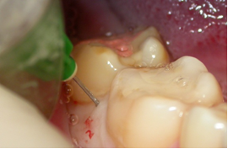
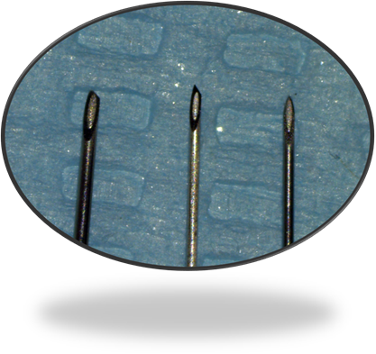
Safety and efficacy of intraosseous anesthesia in dentistry
Bogaevskaya O.Yu., Sokhov S.T. PhD
Due to significant deficiencies and complications of conduction anesthesia, many authors recommend the intraosseous method. The evolution of intraosseous anesthesia in the direction of simplifying the method of use led to the appearance of osteocentral and transcortical anesthesia, which greatly simplified the analgesia even in the treatment of pulpits of the lower molars. Intraosseous injection manifested itself as a highly effective anesthesia with a rapid onset of the effect ( 20-60 sec) and which is not accompanied by paresthesia of soft tissues. It allows to use smaller doses than necessary for conduction and infiltration methods of anesthesia.
The volume of injected intraosseous anesthetic is limited by the amount of spongy material, which is limited by the lamina of the compact substance of the jaw bone and the roots of the teeth. The average amount of anesthetic for effective anesthesia is 0,4±0,08 ml.
Research result. The Intraosseous anesthesia made with “Quick Sleeper” computer injectors differs from other types of anesthesia by the volume of injected anesthetic (0,2-0,4ml) and by a shorter latent period (40-60sec). The Intraosseous anesthesia needles are made of more durable alloy (pic.2) and they have an asymmetric sharpening that makes it easy to penetrate deep into the bone tissue during rotation. Duration of intraosseous anesthesia depends on the concentration of epinephrine in the local anesthetic. The duration of analgesia after the intraosseous anesthesia with epinephrine 1:100000 was 52,1±8,7 min. Local anesthetic with epinephrine 1:200000 – the duration of analgesia was 41,6±7,4 min. The analgesic effect of anesthetic without vasoconstrictor lasted for 9,3±4,3 min.
During intraosseous anesthesia with a local anesthetic solution with epinephrine 1: 200000 and without a vasoconstrictor, no statistically significant changes in blood pressure parameters were detected. During intraosseous anesthesia with articaine and epinephrine 1:100000, there is a short-term increase in systolic blood pressure by an average of 4,5% (5-6 mm hg) and an increase in the frequency of cardiovascular contractions by an average of 15,6% (8-13 beats/minute).
Summary
Automated injectors provide safe and effective intraosseous analgesia in dentistry.
Intraosseous analgesia has a high patient satisfaction rate in terms of efficiency and comfort – more than 97%.
The aim is to increase safety and efficiency of intraosseous anesthesia by automated injectors.
Materials and methods
The method of intraosseous anesthesia during dental procedures in the inferior jaw area was studied. (pic.1). The efficacy of intraosseous anesthesia was also studied on 42 patients with dental problems in the area of molars. The patients were divided into three groups, depending on the composition of the injected anesthetic. The first group of patients: anesthetic was injected with a vasoconstrictor concentration of 1:100000. The second group: anesthetic was injected with a vasoconstrictor concentration of 1:200000. The third group: anesthetic was injected without vasoconstrictor.
Recent Publication
1. Augello M, von Jackowski J, Grätz KW, Jacobsen C (2011) Needle breakage during local anesthesia in the oral cavity - a retrospective of the last 50 years with guidelines for treatment and prevention. Clin Oral Investig 15:3–8. https://doi.org/10.1007/s00784-010- 0442-6
2. Bangerter C. et all. The use of intraosseous anesthesia among endodontists: results of a questionnaire//Journal of Endodontics, ISSN: 18783554.- 2009.- Vol.35 (1).-P.15-18.
3. Van den Akker HP and Baart JA (2017) Local Complications –Needle Breakage. In: Baart JA, Brand HS (eds.) Local Anaesthesia in Dentistry, Springer International Publishing, pp 148–150. ISBN 978–3–319-43704-0. doi: https://doi.org/10.1007/ 978-3-319-43705-7
Pic.1. Intraosseous anesthesia method.
Pic.2. The Intraosseous anesthesia needles have an asymmetric sharpening

