Slide 1

Novel Bone Regeneration Drug “Osteogrow”: “Therapeutic Solution for Lumbar Back Pain” as a part of the clinical trial in a new indication involving patients with chronic back pain.
Tjaša Rakovec, Robert Ivanec
Clinres Farmacija d.o.o.
03/15/2019

Slide 2
Clinres Farmacija, Contract Research Organisation, is one of the 12 Consortium Members from 7 EU countries, and is responsible for clinical trial Project Management and Pharmacovigilance activities for the OSTEOproSPINE clinical trial with its full name:
Patient and evaluator blinded non-inferiority study on safety, tolerability and lumbar fusion efficacy of a single administration of Osteogrow (rhBMP6 in autologous blood coagulum (ABC) carrier) in adult patients treated by posterolateral lumbar interbody fusion (PLIF) for degenerative disc disease.
OSTEOproSPINE_e-poster_20190312

Slide 3
Treatment of lumbar spine pain before OSTEOproSPINE
PLIF - Posterolateral interbody spinal fusion
Lumbar spine pain is caused by
degenerative spine disorders.
Current PLIF intervention involves the use of
metal instruments supplemented by iliac crest
OSTEOproSPINE_e-poster_20190312

Slide 4
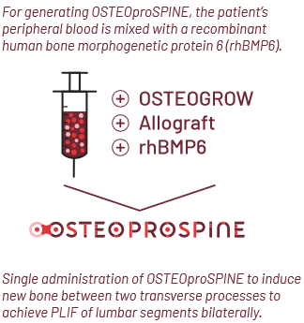
OSTEOproSPINE
Generating a novel bone inductive drug to allow fusion of lumbar vertebrae: The new Croatian medicine Osteogrow is made from an autologous blood clot, in which a recombinant protein is added and after a specific binding, a medicine is formed, which is then injected into the patient. It is implanted on the specific spot where we wish to create new bone tissue.
OSTEOproSPINE_e-poster_20190312

Slide 5
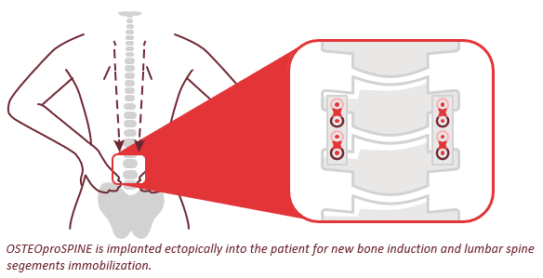
Using OSTEOproSPINE in PLIF
OSTEOproSPINE is generated by combining patient’s own peripheral blood rhBMP6 reinforced with a compression resistant matrix to achieve an implant with defined rheological properties to implant locally.
New generated bone triggered by OSTEOproSPINE stabilises the lumbar spine together with the inserted fusion to replace for removed degenerated intervertebral disc(s).
OSTEOproSPINE_e-poster_20190312

Slide 6
Objectives of the clinical trial
The primary objective of the trial is to:
Evaluate safety and composite endpoint non-inferiority of two doses of Osteogrow+Allograft delivered bilaterally between transverse processes of a single lumbar spine segment in comparison to autologous iliac crest bone graft (with a noninferiority absolute margin of 10% as patient success at 24 months after surgery).
The secondary objectives of the trial are to:
Demonstrate fusion success superiority of a single (local) dose of Osteogrow+Allograft delivered bilaterally between transverse processes of a single lumbar spine segment.
Explore improvement and show superiority in ODI, pelvic pain (autologous bone donor site), general health status and patient satisfaction.
Explore the rhBMP6 antibody level in plasma.
OSTEOproSPINE_e-poster_20190312

Slide 7
Patient enrolment
A total of 192 patients will be randomized in a 1:1:1 ratio to the following treatment groups:
1) Standard of care (SoC, consisting of 360 degrees stabilization with intervertebral cages filled with local (host) bone, instrumentation with pedicle screws and bilateral autologous bone graft from iliac-crest in the lateral gutter),
2) Osteogrow+Allograft+0.5 mg rhBMP6 (implanted into each lateral gutter after 360 degrees stabilization with intervertebral cages filled with local (host) bone and instrumentation with pedicle screws) and
3) Osteogrow+Allograft +1 mg rhBMP6 (implanted into each lateral gutter after 360 degrees stabilization with intervertebral cages filled with local (host) bone and instrumentation with pedicle screws).
The control group (SoC) is included to explore the safety and efficacy of Osteogrow implant to which a compression resistant matrix is added (allograft bone) in comparison to autologous iliac crest bone graft.
OSTEOproSPINE_e-poster_20190312

Slide 8
Patient enrollment, cont‘d
Patient enrolment is planned in 3 subsequent stages:
Stage 1 - 15 patients,
Stage 2 - 75 patients and
Stage 3 - 102 patients.
OSTEOproSPINE_e-poster_20190312

Slide 9
Progress
The first 15 patients were randomized in a 1:1:1 ratio and followed-up for three months at one clinical site in Austria.
An independent data safety monitoring board (IDSMB) was set up and they have reviewed the available data at 3 months after the surgery for first 15 patients.
There were no safety concerns raised by the Independent Drug Safety Monitoring Board (IDSMB) and patient enrolment will continue until a total of 90 patients are included with a resultant 1:1:1 assignment (Stage 2).
As after Stage 1, if no safety and efficacy concerns are raised by the IDSMB after 3 months following surgery, patient’s enrolment in stage 3 will continue to recruit additional 102 patients. At stage 2 and 3 more recruitment sites in the EU will be included. Each patient will be followed-up for 24 months.
OSTEOproSPINE_e-poster_20190312

Slide 10

SUMMARY
Clinical trial:
the first trial of Osteogrow+Allograft (OSTEOproSPINE) with lumbar spine single segment stabilization
Phase II, randomized, controlled trial, partially blinded
Investigational Medicinal product:
Osteogrow: Therapeutic Solution for Lumbar Back Pain
Indication: chronic back pain (degenerative disc disease)
Start of patient recruitment: 25th of May 2018
Additional information available at: info@clinres.si
OSTEOproSPINE_e-poster_20190312

