Slide 1




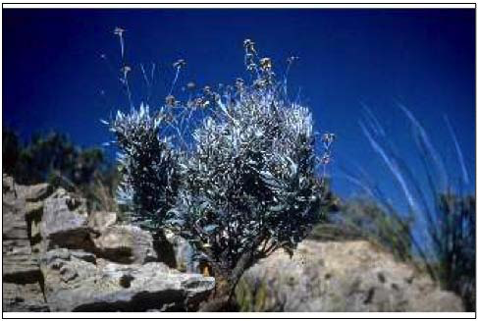
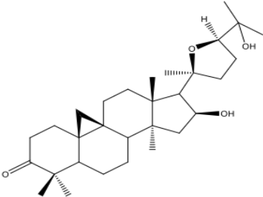
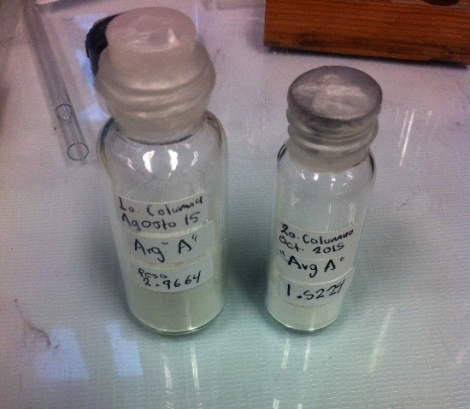
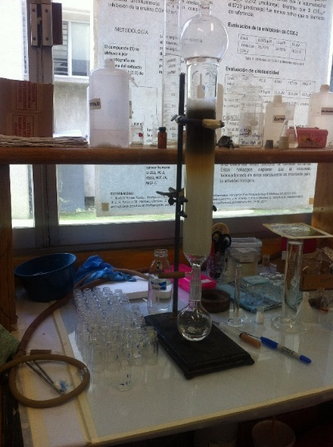
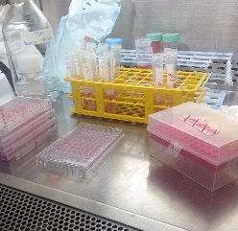
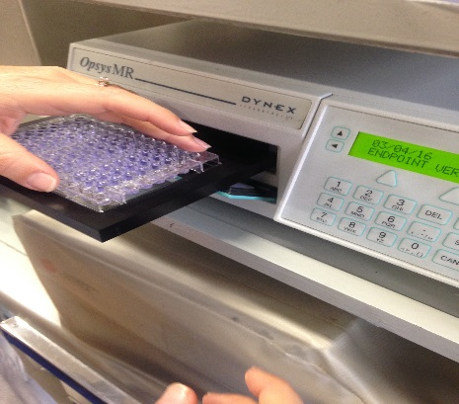
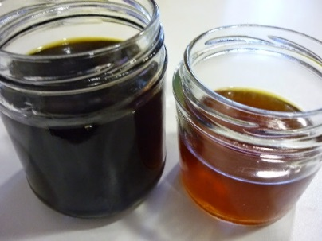
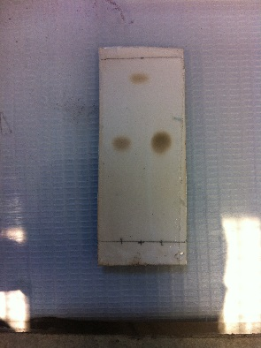
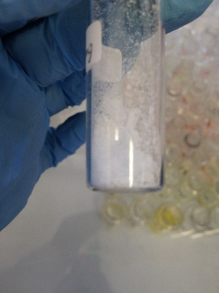
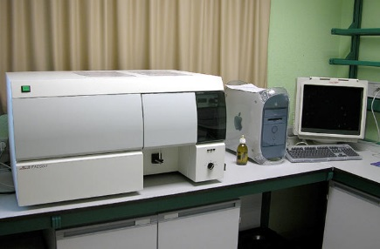
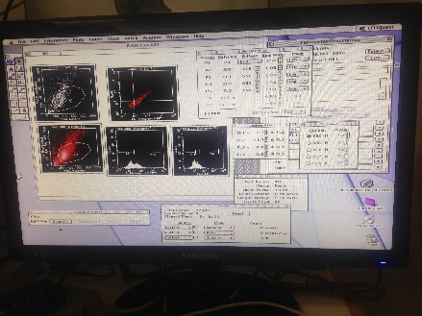
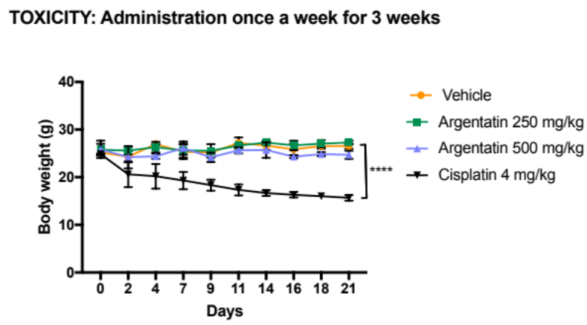
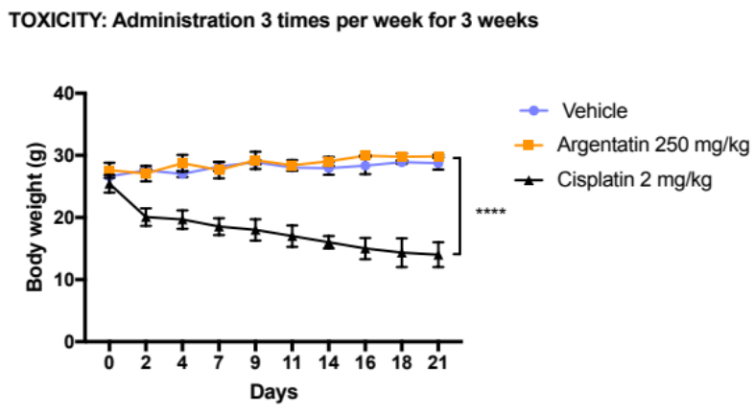
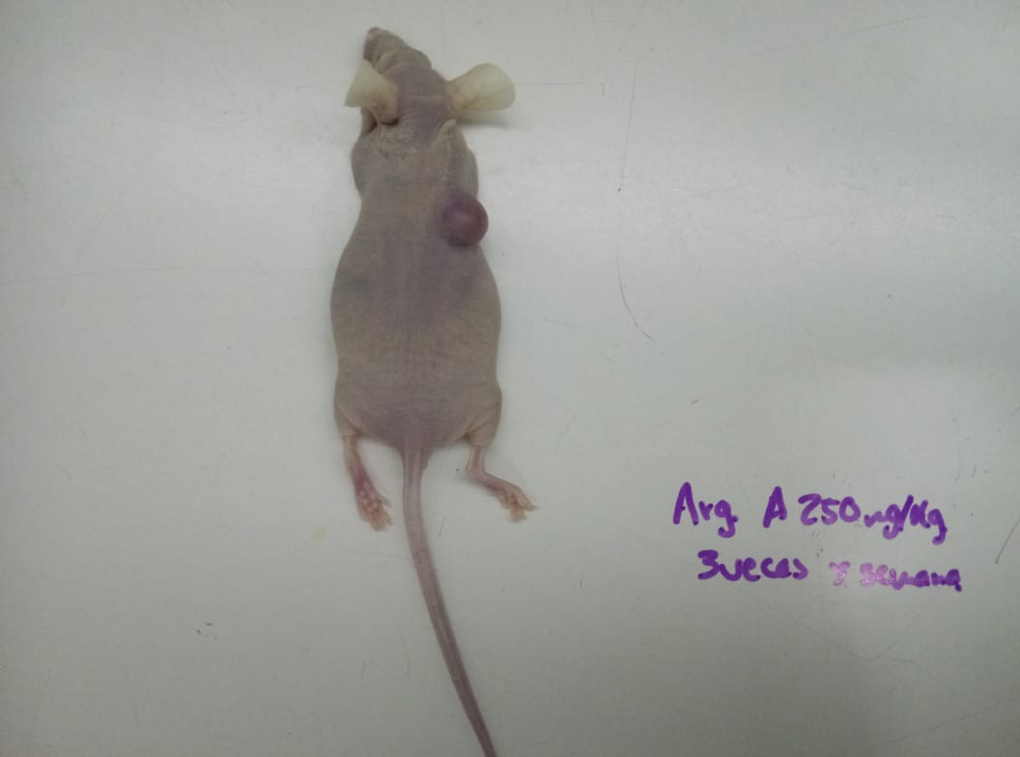
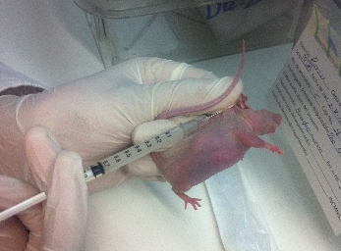
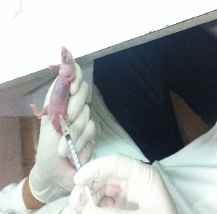
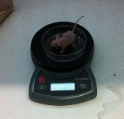
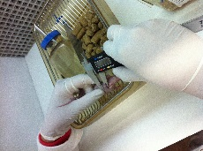
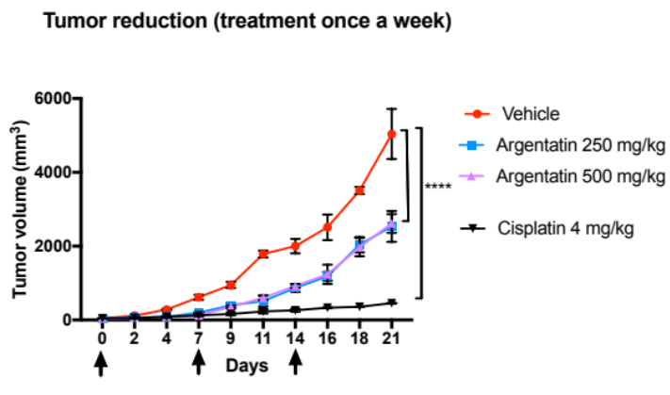
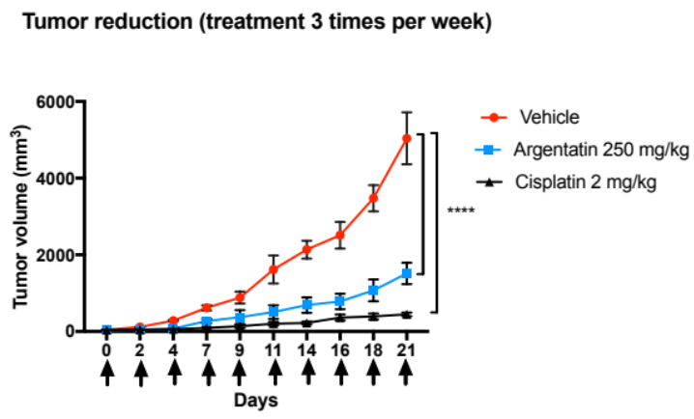
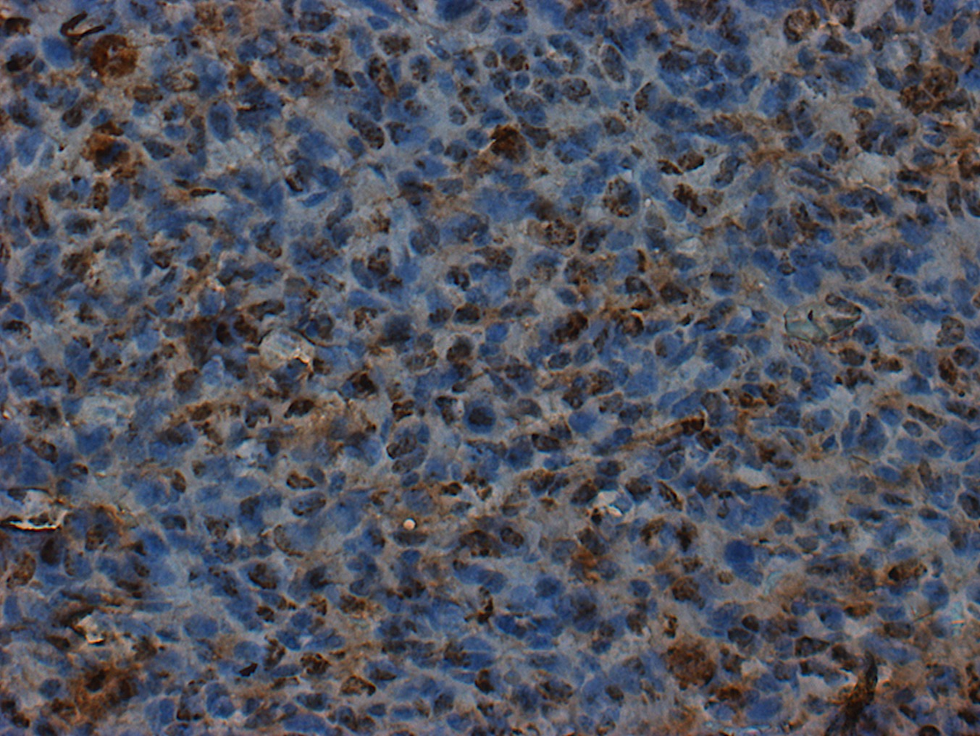
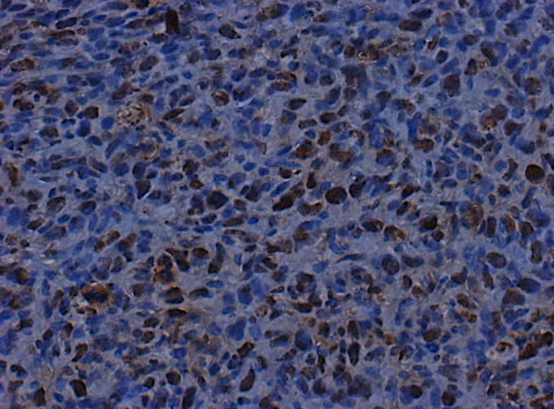
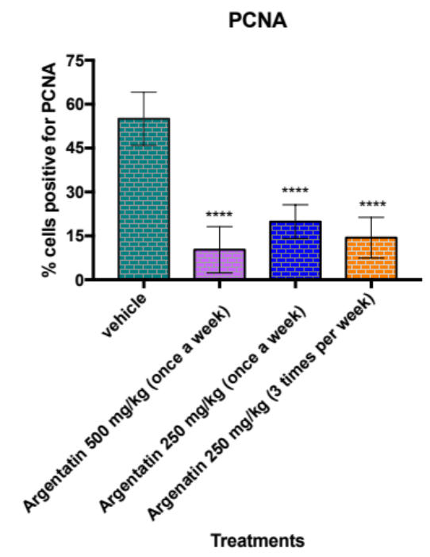
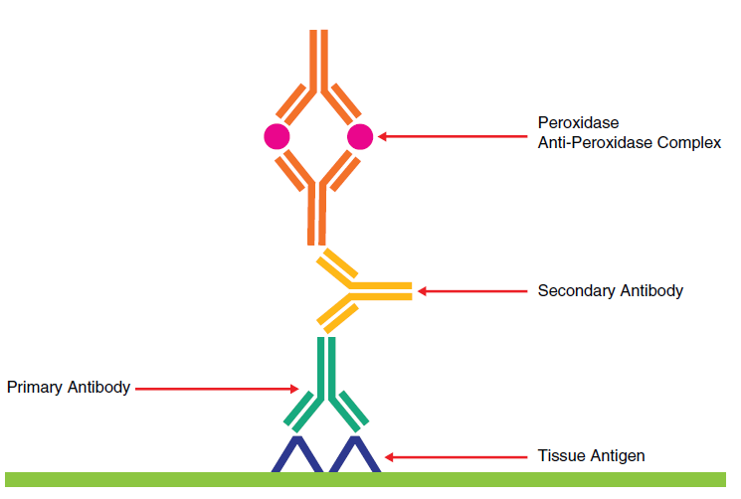
Universidad Nacional Autónoma de México
"EVALUATION OF THE ANTITUMORAL ACTIVITY IN CANCER OF COLON IN VIVO OF ARGENTATIN A, ISOLATED OF PARTHENIUM ARGENTATUM A. GRAY"
Zaira Tavarez Santamaría¹, Beatriz del Carmen Couder García¹, Nadia J. Jacobo Herrera², Alejandro Zentella Dehesa², Leticia Rocha Zavaleta³ Mariano Martínez Vázquez¹
Instituto de Química, Universidad Nacional Autónoma de México, Circuito Exterior s/n, Ciudad Universitaria. Delegación Coyoacán. C.P. 04510, Ciudad de México.
Instituto Nacional de Ciencias Médicas y Nutrición Salvador Zubirán, Vasco de Quiroga 15, Tlalpan, C.P. 14000 Ciudad de México.
Instituto de Investigaciones Biomédicas. Circuito Mario de la Cueva s/n, Coyoacán, Ciudad Universitaria, 04510 Ciudad de México.
Contact: zaira_03@live.com.mx
INTRODUCTION:
Argentatin A is cycloartane-type triterpene and is one of the main components of the resin obtained as waste from the industrial process of getting natural rubber from Parthenium argentatum Gray, a species known as guayule. Previous studies by our group and others had been shown both the anti-inflammatory activity and the antiproliferative effect against several human cancer cell lines of argentatin A. Even though today there are different drugs, chemical and biological, for the treatment of colon cancer, several patients do not respond to the treatments, together with the fact that several drugs induce severe side effects. Taking into account the above, we decided to investigate both the inhibition of the proliferation of the HCT-116 human colon cancer cell line as well as its antitumor effect evaluated in vivo in a mice cancer xenotransplant model.
Parthenium argentatum Gray
Chemical structure of Argentatin A
METHODS:
2. CYTOTOXICITY ASSAY
RESULTS AND DISCUSSION:
1. ISOLATION AND IDENTIFICATION OF ARGENTATIN A
The evaluation of the cytotoxic activity of Argentatin A by the crystal violet method was performed at 24, 48 and 72 h in different colon cancer cell lines: HCT116, HCT15, SW620. Cisplatin was used as a positive control.
8.04 grams
PM 472.69 g / mol
Purity 99.78%
PF. 156-158 ºC
Total yield: 50%
Table 1. Our results indicated that argentatin A showed a modest cytotoxic effect against HCT-15, HCT-116 and SW-620 lines of human colon cancers, although the HCT-116 line was more sensitive to the administration of this triterpene
A fact that draws attention is that despite the cytotoxic activity of this triterpene on the three lines of cancer human evaluated, it just induced apoptosis in the HCHT-116 (30 μM) line at 72 hours. This result indicates that argentatin A could induce apoptosis at long incubation times (Graphs 1 and 2). However, like argentatin B, argentatin A also induces senescence processes, which eventually lead to cell death (Graph 3).
The preparation of Argentina A was carried out by column chromatography from 110 grams of resin.
3. APOPTOSIS DETERMINATION
4. CYTOCHEMICAL STAINING WITH SA-B-GALACTOSIDASE
A
The apoptosis assay was performed by flow cytometry with a FACScan using the annexin V and propidium iodide fluorochromes. The HCT116 and HCT15 cell lines were stimulated at concentrations of 57 and 60 μM respectively for 24, 48 and 72 h.
HCT15 and HCT 116 cells were seeded in 24-well plates and incubated with 30 μM of Argentatin A at 24 48 and 72 h. Cytochemical staining was performed with SA-B-Galactosidase Staining Kit.
B
C
Graph 3. A) HCT-116 cells treated by Argentatin A during 72 h at 30μM dose. B) 𝞫-galactosidase activity on HCT-116 cells, C) 𝞫 -galactosidase activity on HCT-15 cells
C
D
5. TOXICITY TEST IN NU / NU MICE AND XENOTRANSPLANT ASSAY
% Inhibition=%Vv-%VTx
A
B
Monitoring 11 days before treatment
Administration dates
Graph 4 A). Mice nu/nu body weight variation treated with argentatin A once a week for 3 weeks. B) Mice nu/nu body weight variation treated with argentatin A 3 times a week for 3 weeks.C) mouse treated with cisplatin and D) mouse treated with argentatin A. Is very clear that argentatin A did not induce weight loss as induced by cisplatin.
Administration once a week
Negative control: 10% DMSO + sesame oil.
Positive control: Cisplatin 4 mg / kg
Argentatin A: 250 mg / kg
Argentatin A: 500 mg / kg
(50mm³)
2
4
7
9
11
14
16
18
21
1.5x10⁶ HCT116 cells
Day 0
END OF THE EXPERIMENT
Argentatin A was administered at doses of 250 as 500 mg/kg once a week for 21 days. The results of this trial indicated a tumor reduction of 49.1% and 48.8% respectively compare with those tumors of the untreated mice (graph 5, figure 1). Considering that perhaps treatment with more frequency but with the lowest dose tested could have a better effect, we decided to administer the dose of 250 mg/kg three times per week for 21 days. The results indicated a 78.1% reduction of the tumor compared to the tumors of the untreated mice (graph 6, figure 2).
graph 5, figure 1
Monitoring 11 days before treatment
% Inhibition=%Vv-%VTx
graph 6, figure 2
(50mm³)
END OF THE EXPERIMENT
Administration 3 times per week
Negative control: 10% DMSO + sesame oil.
Positive control: Cisplatin 2 mg / kg
Argentatin A: 250 mg / kg
Day 0
2
4
7
9
11
14
16
18
21
Administration dates
1.5x10⁶ HCT116 cells
vehicle
500 mg/ once a week
250 mg/ once a week
250 mg/ 3 times per week
6. IMMUNOHISTOCHEMISTRY
Figure 3 and Graph 7. A was evaluated by the expression of proliferating cell nuclear antigen (PCNA) a marker of cell proliferation. Administration of argentatin A at 500 mg/kg dose once a week as well as 250 mg dose three times a week for 21 days decreased the average number of cells positive for PCNA.
Incubation with the primary antibody: anti-PCNA. The acquisition of the images was done through an inverted microscope Olympus IX71 using the software Qcapturepro 5 of the company QImaging.
CONCLUSIONS:
REFERENCES:
In conclusion, our results showed that the administration of Argentina A at a dose of 250 mg/kg three times a week for 21 days, in our assay using HCT-116 cells, similarly decreases the tumor mass under the same administration scheme of cisplatin at a dose of 2 mg/kg. However, the toxicity shown by these two compounds is very different. Argentatin A did not induce weight loss or liver damage as cisplatin does. Although more studies are required to determine the mechanism of cell death caused by argentatin A, however, our results indicate the appropriateness of initiating clinical studies with argentatin A
1.Romero, JC. et al. Synthesis, anti-inflammatory activity and modeling studies of cycloartane-type terpenes derivatives isolated from Parthenium argentatum.
Elsevier, 2014, 22; 6893-6898.
2.Castro, AJ. et al, A. Mexican medicinal plants used for cancer treatment: Pharmacological, phytochemical and ethnobotanical studies. Elsevier 2011; 945–972.
3 Rocha A. Natural products in cáncer therapy. Curr Opin Pharmacol. 2001; 1 (4): 364-369.
4. Alcántara F. (2016). Efecto de la Argentatina B en ratones atímicos xenotransplantados con células de cáncer de colon (HCT-15) y próstata (PC-3). (Tesis).
Universidad Nacional Autónoma de México. Ciudad de México.

