Slide 1


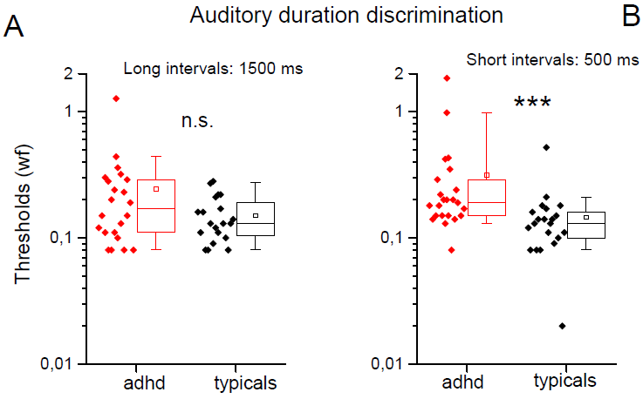
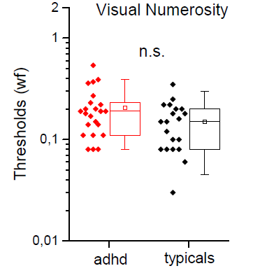
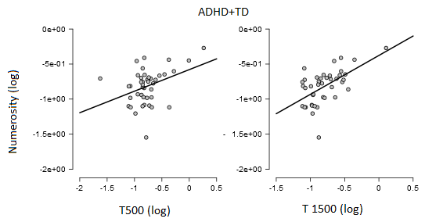
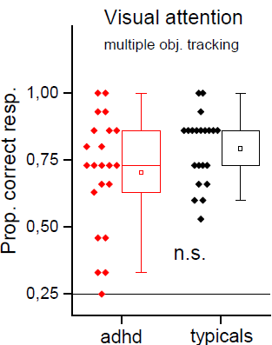
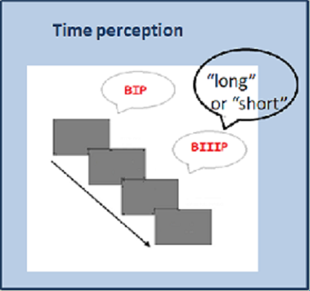
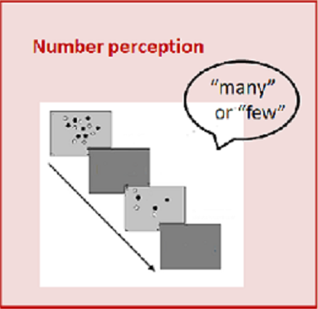
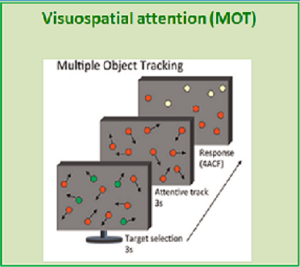
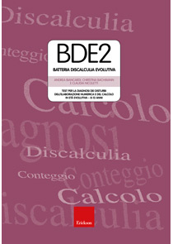
Attention, Time and Numerosity in children and adolescents with ADHD
M. Bartoli¹, G. Anobile¹ , A. Tacchi¹, C.Pfanner¹, G.Masi¹, G. Cioni^{1,2}, F. Tinelli¹
^{1,} IRCCS Stella Maris Foundation , Scientific Institute of Child Neurology and Psychiatry, viale del Tirreno 331, 56018 Calambrone-Pisa, Italy
^{2,} University of Pisa, Pisa
Introduction: Time, space, math and numerosity are ubiquitous dimensions of human lives. An influential theory (ATOM - Walsh, 2003) suggested that all these magnitudes may be encoded by a common neural mechanism, mainly located in the parietal cortex. Another function processed in the parietal cortex is attention. In fact, as reported by Atkinson (Atkinson 2017), dorsal stream is also important for attention. Additional evidences can be found in studies of atypical populations; however, we have not firm conclusion. In this line, the aim of this study is to test the association of parietal functions in children and adolescents with ADHD
Results:
ADHD performed worse both in time and number discrimination, with a statistical significative difference only for T500, not depending on IQ
Positive correlation time and numerosity
No difference
Patients and Methods: we enrolled 22 ADHD and 22 typical children and adolescents, matched for age (8-14 years old).
We administered:
Conclusions: Our results generally confirm ATOM theory but also show that selective impairments are possible. ADHD subjects seem to show a dorsal vulnerability. Moreover given that time perception deficits does not depend on attention, our results suggest that ADHD may by characterized by a specific time encoding deficit, together with impaired attention skills

