Slide 1
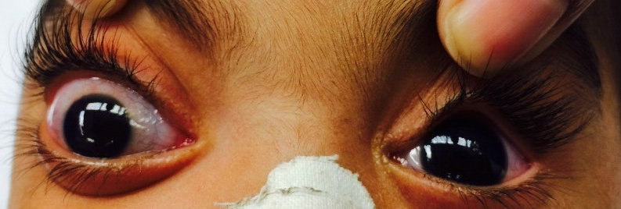
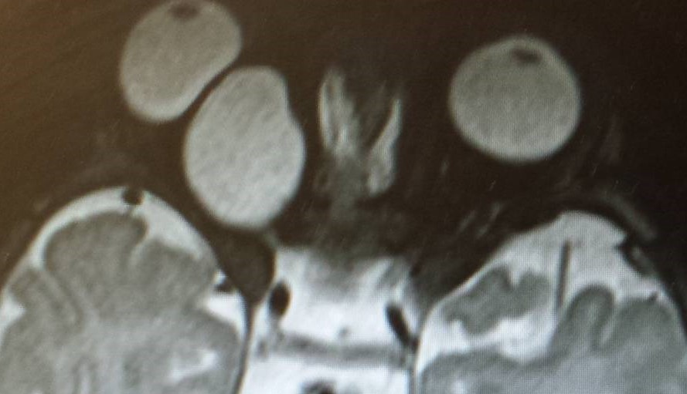
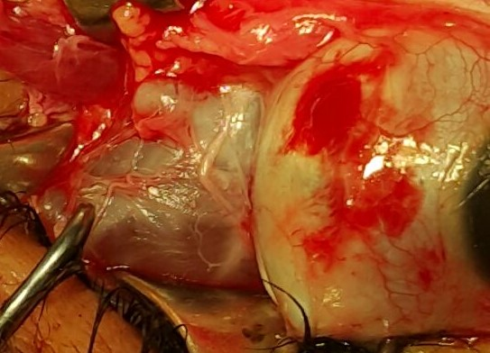
HOLMES-ADIES SYNDROME- A rare neuro-ophthalmological disorder in a 12 year old girl
Zubaida Sirang, Irfan Kabeeruddin Jeeva,
Aga Khan University, Hospital Karachi, Pakistan.
Introduction
Intervention/Surgery
Right glio-ependymal cyst!
Ultrasound guided aspiration was successfully performed, however the cyst reformed after a 4 weeks.
The cyst was excised completely and sent for the histopathology. Intraopreratively, the cyst gave an appearance of a vestigial eye. Histopathology was reported as gilo-ependymal cyst.
Post-operatively the patient is doing good with no recurrence in a year period.
Glioependymal cysts,also known as Neuroglial cysts ,are benign epithelial lined cystic lesions that can potentially occur anywherein the neuraxis. ¹
They are very rare, representing less than 1% of intracranial cysts.²
Significance/Uniqueness of the Case
Glioependymal cyst, also known as neuroglial or neuroepithelial cysts, are considered to arise from ectopic rests of primitive neuroglial tissue.¹
They are round, smooth, filled with CSF looking fluid and can be found intra- or extra-parenchymal with the former being more common. ²
The most common location is frontal lobe.²
A case of proptosis with congenital glioependymal cyst has been reported in the literature but the origin of cyst was in middle cranial fossa, that extended into the right orbit.³
Similarly, cases with orbital gliopendymal cyst in association with coloboma and microophthalmia have been reported in the literature.⁴
To the best of our knowledge thi is the first case of retro-orbital glio-ependymal cyst.
This is the first case report of isolated retro-orbital glio-ependymal cyst in an anatomically normal eye in an infant.
Discussion
Patient Description
A 2 month old baby boy, known case of Dandly Walker Syndrome, was referred to us by his neurologist for the evaluation of right protruding eye.
The proptosis was progressive and painless.
There was no history of trauma and he had no associated systemic symptoms.
On examination, exophthalmos readings measured right eye axial proptosis of 22 mm, left eye 12 mm and intercanthal distance of 82 mm
Fundoscopy showed right pale optic disc and normal looking left fundus.
MRI orbits with contrast showed right sided extraocular retro-orbital well-defined cystic lesion, 22x17 mm in size, hyperintense on T2 and hypointense on T1 weighted images.
.
Epelman M1, Daneman A, Blaser SI, Ortiz-Neira C, Konen O, Jarrín J, Navarro OM Differential diagnosis of intracranial cystic lesions at head US: correlation with CT and MR imaging. Radiographics. 2006 Jan-Feb;26(1):173-96
Osborn AG, Preece MT. Intracranial Cysts: Radiologic-Pathologic Correlation and Imaging Approach. Radiology (2006); 239: 650-664
Obaldo, Lei Shao, and Lisa H. Lowe Congenital Glioependymal Cyst Presenting with Severe ProptosisAJNR Am J Neuroradiol June 2007 28: 999-100010.3174/ajnr.A0533.
Garcia LM1, Castro E, Foster JA, Green RW, Traboulsi EI. Colobomatous microphthalmia and orbital neuroglial cyst: case report. Ophthalmic Genet. 2002 Mar;23(1):37-42.
.
References

