Slide 1


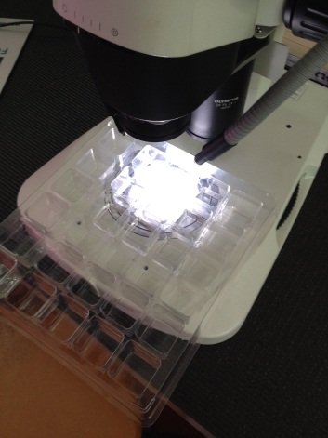
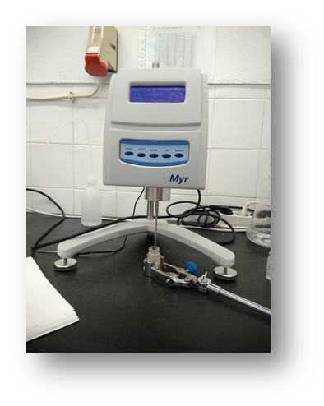
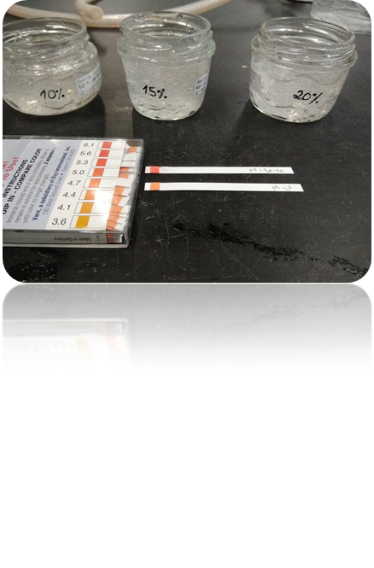
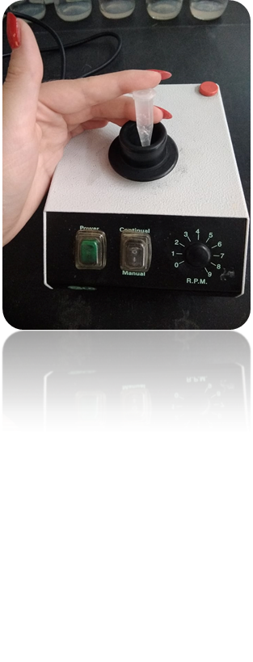
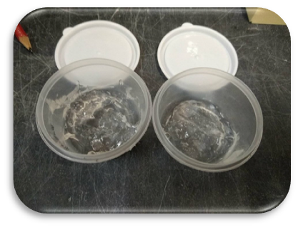
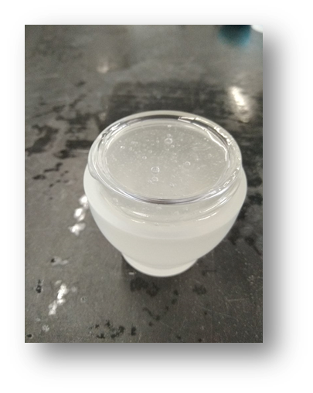
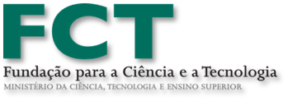

Development of an anti-aging gel with natural products: hydro-aqueous extract and essential oils of Salvia officinalis
Hugo Goes^{1,2}, Estela Meireles², , Conceição Fernandes ^{1,2}Mª João Sousa^{1,2}
1 Mountain Research Centre - Escola Superior Agrária-Instituto Politécnico de Bragança, Campus de Santa Apolónia, Apartado 117, 5301-855 Bragança, Portugal
2 Polytechnic Institute of Bragança - Instituto Politécnico de Bragança, Campus de Santa Apolónia, 5300-253 Bragança, Portugal
Introduction
Results
The results of the pH analysis did not show any change with the application of the essential oil of S. elegans and only a small increase with the S. officinalis oil, but still in the appropriated pH for topic application. The viscosity tests showed that these formulations behaved as a thixotropic non-Newtonian fluid. Also theses formulations showed no changes in either the vibration or light exposure tests. For S. officinalis five alcoholic extract concentrations were tested (0.15% to 2.50%) and immobilisation/death percentage after 12 hours. While the 1 h LC50 value of S. officinalis oil was estimated as 1.31 %, the 2 h LC50 value was lower, estimated vas 0.37% and with same value for 12 h LC50 (0.37%). These results suggest that with time exposition, probably light or/and oxygen, the value of safe dose increase (or toxicity diminish). For S. ellegans three alcoholic extract concentrations were tested (1.25%, 2.5% and 5%) and values of LC50 obtained, Results suggest that, although same pattern, S. ellegans exhibit lower toxicity comparing S. oficinalis.
Salvia officinalis L. (Sage) and Salvia elegans sp. are perennial plants in the family of Lamiaceae. In new review highlights on the pharmacological findings that have been frequently reported for S. officinalis. These findings include anticancer, anti-inflammatory, antinociceptive, antioxidant, antimicrobial, antimutagenic, antidementia, hypoglycemic, and hypolipidemic effects. Most of the phytochemicals which are reported from S. officinalis have been isolated from its essential oil, alcoholic extract, aqueous extract, butanol fraction, and infusion preparation. More than 120 components have been characterized in the essential oil prepared from aerial parts of S. officinalis. ( Ghorbani Esmaeilizadeh, 2017).
Fig 4 – Determination of the pH
Fig 3 - Observation for immobilized/death daphnids
Fig 4 – Determination of the viscosity
Fig.5 – vibration tests
Objective
The objective of this study was to create two anti-ageing gels (carbopol e meticelulose) using essential oil of S.officinalis and hidroalcoholic extract of S. officinalis and S. elegans. The purpose of the essential oil is to be a conservative compound and the hidroalcoholic extract was the bioactive compounds (phenols) .
Material and Methods
The extraction of the essencial oils was made by hidrodestilation using a Clevenger apparatus during 3 h.
The hidroalcoolic extration was made by decoction These formulas were put through several test including stability, physic and chemical, (pH, Viscosity, vibration assay, stability under day light) and acute toxicity evaluations.
The toxicity test was established using daphnia magna to determine the dose with immobile or kill 50% of the population. Young daphnids (age <24 h) are exposed to a range of concentrations of the oils extracts. Since oils extracts are of limited water solubility, essays were conducted using Tween 80 as solvent. For S. officinalis five oil concentrations were tested (0.15% to 2.50%) and immobilisation/death percentage of animals. The tests were adapted from OECD Guideline 202 (OECD Guidelines for Testing of Chemicals 202: Daphnia sp. Acute Immobilisation Test (2004). The dilution water used was ISO 6341 medium at pH adjusted to 7.8±0.2. Toxicity tests were conducted in test vessels containing 3-4 animals, with four vessels for each concentration tested. Control was daphnids in dilution water and daphnids in Tween 80.
The vessels were kept at 20 ±1 °C under a 16 h light and 8 h dark regime and the exposure period was 12 hours. The animals were observed every 30 minutes and immobilised/ death animals were recorded.
Fig 6- Mortalities of D. magna after 12 h exposed to different Salvia oficinalis oils concentrations.
LC50 | % of oil
1 h | 1.31
1.5 h | 0.91
2 h | 0.37
12 h | 0.37
LC50 | % of oil
1 h | 4.06
1.5 h | 3.50
2 h | 2.01
12 h | 1.79
Fig 1- Carbopol gel
Table1- LC50 values of Salvia oficinalis oils for
D. magna in different times.
Table2- LC50 values of Salvia ellegans oils for
D. magna in different times.
Fig 2 - methylcellulose gel
ACKNOWLEDGEMENTS
This study was partially funded by Fundação para a Ciência e a Tecnologia (FCT) under research contracts UID/AMB/50017/2013, FEDER PT2020 – Compete 2020

