Slide 1


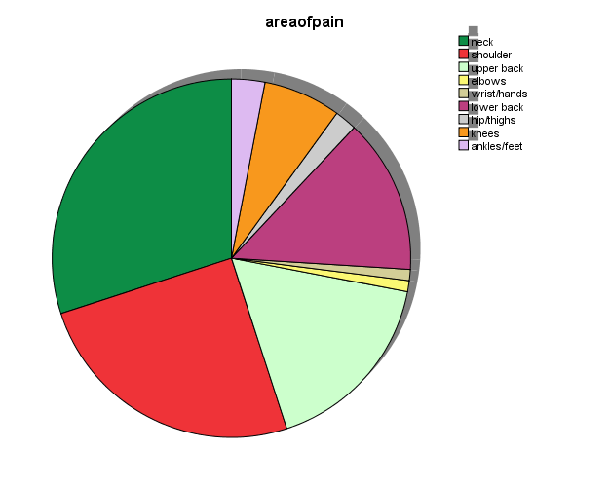
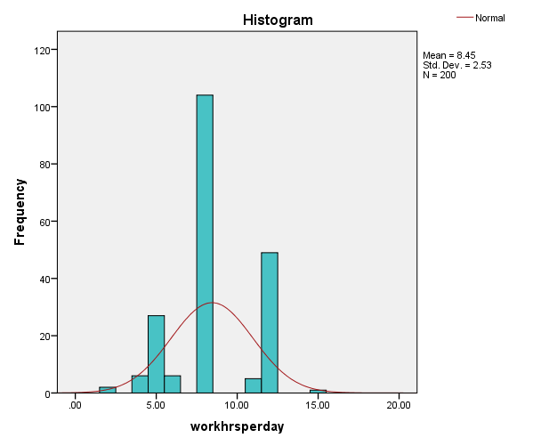
THE RELATION OF MUSCULOSKELETAL DISORDER WITH WORK PRODUCTIVITY IN OFFICE WORKERS. (AN OBSERVSTIONAL CROSS SECTIONAL STUDY)
INTRODUCTION
METHODS
Musculoskeletal Disorders (MSDs) are widespread throughout the world. Work related MSDs are second most common cause of disability in work setting. These disorders are responsible for 40-50% of the costs of all work-related diseases. Work-related musculoskeletal disorders (WMSD) are a main concern for public health and commonly lead to temporary or permanent work incapability.
Observational cross sectional study.
Data collected from 196 respondents
Office worker of ages 25-45 with 1 year experience were included.
Data collected by standard questionnaires..
ABSTRACT:
Previous studies suggests that work-related musculoskeletal disorders (WMSD) frequently lead to temporary or permanent work inability. Prolonged PC use is the major cause of majority of musculoskeletal side effects in the neck, lower back, shoulder girdle and upper limbs in office workers. However, these MSK disorders can be prevented by the pre-employment or periodic medical examinations of office personals in order to control WMSDs.
To access the relationship between the presence of musculoskeletal disorders and fatigue in office works and how these disorders can affect their work productivity.
196 male and female office workers were assigned randomly to collect data. Data were gathered through a demographic questionnaire, and work limitation Questionnaire.
The results revealed that the highest prevalence rates of MSK symptoms in past week were related to shoulders (40.8%), neck (28.6%), low back (12.2%), upper back (7.7%), knee (7.1%) and elbow (7%). Additionally, the severity of discomfort/pain in neck, shoulders, lower back and thighs was correlated to total fatigue. The severity of discomfort/pain in neck, lower back, buttock and thighs was correlated to concentration/focus subscale of productivity.
Improvement of working conditions is suggested to reduce musculoskeletal problems and fatigue and enhance productivity.
RESULTS
. The mean age of respondents was 37 years old.
Prevalence of discomfort/pain in neck is highest .
Neck: 30%, shoulder: 25% and upper back: 17%.
CONCLUSION
People with pain/discomfort avoid exercise and have long work hours. WMSDs are due to mental, physical and work place factors.
REFRENCES :
1. Horton R. GBD 2010: understanding disease, injury, and risk. The Lancet. 2012;380(9859):20534.
2. Armijo-Olivo S, Woodhouse LJ, Steenstra IA, Gross DP. Predictive value of the DASH tool for predicting return to work of injured workers with musculoskeletal disorders of the upper extremity. Occup Environ Med. 2016;73(12):807-15.
3. Cammarota A, editor The European Commission initiative on WRMSDs: Recent developments2007: Presentation at EUROFOUND conference on ‘Musculoskeletal disorders’, Lisbon, October..
PRESENTED BY,
SABA ALI GILL

