Slide 1
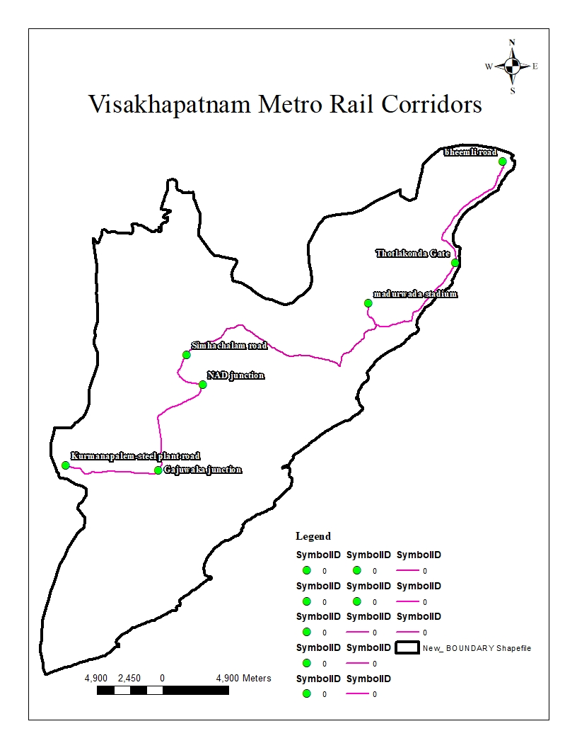
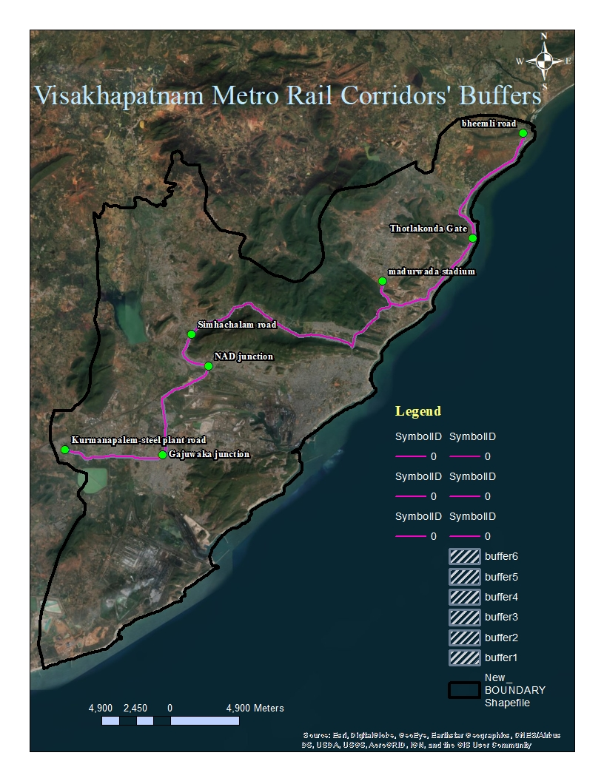
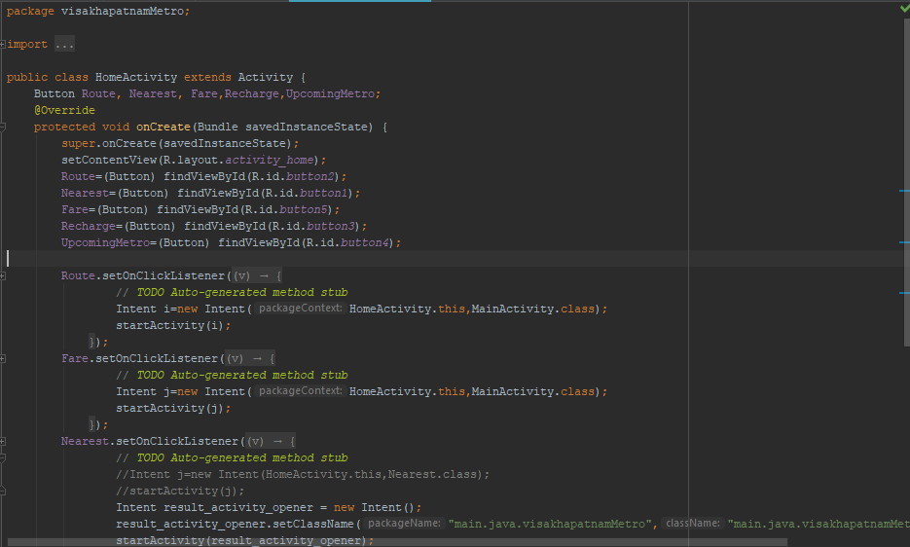
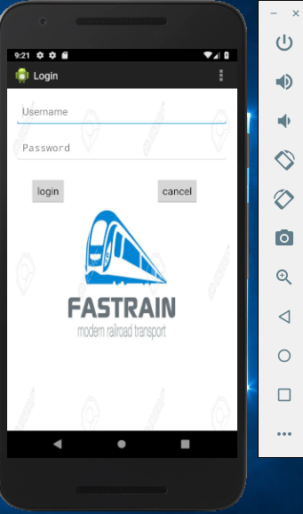
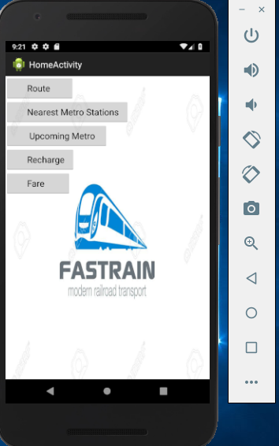
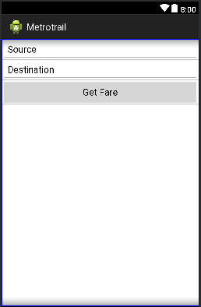
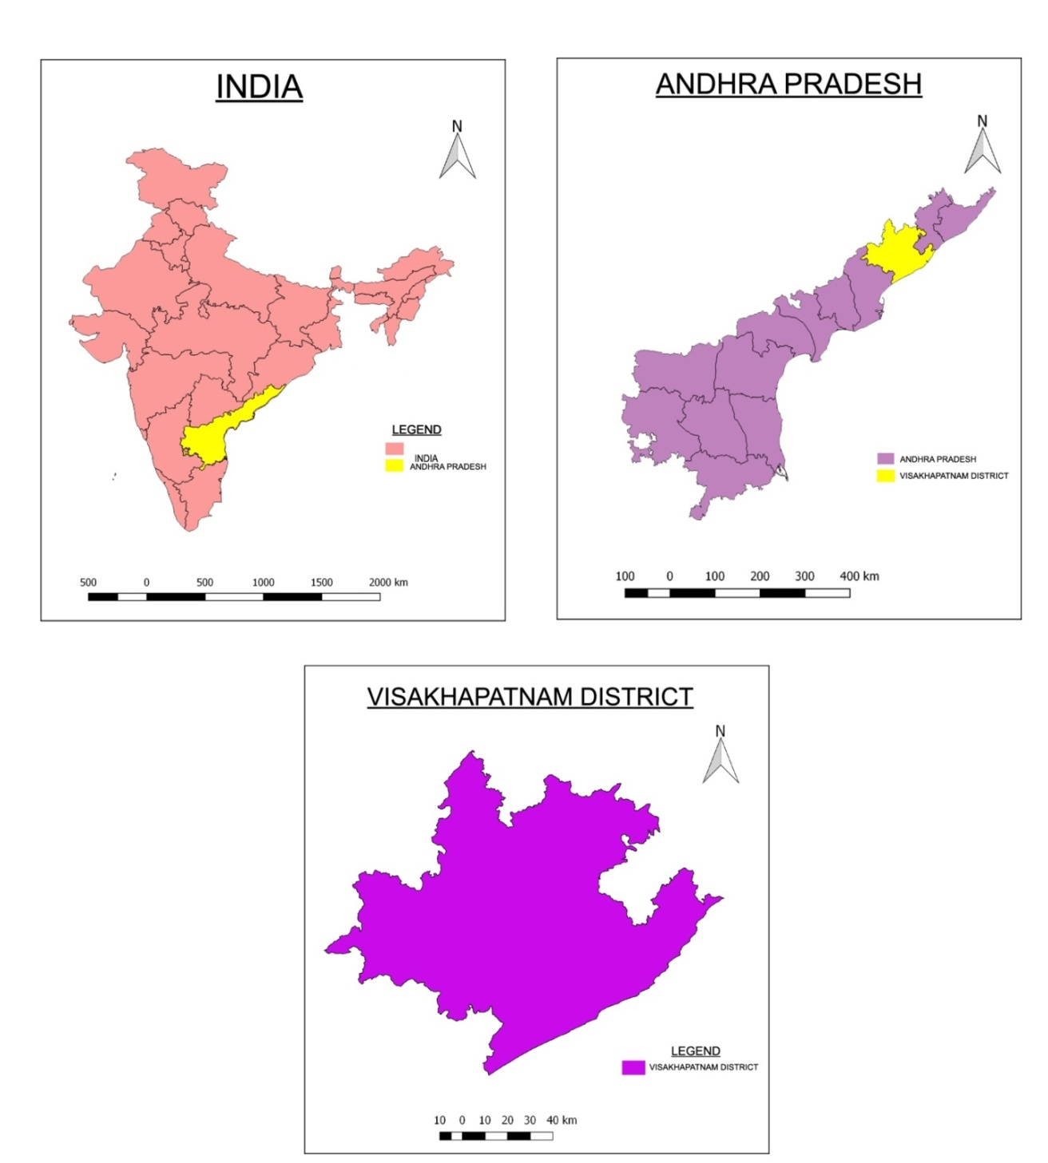
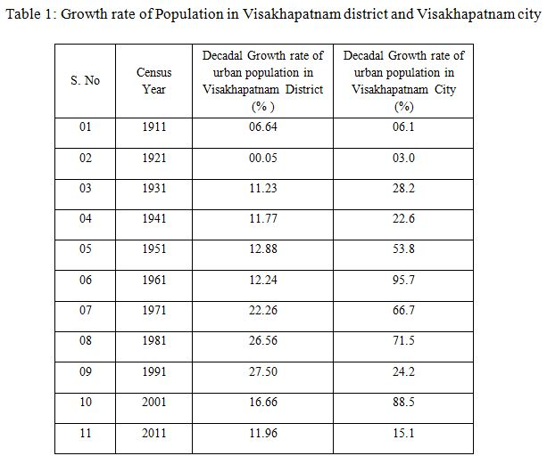
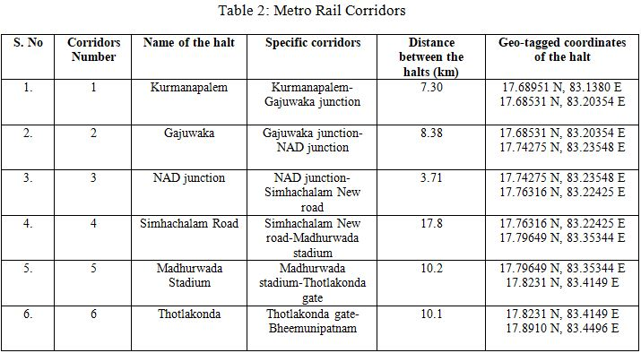
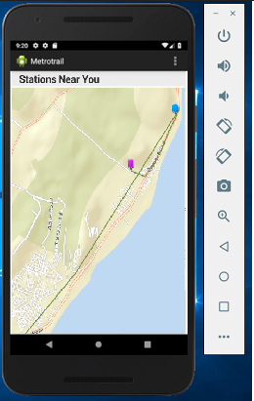
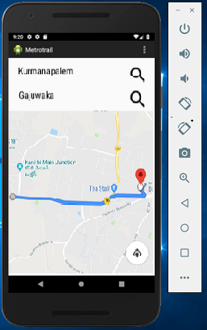
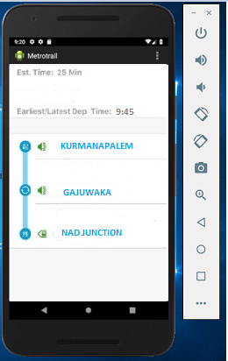
INTRODUCTION
A Geo-Spatial Study on Smart City of Visakhapatnam Metro Rail Project,
Andhra Pradesh, India
The infrastructure projects are important for the development of a nation and are also a reflection of any country’s burgeoning. The nature of these impacts could be either positive or negative, depending upon their potential to favorably or adversely affect the surrounding environment and also the resident community. Growing traffic congestion, the need to preserve the environment from various pollution problems, the issues related to road safety and demands of the civilians for quick and easy access transportation are the main reasons for many cities worldwide to consider new initiatives in public transit systems.
In India, the number of road commutes is quickly increasing as a growing middle class can now afford to buy costlier and sophisticated commutes. India's road conditions have not kept up with the increase in the vehicle numbers. As a result, India has launched various rapid transit efforts, such as the Metro railways in most of the metropolitan cities of India.
Metro rail is a form of mass transit public transport system employing trains. The metro rail system, unlike conventional rail-based systems is grade separated from the other traffic or provided with separate right of way (ROW) to avoid conflict with other urban transportation networks. The system is provided in an urban area and is mostly operated by electricity with high capacity and frequency.
The application of GIS to a diverse range of problems in Transportation engineering is well established. It is a powerful tool for analysis of both spatial and non-spatial data and for solving important problems of networking. Geographic Information Systems (GIS) have been widely used in the field of transportation since location information is critical for transportation applications such as transportation planning, modeling, transit service planning etc. The significant contribution offered by GIS is the ability to manage data spatially and then overlay these layers to perform spatial analyses. Thus, when a transit routes layer and an individual corridors layer are overlaid on a land use layer, we can analyze the socio-economic characteristics of the area surrounding the transit route and the corridors by buffering that area. GIS also provides the ability to calculate the shortest path to any particular corridor from any particular location. The present study focuses on how GIS can be used in mass rapid transit planning since it is gaining lot of importance these days because of the growing concern over the impact of vehicles on the environment and the quality of life in urban areas.
Aditya Allamraju
(allamrajuadi@gmail.com)
METHODOLOGY
GIS stores information about the world as a collection of thematic layers those can be linked together by geography. This simple but extremely powerful and versatile concept has proven invaluable for solving many real-world problems ranging from tracking delivery vehicles, recording details of planning applications and modeling.
Network analysis:
The network analysis in the GIS is based on the following new route features. They are:
Stops feature layer: This layer stores the network locations that are used as stops in route analysis. The Stops layer is symbolized by default in four types: Located Stops, Unallocated Stops, Error and Time Violation Stop. You can modify the symbology in the Layer Properties dialog box of Stops. There is a new symbology category, Network analyst stops, added for the stops for network analysis class. You can modify the symbol, color, text for any type of stop. When a new route analysis layer is created, the Stops layer has no features. It is populated only when network locations are added into it.
Stop properties
Object ID: The unique ID of the network location is assigned automatically.
Name: The name for a network location is assigned automatically when it is added to the map. You can rename the network location by clicking it, selecting the existing text and replacing it with the new name.
Route Name: This represents the name of the route to which the stop belongs. Using this name property, stops within one route analysis layer can be assigned to multiple routes.
Barriers feature layer: Barriers are used in route analysis to denote points from which a route cannot traverse through. The Barriers layer is classified by default in three types: Located, Unallocated and Error. The symbology of each can be modified in the Layer Properties of the Barriers layer. The Barriers layer functions as any other feature layer in Arc Map. When a new route analysis layer is created, the Barriers layer has no features. It is populated only when network locations are added into it.
Route feature layer: The Route feature layer stores the resultant route of route analysis. As with other feature layers, its symbology can be accessed and altered from the Layer Properties dialog box. The Route layer on the Network Analyst Window is empty until the analysis is complete. Once the best route is found, it is displayed on the Network Analyst Window.
The present study proposes six corridors (stages) of over 54-km length. In this study, the SOI toposheets, Google Earth imagery, IRS satellite imagery, GPS techniques are used to extract the thematic layers of rail, road, heritage buildings, topography etc. thereby revealing the shortest path and cost effective metro rail corridors. A 50-m buffer is generated in ArcMap-10.6 to assess the extent of affecting to the existing buildings, infrastructure (land use) and topography (land cover).
STUDY AREA
The study area-Visakhapatnam initially got its name from ‘Vaishakha’, the disciple of Lord Gautama Buddha. During the East India Company rule in India, when the Britishers built a port along the natural harbor here, they pronounced the original name as Vizagapatam (pronounced as Vee-Zaag-ah-paat-ahm). But when they wrote it down, whoever read it pronounced it as Y-zag-ah-patam. Thus Visakhapatnam became Vizagapatam and in short, Vizag. “Vizagapatam” could also be spelled Visakhapatnam in the West European alphabet. The citizens of Visakhapatnam came to be known as Vizagites.
Visakhapatnam is a cosmopolitan town and the presence of defense and other public sector offices makes the city's composition more cosmopolitan. It is the second largest city and the financial capital of the Indian state of Andhra Pradesh; also the third largest city on the east coast of India (after Chennai and Kolkata).It is nestled among the hills of the Eastern Ghats and faces the Bay of Bengal on the east. Its geographical location is 17°42′15″N and 83°17′52″E (Figure 1). It is the most populous city in the state with a population of 2,035,922 as of 2011, making it the 14th largest city in the country. It is also the 9th most populous metropolitan area in India with a population of 5,340,000.The population of Visakhapatnam in the past five years is as follows: 2.4 Million, 2.8 Million, 3.1 Million, 3.5 Million and 3.78 Million in the years 2013, 2014, 2015, 2016 and 2017 respectively. By this, the population of Visakhapatnam in 2018 is estimated to be 4.056 Million. The population density of Visakhapatnam city is 3000/km². Table 1 shows the decadal growth rate of population in the study area.
Some of the magnificent places in Visakhapatnam for tourism include Yarada beach, Rushikonda beach, Indira Gandhi zoological park, Kailasagiri park, VUDA park, INS Kurusura submarine museum, Dolphin’s nose, R.K beach, VUDA city central park, Victory at Sea War Memorial, Bheemunipatnam Beach, Tenneti Park, Visakha Museum, Matsya Darshini (Aquarium), Thotlakonda, Kambalakonda Wildlife Sanctuary, Ramanaidu Film Studios, Gangavaram Beach, TU 142 Air Craft Museum, Light House and The Ross Hill.
Visakhapatnam, commonly referred to as the City of Destiny, has been selected as one of the Indian cities to be developed as a smart city under the Smart Cities Mission. The city was ranked eighth among the top 20 cities shortlisted to be developed as a Smart City. AECOM is providing the master plan and sector specific smart infrastructure project plans for the Visakhapatnam Smart City in Andhra Pradesh, India. The aim of the Smart City is to efficiently utilize the available assets, resources and infrastructure to enhance the quality of urban life and provide a clean, sustainable environment for living . The main focus will be on core infrastructure services like power supply, sanitation, disaster management, efficient urban mobility; public transportation, safety, social security etc. In context of the Visakhapatnam Smart City, Visakhapatnam Metro Rail is proposed which is a rapid transit system in the Greater Visakhapatnam Municipal Corporation (GVMC), Andhra Pradesh, India. The system is proposed to reduce traffic congestion, pollution, man-hours as well as providing a modern and efficient public transport system in the city.
Figure 2. Layout view of Visakhapatnam Metro Rail corridors
Figure 3. Layout view of Visakhapatnam Metro Corridors’ buffers
Figure 10. Source code of the Visakhapatnam Metro Rail app developed in Eclipse software
CONCLUSIONS
ANALYSIS
From the above analysis we can conclude that the growing industrialization and urbanization is attracting people from rural and other areas to concentrate in the Visakhapatnam city thus engendering population growth .The aggregate Visakhapatnam region urban populace is around 20.37 lakh and in which around 47.51% of populace are living in urban regions. Assist 85% of the aggregate locale urban populace are living in Visakhapatnam city only. Regarding decadal development rate of urban populace of Visakhapatnam city, most elevated development rate (95.7%) was recorded amid 1951-61 period, trailed by 1991-2001 period with 88.5% development rate. While around 21.3% of decadal development rate of populace recorded amid 2001-2011 in Visakhapatnam City. So, there is a great demand of urbanization and development of new and convenient mode of transportation to reduce the pollution, man-hours etc. which is the reason for the proposal of a Metro Rail in the Visakhapatnam city. Moreover, the ‘Visakhaptnam Metro Rail’ android application shows the route connectives with the nearby tourism places, educational hubs, industries etc.
The Metro Rail project proposal consists of six stages starting from Kurmanapalem to Bheemunipatnam stretch which covers a total distance of 57.49 km. The following table 2 shows the different names of the halts, distance between consequent stages and also the geo-tagged coordinates for the establishment of the Metro Rail. The following stages have been proposed keeping in mind the importance of network connectivity to tourists places (Bheemunipatnam), educational and industrial hubs (Thotlakonda gate- IT Sez); also as a check to the traffic congestion in highly traffic zones (Madhurwada, NAD junction, Gajuwaka junction and Kurmanapalem) (Figure 2). Furthermore, a 50m buffer line around the corridors has shown the extent of land use/ cover affected while considering and construction of the following corridors for the Visakhapatnam Metro Project (Figure 3). A demo of the ‘Visakhapatnam Metro Rail’ app is also made and the results are shown in the Figure 4 to Figure 9. The source code to the android application is provided in Figure 10.
Table 1.Growth rate of population in the study area
Table 2. Brief illustration of Metro Rail corridors.
Figure 4. Login page of Visakhapatnam Metro Rail app
Figure 5.Home page of Visakhapatnam Metro Rail app
Figure 6.Get_Fare page of Visakhapatnam Metro Rail app
REFERENCES
Sara I. Mohammad, Patricia C. Melo, Daniel J. Graham (2017). “The effect of the Dubai Metro on the value of residential and commercial properties”; The Journal of Transport and Land Use; Vol. 10(1); pp. 263–290.
SaurabhY.Chandarana (2015). “Delhi Metro Rail Project- First Modern Metro Rail Project of India”; CE597 – Infrastructure Planning Individual Assignment, Purdue University, West Lafayette, IN; pp.1-13.
Dipti Ranjan Mohapatra (2015). “An Economic Analysis of Light Rail Transit in Addis Ababa, Ethiopia”; European Academic Research; Vol. 3(3); pp. 3114-3144.
Niraj Sharma, Rajni Dhyani, S. Gangopadhyay (2013). “Critical Issues Related to Metro Rail Projects in India”; Journal of Infrastructure Development; Vol. 5(1); pp. 67–86.
V.Sridhar (2012). “Automated System Design for Metro Train”; International Journal of Computer Science Engineering (IJCSE); Vol. 1(1); pp. 30-41.
“Metro Brazil: Overview” (2012). Global Cities Initiative, Brookings.
Sachin Sabharwal, Mona Goel (2011). “Delhi Metro: A Solution to the Problem of Congestion and Pollution in the Modern City like Delhi”; International Journal Of Business Economics And Management Research; Vol. 2(9); pp.53-60.
8. N. Sivasailam (2010). “An overview of present & Future of Bangalore Metro Rail Project”; 12th World Conference on Transport Research.
“Metro, light rail and tram systems in Europe” (2009). Published by ERRAC Roadmaps, The FP7 project of ERRAC - The European Rail Research Advisory Council; pp. 1-40.
Mukti Advani, Geetam Tiwari (2005). “Evaluation of Public Transport Systems: Case Study of Delhi Metro”; Proceeding in START-2005 Conference held at IIT Kharagpur, India; pp. 1-8.
Figure 1. Location Map of the study area
Figure 7. Nearest station page of Visakhapatnam Metro Rail app
Figure 8. Current station to destination station route page of Visakhapatnam Metro Rail app
Figure 9. Upcoming station page of Visakhapatnam Metro Rail app

